Slide 1


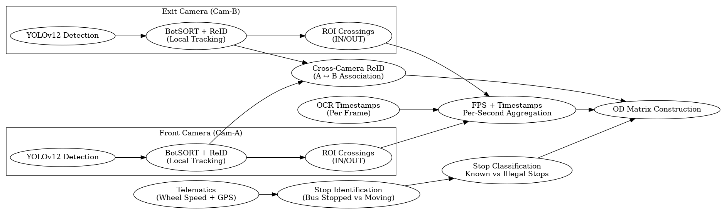
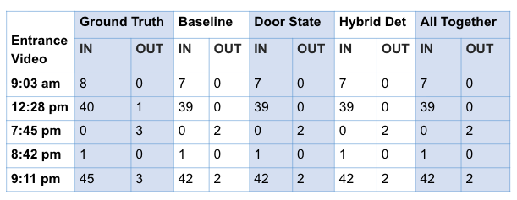
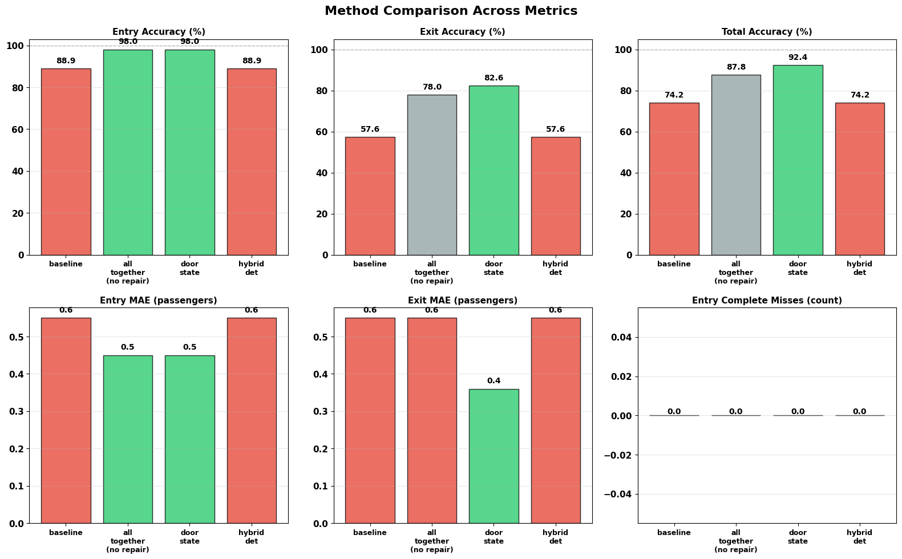
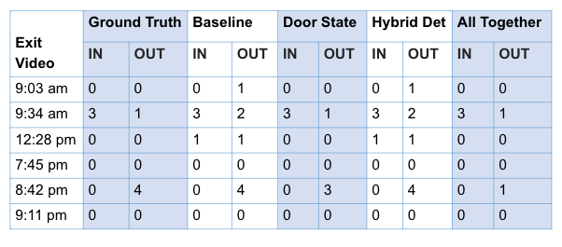
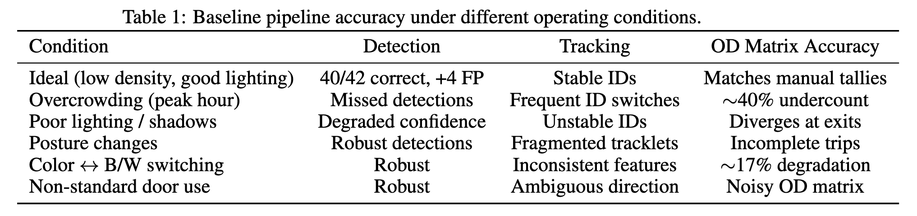
Recovering Origin–Destination Flows from Bus CCTV: Early Results from Nairobi and Kigali
Nthenya Kyatha, Jay Taneja
College of Information & Computer Science, UMass Amherst
Corresponding email: mkyatha@umass.edu
Motivation: Why OD from CCTV?
Contribution
UrbanAI Context
Public transport in sub-Saharan Africa (SSA) is dominated by buses and matatus that routinely operate over capacity.
Agencies still rely on manual OD surveys that are:
infrequent and expensive
hard to scale
blind to illegal roadside stops and detailed in-vehicle flows.
Existing automated approaches (AFC, APCs, RFID, mobile phone data) are:
hardware-heavy, high-maintenance
often not deployed at scale in SSA
usually provide aggregate counts, not passenger-level OD.
Key idea: Use CCTV that already exists for security + telematics to recover passenger-level OD flows with minimal extra hardware.
Baseline 4-stage CCTV + telematics pipeline for OD inference tailored to SSA buses.
Deployment on real buses in Nairobi and Kigali using only existing CCTV + telematics—no extra sensors.
Quantitative evaluation on annotated short clips:
  High accuracy under low-density, well-lit conditions
  Sharp degradation under overcrowding, modality shifts, posture changes, and non-standard door use.
Simple, domain-informed fixes (door-state gating + flexible stop definition) that substantially boost exit-door accuracy without changing the detector or Re-ID backbone.
Takeaway: We can already recover useful OD matrices from messy SSA CCTV, but door context and telematics matter more than just better CNNs.
Setting: Buses in Nairobi (Kenya) and Kigali (Rwanda) with onboard CCTV and telematics.
Typical challenges:
Overcrowded doorways
Low-resolution, sometimes monochrome CCTV
Non-standard door usage
Illegal stops in traffic, away from official bus stops.
Goal: Enable data-driven route design, equity analysis, and e-bus planning using vision + onboard sensors.
Data & Evaluation
11 CCTV segments, 3–8 minutes each.
Conditions evaluated include low, medium and peak crowding, color vs monochrome segments and partial occlusions.
Ground truth data contains per-door entry/exit counts and derived OD matrices per clip.
System Overview
Baseline Pipeline
gating
Door Status (Closed/Open)
For each camera, detect and track passengers with BotSORT + ReID to get per-camera tracklets.
Link tracklets from front camera (Cam-A) and exit door camera (Cam-B).
OCR to extract on frame timestamp & aggregate ROI-based IN/OUT events into per-second counts.
Use telematics data (GPS, wheel speed) to detect and classify stops.
New: Use head detection for IN/OUT events during overcrowding and activate counter ONLY when door is open.
For each passenger trajectory, identify boarding stop and alighting stop → increment cell in OD matrix.
Full body + Head Detector
Two–stream pipeline with new and enhanced modules highlighted. Baseline (black): Same logic for both cameras but works in low-crowd conditions. Reality: Exit door is a choke point → heavy occlusion, queues, posture changes.
Results
Hybrid detector does not improve exit accuracy on current segments vs baseline.
Takeaway: Simple domain cues (door state, near-zero speed with open doors) fix more than just adding another detector.
Deployment-Specific Challenges
Key Takeaways
Next Steps
During overcrowding & occlusion at doors, only heads visible; tracklets fragment.
Due to posture changes (standing, sitting, leaning) appearance embeddings drift; Re-ID continuity breaks.
Modality shifts (color ↔ monochrome / IR) causes a drop in recall; embeddings unstable.
Visual similarity (uniforms, similar clothing) cause identity switches; ambiguous matches.
Boarding + alighting both doors cause a mismatch between direction of motion and door semantics.
CCTV-only OD is feasible in low-resource settings when fused with telematics.
Behavioral and operational context (door state, stop logic) is as important as model choice.
Simple rules (door gating, near-zero speed with open doors) deliver big gains in exit-door accuracy.
Failure under extreme crowding and modality shifts highlight the need for robust, deployment-aware Re-ID embeddings and trajectory-aware identity repair and motion-informed gating.
Build stronger cross-camera, motion-aware gating + cost-optimal assignment for crowded doors.
Controlled robustness studies by varying crowding and posture to quantify ID stability.
Scale to full-day deployments and analyze equity impacts.
Streamline the counter to be queue aware so that people waiting outside are not counted until they truly cross into or out of the vehicle.
Authors thank BasiGo for granting access to CCTV footage and operational data from buses in Nairobi and Kigali, UMass Amherst for institutional support, computing resources, and mentoring and WiML for providing travel support.

Slide 2
Recovering Origin–Destination Flows from Bus CCTV: Early Results from Nairobi and Kigali
gating
Door Status (Closed/Open)
Full body + Head Detector
Pose Detector
Two–stream pipeline with new and enhanced modules highlighted. Baseline (black): Same logic for both cameras but works in low-crowd conditions. Reality: Exit door is a choke point → heavy occlusion, queues, posture changes.
Authors thank BasiGo for granting access to CCTV footage and operational data from buses in Nairobi and Kigali, UMass Amherst for institutional support, computing resources, and mentoring and WiML for providing travel support.

