Slide 1
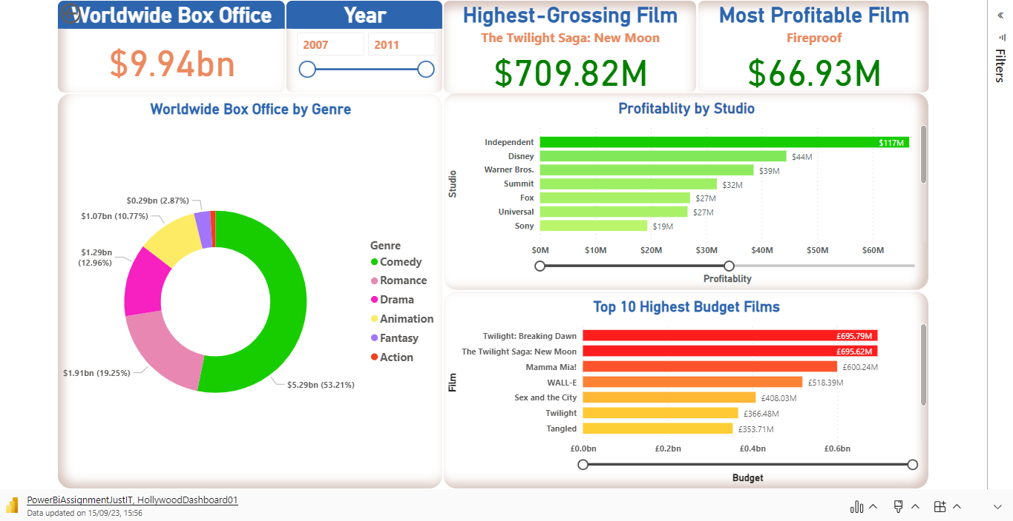
Hollywood Box Office 2007 - 2011 (Interactive)

Slide 2
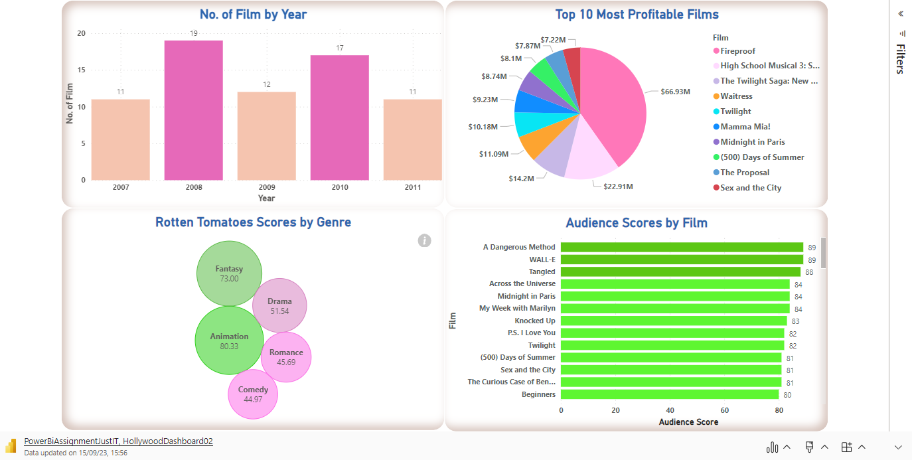
By Films 2007 – 2011 (Interactive)

