Slide 1
R + Power BI Project Kyaw Lin
15th September 2023
LINK for Completed Power BI, Excels and R Files

Slide 2
Table of Contents
1. Initial Exploratory Analysis --------------------------------------------------------------------------------------3
2. Clean Data -----------------------------------------------------------------------------------------------------------4
3. Exploratory Data Analysis ----------------------------------------------------------------------------------------5
4. Export Data ----------------------------------------------------------------------------------------------------------6
5. Create Power BI Dashboards -------------------------------------------------------------------------------7 & 8

Slide 3
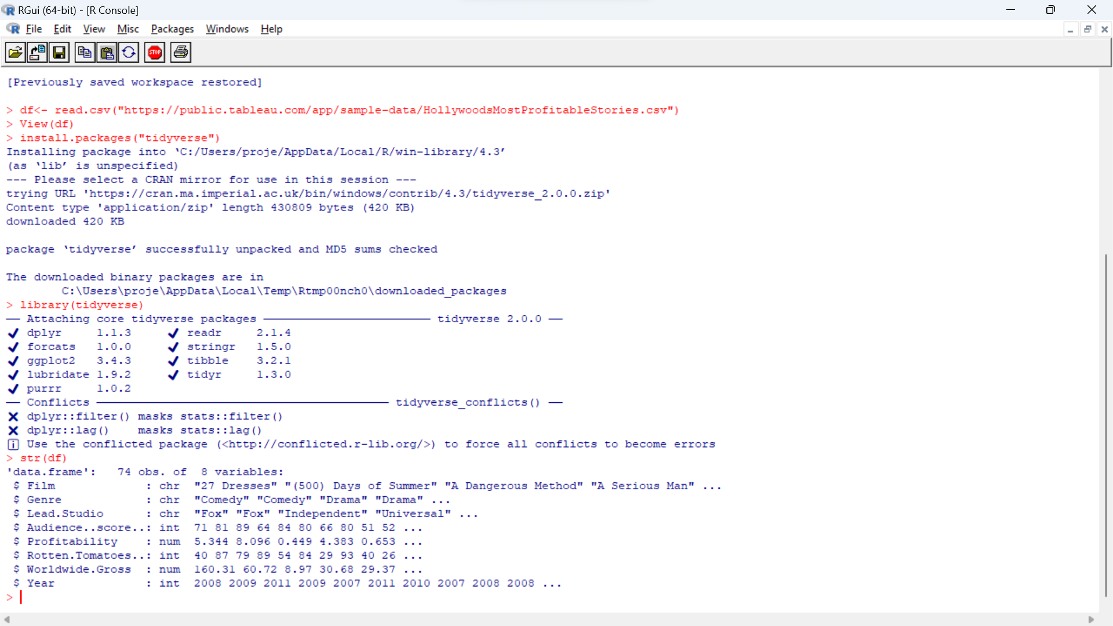
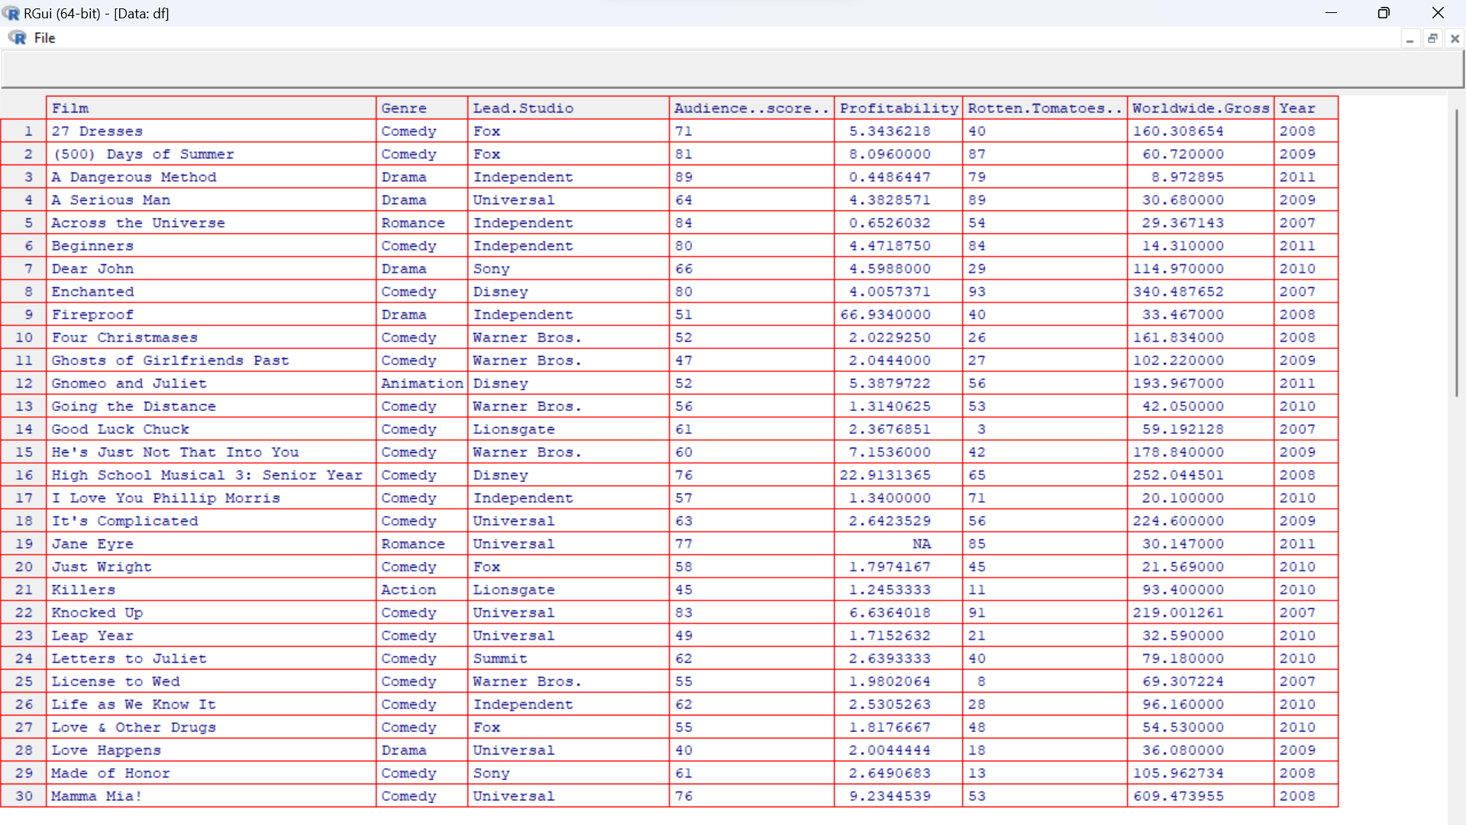
1. Initial Exploratory Analysis
-To load the data from URL (csv file);
df<- read.csv(“URL”)
-To view the file;
View(df)
-To load the library;
install.packages(“tidyverse”)
-To import the library;
library(tidyverse)
-To check data types;
str(df)
*R Syntaxes are case sensitive.

Slide 4
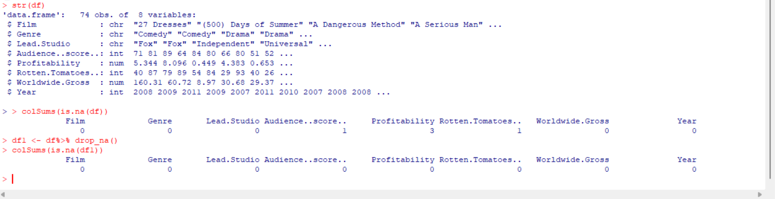
2. Clean Data
-To check for missing values;
colSums(is.na(df))
-To drop missing values;
Df1 <- df %>% drop_na()
-To check to ensure the rows have been removed;
colSums(is.na(df1))
*R Syntaxes are case sensitive.

Slide 5
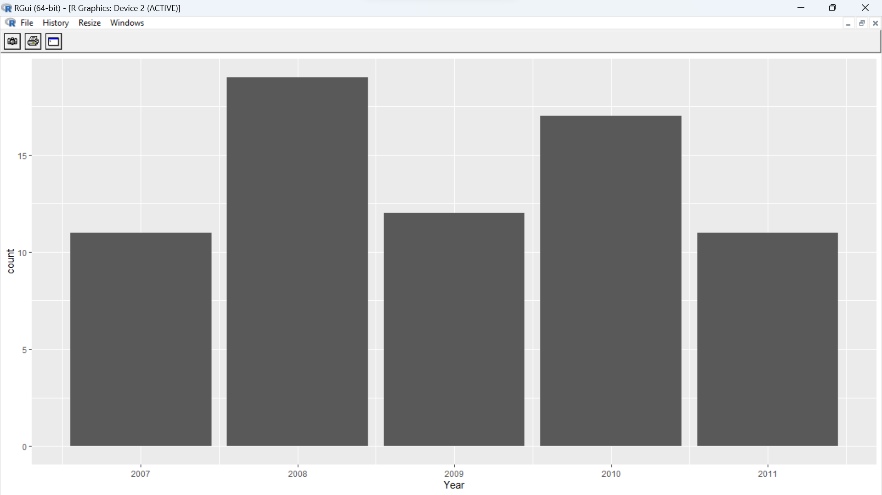
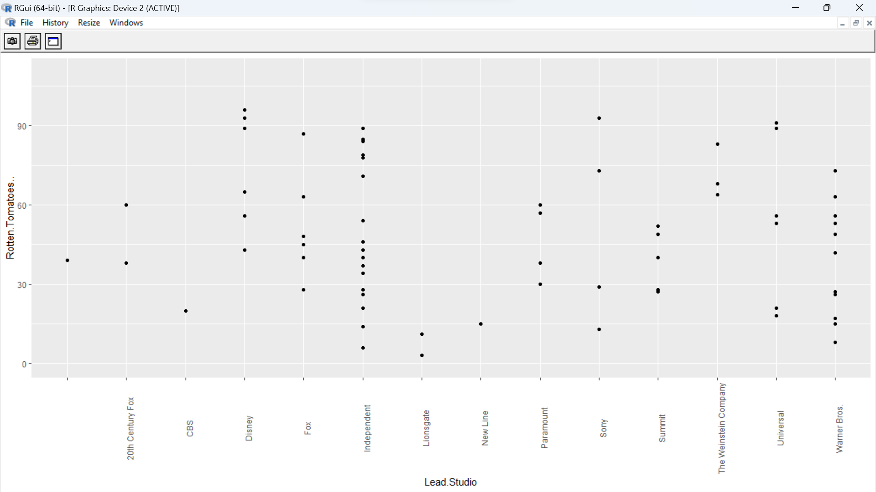
3. Exploratory Data Analysis
-To summarize statistics;
Summary(df1)
-To create scatterplot;
ggplot(df1, aes(x=Lead.Studio, y=Rotten.Tomatoes..)) + geom_point() + scale_y_continuous(labels = scales::comma) + coord_cartesian(ylim = c(0,110)) + theme(axis.text.x = element_text(angle = 90))
-To create bar chart;
ggplot(df1, aes(x=Year)) + geom_bar()
*R Syntaxes are case sensitive.

Slide 6
4. Export Data
-To export the clean data;
write.csv(df1, “fileName.csv")
*R Syntaxes are case sensitive.

Slide 7
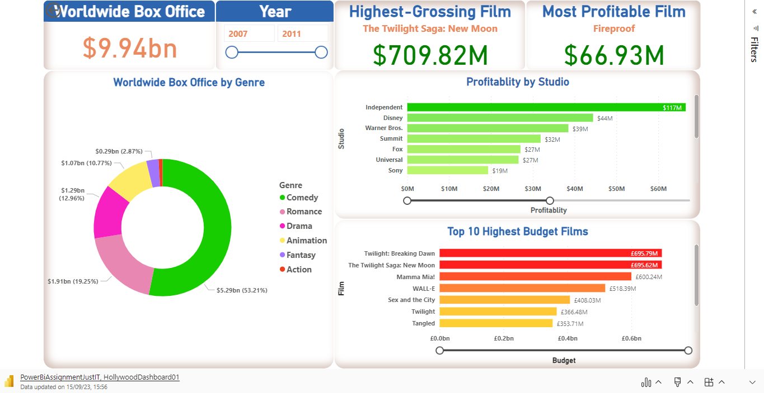
4. Create Power BI Dashboards (Interactive)

Slide 8
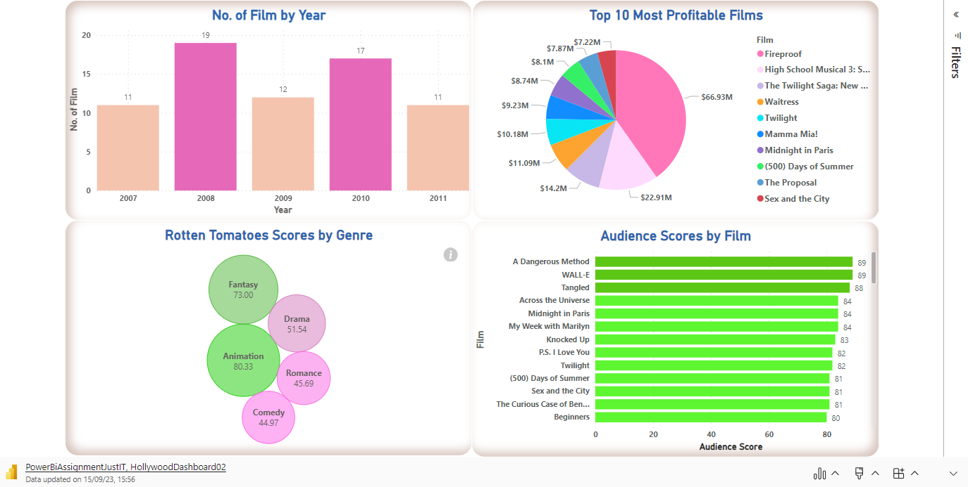
Power BI Dashboards (Interactive)

