Slide 1

STUDENT APARTMENT FINDER PLATFORM
By Team 3idiots
Phyo Wai Aung · Kyaw Linn · Arkar Kyaw Oo

Slide 2
PROBLEM AND TARGET USERS
Apartment searching is scattered, slow,
and difficult to compare
Students currently search through:
Facebook groups
Rental agents
Different websites
Friends and personal recommendations
Information about price, distance, facilities, availability, photographs, and location may be incomplete or outdated.
Primary users
First-year students
International students
Students searching for off-campus housing
The problem: Students need one reliable place
to compare accommodation near campus.

Slide 3
EVIDENCE AND VALIDATION
TESTING CONFIRMED THE MAIN WORKFLOW AND IDENTIFIED MINOR IMPROVEMENTS
Lab 13 role-based testing
5 tester profiles
15 task attempts
12 successful
3 partially completed
0 complete failures
Average score: 4.1/5
Main findings
The homepage purpose was clear.
Search and apartment details worked.
Some form instructions, status labels, and controls needed clarification.

Slide 4
SOLUTION AND VALUE PROPOSITION
ONE PLATFORM CONNECTS STUDENTS, LANDLORDS,
AND ADMINISTRATORS
FOR
ADMINISTRATORS
FOR STUDENTS
FOR LANDLORDS
Search, filter, compare, view locations, contact landlords, and find roommate opportunities.
Submit structured apartment information, prices, facilities, locations, and photographs.
Review listings, moderate roommate posts, manage records, and monitor metrics.
VALUE PROPOSITION
THE STUDENT APARTMENT FINDER HELPS UNIVERSITY STUDENTS MAKE FASTER AND MORE CONFIDENT HOUSING DECISIONS BY BRINGING IMPORTANT APARTMENT INFORMATION TOGETHER.

Slide 5
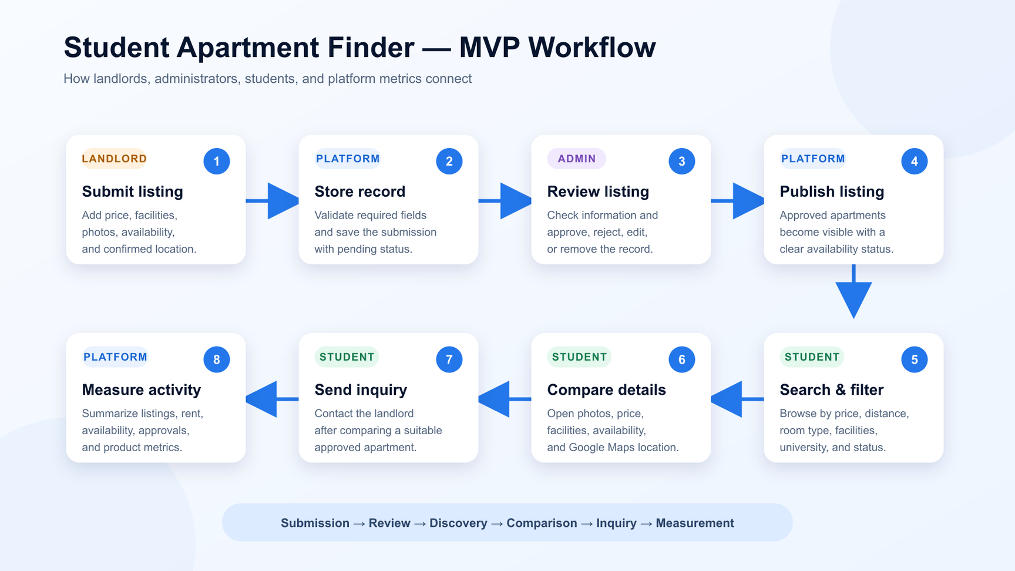
WORKING PROTOTYPE
THE MVP DEMONSTRATES A COMPLETE USER PATHWAY

Slide 6
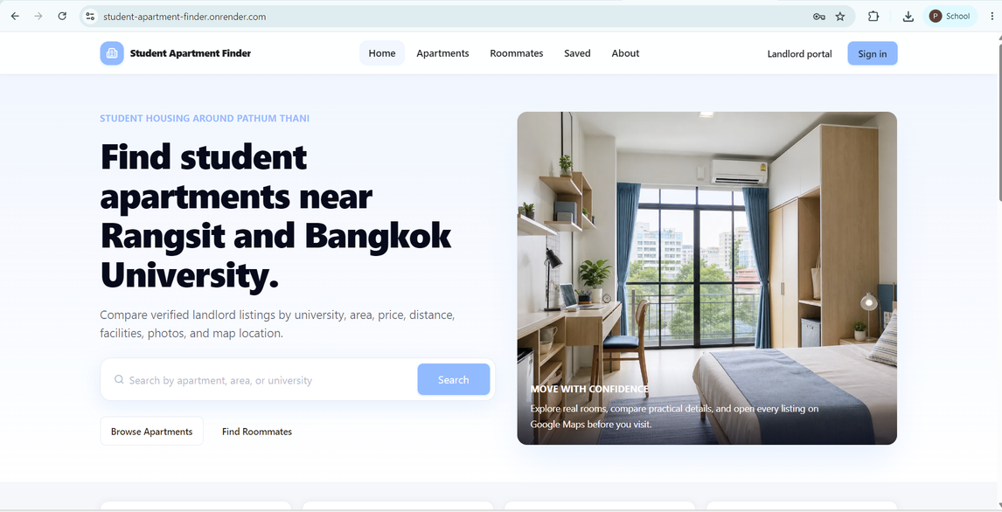
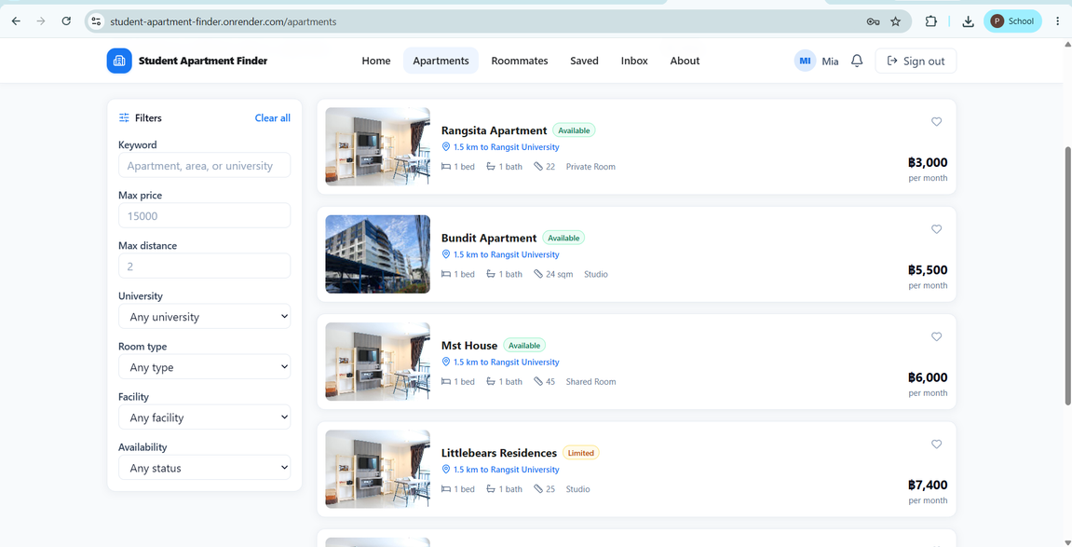
THE STUDENT JOURNEY WORKS END TO END
STUDENTS CAN DISCOVER AND COMPARE APARTMENTS

Slide 7
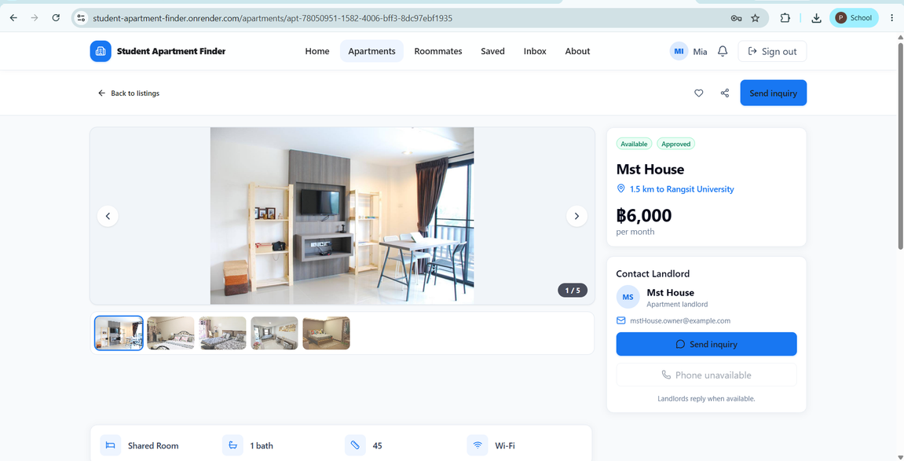
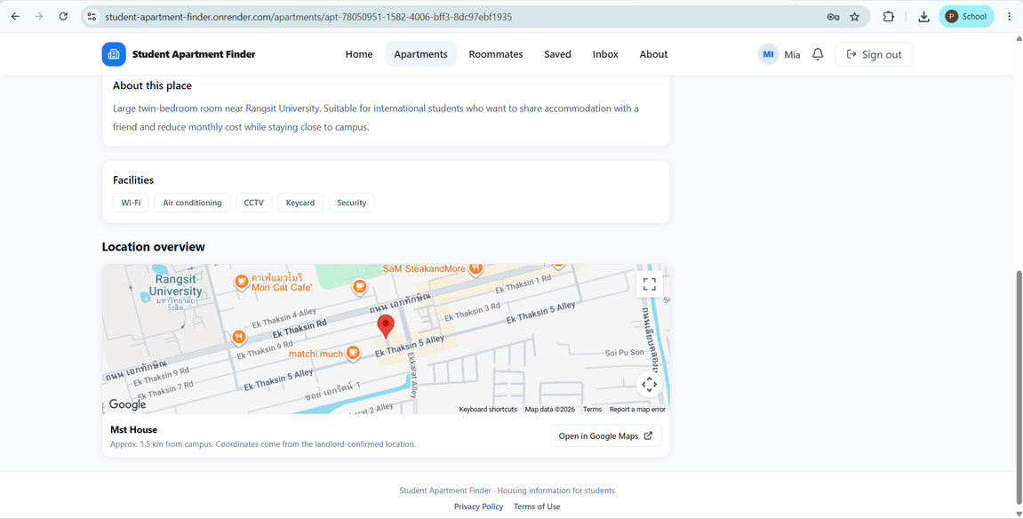
THE STUDENT JOURNEY WORKS END TO END
DETAIL VIEWS SUPPORT CONFIDENT DECISIONS

Slide 8
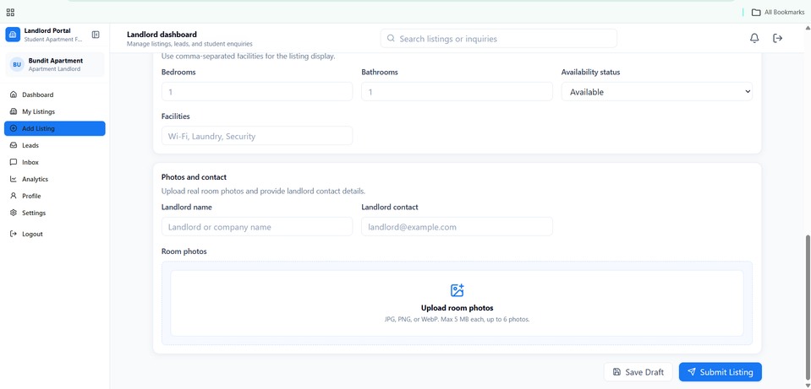
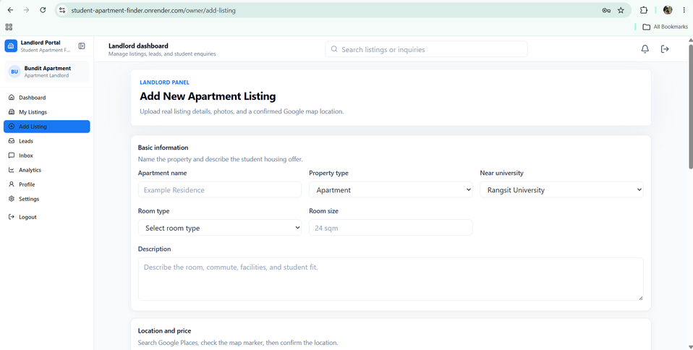
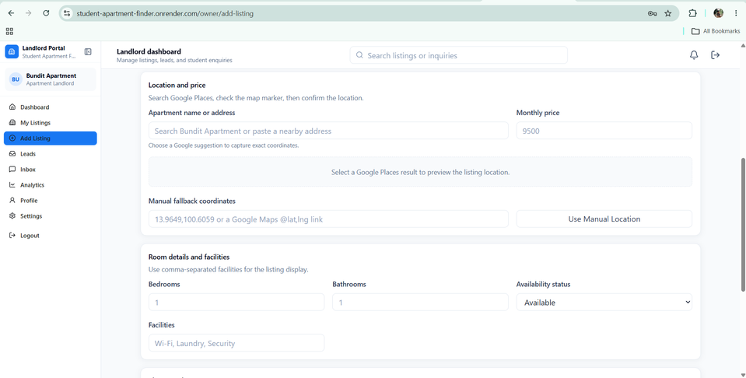
LANDLORDS AND ADMINISTRATORS MANAGE PLATFORM RECORDS
LANDLORDS CAN SUBMIT STRUCTURED LISTINGS

Slide 9
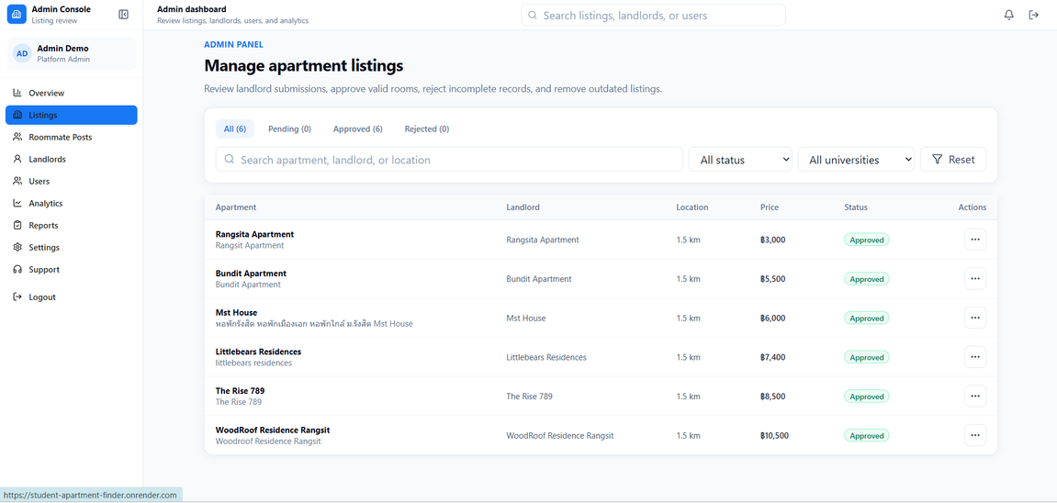
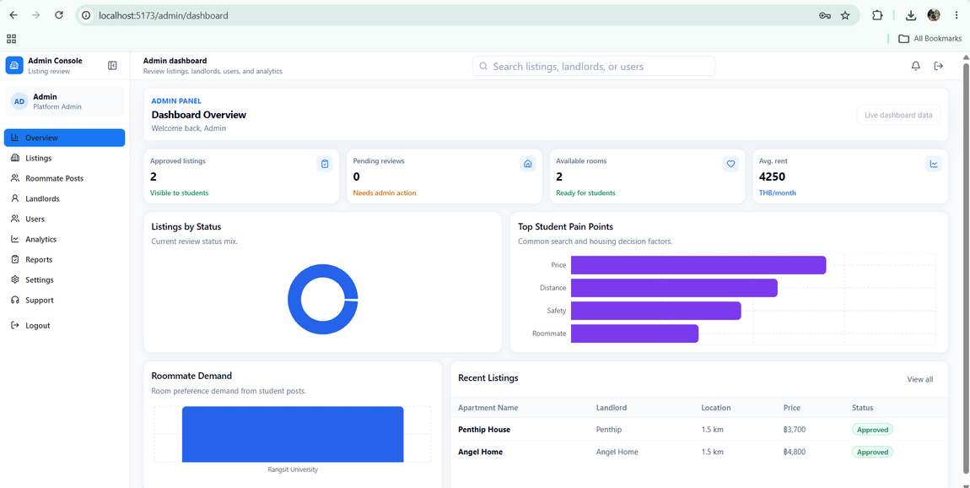
LANDLORDS AND ADMINISTRATORS MANAGE PLATFORM RECORDS
ADMINISTRATORS CAN REVIEW RECORDS AND MONITOR METRICS

Slide 10
BUSINESS MODEL &
GO-TO-MARKET
STUDENT ACCESS CREATES DEMAND;
LANDLORD SERVICES CREATE REVENUE POTENTIAL
Customer segments
University students
Apartment landlords
Universities and student-support organizations
Possible revenue
Promoted landlord listings
Landlord subscription services
Verified-listing services
University and accommodation partnerships
Go-to-market channels
University student groups
Social media
Student orientation
Landing page
Landlord outreach
User referrals

Slide 11
PRODUCT METRICS AND TESTING
THE CURRENT MVP DEMONSTRATES REAL APARTMENT COMPARISON DATA
FINAL WORKFLOW CHECK
Metric | Result | Status
Approved apartments | 6 | Complete
Monthly price range | THB 3,000–10,500 | Complete
Average monthly rent | THB 6,817 | Complete
Successful checks | 6 of 8 — 75% | Successful
Partial checks | 2 of 8 — 25% | Verify
Failed checks | 0 | No failures
Private contact details | Excluded | Protected

Slide 12
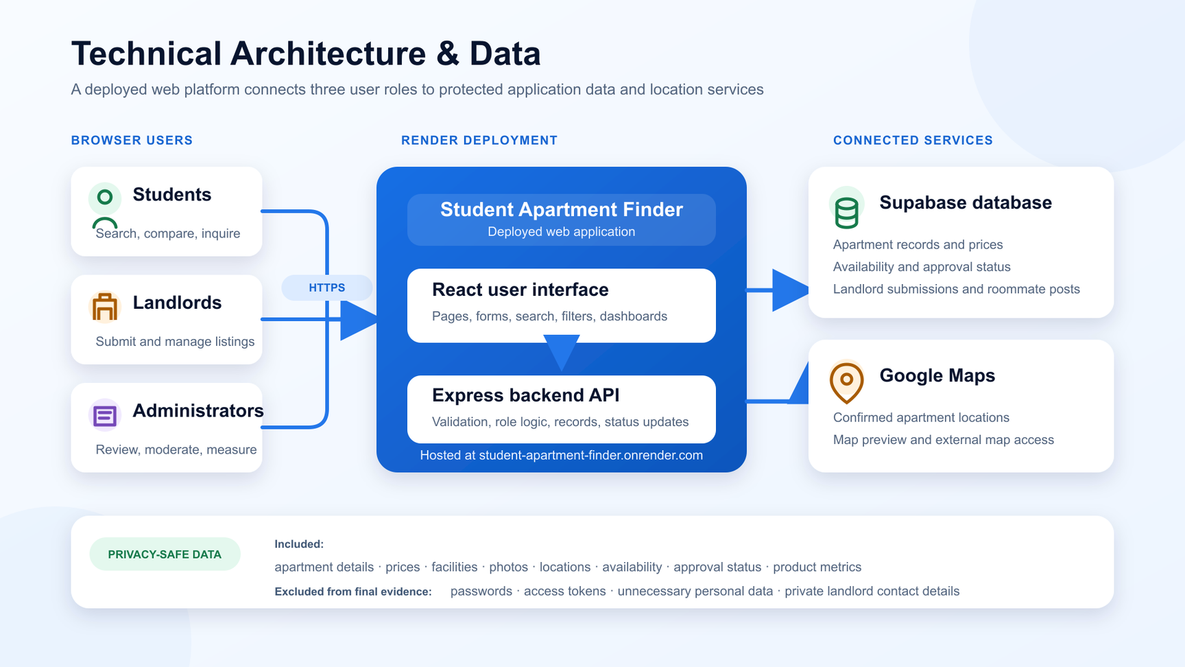
TECHNICAL ARCHITECTURE & DATA
A deployed web platform supports three user roles

Slide 13
FINAL STATUS AND IMPROVEMENTS
Most requirements are complete; two areas need final verification
COMPLETED
HOMEPAGE AND MAIN PATHWAY
APARTMENT RECORDS AND LISTS
SEARCH AND FILTERS
DETAIL VIEW AND MAPS
STATUS TRACKING
ADMINISTRATOR FUNCTIONS
DASHBOARD AND METRICS
REQUIREMENT TRACEABILITY
PARTIALLY COMPLETED
FR-03: FINAL LANDLORD-SUBMISSION VERIFICATION
FR-10: FINAL FORM GUIDANCE AND VALIDATION VERIFICATION
NEXT PRIORITIES
VERIFY LANDLORD-FORM IMPROVEMENTS.
TEST WITH REAL STUDENTS AND LANDLORDS.
ADD MORE VERIFIED APARTMENTS.
STRENGTHEN ROOMMATE SAFETY AND MODERATION.
EXPAND PRIVACY-SAFE PRODUCT METRICS.

Slide 14
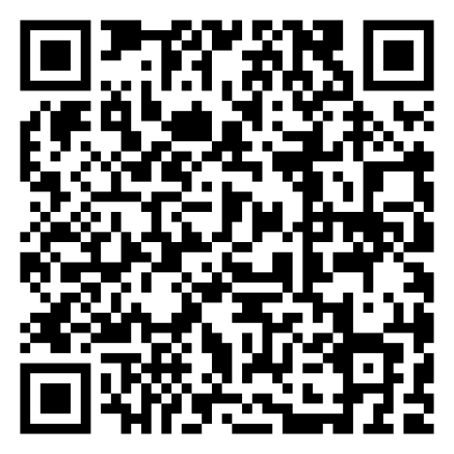
CLOSING AND Q&A
Student housing information should be easier to find and compare
THE STUDENT APARTMENT FINDER BRINGS APARTMENT LISTINGS, PRICES, FACILITIES, PHOTOGRAPHS, AVAILABILITY, CONTACTS, AND LOCATIONS INTO ONE ORGANIZED PLATFORM.
STUDENTS: FIND AND COMPARE ACCOMMODATION.
LANDLORDS: SHARE ACCURATE LISTINGS.
PARTNERS: SUPPORT RELIABLE STUDENT-HOUSING ACCESS.
LIVE PROTOTYPE
STUDENT-APARTMENT-FINDER.ONRENDER.COM

Slide 15
THANK YOU
FOR YOUR ATTENTION!

