Slide 1
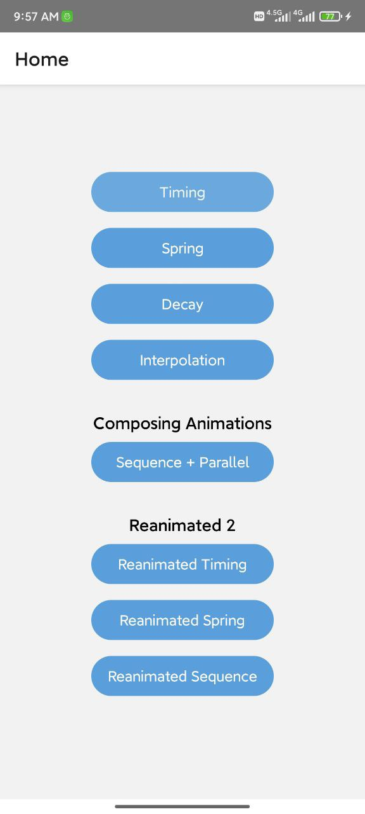
React native
Animation & reanimated 2

Slide 2
Animated api
Animation system provided by React Native
Create Animation value with Animated.Value()
Use useRef() to persist values between renders for Animated.Value
Animatable component types
View
Text
Image
ScrollView
FlatList
SectionList
Can create using Animated.createAnimatedComponent()
Full Documentation => https://reactnative.dev/docs/animated

Slide 3
Animation types
Animated.timing()
Animated.spring()
Animated.decay()

Slide 4
1) timing – animation
Animates value over a time using Easing functions
timing(value, config)
Eg =>
Animated.timing(animatedValue, {
toValue: 100,
easing: Easing.inOut, // default
duration: 500, // milliseconds
delay: 200
}).start();
All timing config options => https://reactnative.dev/docs/animated#timing

Slide 5
timing – easing functions
Easing =>Acceleration or Deceleration.
All Easing methods => https://reactnative.dev/docs/easing#methods

Slide 6
2) spring – animation type
a) Real world spring
b)React native Animated spring
Provides a simple spring physics model
spring(value, config)
Eg =>
Animated.spring(animatedValue, {
toValue: 100,
delay: 200
}).start();
All spring config options => https://reactnative.dev/docs/animated#spring

Slide 7
3) Decay – animation type
Starts with an initial velocity and gradually slows to a stop
decay(value, config)
Eg =>
Animated.decay(animatedValue, {
toValue: 100,
duration: 500
}).start();
All decay config options => https://reactnative.dev/docs/animated#decay

Slide 8
interpolation
Maps input ranges to output ranges
Output ranges can be numbers, colors, degrees
Eg =>
<Animated.View
style={{
opacity: fadeAnim, // Animated.Value
transform: [{
translateX: fadeAnim.interpolate({
inputRange: [0, 1],
outputRange: [150, 250]
}),
}],
}} />
Color
<Animated.View
style={{
opacity: fadeAnim, // Animated.Value
backgroundColor: fadeAnim.interpolate({
inputRange: [0, 1],
outputRange: [‘red’, ‘blue’]
})
}} />
All decay config options => https://reactnative.dev/docs/animated#composing-animations

Slide 9
Composing animations
Animations can be combined and played in sequence or in parallel
Documentation => https://reactnative.dev/docs/animated#composing-animations

Slide 10
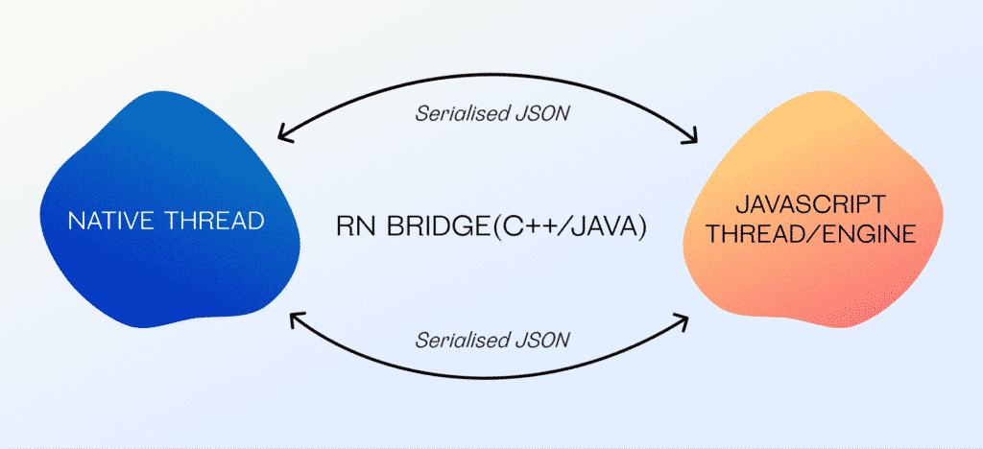
useNativedriver
React Native Old Architecture
Low performance for Animation
useNativeDriver => true
Perform Animation on UI Thread
Improve Animation Performance
Doesn’t support for COLOR

Slide 11
React native reanimated 2
Third party library for React Native Animation
Reanimated 2 is version 2 of reanimated API
Create Animations on UI Thread
Better Performance than Animated API
useSharedValues => Animated API’s Animated.Value()
useAnimatedStyle => For styling animated components
Official Documentation
https://docs.swmansion.com/react-native-reanimated/docs
Installation
https://docs.swmansion.com/react-native-reanimated/docs/fundamentals/installation

Slide 12
Reanimated 2 - animations
Timing Animation
withTiming(toValue, options)
Options
Duration
Easing
https://docs.swmansion.com/react-native-reanimated/docs/api/animations/withTiming
Spring Animation
withSpring(toValue, options)
https://docs.swmansion.com/react-native-reanimated/docs/api/animations/withSpring

Slide 13
Study sites
https://reactnative.dev/docs/animations
https://reactnative.dev/docs/animated
https://docs.swmansion.com/react-native-reanimated/docs/
https://www.youtube.com/c/wcandillon

