Slide 1

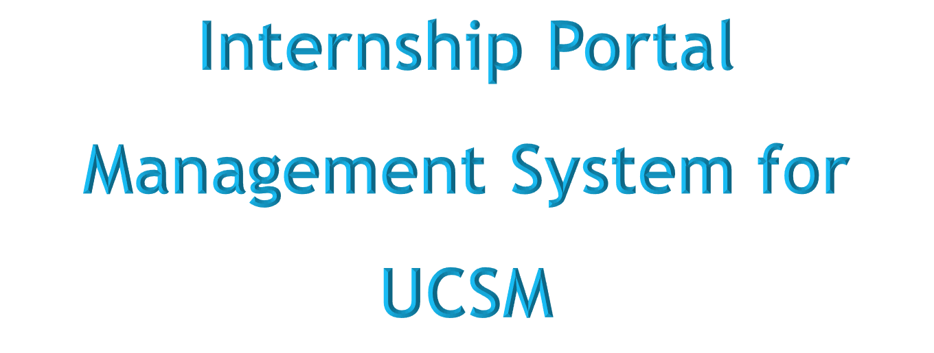

1.3.2024
1

Slide 2
Supervisor – Dr.Myo Khaing
Team Members-
Mg Htet Oo Wai Yan (MKPT- 6991) – Leader
Mg Kyaw Naing Moe (MKPT - 6978)
Ma Thae Ei Thone (MKPT - 6990)
Ma Saw Yoon Nwe (MKPT - 7005)
2

Slide 3
Contents
Flowchart Diagrams
Use Case Diagrams
Sequence Diagram
ER Diagram
UI Designs
Gantt Chart
Conclusion
Abstract
Introduction
Objectives
Advantages
Disadvantages
Functional Requirements
Nonfunctional Requirements
3

Slide 4
Abstract
Internship is an essential part of many students’ education before they graduate, providing them with valuable hands-on experience and exposure to the working world.
Internship Portal Management System is a web-based, user-friendly, and useable system to meet the specific needs of internship process.
The system provides all necessary informations of internship that will be effective and efficient for stakeholders such as academicians, students and companies.
The project aims to ease internship process by linking particular users.
The system is developed using PHP, MySQL Database, HTML, CSS and JavaScript and Bootstrap for UI.
4

Slide 5
Introduction
The system is a communication between university students, educational institutions and industries.
It is a simple user interface which involves three participants; university, student and company.
Student will be able to login into the system after registration and search for a relevant job and apply for those positions.
Company will be able to post all about vacant jobs and descriptions of their community after registration and login process.
Student and company must fill all necessary informations under their respective profiles.
5

Slide 6
Objectives
To enable the students to register themselves with the website, look up for different jobs according to their qualifications and apply for those jobs conveniently.
To help the university to ease the process of informing students internship opportunities making them aware of their skills and abilities.
To provide company to be recognized their responsibility and to ease getting of potential candidates.
To strengthen linkages between students, educational institutions and industries.
To integrate all of online real-time informations about the jobs available in the agencies and the user informations in one palace at one time.
6

Slide 7
Advantages
It will provide a platform for communication and collaboration between interns and their supervisors, helping to facilitate a positive and productive internship experience.
It will provide companies to expand their business with a wide range of popularity and enable them to find the suitable candidates for their vacant positions.
It facilitates easy sharing informations and efficient selection process.
It can identify trends and make informed decisions for future internships.
It is less time taking and reduces cost for all participants.
It reduces paperwork and human resources.
7

Slide 8
Disadvantages
It relies on technology, there is a rick of technical glitches, system failure, or website crashes.
User may face connectivity issues while accessing the internship portal.
Student can’t know the actual condition of industrial relations.
It cannot be use offline.
8

Slide 9
Functional Requirements
User Login: Users must login with username and password to the system after registration. If they are invalid, can’t enter the system.
Registration: A new user will have to register in the system by providing essential details in order to use the web-services.
Validation: The system will approve all information of these two users after checking such as username and password.
Search Jobs: The student can view different jobs after confirming the login, search and apply by providing the necessary details.
Post Jobs: Company can post vacancies.
9

Slide 10
Nonfunctional Requirements
Efficiency: When the system is implemented, university students and companies can view and upload job vacancies respectively from their homes easily without any difficulty.
Usability: The system is designed for a user-friendly environment and ease of use.
Reliability: The system should provide a reliable environment for both students and companies.
Security: An unauthorized person cannot access the panel and database, and do not read and write the information.
Scalability: The system may be expand later with increasing amounts of users, data and performances.
Availability: It will be available online 24/7 a week.
10

Slide 11
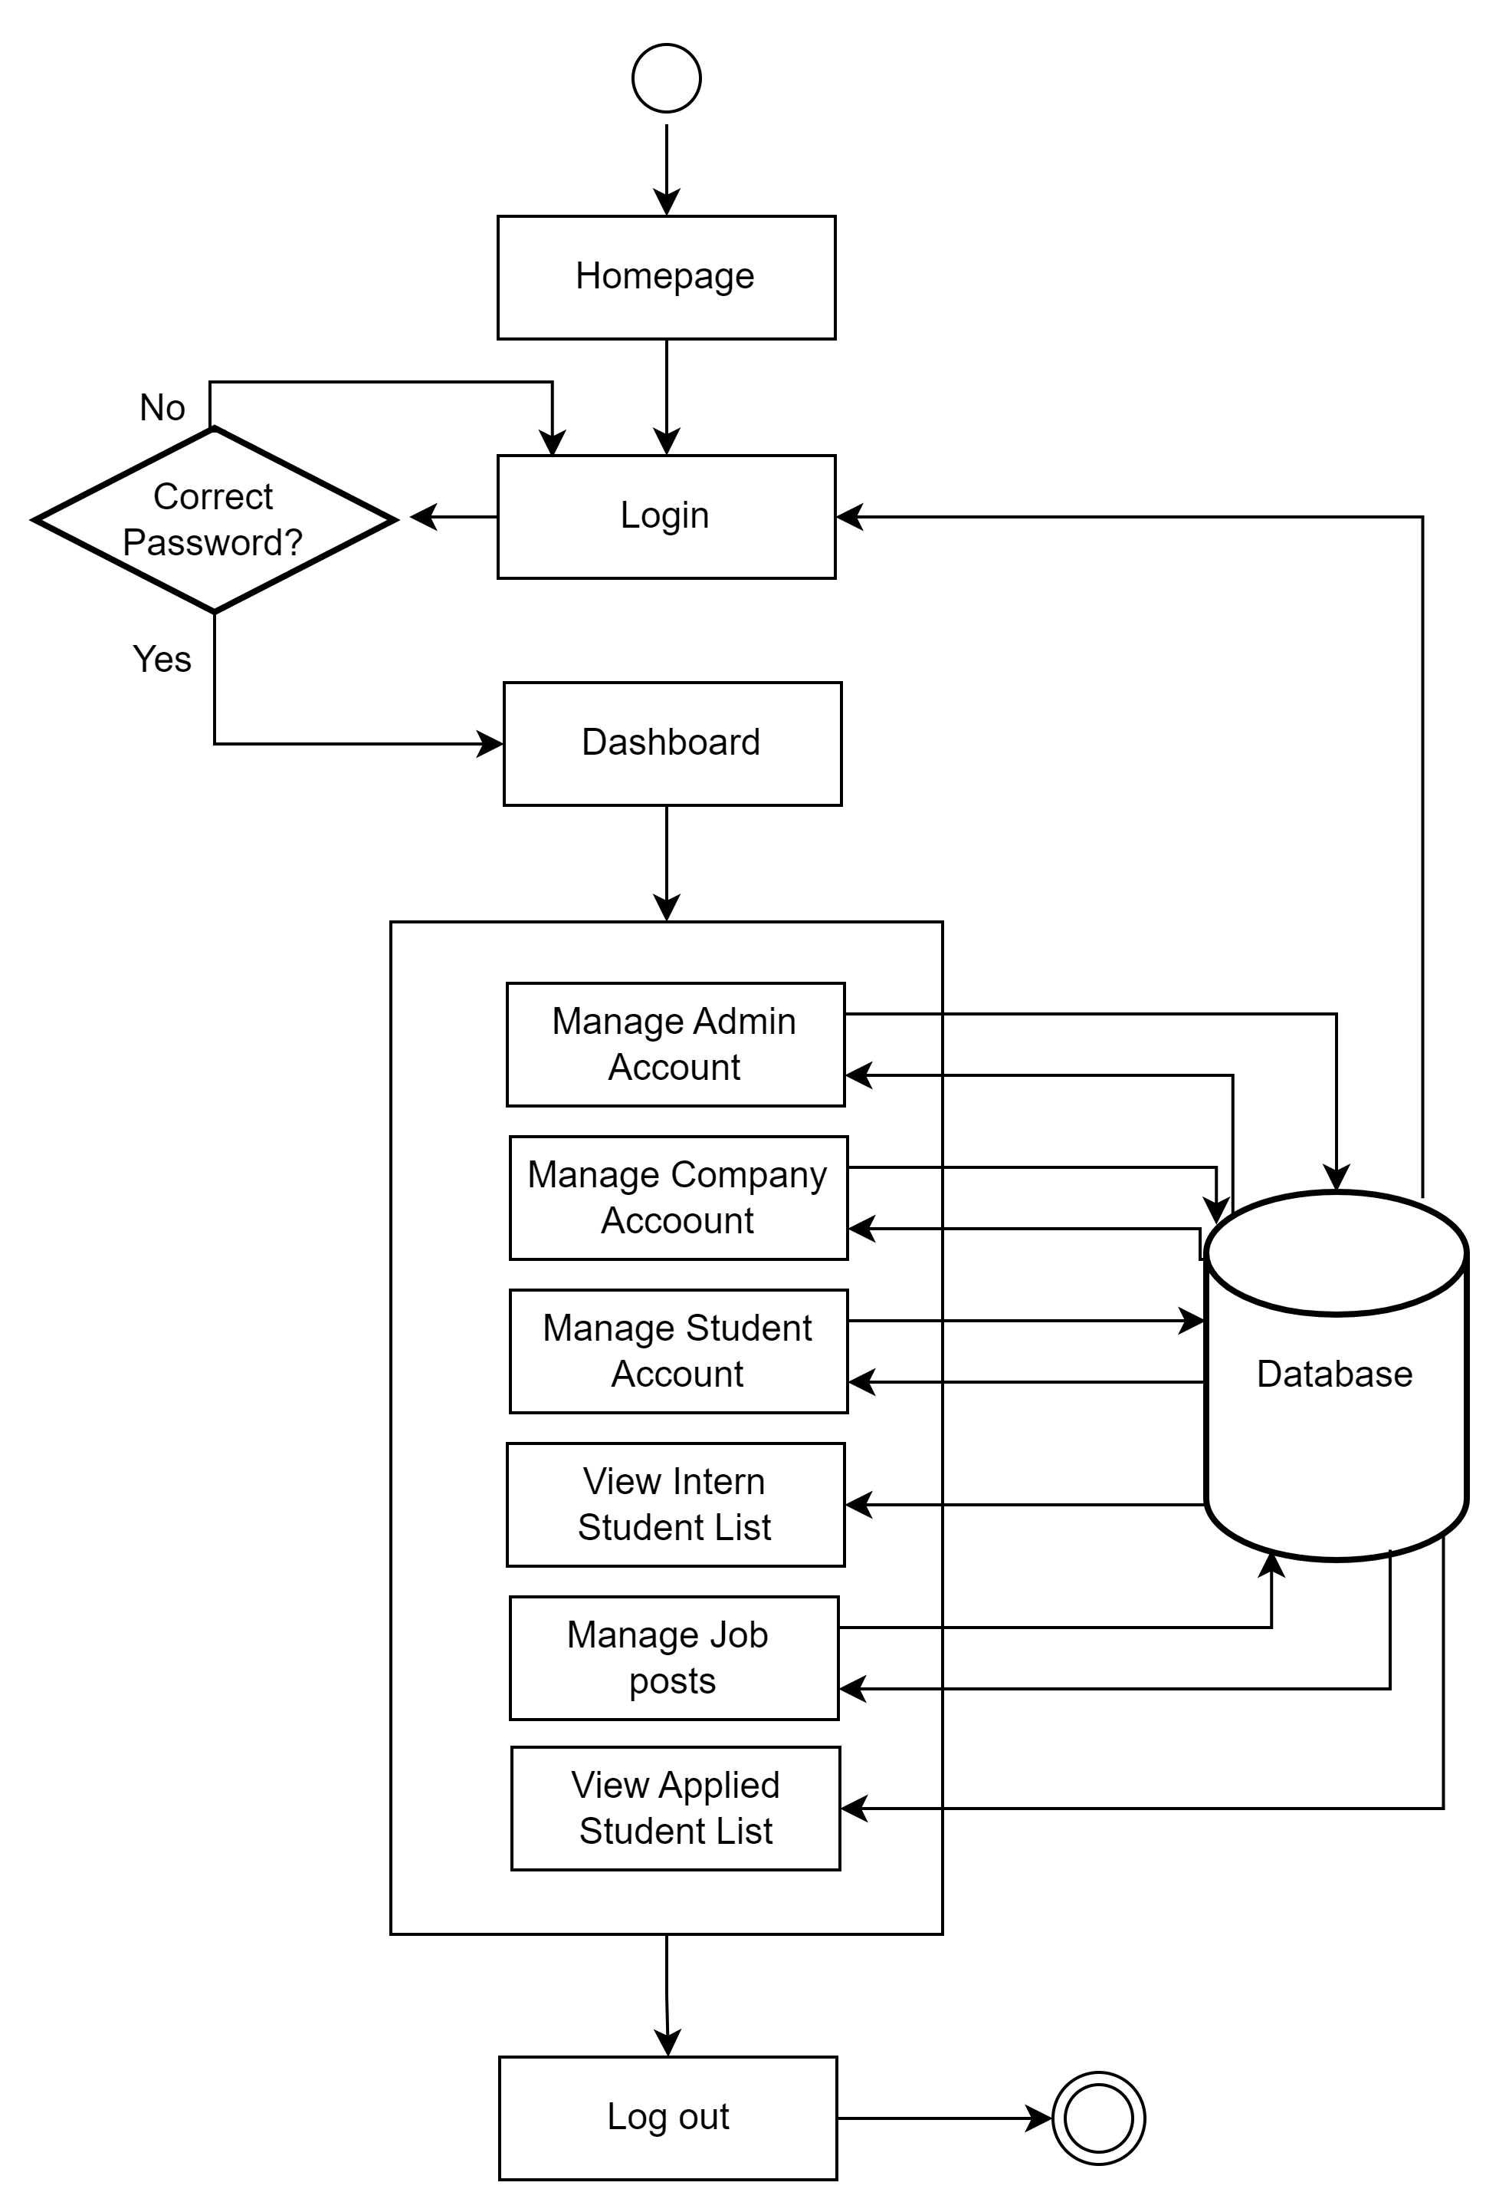
Flowchart for Admin
11

Slide 12
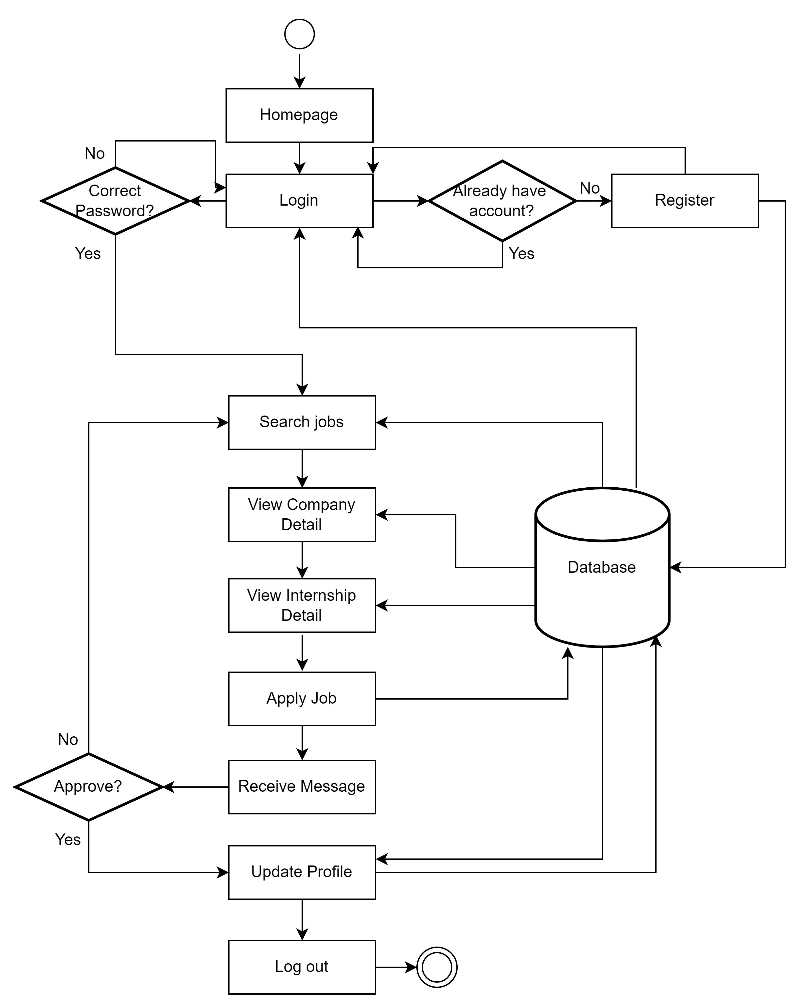
Flowchart for Student
12

Slide 13
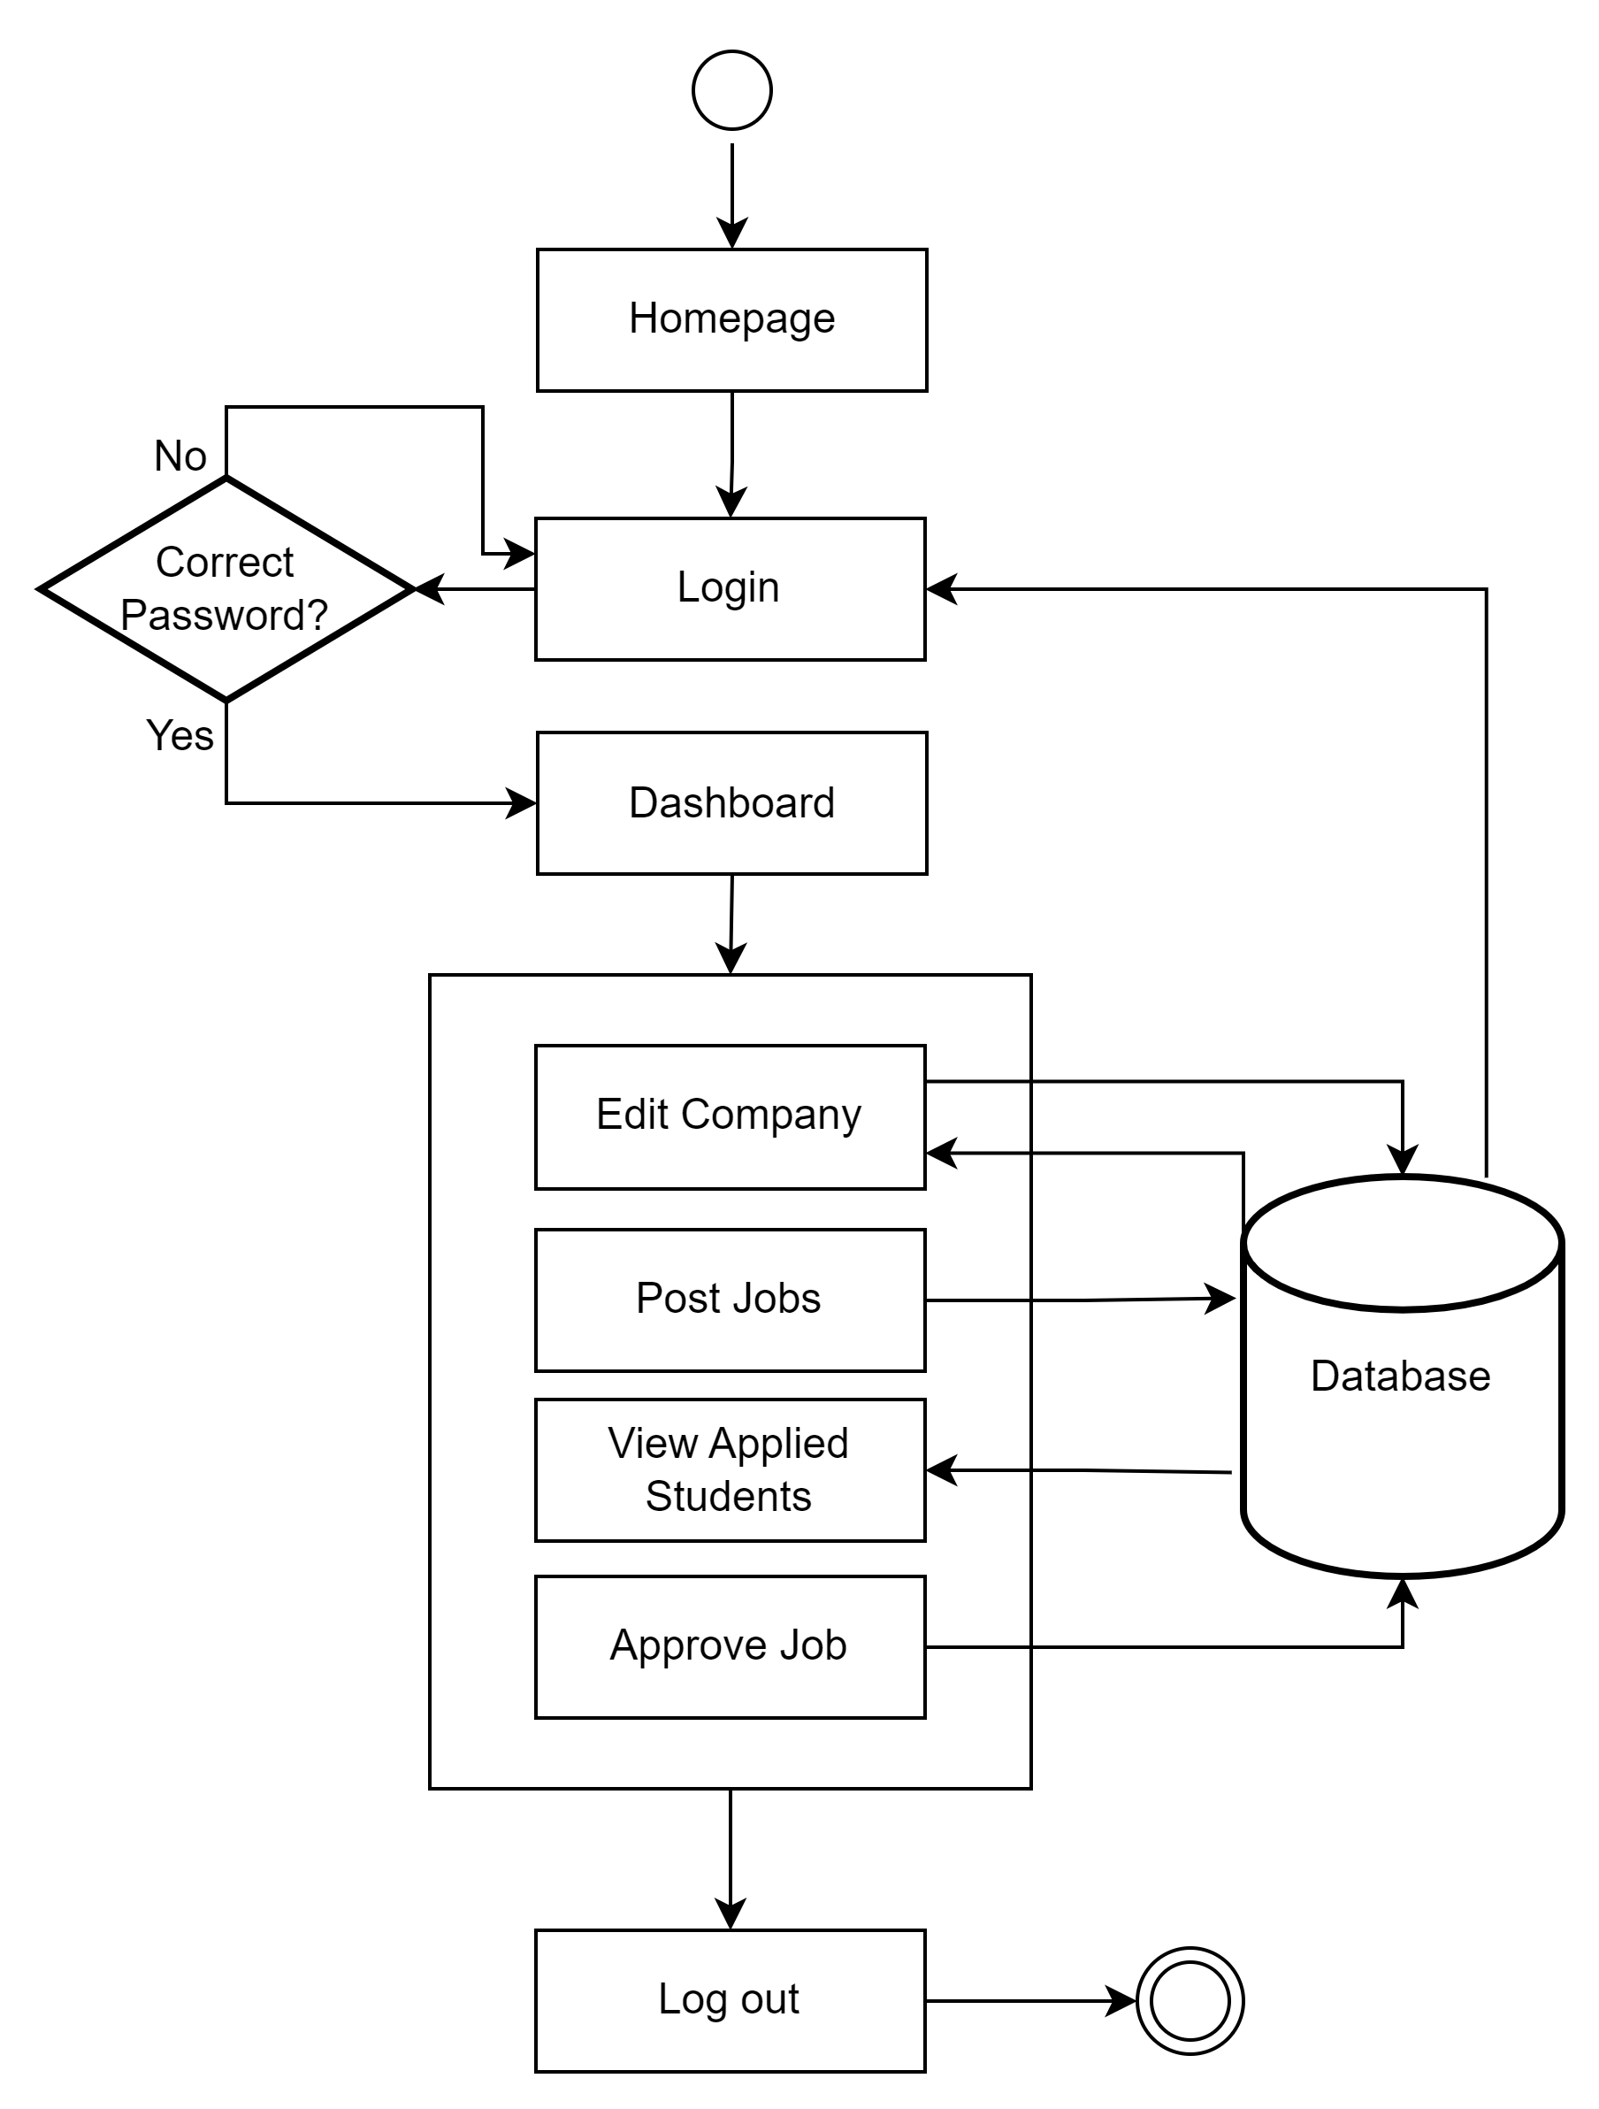
Flowchart for Company
13

Slide 14
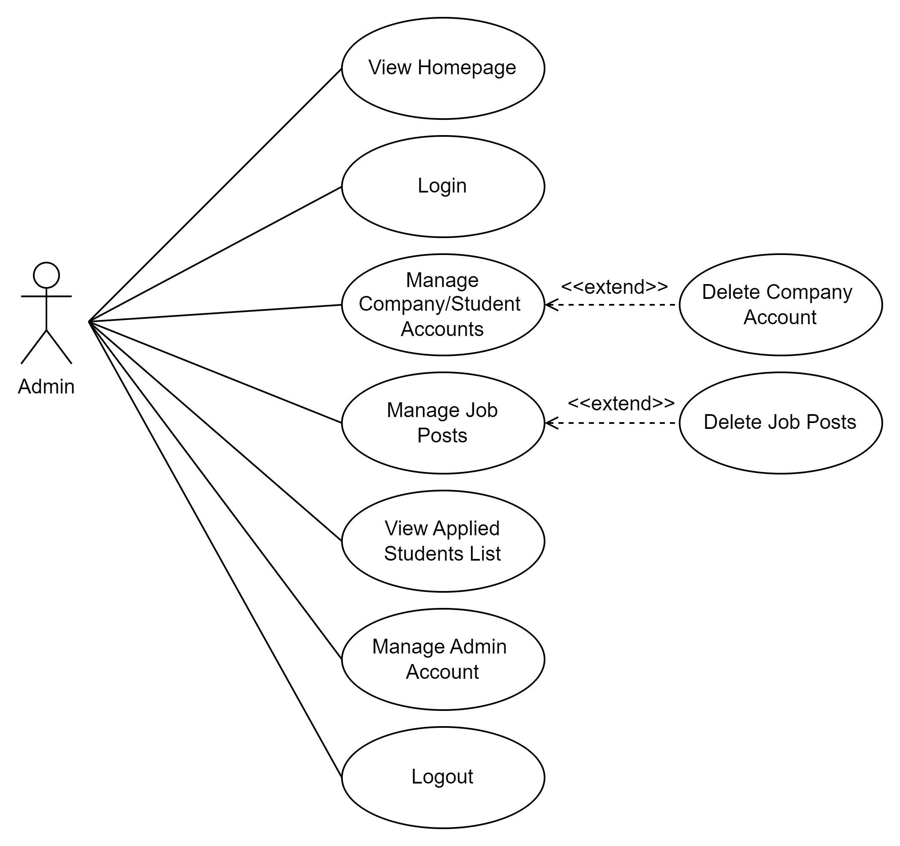
Use Case Diagram for Admin
14

Slide 15
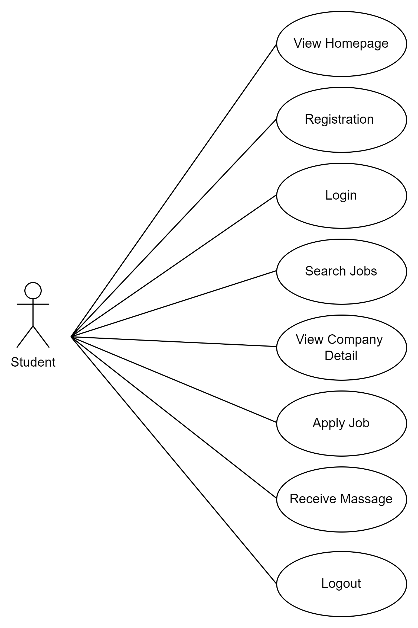
Use Case Diagram for Student
15

Slide 16
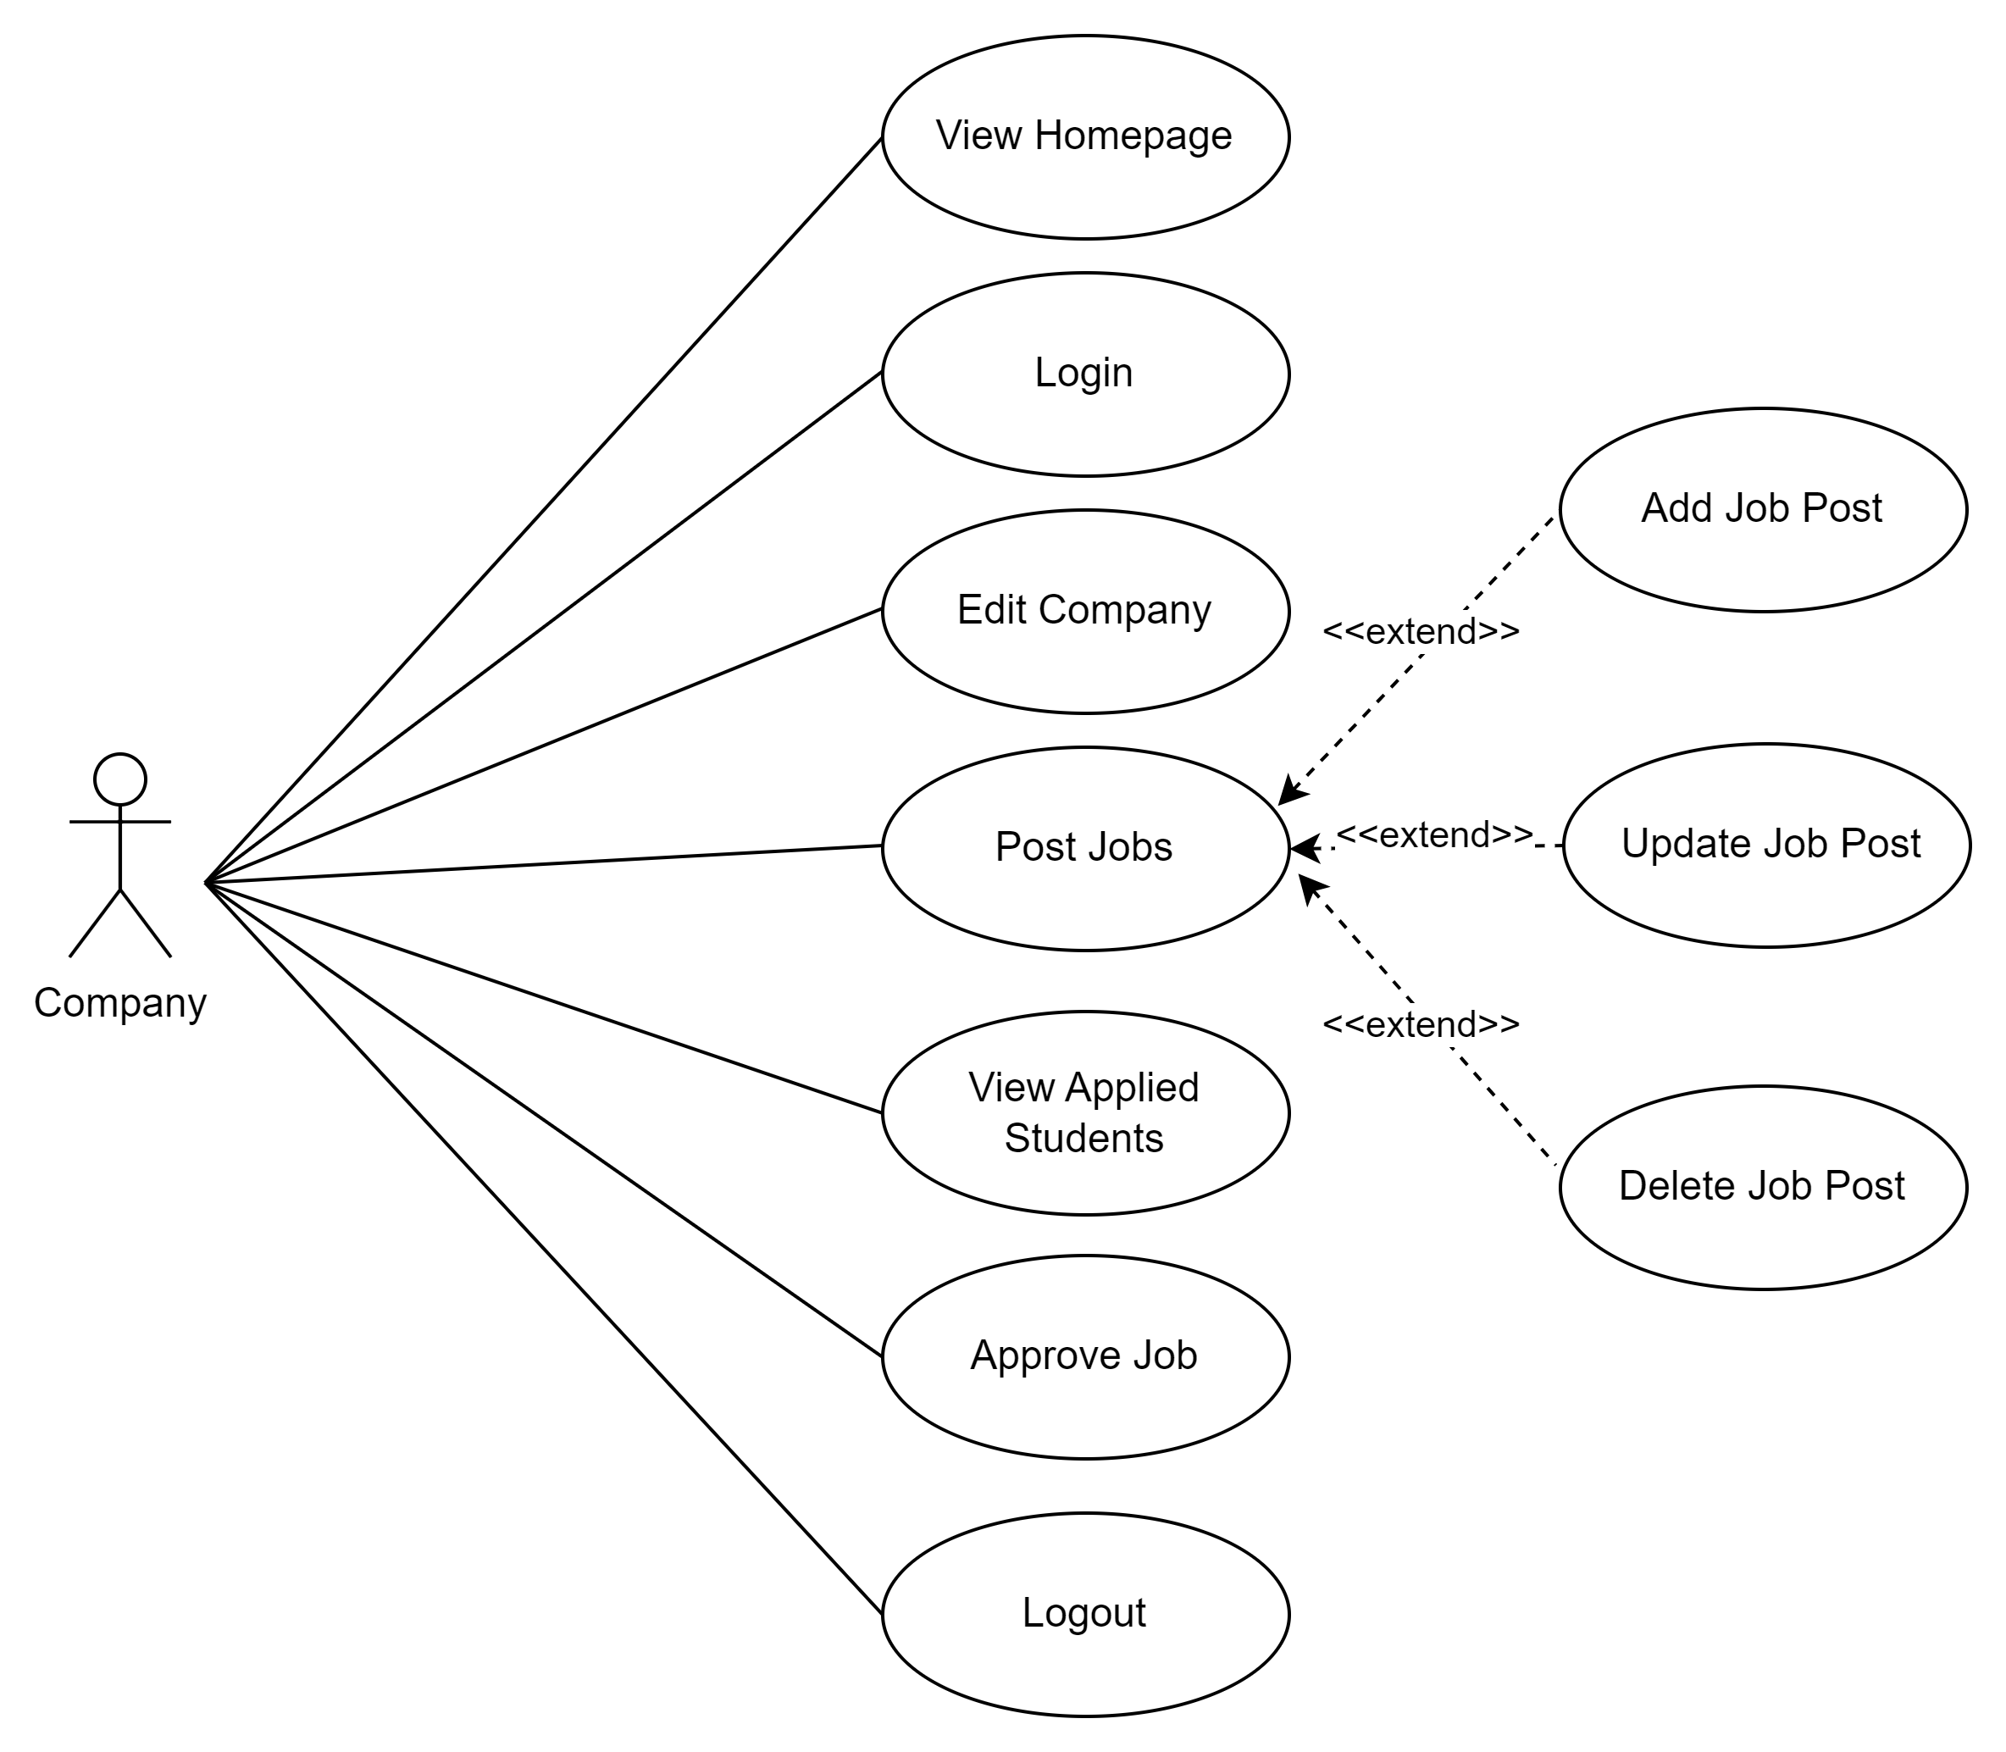
Use Case Diagram for Company
16

Slide 17
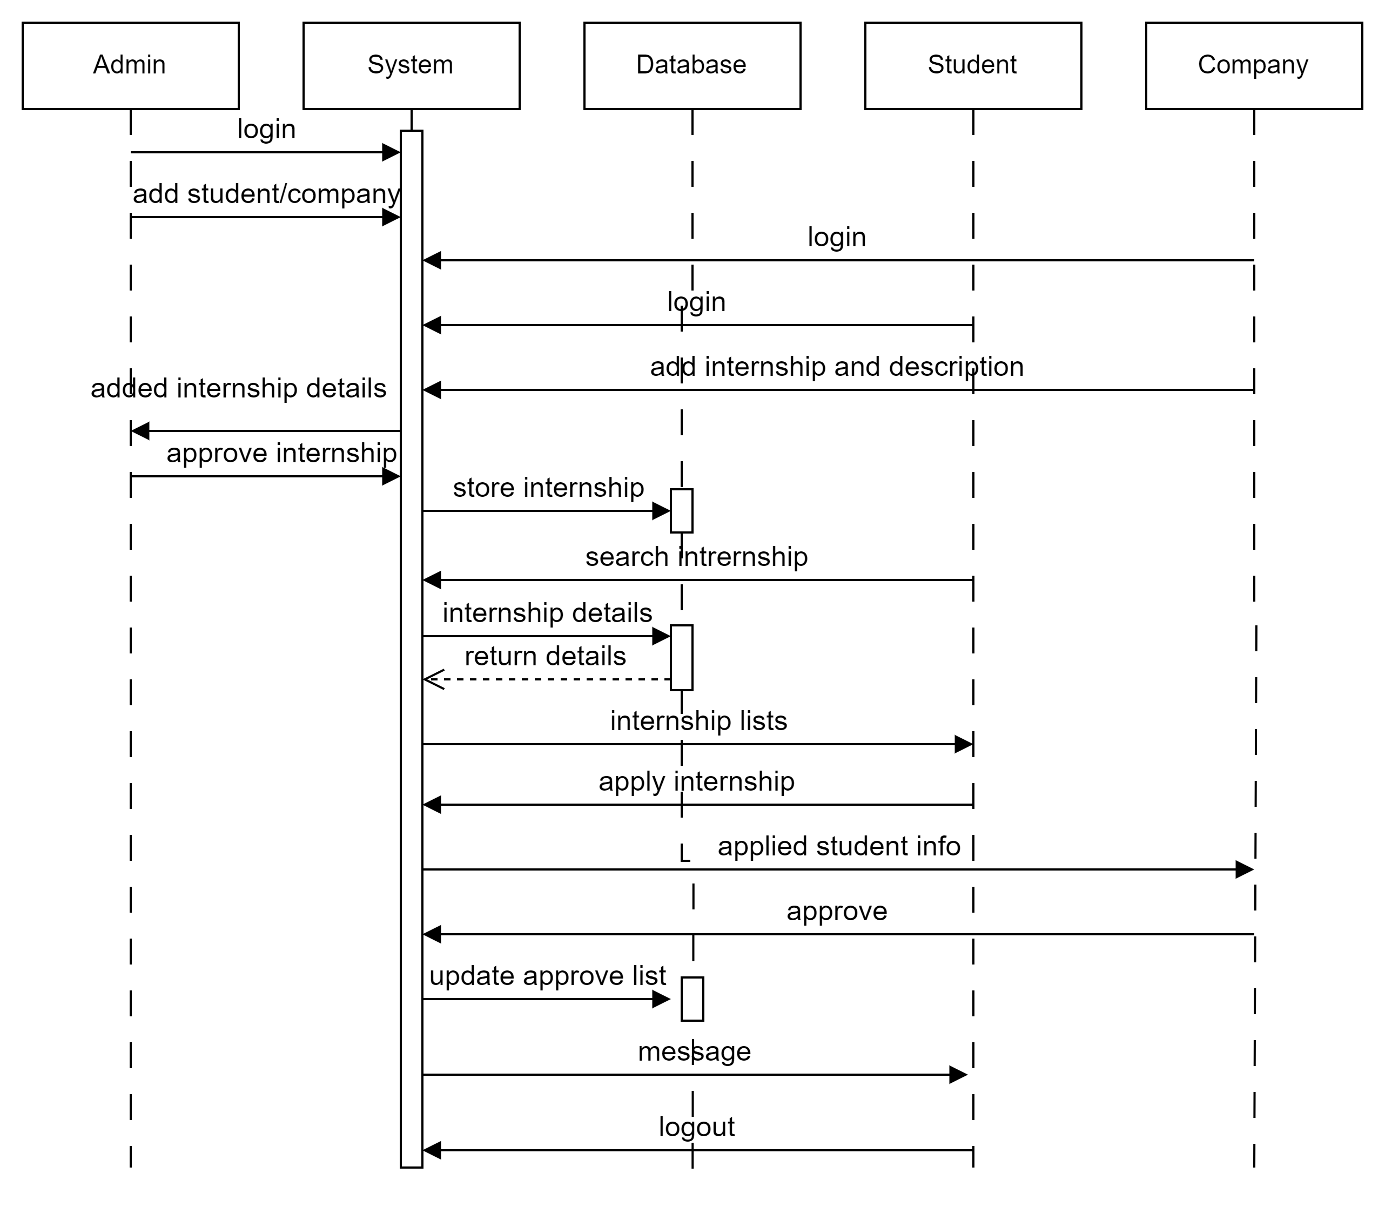
Sequence Diagram
17

Slide 18
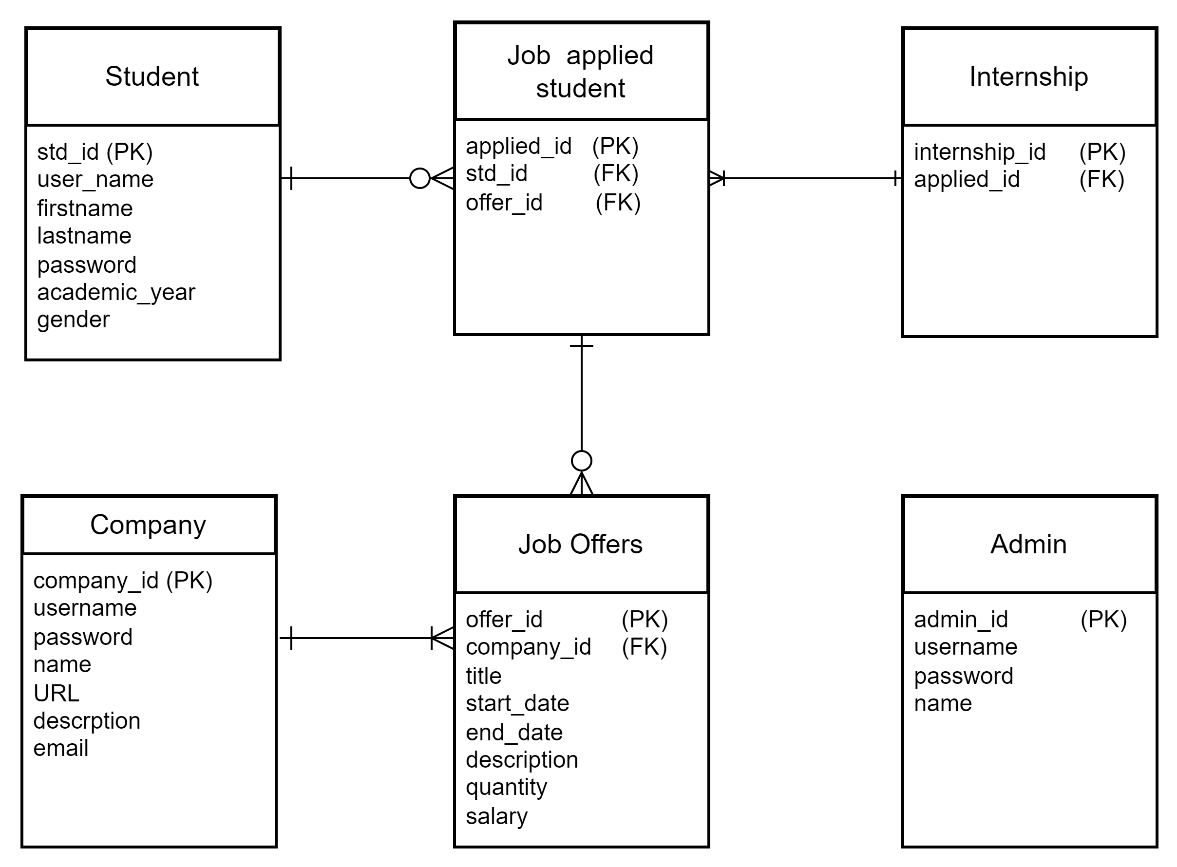
ER Diagram
18

Slide 19
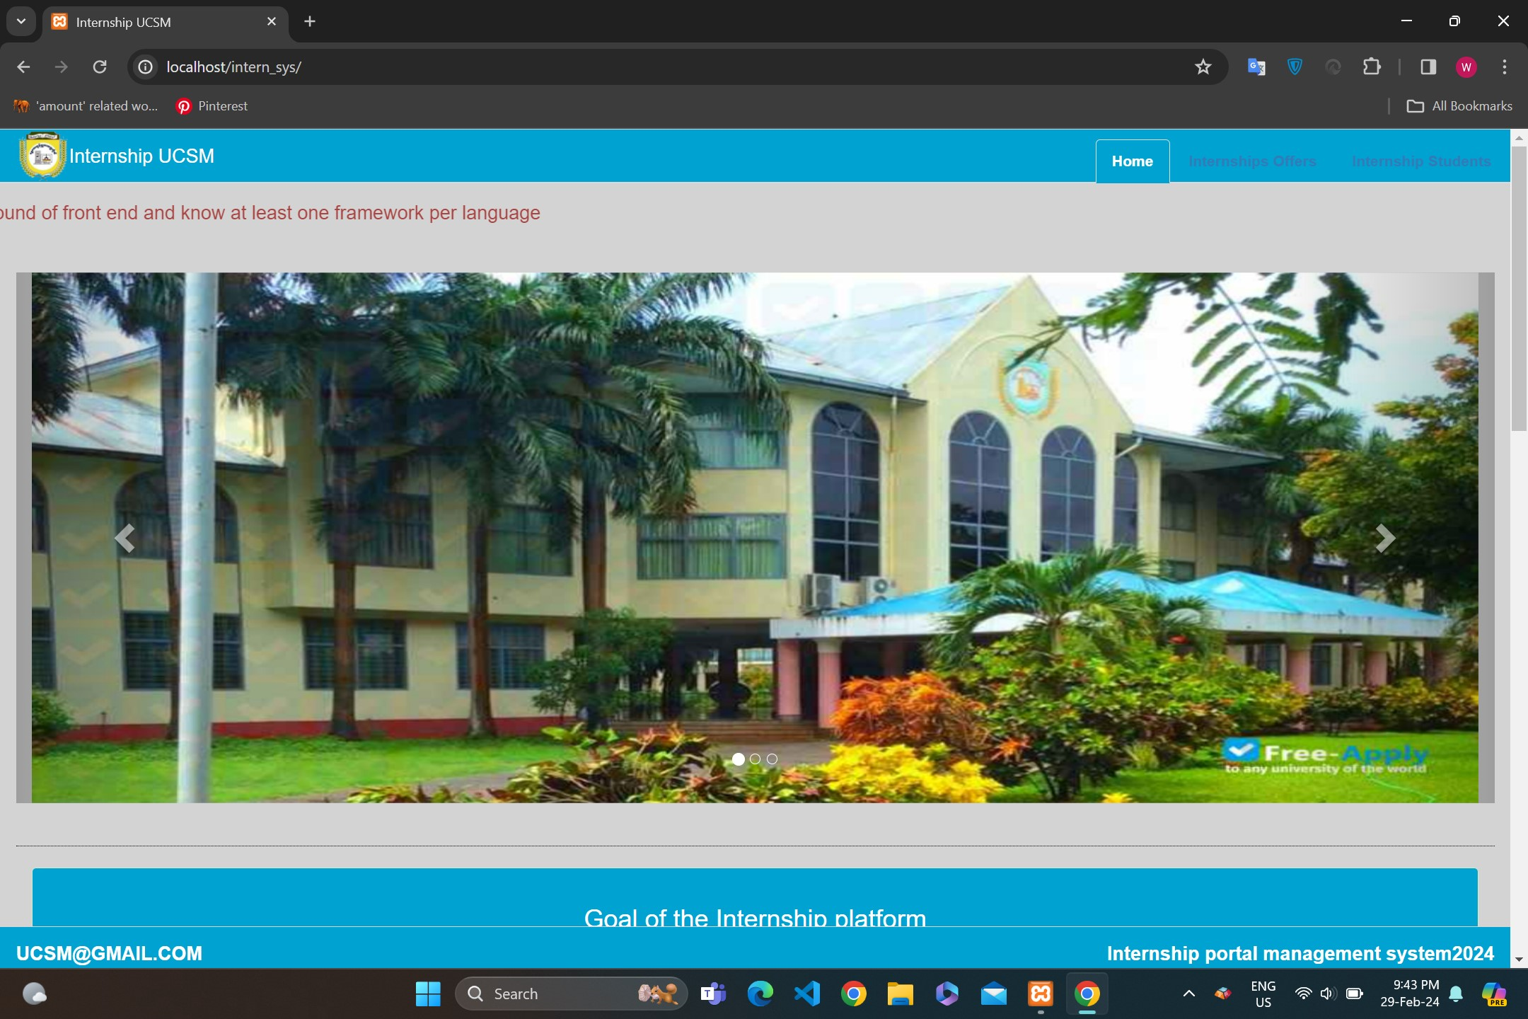

Homepage->Home
19

Slide 20
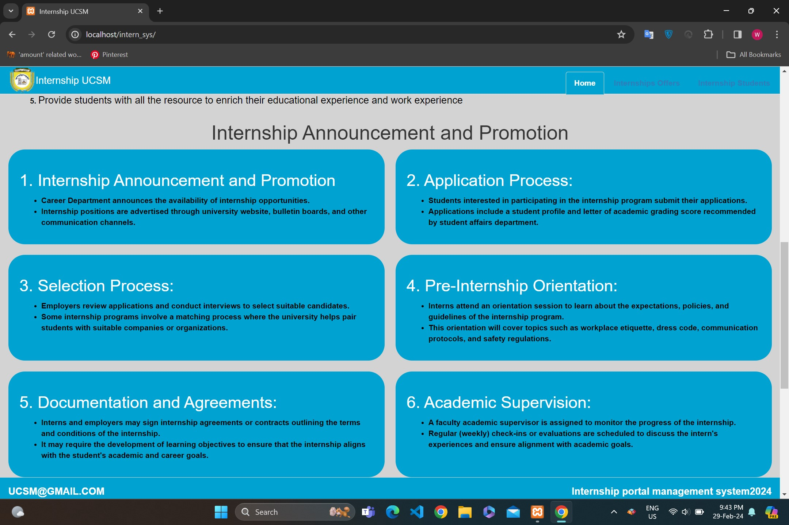
Hompage->About Internship
20

Slide 21
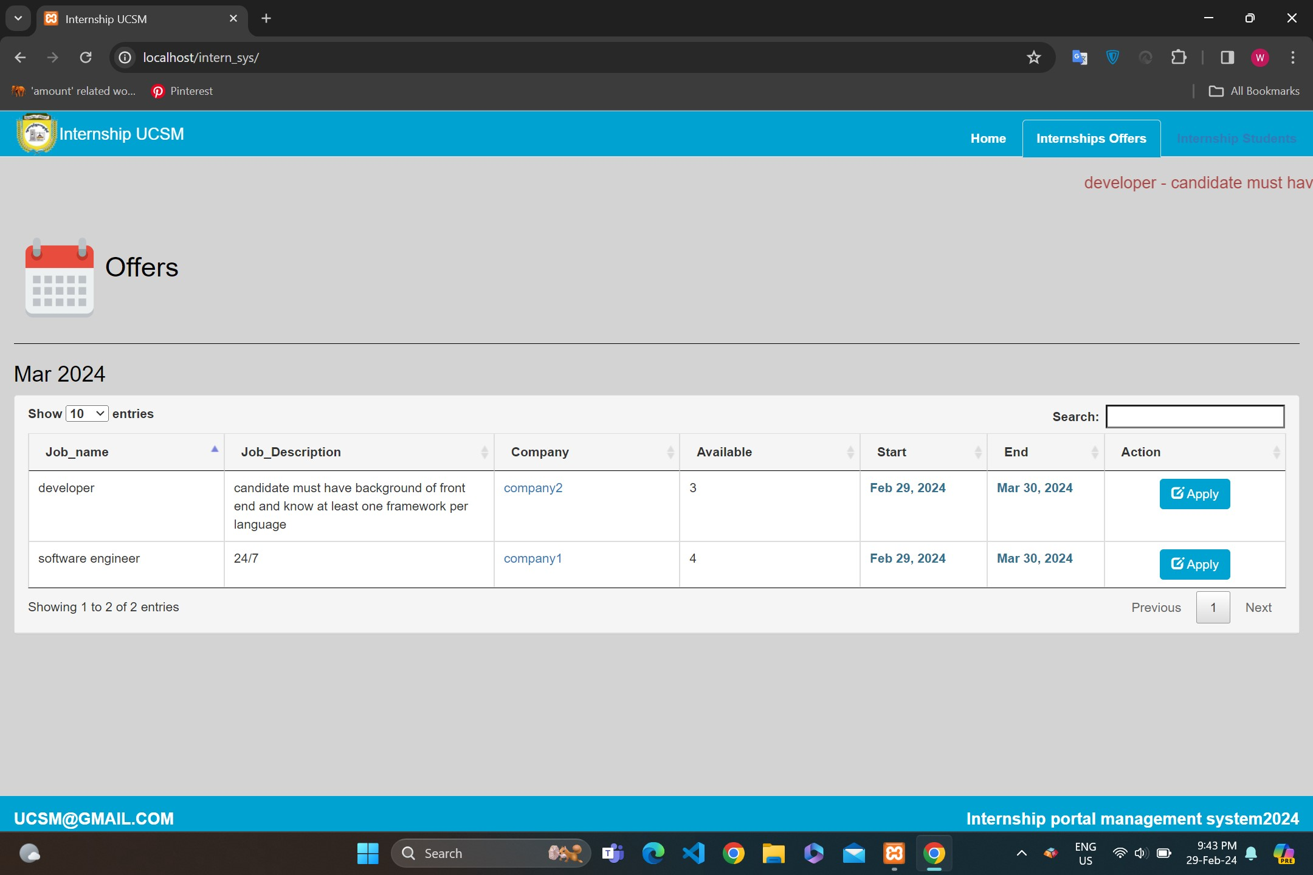
Hompage->Internship Offers
21

Slide 22
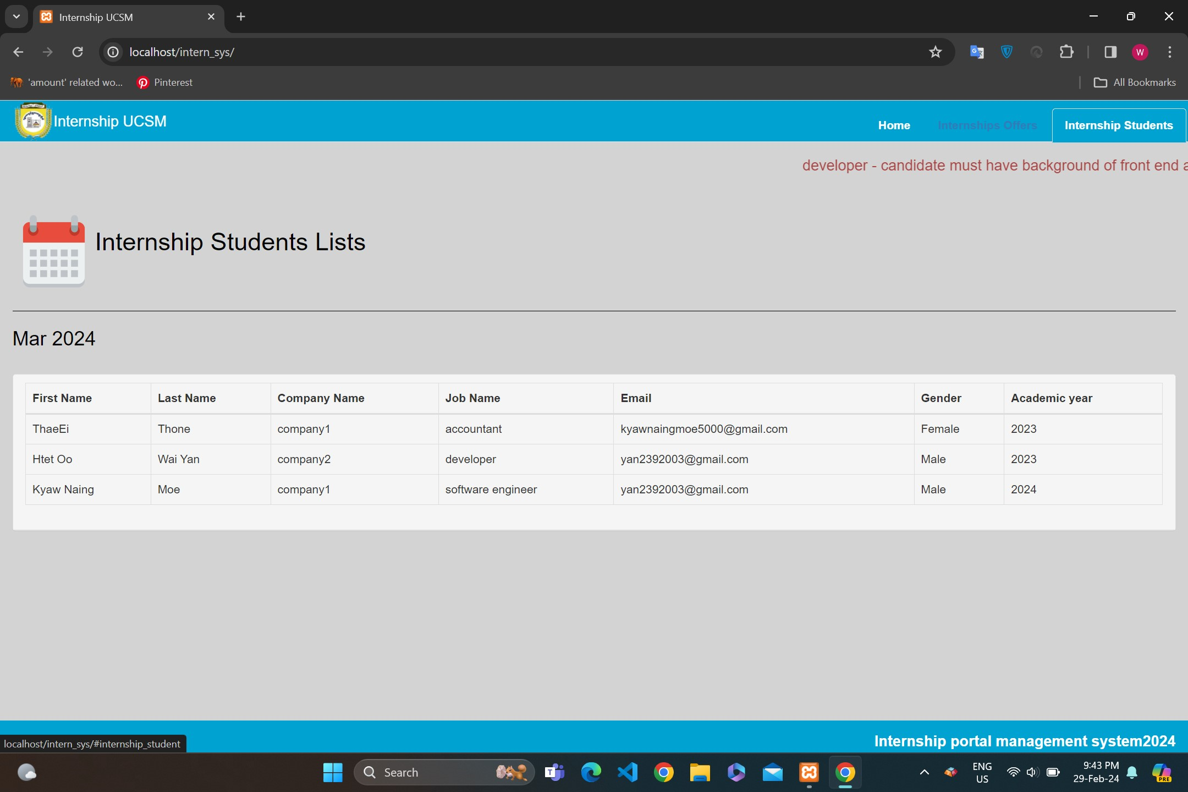
Hompage->Internship Student List
22

Slide 23
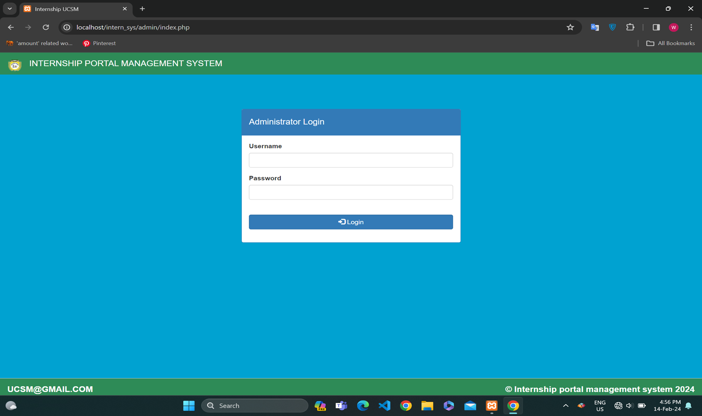
Administrator Login
23

Slide 24
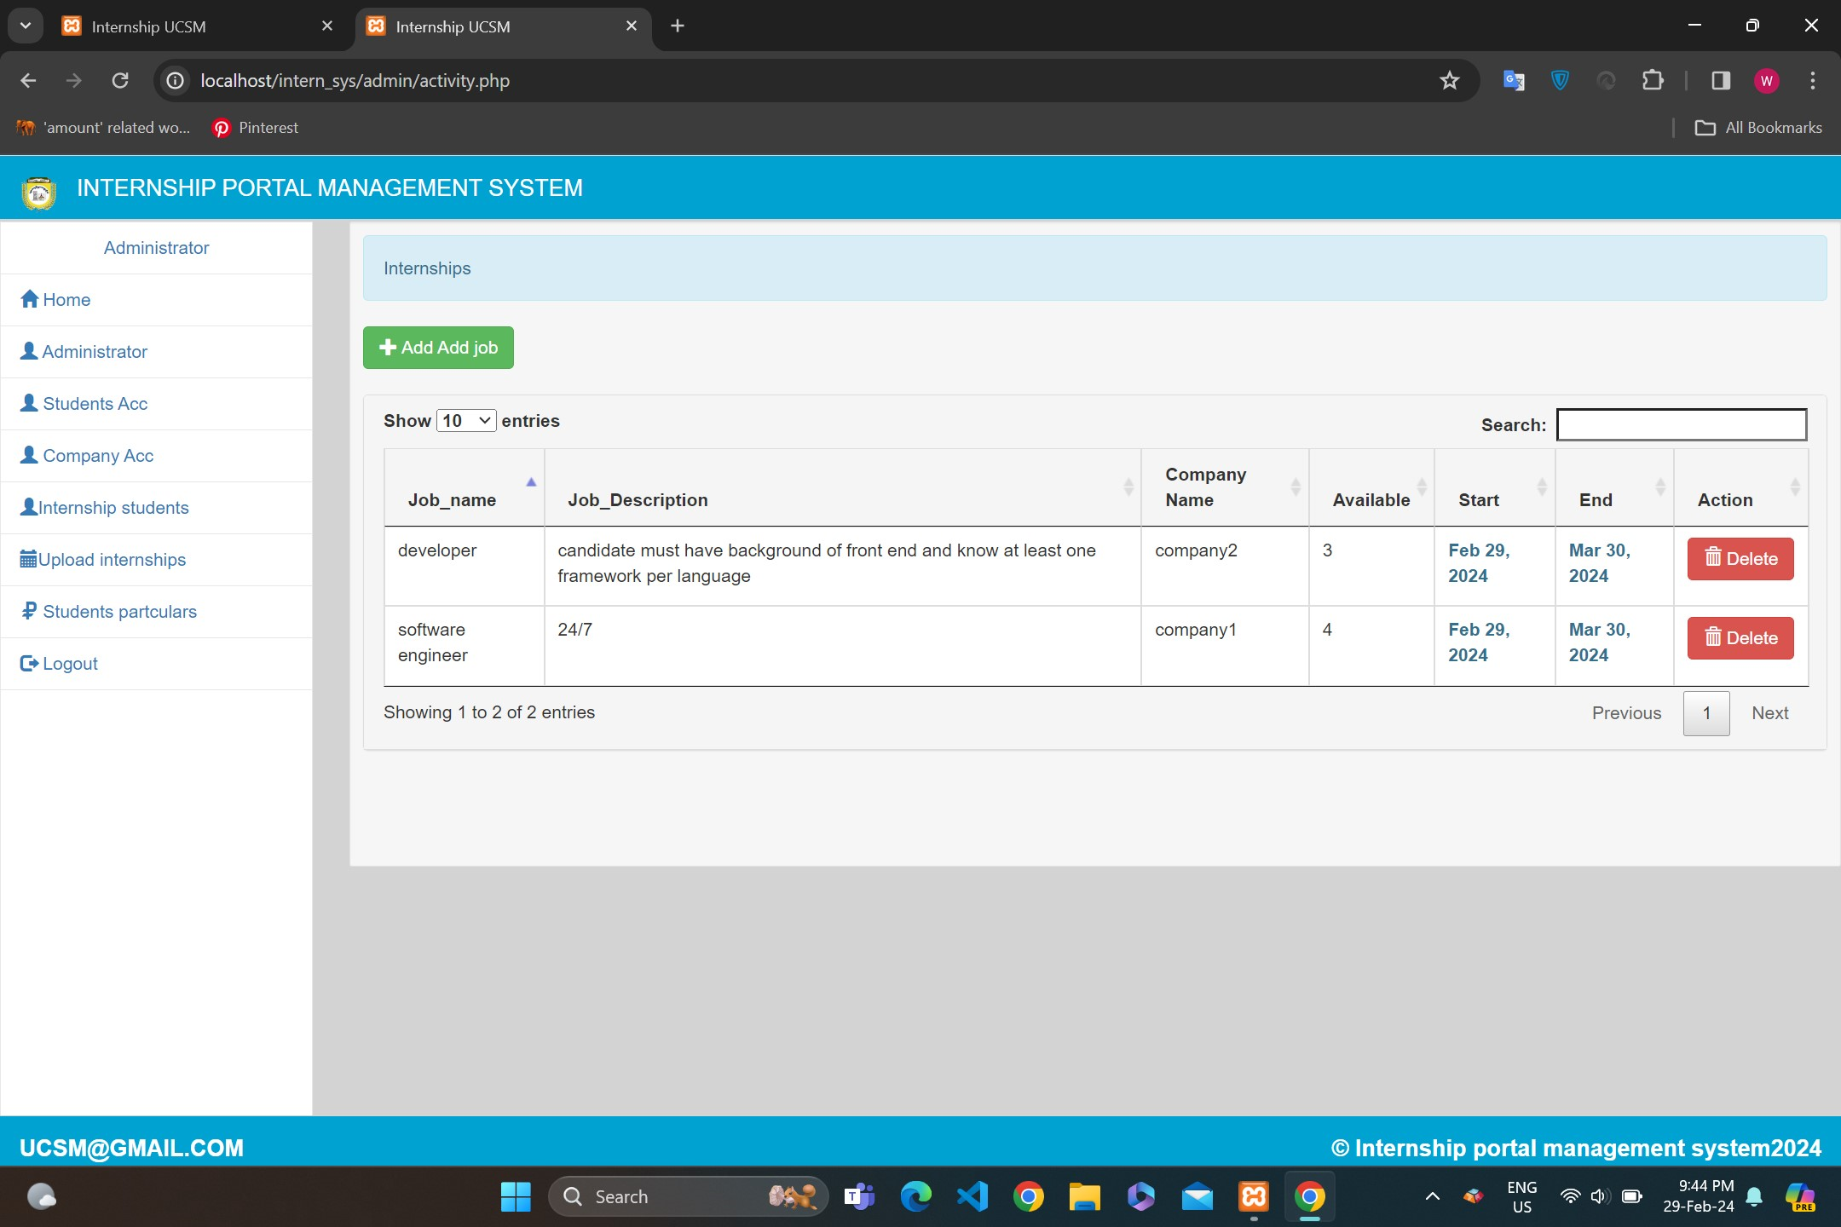

Admin Dashboard
24

Slide 25
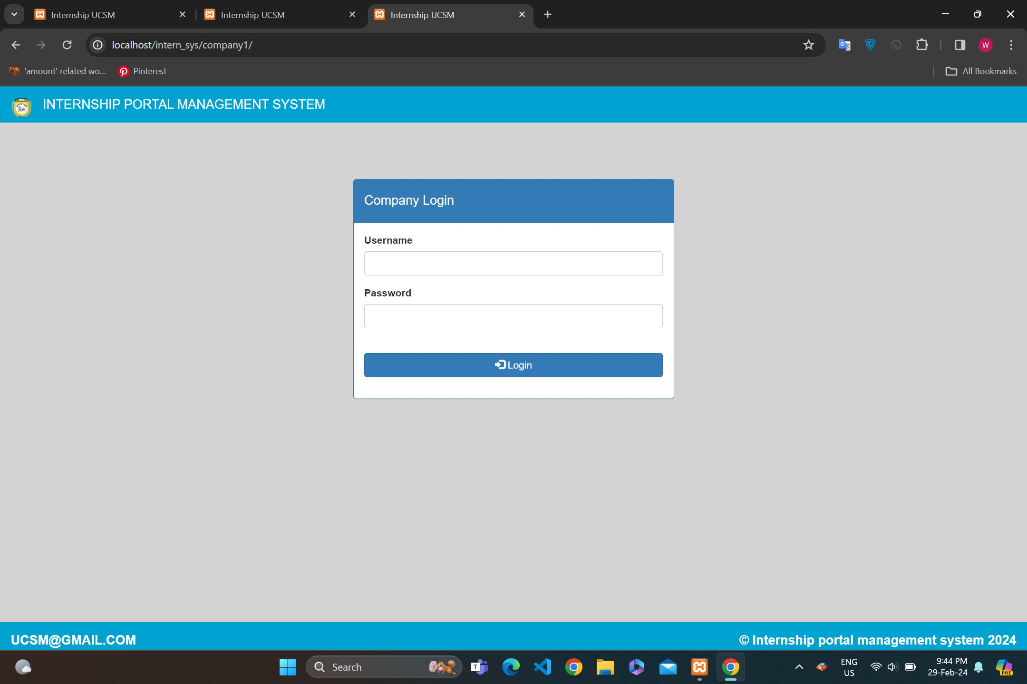
Company Login
25

Slide 26
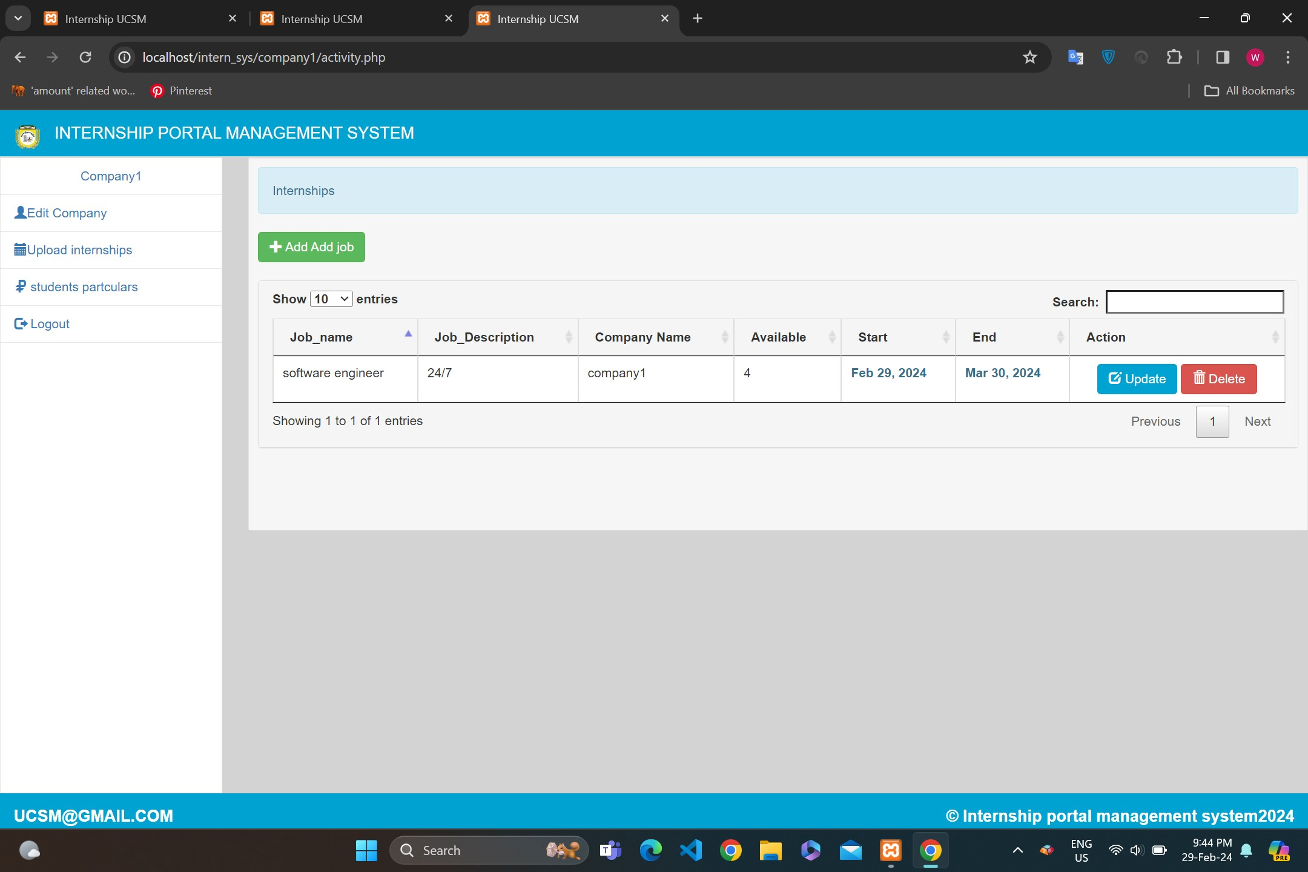
Company Dashboard
26

Slide 27
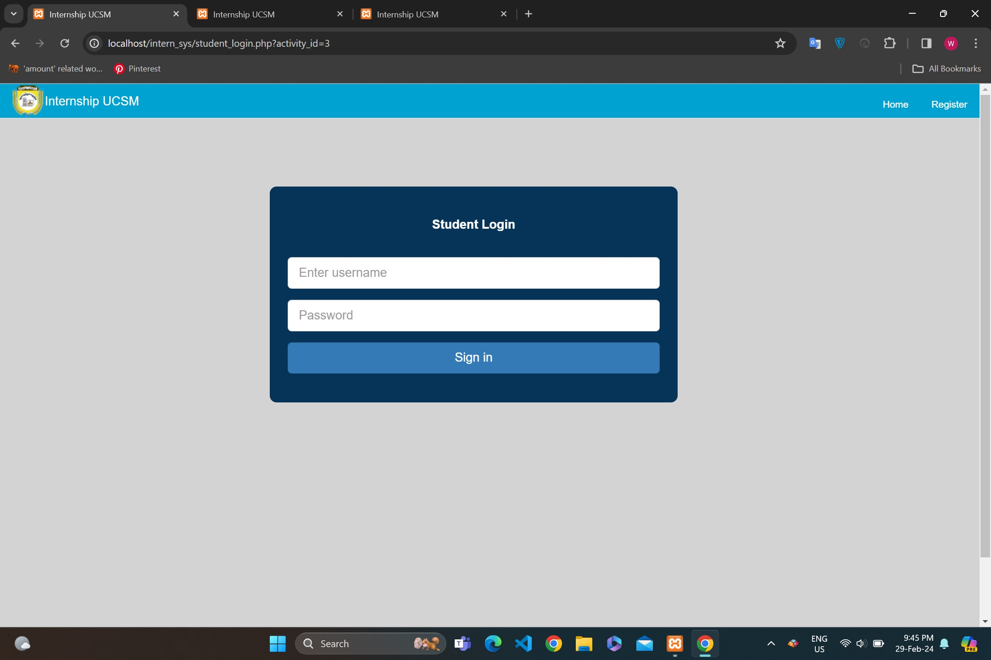
Student Login
27

Slide 28
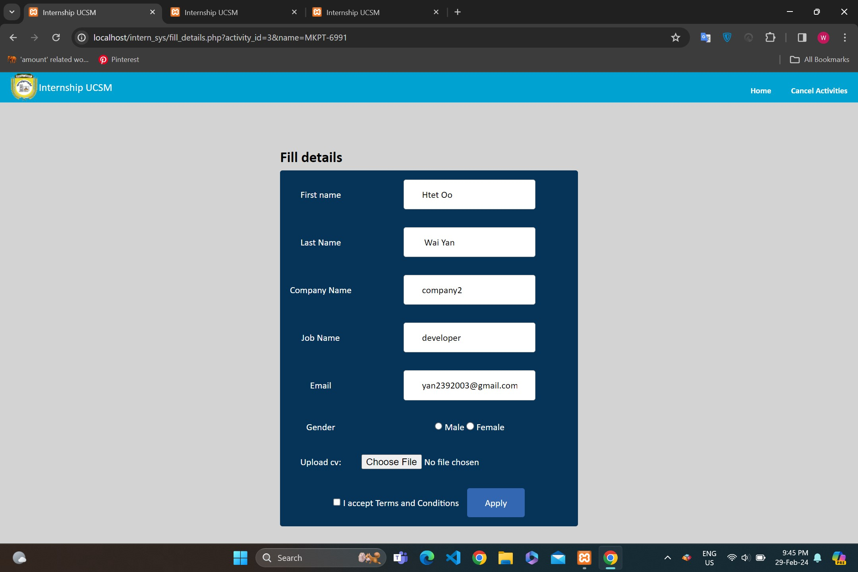
Fill details
28

Slide 29
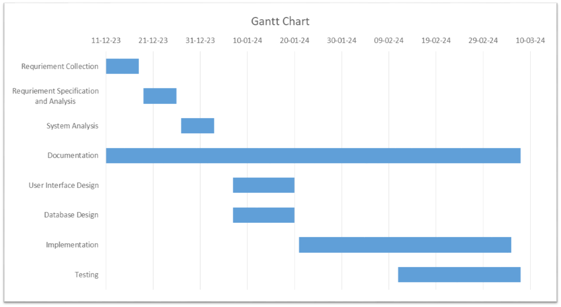
Gantt Chart
29

Slide 30
Conclusion
The outcome of this project is a web-based internship portal that students can seek for internships based on their educational skills, interest, while company can post internship vacancies.
The system will provide a grid view which displays some choices.
This system is characterized as a user-friendly, easy and flexible system.
It is a system to provide guidance for students, storing information, monitoring and administering the parties of an internship program.
30

Slide 31
Thank you so much for all your support!
31

