Slide 1

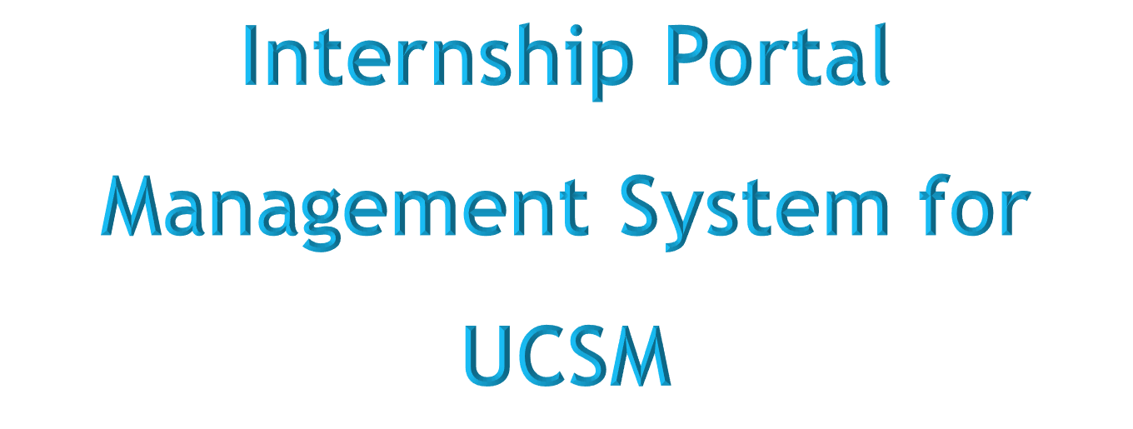

1

Slide 2

Team Members-
Mg Htet Oo Wai Yan (MKPT- 6991) – Leader
Mg Kyaw Naing Moe (MKPT - 6978)
Ma Thae Ei Thone (MKPT - 6990)
Ma Saw Yoon Nwe (MKPT - 7005)
2

Slide 3
Contents
Flow Chart Diagram
ER Diagram
Use Case Diagram
Sequence Diagram
Gantt Chart
Conclusion
Abstract
Introduction
Objectives
Advantages
Disadvantages
Functional Requirements
Nonfunctional Requirements
3

Slide 4
Abstract
Internship are an essential part of many students’ education before they graduate, providing them with valuable hands-on experience and exposure to the working world.
Internship Portal Management System is a web-based, user-friendly, and useable system to meet the specific needs of internship process.
The system provides all necessary informations of internship that will be effective and efficient for stakeholders such as academicians, students and companies.
The project aims to ease internship process by linking particular users.
The system is developed using PHP, MySQL Database, HTML, CSS and JavaScript.
4

Slide 5
Introduction
The system is a communication between university students, educational institutions and industries.
It is a simple user interface which involves three participants; university, student and company.
The university will be able to control about registrations of both student and company and view all their details to approve trustable informations.
Student will be able to login into the system after registration and search for a relevant job, apply for those positions.
Company Wil be able to post all about vacant jobs and descriptions of their community after registration and login process.
Student and company must fill all necessary informations under their respective profiles and require approval from the university to be a part of the internship portal.
5

Slide 6
Objectives
To enable the students to register themselves with the website, look up for different jobs according to their qualifications and apply for those jobs conveniently
To help the university to ease the process of informing students internship opportunities making them aware of their skills and abilities
To provide company to be recognized their responsibility and to ease getting of potential candidates
To strengthen linkages between students, educational institutions and industries
To integrate all of online real-time informations about the jobs available in the agencies and the user informations in one palace at one time.
6

Slide 7
Advantages
It will provide a platform for communication and collaboration between interns and their supervisors, helping to facilitate a positive and productive internship experience.
It provide companies to expand their business with a wide range of popularity and enable them to find the suitable candidates for their vacant positions.
It is less time taking and reduces cost for all participants.
It reduces paperwork and human resources.
It can prevent biases and corruption.
7

Slide 8
Disadvantages
It relies on technology, there is a rick of technical glitches, system failure, or website crashes.
Users may face connectivity issues while accessing the internship portal.
Students can’t know the condition of industrial relations.
It cannot be use offline.
8

Slide 9
Functional Requirements
User Login: This feature is used by the users and university to login into the system. He must login with his username and password to the system after registration. If they are invalid, the user is not allowed to enter the system.
Registration: A new user will have to register in the system by providing essential details in order to use the web-services. The university must accept a new user. The system must be able to verify and validate the informations. It must encrypt the password of the user to provide security.
Search Jobs: The student can search for the desired jobs. He can view different jobs after confirming the login, search and apply by providing the necessary details.
Post Jobs: Company can post vacancies.
Validation: The university will approve all information of these two users after checking.
9

Slide 10
Nonfunctional Requirements
Efficiency: When the system is implemented, university students and companies can view and upload job vacancies respectively from their homes easily without any difficulty.
Usability: The system is designed for a user-friendly environment and ease of use.
Reliability: The system should provide a reliable environment for both students and companies. All jobs should be reached the university without any errors and should be shown to the viewers.
Security: An unauthorized person cannot access the panel and database, and do not read and write the information.
Availability: It will be available online 24/7 a week.
10

Slide 11
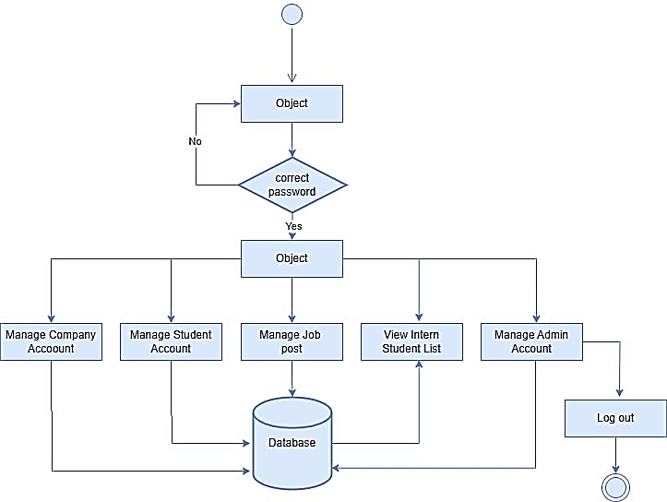
Flow Chart for Admin
Login
Dashboard
11

Slide 12
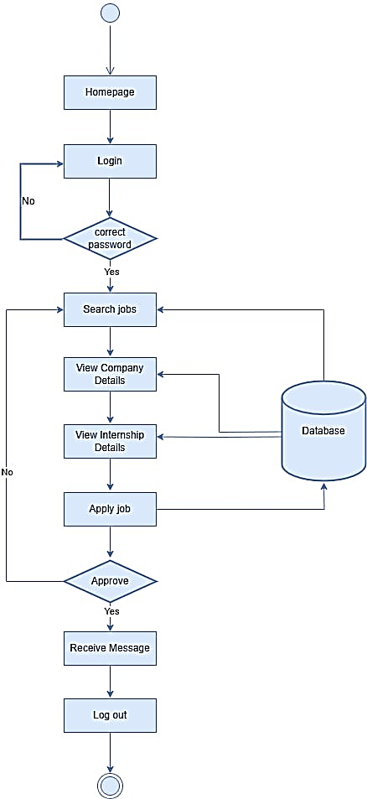
Flow Chart for Student
12

Slide 13
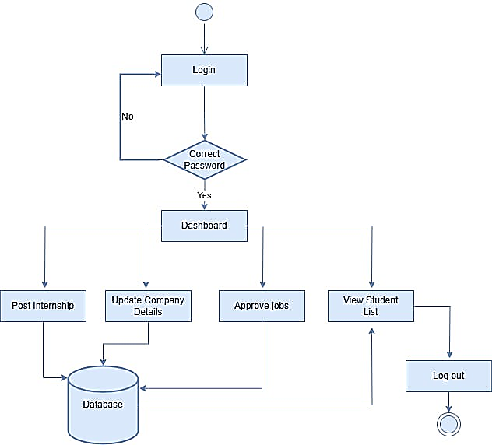
Flow Chart for Company
13

Slide 14
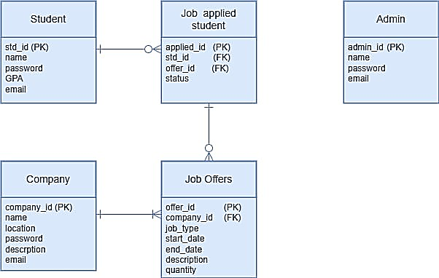
ER Diagram
14

Slide 15
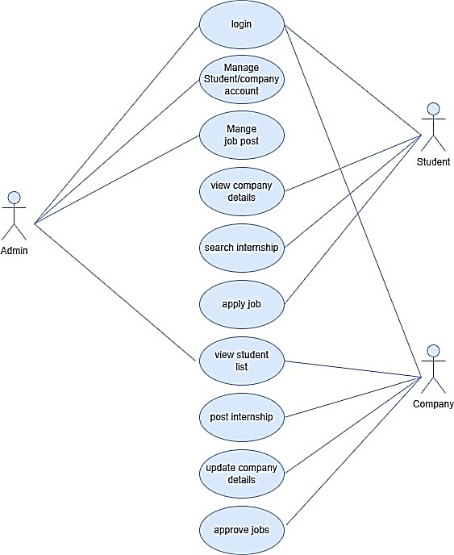
Use Case Diagram
15

Slide 16
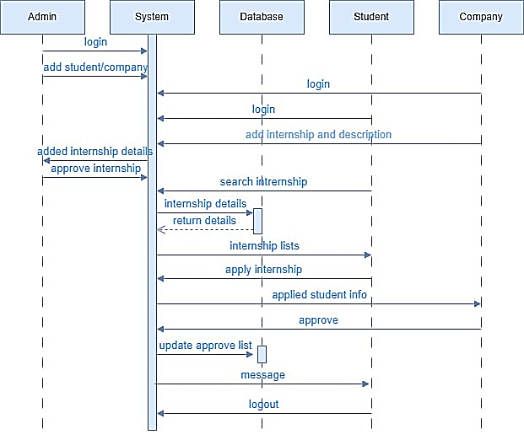
Sequence Diagram
16

Slide 17
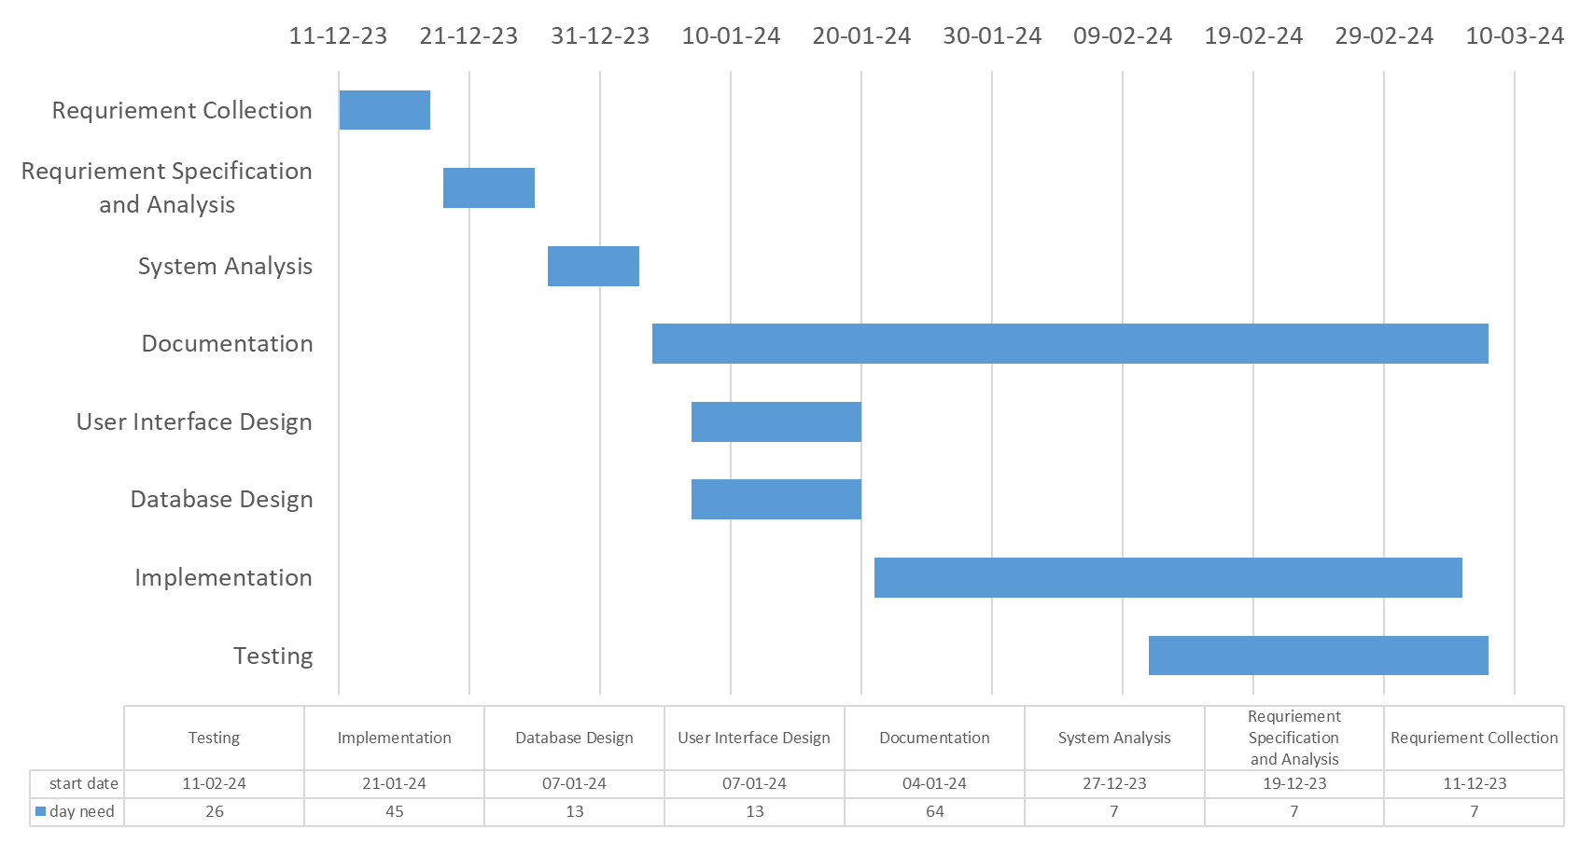
Gantt Chart
17

Slide 18
Conclusion
The outcome of this project is a web-based internship portal that students can seek for internships based on their educational skills, interest, while company can post internship vacancies.
The interface provides a grid view which display the available job name , company name and internship students with their qualifications.
This system is characterized as a user-friendly, easy and flexible system.
It is a system to provide guidance for students, storing information, monitoring and administering the parties of an internship program.
18

Slide 19
Thank you so much for all your support!
19

