Slide 1
Energy Consumption by System

Slide 2
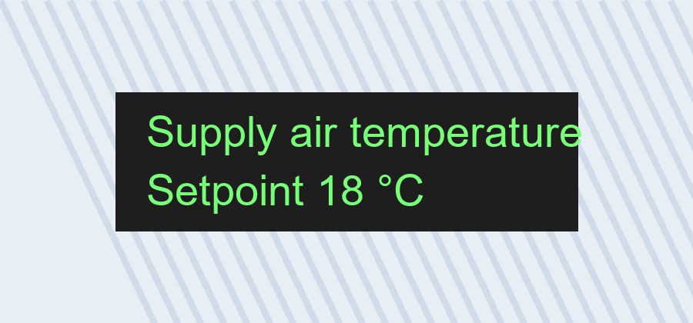

Commissioning Photos

