Slide 1
A meaningful person of the slovak literature Pavol Országh Hviezdoslav
Andrej Shishila IV.A

Slide 2
Life
Vyšný Kubín – Pavol Országh
HU patriot, poet, dramatist, translator
26 - Hviezdoslav – pseudonym
Leader of re-estabilished Slovak Matica
Syllabic-tonic verse system
Hviezdoslav‘s Kubín

Slide 3
workS
Inspiration – Orava – bible
Zuzanka Hraškovie
Hájnikova žena (Gamekeeper‘s wife)
Ežo Vlkolínsky
Translated works from other autors: Goethe – Faust, Shakespeare – Hamlet a.m.o.

Slide 4
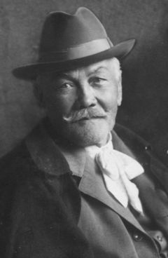
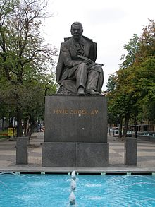
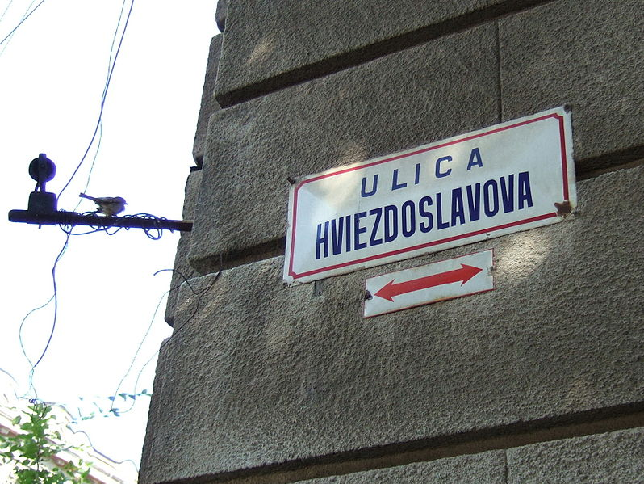
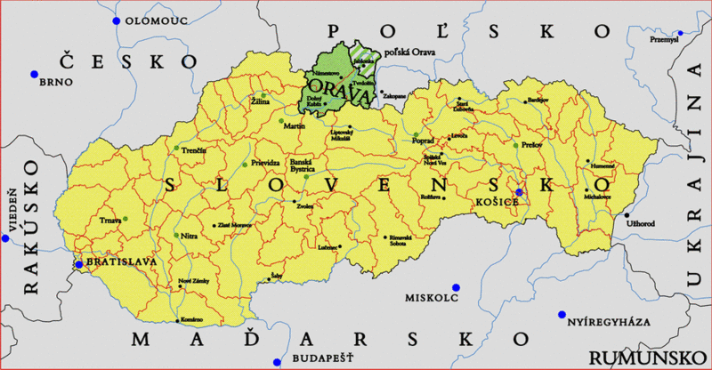
Pictures

Slide 5
Thanks for your time and attention
is it clear?

Slide 6
Ressources
http://en.wikipedia.org/wiki/Pavol_Orsz%C3%A1gh_Hviezdoslav

