Slide 1
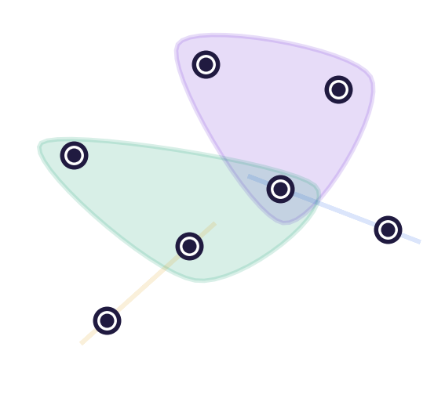
PhD SEMINAR · KATO LABORATORY
HyMeKo
A Hypergraph Model Cognition Framework
From declarative hypergraph structure to structural-prior learning
Csaba Hajdu
Hypergraph systems · signed-graph learning · June 2026
HyMeKo · PhD Seminar
1

Slide 2
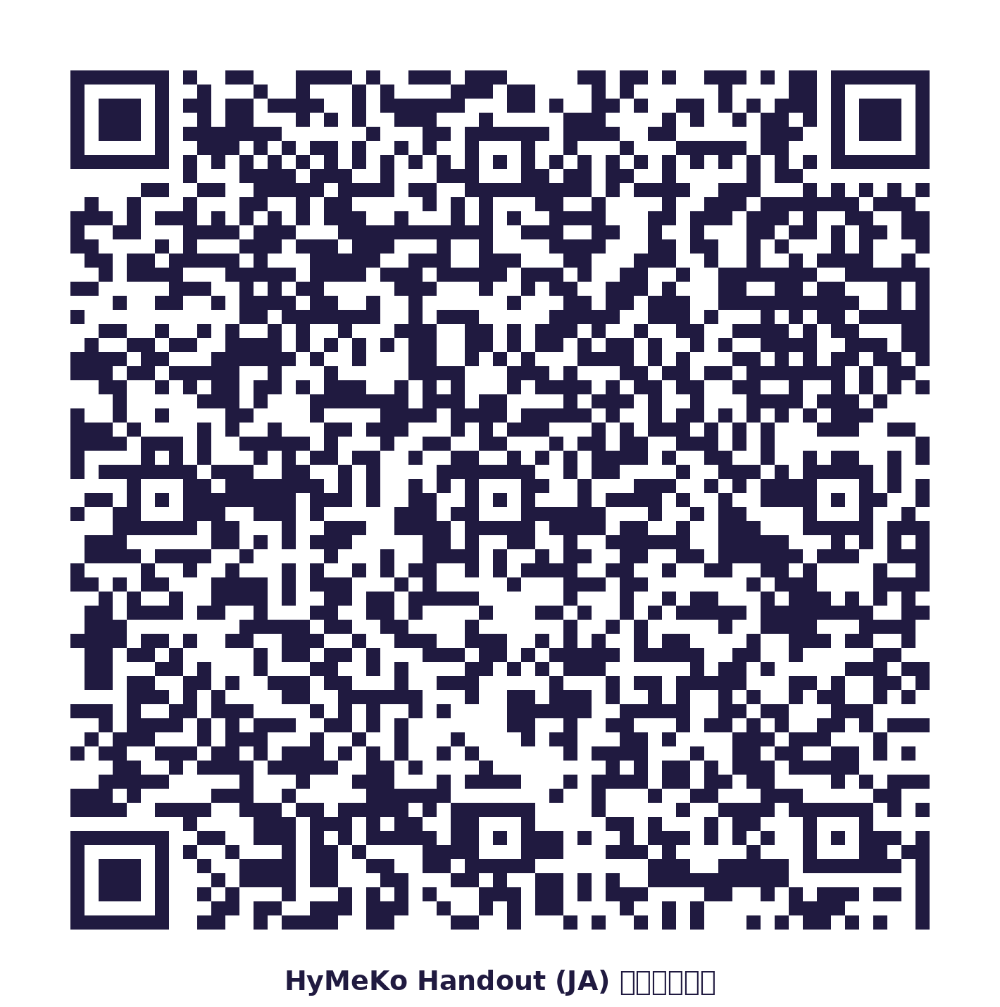
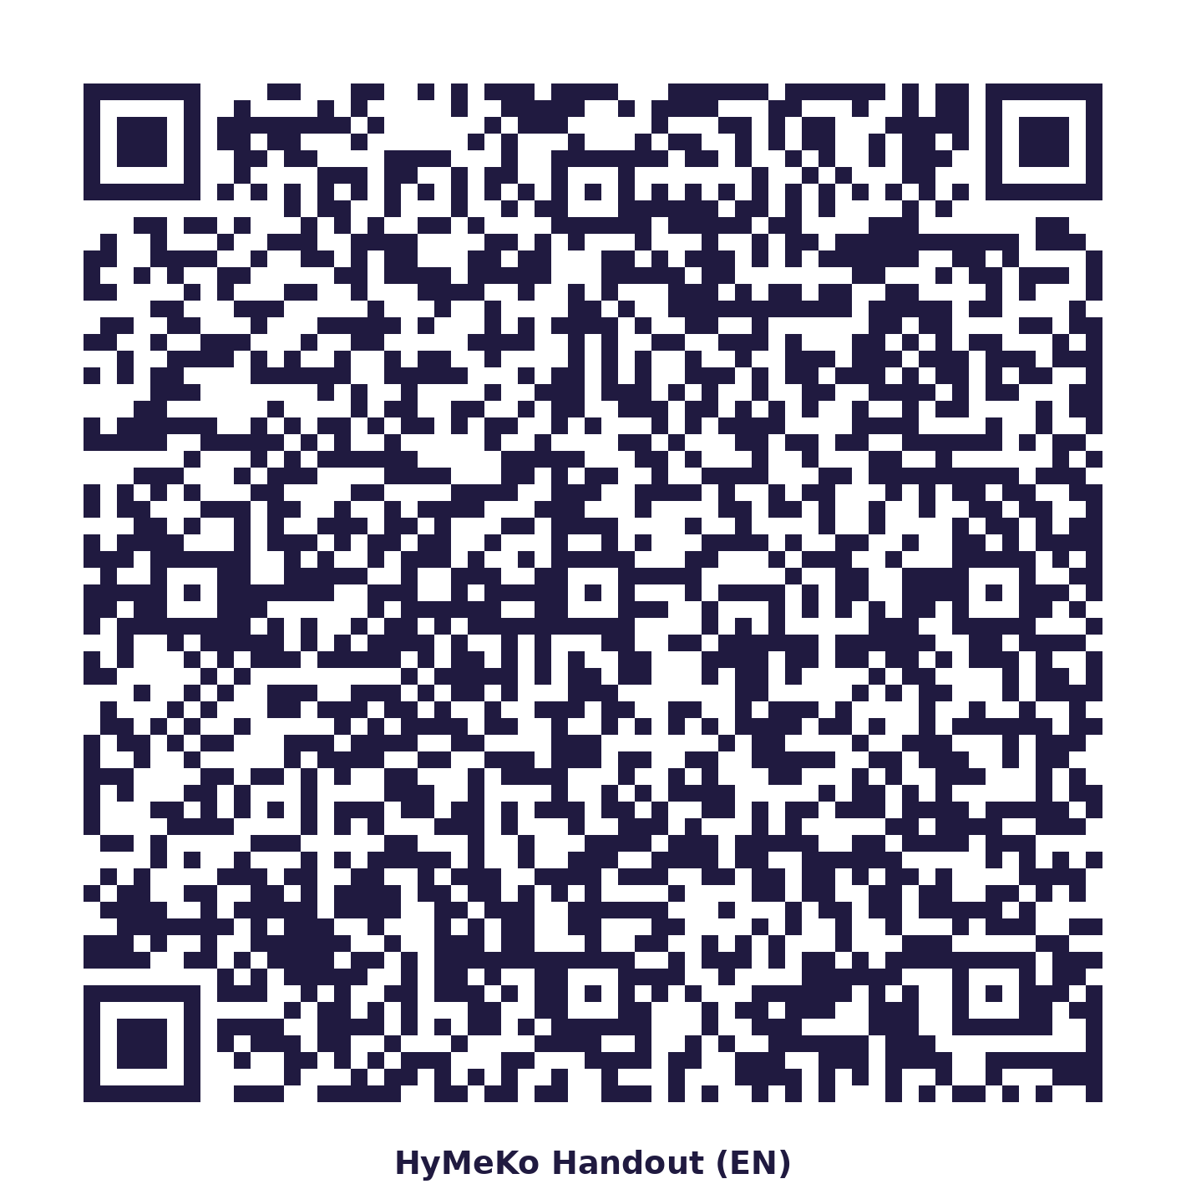


Handout links

Slide 3
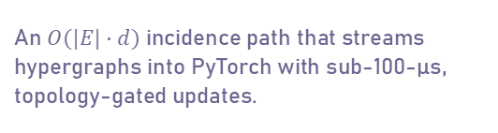
Contributions
1
HyMeKo DSL + Rust compiler
2
Star-expansion zero-copy pipeline
3
Query-driven codegen
A declarative hypergraph language with a SIMD-lexed, LALRPOP-parsed pipeline to a hashed hypergraph IR.
An $O(|E|·d)$ incidence path that streams hypergraphs into PyTorch with sub-100-µs, topology-gated updates.
One query+template mechanism emits URDF, SDF, MJCF, DOT, ROS 2 launch and torch modules — no recompile.
4
Structural-prior model family
5
Honest-protocol methodology
6
A unified substrate
SignedKAN / HSiKAN / Gömb: cycle-pool priors with KAN activations at SOTA-range AUC and lean parameters.
Label-shuffle leakage audits, 5-seed paired significance, and artifact-backed evidence discipline.
The same hypergraph IR underlies both the engineering and the learning — structure as a first-class prior.
HyMeKo · PhD Seminar
2

Slide 4
HyMeKo, in brief
Hypergraph Model Cognition — one substrate for representing and learning from structured systems
HyMeKo treats the hypergraph as a first-class object. A small declarative language describes a system's parts and the signed, hierarchical, many-to-many relations among them; one engine both renders that structure to many target formats and exposes it to models that learn from the graph's own cycles — so the structure the framework compiles is the structure the model reasons over.
Declarative DSL + IR
Cross-view codegen
Zero-copy runtime
Structural-prior learning
.hymeko → canonical hypergraph IR with Blake3 content-hash identity
one query + template engine → URDF · SDF · MJCF · SysML v2 · PyTorch
O(|E|·d) star expansion streamed to PyTorch via Arrow / DLPack
SignedKAN → HSiKAN → Gömb; cycles as a KAN inductive prior
HyMeKo · PhD Seminar
3

Slide 5
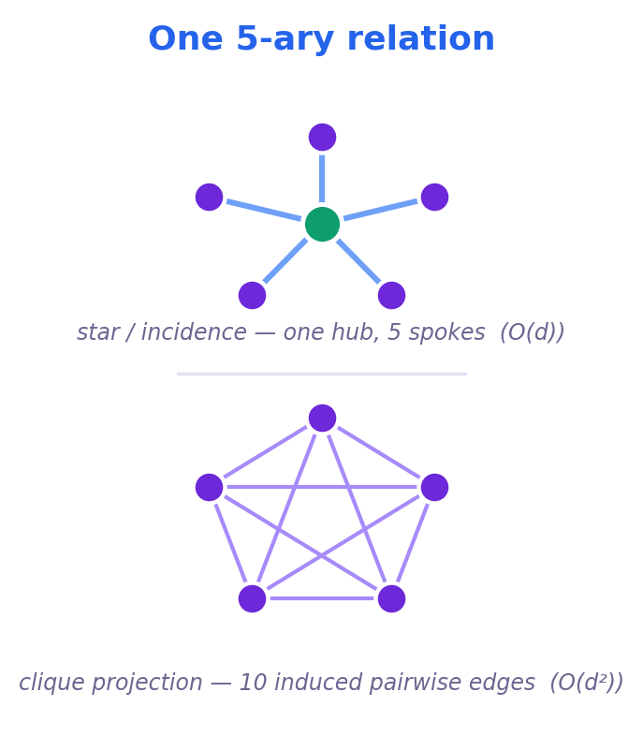
Why hypergraphs?
Real systems are n-ary, not pairwise
A robot joint couples a parent and child link and an axis; a trust vote ties voter, target and sign; a chemical unit binds many reactants; a neural layer fuses many input tensors.
Forcing these relations into pairwise edges means clique projection — every k-ary relation becomes a fully-connected subgraph.
The cost is twofold: the projected adjacency explodes as O(|E|·d²), and the identity of the relation itself is lost.
Two needs follow
represent and operate on hypergraphs faithfully · learn from their structure
HyMeKo · PhD Seminar

Slide 6
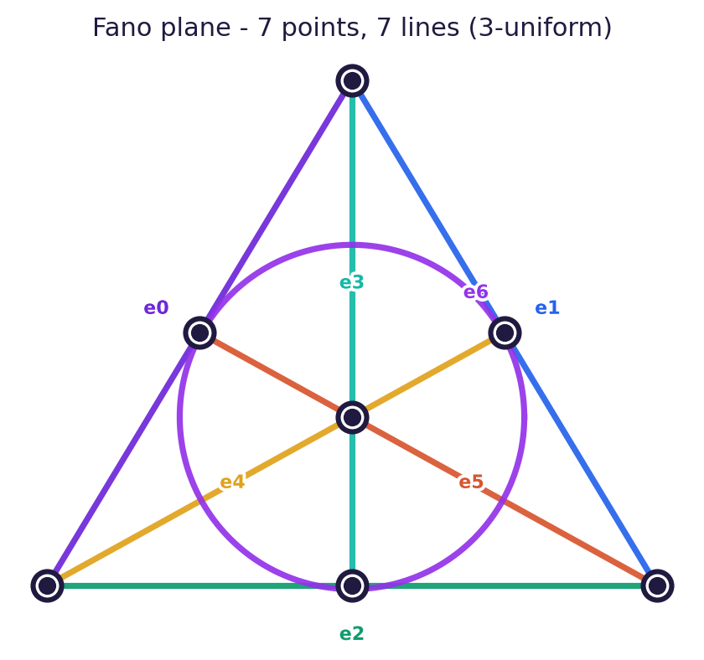
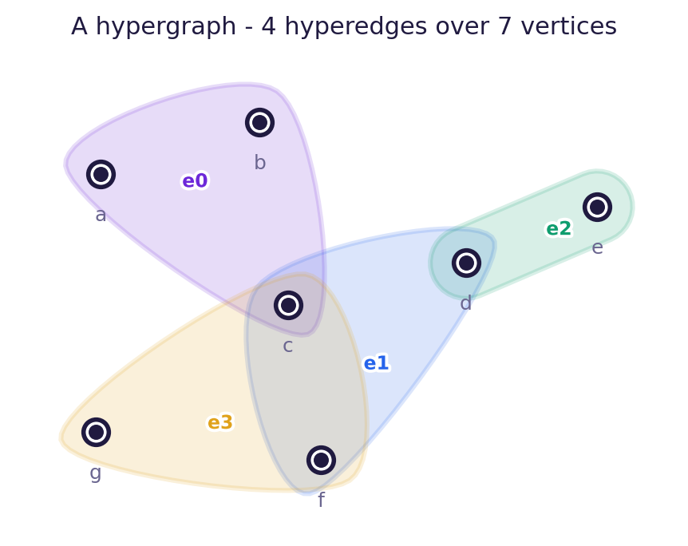
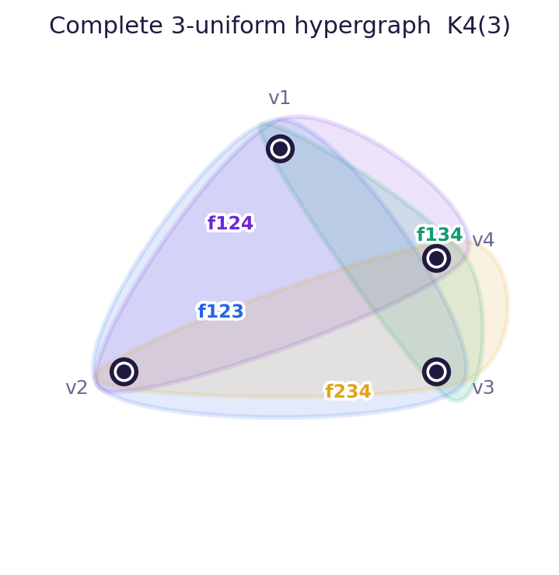
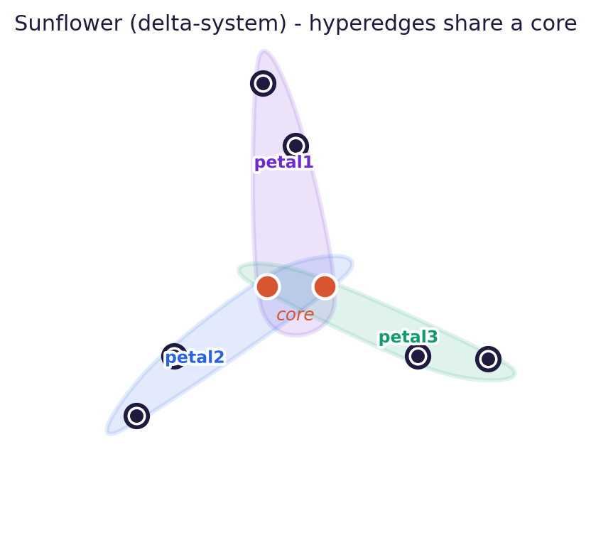
Typical hypergraphs
From the textbook to the engine — each is a .hymeko fixture in data/typical_graphs/, drawn here as hyperedge sets
Fano plane (Steiner triple S(2,3,7))
Generic hypergraph
fano {
n0 n1 n2 n3 n4 n5 n6
@e0 (~n0,~n1,~n3);
@e1 (~n0,~n2,~n6);
@e2 (~n0,~n4,~n5);
@e3 (~n1,~n2,~n4);
@e4 (~n2,~n3,~n5);
@e5 (~n3,~n4,~n6);
@e6 (~n1,~n5,~n6);
}
generic {
a b c d e f g
@e0 (~a,~b,~c);
@e1 (~c,~d,~f);
@e2 (~d,~e);
@e3 (~c,~g,~f);
}
Complete 3-uniform K4(3)
Sunflower (Δ-system)
k4_3uniform {
v1 v2 v3 v4
@f123 (~v1,~v2,~v3);
@f124 (~v1,~v2,~v4);
@f134 (~v1,~v3,~v4);
@f234 (~v2,~v3,~v4);
}
sunflower {
core_a core_b
p1a p1b p2a p2b p3a p3b
@petal1 (~core_a,~core_b,
~p1a,~p1b);
@petal2 (~core_a,~core_b,
~p2a,~p2b);
@petal3 (~core_a,~core_b,
~p3a,~p3b);
}
HyMeKo · PhD Seminar
5

Slide 7
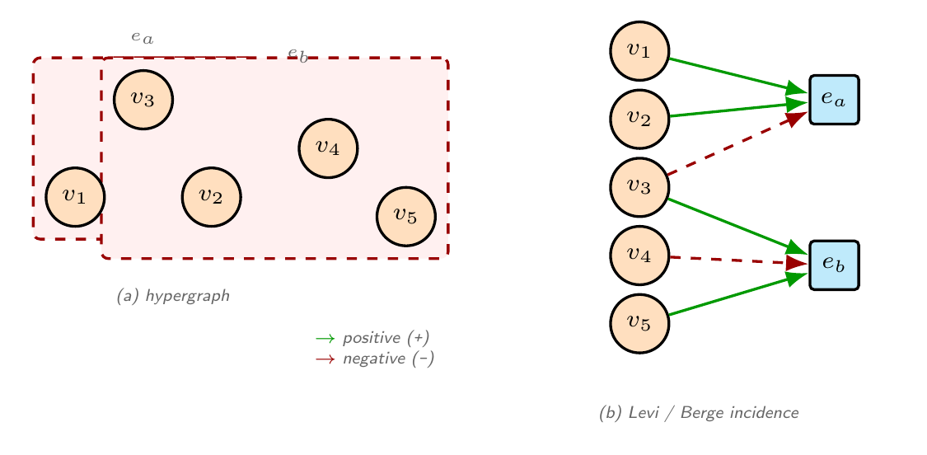
Same underlying graph, different views!
A hyperedge and its signed incidence
The star expansion is the bipartite Levi / Berge incidence — one hub per hyperedge, with signed + / − arcs to its member vertices
Left: the hypergraph (hyperedges e_a, e_b over vertices). Right: each hyperedge becomes a hub; + / − arcs encode the signed incidence — the O(|E|·d) star tensor the engine streams to PyTorch.
HyMeKo · PhD Seminar
6

Slide 8
One substrate, two payoffs
The thesis in a single picture
HyMeKo hypergraph substrate
one DSL · one IR · structure as a first-class object
ENGINEERING
LEARNING
Declarative DSL + Rust compiler
Star-expansion zero-copy pipeline → PyTorch
Query-driven robotics codegen (URDF/SDF/MJCF/ROS 2)
Structural priors: cycles & walks as tuples
SignedKAN / HSiKAN / Gömb architectures
SOTA-range signed-graph link prediction, lean params
HyMeKo · PhD Seminar
7

Slide 9
What HyMeKo describes
A declarative model of structured systems as signed, hierarchical hypergraphs
HyMeKo captures a system's parts and the n-ary, signed, hierarchical relations among them in one canonical hypergraph IR with content-hash identity — then renders that single description into many views.
Robotic & cyber-physical
Systems engineering
Signed relational graphs
Neural dataflow
links · joints · axes · signs
components · ports · flows
trust votes · balance · cycles
tensors · layers · signed hyperarcs
→ URDF · SDF · MJCF · Gazebo
→ SysML v2 · MBSE
→ link prediction
→ torch module · NAS
One canonical hypergraph IR · Blake3 structural identity · cross-view consistency across every emitted target
HyMeKo · PhD Seminar
8

Slide 10
Goals at two levels
What the language aims to do, and what the infrastructure underneath aims to deliver
The language
The infrastructure
MODELLING GOALS
ENGINE GOALS
One declarative source of truth for n-ary, signed, hierarchical structure
Cross-view consistency — many targets, one IR, provably the same system
Canonical hashing for structural identity and equality
Bridge model-based systems engineering (SysML) with executable robotics & ML
High-performance Rust engine — SIMD lexer, ~15 crates, 500+ passing tests
Real-time zero-copy streaming to PyTorch — O(|E|·d) star, sub-100-µs
Multi-surface: PyO3 wheel · WebAssembly editor · MCP server · REST
Reproducibility: benchmark harness, paired-seed evidence, 16 GB memory budget
HyMeKo · PhD Seminar
9

Slide 11
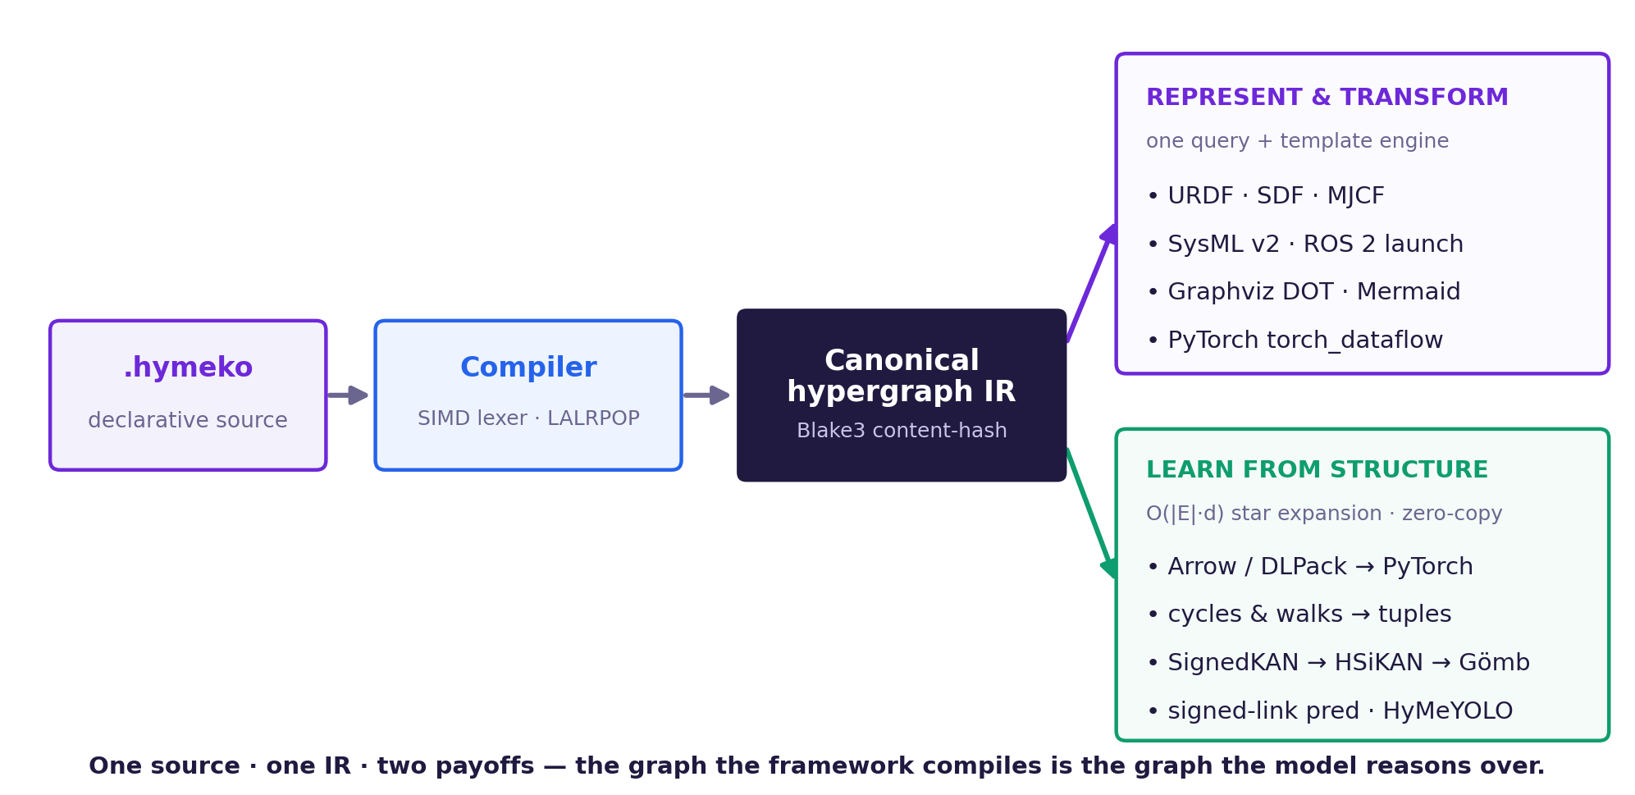
The HyMeKo workflow — at a glance
From a declarative source to every target format — and to a structural-prior model — through one canonical IR.
HyMeKo · PhD Seminar
10

Slide 12
PART I
The HyMeKo Framework
A domain-specific language and a high-performance Rust engine for hypergraphs
HyMeKo · PhD Seminar
11

Slide 13
A declarative language for hypergraphs
PART I · FRAMEWORK
Hyperedges are first-class
edges connect arbitrary numbers of nodes, not just pairs
Hierarchical paths
nodes nest; references resolve through dot-paths like Root.A.B
Signed arc bindings
+/− mark the orientation of a relation (parent/child, in/out)
Tags = roles
<link>, <input>, <dataflow> classify a node's semantics
reuse_arm.hymeko
arm_reuse_description {
@"meta_kinematics.hymeko";
using kinematics.elements as el;
using kinematics.geometry as geo;
using kinematics.axes as ax;
}
robot: el, geo, ax {
base: el.link { mass 2.0;
link_geometry: geo.cylinder { dimension [0.075,0.2]; }
visual -> link_geometry; collision -> link_geometry; }
forearm: el.link { mass 0.6;
link_geometry: geo.cylinder { dimension [0.05,0.3]; }
visual -> link_geometry; collision -> link_geometry; }
wheel: el.link { mass 0.3;
link_geometry: geo.cylinder { dimension [0.1,0.05]; }
visual -> link_geometry; collision -> link_geometry; }
@shoulder: meta_kinematics.kinematics.rev_joint {
(+ base [[0,0,0.2],[0,0,0]], -forearm, -ax.AXIS_Z); }
@hub: meta_kinematics.kinematics.conti_joint {
(+ base [[0.1,0,0],[0,0,0]], -wheel, -ax.AXIS_Y); }
}
Compiles as-is (grammar: parser/src/hymeko.lalrpop; cf. data/profiles/robot_arm.hymeko). One import + one geometry per link, referenced by visual + collision — defined once, no duplication.
HyMeKo · PhD Seminar
12

Slide 14
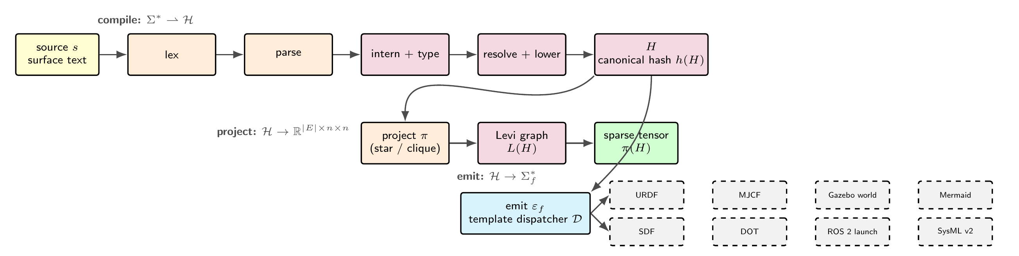
From source text to a hypergraph IR
PART I · FRAMEWORK
A complete compiler pipeline, written in Rust
Blake3
content-hash node identity
Symbol interning
memory-efficient paths
Star / clique
two tensor expansions
HyMeKo · PhD Seminar
13

Slide 15
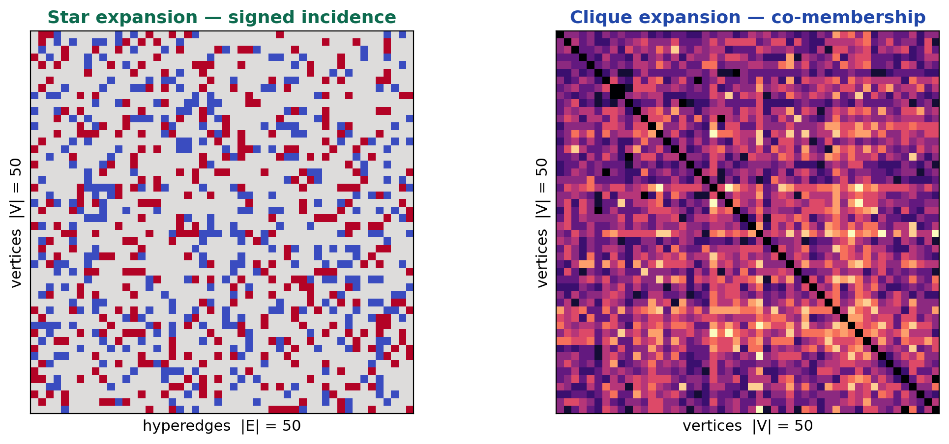
Star vs clique: the efficiency argument
PART I · FRAMEWORK
Same 50-node / 50-edge / 0.30-density hypergraph, two materialisations
STAR · incidence $O(|E|·d)$
CLIQUE · projected adjacency $O(|E|·d²)$
1,498 NNZ 79.7 ms
10,991 NNZ 496 ms
Still: same graph
Different tensor view
Star expansion keeps structure
Clique expansion algebraic analysis
Star expansion is what keeps hypergraph neural networks scalable.
HyMeKo · PhD Seminar
14

Slide 16
A zero-copy bridge to the GPU
PART I · FRAMEWORK
Control plane and data plane are separated; topology changes and weight streams take different paths
Rust core + daemon
Blake3 topology hash · Iceoryx2 service
Shared memory
Apache Arrow record batches in /dev/shm
PyO3 + DLPack
map pointer · zero-copy handshake
PyTorch GPU
training loop
The topology-hash gate
< 100 µs
memory injection
hash changed → Structural update: re-emit Arrow mapping $(k, i, j)$, subscriber re-maps memory.
hash same → Fast path: stream raw f32 weights only — no re-allocation, no serialization.
Architecture is modelled in SysML 2 — control-plane / data-plane, sequence, and state views.
HyMeKo · PhD Seminar
15

Slide 17
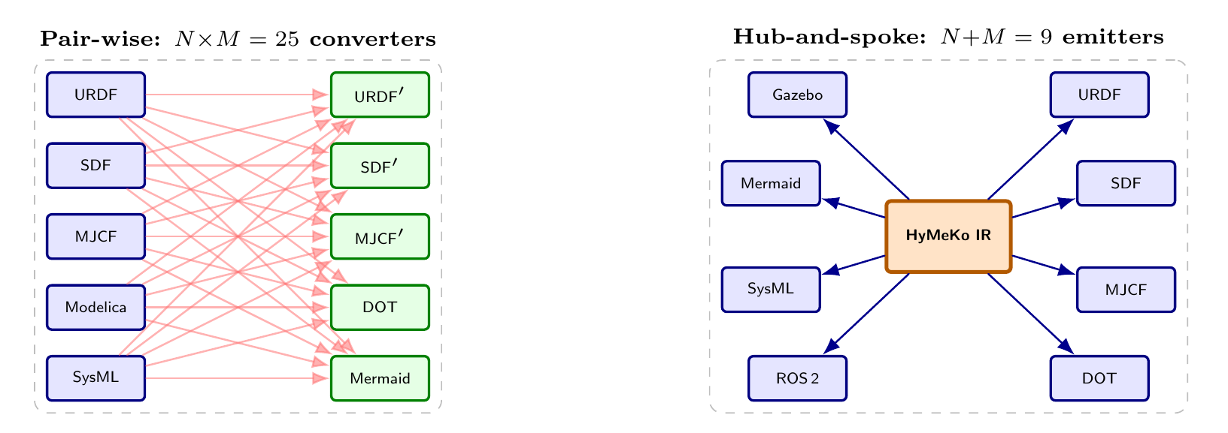
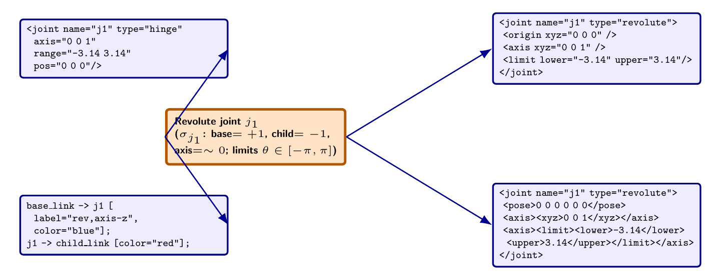

Query-driven transforms: one graph, many targets
PART I · FRAMEWORK
A compiled hypergraph becomes any text output through a query + template pair.
No Rust, no recompile — the engine stays domain-neutral.
One IR, many targets
Pair-wise converters $(N×M)$collapse to a hub-and-spoke $(N+M)$ around the canonical IR.
queries.hymeko + template.urdf.xml
links: link {}
@revolute_joints: rev_joint {}
{{#each revolute_joints}}
<joint name="{{name}}" type="revolute">
<parent link="{{bind:+:0}}"/>
<child link="{{bind:-:0}}"/>
</joint>
{{/each}}
Cross-format invariant: one source → consistent outputs, one canonical hash
hymeko transform robot.hymeko -t urdf -o robot.urdf
HyMeKo · PhD Seminar
16

Slide 18
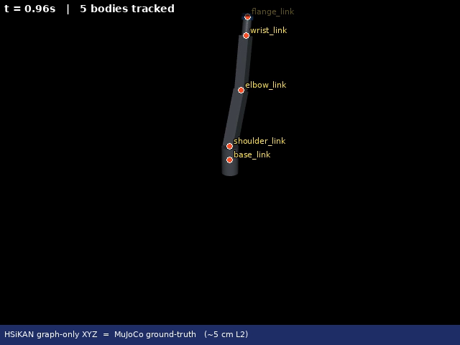
How compact is the DSL?
PART I · FRAMEWORK
Same robot, full description — HyMeKo (one source) vs what each ecosystem needs.
Kinematic structure | HyMeKo | URDF + ROS/Gazebo | MuJoCo (MJCF)
2-joint connection | 71 | 164 | 91
SCARA | 101 | 252 | 129
6-DoF arm + control stack | 6,134 (1 file) | ≈10 k (4 files) | can't (mech. only)
The generated robot, simulated in MuJoCo — compiled from the same .hymeko source.
HyMeKo says the whole deployable system once — in one file, with reuse.
The 6-DoF source carries mechanism + control interfaces + limits + sensors + Gazebo sim + a trajectory controller, with a single control definition reused across all six joints and one geometry per link (visual + collision). The ROS/Gazebo equivalent is a bundle — URDF + world SDF + launch + ros2_control YAML (~10 kB, ~4 hand-synced files).
MuJoCo's MJCF can't express the ros2_control interfaces, controller or plugins at all; even approximating the interfaces takes 18 actuators + 12 sensors — one per joint per interface, no reuse. (PhD defense, Thesis I.)
HyMeKo · PhD Seminar
17

Slide 19
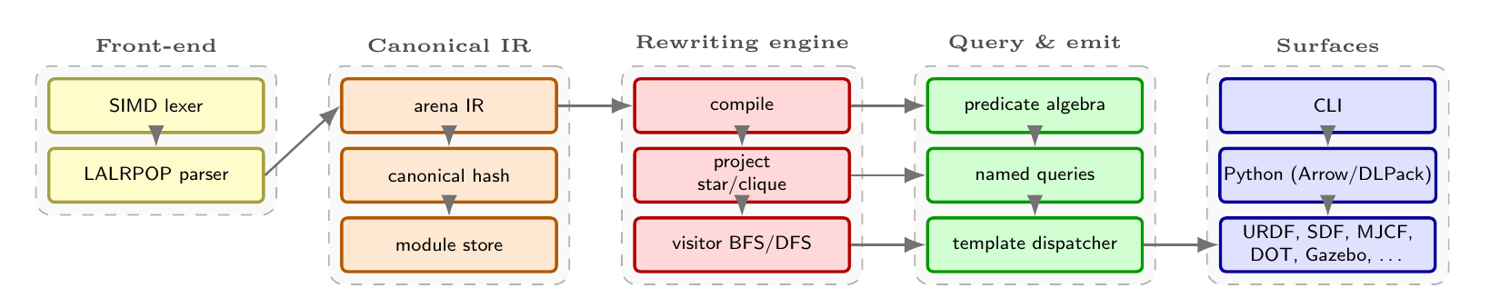
Built like a system, not a script
PART I · FRAMEWORK
Systems-engineering discipline is part of the contribution, not an afterthought
SysML 2 models
Workspace of crates
Every architecture view — use-case, sequence, state, layered — has a formal SysML 2 companion beside its Mermaid rendering.
~25 hymeko_* crates · explicit dependency boundaries
Core protection
Plan-first protocol
A CORE.YAML contract marks load-bearing modules read-only; any core change requires a written plan and migration path first.
Non-trivial changes ship a four-format plan (LaTeX, PDF, TikZ, Mermaid) before code — an audit trail, not improvisation.
HyMeKo · PhD Seminar
18

Slide 20
PART II
Learning on Structure
When the graph's own cycles become the model's inductive prior
HyMeKo · PhD Seminar
19

Slide 21
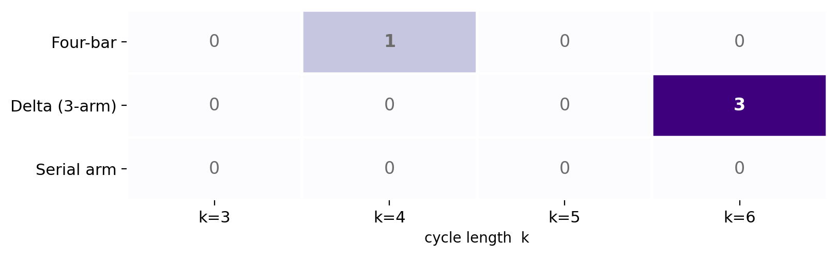
From structure to inductive prior
PART II · SCIENCE
Signed graphs
trust networks with +/− edges (Bitcoin, Slashdot, Epinions, Wikipedia votes).
The structural signal
balance theory lives in cycles — the product of signs around a cycle predicts a missing edge's sign. Cycles and walks become tuples.
Kolmogorov–Arnold activations
SignedKAN / HSiKAN replace ReLU with learnable Catmull–Rom basis activations over those tuples.
The same substrate expresses the model
HSiKAN's architecture and training loop are written in .hymeko — layers are nodes, the dataflow is signed hyperarcs:
sk_k3 : signedkan_layer { arity 3; }
sk_k4 : signedkan_layer { arity 4; }
mixer : arity_mixer { mix_K 2; }
@flow_k3 (+t_in, ~sk_k3, -t_emb_k3);
@flow_mix (+t_emb_k3, +t_emb_k4,
~mixer, -t_emb);
Cycle-arity compass — the mechanism-family fingerprint
Architecture search even becomes a P-graph feasibility problem on the same IR.
HyMeKo · PhD Seminar
20

Slide 22
The model family: SignedKAN → HSiKAN → Gömb
PART II · SCIENCE
Three layers of the same idea — learnable spline activations driven by graph structure
SignedKAN
HSiKAN
Gömb
THE BASE LAYER
HYPER SIGNED-GRAPH KAN
THE STRICT CASCADE
A Kolmogorov–Arnold layer for signed graphs: learnable Catmull–Rom spline activations replace fixed ReLU, applied to signed edge / cycle features.
Lifts SignedKAN to hyperedges and mixed arity: per-arity layers (k = 3, 4, …) over cycle & walk tuples, fused by an arity mixer; per-edge CR recipe.
The deployable configuration: Clifford-FIR → HSiKAN-CR → CPML, with the cycle pool enumerated over training edges only — SOTA-range, lean, leakage-free.
KAN activations on signed features
+ hyperedges · mixed arity · per-edge CR
+ 3-shell cascade · strict cycle pool
Each step strictly contains the previous one and adds structure — never a different code path bolted on.
HyMeKo · PhD Seminar
21

Slide 23
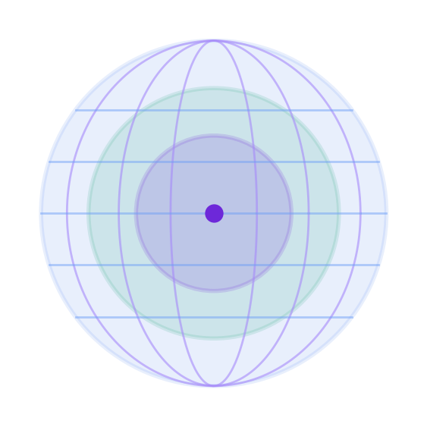
Gömb: a strict structural-prior cascade
PART II · SCIENCE
A three-shell cascade in which the cycle pool is enumerated over training edges only
1
2
3
Clifford-FIR
HSiKAN-CR
CPML
Clifford-FIR: quaternion / multivector signed filter over the edge neighbourhood
Hyper-signed KAN with per-edge Catmull–Rom activations
Cycle-pool message layer — the strict structural read-out
Strict by construction
Because the cycle pool never sees a test-edge sign, Gömb has no transductive σ-leakage. A label-shuffle test collapses it to chance (0.540 AUC) — proof the architecture is a structural predictor, not a leak.
HyMeKo · PhD Seminar
22

Slide 24
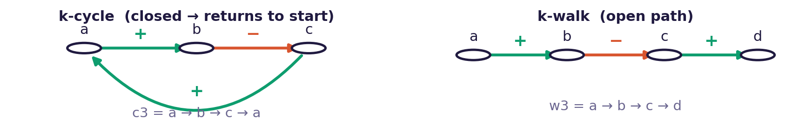
What is k-enumeration? Why HSiKAN needs it
PART II · SCIENCE
Enumerating the closed cycles (and short walks) of each arity k that become the model's structural features
Tuples: cycles c3 · c4 · c5 and short walks w2 · w3 — one SignedKAN layer per arity, fused by the arity mixer.
What it enumerates
Why HSiKAN needs it
How it is bounded
k-enumeration finds the closed cycles of length k in the signed graph — the k-ary tuples c3, c4, c5 (plus short walks w2, w3). Each tuple is a candidate structural feature carrying a sign-product.
HSiKAN builds its prediction from these tuples: a SignedKAN layer per arity, fused by the arity mixer. With no enumerated cycles there are no structural features and the network collapses to a blind MLP. Balance theory lives in cycles — a missing edge's sign is read from the σ-products of the cycles that would close through it.
Enumeration is the combinatorial bottleneck. HSiKAN caps it: per-vertex top-k by a scorer (e.g. fraction-negative) and per-arity caps (max_k). Strict mode enumerates over training edges only — which is also what prevents the leakage on the previous slide.
HyMeKo · PhD Seminar
23

Slide 25
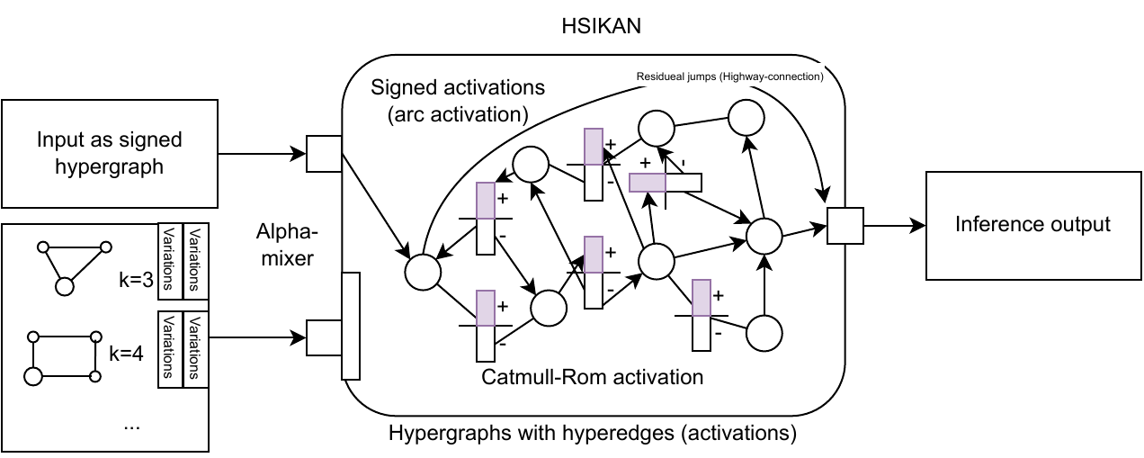
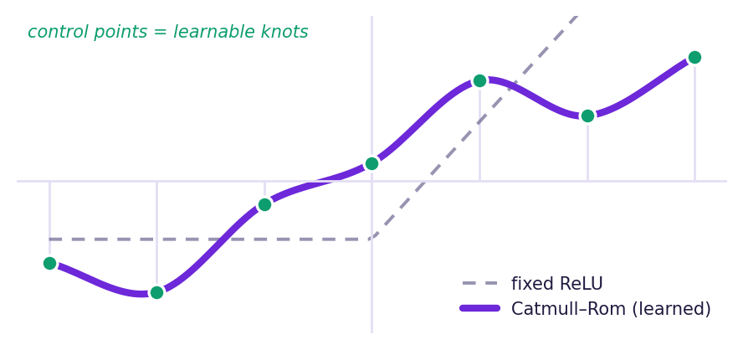
Inside HSiKAN
PART II · SCIENCE
The middle shell — learnable spline activations over signed cycle & walk tuples
Catmull–Rom activation
Mixed arity
Quaternion sign-attention
Independent layers for k = 3 and k = 4 over cycle & walk tuples, fused by an arity mixer.
Multi-head; hidden / 4 independent quaternions per head; scores anchor, consecutive and pair signs along each cycle.
Per-edge Catmull–Rom highway (edge_cr). Each signed edge carries its own learnable CR spline as a residual highway — the strong reference cell extension (Slashdot 0.907, Epinions 0.846; 5-seed paired).
HyMeKo · PhD Seminar
24

Slide 26
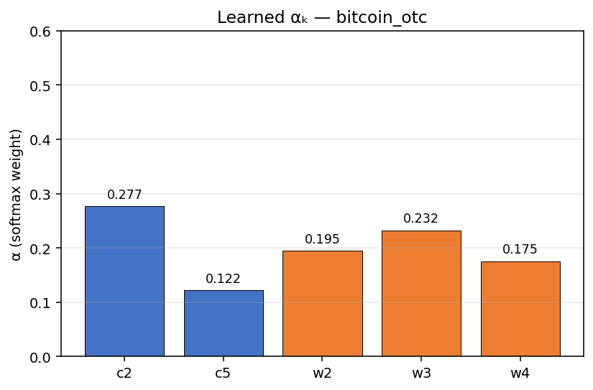
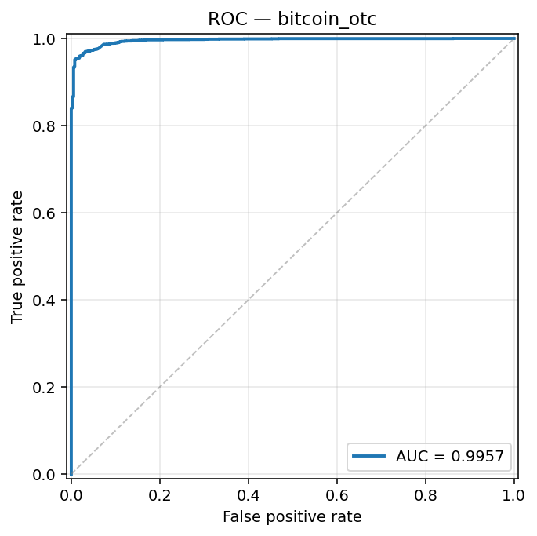
HSiKAN, learned: αₖ regime and ROC
PART II · SCIENCE
Real output of the link-prediction inference demo on the trained Bitcoin-OTC checkpoint
Learned αₖ — per-arity weight
ROC — AUROC 0.9957
The αₖ compass concentrates on c2 / w3; AUROC 0.9957 is the standard transductive convention (optuna_best) — the strict-protocol baseline is on the results slide.
HyMeKo · PhD Seminar
25

Slide 27
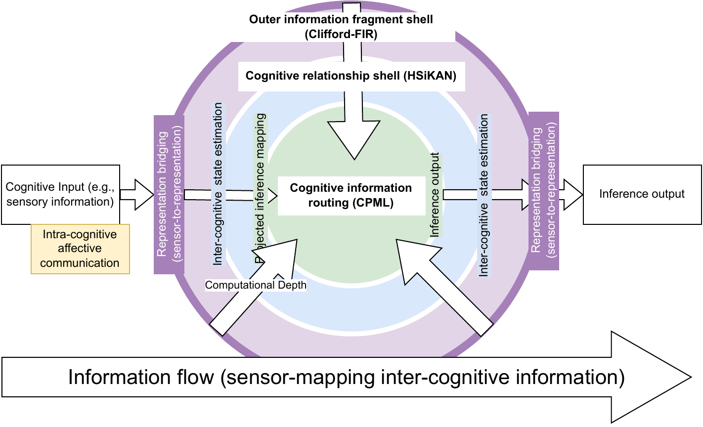
Clifford-FIR and quaternion machinery
PART II · SCIENCE
Geometric algebra under the cascade — and a visual-cortex analogy
Three shells ≈ a visual-cortex stack
Clifford-FIR filter banks · outer shell
M parallel Clifford-FIR banks. The cycle arity sets the FIR filter length; each bank's Clifford coefficients are staggered at initialisation. Built on the hymeko_clifford autograd backend — multivectors, blade products, a (p, q) metric signature.
Quaternion sign-attention
The sign structure along a cycle is scored with Hamilton-product (quaternion) attention; a multi-head variant runs hidden / 4 independent quaternions per head, and carries the highway gate on the Bitcoin-OTC configuration.
Clifford-FIR (V1) → HSiKAN-CR (V4) → CPML (IT), wrapped by cognitive information routing.
HyMeKo · PhD Seminar
26

Slide 28
Signed-graph link prediction results
PART II · SCIENCE
Held-out test ROC–AUC, mean over 5 seeds · Gömb-strict (honest protocol)
Model | Bitcoin α | Bitcoin OTC | Slashdot | Epinions
Gömb-strict (ours) | 0.897 | 0.915 | 0.902 | 0.943
Gömb + fine-tune (ours) | — | — | — | 0.953
SGCN | 0.929 | 0.942 | 0.919 | —
SiGAT | 0.903 | 0.932 | — | ~0.95
MLP (blind) | 0.892 | 0.908 | 0.888 | —
Two more SNAP signed graphs
wiki_elec 0.911 ± 0.001 · wikisigned 0.894 ± 0.002 — same config, no re-tuning.
Under the field's standard transductive convention, the tuned optuna_best lifts Bitcoin to 0.996 / 0.993.
HyMeKo · PhD Seminar
27

Slide 29
SOTA range — at a fraction of the cost
PART II · SCIENCE
The structural prior does the heavy lifting, so the network can stay small
30,487
11x
¼
5 seeds
parameters
faster forward
the parameters
every number
Bitcoin α optuna_best — about ½ the joint baseline
Bitcoin OTC lean model vs the h=16 joint mix
OTC at 23,815 params, yet higher AUC
paired-Δ significance before any paper promotion
Forward latency · Bitcoin OTC (lower is better)
30.5 ms vs 342 ms
The lean model runs ~11× faster at forward than the h=16 joint mix, at ¼ the parameters and equal-or-better AUC. Inference cost scales with the structural prior, not with network width.
Compute: large-scale multi-seed runs use the Komondor supercomputer (KIFÜ, NVIDIA A100); the lean models above also fit a single 8 GB GPU.
HyMeKo · PhD Seminar
28

Slide 30
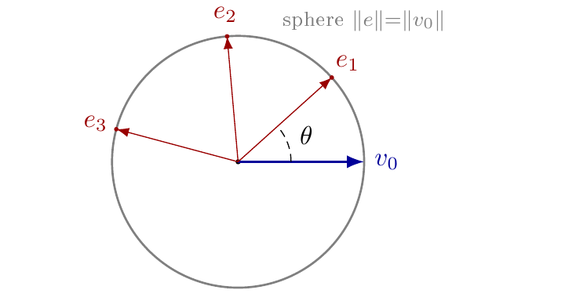
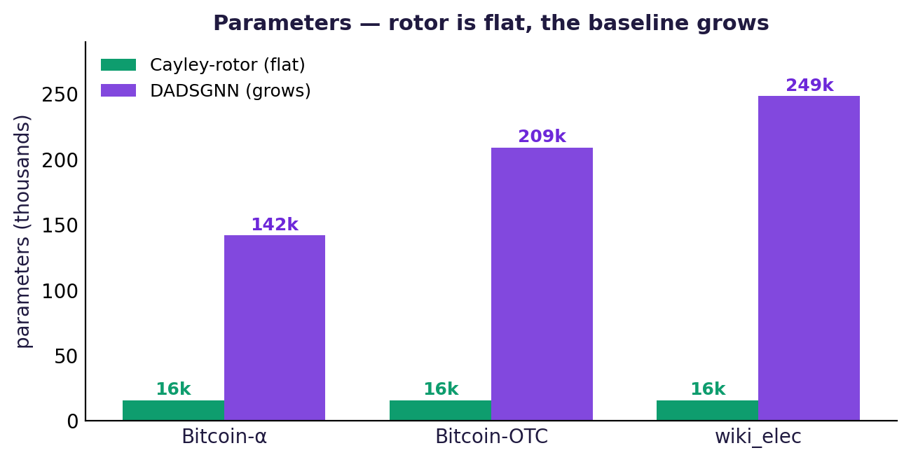
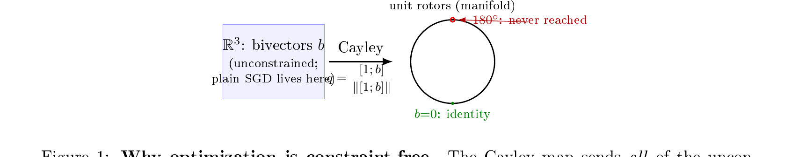
New result: Cayley-rotor embeddings
PART II · SCIENCE
A flat-parameter, inductive, leakage-free embedding — matches a growing-parameter baseline at ~9–16× fewer parameters.
Embedding = learned rotation of one reference on a sphere (angle θ = similarity); the Cayley map keeps it on the rotor manifold.
Dataset | Rotor AUROC | Rotor params | DADSGNN AUROC | DADSGNN params
Bitcoin-α | 0.867 ± 0.011 | 15.8k | 0.860 ± 0.011 | 142k
Bitcoin-OTC | 0.894 ± 0.006 | 15.8k | 0.880 ± 0.007 | 209k
wiki_elec | 0.885 ± 0.002 | 15.8k | 0.896 ± 0.007 | 249k
Matches/leads on Bitcoin-α & OTC and within ~0.01 on wiki_elec — at a fraction of the parameters; label-shuffle → ~0.50 (leakage-clean). 5 seeds · reports/rotor_multiseed_20260616.jsonl
HyMeKo · PhD Seminar
29

Slide 31
What is leakage? Why it matters
PART II · SCIENCE
Test-set information slipping into training — and why a benchmark can't be trusted until it's ruled out
What it is
In signed graphs
Leakage is when a model gains access — directly or indirectly — to information about the held-out test labels while it trains. The reported score then measures memorisation of that leaked signal, not genuine generalisation to unseen data.
Under the transductive convention a cycle's sign-product σ can include the sign of a test edge. A cycle feature then silently carries the very label being predicted — leakage through structure, not through code.
Why it matters. Inflated, non-reproducible numbers; a model that looks state-of-the-art but fails on truly unseen edges; unfair comparison between methods; lost trust. Detecting leakage (label-shuffle → AUROC ≈ 0.5) and removing it (a train-only cycle pool) is exactly what makes a result honest.
HyMeKo · PhD Seminar
30

Slide 32
Honesty as a protocol
PART II · SCIENCE
Strong numbers are only worth as much as the discipline that audits them
Label-shuffle diagnostic
Leakage audit
Shuffle training signs: a true structural predictor collapses to chance. Gömb → 0.540 (clean); leaky variants stay near 0.99 — the test that separates prior from leakage.
An external audit found σ-leakage in early HSiKAN tuned numbers. The strict cycle-pool variant became the honest architectural baseline reported here.
Bug-vs-honest correction
Evidence discipline
A detection-metric bug had inflated a vision mAP to 0.723 ± 0.180; the corrected COCO matching gives 0.504 ± 0.039 — published as the honest reference.
Every result row maps to an on-disk artifact path; an in-flight claim must cite a growing log file. No number floats free of its file.
HyMeKo · PhD Seminar
31

Slide 33
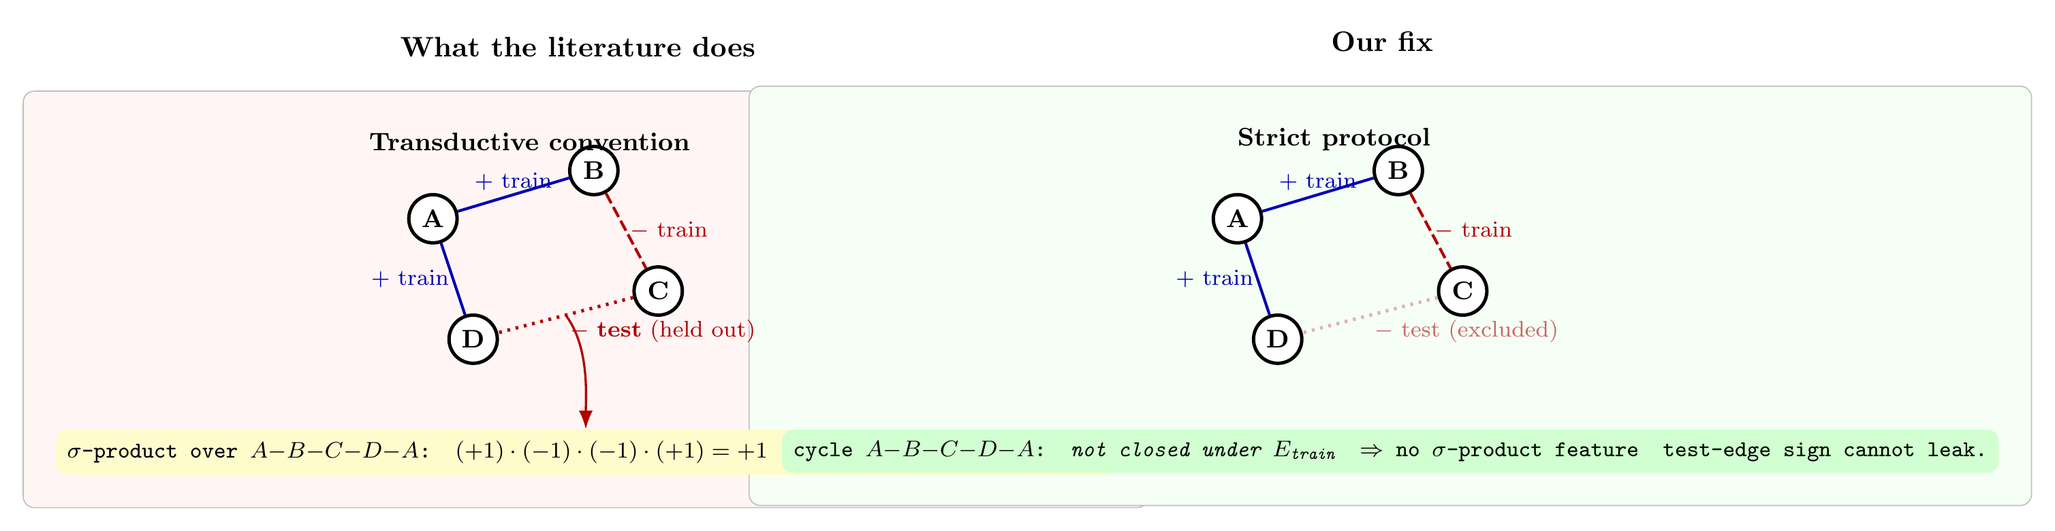
How we know it isn't leakage
PART II · SCIENCE
The label-shuffle test — and what transductive σ-leakage looks like
The metric. Re-train with the training-edge signs randomly permuted. A model using only legitimate structure must fall to chance (AUROC ≈ 0.5); one that secretly reads test-edge signs — through the σ-products of cycles that pass through a test edge — stays high. Gömb collapses to 0.540 (strict by construction); early tuned HSiKAN stayed near 0.99, exposing σ-leakage — so the strict cycle pool, enumerated over training edges only, is the honest baseline.
HyMeKo · PhD Seminar
32

Slide 34
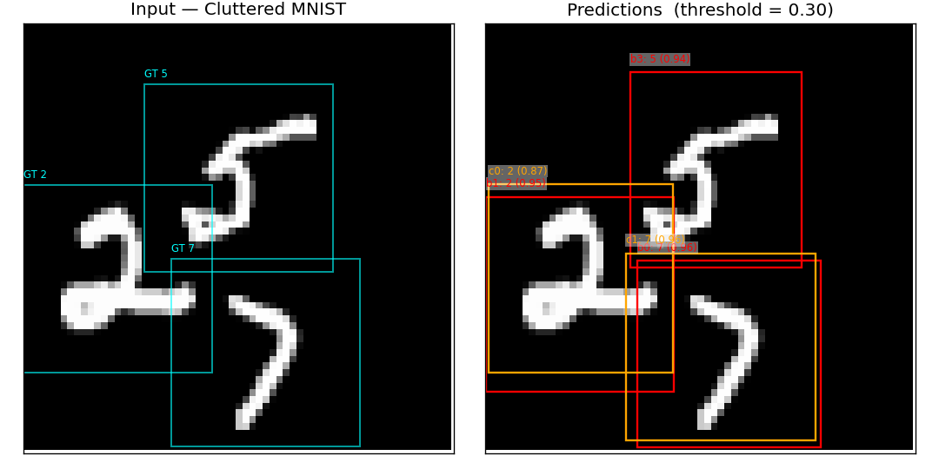
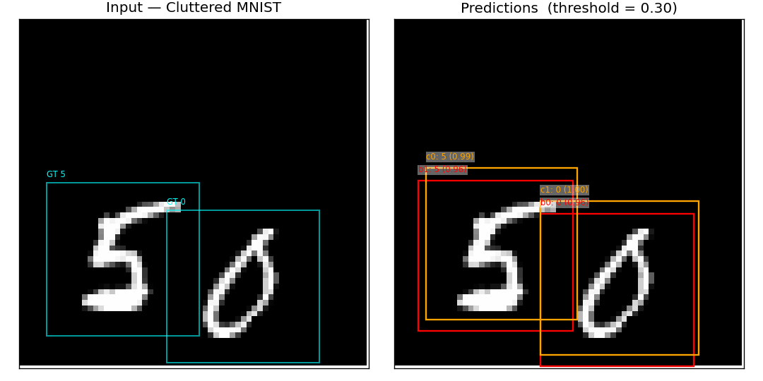
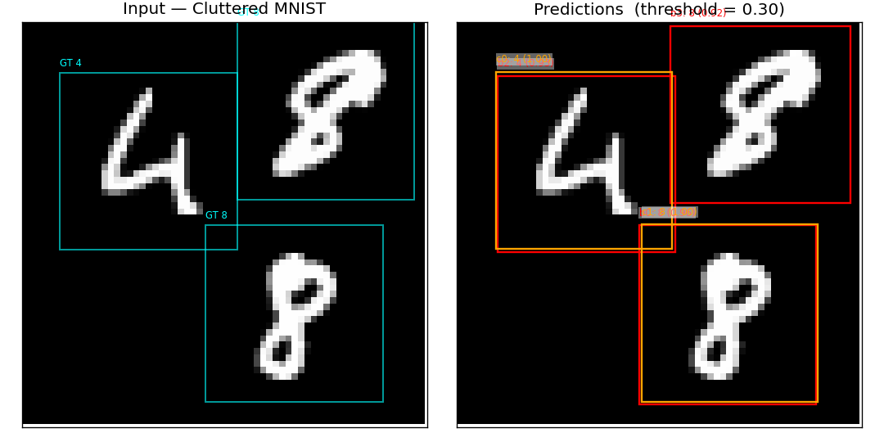
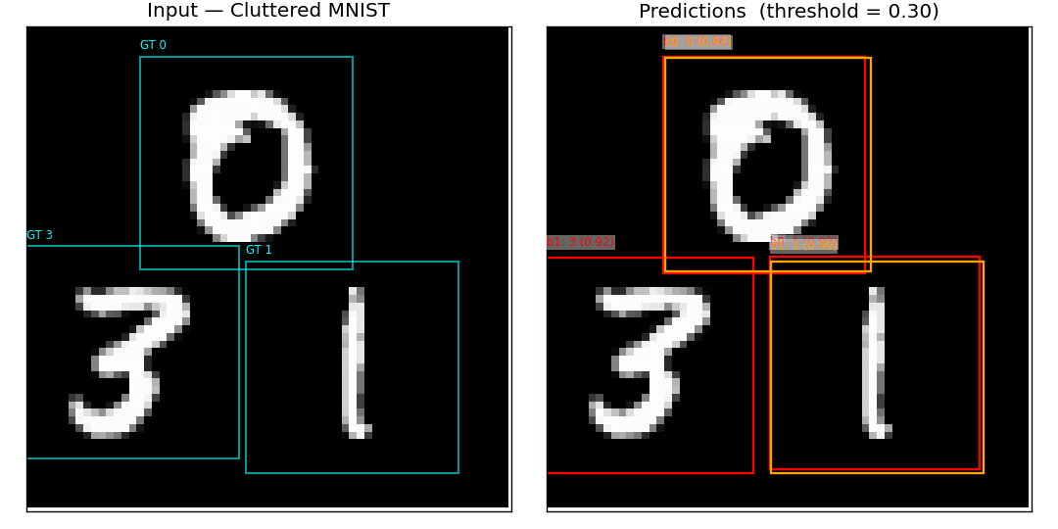
HyMeYOLO: detections on Cluttered MNIST
PART II · SCIENCE
Input with ground-truth boxes (cyan) vs the + ricci-mod detector's predictions (red / orange, score ≥ 0.30)
Single-scale detector, honest mAP_50 ≈ 0.90 (Stage-B HSiKAN-CR). The HSiKAN-CR activation localises digits in clutter at parity with a ReLU backbone.
HyMeKo · PhD Seminar
33

Slide 35
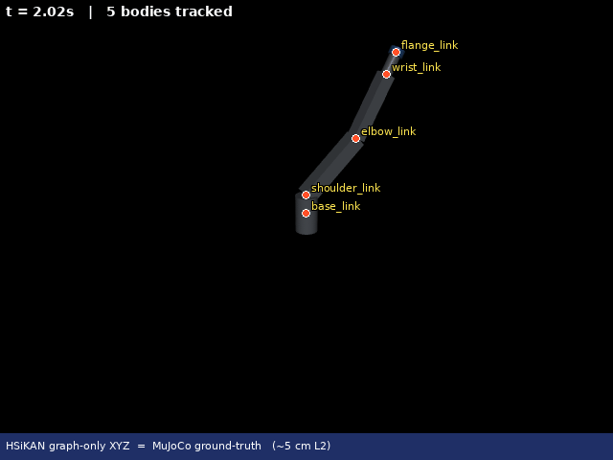
The bridge
Framework and science are one idea seen at two altitudes
1
2
3
4
.hymeko structure
Hypergraph IR
Sparse incidence tensor
Structural-prior model
robot · trust graph · neural dataflow
Blake3 identity · star expansion
O(|E|·d), zero-copy to PyTorch
cycles & walks → KAN activations
Live demo · HSiKAN graph-only kinematics vs MuJoCo (~5 cm L2)
One DSL describes the robot and the network that reasons about it.
The hypergraph that the framework compiles is the same hypergraph whose cycles the model learns from — and the same kinematic structure HSiKAN predicts from graph topology alone.
HyMeKo · PhD Seminar
34

Slide 36
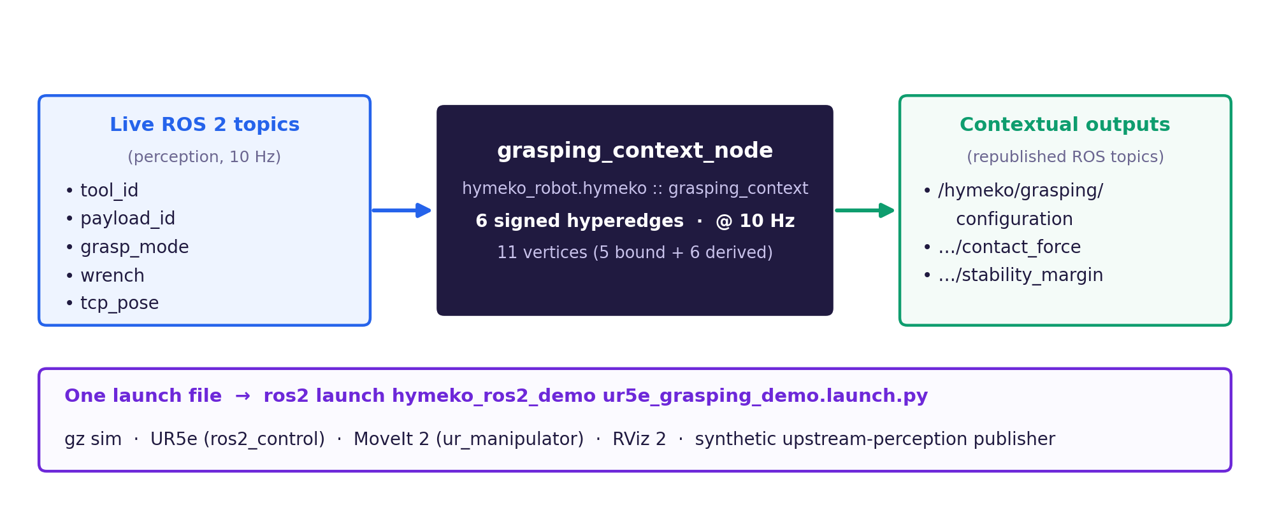
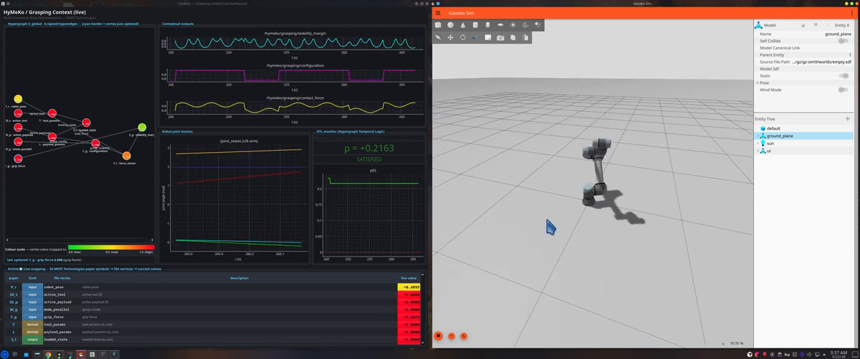
Live demo: UR5e grasping context
PART I · FRAMEWORK
MDPI Technologies Tier-1 — one .hymeko evaluated live against ROS 2 topics in Gazebo (built).
Live data flow (schematic)
Live demo — MoveIt + Gazebo (video, 42 s)
One command brings up gz sim + UR5e + MoveIt 2 + RViz 2 + the HyMeKo context node — the flow ticks at 10 Hz.
grasping_context_node loads hymeko_robot.hymeko, evaluates 6 signed hyperedges over 11 vertices, and republishes configuration / contact-force / stability-margin as ROS topics.
Scope: an integration demo — the framework on the robot stack — not a grasping-policy claim.
HyMeKo · PhD Seminar
35

Slide 37
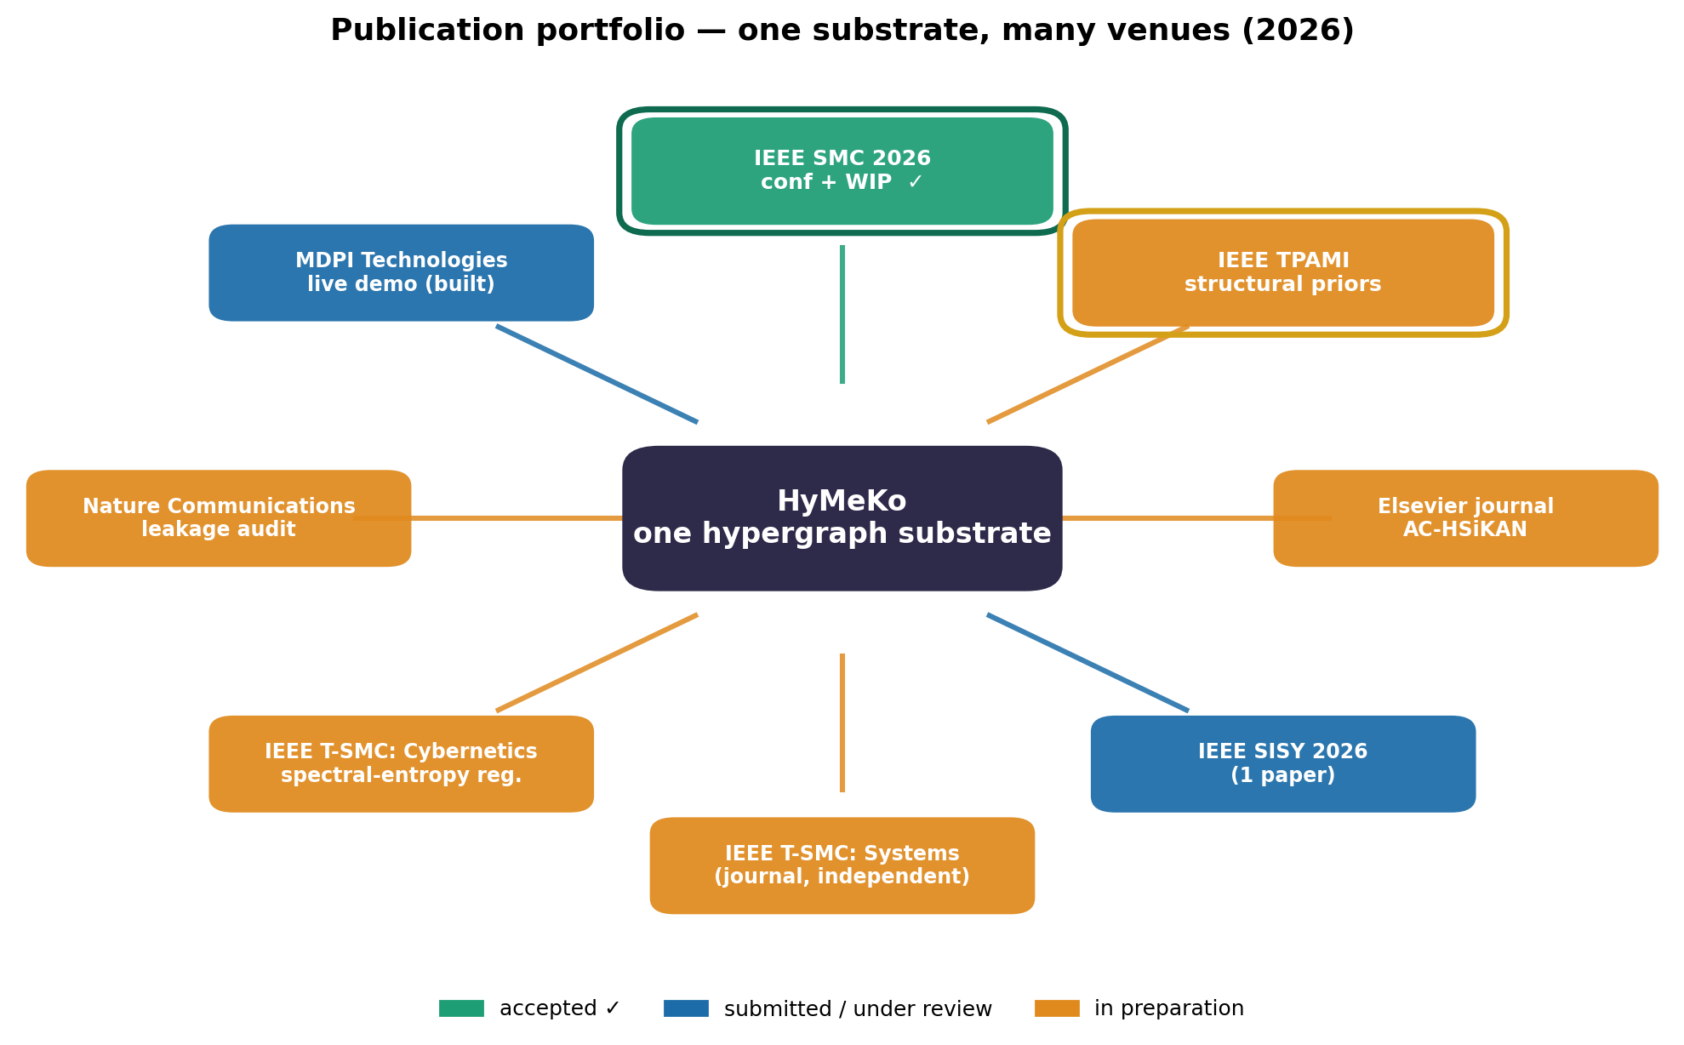
Publications & submissions (2026) — 2 accepted at IEEE SMC 2026 ✓
[accepted ✓] HyMeKo: A Canonical-Hypergraph Infrastructure for Cross-View Consistency in CPS Engineering — IEEE SMC 2026 (Regular)
[accepted ✓] HSiKAN: Mixed-Arity Signed Kolmogorov–Arnold Networks for Signed-Graph Link Prediction — IEEE SMC 2026 (WIP)
[in prep] AC-HSiKAN: signed-link prediction — Elsevier journal
[submitted] Cycles vs. Walks: two inductive biases in Signed KAN — IEEE SISY 2026
[in prep] HyMeKo (journal extension, independent of SMC conf) — IEEE T-SMC: Systems
[in prep] Spectral-entropy regularization, Lyapunov schedule — IEEE T-SMC: Cybernetics
★ [in prep] Signed-hypergraph structural priors for relational learning — IEEE TPAMI
[in prep] HSiKAN + honest σ-masked protocol for signed-graph link prediction — Nature Communications
[in prep] GPU-kernels journal extension (independent) — IEEE T-SMC: Systems
[submitted] HyMeKo live demo (built) — MDPI Technologies
Co-authors: László Környei · Katalin Kovács · Ádám Csapó · and others

Slide 38
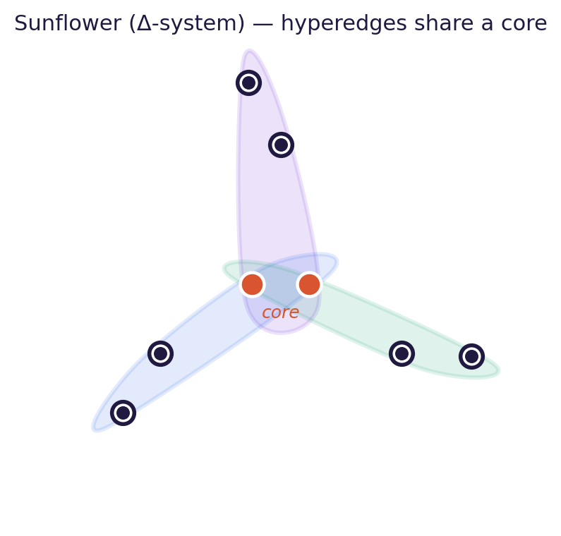
Future work
• σ-masked strict protocol — finish the sign-aware leakage audit + 5-seed grid; lock the honest operating point.
• Round-trip .hymeko → torch.nn — structural parity holds; next: runnable round-trip + faithful Soma vision (Hodge/stim/patch).
• Broader transform targets — task emitters (BehaviorTree.CPP / PDDL / ROS 2 actions) for the .hymeko task layer.
• Larger-scale corpora — bigger signed-graph & vision datasets under the 16 GB RSS discipline.
• HSMM → FPGA — Nagare dataflow → HSMM abstract machine → Zynq (theory → systems → compiler).
• Authoring surface — in-browser editor: multi-file imports & profiles, parametric generators, arc-value editing.
broader transform targets
runnable .hymeko → torch.nn
faithful Soma vision
parametric generators / authoring

Slide 39


Acknowledgements
With thanks to Kato Laboratory (Prof. Shohei Kato) for hosting this seminar.
Supervisor: Prof. Dr. Ádám Csapó (Budapest Corvinus University)
Home laboratory: Applied Artificial Intelligence Laboratory, Department of Informatics
Collaborators & co-authors: Dr. László Környei, Dr. Katalin Kovács, Prof. Dr. Ádám Csapó, Prof. Dr. Péter Galambos, Zoltán Szilágyi
Students & teammates:
Lecturers: Dr. Katalin Kovács, Dr. Boldizsár Tüű-Szabó, Dr. Brigitta Szí,
Contributors: Dr. László Környei, dr. Éva Rampasek, Prof. Dr. János Tőzsér, Dr. Károly Tempfl, Dr. Dávid Törőcsik
External contributors: Dr. Károly Széll (Óbuda University), Zoltán Szilágyi (Óbuda University)
Doctoral students: Samy Borsos, Barnabás Kopcsándi, Márk Gaál
Students: Kata Horváth, Attila Ötvös, Ádám Ragasits, Gyula Szakál, Gilgames Kiss
Thank you. ありがとうございました。
Main research themes
Behavior analysis (human and animal motion): healthcare and agriculture
Perception: computer vision tasks, transfer learning, pose detection & estimation
Robotics: mobile manipulators, industrial robotics, HRI, simulation
Systems engineering and Information systems engineering
HyMeKo · PhD Seminar
39

Slide 40

Conclusion & outlook
HyMeKo is one hypergraph substrate with two payoffs: a production-grade Rust framework for representing and transforming hypergraphs, and a family of structural-prior models that turn a graph's own cycles into an inductive bias.
Open directions
A σ-masked strict protocol that fixes the over-aggressive filter artifact
The under-explored above-1.0 Ricci-modulation regime
Round-trip codegen: compile a .hymeko architecture straight to a torch.nn module
Broader transform targets and larger signed-graph corpora
I would be especially interested in discussing how this representation could connect to ongoing work in cognitive robotics and learning systems at Kato Laboratory.
Thank you — questions welcome. Csaba Hajdu · Kato Laboratory seminar · June 2026
Code & docs: github.com/kyberszittya/hymeko_framework_rust
HyMeKo · PhD Seminar
40

