Slide 1
Jumping for JS

Slide 2
Today’s Class

Slide 3
Objectives
In today’s class we’ll be covering:
The Art of Pseudo-Coding
Building Rock-Paper-Scissors
JavaScript Functions

Slide 4
Basics Recap

Slide 5
Deep Philosophy
What is JavaScript?
(And what is it used for?)

Slide 6

JavaScript Definitions
JavaScript is the third of the three fundamental programming languages of the modern web (along with HTML, CSS)
JavaScript allows developers to create dynamic web applications capable of taking in user inputs, changing what’s displayed to users, animating elements, and much more.

Slide 7
Please… Don’t Pick Me.
What is a Variable?
(And how do we declare one?)

Slide 8
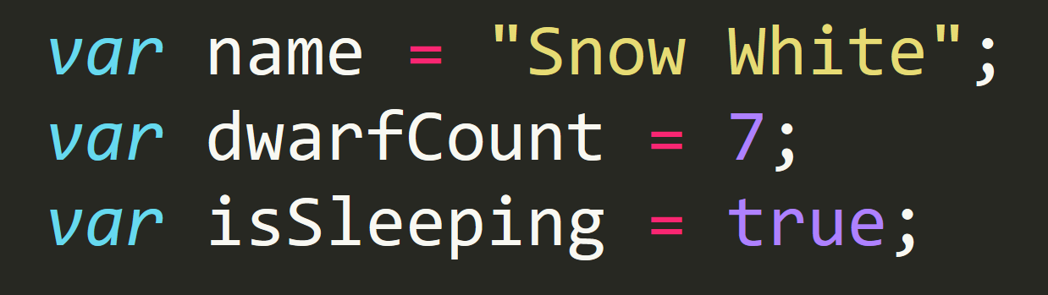
Basic Variables
Variables are the nouns of programming.
They are “things” (Numbers, Strings, Booleans, etc.)
They are composed of variable names and values

Slide 9
Please… Don’t Pick Me.
What is meant by console.log?
(And how does it differ from an alert, prompt, or confirm?)

Slide 10
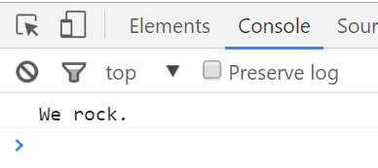
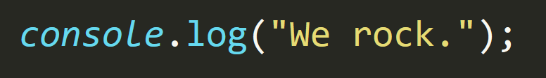
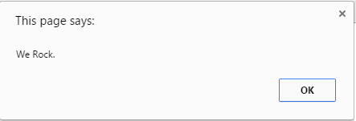
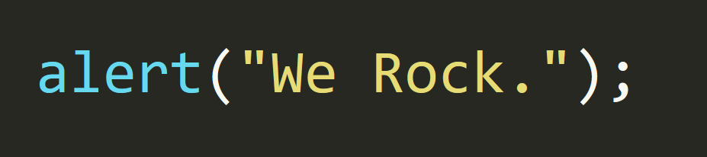
Basic Variables
Console.log displays discreetly to the debugger.
Alert displays a pop-up message to the user.

Slide 11
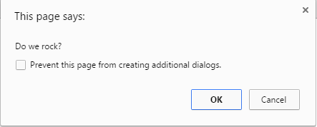
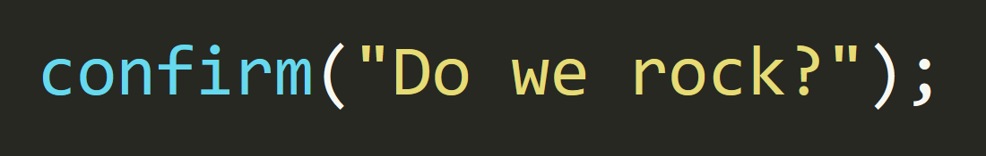
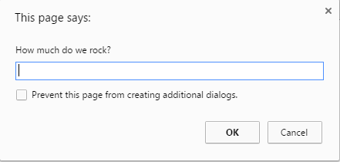
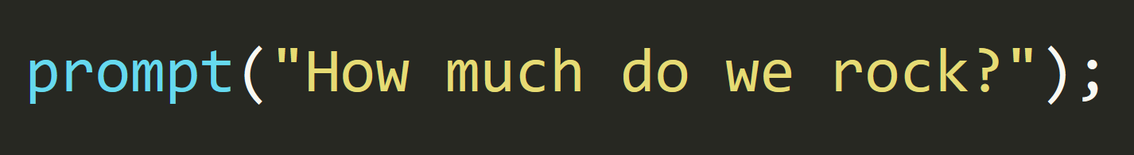
Basic Variables
Confirm displays a True/False popup.
Alert displays a prompt with a text-box input.

Slide 12
Please… Don’t Pick Me.
How do we “write” text to the HTML itself?

Slide 13
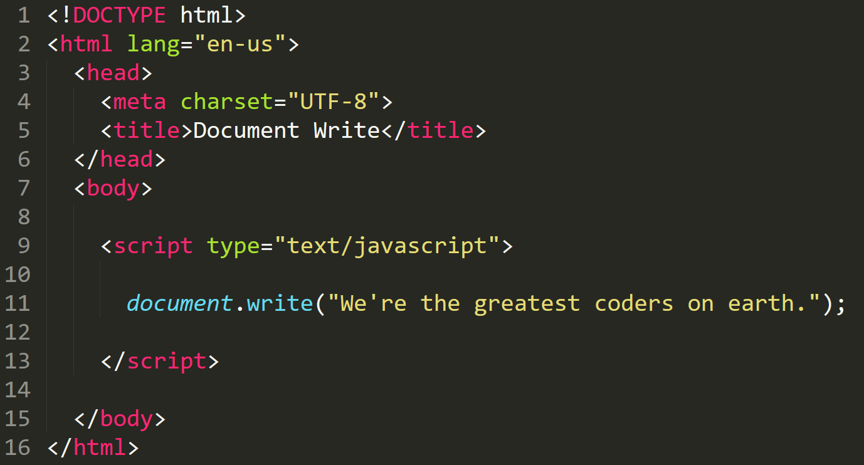

Writing to HTML
We can use JavaScript to directly write to the HTML page itself using document.write( ).
Later we will go over much more advanced approaches for writing HTML using JavaScript and jQuery.
Test.html (chrome)
Test.html
(sublime)

Slide 14
Please… Don’t Pick Me.
How do we check conditions?

Slide 15
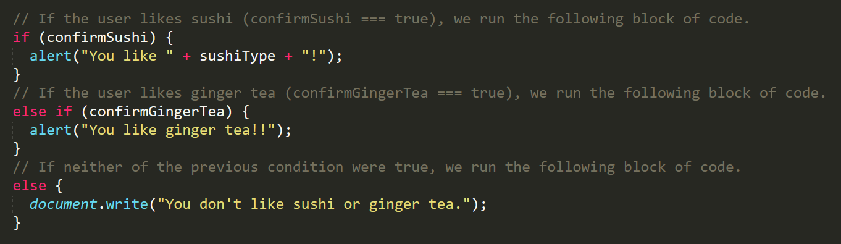
If/Else Statements
If/Else statements are critical.
Each statement is composed of an if, else-if, or else (keyword), a condition, and the resulting code in { } curly brackets.

Slide 16
Please… Don’t Pick Me.
What is an array?

Slide 17
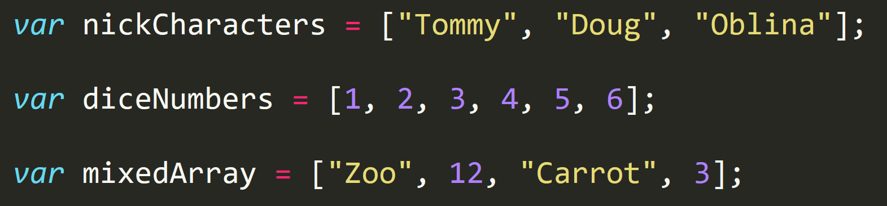
Basic Arrays
Arrays are a type of variable that are collections.
These collections can be made up of strings, numbers, booleans, other arrays, objects, anything.
Each element of the array is marked by an index. Indexes always start with 0.

Slide 18
Functions

Slide 19
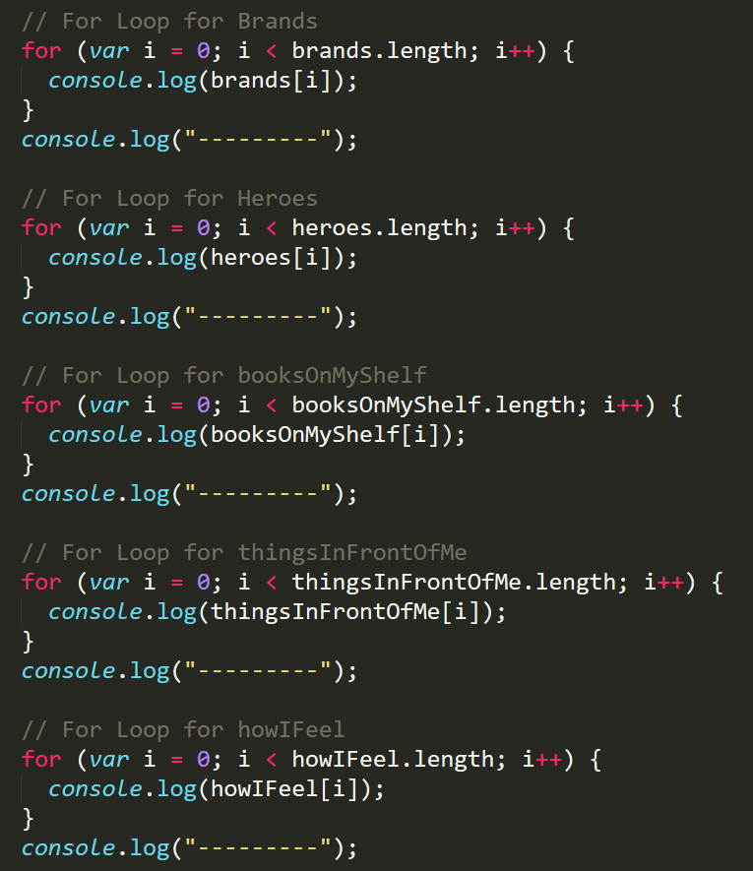
Mondo Repetitive…
Who wants to maintain this??
Hint: No one.

Slide 20
Demo Time
Instructor: Demo
(SuperHeroLogging_withFunctions.html | 26-SuperHeroLogging)

Slide 21
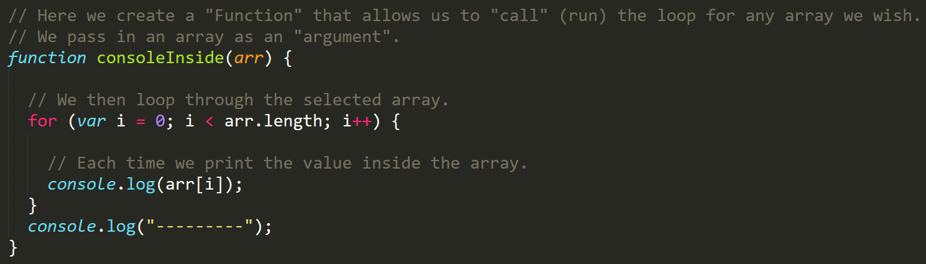
Much Better with Functions!
Squeaky Clean Code.
Minimal repetition

Slide 22
Questions

