Slide 1
JS and jQuery Jubilee

Slide 2
This shouldn’t be you…

Slide 3
Remember this!
“You can’t tell whether you’re learning something when you’re learning it—in fact, learning feels a lot more like frustration.”
“What I’ve learned is that during this period of frustration is actually when people improve the most, and their improvements are usually obvious to an outsider. If you feel frustrated while trying to understand new concepts, try to remember that it might not feel like it, but you’re probably rapidly expanding your knowledge.”
Jeff Dickey, Author of Write Modern Web Apps with the MEAN Stack: Mongo, Express, AngularJS, and Node.JS

Slide 4

Feedback #1 – Pace is Fast!!!
That said, as instructors / TAs we are here to help.
Stay for office hours!
In addition to using the time to understand concepts… it’s a great way for us to identify weaknesses and outline steps to get on the right track.
We’ll also have formal, weekly reviews.

Slide 5

Your Brain on JavaScript…

Slide 6
Today’s Class

Slide 7
Objectives
Practice Javascript Scope
Build a jQuery Calculator

Slide 8
Lexical Scope

Slide 9
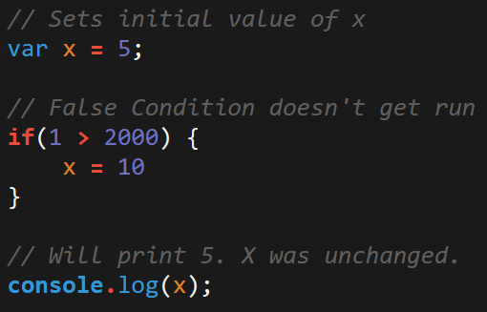
Javascript Scope
In Javascript curly brackets { } indicate blocks of code.
In order for the code inside the curly brackets to be executed, it must meet the condition or it must be called (example: functions).
These blocks of code have the power to affect variables outside the curly brackets if those variables were declared outside – so be careful!

Slide 10
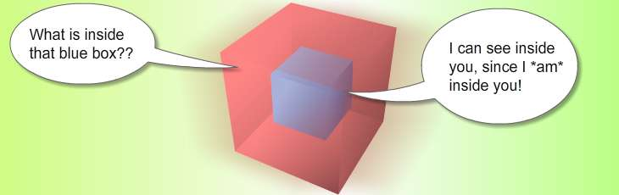
Scope = Boxes in Boxes
Scope impacts which variables can be accessed by which function.

Slide 11
Scope = Boxes in Boxes
function global()
function inner()
function eveninner()
function innest()

Slide 12
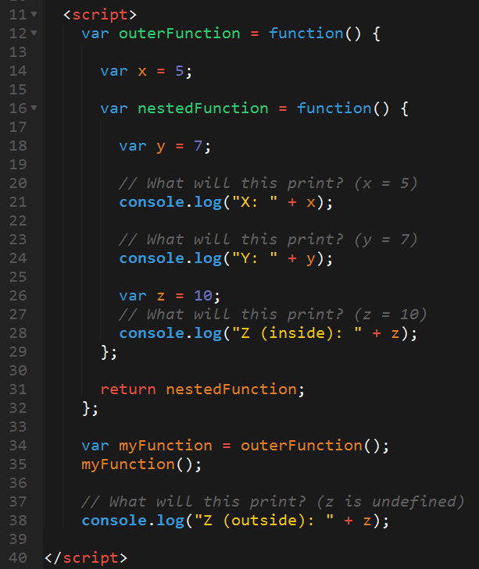
Javascript Scope Example (Tricky)
Here nested function is clearly able to access the variables of their parent function.
Whereas outer function has no idea what the variable z is because it was declared in a child function.

Slide 13
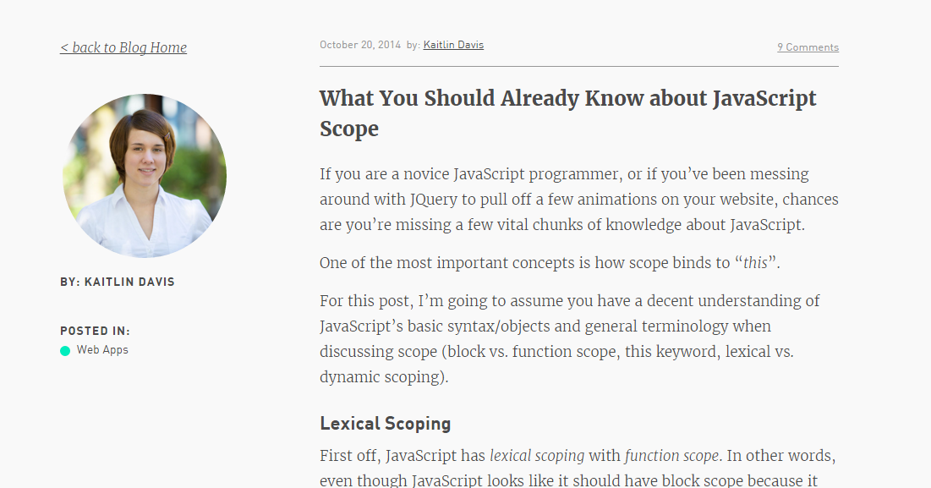
Helpful Article (If you’d like to learn more…)

Slide 14
Questions

