Slide 1
Computer Science Context

Slide 2

Welcome To…
“Computer Science Fundamentals”

Slide 3
Remember…
Computer Science “Fundamentals”
Isn’t about “easy” computer science stuff.
Rather, it’s about the “fundamental” concepts that underlie all of the work we’ve been doing to date.
The biggest takeaway is to understand that there are different tools to increase computational efficiency.

Slide 4
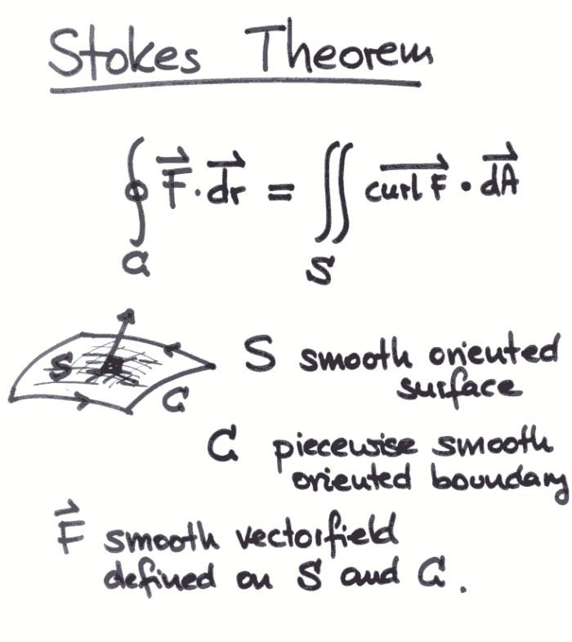
“Fundamentals”
Remember this stuff?
Yeah. Me neither.

Slide 5
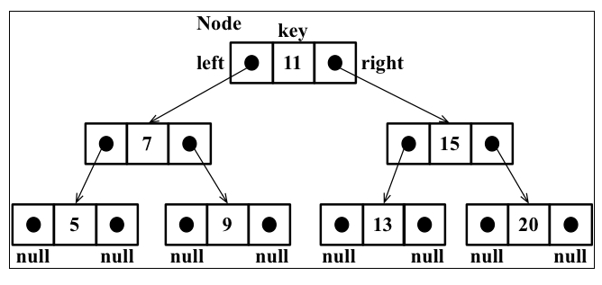
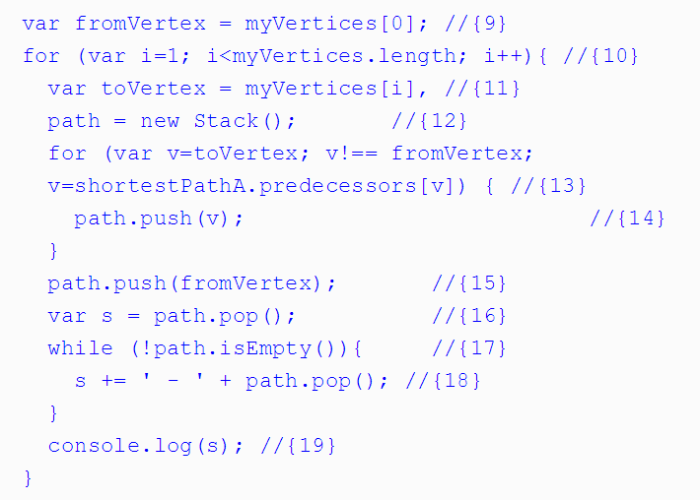
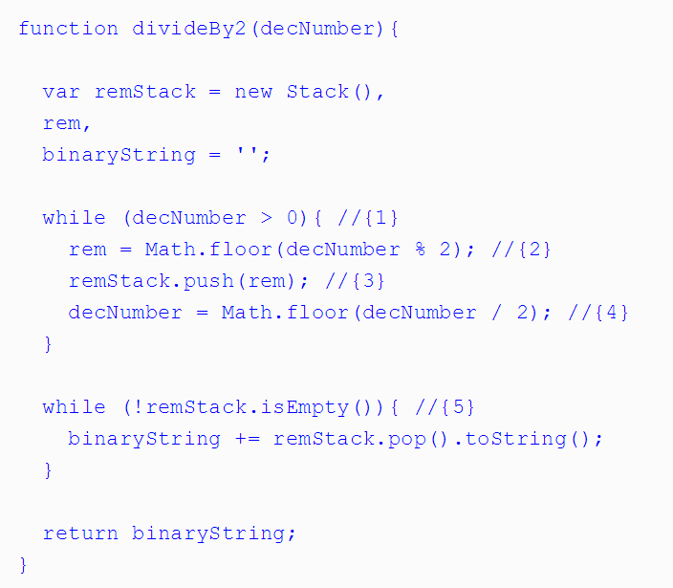
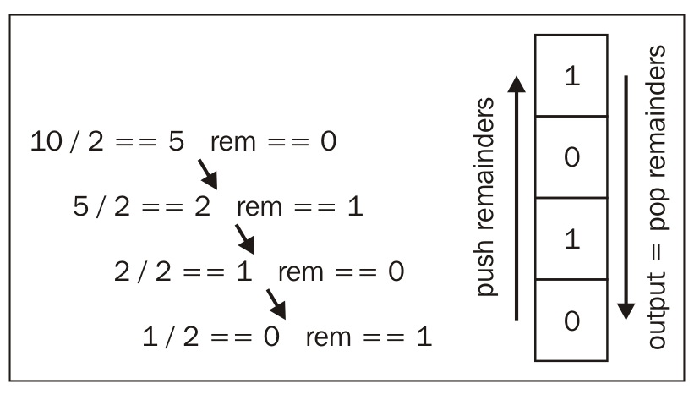
It gets hairy… and scary.

Slide 6

Be Wary of Imposter Syndrome!
Don’t let the hard stuff scare you…

Slide 7
Why Cover This?
These concepts sometimes appear in coding interviews
When inheriting large code-bases you may be tasked to “optimize” code efficiency.
The computational challenges here forces you to deepen your understanding.

Slide 8
Bottom Line
My goal is to give you the terminology and the concepts.
Enough insight that you can understand the context of interview questions that come your way.
And… to encourage those of you into math to take a second look.

Slide 9
Efficiency

Slide 10
What does “efficient” mean?
We talk a lot about “efficiency”.

Slide 11
What does “efficient” mean?
But…

Slide 12
What does “efficient” mean?
What, exactly, does “efficient” mean?

Slide 13
Fewer Steps = Faster Code
Number of steps ~ Efficiency

Slide 14
Fewer Steps = Faster Code
More steps = Less Efficient
Fewer Steps = More Efficient

Slide 15
What’s a “step”?
A step is an instruction to the computer.
All computations boil down to a handful of “basic steps”.
Arithmetic (+, *, etc.)
Assignment (var x = 42;)
Boolean tests (x === 42)
Reading from memory
Writing from memory

Slide 16
What’s a “step”?
Each of these counts as a step.

Slide 17
What’s a “step”?
Fewer Steps = Faster Code

Slide 18
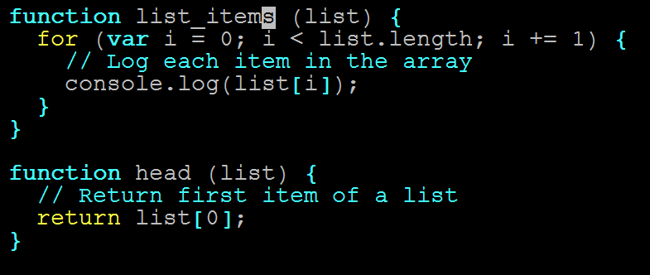
Pop Quiz (!)
Which function is more efficient?
(Which has fewer instructions?)

Slide 19
Count Instructions
Count the instructions!

Slide 20
Count Instructions
head = 1 instruction

Slide 21
Count Instructions
list_items = n instructions
…
(n = list.length)

Slide 22
The Verdict
head is more efficient.

Slide 23
The Verdict
But list_names isn’t bad…

Slide 24
Time Complexity

Slide 25
Quantifying Efficiency
head always executes one instruction…

Slide 26
Quantifying Efficiency
…No matter how long our array is

Slide 27
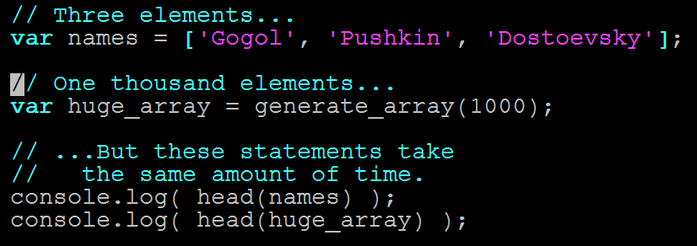
Quantifying Efficiency
head takes same amount of time on any input

Slide 28
Quantifying Efficiency
list_items needs n instructions

Slide 29
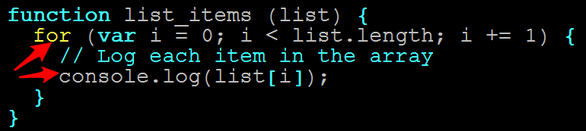
Quantifying Efficiency
One console.log per item

Slide 30
Quantifying Efficiency
console.log is fast…

Slide 31
Quantifying Efficiency
…but not free.

Slide 32
Quantifying Efficiency
Longer arrays = more time

Slide 33
Quantifying Efficiency
Double array length = Double time
Triple array length = Triple time

Slide 34
Quantifying Efficiency
In other words…

Slide 35
Quantifying Efficiency
The running times of head and list_items scale differently.

Slide 36
Quantifying Efficiency
Time complexity = Rate at which algorithm slows as input grows

Slide 37
Quantifying Efficiency
head is always one instruction

Slide 38
Quantifying Efficiency
Running time does not slow for larger inputs

Slide 39
Quantifying Efficiency
In other words…

Slide 40
Quantifying Efficiency
The running time of head is constant.

Slide 41
Quantifying Efficiency
list_items takes n instructions

Slide 42
Quantifying Efficiency
Running time depends on array

Slide 43
Quantifying Efficiency
Double array length, double time
Etc…

Slide 44
Quantifying Efficiency
Running time increase linearly with array length.

Slide 45
Big O Notation

Slide 46
Big O
Big O notation lets us describe how running time scales when we increase the input size (n)
Denoted with a big O, and the “growth factor” in parentheses
Examples:
head ~ O(1)
Grows like “1”—i.e., running time never grows
list_items ~ O(n)
Grows like “n”—i.e., gets bigger as n gets bigger

Slide 47
Big O
There are other Big O “classes”

Slide 48
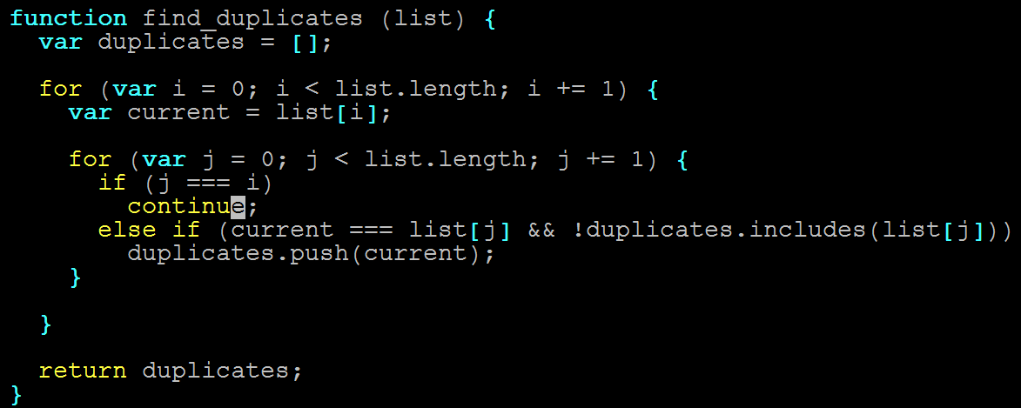
Big O
n steps for each of the n items in list (!)

Slide 49
Big O
2x length = 4x time
3x length = 9x time
nx length = n² time

Slide 50
Big O
Running time grows as square of input

Slide 51
Big O
find_duplicates ~ O(n²)
“Quadratic time complexity”

Slide 52
Big O
MAJOR INSIGHT

Slide 53
Big O
2 nested for loops ~ O(n²)

Slide 54
Big O
NOT COINCIDENCE!

Slide 55
Big O
3 nested for loops ~ O(n³)
Etc.

Slide 56
Big O
One more…

Slide 57
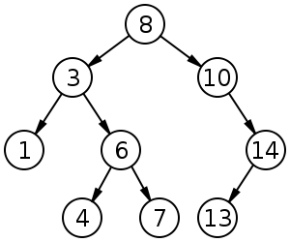
Big O
How fast is binary search?

Slide 58
Big O
Is it…
O(1)
O(n)
O(n²⁾
Something else?...

Slide 59
Big O
Something else.
Why?

Slide 60
Exercise
Binary search this array by hand, for 3, then 9.
Count the steps.

Slide 61
Big O
3 steps.

Slide 62
Big O
Add the digits 11-20. Repeat.

Slide 63
Big O
4 steps (!)

Slide 64
Big O
Much faster than linear.

Slide 65
Big O
(input size)² ~ 2x running time
(input size)³ ~ 3x running time
^{Etc.}

Slide 66
Big O
This is called O(lg n).

Slide 67
Big O
lg n = how many times do I divide n by two to get to 1?

Slide 68
Logarithm Example
What is lg 8?

Slide 69
Logarithm Example
8 / 2 = 4 (1)
4 / 2 = 2 (2)
2 / 2 = 1 (3)

Slide 70
Logarithm Example
lg 8 = 3
^{But if this is confusing…}

Slide 71
Logarithm Example
Don’t worry about it.

Slide 72
Big O Review
head ~ O(1)
Grows like “1”—i.e., 2x input size -> 1x running time
list_items ~ O(n)
Grows like “n”—i.e., 2x input size -> 2x running time
find_duplicates ~ O(n²)
Grows like “n^{2”}—i.e., 2x input size -> 4x running time
binary_search ~ O(lg n)
Grows like “lg n”—i.e, (input size)² -> 2x running time

Slide 73
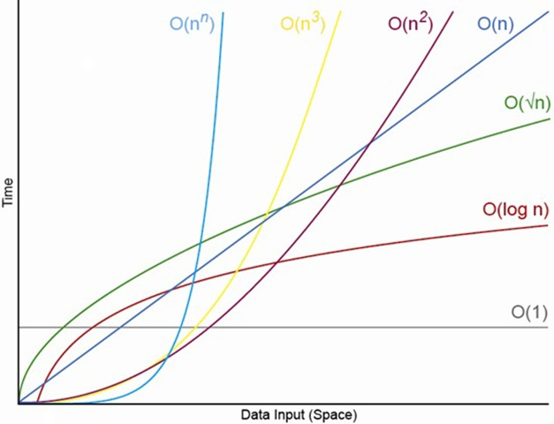
Big O Comparisons

Slide 74
Questions

