Slide 1


Slide 2
THIS JUST IN
Nlp applications on…
Notes:
All news shows are fake news! They begin with good morning/evening/afternoon and then proceed to tell you why it’s not!

Slide 3
Applying Machine Learning to Funko POPS!
What are POP!s?
Pop–culture vinyl figures and collectibles
Why POP’s?
Typically retail for $8 to $10 with exclusive or limited editions selling for $15
Insane resale values:
The Top 10 sales over the past 30 days were all over $1800
The most popular POP, Headless Ned Stark from GoT, average a price of $2032.86 over 7 sales within the last 30 days

Slide 4
Applying Machine Learning to Funko POPS!
So what?
Using machine learning to try to interpret POP values from e-bay listings
Look for patterns in which POP’s have the best resale value for investment purposes
Predict which e-bay listings will sell at ask price or go for best offer
Eventually program a bot to buy/sell on e-Bay the way investors use algorithms to invest in the market

Slide 5
APPROACH
SOURCES:
https://www.ebay.com/
https://www.poppriceguide.com/

Slide 6
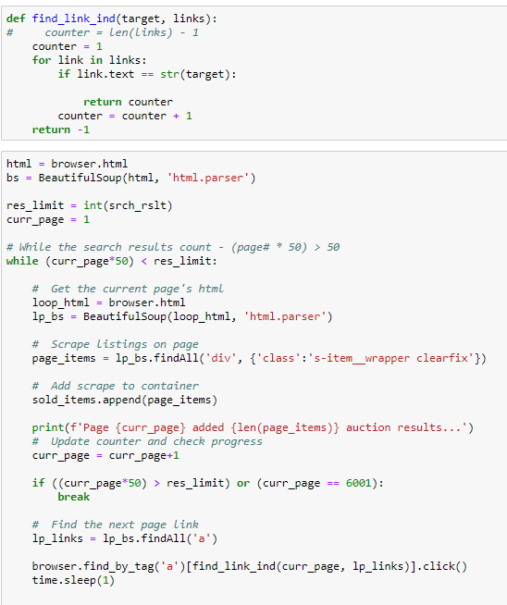
CODING: Extraction
Lack of unique ID’s and identifiers

Slide 7
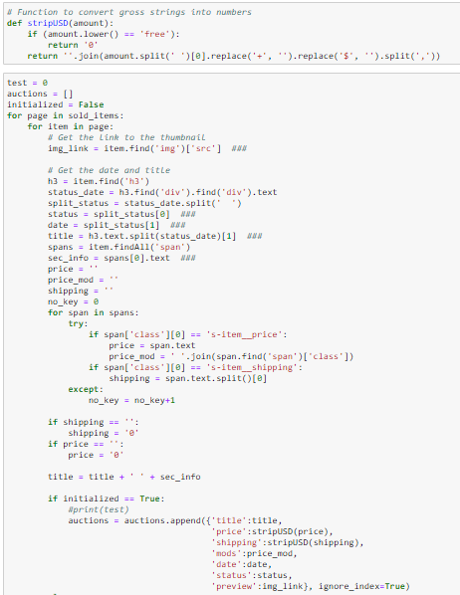
CODING: Extraction
Targeted 327,000 results…
Stopped at 18,700

Slide 8
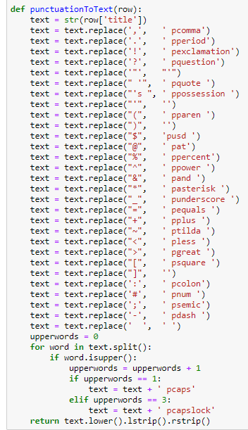
CODING: Cleanup
Instead of using regex to strip non-alphanum…
Keep note of punctuation
See if punctuation influenced results

Slide 9
Applying Machine Learning to Funko POPS!
Raw
“E-Bay Listing”
String
Punctuation
To
Text
String
Token
Representation
Removal
Of Stop Words
Naïve Bayes
Classifier
(64.823% Accuracy)
Inverse Document Frequency
Scaled
Vector
Term Frequency
Vectors

Slide 10
Applying Machine Learning to Funko POPS!
https://www.poppriceguide.com/ Scrape:
Taking names from E-bay results
Search matching results
Use price guide scraped data to further train the classifier
Unstable site stopped with less than 6% of matching data..

Slide 11
Applying Machine Learning to Funko POPS! Sarcasm
So now what?
Repurpose same code and methods to process a Sarcasm dataset
Sarcasm dataset based on headlines from The Onion and Huffington Post
Naïve Bayers classifier was able to predict Sarcasm with:
80.265% accuracy

Slide 12

Applying Machine Learning to Sarcasm
Now what?
Further tested the classifier on 80 sarcastic quotes
Plus random statements or sarcasm and seriousness and…
Success rate less than 50%

Slide 13
Applying Machine Learning to Sarcasm
News
So what did we actually accomplish?
Classifier wasn’t detecting sarcasm as much as patterns in The Onion’s versus Huffington Post’s headlining process
OK, let’s look at more news then!

Slide 14
Applying Machine Learning to News
Using headlines from:
CNN, New York Times, Fox News, The Washington Post, The Guardian, etc…
Only news sources passing NewsGuard were used
Discounting sources such as Breightbart
Clean and tokenize their headlines like before
Mix and match and see what we learn!

Slide 15
Applying Machine Learning to News
Model
Results
Left vs Right (2/All)
https://mediabiasfactcheck.com/
CNN vs FOX
CNN vs Vox
CNN vs The Onion
69.567% accurate
70.843% accurate
81.028% accurate
84.894% accurate

Slide 16
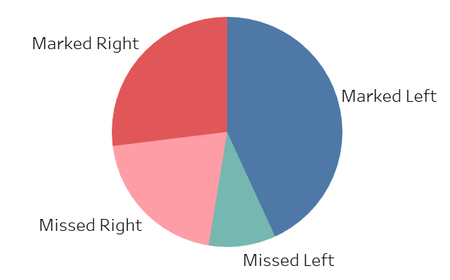
Combined News Bias Model Accuracy

Slide 17
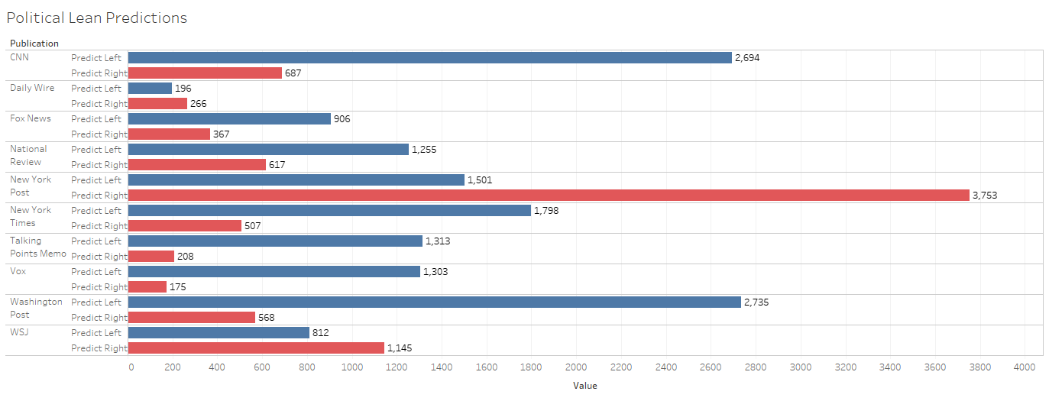
Predictions by Source

Slide 18
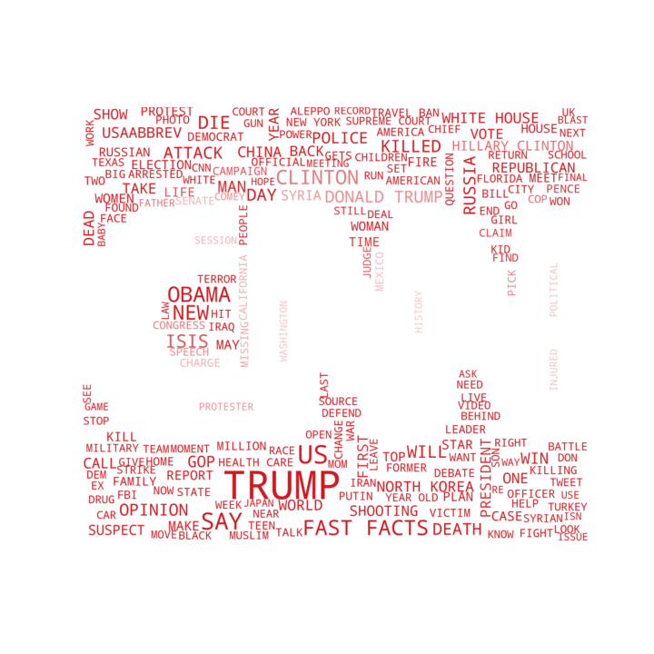

Guess the News Source from its Wordcloud

Slide 19
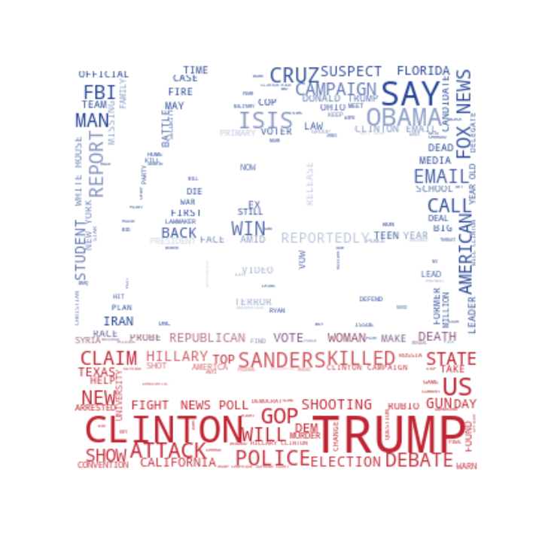
Guess the News Source from its Wordcloud

Slide 20

Guess the News Source from its Wordcloud

Slide 21
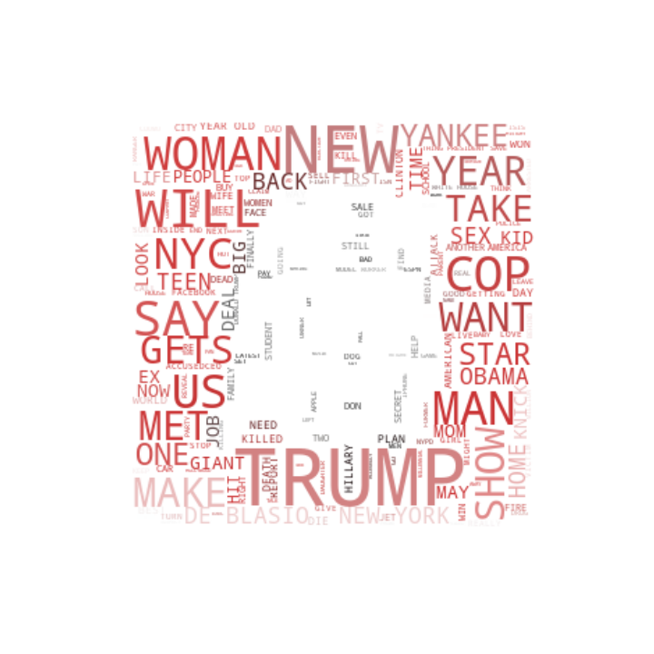
Guess the News Source from its Wordcloud

Slide 22

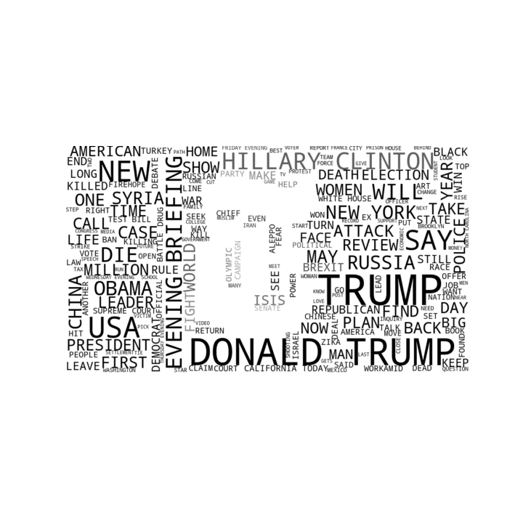
Guess the News Source from its Wordcloud

Slide 23

Guess the News Source from its Wordcloud

Slide 24
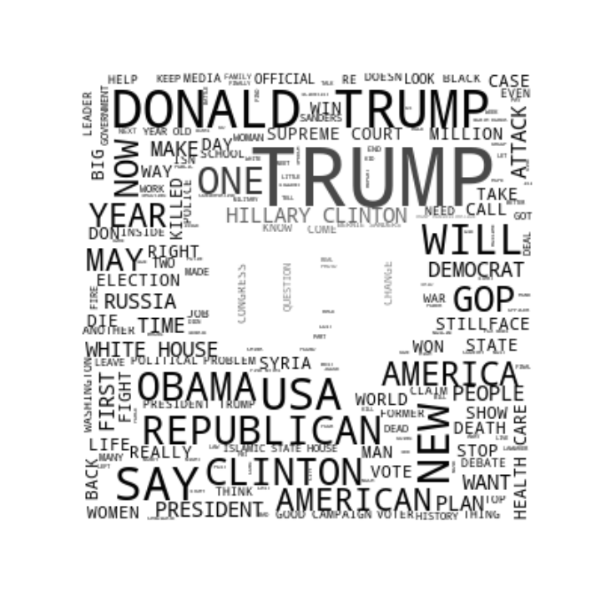
Guess the News Source from its Wordcloud

Slide 25

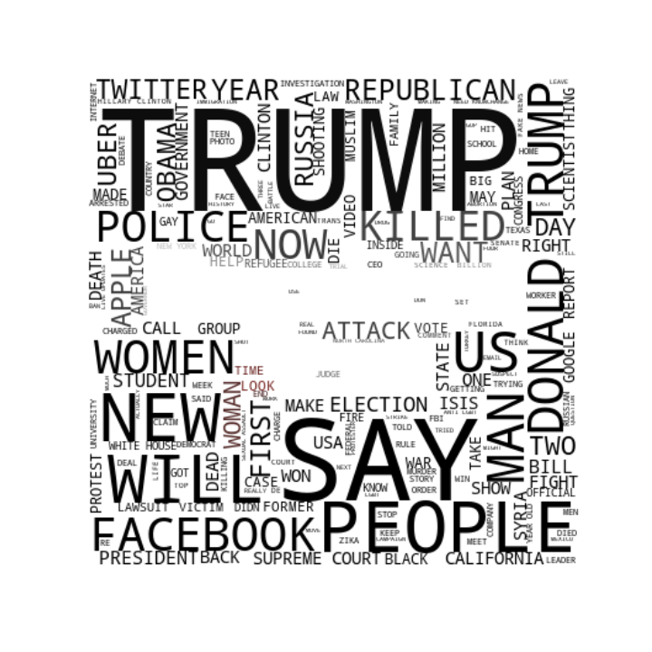
Guess the News Source from its Wordcloud

Slide 26
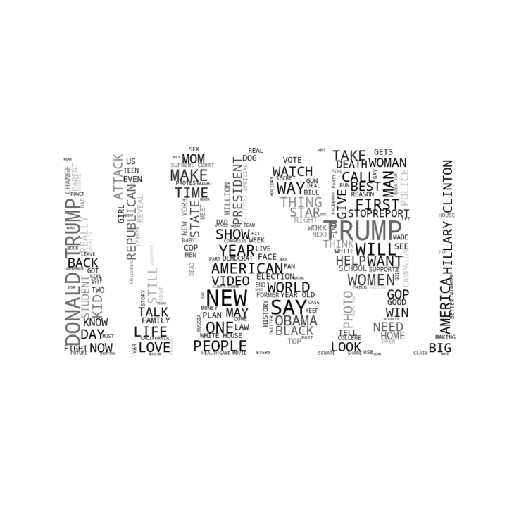
Guess the News Source from its Wordcloud

Slide 27
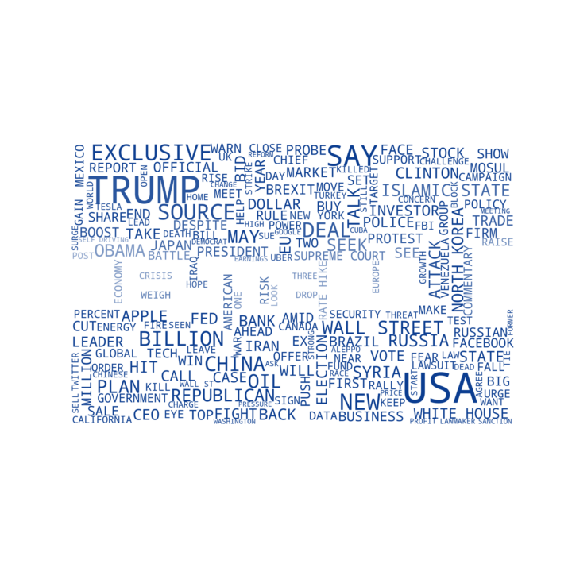

Guess the News Source from its Wordcloud

Slide 28


Guess the News Source from its Wordcloud

Slide 29


Guess the News Source from its Wordcloud

Slide 30

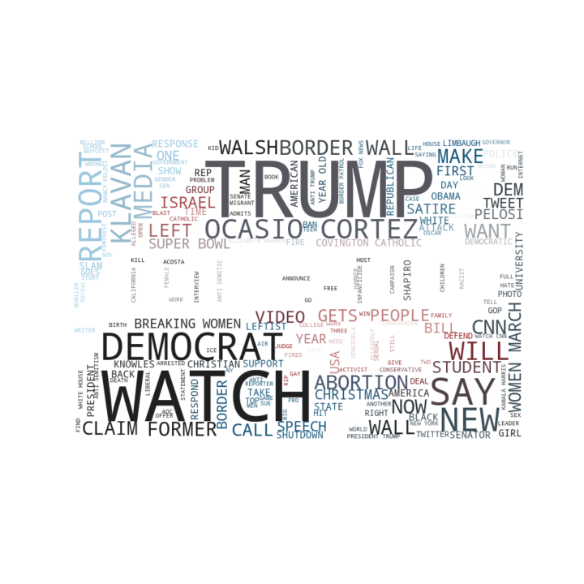
Guess the News Source from its Wordcloud

Slide 31
THIS IS WHERE YOU WOULD ASK QUESTIONS IF YOU HAD ANY…
Or if there was any time left

