Slide 1
Prophages in marine bacteria: dangerous molecular time bombs or the key to survival in the seas?
Mini-Review
John H Paul
College of Marine Science
University of South Florida, St Petersburg, FL, USA

Slide 2
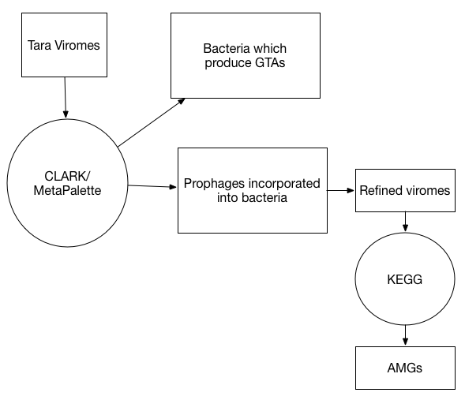

Slide 3
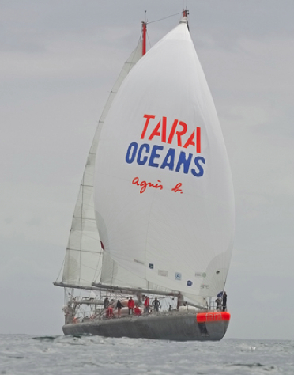
Tara Oceans
12 years
300K km
10 expeditions
28 publications
100TB of data

Slide 4
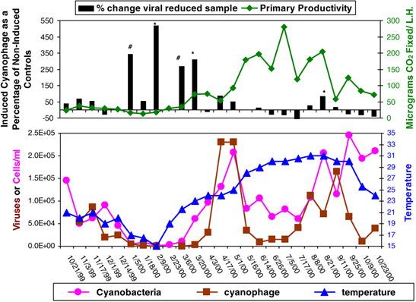
Level of prophage induction

Slide 5
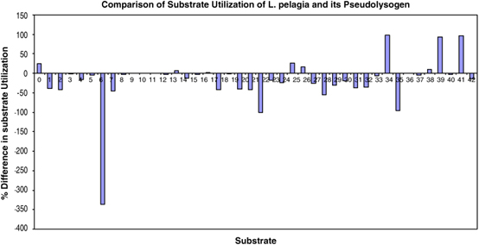
Relative substrate utilization between Listonella pelagia and its pseudolysogen

Slide 6
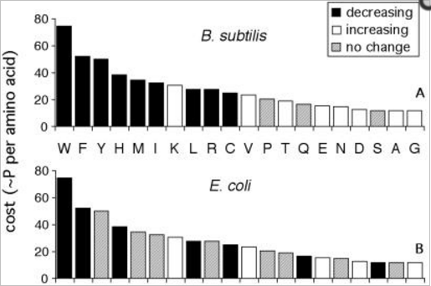
Changes in amino acid composition
Metabolic efficiency and amino acid composition in the proteomes of Escherichia coli and Bacillus subtilis. Proc Natl Acad Sci U S A. 2002 Mar 19;99(6):3695-700. Akashi H, Gojobori T.

Slide 7
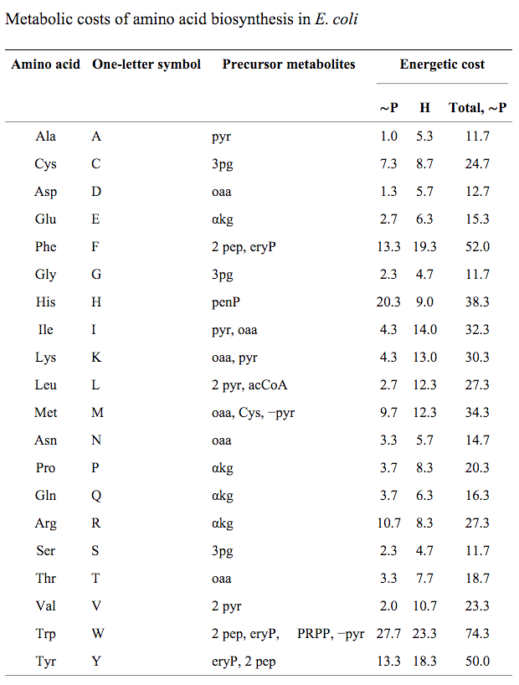
Ibid.

