Slide 1
R Exercise 1: Checking linear model assumptions; outliers
Slides by Max Li, based on Brian McGill’s materials at stats.brianmcgill.org

Slide 2
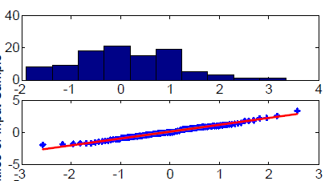
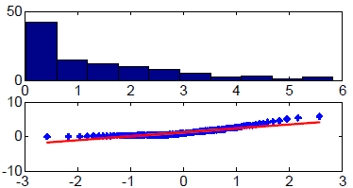
Checking the GLM assumptions (normality)
Histogram and Quantile-Quantile plot of residuals ε_{i(j)}: check the normality of errors
Normal
Non-normal (needs log transformation)

Slide 3
If non-normal
GLM are quite robust even if the errors are not normal.
As long as the distribution of errors has a peak with reasonable symmetry.
If the distribution is heavily skewed
Transform the data (but see Zuur et al. 2010)
Log(Y) – If Y is the product (instead of sum) of independent factors
Sqrt(Y) – If expect y to be a Poisson count
1/Y – common for rates (e.g. # offspring/female)
Arcsin(sqrt(Y)) – for proportion (0-1)
Power (Box-Cox) Transformation: more general, includes the above first 3. Available in MASS package in R.
Report backtransform parameters (e.g. effect size)
Non-parametric tests (but see Stewart-Oaten 1995)
Generalized linear model

Slide 4
If heteroscedastic
ANOVA is robust if design is nearly balanced
Regression moderately robust, but the estimates are biased by one side of the regression
Good transformation may fix the problem
Using other methods that do not require homoscedasticity (e.g. generalized least square)

Slide 5
Outliers in GLM
The normal distribution assumes the tails are small, the chance of observing extreme values (~3+ standard deviations) is extremely low, extreme outliers “shouldn’t” occur given the often small sample size
Can heavily skew estimates
Detecting outliers
Obvious in residual plots
Outside the whiskers in Box plots
Also calculate leverage of influence (or Cook’s distance)

Slide 6
How to handle outliers
Revisit the data point
Most often a data entry or other human error
Revisit notes about that site/experiment/data point
Remove if:
Has high leverage and care about estimating parameters
Obvious experimental issue
If you remove – grossly unethical to fail to report this. OK to report and explain why

Slide 7
Checking GLM assumptions and outliers in R
birdsdiet <- read.csv('http://130.111.193.18/stats/birdsdiet.csv')
lm1 <- lm(MaxAbund~Mass,data=birdsdiet)
plot (lm1)
1st graph: How do the residuals change with the fitted value? Is the model linear? Errors independent? Homoscedastic?
2nd graph: Are the residuals normally distributed?
3rd graph: Similar to first graph except it uses sqrt(|ε_{i}|). Are the errors homoscedastic?
4th graph: Is there any data point that has strong influence on the model? (Those close or beyond the Cook’s distance contour)

