Slide 1
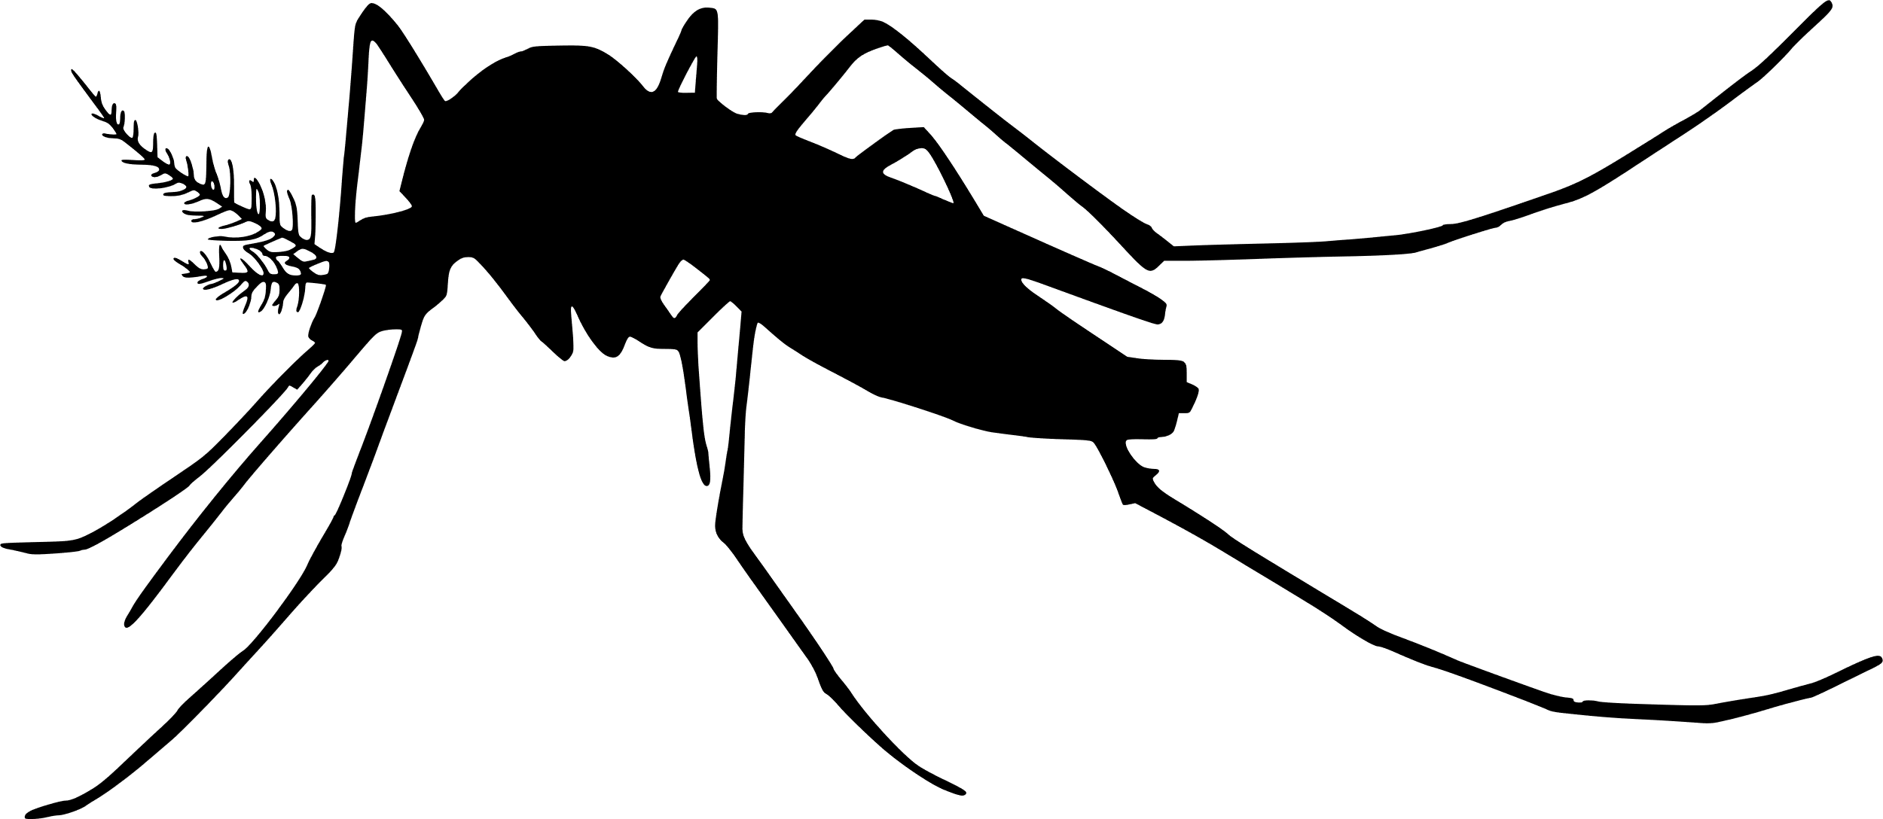
The blood feeding process
Newly-emerged mosquitoes and those that have recently finished ovipositing
Locate host
“Questing”
Landing
Probing
Depart and quest for new host
Feeding failure
Ingesting
Repletion:
Proceed to oviposition stage
Persist on same host
Notes:
Maybe: combine probing, salivation, and feeding then break them out later when focusing on transmission

Slide 2
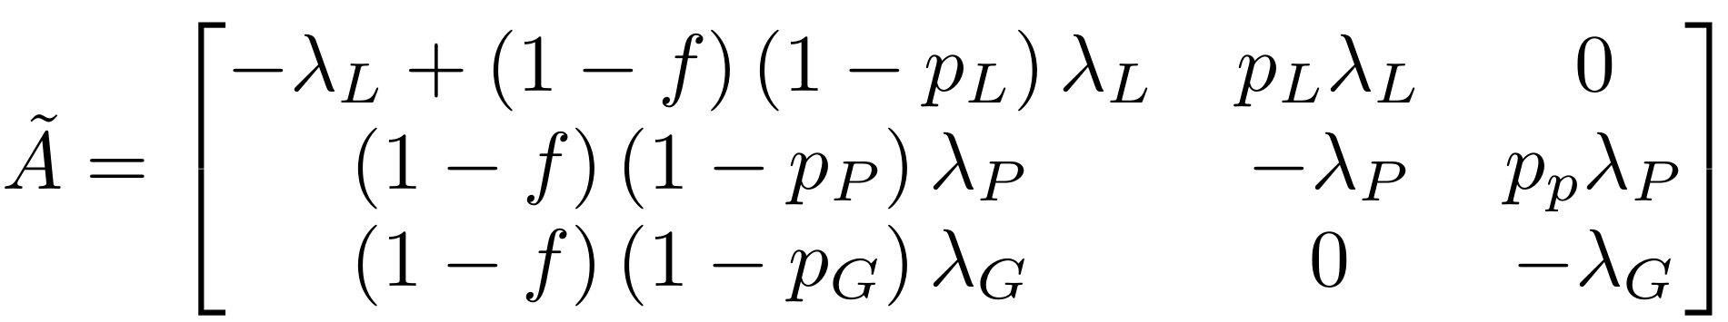








Reduced blood-feeding process
7 parameters total:
- 3 rates (lambda’s)
- 3 failure probabilities (p’s)
f, probability of returning to questing
Two ways to leave the system:
Return to questing
Proceed to oviposition
Landing
$$f\left(1−p_{L}\right)λ_{L}$$
$$p_{L}λ_{L}$$
Probing
$$\left(1−f\right)\left(1−p_{P}\right)λ_{P}$$
$$p_{P}λ_{P}$$
Feeding failure
$$f\left(1−p_{P}\right)λ_{P}$$
Ingesting
$$\left(1−f\right)\left(1−p_{G}\right)λ_{G}$$
$$p_{G}λ_{G}$$
Persist on same host
$$f\left(1−p_{G}\right)λ_{G}$$
Depart and quest for new host
Repletion
Notes:
Maybe: combine probing, salivation, and feeding then break them out later when focusing on transmission

Slide 3
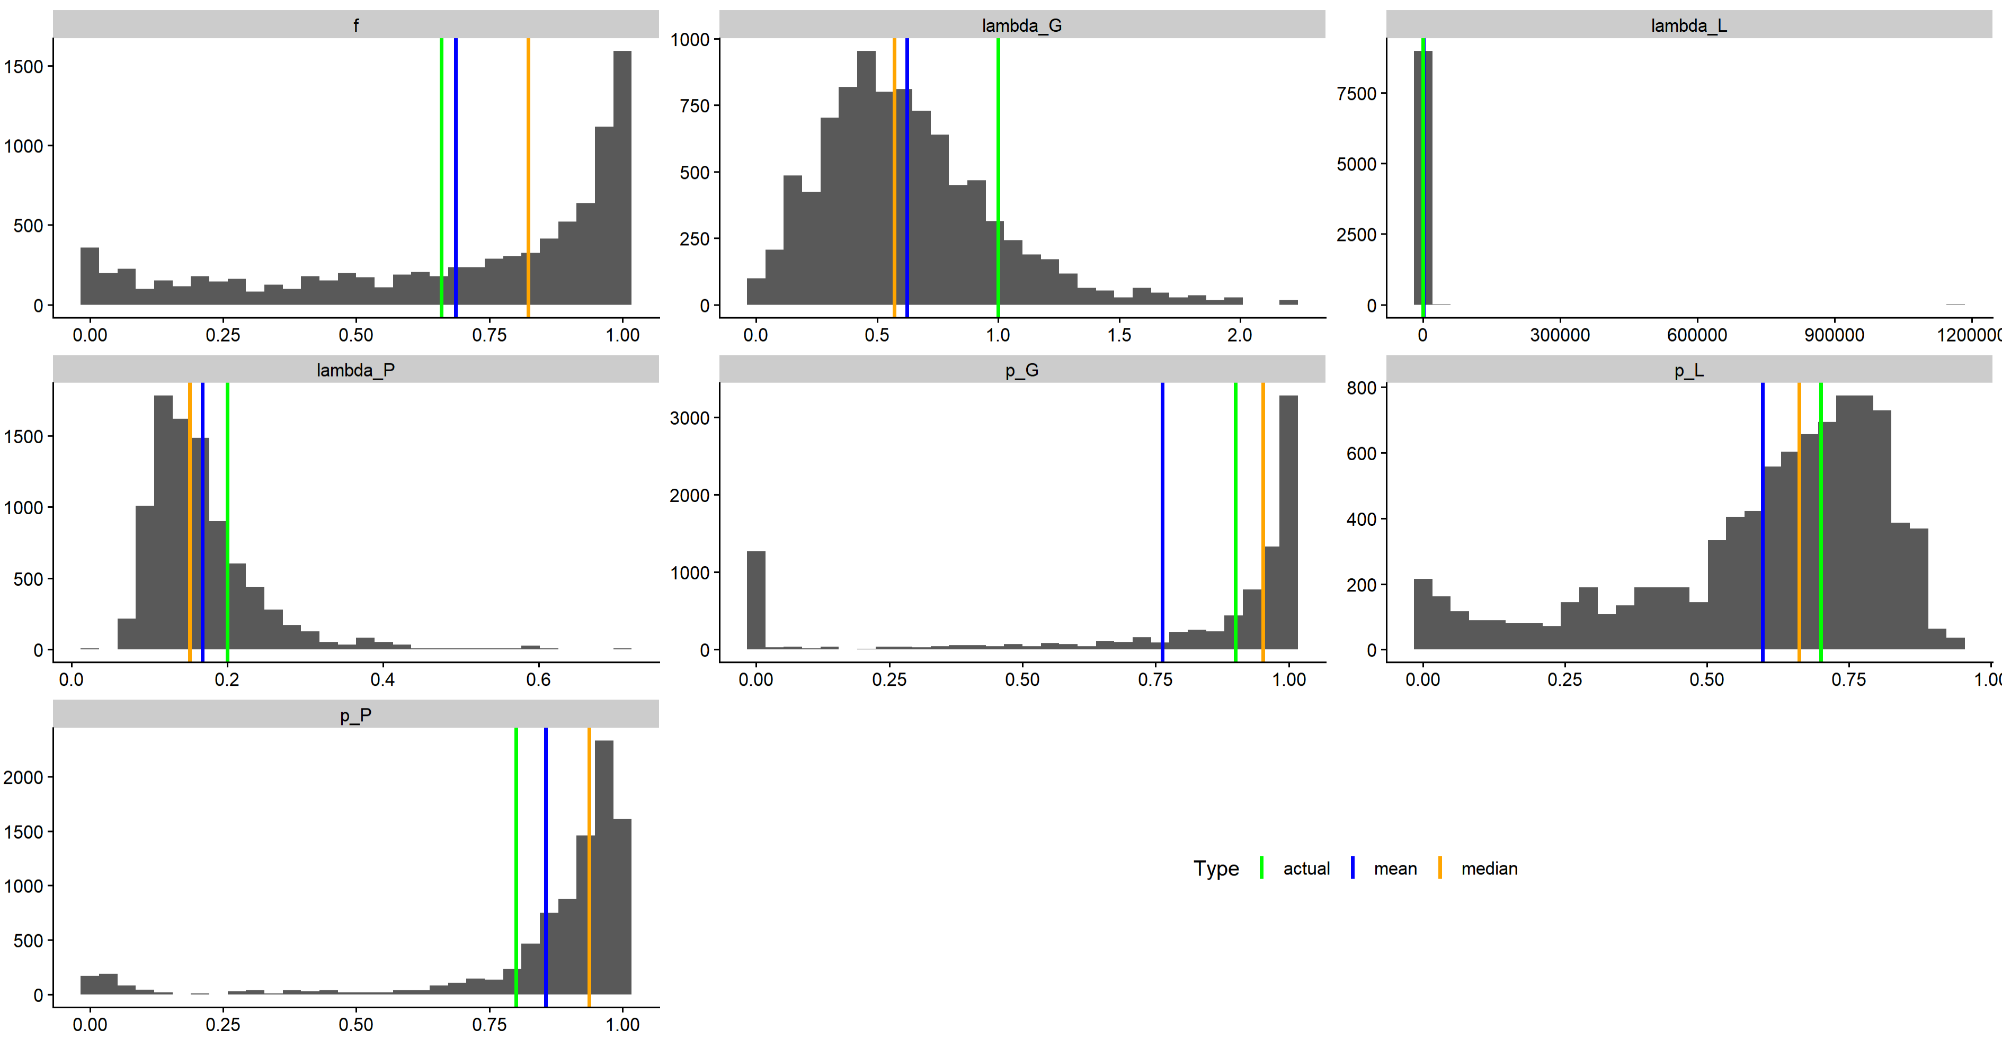







Mechanistic parameter posterior distributions
$f$, probability of returning to questing
$λ_{G}$, rate leaving ingestion stage
$λ_{L}$, rate leaving landing stage
Actual = 0.66
Mean = 0.69
Median = 0.82
Actual = 1
Mean = 0.62
Median = 0.57
Actual = 0.1
Mean = 1191.39
Median = 0.12
$λ_{P}$, rate leaving probing stage
$p_{G}$, Prob. successful ingestion
$p_{L}$, Prob. successful landing
Actual = 0.2
Mean = 0.17
Median = 0.15
Actual = 0.9
Mean = 0.76
Median = 0.95
Actual = 0.7
Mean = 0.60
Median = 0.66
$p_{P}$, Prob. successful probing
Actual = 0.8
Mean = 0.86
Median = 0.94

Slide 4
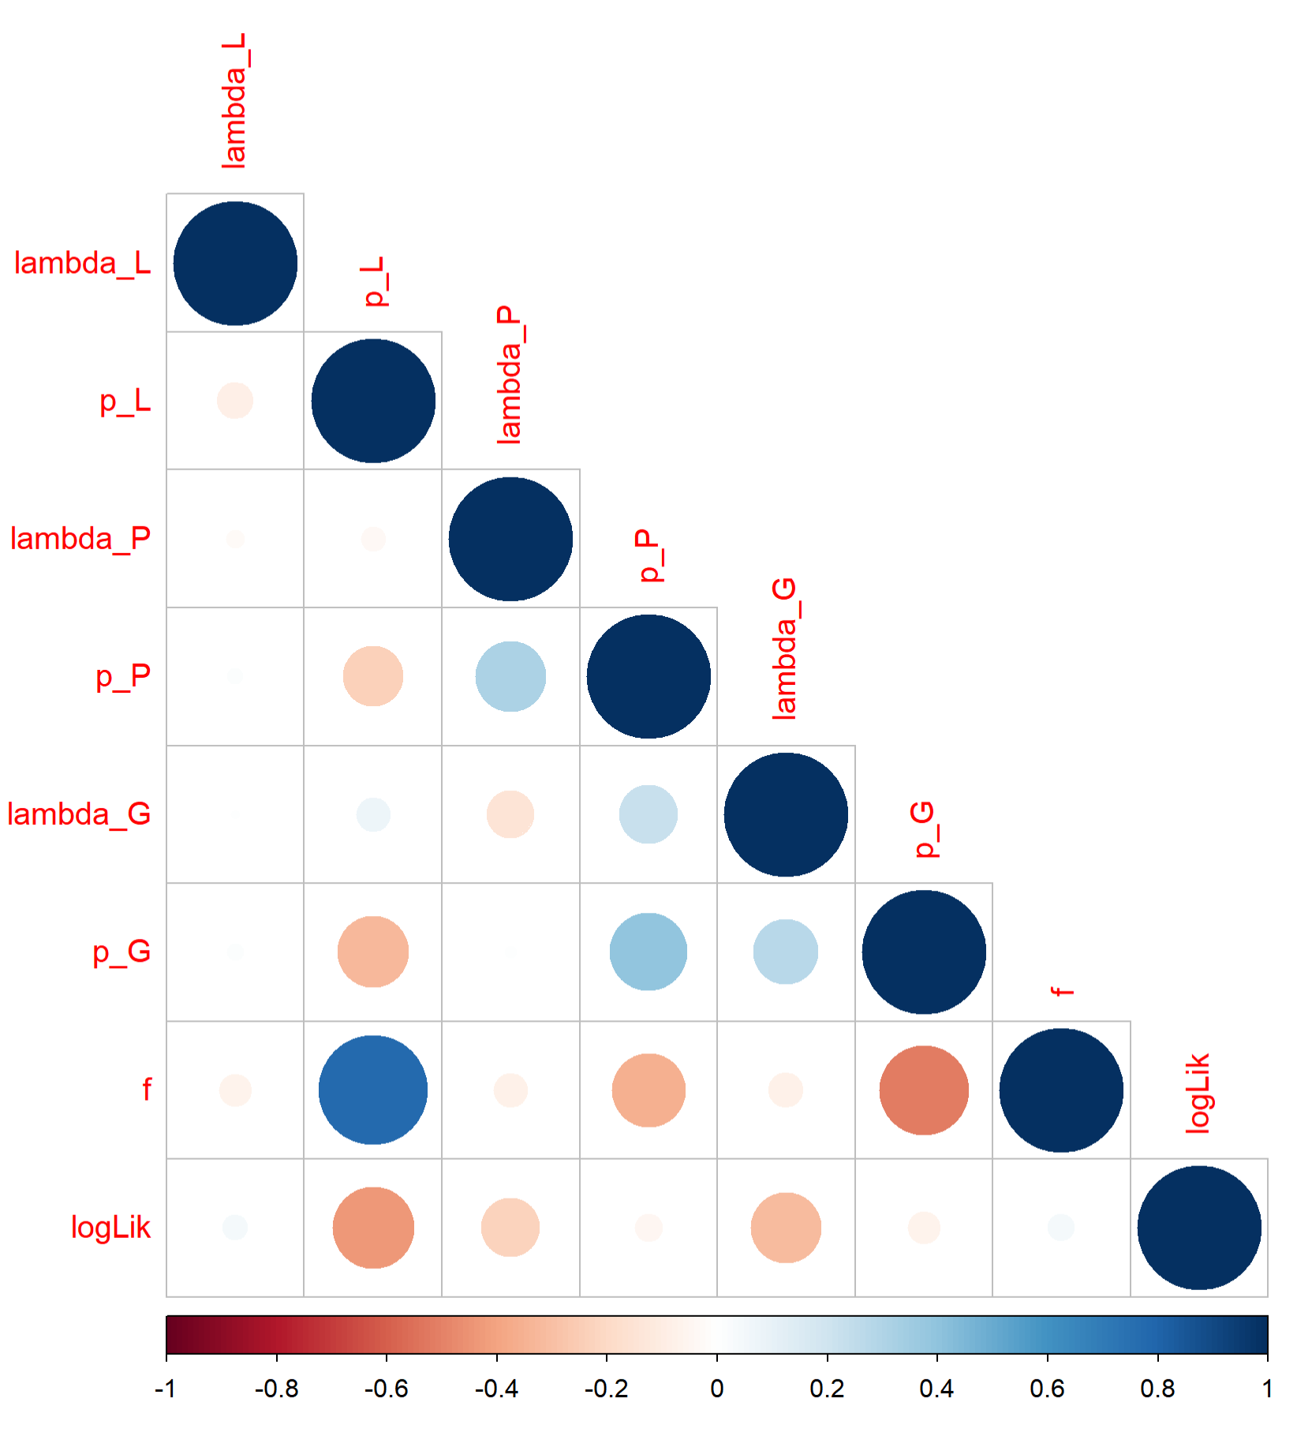

Correlations among fitted mechanistic parameters
$f$ and $p_{L}$strongly correlated
- Correlations of $p_{L}$ and $λ_{G}$with log(Likelihood) suggest the fitting method is not converging well

Slide 5
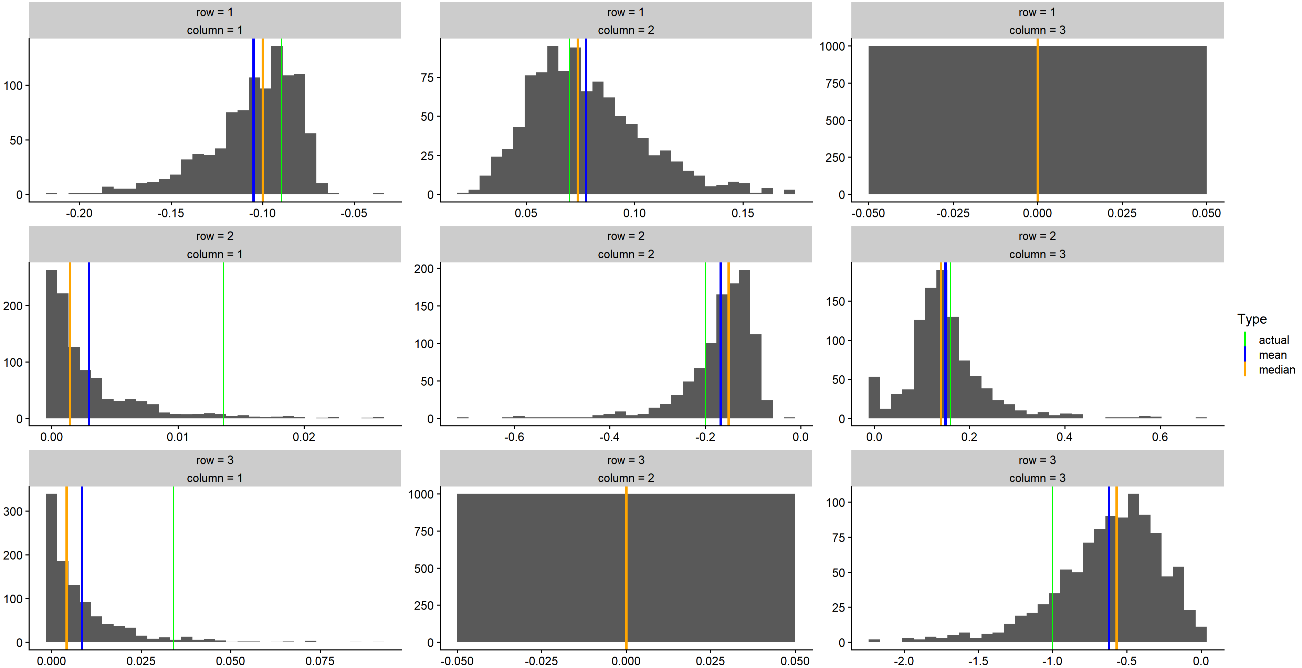
Mechanistic matrix entry posterior distributions

Slide 6
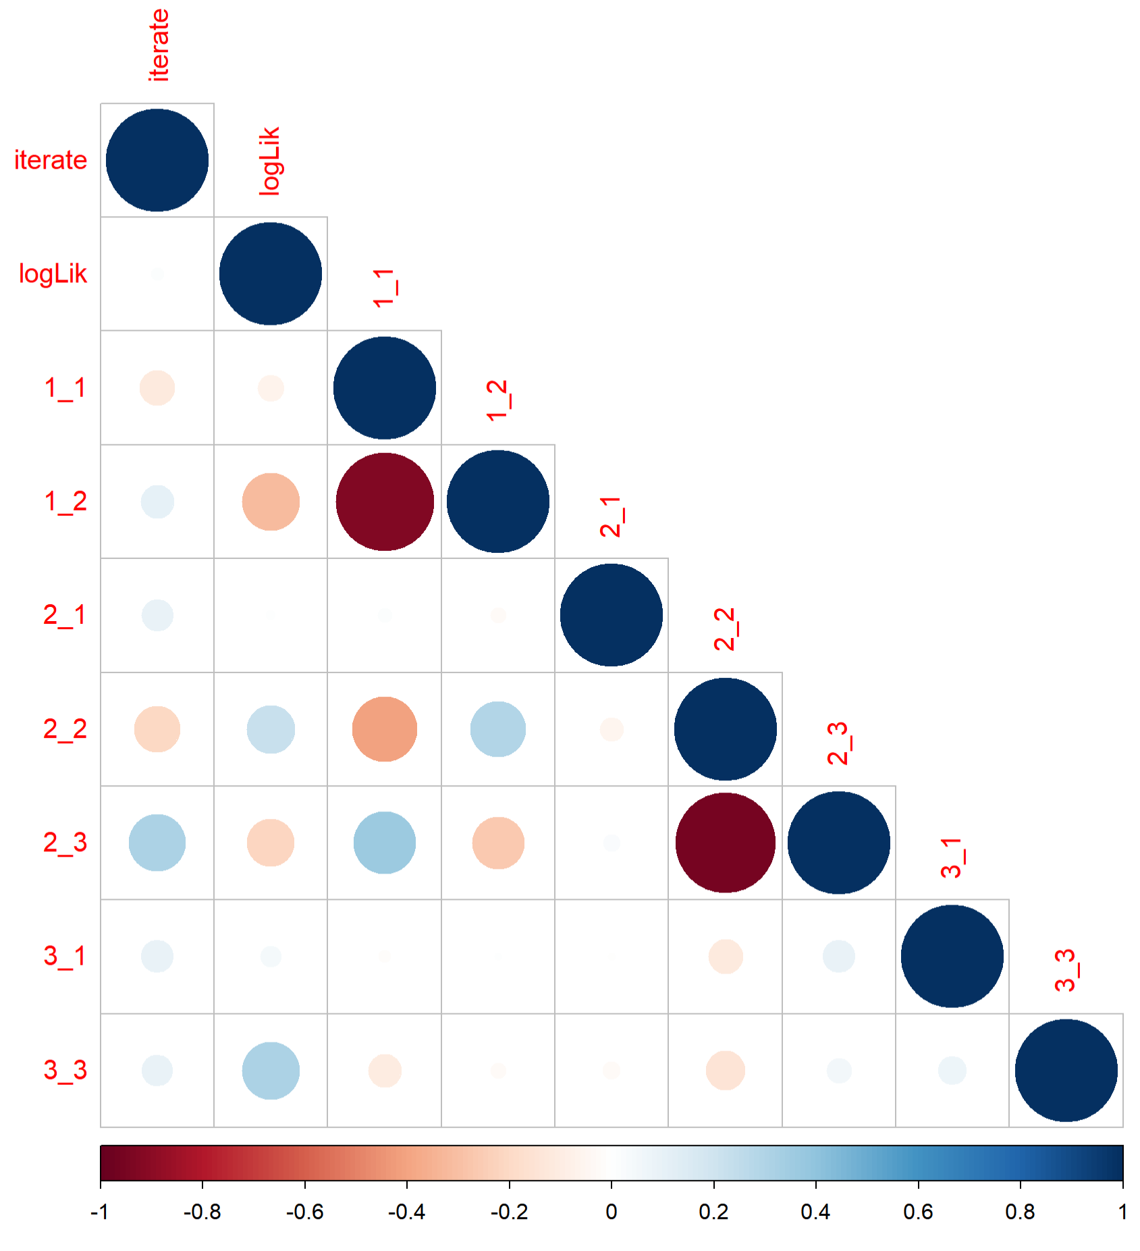

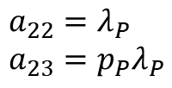
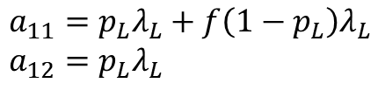
Correlations among fitted mechanistic parameters
$a_{12}$ and $a_{11}$ strongly positively correlated
$a_{23}$ and $a_{22}$ strongly positively correlated
Possibly due to $p_{P}≈1$
- No strong correlations between log(Likelihood) and any of the matrix entries
$$a_{11}=p_{L}λ_{L}+f\left(1−p_{L}\right)λ_{L} \\ a_{12}=p_{L}λ_{L}$$
$$a_{22}=λ_{P} \\ a_{23}=p_{P}λ_{P}$$

Slide 7
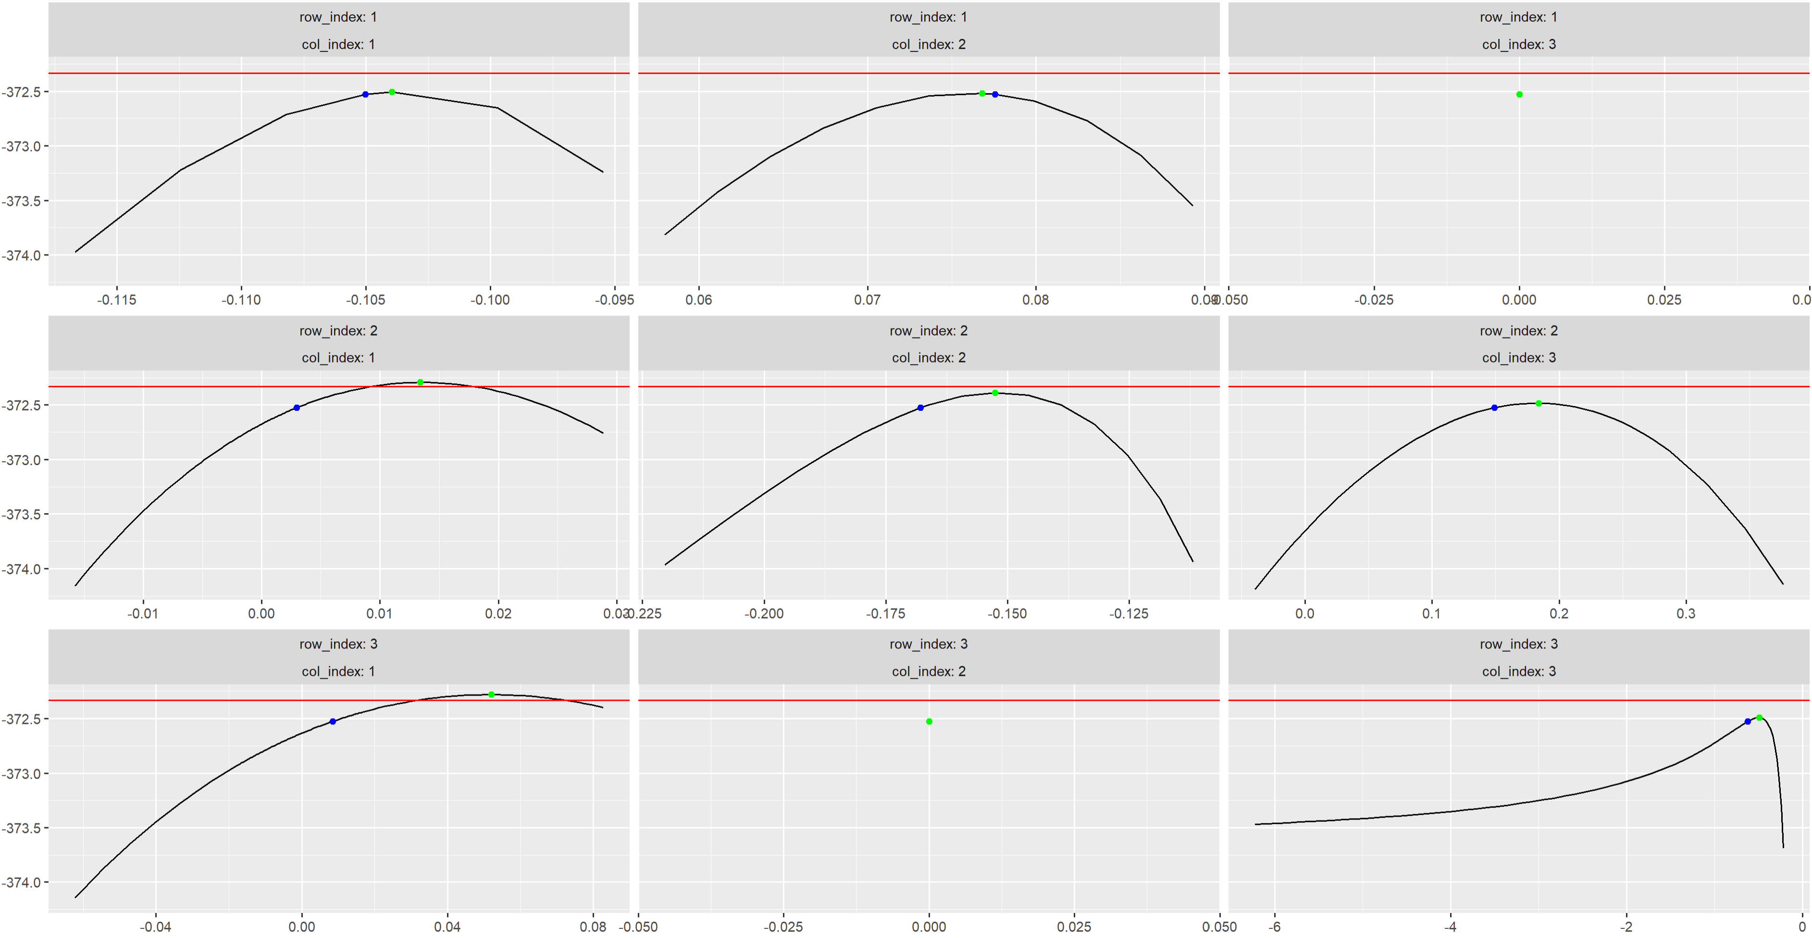
Profile likelihood analysis

