Slide 1

The blood feeding process
Newly-emerged mosquitoes and those that have recently finished ovipositing
Locate host
“Questing”
Landing
Probing
Depart and quest for new host
Feeding failure
Ingesting
Repletion:
Proceed to oviposition stage
Persist on same host
Notes:
Maybe: combine probing, salivation, and feeding then break them out later when focusing on transmission

Slide 2
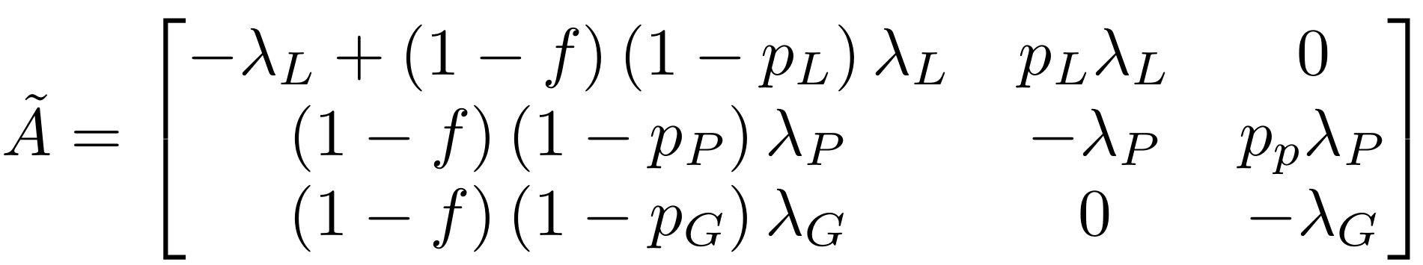








Reduced blood-feeding process
7 parameters total:
- 3 rates (lambda’s)
- 3 failure probabilities (p’s)
f, probability of returning to questing
Two ways to leave the system:
Return to questing
Proceed to oviposition
Landing
$$f\left(1−p_{L}\right)λ_{L}$$
$$p_{L}λ_{L}$$
Probing
$$\left(1−f\right)\left(1−p_{P}\right)λ_{P}$$
$$p_{P}λ_{P}$$
Feeding failure
$$f\left(1−p_{P}\right)λ_{P}$$
Ingesting
$$\left(1−f\right)\left(1−p_{G}\right)λ_{G}$$
$$p_{G}λ_{G}$$
Persist on same host
$$f\left(1−p_{G}\right)λ_{G}$$
Depart and quest for new host
Repletion
Notes:
Maybe: combine probing, salivation, and feeding then break them out later when focusing on transmission

Slide 3
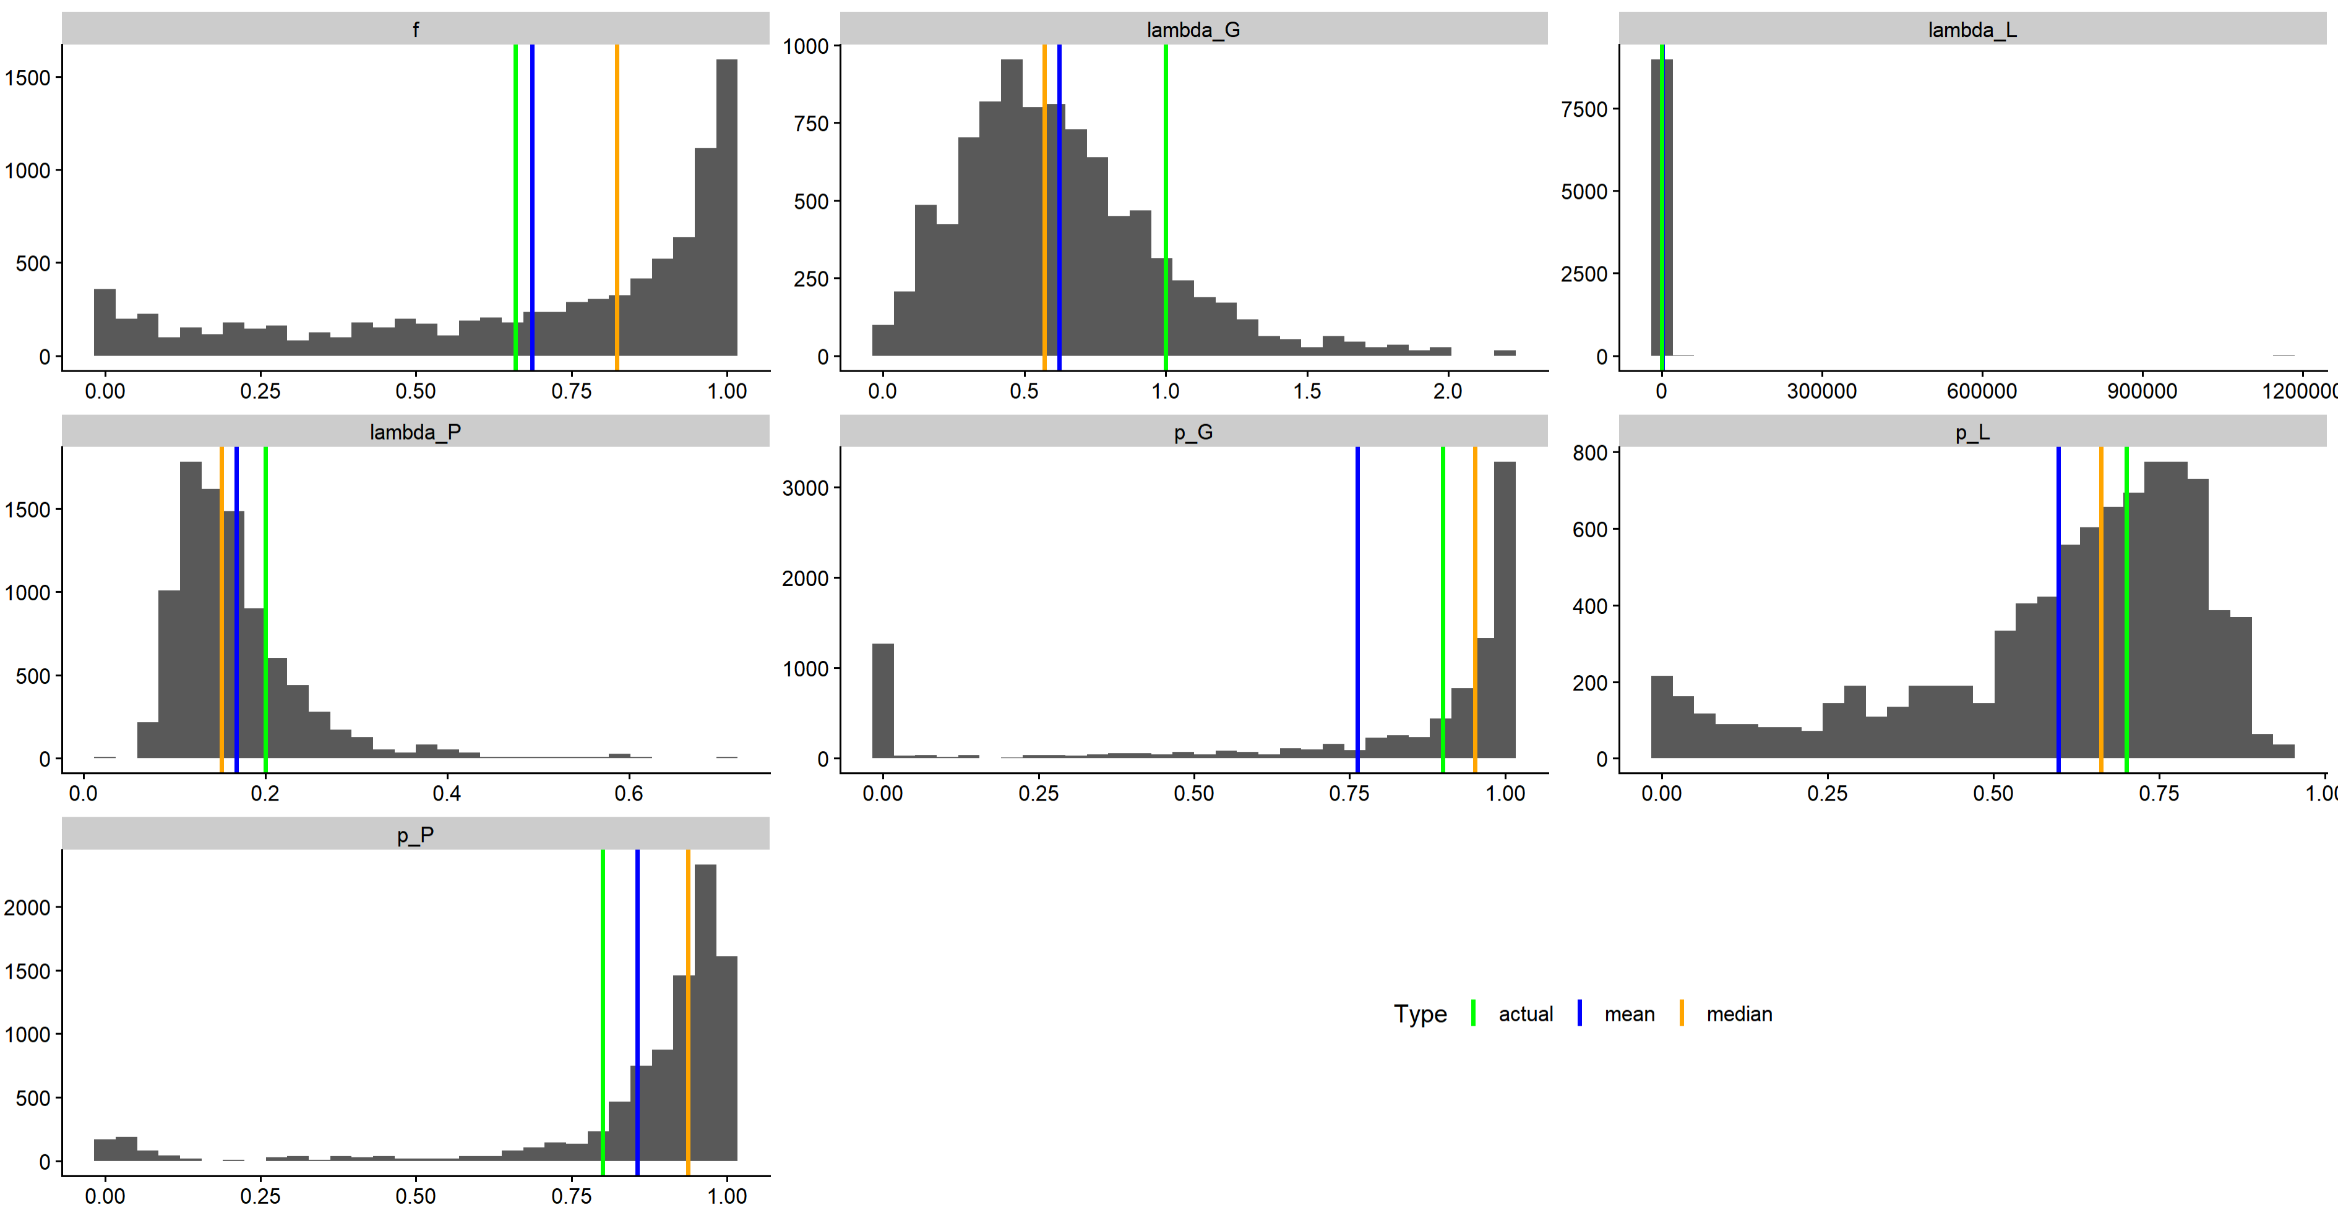







Mechanistic parameter posterior distributions
$f$, probability of returning to questing
$λ_{G}$, rate leaving ingestion stage
$λ_{L}$, rate leaving landing stage
Actual = 0.66
Mean = 0.69
Median = 0.82
Actual = 1
Mean = 0.62
Median = 0.57
Actual = 0.1
Mean = 1191.39
Median = 0.12
$λ_{P}$, rate leaving probing stage
$p_{G}$, Prob. successful ingestion
$p_{L}$, Prob. successful landing
Actual = 0.2
Mean = 0.17
Median = 0.15
Actual = 0.9
Mean = 0.76
Median = 0.95
Actual = 0.7
Mean = 0.60
Median = 0.66
$p_{P}$, Prob. successful probing
Actual = 0.8
Mean = 0.86
Median = 0.94

Slide 4
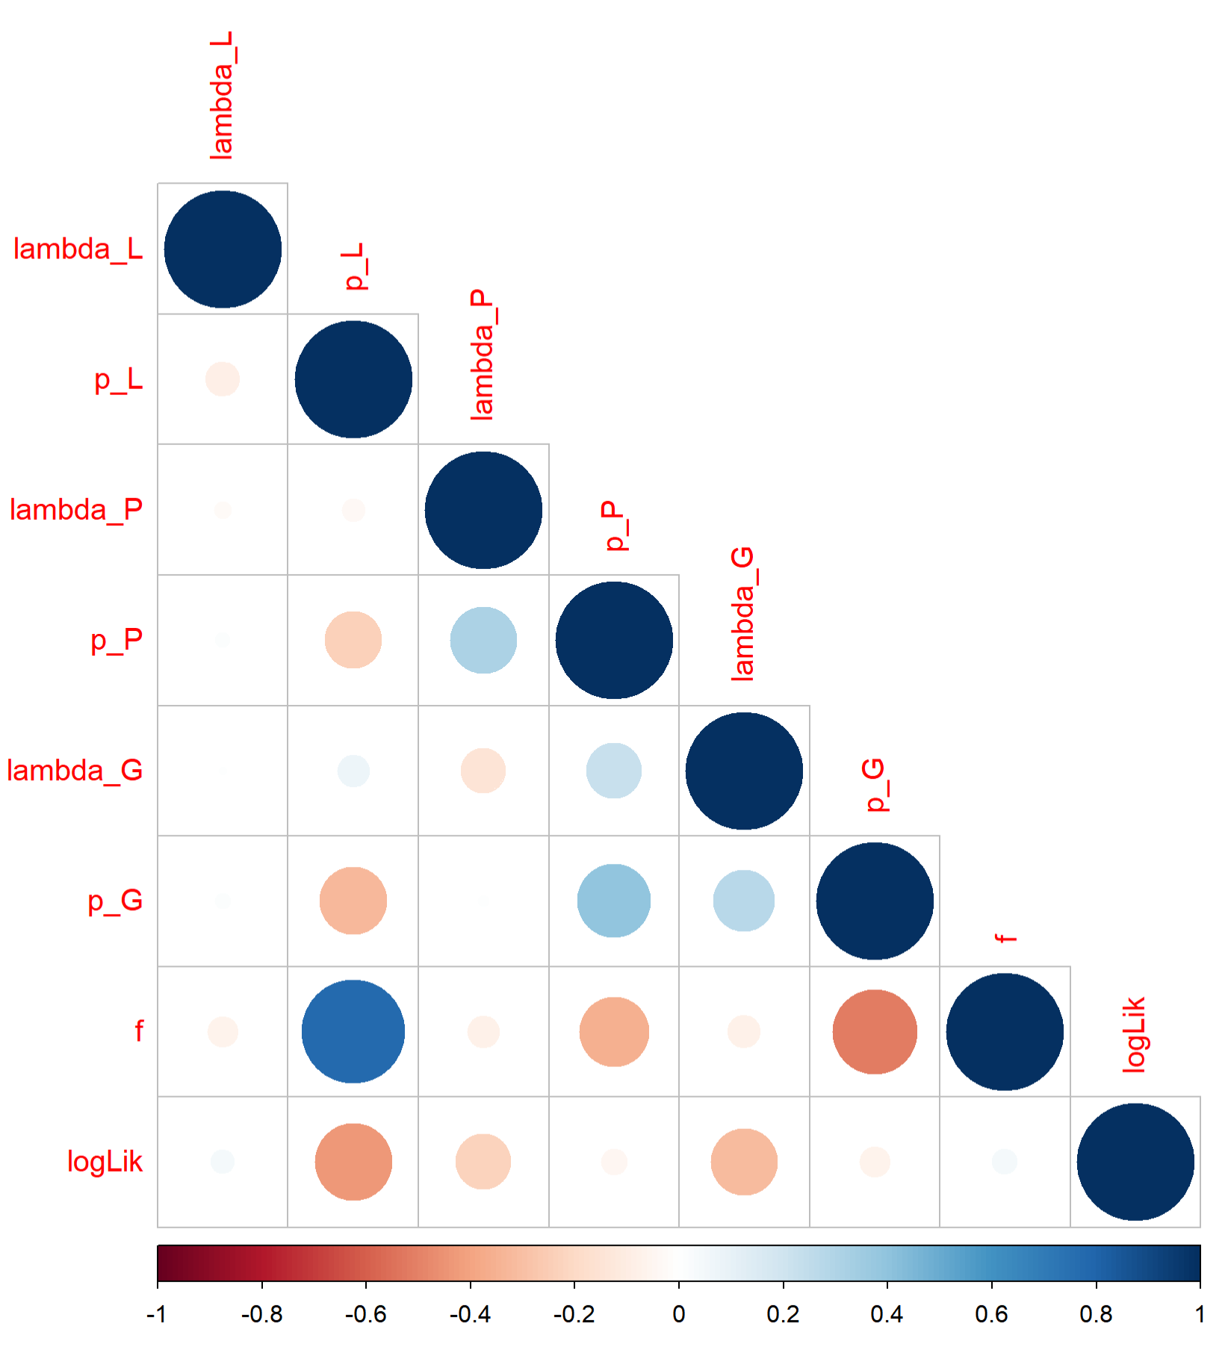

Correlations among fitted mechanistic parameters
$f$ and $p_{L}$strongly correlated
- Correlations of $p_{L}$ and $λ_{G}$with log(Likelihood) suggest the fitting method is not converging well

Slide 5
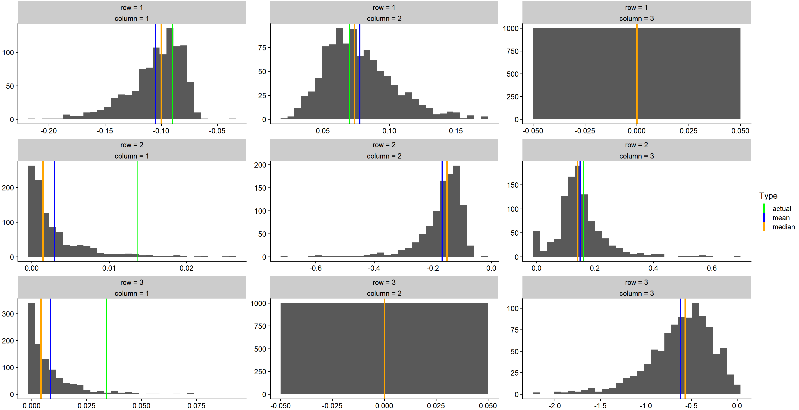
Mechanistic matrix entry posterior distributions

Slide 6
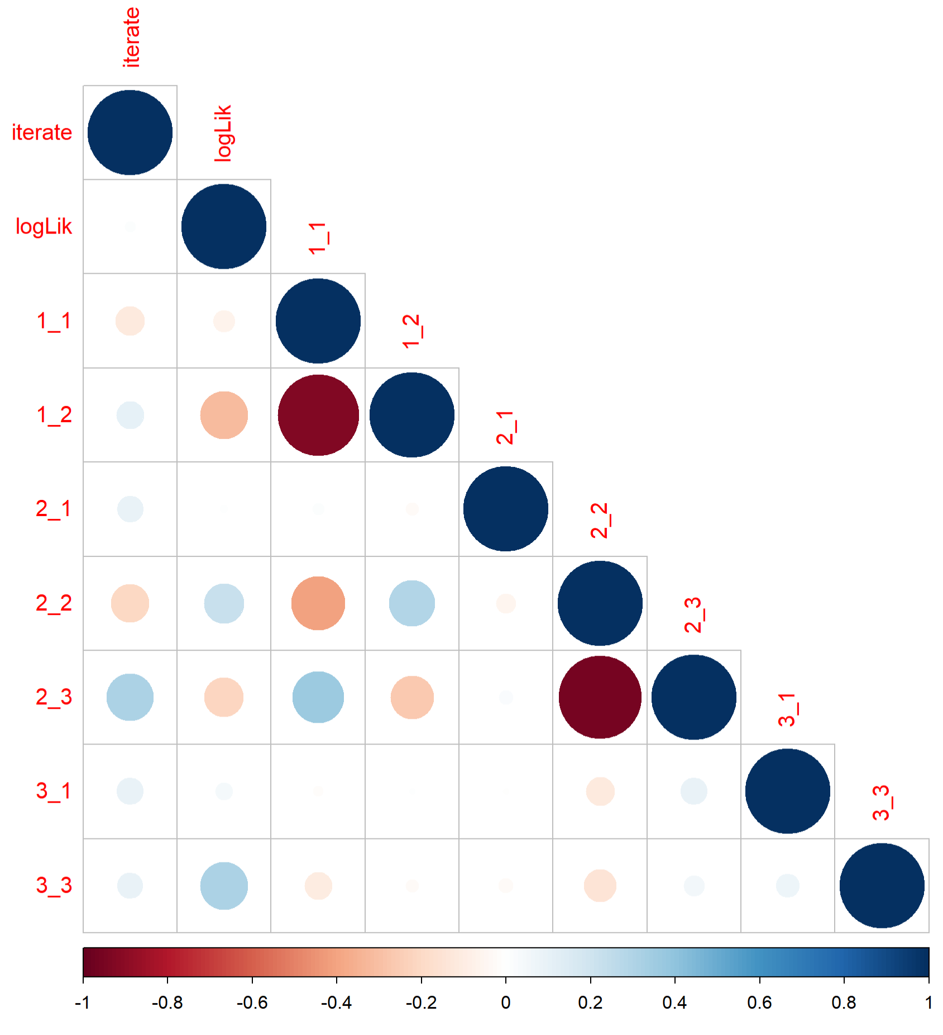

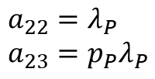
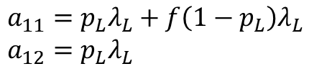
Correlations among fitted mechanistic parameters
$a_{12}$ and $a_{11}$ strongly positively correlated
$a_{23}$ and $a_{22}$ strongly positively correlated
Possibly due to $p_{P}≈1$
- No strong correlations between log(Likelihood) and any of the matrix entries
$$a_{11}=p_{L}λ_{L}+f\left(1−p_{L}\right)λ_{L} \\ a_{12}=p_{L}λ_{L}$$
$$a_{22}=λ_{P} \\ a_{23}=p_{P}λ_{P}$$

Slide 7
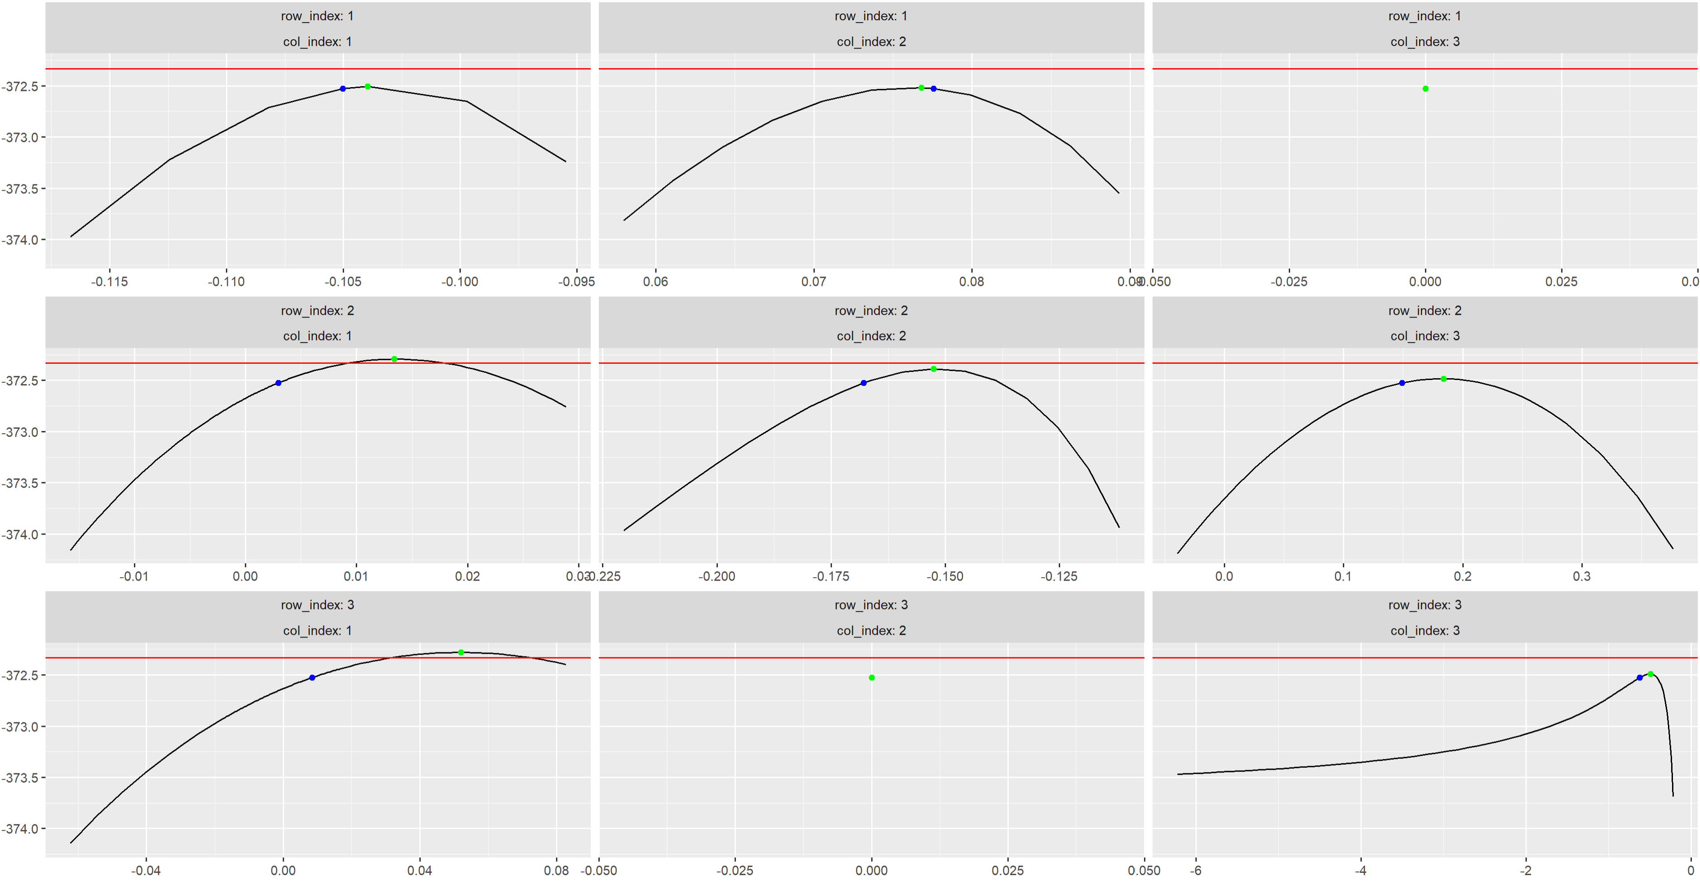
Profile likelihood analysis

Slide 8
Sensitivity analysis process
For each sample of parameters from the fitting process,
Vary each parameter (+ a dummy) from 25% to 175% of its sample value
Calculate R0 and R (mosq. pop. reproductive number)
Calculate PRCCs of R0 and R wrt each parameter
Importance of each parameter is decided by
(Necessary) the probability that it’s PRCC value is significantly different from the dummy variable’s – t-test
(Sufficient) Mean PRCC value far away from zero

Slide 9
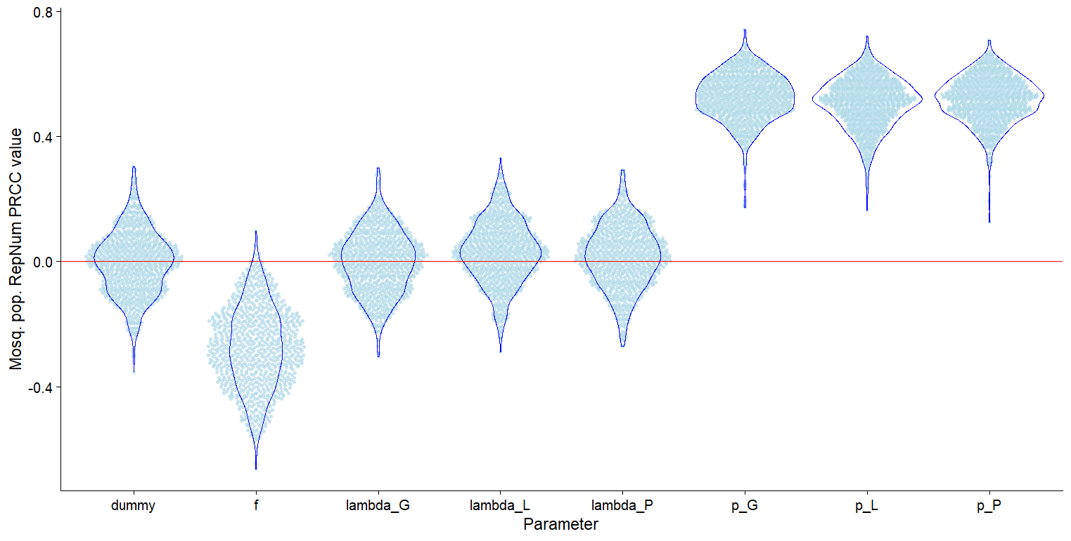

Slide 10
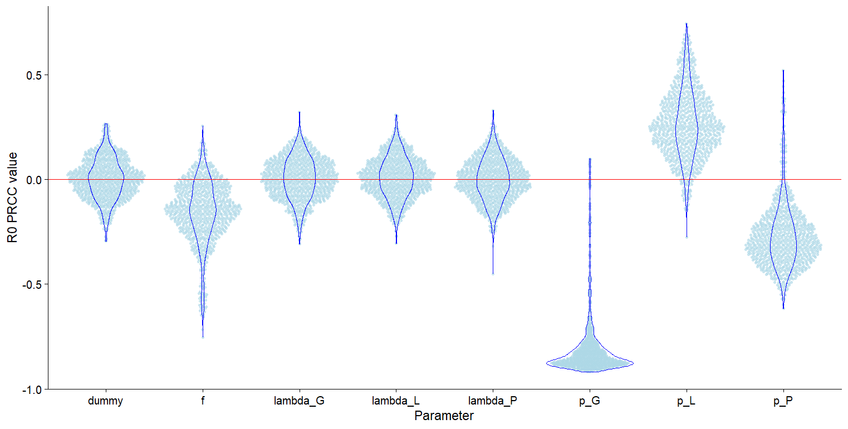

Slide 11
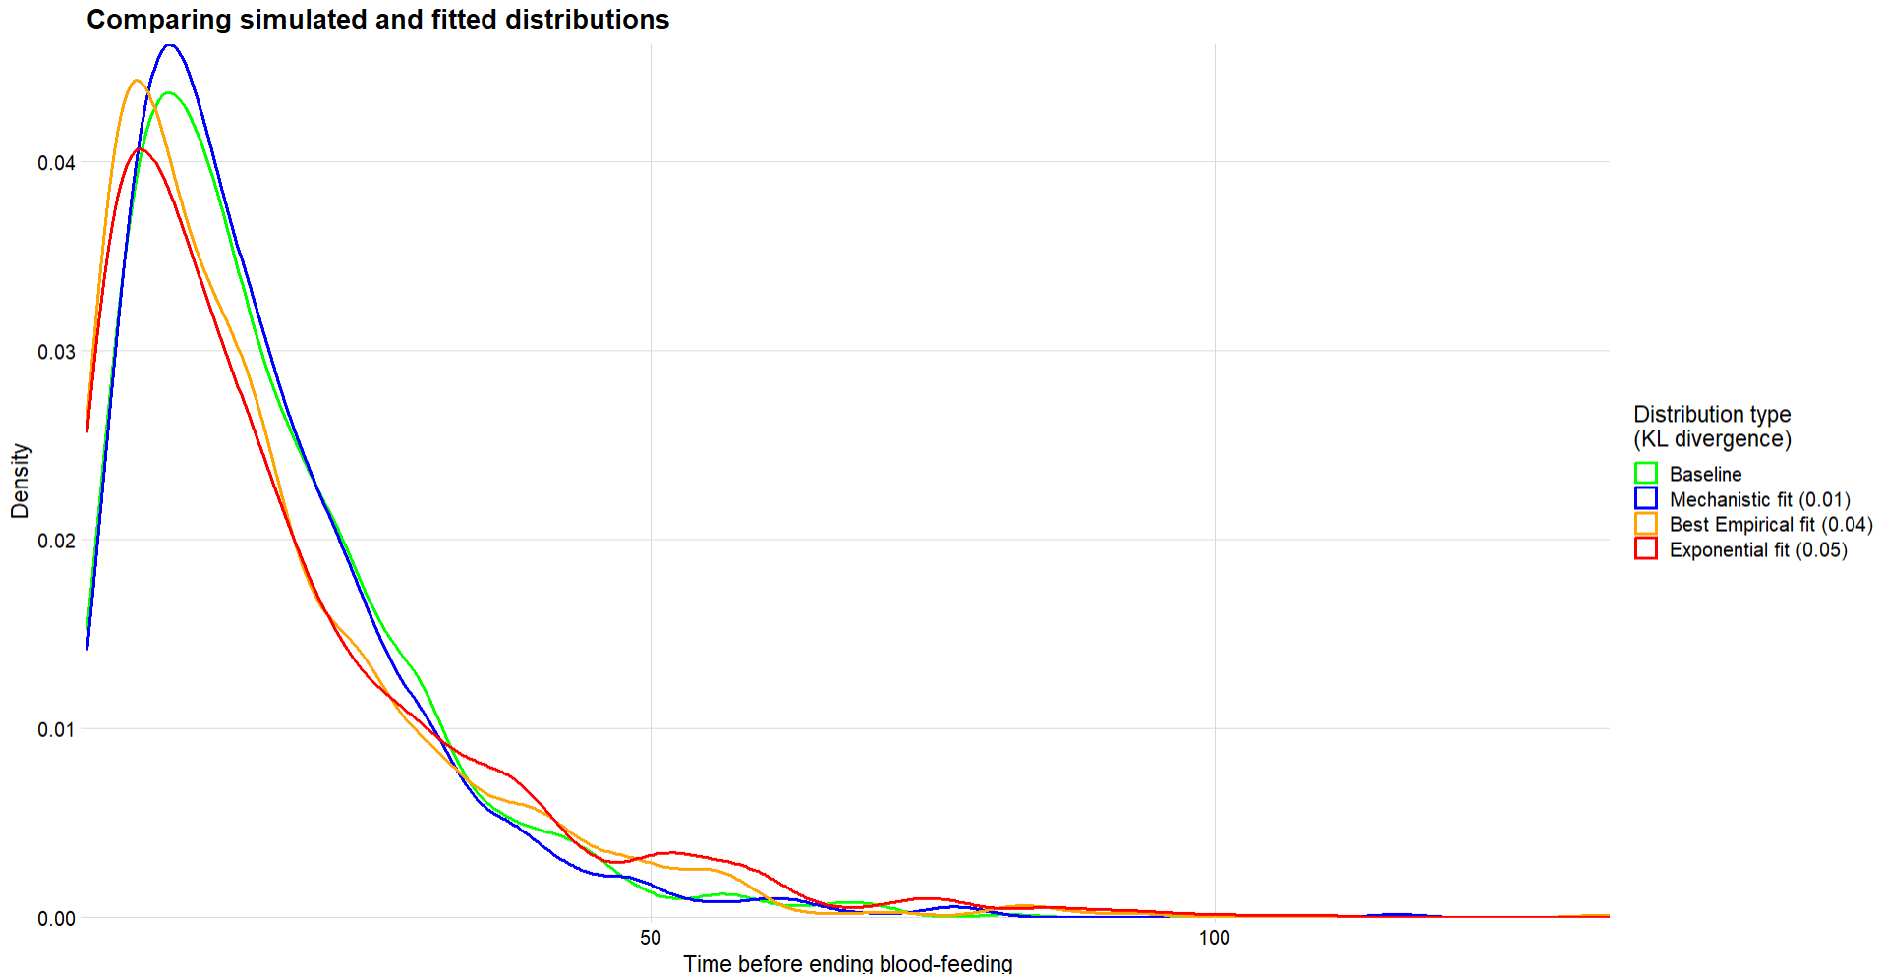

Slide 12
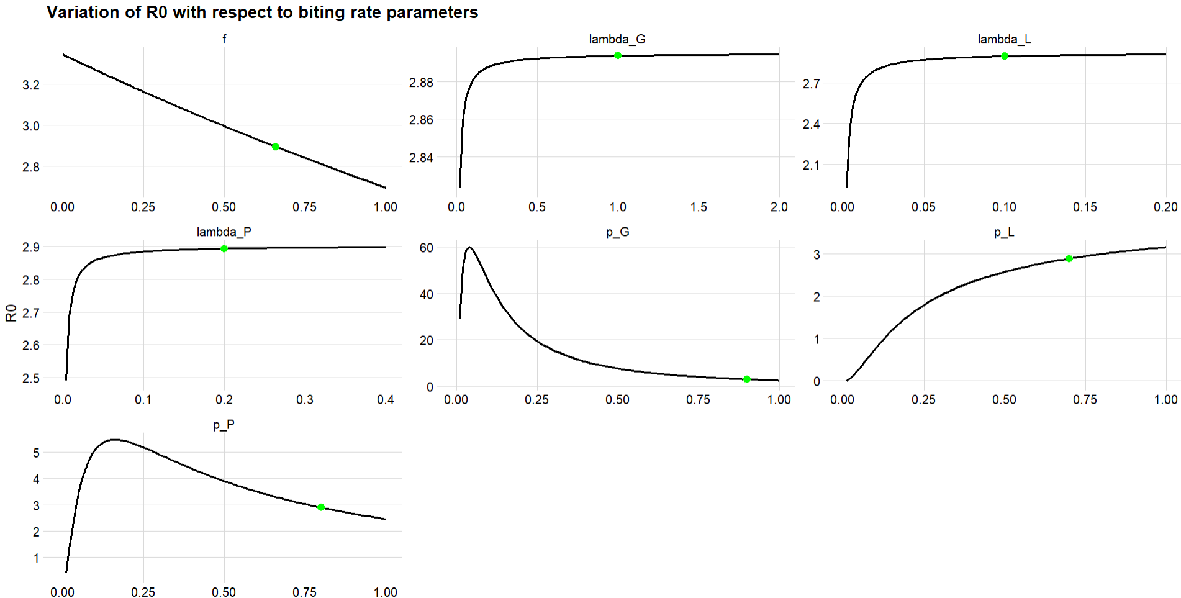

Slide 13
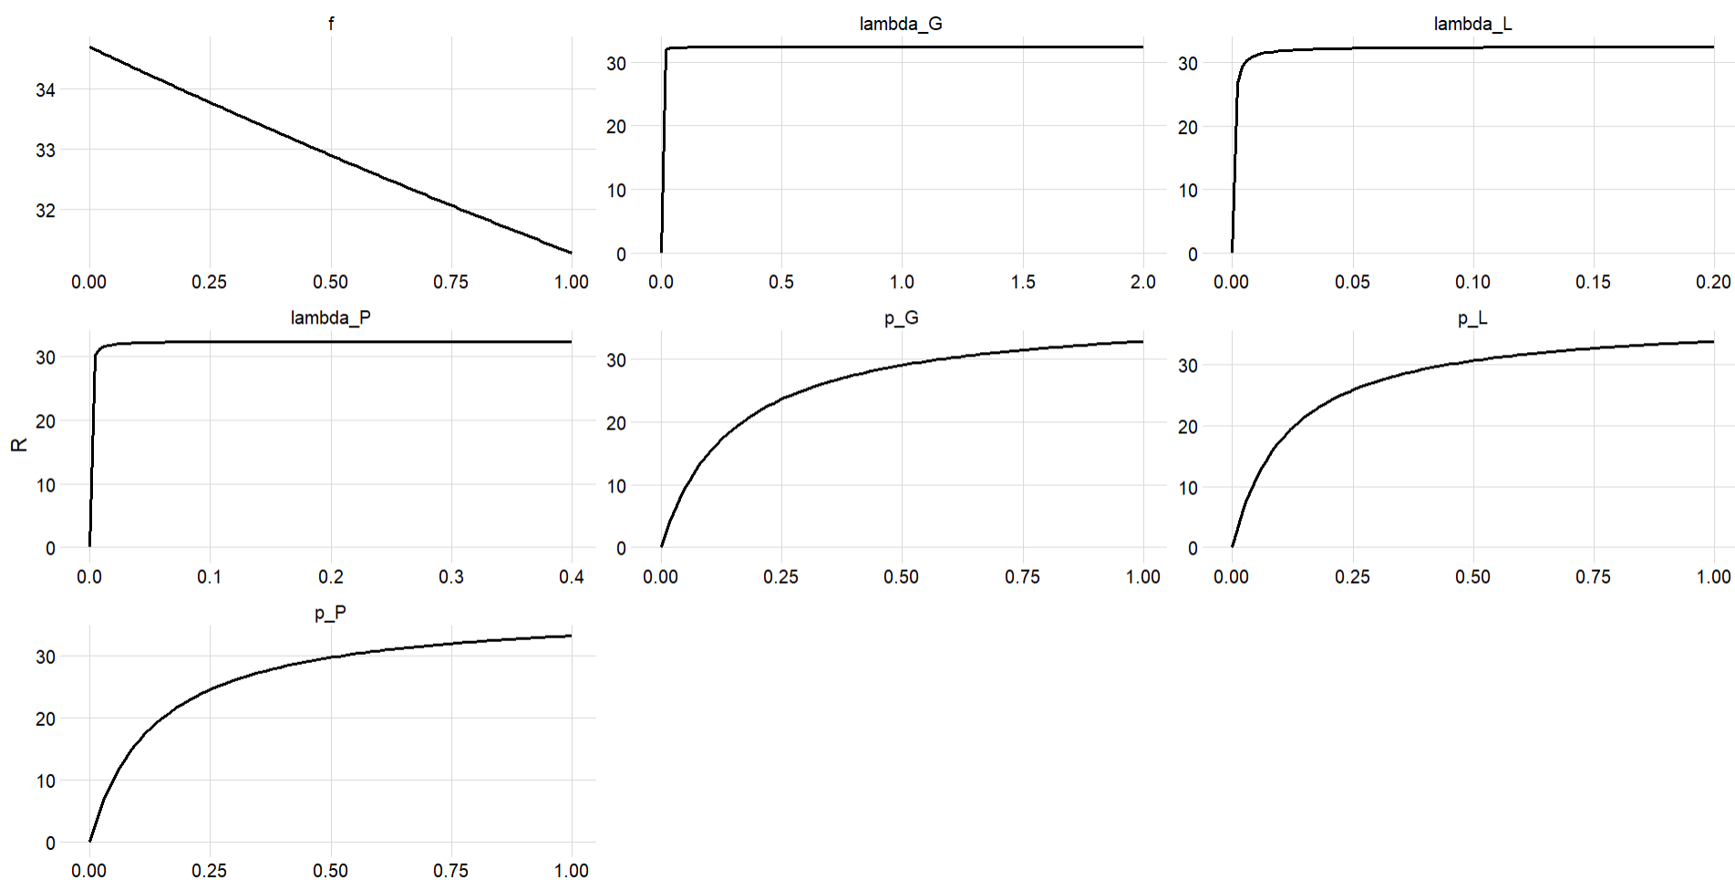
Mosquito population reproductive number

Slide 14
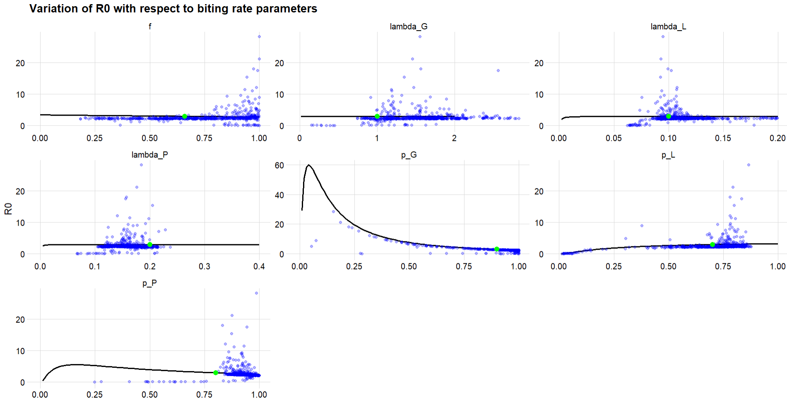
Blue points are sampled from posterior distributions of fitted parameters (parameter values are correlated)

Slide 15
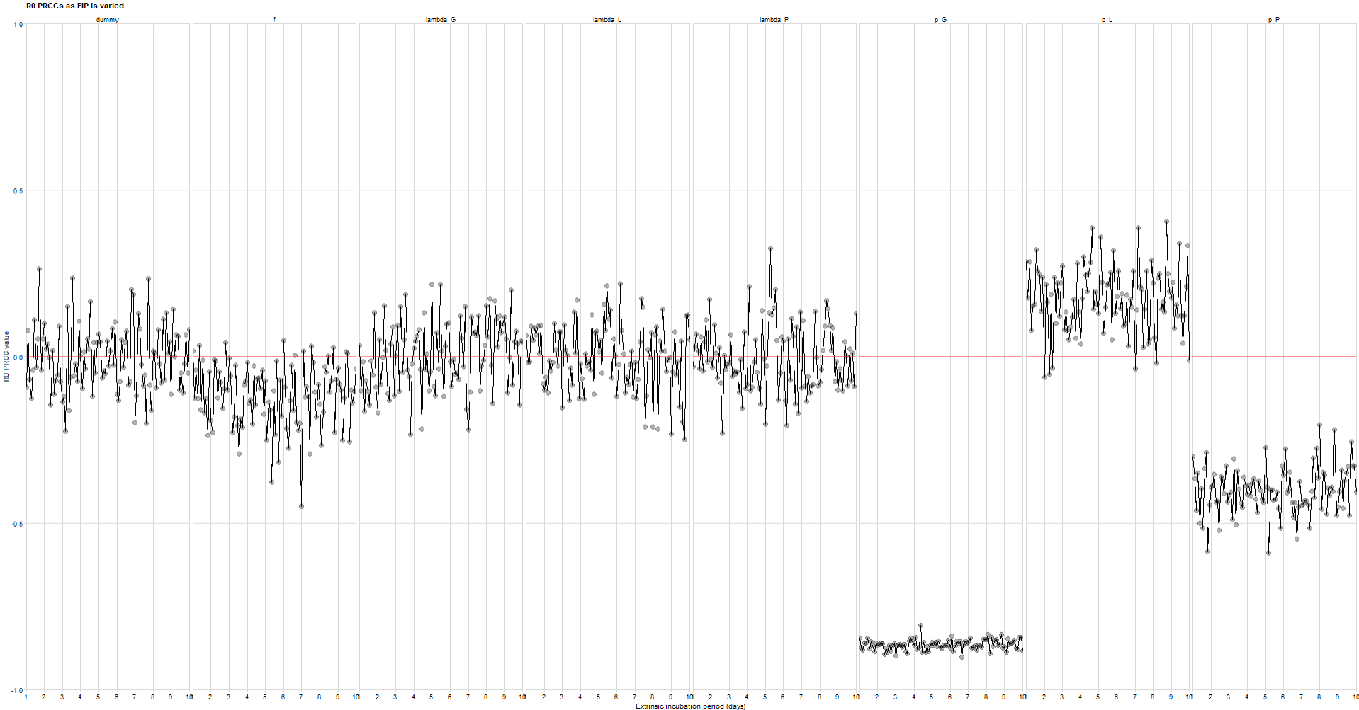

Slide 16
