Slide 1
Parameter name | Value |  | Parameter name | Value
Mosquito lifespan | 20 days |  | Average host-seeking duration | 8 hours
Oviposition period | 5 days |  | Seek-new-host probability | 50%
Resting period | 2 days |  | Landing success probability | 50%
Eggs per female per day | 300 eggs per female per day |  | Exit rate from landing stage | 1/(10 minutes)
Larval development period | 12 days |  | Probing success probability | 50%
Larvae survival probability | 62.5% |  | Exit rate from probing stage | 1/(5 minutes)
Larvae carrying capacity | 30 billion |  | Ingestion success probability | 50%
Extrinsic incubation period | 6 days |  | Exit rate from ingestion stage | 1/(1 minutes)
Host-to-vector transmission probability | 1%
Vector-to-host transmission probability | 1%
Host infectious period | 7 days
Host lifespan | 65 years
Host carrying capacity | 10 million
Notes:
Table of baseline parameter values

Slide 2
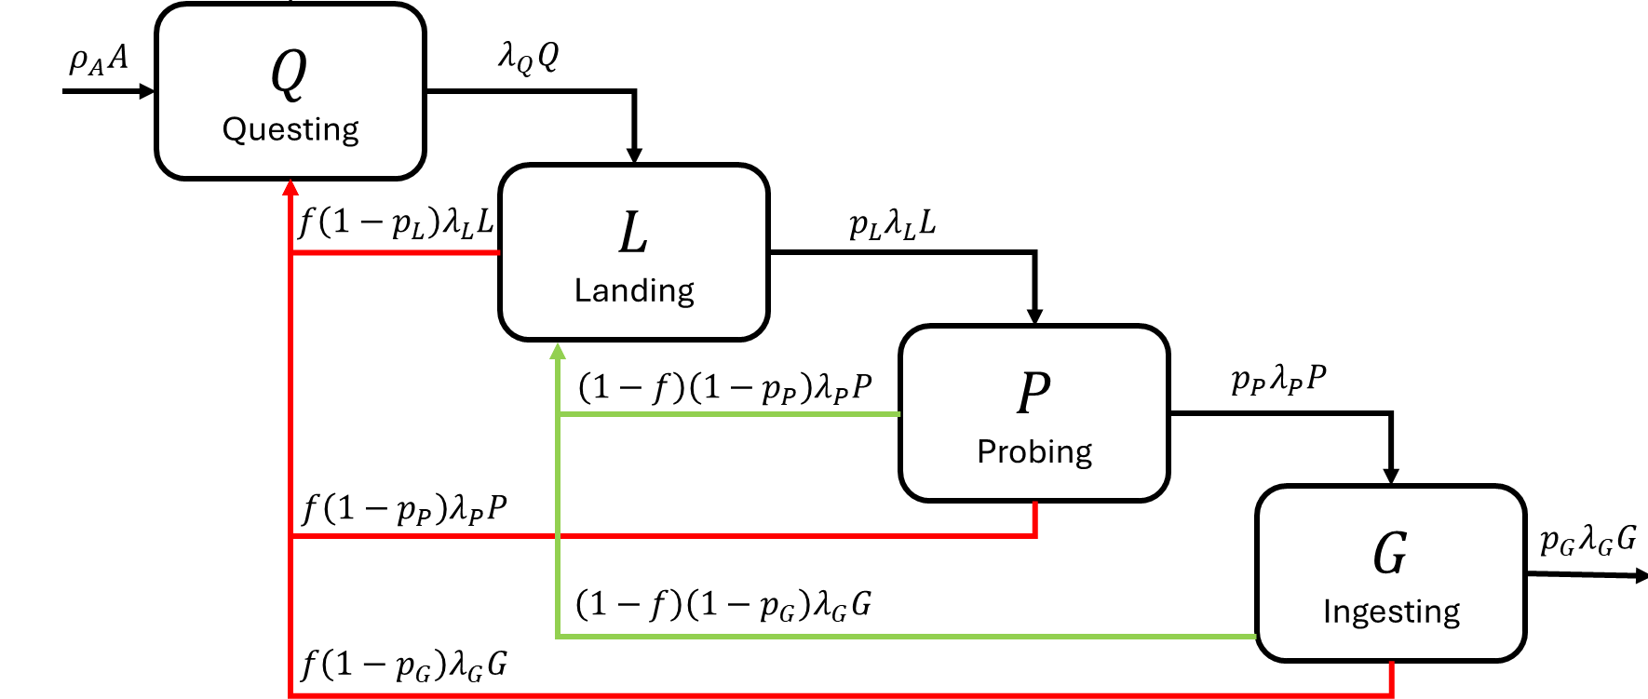
Are contacts counted by entrance or exit?
Do transmissive contacts occur upon entering a state or exiting it ?

Slide 3


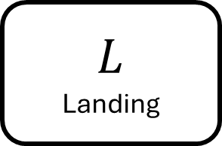


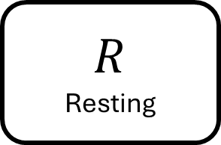



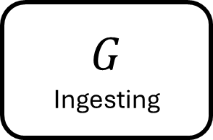
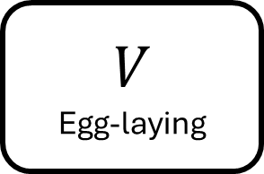

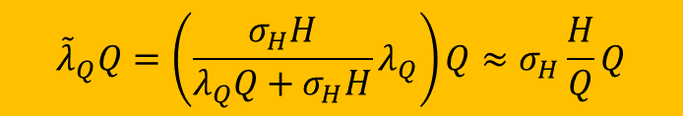
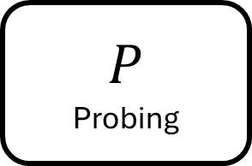


When does density-dependence matter?
Not at the point of transmission, but during host-seeking.
Not yet implemented!
$$γ_{R}R$$
$${\tilde{λ}}_{Q}Q=\left(\frac{σ_{H}H}{λ_{Q}Q+σ_{H}H}λ_{Q}\right)Q≈σ_{H}\frac{H}{Q}Q$$
$$Q$$
Questing
$$R$$
Resting
$$ρ_{A}A$$
$$L$$
Landing
$$f\left(1−p_{L}\right)λ_{L}L$$
$$p_{L}λ_{L}L$$
$$γ_{V}V$$
$$P$$
Probing
$$\left(1−f\right)\left(1−p_{P}\right)λ_{P}P$$
$$p_{P}λ_{P}P$$
$$f\left(1−p_{P}\right)λ_{P}P$$
$$G$$
Ingesting
$$V$$
Egg-laying
$$p_{G}λ_{G}G$$
$$\left(1−f\right)\left(1−p_{G}\right)λ_{G}G$$
$$f\left(1−p_{G}\right)λ_{G}G$$

Slide 4
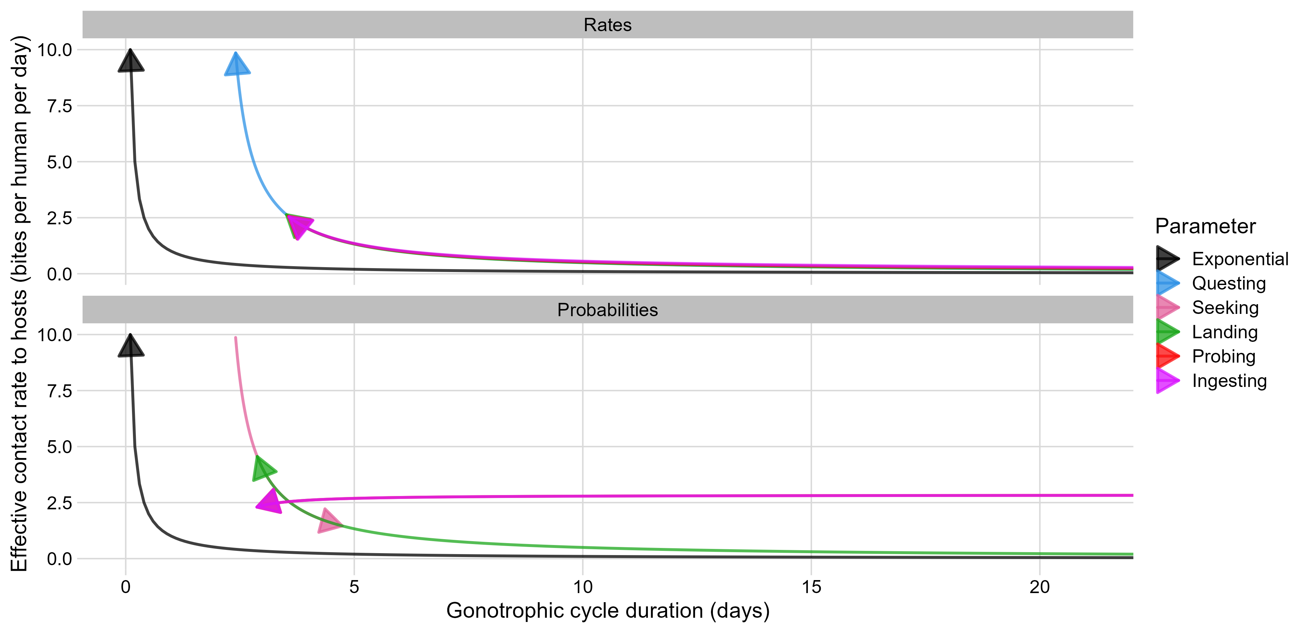
Host contact rate as a function of Gonotrophic cycle duration
Arrows point in the direction of increasing parameter value

Slide 5
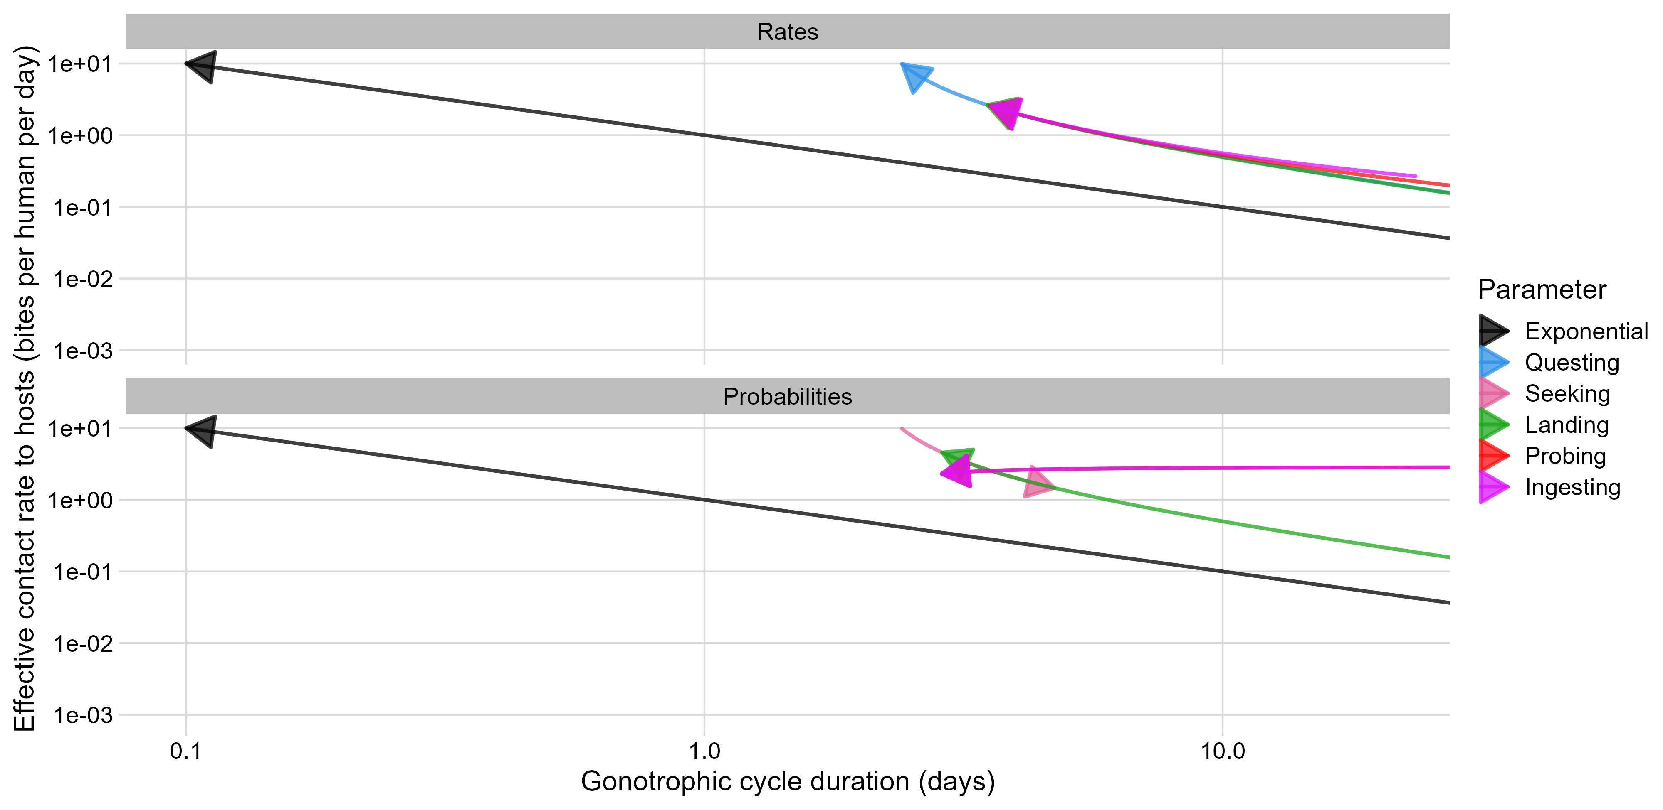
Host contact rate as a function of Gonotrophic cycle duration (on a log-log scale)

Slide 6
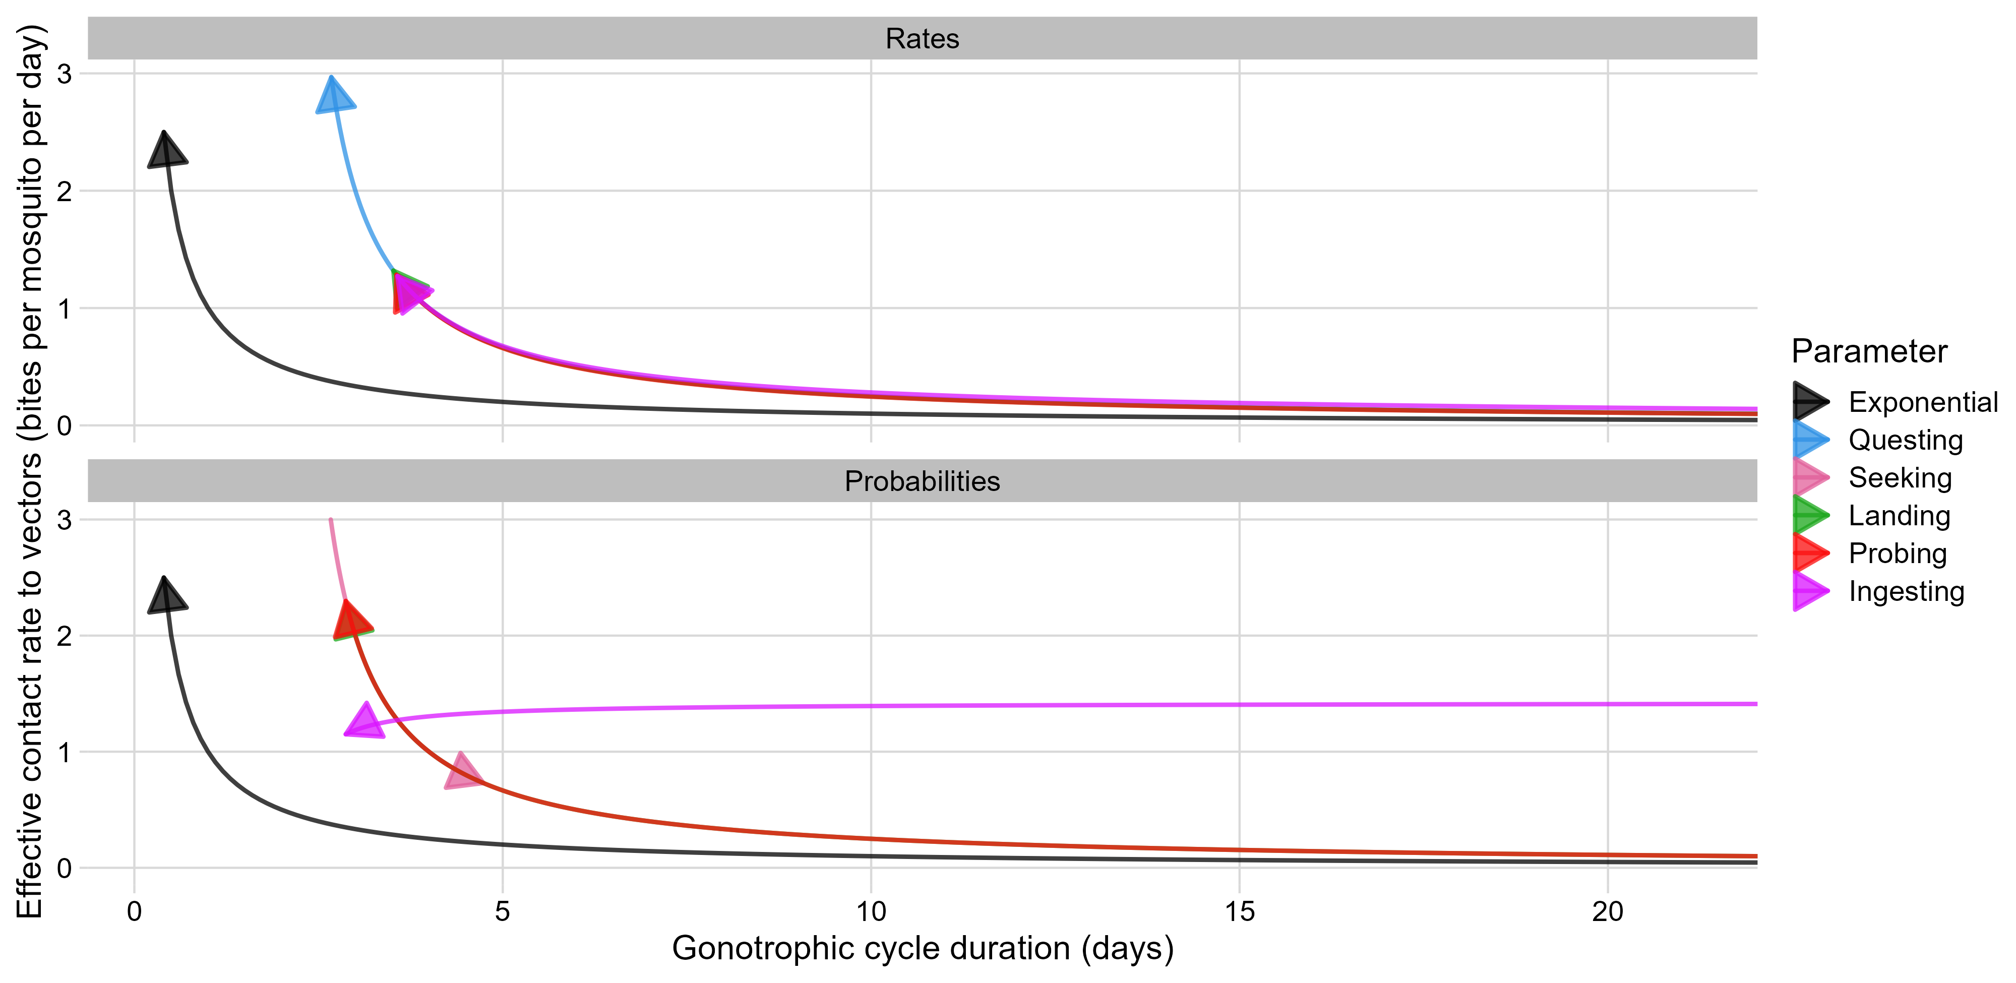
Vector contact rate as a function of Gonotrophic cycle duration

Slide 7
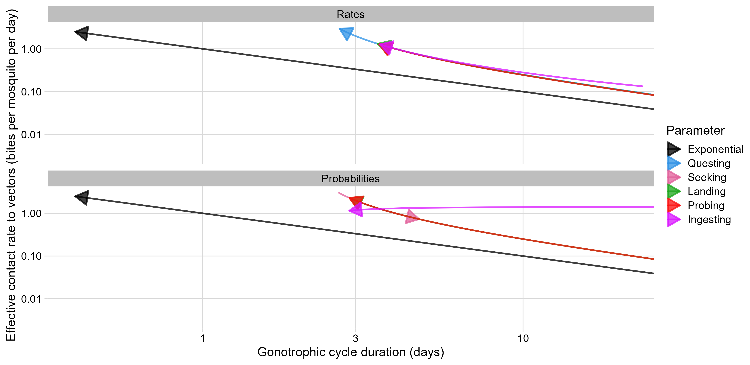
Vector contact rate as a function of Gonotrophic cycle duration (on a log-log scale)

Slide 8
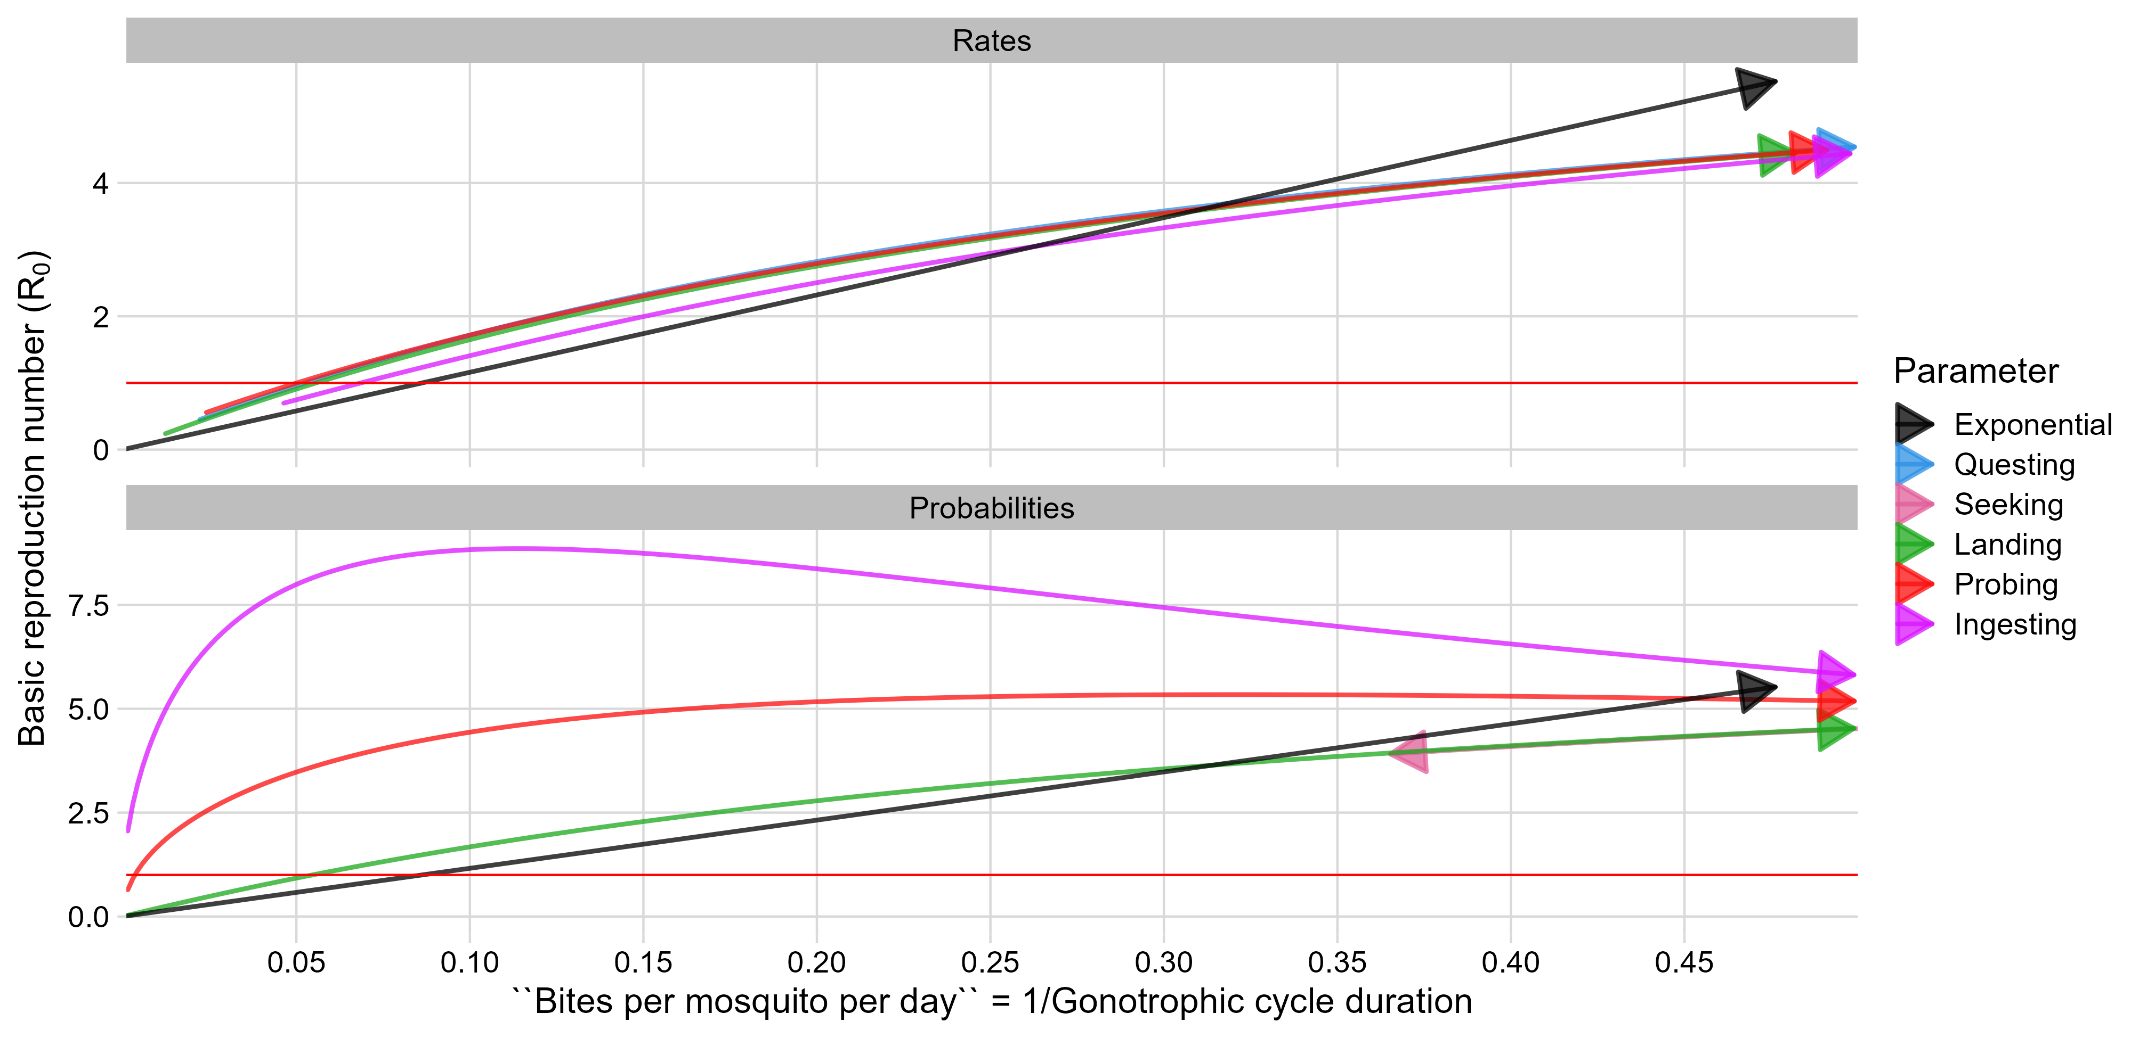
R₀ as a function of biting rate = 1/ GCD

Slide 9
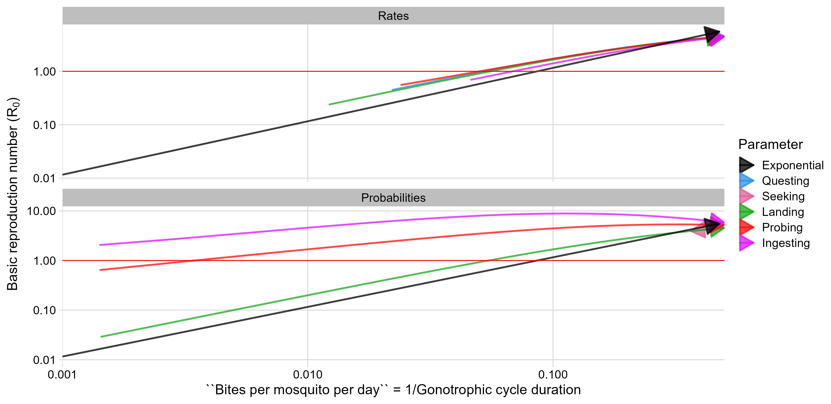
R₀ as a function of biting rate = 1/ GCD (on a log-log scale)

