Slide 1
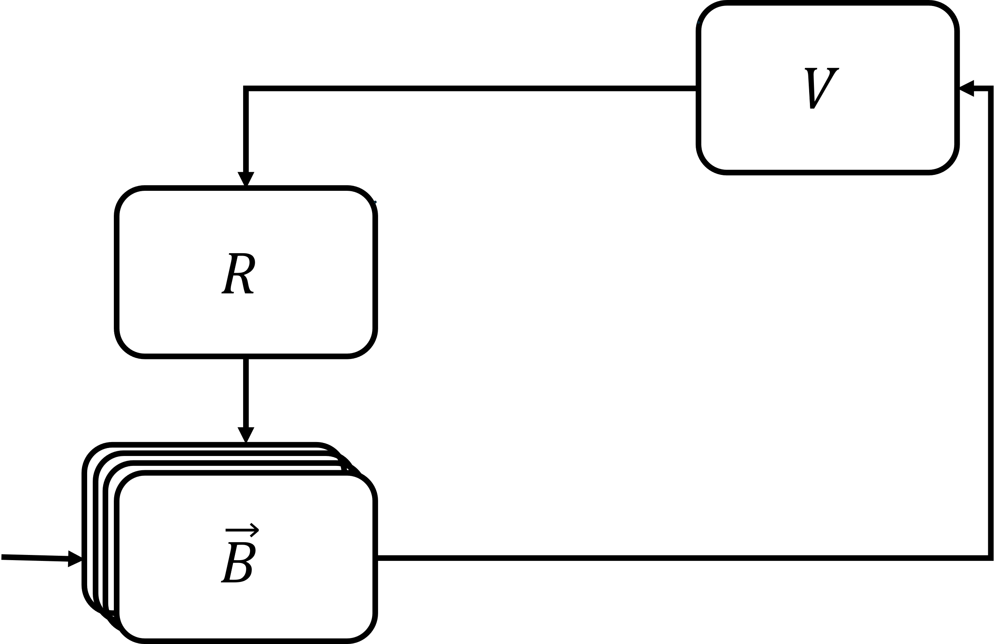
Mosquito population
Susceptible
Exposed
Infectious
Exposure
Pathogen development
Host population
Recovered
Infected
Susceptible

Slide 2
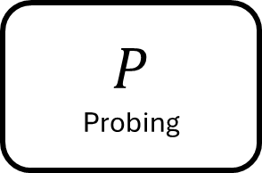
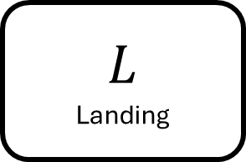


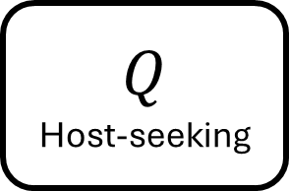


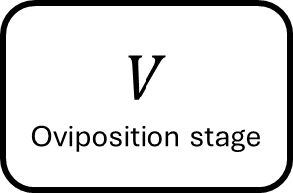
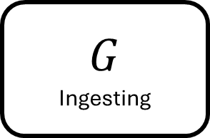
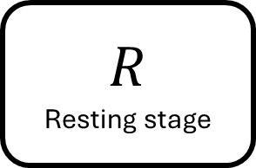








$$R$$
Resting stage
$$V$$
Oviposition stage
$$γ_{V}$$
$$γ_{R}$$
$$Q$$
Host-seeking
$$ρ_{J}$$
$$p_{Q}λ_{Q}$$
$$L$$
Landing
$${p_{G}λ}_{G}$$
$${p_{L}λ}_{L}$$
$${\left(1−σ\right)\left(1−p_{L}\right)λ}_{L}$$
$$P$$
Probing
$${p_{P}λ}_{P}$$
$$σ{\left(1−p_{P}\right)λ}_{P}$$
$$\left(1−σ\right){\left(1−p_{P}\right)λ}_{P}$$
$$G$$
Ingesting
$$σ{\left(1−p_{G}\right)λ}_{G}$$
$$\left(1−σ\right){\left(1−p_{G}\right)λ}_{G}$$

