Slide 1
Once bitten, twice shy: modeling trade-offs between mosquito biting persistence and vertebrate host defensive behaviors
Kyle Dahlin
Postdoctoral Researcher
Virginia Tech, Department of Mathematics
Joint Mathematics Meetings 2024 San Francisco, California, USA

Slide 2
Acknowledgements
In collaboration with Lauren Childs and Michael Robert
Supported by NSF MPS Ascending Postdoctoral Researcher Scholar award

Slide 3
Importance of mosquito-borne disease

Slide 4
What is multiple blood feeding and why does it matter?

Slide 5
How does multiple blood feeding work?

Slide 6
Drivers of multiple* blood feeding
Larval conditions
Less “healthy” adults may need multiple blood meals to obtain sufficient nutrients for egg formation and oviposition
Meal diversity
Feeding on a variety of blood meal sources may lead to higher fecundity
Interruption by defensive behavior
Defensive behaviors of animals can destroy mosquitoes
Some animals feed on mosquitoes
*some authors differentiate between “multiple” and “interrupted” blood feeding

Slide 7
Should multiple blood feeding behavior increase or decrease transmission potential?
Increase
Decrease
More contact events, more opportunities for transmission
(Potentially) allows for full cycle of transmission (host→vector→host) in a single gonotrophic cycle
Earlier opportunities for transmission (decrease in time between to and from transmission)
Shorter periods of contact, smaller probability of successful transmission
Multiple blood feeding is risky; decreases mosquito lifespan and infectious period

Slide 8
Interrupted feeding vs. multiple blood feeding

Slide 9
Research questions

Slide 10
Base model
Use Paul Hurtado’s formalism to express model in matrix-vector form
Explain that the biting process dynamics are encapsulated in the vector alpha and matrix A

Slide 11
Case studies: disruption vs. destiny
Talk about the biology behind the distinction

Slide 12
Disruption compartmental diagram

Slide 13
Disruption system of equations
Explain the key parameters: sigma and lambda
Briefly describe alpha and A

Slide 14
Destiny compartmental diagram

Slide 15
Destiny system of equations
Explain the key parameters: kappa and lambda
Briefly describe alpha and A

Slide 16
Big-picture model comparison
Put the two diagrams next to each other on the same slide
Point out apparent similarities and differences
Make clear how each model can be reduced to a “standard” one by parameterizing appropriately
Explain the idea of “type”: A mosquito of “type i” needs to take exactly i blood meals to be able to attain repletion and oviposit

Slide 17
Re-phrase research questions in terms of models
Interpret the questions as something quantifiable
How do differences in biting process dynamics impact predictions of transmission potential?
Three ways of quantifying:
Mosquito reproductive number: Mosquito population persistence and overall density
Equilibrium proportion of mosquitoes biting > 2 in a fixed time window (representing EIP)
Biting pressure = population-level bites per unit time
First need to parameterize models

Slide 18
Baseline parameters
These are the same in both models, generally they do not have to do with the biting process
We set a fixed maximum number of blood meals for now (will explore how changing this impacts results later)

Slide 19
Comparative parameters
The two models are distinct. We want ways to set the sigma’s, kappa’s, and lambda’s so that the models are in some sense comparable.
We consider scenarios for the rates (lambda’s) and probabilities (sigma’s or kappa’s)

Slide 20
Rate assumptions
All biting rates are equal to a fixed rate lambda
This is the simplest way to parameterize the models but perhaps accentuates the differences between the two
Cycle durations are equal
This means that no matter the type of mosquito, the average duration it takes for it so successfully reach oviposition is 1/lambda (using same lambda as above)
NB: For the disruption model, Assumption 2 sets strict bounds on values of sigma’s. Notably sigma_1 > ½ . These bounds limit our assumptions on the probabilities

Slide 21
Probability assumption(s)
The likelihood of a type i+1 mosquito is nu lower than a type i mosquito
The bounds prescribed by the second rate assumption for the disruption model require that nu < 0.5

Slide 22
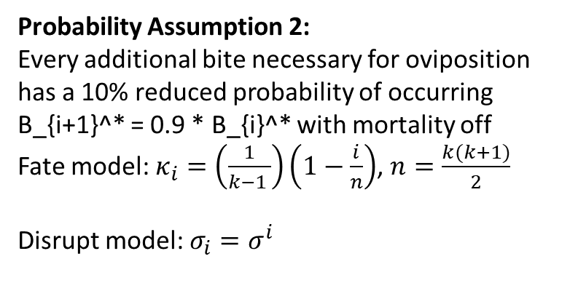
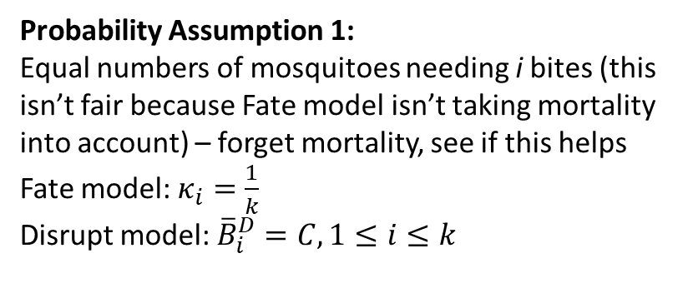
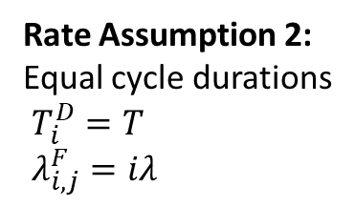
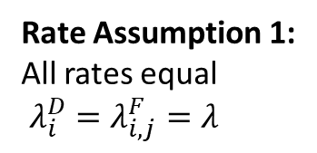
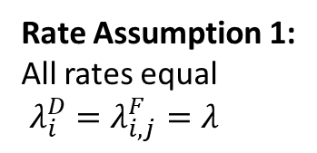
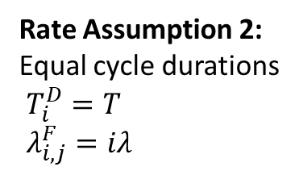
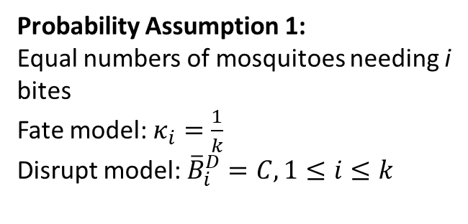
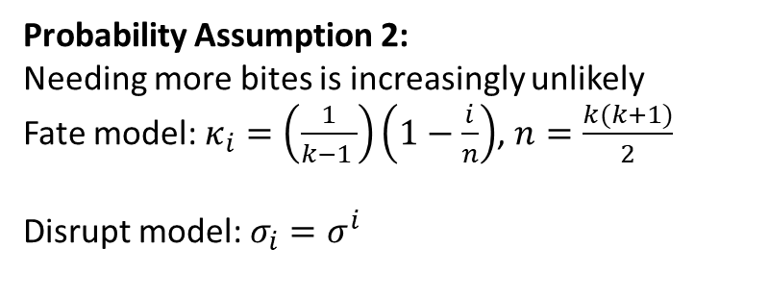
Rate Assumption 1:
All rates equal
$λ_{i}^{D}=λ_{i,j}^{F}=λ$
Rate Assumption 1:
All rates equal
$λ_{i}^{D}=λ_{i,j}^{F}=λ$
1
2
Probability Assumption 1:
Equal numbers of mosquitoes needing i bites (this isn’t fair because Fate model isn’t taking mortality into account) – forget mortality, see if this helps
Fate model: $κ_{i}=\frac{1}{k}$
Disrupt model: ${\overline{B}}_{i}^{D}=C,1≤i≤k$
Probability Assumption 2:
Every additional bite necessary for oviposition has a 10% reduced probability of occurring
B_{i+1}^* = 0.9 * B_{i}^* with mortality off
Fate model: $κ_{i}=\left(\frac{1}{k−1 }\right)\left(1−\frac{i}{n}\right)$, $n=\frac{k(k+1)}{2}$
Disrupt model: $σ_{i}=σ^{i}$
Rate Assumption 2:
Equal cycle durations
$T_{i}^{D}=T$
$λ_{i,j}^{F}=iλ$
Rate Assumption 2:
Equal cycle durations
$T_{i}^{D}=T$
$λ_{i,j}^{F}=iλ$
3
Inconsistent
Probability Assumption 2:
Needing more bites is increasingly unlikely
Fate model: $κ_{i}=\left(\frac{1}{k−1 }\right)\left(1−\frac{i}{n}\right)$, $n=\frac{k(k+1)}{2}$
Disrupt model: $σ_{i}=σ^{i}$
Probability Assumption 1:
Equal numbers of mosquitoes needing i bites
Fate model: $κ_{i}=\frac{1}{k}$
Disrupt model: ${\overline{B}}_{i}^{D}=C,1≤i≤k$

