Slide 1
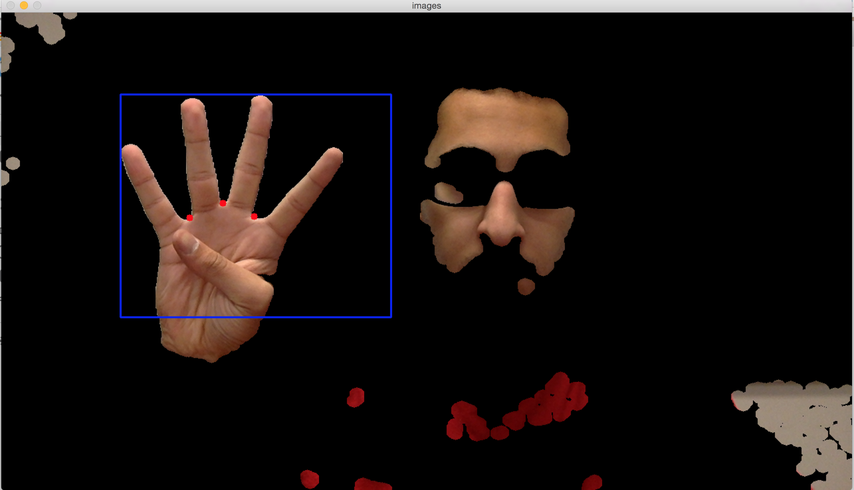
“Project Palm”
Nikhil Dixit | Thejas Prasad | Chirag Sakhuja | Julian Sia

Slide 2
Overview
Motivation
Description
Objectives
Methods
Results
Progress
Performance
Demo
Challenges

Slide 3
Motivation
Extend the range of use (literally) of your machine
Explore more about tracking with motion

Slide 4
Description
Capture video from webcam
Track fingers across frames
Translate gestures into mouse operations

Slide 5
Objectives
P1: Track and extract the hand using a built in webcam
P2: Track individual fingers from the extracted hand
P3: Analyze the traces of the fingers to identify gestures
P4: Map the gestures to mouse

Slide 6
Methods

Slide 7
Methods: Languages, Libraries, Hardware
Python 2.7
NumPy
OpenCV
PyUserInput
Laptop Specs
Intel i5 @ 2.6 GHz
720p webcam

Slide 8
Methods: Algorithm
hue = detect_hue()
while(camera is recording):
frame = current_frame(camera)
cleaned_frame = preprocess(frame, hue)
hand = detect_hand(cleaned_frame)
fingers = detect_fingers(hand)
map_to_mouse(fingers)

Slide 9
Methods: Algorithm – detect_hue()
def detect_hue():
Capture hue from predetermined region for 25 frames
Take 5th and 95th percentiles of hues in region
Adjust base hue parameters

Slide 10
Methods: Algorithm – preprocess()
def preprocess(frame, hue):
Convert frame to HSV
“Black out” non-skin parts of frame
Apply erosions and dilations to remove noise
Apply Gaussian blur to smooth edges
Convert from HSV to gray

Slide 11
Methods: Algorithm – detect_hand(), detect_fingers()
def detect_hand(cleaned_frame):
Find all contours in frame
Take contour with largest area (by our definition, this is the “hand”)
def detect_fingers(detected_hand):
Draw convex hull using contours
Find convexity defects (which correspond to # of fingers)
Dismiss spurious fingers

Slide 12
Methods: Algorithm – map_to_mouse()
def map_to_mouse(fingers):
if (2 fingers up)
lock mouse
if (2 fingers down)
do left click
else if (3 fingers up)
lock mouse
if (3 fingers down)
do right click
else
track mouse corresponding to palm movement

Slide 13
Results

Slide 14
Results
P1: Tracking and extracting the hand using a built in webcam
P2: Track individual fingers from the extracted hand
P3: Analyze the traces of the fingers to identify gestures
P4: Map the gestures to mouse
denotes an Original/Complete Objective
denotes an Original/Partially Complete Objective
denotes a Modified/Complete Objective
Notes:
P2
One of our progress reports asserted that we would track finger detection performance based on a single index finger is open or closed; we changed this metric to how many fingers were up in the frame vs. how many fingers were actually detected
P4
Initially intended to track more built-in gestures; final product can only track left click, right click, open palm

Slide 15
Achievement Statistics
P1: 69.6% accuracy
P2: 46.7% accuracy**
P3: undefined
P4: undefined
denotes an Original/Complete Objective
denotes an Original/Partially Complete Objective
denotes a Modified/Complete Objective
denotes a non-ideal case

Slide 16
P1: Hand Tracking & Extraction
Progress: Completed
Performance
Good for clear, consistent, well-lit, non-skin colored backgrounds
Bad with noisy backgrounds

Slide 17
P2: Digit Tracking & Extraction
Progress: Completed
Performance
Good when hand is neither obfuscated by another object in the front nor partially obfuscating the face
Difficult to distinguish 1 from 0 fingers
Spurious single finger detection in dark area

Slide 18
P3: Gesture Tracking
Progress: Completed
Performance
Good when hand is neither obfuscated by another object in the front nor partially obfuscating the face
Difficult to distinguish 1 from 0 fingers

Slide 19
P4: Map Arbitrary Gestures
Progress: Partially Complete
Performance
Good performance when conditions listed in P1, P2, and P3 are met
Somewhat sluggish mouse movement
Mouse, Left click, and right click (somewhat)
No scrolling, drag and drop, pinch and zoom, arbitrary gesture tracking

Slide 20
Demo

Slide 21
Challenges ☹
Spurious Skin Detection (False +)
Partial Fix: Erosions and Dilations, Blurring
More Robust Potential Fix: Stereo Vision
Spurious finger detection (False +)
Fix: Dismissal Heuristic
More Robust Potential Fix: Hull points
Suboptimal Detection (False -)
Skin heuristic based on fixed range
Potential Fix: Dynamic Range

Slide 22
Questions?

Slide 23
Further Reading
Adaptive Skin Color Model for Hand Segmentation by Dawod et. al.
Implementation of an Improved HCI Application for Hand Gesture Recognition by Joshi et. Al.

Slide 24
Citations
http://www.pyimagesearch.com/2014/08/18/skin-detection-step-step-example-using-python-opencv/
http://simena86.github.io/blog/2013/08/12/hand-tracking-and-recognition-with-opencv/

