Slide 1


Martin Marietta Materials
Group Names:
Kofi Yeboah
Ameen Rufai

Slide 2

Background Information
Martin Marietta Materials is an American building materials company that specializes in producing and supplying aggregates, cement, ready-mixed concrete, and asphalt for use in various construction projects.
Headquarters: located in Raleigh, North Carolina, and operates over 300 quarries, mines, distribution yards, and plants in 27 states as well as in Canada and the Bahamas.
Martin Marietta Materials employs more than 17,000 people across its operations in the US.
The company's network infrastructure includes fiber optic cables, microwave links, and wireless connectivity.

Slide 3
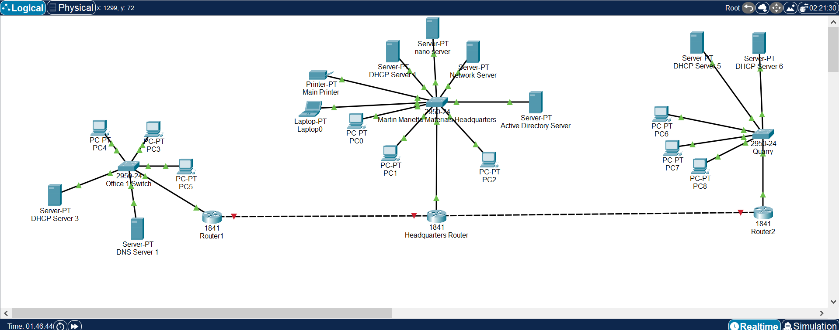
Company Setup

Slide 4
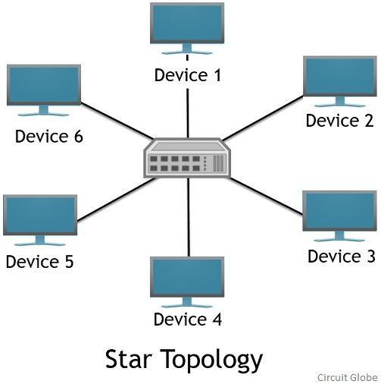
Topology & Cables
The type of topology we used for our company is a Star Topology. Each device on the network is connected to a switch using individual cables.
Why? In case of one device or cable failure will not affect the rest of devices or entire network.
Cables Used: Fast Ethernet Cables, Copper Straight Through Cables, and Copper Cross Over Cables.

Slide 5
Wide Area Network (WAN)
Wide area networks are designed to connect networks over long distances. For example: across cities, states, and countries.
Using WAN for our company will help with efficient data sharing, global connectivity, enhanced security over data sharing, and centralized network management.

Slide 6
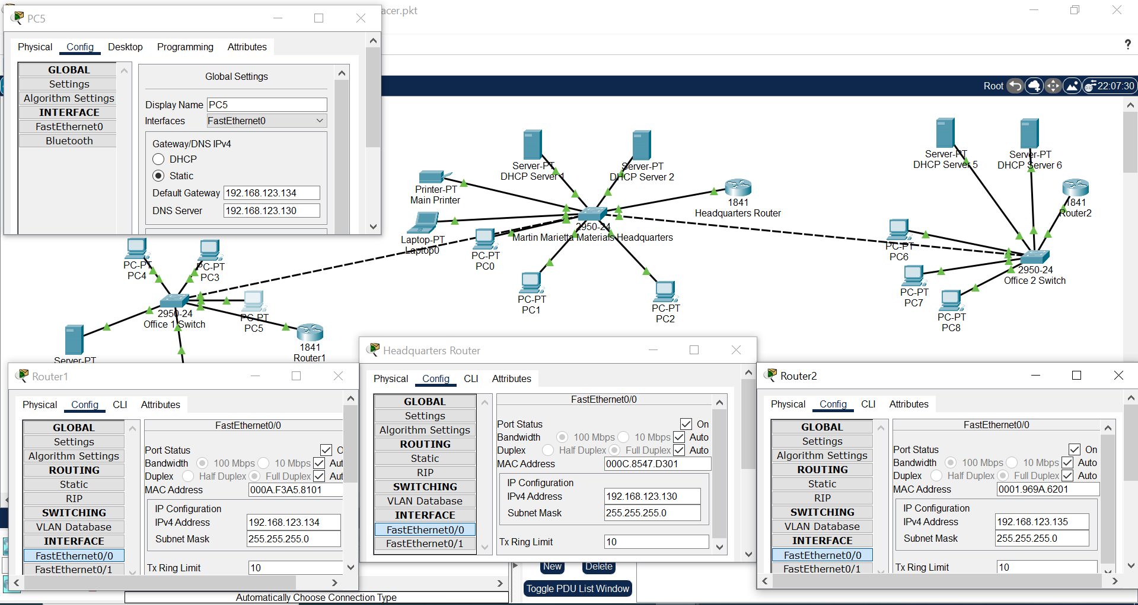
Subnet Mask & IP Address

