Slide 1
Network Services Automation
Group Names
Kofi Yeboah
Jaylen Smith
Victor Chabifor
Instructor Adedoyin
CTEC 435

Slide 2
Introduction
This project involves building an NSA server to automate network services like DNS, DHCP, and VPN.
The purpose of Network Service Automation (NSA) is to streamline and simplify the configuration, management, and operation of network services with minimal human intervention.

Slide 3
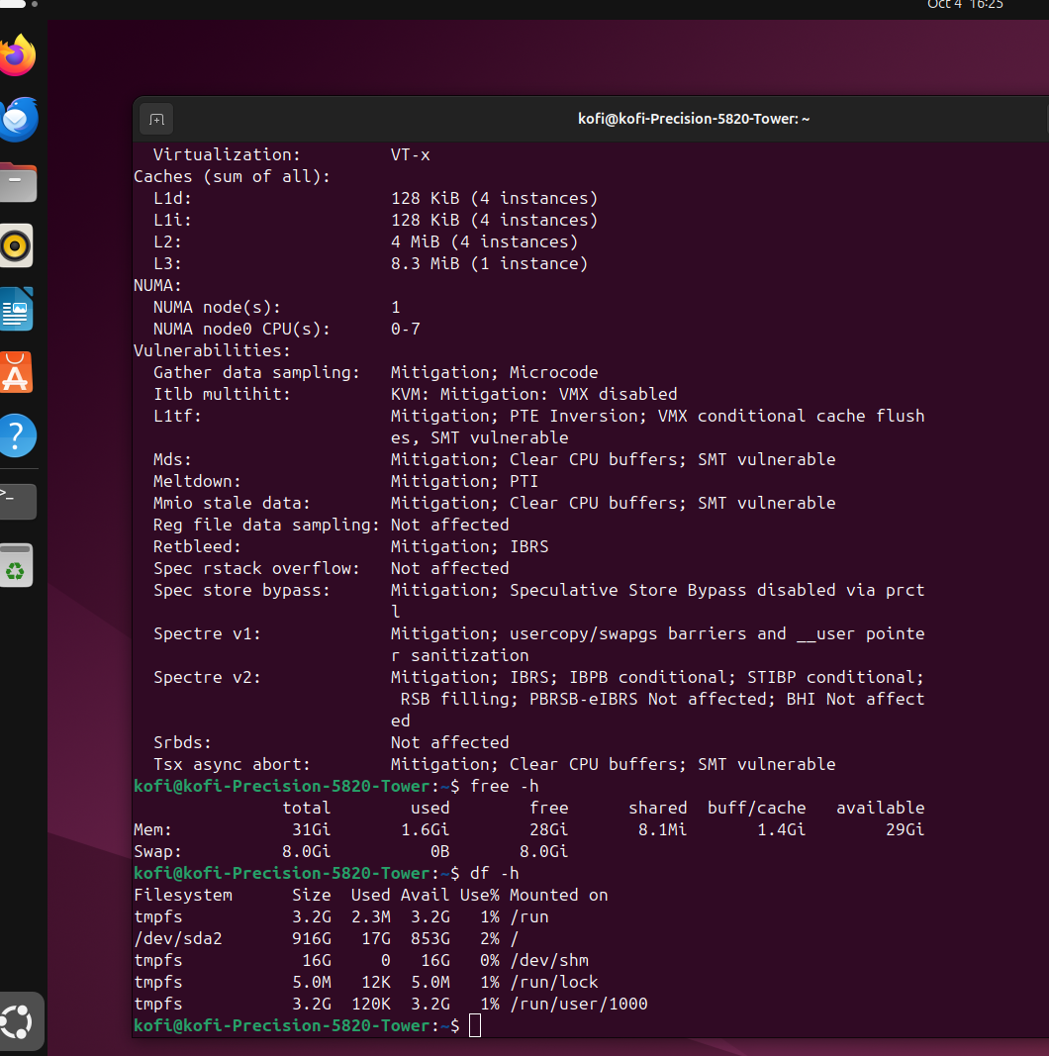
Server Hardware Requirements
Hardware Specifications:
- CPU: Quad-core 2.0 GHz or higher
- RAM: 16 GB minimum
- Storage: 500 GB SSD
- Network: 1 Gbps NIC

Slide 4

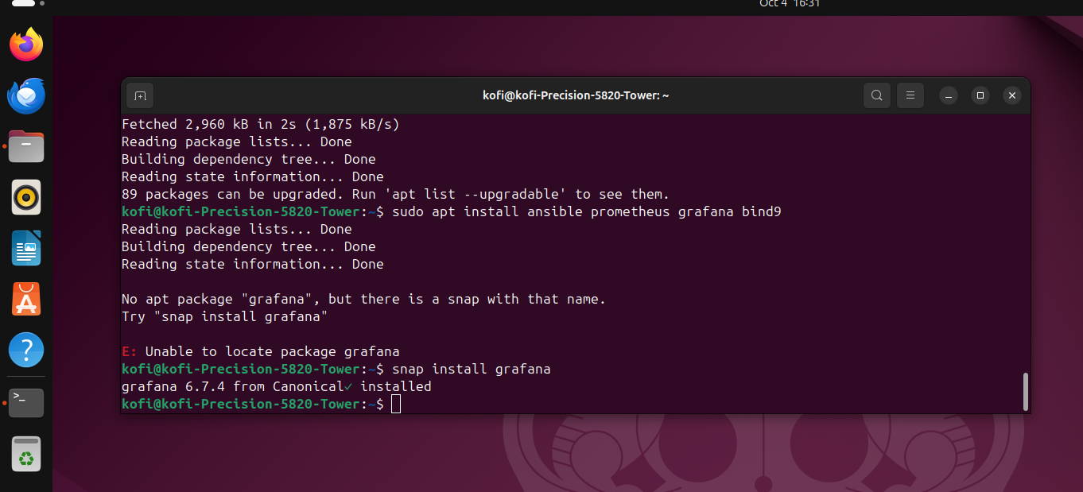
Server Software Requirements
Installed Software:
- OS: Ubuntu 22.04
- Automation: Ansible
- Monitoring: Prometheus, Grafana
- Additional Packages: BIND (DNS), ISC DHCP

Slide 5
Server Security Setup
Security Measures:
- Strong password policy
- SSH key-based authentication
- Configured firewall (UFW)
- TLS/SSL encryption

Slide 6
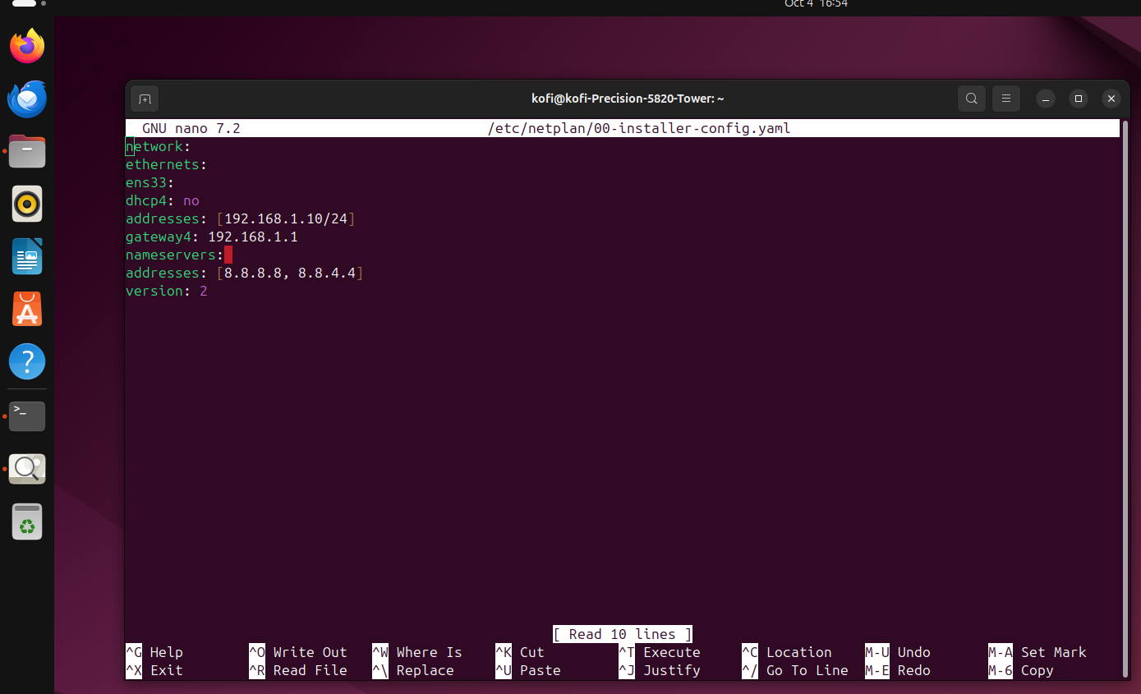
Network Setup (Server)
Network Configuration:
- Static IP: 192.168.1.10
- Subnet Mask: 255.255.255.0
- Gateway: 192.168.1.1
- DNS: 8.8.8.8

Slide 7
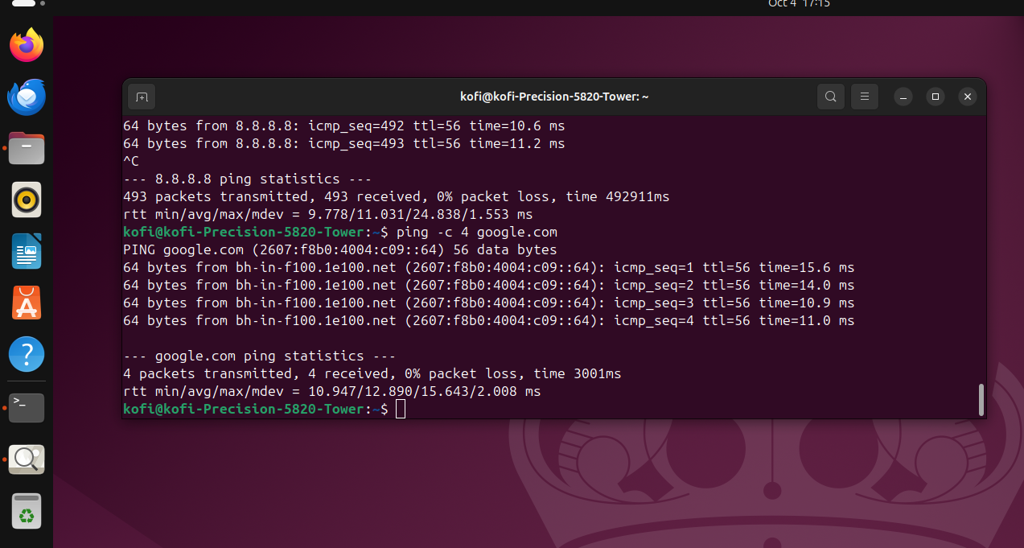
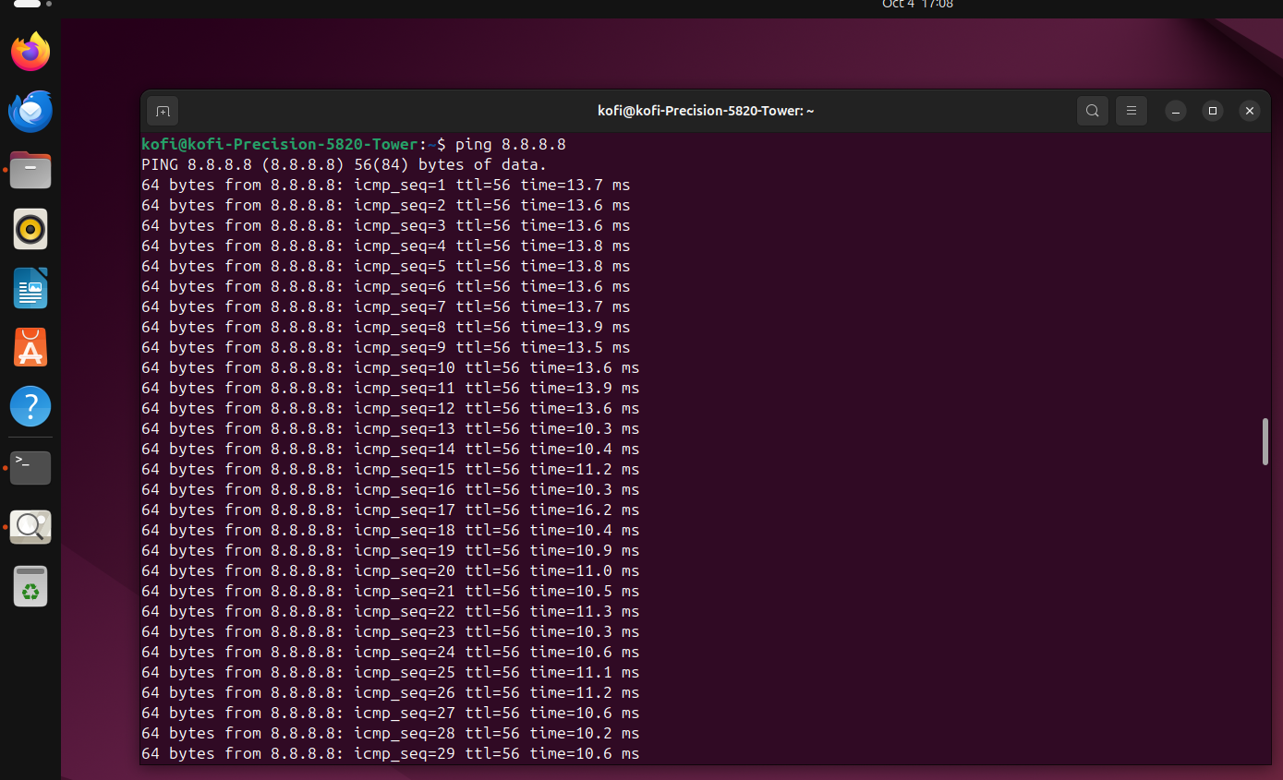
Server Testing
Testing the server:
- Ping external networks for connectivity
- Test DNS and DHCP configurations
- Use Ansible playbooks for automated service checks

Slide 8
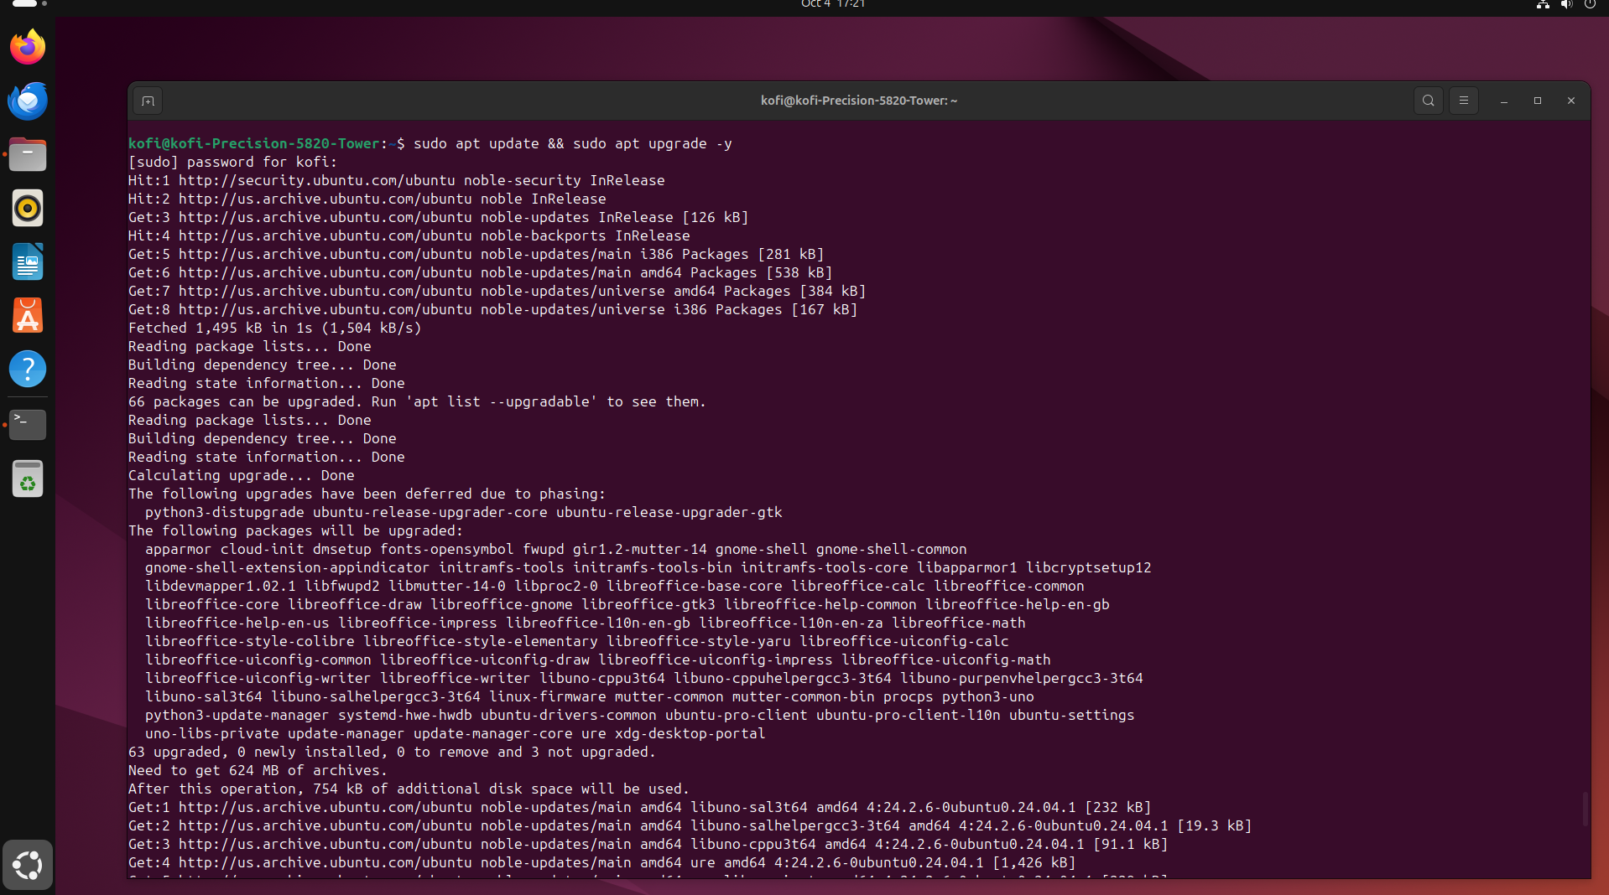
Server Maintenance
Maintenance Plan:
- Regular software updates
- Automated daily backups
- Monitoring performance with Prometheus and Grafana

Slide 9
Troubleshooting (Server)
Troubleshooting Issues:
- Network misconfiguration (IP issues)
- Automation script errors (Ansible playbook failures)
- Resolved by checking logs and rerunning playbooks

Slide 10
User Machine Setup
User Machine:
- Hardware: CPU 2.0 GHz, 8 GB RAM
- Software: SSH client (PuTTY)
- Network Settings: Configured IP, Subnet Mask, Gateway, DNS

Slide 11
Conclusion and Future Steps
Automation is key to managing modern networks because it reduces human errors and ensures consistent configurations across devices. It streamlines repetitive tasks, minimizing mistakes that can lead to downtime or security issues. By automatically applying updates and patches, automation also strengthens network security. Additionally, it allows networks to grow without requiring more manual work, making it easier to scale. Overall, automation makes network management more efficient, secure, and reliable.
Future improvements include expanding automation scope and enhancing security.

