Slide 1
MidTerm Review
Notes:
set-up :
https://scheme.cs61a.org/ demo: (define (falsey val) (begin (print val) #f))
(define-macro (if-macro cond1 expr1 else expr2) `(if ,cond1 ,expr1 ,expr2))
___
(define-macro (add-or-sub cond1 x1 x2)`(if ,cond1 (+ ,x1 ,x2)(- ,x1 ,x2)))

Slide 2
What Is this course about?
A course about managing complexity
Mastering functional abstraction and data abstraction
Learning trade-offs of various programming paradigms
An introduction to programming
Learning how to write programs in Python, Scheme, and SQL
Combining multiple programming techniques in large projects
Understanding how computers interpret programming languages
A challenging course that demanded a lot of you

Slide 3
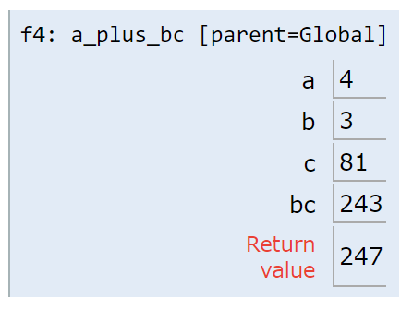
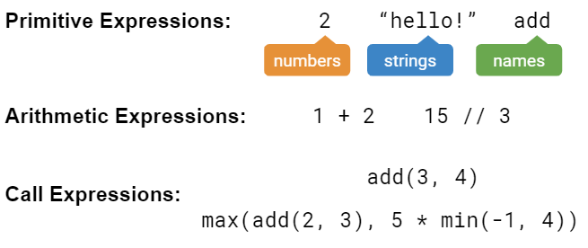
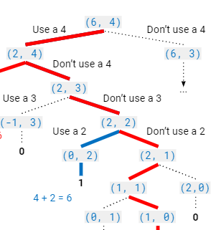
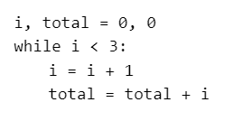
“Building Blocks” of Programs

Slide 4
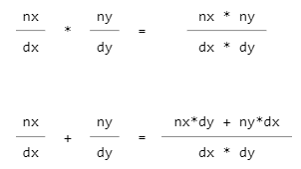

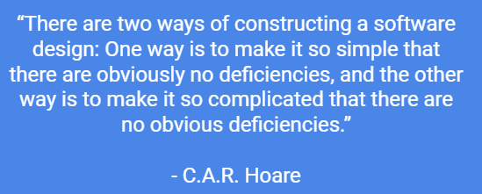
Managing Complexity

Slide 5
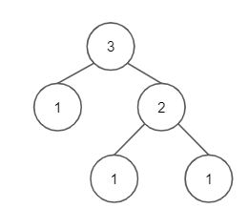
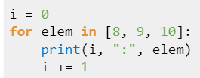
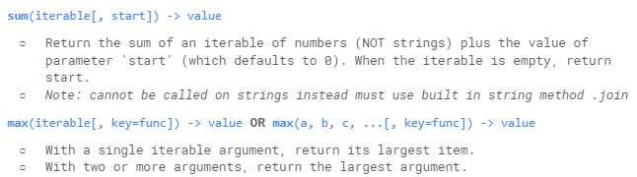
Representing Collections of Data

Slide 6
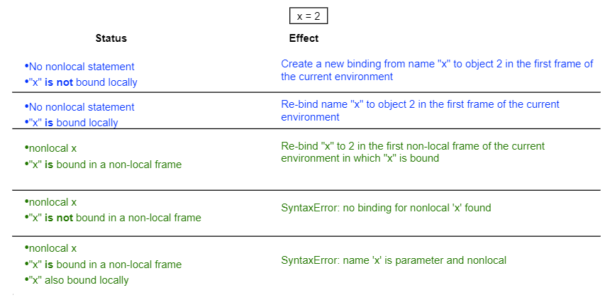

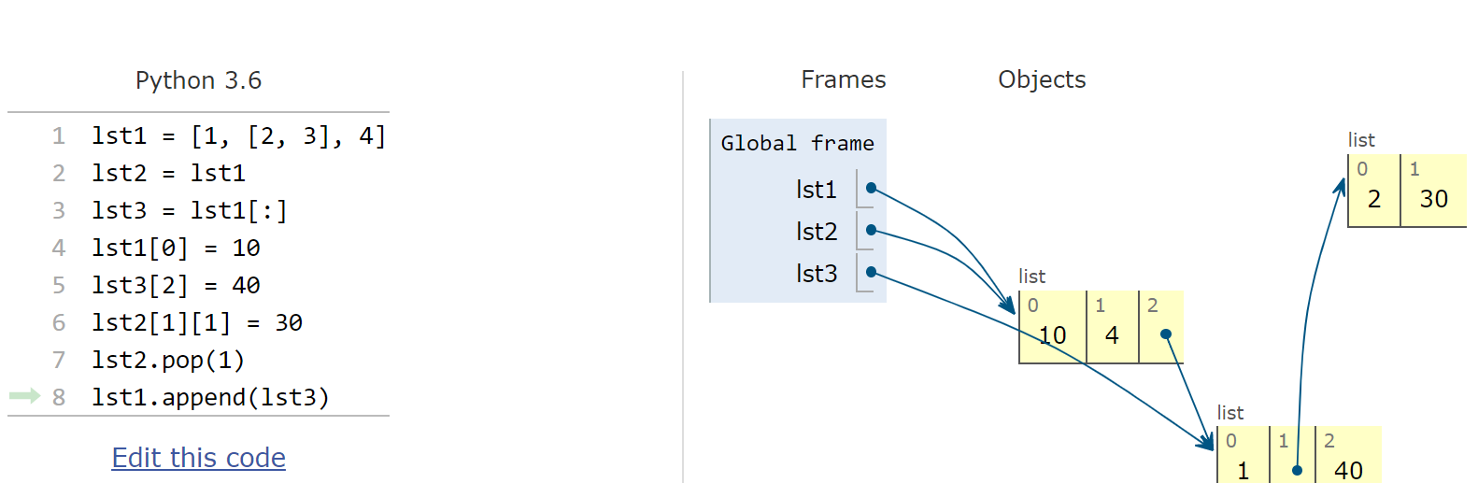
Mutability

Slide 7
(Higher-Order) Functions

Slide 8
Functions
A function is made up of a series of statements, and takes in an input and maps it to an output.
How we describe functions:
Domain: The set of possible inputs a function may take in.
Range: The set of possible output values a function may return.
Behavior: The relationship between input and output.
EXAM TIP:
Pay close attention to the specified domain and range of a function on the exam. What do the parameters represent? What should the function return?

Slide 9
Higher Order Functions
A higher-order function is:
A function that takes a function as an argument and/or
A function that returns a function as a return value
¹
²
³
def do_twice(f):
f()
f()
¹
²
³
def do_nothin(f):
return f
and/or

Slide 10
Lambda Expressions
A lambda expression is an expression that evaluates to a function.
In the above example, on line 1, the RHS is a lambda expression that evaluates to a function; and then we are binding it to f.
Note:
Lambda functions have no intrinsic name
Their parent frame is the frame in which they were defined
>>> f = lambda x: x * x
>>> f(2)
4
do_twice(lambda: print(“Hello!”))
http://bit.ly/lambda4eva

Slide 11
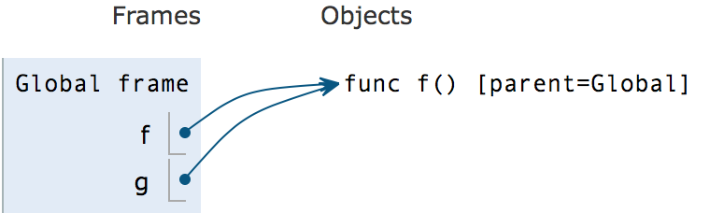
Functions in Environment Diagrams
def f():
return 1
g = f
Unlike primitive values, functions are written in the objects section.
We also write the parent of the function, the frame in which it was defined.
When a function is passed to another variable, we draw another arrow to the existing function object.

Slide 12
Environment Diagram Tips
Name of frame should be intrinsic name of function
Parent frame of a function never changes once you write it down
Don't conflate: function name vs. function call
Remember evaluation procedure
Evaluate the operator (usually a lookup)
Evaluate the operands (may involve calling another function)
Apply the operator on the operands (this is where you actually call the function and make a new frame)

Slide 13
Practice: Hippity-Hoppity-HOFy
Please draw an environment diagram for the following program.
def hop(y):
def hip(f):
return wrap(f(y))
def wrap(x):
return x + y
return hip
z = hop(2)(lambda x: x+2)
links.cs61a.org/mtreview-hiphop
Notes:
Remind the students why the parent of the lambda function is the global frame

Slide 14
Practice: do_n_then_again
Implement a function that takes in a positive integer n, a value x, and returns a function that will continue to take in functions one at a time, applying the first function to x n times, the second function to the new value of x (n-1) times, and so on until n functions have been passed in; after which the value after all of the operations is returned.
>>> do_n = do_n_then_again(1, 2)
>>> do_n(lambda x: x * x)
4 # (2 * 2)
>>> do_n = do_n_then_again(3, 2)
>>> do_n(lambda x: x+2)(lambda x: x*x)(lambda x: -x)
-4096 # (((2 + 2 + 2 + 2)^2)^2) * -1

Slide 15
Implement do_n_then_again
>>> do_n = do_n_then_again(1, 2)
>>> do_n(lambda x: x * x)
4 # (2 * 2)
>>> do_n = do_n_then_again(3, 2)
>>> do_n(lambda x: x+2)(lambda x: x*x)(lambda x: -x)
-4096 # (((2 + 2 + 2 + 2)^2)^2) * -1
¹
²
³
⁴
⁵
⁶
⁷
⁸
⁹
def do_n_then_again(n, x):
def do_n(f):
if __________:
return __________
_________
for _ in __________:
__________________
return do_n_then_again(____, ___)
return do_n
def do_n_then_again(n, x):
def do_n(f):
if n == 1:
return f(x)
new_x = x
for _ in range(n):
new_x = f(new_x)
return do_n_then_again(n-1, new_x)
return do_n
Notes:
Play animations on this slide to see the skeleton code

Slide 16
Sequences

Slide 17
The Basics
Definitions:
Sequence: a collection of values
List: an ordered sequence of values of any data type
Index: start from 0
Functions:
len(lst): returns number of elements in the list
range(start, end): function creates a sequence containing the values within a specified range.
start is inclusive, end is exclusive
can work with 1 input; start defaults to 0
Ie. range(0,5) is the same as range(5)

Slide 18
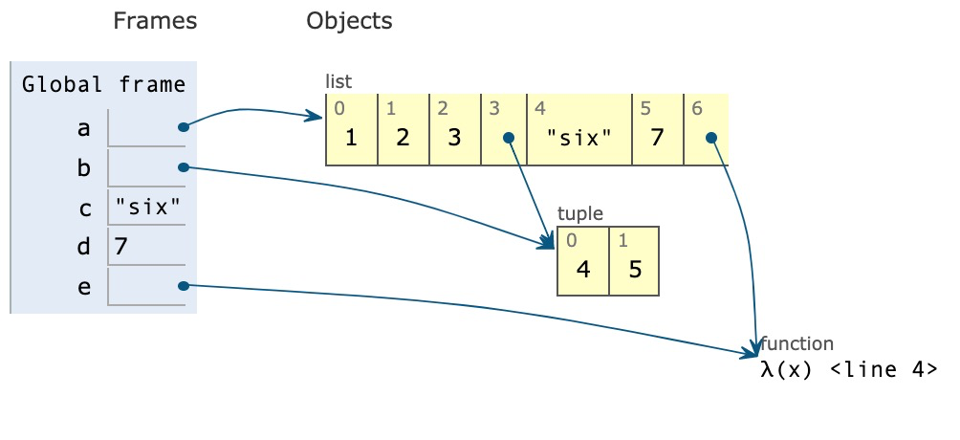
Box and Pointer Diagram
Lists are drawn using boxes and pointers in environment diagrams
1 a = [1, 2, 3]
2 b = [4,5]
3 c , d = “six” , 7
4 e = lambda x: 8
5 a.append(b)
6 a.append(c)
7 a.append(d)
8 a.append(e)
Python Tutor

Slide 19
For loop & List comprehension
Suppose that we’re given a list and want to make a new one where we double all the even elements of the original.
For loops are a convenient way to iterate through a list
1 result = []
2 for elem in a_list:
3 if elem % 2 == 0:
4 result += [elem * 2]
5 return result
List Comprehensions are a compact way to create a new list from an existing one
1 result = [elem*2 for elem in a_list if elem % 2 == 0]

Slide 20
Mutating a list vs. Creating a list
lst.append(element)
lst.extend(sequence)
lst1 += lst2
lst.insert(index, element)
lst.remove(element)
lst.pop(index)
lst1[0:1] = lst2[0:5]
replaces the 0-th box with 5 elements from lst2
All of above except pop return None
Slicing
lst[start:end:step]
Shallow copying
lst[:]
Concatenating
lst1 = lst1 + lst2
List constructor
lst2 = list(lst1)
Notes:
Alex: put em on yer cheat sheet

Slide 21
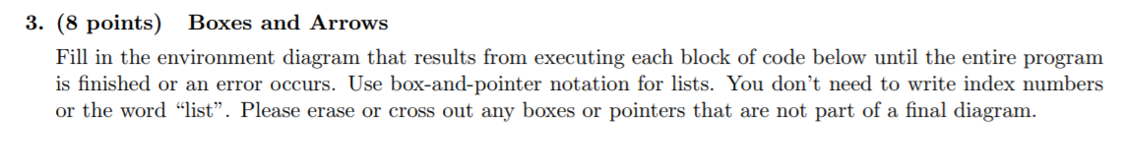
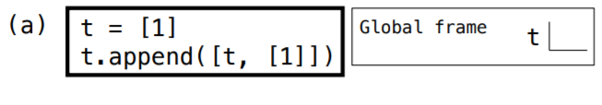
Question 3: (Fall 2016)

Slide 22
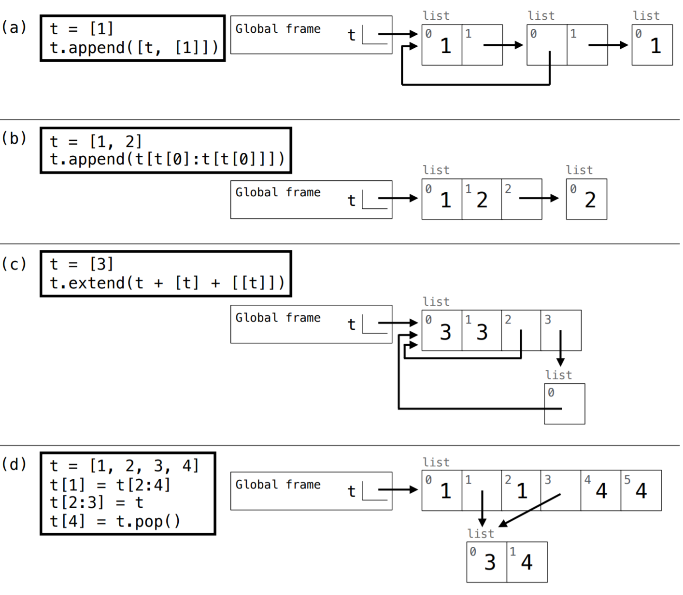
Question 3: (Fall 2016)

Slide 23
Question 3: (Fall 2016)

Slide 24
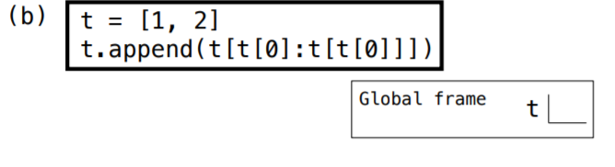
Question 3: (Fall 2016)

Slide 25
Question 3: (Fall 2016)

Slide 26
Question 3: (Fall 2016)
eval operand:
t.append( t [ 1 : t [1] ])
t.append( t [ 1 : 2 ])
t.append( [2] )

Slide 27
Question 3: (Fall 2016)
eval operand:
t.append( t [ 1 : t [1] ])
t.append( t [ 1 : 2 ])
t.append( [2] )

Slide 28
Summer 14 Midterm 2 (Modified)
Draw box and pointer Diagram for the following code.
1 a = [1, 2, 3]
2 b = [4, a, lambda: a[2][0]]
3 a[0] = b[1] is a
4 a[2] = b
5 c = b[:]
6 a[1] = c[2]()
7 d = b[1].pop(0)
8 b[1].append(d)
Python Tutor

Slide 29
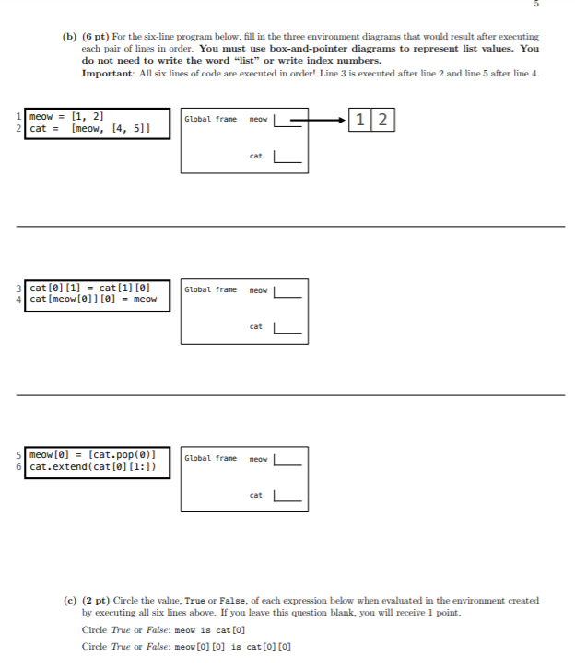
Fall 14 Final

Slide 30
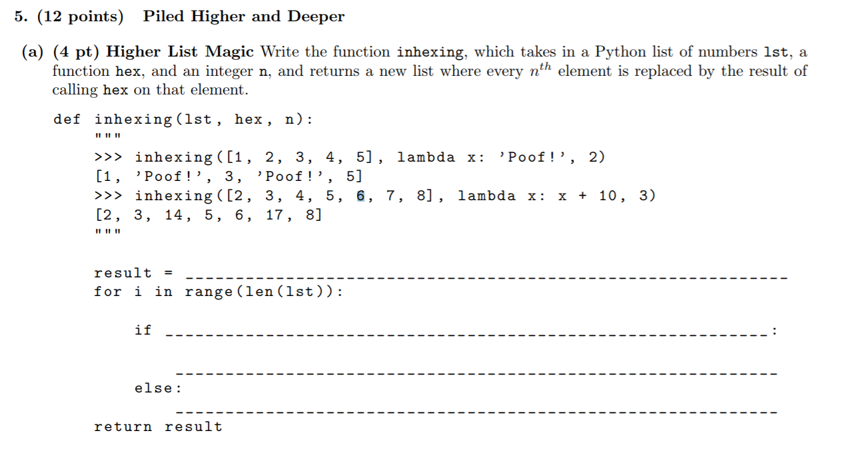
Su14 Midterm 2

Slide 31
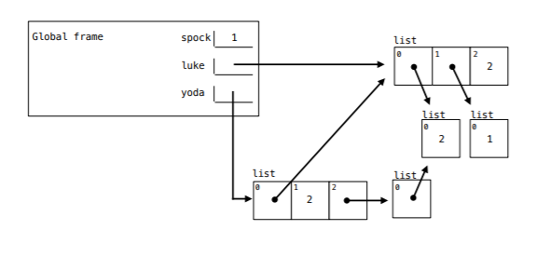
Fall 14 Midterm 2
Fill in the blanks that the code results in the environment diagram shown. You can use only brackets, commas, colors and te names luke, spock, and yoda, NOT integer literals
1 spoke, yoda = 1, 2
2 luke = [ ]
3 yoda = 0
4 yoda = [ ]
5 yoda.append( )

Slide 32
Recursion and Tree Recursion

Slide 33
The Basics
Base Case(s)
Simplest possible inputs for the problem
May be more than one!
Shrinking the problem
Call the function again with slightly smaller inputs!
Using the solved smaller problem
To write a working recursive function, you should assume that you can call it on smaller input and use this to solve the larger problem

Slide 34
Tree Recursion
Recursive function with (potentially) more than one recursive call
Rest is the same!
When you draw out the function calls, it forms a tree shape
Usually split up into different cases: you take one of several options or explore all the different choices
Example: Count Partitions (yes, again)

Slide 35
Revisiting Count Partitions
Suppose we want to find all the sets of integers which sum to 4, where all the integers are positive and less than or equal to 3.
1 def count_part(n, m):
2 if n == 0:
3 return 1
4 elif n < 0:
5 return 0
6 elif m == 0:
7 return 0
8 else:
9 with_m = count_part(n - m, m)
10 wo_m = count_part(n, m - 1)
11 return with_m + wo_m
Two possibilities:
Set has a 3
It doesn’t
Generally, many tree recursion problems have cases of the form “use this first one or don’t”, or “use one of these”
Why do we consider these two cases?
They don’t overlap, include all the possible solutions, and slowly work towards our base cases.

Slide 36
Practice Problem: Your Father’s Parentheses
Suppose we have a sequence of quantities that we want to multiply together, but can only multiply two at a time.
We can express the various ways of doing so by counting the number of different ways to parenthesize the sequence.
Define a function count_groupings(n) that returns the number of ways parenthesizing the product of n numbers, where n > 0.
Source: Mt1, Spring 2016

Slide 37
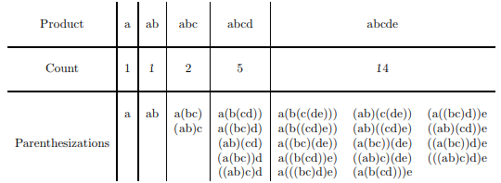
Your Father’s Parentheses
For example, here are the possibilities for products of 1, 2, 3, 4 and 5 elements:
Notes:
d

Slide 38
Your Father’s Parentheses
def count_groupings(n):
if n == 1:
return ____________________________________
elif n == 2:
return ____________________________________
_______________________________________________
for ___________________________________________
__________________________________________
return ________________________________________

Slide 39
Your Father’s Parentheses
def count_groupings(n):
if n == 1:
return 0___________________________________
elif n == 2:
return 1___________________________________
_______________________________________________
for ___________________________________________
___________________________________________
return ________________________________________

Slide 40
Your Father’s Parentheses
def count_groupings(n):
if n == 1:
return 0___________________________________
elif n == 2:
return 1___________________________________
total = 0______________________________________
for i in range(1, n)___________________________
total += count_groupings(i) * count_groupings(n - i)
return total___________________________________

Slide 41
Your Father’s Parentheses
def count_groupings(n):
if n == 1:
return 1___________________________________
elif n == 2:
return 1___________________________________
total = 0______________________________________
for i in range(1, n)______________________
total += count_groupings(i) * count_groupings(n - i)
return total___________________________________

Slide 42
Trees

Slide 43
The Tree Data Abstraction
Constructor def tree(label, branches=[]): Pass in a value (label) for the root node, and a list of branches. Each branch must itself also be a tree. Selectors def label(tree): Returns a value: whatever is stored in the root node.
def branches(tree): Returns a list of tree’s subtrees.
def is_leaf(tree): Returns a boolean: true if tree has no children, false otherwise.

Slide 44
General Structure for Tree Problems
Base Case: smallest version of the problem - no additional work needed to get answer. (usually if it’s a leaf)
Recursive call: do the same function on smaller parts of the tree (usually on the branches)
Final answer: put together results from all the branches
Aggregator functions (max, min, sum, any, all)
Creating a new tree w/ updated label and branches

Slide 45
Practice Problem: replace_with_sum
Write a function replace_with_sum that takes in a tree, and returns a new tree where each node is the sum of itself and all descendant nodes (its children, its children’s children, ...)
1
36
3
6
10
25
2
7
12
7
7
12
5
5

Slide 46
Practice Problem: replace_with_sum
Write a function replace_with_sum that takes in a tree, and returns a new tree where each node is the sum of itself and all descendant nodes (its children, its children’s children, ...)
1 def replace_with_sum(t):
2 if ___________:
3 return __________________
4 new_branches = _____________
5 branch_sum = sum(___________)
6 return tree(______, _______)
7
8
2
1
4
2
9
3
4
2

Slide 47
Strategy: replace_with_sum
Key idea: take the recursive leap of faith and trust that replace_with_sum will do what it’s supposed to on smaller problems (branches)
1
3
6
2
7
12
5

Slide 48
Strategy: replace_with_sum
Key idea: take the recursive leap of faith and trust that replace_with_sum will do what it’s supposed to on smaller problems (branches)
1
replace_with_sum(b)
replace_with_sum(b)
10
25
7
7
12
5

Slide 49
Strategy: replace_with_sum
Since the branches are all done thanks to recursion, the root node of each branch has the total sum of all nodes in it
1
Sum of green branch: 10
Sum of purple branch: 25
10
25
7
7
12
5

Slide 50
Strategy: replace_with_sum
Add these up with the root node and we’re done!
Note that the only thing left to change after the recursive calls was the root node.
36
10
25
7
7
12
5

Slide 51
Solution: replace_with_sum
Base Case: smallest version of the problem - no additional work needed. (usually if it’s a leaf)
1 def replace_with_sum(t):
2
3
4
5
6
7
8

Slide 52
Solution: replace_with_sum
Base Case: smallest version of the problem - no additional work needed. (usually if it’s a leaf)
1 def replace_with_sum(t):
2 if _____________:
3 return _____________________
4
5
6
7
8

Slide 53
Solution: replace_with_sum
Base Case: smallest version of the problem - no additional work needed. (usually if it’s a leaf)
1 def replace_with_sum(t):
2 if is_leaf(t):
3 return tree(label(t))
4
5
6
7
8
Simplest possible input: if the tree is just a single leaf,
there’s no summing necessary

Slide 54
Solution: replace_with_sum
Recursive call: do the same function on smaller parts of the tree (usually the branches)
1 def replace_with_sum(tree):
2 if is_leaf(tree):
3 return label(tree)
4 new_branches = [replace_with_sum(b) for b in
5 branches(tree)]
6
7
8
1 def replace_with_sum(t):
2 if is_leaf(t):
3 return tree(label(t))
4 new_branches = ______________________________
5
6
7
8

Slide 55
Solution: replace_with_sum
Recursive call: do the same function on smaller parts of the tree (usually the branches)
1 def replace_with_sum(tree):
2 if is_leaf(tree):
3 return label(tree)
4 new_branches = [replace_with_sum(b) for b in
5 branches(tree)]
6
7
8
1 def replace_with_sum(t):
2 if is_leaf(t):
3 return tree(label(t))
4 new_branches = [replace_with_sum(b) for b in
5 branches(t)]
6
7
8
Key: don’t go any deeper down the tree, or think about how the recursive calls work. Just trust that they do what they’re supposed to!

Slide 56
Solution: replace_with_sum
Final answer: put together results from all the branches
1 def replace_with_sum(tree):
2 if is_leaf(tree):
3 return label(tree)
4 new_branches = [replace_with_sum(b) for b in
5 branches(tree)]
6 return tree(sum(new_branches), new_branches)
7
8
1 def replace_with_sum(t):
2 if is_leaf(t):
3 return tree(label(t))
4 new_branches = [replace_with_sum(b) for b in
5 branches(t)]
6 branch_sum = ________________________________
7
8

Slide 57
Solution: replace_with_sum
Final answer: put together results from all the branches
1 def replace_with_sum(tree):
2 if is_leaf(tree):
3 return label(tree)
4 new_branches = [replace_with_sum(b) for b in
5 branches(tree)]
6 return tree(sum(new_branches), new_branches)
7
8
1 def replace_with_sum(t):
2 if is_leaf(t):
3 return tree(label(t))
4 new_branches = [replace_with_sum(b) for b in
5 branches(t)]
6 branch_sum = sum([label(b) for b in new_branches])
7
8

Slide 58
Solution: replace_with_sum
Final answer: put together results from all the branches
1 def replace_with_sum(tree):
2 if is_leaf(tree):
3 return label(tree)
4 new_branches = [replace_with_sum(b) for b in
5 branches(tree)]
6 return tree(sum(new_branches), new_branches)
7
8
1 def replace_with_sum(t):
2 if is_leaf(t):
3 return tree(label(t))
4 new_branches = [replace_with_sum(b) for b in
5 branches(t)]
6 branch_sum = sum([label(b) for b in new_branches])
7 return _______________________________________
8

Slide 59
Solution: replace_with_sum
Final answer: put together results from all the branches
1 def replace_with_sum(tree):
2 if is_leaf(tree):
3 return label(tree)
4 new_branches = [replace_with_sum(b) for b in
5 branches(tree)]
6 return tree(sum(new_branches), new_branches)
7
8
1 def replace_with_sum(t):
2 if is_leaf(t):
3 return tree(label(t))
4 new_branches = [replace_with_sum(b) for b in
5 branches(t)]
6 branch_sum = sum([label(b) for b in new_branches])
7 return tree(label(t) + branch_sum, new_branches)
8
Note: after the recursive calls, the only thing you need to modify directly is the root label

Slide 60
Practice Problem: closest (Sp15)
Implement closest, which takes a tree of numbers t and returns the smallest absolute difference anywhere in the tree between a label and the sum of the labels of its branches.
1 def closest(t):
2 """
3 # |10 - (2 + 8)| = 0
4 >>> closest(tree(10,
5 [tree(2), tree(8,
6 [tree(4), tree(3)])]))
7 0
8
9 diff = abs(______________________________________)
10 return min(______________________________________)
11

Slide 61
Practice Problem: closest (Sp15)
Smallest difference: 0
(|10 - (2+8)| = 0)
10
Smallest difference: 2
2
8
Smallest difference: 1
(|8- (4 + 3)| = 1)
4
3

Slide 62
Practice Problem: closest (Sp15)
Smallest difference: 0
(|10 - (2+8)| = 0)
10
Smallest difference: 2
2
8
Smallest difference: 1
(|8 - (4 + 3)| = 1)
4
3

Slide 63
Practice Problem: closest (Sp15)
Implement closest, which takes a tree of numbers t and returns the smallest absolute difference anywhere in the tree between a label and the sum of the labels of its branches.
1 def closest(t):
2 """
3 # |10 - (2 + 8)| = 0
4 >>> closest(tree(10,
5 [tree(2), tree(8,
6 [tree(4), tree(3)])]))
7 0
8
9 diff = abs(______________________________________)
10 return min(______________________________________)
11

Slide 64
Strategy: closest (Sp15)
Start by looking at the skeleton for hints.
No if...probably an implicit base case! (list comprehension?)
min...will probably consider many possible closest values
1 def closest(t):
2 """
3 # |10 - (2 + 8)| = 0
4 >>> closest(tree(10,
5 [tree(2), tree(8,
6 [tree(4), tree(3)])]))
7 0
8
9 diff = abs(______________________________________)
10 return min(______________________________________)
11

Slide 65
Strategy: closest (Sp15)
Key idea: we can check the smallest difference using each of the branches, and the smallest difference using the root node, then pick the smallest of all of them
Smallest difference: 0
(|10 - (2+8)| = 0)
10
Smallest difference: 2
2
8
Smallest difference: 1
(|8- (4 + 3)| = 1)
4
3

Slide 66
Strategy: closest (Sp15)
Key idea: we can check the smallest difference using each of the branches, and the smallest difference using the root node, then pick the smallest of all of them
Smallest difference: 0
(|10 - (2+8)| = 0)
10
Smallest difference: 2
2
8
Smallest difference: 1
(|8 - (4 + 3)| = 1)
4
3

Slide 67
Solution: closest (Sp15)
Start by finding the smallest difference using the root node.
1 def closest(t):
2 """
3 # |10 - (2 + 8)| = 0
4 >>> closest(tree(10,
5 [tree(2), tree(8,
6 [tree(4), tree(3)])]))
7 0
8
9
10
11

Slide 68
Solution: closest (Sp15)
Start by finding the smallest difference using the root node.
1 def closest(t):
2 """
3 # |10 - (2 + 8)| = 0
4 >>> closest(tree(10,
5 [tree(2), tree(8,
6 [tree(4), tree(3)])]))
7 0
8
9 diff = abs(label(t) - sum([label(b) for b in
10 branches(t)]))
11

Slide 69
Solution: closest (Sp15)
Then find the smallest difference for each of the branches.
Pick the smallest overall result (using min) for the final answer.
1 def closest(t):
2 """
3 # |10 - (2 + 8)| = 0
4 >>> closest(tree(10,
5 [tree(2), tree(8,
6 [tree(4), tree(3)])]))
7 0
8
9 diff = abs(label(t) - sum([label(b) for b in
10 branches(t)]))
11 return min([diff] + [closest(b) for b in branches(t)])

Slide 70
Solution: closest (Sp15)
1 def closest(t):
2 """
3 # |10 - (2 + 8)| = 0
4 >>> closest(tree(10,
5 [tree(2), tree(8,
6 [tree(4), tree(3)])]))
7 0
8
9 diff = abs(label(t) - sum([label(b) for b in
10 branches(t)]))
11 return min([diff] + [closest(b) for b in branches(t)])

Slide 71
Q&A
Ask us anything!

