Slide 1
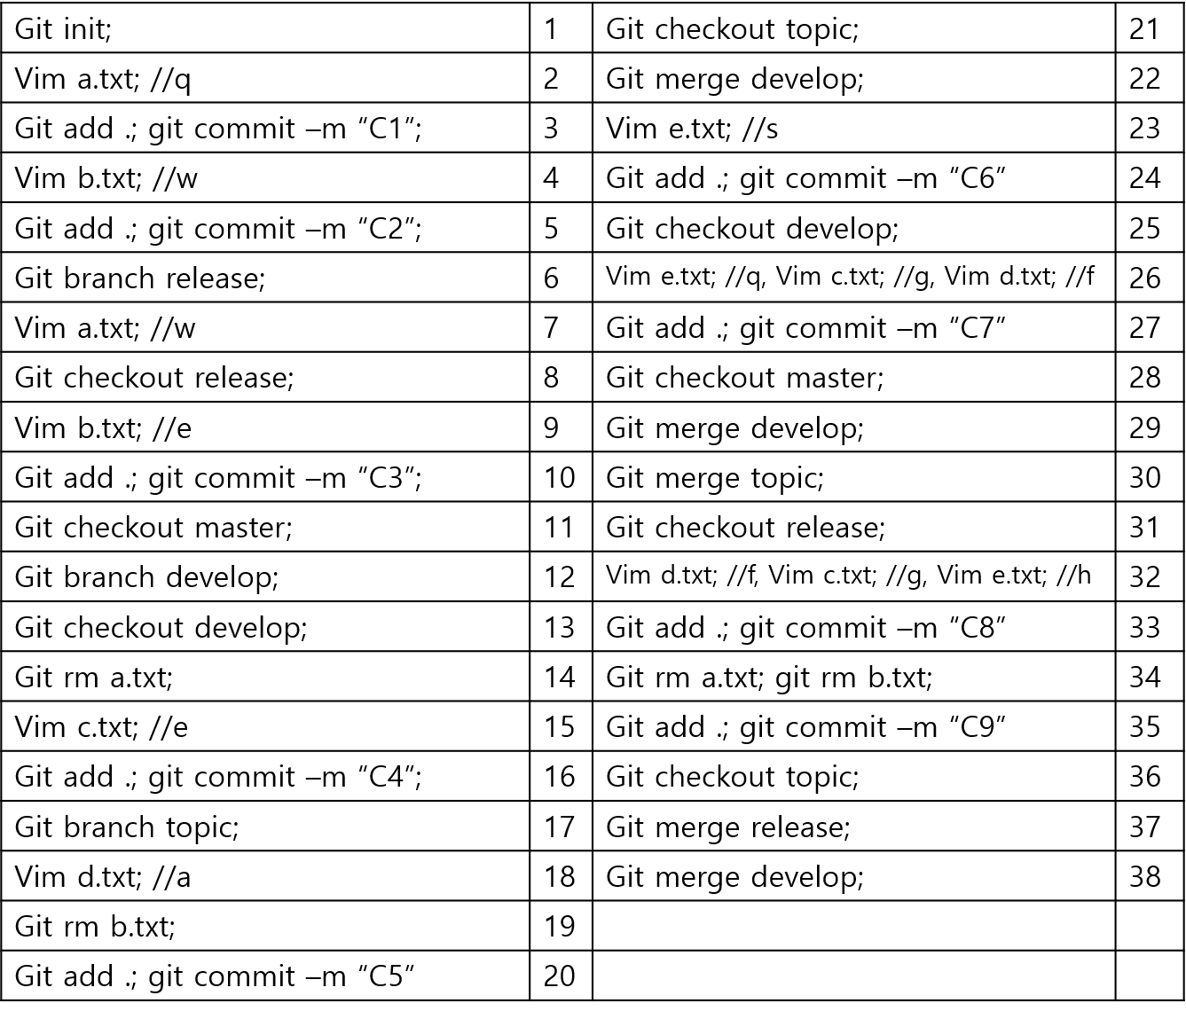
5be31d3:C1
Ada0f70:C2
12b3c03:C3
C5fb545:C8
58fa882:C9
release
376309e:C4
D87d528:C5
A29d4ee:C6
64992d6:MC2
MC3
topic
8b0fc79:C7
c5982c:MC1
HEAD
master
develop
Working dir
X, x, x, x, x | 1 | X, w, e, x, x | 21
q, x, x, x, x | 2 | X, x, e, a, x | 22F
q, x, x, x, x : C1 | 3 | X, x, e, a, s | 23
Q, w, x, x, x | 4 | X, x, e, a, s : C6 | 24
Q, w, x, x, x : C2 | 5 | X, x, e, a, x | 25
Q, w, x, x, x | 6 | X, x, g, f, q | 26
w, w, x, x, x | 7 | X, x, g, f, q : C7 | 27
w, w, x, x, x | 8 | Q, w, x, x, x | 28
w, e, x, x, x | 9 | X, x, g, f, q | 29F
w, e, x, x, x : C3 | 10 | X, x, g, f, k | 30MC1
Q, w, x, x, x | 11 | w, e, x, x, x | 31
Q, w, x, x, x | 12 | W, e, g, f, h | 32
Q, w, x, x, x | 13 | W, e, g, f, h : C8 | 33
X, w, x, x, x | 14 | x, x, g, f, h | 34
X, w, e, x, x | 15 | x, x, g, f, h : C9 | 35
X, w, e, x, x : C4 | 16 | X, x, e, a, s | 36
X, w, e, x, x | 17 | X, x, k, k, k | 37MC2
X, w, e, a, x | 18 | X, x, k, k, k | 38MC3
X, x, e, a, x | 19
X, x, e, a, x : C5 | 20

