Slide 1
Lecture 11.
Minimum Spanning Trees

Slide 2
Minimum Spanning Tree
A town has a set of houses and a set of roads
A road connects 2 and only 2 houses
A road connecting houses u and v has a repair cost w(u, v)
Goal: Repair enough (and no more) roads such that
  everyone stays connected: can reach every house from all other houses, and
  total repair cost is minimum

Slide 3
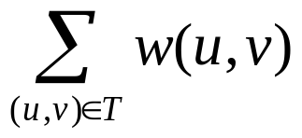
Minimum Spanning Tree
Model as a graph:
  Undirected graph G = (V, E)
  Weight w(u, v) on each edge (u, v) ∈ E
  Find T ⊆ E such that
    T connects all vertices
      (T is a spanning tree)
    w(T ) = is minimized

Slide 4
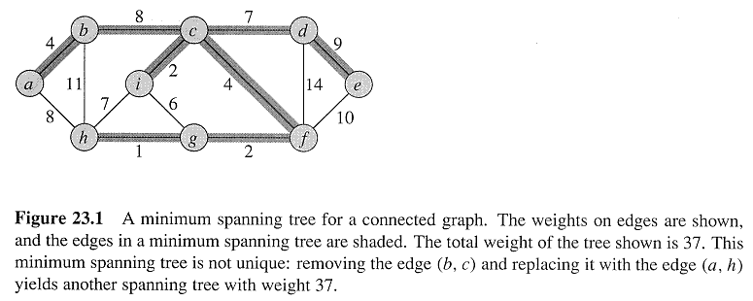
Minimum Spanning Tree
A spanning tree whose weight is minimum over all spanning trees is called a Minimum Spanning Tree, or MST
Example:
In this example, there is more than one MST
Replace edge (b,c) by (a,h)
Get a different spanning tree with the same weight

Slide 5
Minimum Spanning Tree
Which edges form the Minimum Spanning Tree (MST) of the below graph?
A
A
6
6
4
4
5
5
9
H
9
H
B
B
C
C
14
14
2
2
10
10
15
G
15
G
E
E
D
D
3
3
8
F
8
F

Slide 6
Minimum Spanning Tree
MSTs satisfy the optimal substructure property:
an optimal tree is composed of optimal subtrees
  Let T be an MST of G with an edge (u,v) in the middle
  Removing (u,v) partitions T into two trees T₁ and T₂
  Claim: T₁ is an MST of G₁ = (V₁,E₁), and T₂ is an MST of G₂ = (V₂,E₂) ( Do V₁ and V₂ share vertices? Why? )
  Proof: w(T) = w(u,v) + w(T₁) + w(T₂)
  (There can’t be a better tree than T₁ or T₂, or T would be suboptimal)

Slide 7
Growing An MST
Some properties of an MST:
  It has |V| -1 edges
  It has no cycles
  It might not be unique
Building up the solution
  We will build a set A of edges
  Initially, A has no edges
  As we add edges to A, maintain a loop invariant:
    Loop invariant: A is a subset of some MST
  Add only edges that maintain the invariant
  If A is a subset of some MST, an edge (u, v) is safe for A
  if and only if A ∪ {(u, v)} is also a subset of some MST
  So we will add only safe edges

Slide 8
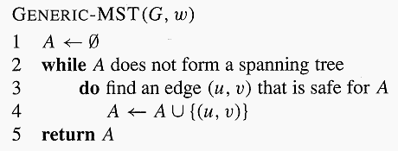
Growing An MST
Generic MST algorithm
Use the loop invariant to show that this generic algorithm works
  Initialization
    The empty set trivially satisfies the loop invariant
  Maintenance
    Since we add only safe edges, A remains a subset of some MST
  Termination
    All edges added to A are in an MST, so when we stop, A is a spanning tree that is also an MST

Slide 9
Growing An MST
Finding a safe edge
  Intuitiveness:
  Let S ⊂ V be any set of vertices that includes h but not g (so that g is in V - S).
  In any MST, there has to be one edge (at least) that connects S with V - S.
  Why not choose the edge with minimum weight?
  Some definitions: Let S ⊂ V and A ⊆ E
    A cut (S, V - S) is a partition of vertices into disjoint sets S and V - S
    Edge (u, v) ∈ E crosses cut (S, V - S)
    if one endpoint is in S and the other is in V - S
    A cut respects A if and only if no edge in A crosses the cut
    An edge is a light edge crossing a cut
    if and only if its weight is minimum over all edges crossing the cut

Slide 10
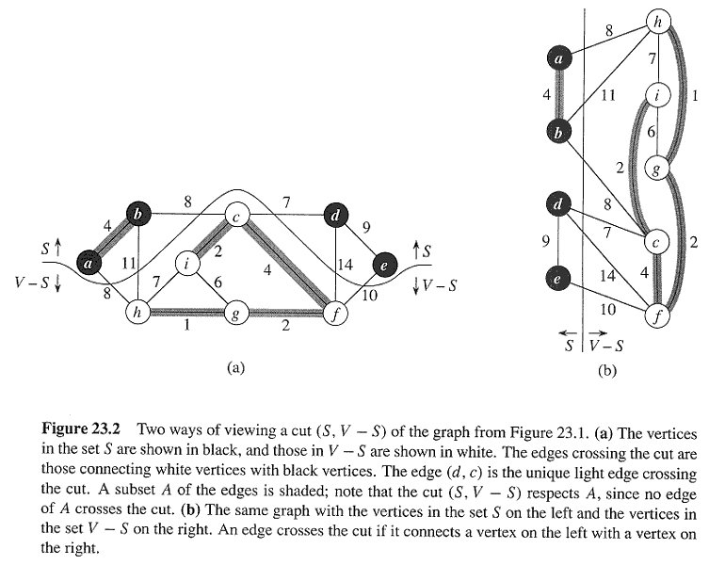
Growing An MST
cut, crosses, respects, light edge

Slide 11
Growing An MST
Theorem
  Let T be MST of G, and let A ⊆ T be subtree of T
  Let (u,v) be min-weight edge connecting A to V-A
  Then (u,v) ∈ T

Slide 12
Disjoint-Set Union Problem
Want a data structure to support disjoint sets
  Collection of disjoint sets S = {S_{i}}, S_{i} ∩ S_{j} = ∅
Need to support following operations:
  MakeSet(x): S = S U {{x}}
  Union(S_{i}, S_{j}): S = S - {S_{i}, S_{j}} U {S_{i} U S_{j}}
  FindSet(x): return S_{i} ∈ S such that x ∈ S_{i}
Before discussing implementation details,
we look at example application: MSTs

Slide 13
Kruskal’s Algorithm
Run the algorithm:
2
19
9
Kruskal()
{
T = ∅;
for each v ∈ V
MakeSet(v);
sort E by increasing edge weight w
for each (u,v) ∈ E (in sorted order)
if FindSet(u) ≠ FindSet(v)
T = T U {{u,v}};
Union(FindSet(u), FindSet(v));
}
14
17
8
25
5
21
13
1

Slide 14
Kruskal’s Algorithm
Run the algorithm:
2
19
9
Kruskal()
{
T = ∅;
for each v ∈ V
MakeSet(v);
sort E by increasing edge weight w
for each (u,v) ∈ E (in sorted order)
if FindSet(u) ≠ FindSet(v)
T = T U {{u,v}};
Union(FindSet(u), FindSet(v));
}
14
17
8
25
5
21
13
1

Slide 15
Kruskal’s Algorithm
Run the algorithm:
2
19
9
Kruskal()
{
T = ∅;
for each v ∈ V
MakeSet(v);
sort E by increasing edge weight w
for each (u,v) ∈ E (in sorted order)
if FindSet(u) ≠ FindSet(v)
T = T U {{u,v}};
Union(FindSet(u), FindSet(v));
}
14
17
8
25
5
21
13
1?

Slide 16
Kruskal’s Algorithm
Run the algorithm:
2
19
9
Kruskal()
{
T = ∅;
for each v ∈ V
MakeSet(v);
sort E by increasing edge weight w
for each (u,v) ∈ E (in sorted order)
if FindSet(u) ≠ FindSet(v)
T = T U {{u,v}};
Union(FindSet(u), FindSet(v));
}
14
17
8
25
5
21
13
1

Slide 17
Kruskal’s Algorithm
Run the algorithm:
2?
19
9
Kruskal()
{
T = ∅;
for each v ∈ V
MakeSet(v);
sort E by increasing edge weight w
for each (u,v) ∈ E (in sorted order)
if FindSet(u) ≠ FindSet(v)
T = T U {{u,v}};
Union(FindSet(u), FindSet(v));
}
14
17
8
25
5
21
13
1

Slide 18
Kruskal’s Algorithm
Run the algorithm:
2
19
9
Kruskal()
{
T = ∅;
for each v ∈ V
MakeSet(v);
sort E by increasing edge weight w
for each (u,v) ∈ E (in sorted order)
if FindSet(u) ≠ FindSet(v)
T = T U {{u,v}};
Union(FindSet(u), FindSet(v));
}
14
17
8
25
5
21
13
1

Slide 19
Kruskal’s Algorithm
Run the algorithm:
2
19
9
Kruskal()
{
T = ∅;
for each v ∈ V
MakeSet(v);
sort E by increasing edge weight w
for each (u,v) ∈ E (in sorted order)
if FindSet(u) ≠ FindSet(v)
T = T U {{u,v}};
Union(FindSet(u), FindSet(v));
}
14
17
8
25
5?
21
13
1

Slide 20
Kruskal’s Algorithm
Run the algorithm:
2
19
9
Kruskal()
{
T = ∅;
for each v ∈ V
MakeSet(v);
sort E by increasing edge weight w
for each (u,v) ∈ E (in sorted order)
if FindSet(u) ≠ FindSet(v)
T = T U {{u,v}};
Union(FindSet(u), FindSet(v));
}
14
17
8
25
5
21
13
1

Slide 21
Kruskal’s Algorithm
Run the algorithm:
2
19
9
Kruskal()
{
T = ∅;
for each v ∈ V
MakeSet(v);
sort E by increasing edge weight w
for each (u,v) ∈ E (in sorted order)
if FindSet(u) ≠ FindSet(v)
T = T U {{u,v}};
Union(FindSet(u), FindSet(v));
}
14
17
8?
25
5
21
13
1

Slide 22
Kruskal’s Algorithm
Run the algorithm:
2
19
9
Kruskal()
{
T = ∅;
for each v ∈ V
MakeSet(v);
sort E by increasing edge weight w
for each (u,v) ∈ E (in sorted order)
if FindSet(u) ≠ FindSet(v)
T = T U {{u,v}};
Union(FindSet(u), FindSet(v));
}
14
17
8
25
5
21
13
1

Slide 23
Kruskal’s Algorithm
Run the algorithm:
2
19
9?
Kruskal()
{
T = ∅;
for each v ∈ V
MakeSet(v);
sort E by increasing edge weight w
for each (u,v) ∈ E (in sorted order)
if FindSet(u) ≠ FindSet(v)
T = T U {{u,v}};
Union(FindSet(u), FindSet(v));
}
14
17
8
25
5
21
13
1

Slide 24
Kruskal’s Algorithm
Run the algorithm:
2
19
9
Kruskal()
{
T = ∅;
for each v ∈ V
MakeSet(v);
sort E by increasing edge weight w
for each (u,v) ∈ E (in sorted order)
if FindSet(u) ≠ FindSet(v)
T = T U {{u,v}};
Union(FindSet(u), FindSet(v));
}
14
17
8
25
5
21
13
1

Slide 25
Kruskal’s Algorithm
Run the algorithm:
2
19
9
Kruskal()
{
T = ∅;
for each v ∈ V
MakeSet(v);
sort E by increasing edge weight w
for each (u,v) ∈ E (in sorted order)
if FindSet(u) ≠ FindSet(v)
T = T U {{u,v}};
Union(FindSet(u), FindSet(v));
}
14
17
8
25
5
21
13?
1

Slide 26
Kruskal’s Algorithm
Run the algorithm:
2
19
9
Kruskal()
{
T = ∅;
for each v ∈ V
MakeSet(v);
sort E by increasing edge weight w
for each (u,v) ∈ E (in sorted order)
if FindSet(u) ≠ FindSet(v)
T = T U {{u,v}};
Union(FindSet(u), FindSet(v));
}
14
17
8
25
5
21
13
1

Slide 27
Kruskal’s Algorithm
Run the algorithm:
2
19
9
Kruskal()
{
T = ∅;
for each v ∈ V
MakeSet(v);
sort E by increasing edge weight w
for each (u,v) ∈ E (in sorted order)
if FindSet(u) ≠ FindSet(v)
T = T U {{u,v}};
Union(FindSet(u), FindSet(v));
}
14?
17
8
25
5
21
13
1

Slide 28
Kruskal’s Algorithm
Run the algorithm:
2
19
9
Kruskal()
{
T = ∅;
for each v ∈ V
MakeSet(v);
sort E by increasing edge weight w
for each (u,v) ∈ E (in sorted order)
if FindSet(u) ≠ FindSet(v)
T = T U {{u,v}};
Union(FindSet(u), FindSet(v));
}
14
17
8
25
5
21
13
1

Slide 29
Kruskal’s Algorithm
Run the algorithm:
2
19
9
Kruskal()
{
T = ∅;
for each v ∈ V
MakeSet(v);
sort E by increasing edge weight w
for each (u,v) ∈ E (in sorted order)
if FindSet(u) ≠ FindSet(v)
T = T U {{u,v}};
Union(FindSet(u), FindSet(v));
}
14
17?
8
25
5
21
13
1

Slide 30
Kruskal’s Algorithm
Run the algorithm:
2
19?
9
Kruskal()
{
T = ∅;
for each v ∈ V
MakeSet(v);
sort E by increasing edge weight w
for each (u,v) ∈ E (in sorted order)
if FindSet(u) ≠ FindSet(v)
T = T U {{u,v}};
Union(FindSet(u), FindSet(v));
}
14
17
8
25
5
21
13
1

Slide 31
Kruskal’s Algorithm
Run the algorithm:
2
19
9
Kruskal()
{
T = ∅;
for each v ∈ V
MakeSet(v);
sort E by increasing edge weight w
for each (u,v) ∈ E (in sorted order)
if FindSet(u) ≠ FindSet(v)
T = T U {{u,v}};
Union(FindSet(u), FindSet(v));
}
14
17
8
25
5
21?
13
1

Slide 32
Kruskal’s Algorithm
Run the algorithm:
2
19
9
Kruskal()
{
T = ∅;
for each v ∈ V
MakeSet(v);
sort E by increasing edge weight w
for each (u,v) ∈ E (in sorted order)
if FindSet(u) ≠ FindSet(v)
T = T U {{u,v}};
Union(FindSet(u), FindSet(v));
}
14
17
8
25?
5
21
13
1

Slide 33
Kruskal’s Algorithm
Run the algorithm:
2
19
9
Kruskal()
{
T = ∅;
for each v ∈ V
MakeSet(v);
sort E by increasing edge weight w
for each (u,v) ∈ E (in sorted order)
if FindSet(u) ≠ FindSet(v)
T = T U {{u,v}};
Union(FindSet(u), FindSet(v));
}
14
17
8
25
5
21
13
1

Slide 34
Kruskal’s Algorithm
Run the algorithm:
2
19
9
Kruskal()
{
T = ∅;
for each v ∈ V
MakeSet(v);
sort E by increasing edge weight w
for each (u,v) ∈ E (in sorted order)
if FindSet(u) ≠ FindSet(v)
T = T U {{u,v}};
Union(FindSet(u), FindSet(v));
}
14
17
8
25
5
21
13
1

Slide 35
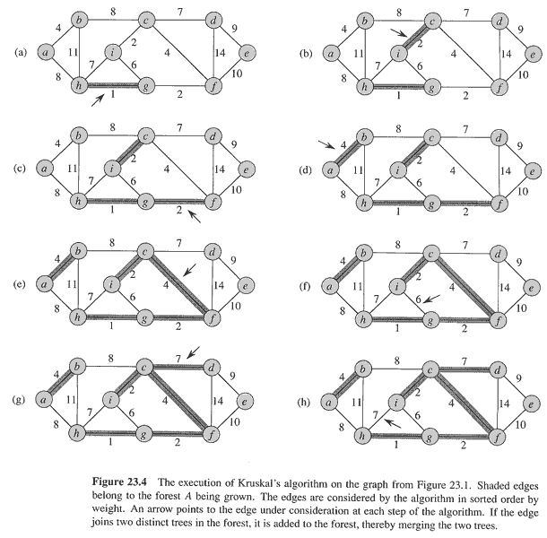
Kruskal’s Algorithm

Slide 36
Kruskal’s Algorithm

Slide 37
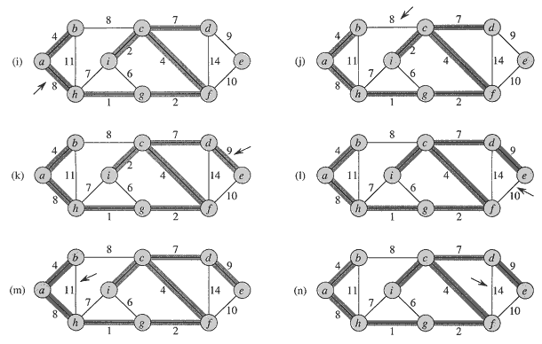
Kruskal’s Algorithm

Slide 38
Kruskal’s Algorithm
What will affect the running time?
1 Sort
O(V) MakeSet() calls
O(E) FindSet() calls
O(V) Union() calls
(Exactly how many Union()s?)
Kruskal()
{
T = ∅;
for each v ∈ V
MakeSet(v);
sort E by increasing edge weight w
for each (u,v) ∈ E (in sorted order)
if FindSet(u) ≠ FindSet(v)
T = T U {{u,v}};
Union(FindSet(u), FindSet(v));
}

Slide 39
Prim’s Algorithm
6
4
MST-Prim(G, w, r)
Q = V[G];
for each u ∈ Q
key[u] = ∞;
key[r] = 0;
p[r] = NULL;
while (Q not empty)
u = ExtractMin(Q);
for each v ∈ Adj[u]
if (v ∈ Q and w(u,v) < key[v])
p[v] = u;
key[v] = w(u,v);
5
9
14
2
10
15
3
8
Run on example graph

Slide 40
Prim’s Algorithm
6
∞
4
MST-Prim(G, w, r)
Q = V[G];
for each u ∈ Q
key[u] = ∞;
key[r] = 0;
p[r] = NULL;
while (Q not empty)
u = ExtractMin(Q);
for each v ∈ Adj[u]
if (v ∈ Q and w(u,v) < key[v])
p[v] = u;
key[v] = w(u,v);
5
9
∞
∞
∞
14
2
10
15
∞
∞
∞
3
∞
8
Run on example graph

Slide 41
Prim’s Algorithm
6
∞
4
MST-Prim(G, w, r)
Q = V[G];
for each u ∈ Q
key[u] = ∞;
key[r] = 0;
p[r] = NULL;
while (Q not empty)
u = ExtractMin(Q);
for each v ∈ Adj[u]
if (v ∈ Q and w(u,v) < key[v])
p[v] = u;
key[v] = w(u,v);
5
9
∞
∞
∞
14
2
10
15
r
0
∞
∞
3
∞
8
Pick a start vertex r

Slide 42
Prim’s Algorithm
6
∞
4
MST-Prim(G, w, r)
Q = V[G];
for each u ∈ Q
key[u] = ∞;
key[r] = 0;
p[r] = NULL;
while (Q not empty)
u = ExtractMin(Q);
for each v ∈ Adj[u]
if (v ∈ Q and w(u,v) < key[v])
p[v] = u;
key[v] = w(u,v);
5
9
∞
∞
∞
14
2
10
15
u
0
∞
∞
3
∞
8
Black vertices have been removed from Q

Slide 43
Prim’s Algorithm
6
∞
4
MST-Prim(G, w, r)
Q = V[G];
for each u ∈ Q
key[u] = ∞;
key[r] = 0;
p[r] = NULL;
while (Q not empty)
u = ExtractMin(Q);
for each v ∈ Adj[u]
if (v ∈ Q and w(u,v) < key[v])
p[v] = u;
key[v] = w(u,v);
5
9
∞
∞
∞
14
2
10
15
u
0
∞
∞
3
3
8
Black arrows indicate parent pointers

Slide 44
Prim’s Algorithm
6
∞
4
MST-Prim(G, w, r)
Q = V[G];
for each u ∈ Q
key[u] = ∞;
key[r] = 0;
p[r] = NULL;
while (Q not empty)
u = ExtractMin(Q);
for each v ∈ Adj[u]
if (v ∈ Q and w(u,v) < key[v])
p[v] = u;
key[v] = w(u,v);
5
9
14
∞
∞
14
2
10
15
u
0
∞
∞
3
3
8

Slide 45
Prim’s Algorithm
6
∞
4
MST-Prim(G, w, r)
Q = V[G];
for each u ∈ Q
key[u] = ∞;
key[r] = 0;
p[r] = NULL;
while (Q not empty)
u = ExtractMin(Q);
for each v ∈ Adj[u]
if (v ∈ Q and w(u,v) < key[v])
p[v] = u;
key[v] = w(u,v);
5
9
14
∞
∞
14
2
10
15
0
∞
∞
3
3
8
u

Slide 46
Prim’s Algorithm
6
∞
4
MST-Prim(G, w, r)
Q = V[G];
for each u ∈ Q
key[u] = ∞;
key[r] = 0;
p[r] = NULL;
while (Q not empty)
u = ExtractMin(Q);
for each v ∈ Adj[u]
if (v ∈ Q and w(u,v) < key[v])
p[v] = u;
key[v] = w(u,v);
5
9
14
∞
∞
14
2
10
15
0
8
∞
3
3
8
u

Slide 47
Prim’s Algorithm
6
∞
4
MST-Prim(G, w, r)
Q = V[G];
for each u ∈ Q
key[u] = ∞;
key[r] = 0;
p[r] = NULL;
while (Q not empty)
u = ExtractMin(Q);
for each v ∈ Adj[u]
if (v ∈ Q and w(u,v) < key[v])
p[v] = u;
key[v] = w(u,v);
5
9
10
∞
∞
14
2
10
15
0
8
∞
3
3
8
u

Slide 48
Prim’s Algorithm
6
∞
4
MST-Prim(G, w, r)
Q = V[G];
for each u ∈ Q
key[u] = ∞;
key[r] = 0;
p[r] = NULL;
while (Q not empty)
u = ExtractMin(Q);
for each v ∈ Adj[u]
if (v ∈ Q and w(u,v) < key[v])
p[v] = u;
key[v] = w(u,v);
5
9
10
∞
∞
14
2
10
15
0
8
∞
3
3
8
u

Slide 49
Prim’s Algorithm
6
∞
4
MST-Prim(G, w, r)
Q = V[G];
for each u ∈ Q
key[u] = ∞;
key[r] = 0;
p[r] = NULL;
while (Q not empty)
u = ExtractMin(Q);
for each v ∈ Adj[u]
if (v ∈ Q and w(u,v) < key[v])
p[v] = u;
key[v] = w(u,v);
5
9
10
2
∞
14
2
10
15
0
8
∞
3
3
8
u

Slide 50
Prim’s Algorithm
6
∞
4
MST-Prim(G, w, r)
Q = V[G];
for each u ∈ Q
key[u] = ∞;
key[r] = 0;
p[r] = NULL;
while (Q not empty)
u = ExtractMin(Q);
for each v ∈ Adj[u]
if (v ∈ Q and w(u,v) < key[v])
p[v] = u;
key[v] = w(u,v);
5
9
10
2
∞
14
2
10
15
0
8
15
3
3
8
u

Slide 51
Prim’s Algorithm
∞
u
6
4
MST-Prim(G, w, r)
Q = V[G];
for each u ∈ Q
key[u] = ∞;
key[r] = 0;
p[r] = NULL;
while (Q not empty)
u = ExtractMin(Q);
for each v ∈ Adj[u]
if (v ∈ Q and w(u,v) < key[v])
p[v] = u;
key[v] = w(u,v);
5
9
10
2
∞
14
2
10
15
0
8
15
3
3
8

Slide 52
Prim’s Algorithm
∞
u
6
4
MST-Prim(G, w, r)
Q = V[G];
for each u ∈ Q
key[u] = ∞;
key[r] = 0;
p[r] = NULL;
while (Q not empty)
u = ExtractMin(Q);
for each v ∈ Adj[u]
if (v ∈ Q and w(u,v) < key[v])
p[v] = u;
key[v] = w(u,v);
5
9
10
2
9
14
2
10
15
0
8
15
3
3
8

Slide 53
Prim’s Algorithm
4
u
6
4
MST-Prim(G, w, r)
Q = V[G];
for each u ∈ Q
key[u] = ∞;
key[r] = 0;
p[r] = NULL;
while (Q not empty)
u = ExtractMin(Q);
for each v ∈ Adj[u]
if (v ∈ Q and w(u,v) < key[v])
p[v] = u;
key[v] = w(u,v);
5
9
10
2
9
14
2
10
15
0
8
15
3
3
8

Slide 54
Prim’s Algorithm
4
u
6
4
MST-Prim(G, w, r)
Q = V[G];
for each u ∈ Q
key[u] = ∞;
key[r] = 0;
p[r] = NULL;
while (Q not empty)
u = ExtractMin(Q);
for each v ∈ Adj[u]
if (v ∈ Q and w(u,v) < key[v])
p[v] = u;
key[v] = w(u,v);
5
9
5
2
9
14
2
10
15
0
8
15
3
3
8

Slide 55
Prim’s Algorithm
u
6
4
4
MST-Prim(G, w, r)
Q = V[G];
for each u ∈ Q
key[u] = ∞;
key[r] = 0;
p[r] = NULL;
while (Q not empty)
u = ExtractMin(Q);
for each v ∈ Adj[u]
if (v ∈ Q and w(u,v) < key[v])
p[v] = u;
key[v] = w(u,v);
5
9
5
2
9
14
2
10
15
0
8
15
3
3
8

Slide 56
Prim’s Algorithm
u
4
6
4
MST-Prim(G, w, r)
Q = V[G];
for each u ∈ Q
key[u] = ∞;
key[r] = 0;
p[r] = NULL;
while (Q not empty)
u = ExtractMin(Q);
for each v ∈ Adj[u]
if (v ∈ Q and w(u,v) < key[v])
p[v] = u;
key[v] = w(u,v);
5
9
5
2
9
14
2
10
15
0
8
15
3
3
8

Slide 57
Prim’s Algorithm
u
6
4
4
MST-Prim(G, w, r)
Q = V[G];
for each u ∈ Q
key[u] = ∞;
key[r] = 0;
p[r] = NULL;
while (Q not empty)
u = ExtractMin(Q);
for each v ∈ Adj[u]
if (v ∈ Q and w(u,v) < key[v])
p[v] = u;
key[v] = w(u,v);
5
9
5
2
9
14
2
10
15
0
8
15
3
3
8

Slide 58
Prim’s Algorithm
6
4
4
MST-Prim(G, w, r)
Q = V[G];
for each u ∈ Q
key[u] = ∞;
key[r] = 0;
p[r] = NULL;
while (Q not empty)
u = ExtractMin(Q);
for each v ∈ Adj[u]
if (v ∈ Q and w(u,v) < key[v])
p[v] = u;
key[v] = w(u,v);
5
9
5
2
9
14
2
u
10
15
0
8
15
3
3
8

Slide 59
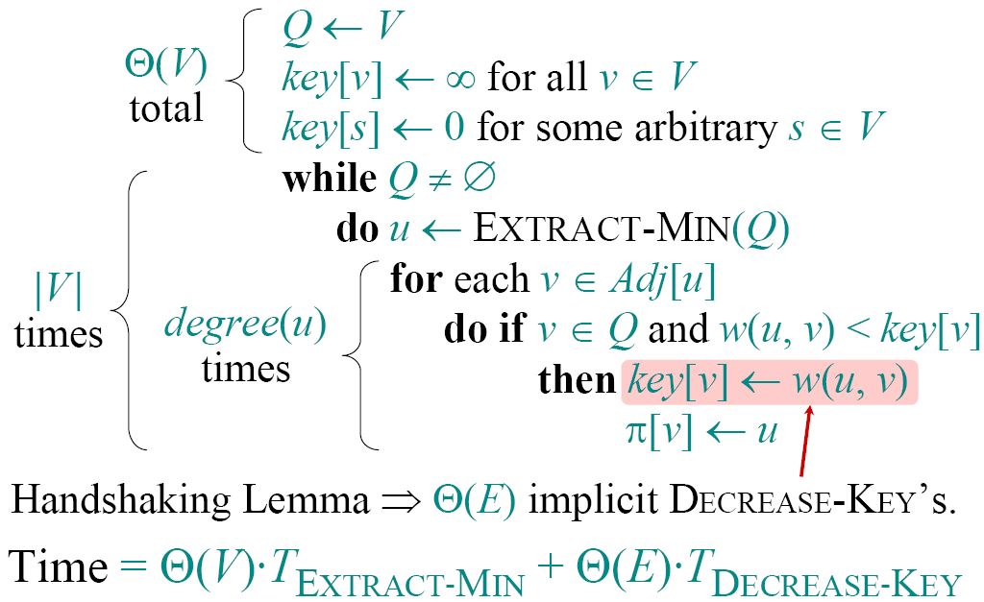
Analysis of Prim’s Algorithm

Slide 60
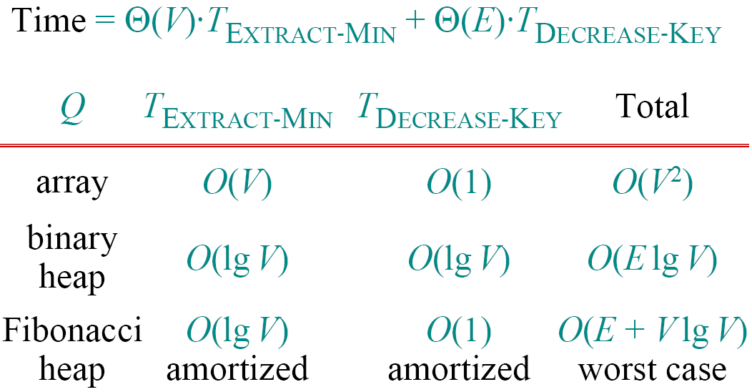
Analysis of Prim’s Algorithm

Slide 61
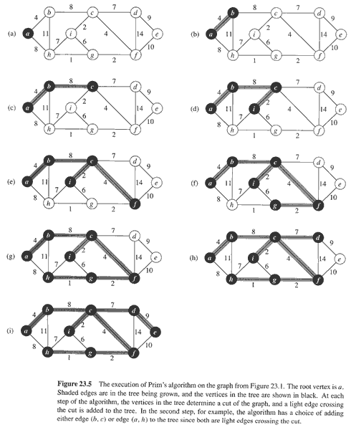
Prim’s Algorithm

Slide 62
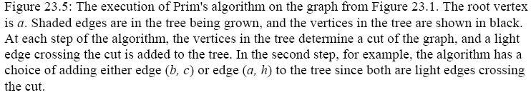
Prim’s Algorithm

