Slide 1
Lecture 12.
Single-Source Shortest Paths
All-Pairs Shortest Paths

Slide 2
Single-Source Shortest Path
Problem: Given a weighted directed graph G,
find the minimum-weight path from a given source vertex s to another vertex v
  Shortest-path
    minimum weight
  Weight of path is sum of edges
  e.g., a road map
    what is the shortest path from Chapel Hill to Charlottesville?

Slide 3
Shortest Path Properties
Again, we have optimal substructure
  the shortest path consists of shortest subpaths:
  Proof: suppose some subpath is not a shortest path
    There must then exist a shorter subpath
    It could substitute the shorter subpath for a shorter path
    But then overall path is not shortest path
    Contradiction

Slide 4
Shortest Path Properties
Define δ(u,v) to be the weight of the shortest path from u to v
Shortest paths satisfy the triangle inequality
  δ(u,v) ≤ δ(u,x) + δ(x,v)
  Proof:
x
u
v
This path is no longer than any other path

Slide 5
Relaxation
A key technique in shortest path algorithms is relaxation
  Idea: for all v, maintain upper bound d[v] on δ(s,v)
  Relax(u,v,w) {
  if (d[v] > d[u]+w) then d[v]=d[u]+w;
  }
5
2
9
5
2
6
Relax
Relax
5
2
7
5
2
6

Slide 6
Bellman-Ford Algorithm
BellmanFord()
for each v ∈ V
d[v] = ∞;
d[s] = 0;
for i=1 to |V|-1
for each edge (u,v) ∈ E
Relax(u,v, w(u,v));
for each edge (u,v) ∈ E
if (d[v] > d[u] + w(u,v))
return “no solution”;
Relax(u,v,w): if (d[v] > d[u]+w) then d[v]=d[u]+w
Initialize d[], which
will converge to
shortest-path value δ
Relaxation:
Make |V|-1 passes,
relaxing each edge
Test for solution
Under what condition
do we get a solution?

Slide 7
Bellman-Ford Algorithm e.g.
t
5
x
t
5
x
∞
-2
∞
6
-2
∞
6
6
-3
-3
s
0
8
s
0
8
-4
7
-4
7
2
2
t
5
x
7
7
-2
∞
∞
7
∞
6
2
4
9
9
y
z
y
z
-3
s
0
8
t
5
x
t
5
x
-4
7
2
6
-2
4
2
-2
4
7
6
6
7
−2
-3
-3
9
8
8
y
z
s
0
-4
7
s
0
-4
7
2
2
7
7
7
2
7
2
9
9
y
z
y
z

Slide 8

Dijkstra’s Algorithm
Input
  A digraph G(V,E) where edges are associated with non-negative weight (cost) and a source src
Output
  Lengths of shortest paths from src to each node in G
Idea : without loss of general
  V = { 1, 2, …, n } where 1 is a source node
  We have two sets
    S : set of nodes already chosen ( S = { 1 } )
    C : set of remaining node ( C = { 2, 3, …, n } )
    D[1, 2, …, n] : containing costs of shortest path

Slide 9
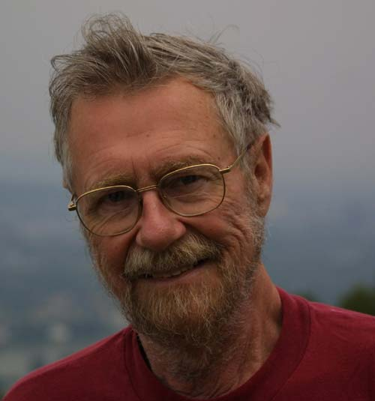
Dijkstra’s Algorithm
Repeatedly add a node v in C to S
whose distance to 1 (source) is minimal until
S = {1, 2, …, n}
Dijkstra ( L[1,…,n, 1,…,n] )
/* L is cost array, L[i,j] : cost if (i,j) in E or : infinity if (i,j) is not in E */
C <- { 2, 3, …, n }
for i <- 2 to n do D[i] <- L[1,i]
repeat (n-2) times
v <- a node in C s.t. D[v] = Min{ D[w] } for each w in C
C <- C – {v}
for each w in C do D[w] <- Min{ D[w], D[v]+L[v,w] }
return D

Slide 10
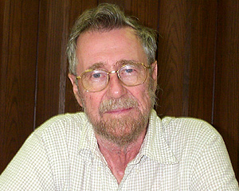
Dijkstra’s Algorithm e.g.
1
50
10
2
30
|V| = 5
|E| = 8
100
20
5
5
10
3
4
50
Step v C D
2 3 4 5
0 -- { 2, 3, 4, 5 }
50 30 100 10
1 5 { 2, 3, 4 }
50 30 20 10
2 4 { 2, 3 }
40 30 20 10
3 3 { 2 }
35 30 20 10

Slide 11
Dijkstra’s Algorithm e.g.
u
v
u
v
u
v
1
1
1
∞
∞
10
8
14
10
8
9
10
9
9
9
2
3
s
0
2
3
0
2
3
s
0
4
6
4
6
4
6
7
7
7
5
5
5
∞
∞
5
7
5
7
2
2
2
x
y
x
y
x
y
u
v
u
v
u
v
1
1
1
10
∞
10
8
13
10
8
9
10
9
9
9
2
3
s
0
2
3
0
2
3
s
0
4
6
4
6
4
6
7
7
7
5
5
5
5
∞
5
7
5
7
2
2
2
x
y
x
y
x
y

Slide 12
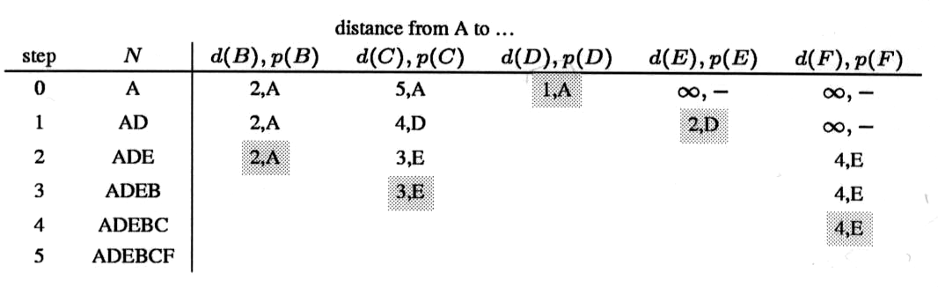
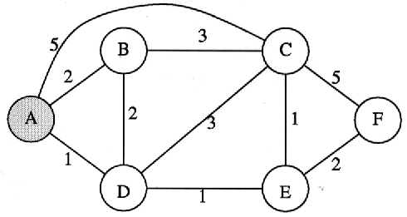
Dijkstra’s Algorithm e.g.

Slide 13
Minimum Steiner Tree
The Steiner problem in graphs (NP-complete)
  Given graph G(V,E)
  A subset S of V
  Find a subgraph
    the minimum cost among all connected subgraphs
    subgraphs contain S
  It is evident that
    the subgraph is a solution of this problem must be a tree
    We briefly call it an optimal tree
|V|=n, |S|=k (k>1)
  “Shortest path problem” when k=2
  “Minimum-cost Spanning Tree problem” when k=n

Slide 14
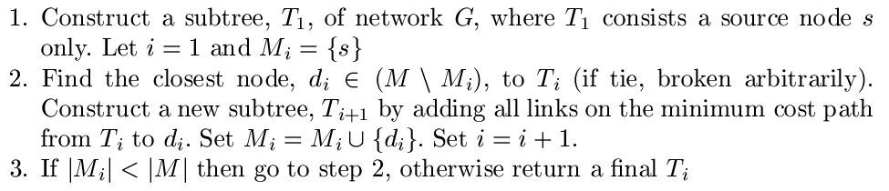
Minimum Steiner Tree
Multicasting
  It refers to the transmission of data from one node to a selected group of nodes
TM Algorithm
  Hiromitsu Takahashi and Akira Matsuyama
  “AN APPROXIMATE SOLUTION FOR THE STEINER PROBLEM IN GRAPHS”
  Math. Japonica, vol. 24, no. 6, pp. 573-577, 1980.
Pseudo Code

Slide 15

Minimum Steiner Tree
TM e.g.
Source
3
2
1
3
2
1
3
1
3
2
4
5
4
3
3
1
2
6
7
Member 1
Member 2

Slide 16
Minimum Steiner Tree
Self-study: KMB Algorithm
  L. Kou, G. Markowsky, and L. Berman
  “A Fast Algorithm for Steiner Trees”
  Acta Informatica, vol. 15, pp. 145-151, 1981.
Source
Source
3
2
3
2
1
3
2
Source
1
3
2
1
3
1
3
1
3
2
5
6
1
3
2
6
7
7
4
4
3
5
4
4
3
5
3
Member 1
Member 2
3
1
2
1
2
6
7
6
7
Member 1
Member 2
Member 1
Member 2

Slide 17
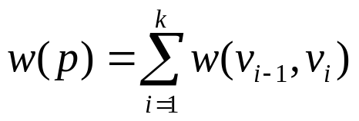
Shortest Path Problems
Input:
  Directed graph G = (V, E)
  Weight function w : E → R
Weight of path p = ⟨v₀, v₁, . . . , v_{k}⟩
Shortest-path weight from u to v
  δ(u, v) = min w(p) : u v if there exists a path from u to v
∞ otherwise
Shortest path from u to v is any path p such that w(p) = δ(u, v)
t
x
3
6
9
3
4
s
0
2
1
2
7
5
3
5
11
6
y
z
p

Slide 18
Shortest Path Representation
d[v] = δ(s, v): a shortest path estimate
  Initially, d[v]=∞
  Reduces as algorithms progress
π[v] = predecessor of v
on a shortest path from s
  If no predecessor, π[v] = NIL
  π induces a tree : shortest path tree
Shortest paths & shortest path trees are not unique
t
x
3
6
9
3
4
s
0
2
1
2
7
5
3
5
11
6
y
z

Slide 19
Relaxation
Relaxing an edge (u, v)
  Testing whether we can improve the shortest path
  to v found so far by going through u
    If d[v] > d[u] + w(u, v)
    we can improve the shortest path to v
    ⇒ update d[v] and π[v]
s
s
u
v
u
v
5
2
9
5
2
6
RELAX(u, v, w)
RELAX(u, v, w)
u
v
u
v
5
2
7
5
2
6

Slide 20
Bellman-Ford Algorithm
t
x
-2
Single-source shortest paths problem
  Computes d[v] and π[v] for all v ∈ V
It allows negative edge weights
Returns:
  TRUE if no negative-weight cycles are reachable from the source s
  FALSE otherwise ⇒ no solution exists
Idea:
  Traverse all the edges |V| – 1 times, every time performing a relaxation step of each edge
6
2
4
-3
s
0
8
-4
7
2
7
7
−2
9
y
z

Slide 21
Dijkstra’s Algorithm
Single-source shortest path problem:
  No negative-weight edges: w(u, v) > 0 ∀ (u, v) ∈ E
Maintains two sets of vertices:
  S = vertices whose final shortest-path
  weights have already been determined
  C = vertices in V – S
Repeatedly select a vertex u ∈ V – S, with the minimum shortest-path estimate d[v]
u
v
1
10
8
9
9
0
2
3
4
6
7
5
5
7
2
x
y

Slide 22
All-Pairs Shortest Paths - Solutions
If we run Bellman-Ford once from each vertex:
  O(V²E),
  which is O(V⁴) if the graph is dense (E = Θ(V²))
If no negative-weight edges, we could run Dijkstra’s algorithm once from each vertex:
  O(VElgV) with binary heap, O(V³lgV) if the graph is dense
  O(EV + V²lgV) with Fibonacci heap, O(V³) if the graph is dense
We’ll see how to do in O(V³) in all cases,
with no fancy data structure

Slide 23
All-Pairs Shortest Paths (APSP)
2
3
4
Given:
  Directed graph G = (V, E)
  Weight function w : E → R
Compute:
  The shortest paths between all pairs of vertices in a graph
  Representation of the result:
    an n×n matrix of shortest-path distances δ(u, v)
1
8
3
2
-4
1
-5
7
5
4
6

Slide 24
All-Pairs Shortest Paths
2
Assume the graph G is given
as adjacency matrix of weights
  W = (w_{ij}), n x n matrix, |V| = n
  Vertices numbered 1 to n
    if i = j
    w_{ij} = if i ≠ j , (i, j) ∈ E
    if i ≠ j , (i, j) ∉ E
Output the result in an n x n matrix
D = (d_{ij}), where d_{ij} = δ(i, j)
Solve the problem using dynamic programming
3
4
1
8
3
2
-4
1
-5
7
0
5
4
6
weight of (i, j)
∞

Slide 25
Optimal Substructure of a Shortest Path
at most m edges
All subpaths of a shortest path are shortest paths
Let p: a shortest path p from vertex i to j that contains at most m edges
If i = j
  w(p) = 0 and p has no edges
∞
11
j
i
k
at most m - 1 edges
p’
If i ≠ j: p = i k → j
  p’ has at most m-1 edges
  p’ is a shortest path
  δ(i, j) =
δ(i, k) + w_{kj}

Slide 26
Recursive Solution
l_{ij}^{(m)} : weight of shortest path i j
that contains at most m edges
m = 0: l_{ij}⁽⁰⁾ = if i = j
if i ≠ j
m ≥ 1: l_{ij}^{(m)} =
  Shortest path from i to j with at most m – 1 edges
  Shortest path from i to j containing at most m edges, considering all possible predecessors (k) of j
at most m edges
0
∞
11
j
∞
i
k
l_{ij}^{(m-1)}
min { , }
min { l_{ik}^{(m-1)} + w_{kj} }
1 ≤ k ≤ n
= min { l_{ik}^{(m-1)} + w_{kj} }
1 ≤ k ≤ n

Slide 27
Computing the Shortest Paths
m = 1: l_{ij}⁽¹⁾ =
  The path between i and j is restricted to 1 edge
Given W = (w_{ij}), compute: L⁽¹⁾, L⁽²⁾, …, L^{(n-1)}, where L^{(m)} = (l_{ij}^{(m)})
L^{(n-1)} contains the actual shortest-path weights
  Given L^{(m-1)} and W ⇒ compute L^{(m)}
  Extend the shortest paths computed so far by one more edge
If the graph has no negative cycles:
all simple shortest paths contain at most n - 1 edges
  δ(i, j) = l_{ij}^{(n-1)} and  l_{ij}^{(n)}, l_{ij}^{(n+1)}. . . l_{ij}^{(n-1)}
w_{ij}
L⁽¹⁾ = W

Slide 28
Extending the Shortest Paths
l_{ij}^{(m)} = min { l_{ik}^{(m-1)} + w_{kj} }
1 ≤ k ≤ n
k
j
j
i
•
k
=
i
L^{(m-1)}
n x n
W
L^{(m)}
Replace: min → +
+ → •
Computing L^{(m)} looks like
matrix multiplication

Slide 29
EXTEND(L, W, n)
l_{ij}^{(m)} = min { l_{ik}^{(m-1)} + w_{kj} }
1 ≤ k ≤ n
create L’, an n × n matrix
for i ← 1 to n
do for j ← 1 to n
do l_{ij}’ ←∞
for k ← 1 to n
do l_{ij}’ ← min ( l_{ij}’, l_{ik} + w_{kj} )
return L’
Running time: Θ(n³)

Slide 30
SLOW-APSP(W,n)
SLOW-ALL-PAIRS-SHORTEST PATHS(W, n)
L⁽¹⁾ ← W
for m ← 2 to n-1
do L^{(m)} ←EXTEND ( L^{(m - 1)}, W, n )
return L^{(n - 1)}
Running time: Θ(n⁴)

Slide 31
Example
2
4
l_{ij}^{(m)} = min { l_{ik}^{(m-1)} + w_{kj} }
1 ≤ k ≤ n
3
1
8
3
2
1
… and so on until L⁽⁴⁾
-4
7
-5
5
4
6
W
L^{(m-1)} = L⁽¹⁾
L^{(m)} = L⁽²⁾
0 | 3 | 8 | ∞ | -4
∞ | 0 | ∞ | 1 | 7
∞ | 4 | 0 | ∞ | ∞
2 | ∞ | -5 | 0 | ∞
∞ | ∞ | ∞ | 6 | 0
0 | 3 | 8 | ∞ | -4
∞ | 0 | ∞ | 1 | 7
∞ | 4 | 0 | ∞ | ∞
2 | ∞ | -5 | 0 | ∞
∞ | ∞ | ∞ | 6 | 0
0
3
8
2
-4
3
0
-4
1
7
∞
4
0
5
11
2
-1
-5
0
-2
8
∞
1
6
0

Slide 32

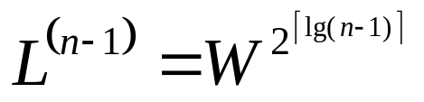
Improving Running Time
No need to compute all L^{(m)} matrices
If no negative-weight cycles exist:
L^{(m)} = L^{(n - 1)} for all m ≥ n – 1
We can compute L^{(n-1)} by computing the sequence:
L⁽¹⁾ = W L⁽²⁾ = W² = W • W
L⁽⁴⁾ = W⁴ = W² • W² L⁽⁸⁾ = W⁸ = W⁴ • W⁴ …

Slide 33
FASTER-APSP(W, n)
L⁽¹⁾ ← W
m ← 1
while m < n - 1
do L^{(2m)} ← EXTEND(L^{(m)}, L^{(m)}, n)
m ← 2m
return L^{(m)}
OK to overshoot: products don’t change after L^{(n - 1)}
Running Time: Θ(n³lg n)

Slide 34
The Floyd-Warshall Algorithm
Given:
  Directed, weighted graph G = (V, E)
  Negative-weight edges may be present
  No negative-weight cycles could be present in the graph
Compute:
  The shortest paths between all pairs of vertices in a graph
2
3
4
1
8
3
2
-4
1
-5
7
5
4
6

Slide 35
The Structure of a Shortest Path
Vertices in G are given by
V = {1, 2, …, n}
Consider a path p = ⟨v₁, v₂, …, v_{l}⟩
  An intermediate vertex of p is
  any vertex in the set {v₂, v₃, …, v_{l -1}}
  e.g.: p = ⟨1, 2, 4, 5⟩: {2, 4}
  p = ⟨2, 4, 5⟩: {4}
3
6
0.5
1
2
3
4
2
1
2
5

Slide 36
The Structure of a Shortest Path
For any pair of vertices i, j ∈ V, consider all paths from i to j whose intermediate vertices are all drawn from a subset {1, 2, …, k}
  Find p, a minimum-weight path from these paths
p₁
i
p_{u}
j
p_{t}
No vertex on these paths has index > k

Slide 37
Example
d_{ij}^{(k)} = the weight of a shortest path from vertex i to vertex j with all intermediary vertices drawn from {1, 2, …, k}
  d₁₃⁽⁰⁾ =
  d₁₃⁽¹⁾ =
  d₁₃⁽²⁾ =
  d₁₃⁽³⁾ =
  d₁₃⁽⁴⁾ =
3
6
6
6
0.5
1
2
5
3
4
5
2
1
4.5

Slide 38
The Structure of a Shortest Path
k is not an intermediate vertex of path p
  Shortest path from i to j with intermediate vertices from {1, 2, …, k} is a shortest path from i to j with intermediate vertices from {1, 2, …, k - 1}
k is an intermediate vertex of path p
  k is not intermediary vertex of p₁, p₂
  p₁ is a shortest path from i to k
  with vertices from {1, 2, …, k - 1}
  p₂ is a shortest path from k to j
  with vertices from {1, 2, …, k - 1}
k
i
j
p
p₁
∞
p₂
k
j
i
p

Slide 39
A Recursive Solution
d_{ij}(k) = the weight of a shortest path from vertex i to vertex j with all intermediary vertices drawn from {1, 2, …, k}
k = 0
  d_{ij}^{(k)} = w_{ij}
k ≥ 1
  Case 1: k is not an intermediate vertex of path p
    d_{ij}^{(k)} = d_{ij}^{(k-1)}
  Case 2: k is an intermediate vertex of path p
    d_{ij}^{(k)} =d_{ik}^{(k-1)} + d_{kj}^{(k-1)}
k
i
j
∞
k
j
i

Slide 40
Computing The Shortest Path Weights
d_{ij}^{(k)} = w_{ij} if k = 0
min { d_{ij}^{(k-1)} , d_{ik}^{(k-1)} + d_{kj}^{(k-1)} } if k ≥ 1
The final solution: D^{(n)} = (d_{ij}^{(n)}):
d_{ij}^{(n)} = δ(i, j) ∀ i, j ∈ V
j
j
+
(k, j)
i
i
(i, k)
D^{(k-1)}
D^{(k)}

Slide 41
FLOYD-WARSHALL(W)
n ← rows[W]
D⁽⁰⁾ ← W
for k ← 1 to n
do for i ← 1 to n
do for j ← 1 to n
do d_{ij}^{(k)} ← min (d_{ij}^{(k-1)}, d_{ik}^{(k-1)} + d_{kj}^{(k-1)})
return D^{(n)}
Running time: Θ(n³)

Slide 42
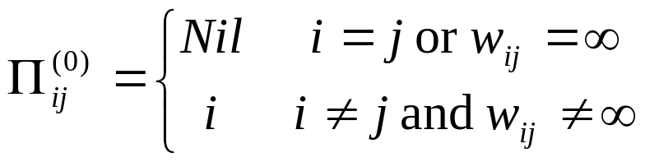
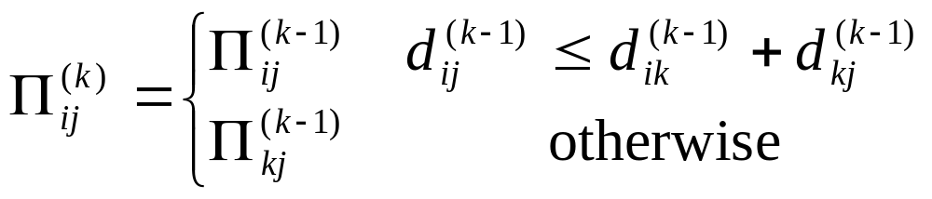
Constructing a Shortest Path

Slide 43

Example
D⁽⁰⁾ = W
⁽⁰⁾
1
2
3
4
5
1
2
3
4
5
1
0 | 3 | 8 | ∞ | -4
∞ | 0 | ∞ | 1 | 7
∞ | 4 | 0 | ∞ | ∞
2 | ∞ | -5 | 0 | ∞
∞ | ∞ | ∞ | 6 | 0
1
N | 1 | 1 | N | 1
N | N | N | 2 | 2
N | 3 | N | N | N
4 | N | 4 | N | N
N | N | N | 5 | N
2
2
2
3
3
3
4
4
4
1
8
3
5
5
2
D⁽¹⁾
⁽¹⁾
1
1
2
3
4
5
1
2
3
4
5
-4
7
-5
1
0
3
8
∞
-4
1
N
1
1
N
1
5
4
6
∞
0
∞
1
7
N
N
N
2
2
2
2
d_{ij}^{(k)} = min {d_{ij}^{(k-1)} , d_{ik}^{(k-1)} + d_{kj}^{(k-1)} }
∞
4
0
∞
∞
N
3
N
N
N
3
3
4
2
5
-5
0
-2
4
1
4
N
1
4
5
∞
∞
∞
6
0
5
N
N
N
5
N

Slide 44
Example
D⁽¹⁾
1
2
3
4
5
⁽¹⁾
1
2
3
4
5
1
0
3
8
∞
-4
1
N
1
1
N
1
2
∞
0
∞
1
7
2
N
N
N
2
2
3
∞
4
0
∞
∞
3
N
3
N
N
N
2
4
2
5
-5
0
-2
4
4
1
4
N
1
3
4
5
∞
∞
∞
6
0
5
N
N
N
5
N
1
8
3
2
D⁽²⁾
1
2
3
4
5
⁽²⁾
1
2
3
4
5
-4
7
1
-5
0
3
8
4
-4
N
1
1
2
1
1
1
5
4
6
∞
0
∞
1
7
N
N
N
2
2
2
2
d_{ij}^{(k)} = min {d_{ij}^{(k-1)} , d_{ik}^{(k-1)} + d_{kj}^{(k-1)} }
3
∞
4
0
5
11
3
N
3
N
2
2
2
5
-5
0
-2
4
1
4
N
1
4
4
5
∞
∞
∞
6
0
5
N
N
N
5
N

Slide 45
Example
D⁽²⁾
1
2
3
4
5
⁽²⁾
1
2
3
4
5
1
0
3
8
4
-4
1
N
1
1
2
1
2
∞
0
∞
1
7
2
N
N
N
2
2
3
∞
4
0
5
11
3
N
3
N
2
2
2
5
-5
0
-2
4
1
4
N
1
2
4
4
3
4
5
∞
∞
∞
6
0
5
N
N
N
5
N
1
8
3
2
D⁽³⁾
⁽³⁾
-4
7
1
-5
0
3
8
4
-4
N
1
1
2
1
5
4
0
1
7
6
∞
∞
N
N
N
2
2
d_{ij}^{(k)} = min {d_{ij}^{(k-1)} , d_{ik}^{(k-1)} + d_{kj}^{(k-1)} }
4
0
5
11
N
3
N
2
2
∞
2
-1
-5
0
-2
4
3
4
N
1
∞
∞
∞
6
0
N
N
N
5
1

Slide 46
Example
D⁽³⁾
⁽³⁾
0
3
8
4
-4
N
1
1
2
1
∞
0
∞
1
7
N
N
N
2
2
∞
4
0
5
11
N
3
N
2
2
2
-1
-5
0
-2
4
3
4
N
1
2
3
4
∞
∞
∞
6
0
N
N
N
5
1
1
8
3
2
D⁽⁴⁾
⁽⁴⁾
-4
7
1
-5
0
3
-1
4
-4
N
1
4
2
1
5
4
6
3
0
-4
1
-1
4
N
4
2
1
d_{ij}^{(k)} = min {d_{ij}^{(k-1)} , d_{ik}^{(k-1)} + d_{kj}^{(k-1)} }
7
4
0
5
3
4
3
N
2
1
2
-1
-5
0
-2
4
3
4
N
1
8
5
1
6
0
4
3
4
5
N

Slide 47
Example
D⁽⁴⁾
⁽⁴⁾
0
3
-1
4
-4
N
1
4
2
1
3
0
-4
1
-1
4
N
4
2
1
7
4
0
5
3
4
3
N
2
1
2
-1
-5
0
-2
4
3
4
N
1
2
3
4
8
5
1
6
0
4
3
4
5
N
1
8
3
2
D⁽⁵⁾
⁽⁵⁾
-4
7
1
-5
0
1
-3
2
-4
N
3
4
5
1
5
4
6
3
0
-4
1
-1
4
N
4
2
1
d_{ij}^{(k)} = min {d_{ij}^{(k-1)} , d_{ik}^{(k-1)} + d_{kj}^{(k-1)} }
7
4
0
5
3
4
3
N
2
1
2
-1
-5
0
-2
4
3
4
N
1
8
5
1
6
0
4
3
4
5
N

