Slide 1
Lecture 13.
Maximum Flow/ P or NP

Slide 2
The Max Flow Problem
G = G(V,E)
x_{ij} = flow on arc (i,j)
u_{ij} = capacity of flow in arc (i,j)
s = source node
t = sink node
Maximize v
Subject to Σ_{j} x_{ij} - Σ_{k} x_{ki} = 0 for each i ≠ s, t
Σ_{j} x_{sj} = v
0 ≤ x_{ij} ≤ u_{ij} for all (i,j) ∈ E
Notes:
Introduce myself and the Tas.
It is critical that students sign up for the virtual campus web site. Hand out instructions on how to use it. Make sure that everyone signs up on the list.
Also, create a class list that is separate from the web site.
Ask for a show of where students come from. There should be four major contingencies:
Grad EECS, ORC, Transportation, Rest

Slide 3
Maximum Flows
We refer to a flow x as maximum if it is feasible and maximizes v
Our objective in the max flow problem is to find a maximum flow
1
8,
7
10
,
8
s
1,
1
t
6,
5
10,
6
2
A max flow problem
Capacities and a non-optimum flow

Slide 4
The Feasibility Problem: Find A Feasible Flow
warehouses
warehouses
retailers
6
1
5
6
6
2
7
7
4
3
5
8
6
4
9
5
4
5
Is there a way of shipping from the warehouses to the retailers to satisfy demand?

Slide 5
Transformation to A Max Flow Problem
warehouses
warehouses
retailers
6
1
6
5
6
6
6
5
2
s
4
7
7
7
4
3
t
5
5
8
6
6
4
4
9
5
5
4
5
There is a 1-1 correspondence with flows from s to t with 24 units (why 24?) and feasible flows for the transportation problem

Slide 6
The Feasibility Problem:Find a matching
persons
tasks
1
5
2
6
3
7
4
8
Is there a way of assigning persons to tasks so that each person is assigned a task, and each task has a person assigned to it?

Slide 7
Transformation to A Max Flow Problem
persons
tasks
1
5
1
1
1
2
6
1
s
1
1
t
1
3
7
1
4
8
Does the maximum flow from s to t have 4 units?

Slide 8
The Residual Network
1
8,
7
10
,
8
1,
1
x
s
t
i
ij
j
u
ij
6,
5
10,
6
2
2
1
1
u - x
ij
ij
8
7
i
x
j
s
1
t
ij
1
4
2
6
We let r_{ij} denote the residual capacity of arc (i,j)
5
The Residual Network G(x)

Slide 9
A Useful Idea: Augmenting Paths
An augmenting path is a path from s to t in the residual network
The residual capacity of the augmenting path P
  δ(P) = min{ r_{ij} : (i,j) ∈ P }
To augment along P is to send δ(P) units of flow along each arc of the path, we modify x and the residual capacities appropriately
r_{ij} := r_{ij} - δ(P) and r_{ji} := r_{ji} + δ(P) for (i,j) ∈ P
2
1
1
2
1
8
7
8
8
s
1
t
s
1
t
1
4
4
5
2
6
6
2
6

Slide 10
The Ford-Fulkerson Max-Flow
Begin
  x := 0
  create the residual network G(x)
  while there is some directed path from s to t in G(x) do
  begin
    let P be a path from s to t in G(x)
    Δ := δ(P)
    send Δ units of flow along P
    update the r's
  end
End { the flow x is now maximum }

Slide 11
The Ford-Fulkerson Max-Flow
4
2
5
3
1
1
1
2
2
s
4
t
3
2
1
3
This is the original network, plus reversals of the arcs

Slide 12
The Ford-Fulkerson Max-Flow
4
2
5
3
1
1
1
2
2
s
4
t
3
2
1
3
This is the original network, and the original residual network

Slide 13
The Ford-Fulkerson Max-Flow
4
2
5
3
1
1
1
2
2
s
4
t
3
2
1
3
Find any s-t path in G(x)

Slide 14
The Ford-Fulkerson Max-Flow
4
2
5
3
1
1
1
2
1
2
s
4
t
2
1
3
2
1
1
1
3
Determine the capacity D of the path
Send Δ units of flow in the path
Update residual capacities

Slide 15
The Ford-Fulkerson Max-Flow
4
2
5
3
1
1
1
2
1
2
s
4
t
2
1
3
2
1
1
1
3
Find any s-t path

Slide 16
The Ford-Fulkerson Max-Flow
4
2
5
3
1
1
1
2
1
1
1
s
4
t
2
1
1
3
2
2
1
1
1
1
3
1
Determine the capacity D of the path Send Δ units of flow in the path
Update residual capacities

Slide 17
The Ford-Fulkerson Max-Flow
4
2
5
3
1
1
1
2
1
1
1
s
4
t
2
1
1
3
2
2
1
1
1
1
3
1
Find any s-t path

Slide 18
The Ford-Fulkerson Max-Flow
4
2
5
3
1
1
1
1
1
1
s
4
t
1
2
1
2
2
3
1
1
1
1
3
1
Determine the capacity D of the path Send Δ units of flow in the path
Update residual capacities

Slide 19
The Ford-Fulkerson Max-Flow
4
2
5
3
1
1
1
1
2
1
1
s
4
t
1
2
1
2
2
3
1
1
1
1
3
1
Find any s-t path

Slide 20
The Ford-Fulkerson Max-Flow
4
2
5
3
1
1
1
1
2
1
1
s
4
t
1
2
1
1
2
2
1
1
1
2
1
2
3
1
Determine the capacity D of the path Send Δ units of flow in the path
Update residual capacities

Slide 21
The Ford-Fulkerson Max-Flow
4
2
5
3
1
1
1
1
2
1
1
s
4
t
1
2
1
1
2
2
1
1
2
1
2
3
1
Find any s-t path

Slide 22
The Ford-Fulkerson Max-Flow
4
3
2
5
1
3
1
2
1
1
1
1
s
4
t
1
2
1
1
2
2
1
1
2
1
2
3
1
Determine the capacity D of the path
Send Δ units of flow in the path
Update residual capacities

Slide 23
The Ford-Fulkerson Max-Flow
4
3
2
5
1
3
1
2
1
1
1
1
s
4
t
1
2
1
1
2
2
1
1
2
1
2
3
1
There is no s-t path in the residual network
This flow is optimal

Slide 24
The Ford-Fulkerson Max-Flow
4
3
2
2
5
5
1
3
1
2
1
1
1
1
s
s
4
4
t
1
2
1
1
2
2
1
1
2
1
2
3
1
3
These are the nodes that are reachable from node s

Slide 25
The Ford-Fulkerson Max-Flow
1
2
5
1
1
2
2
s
4
t
2
2
3
Here is the optimal flow

Slide 26
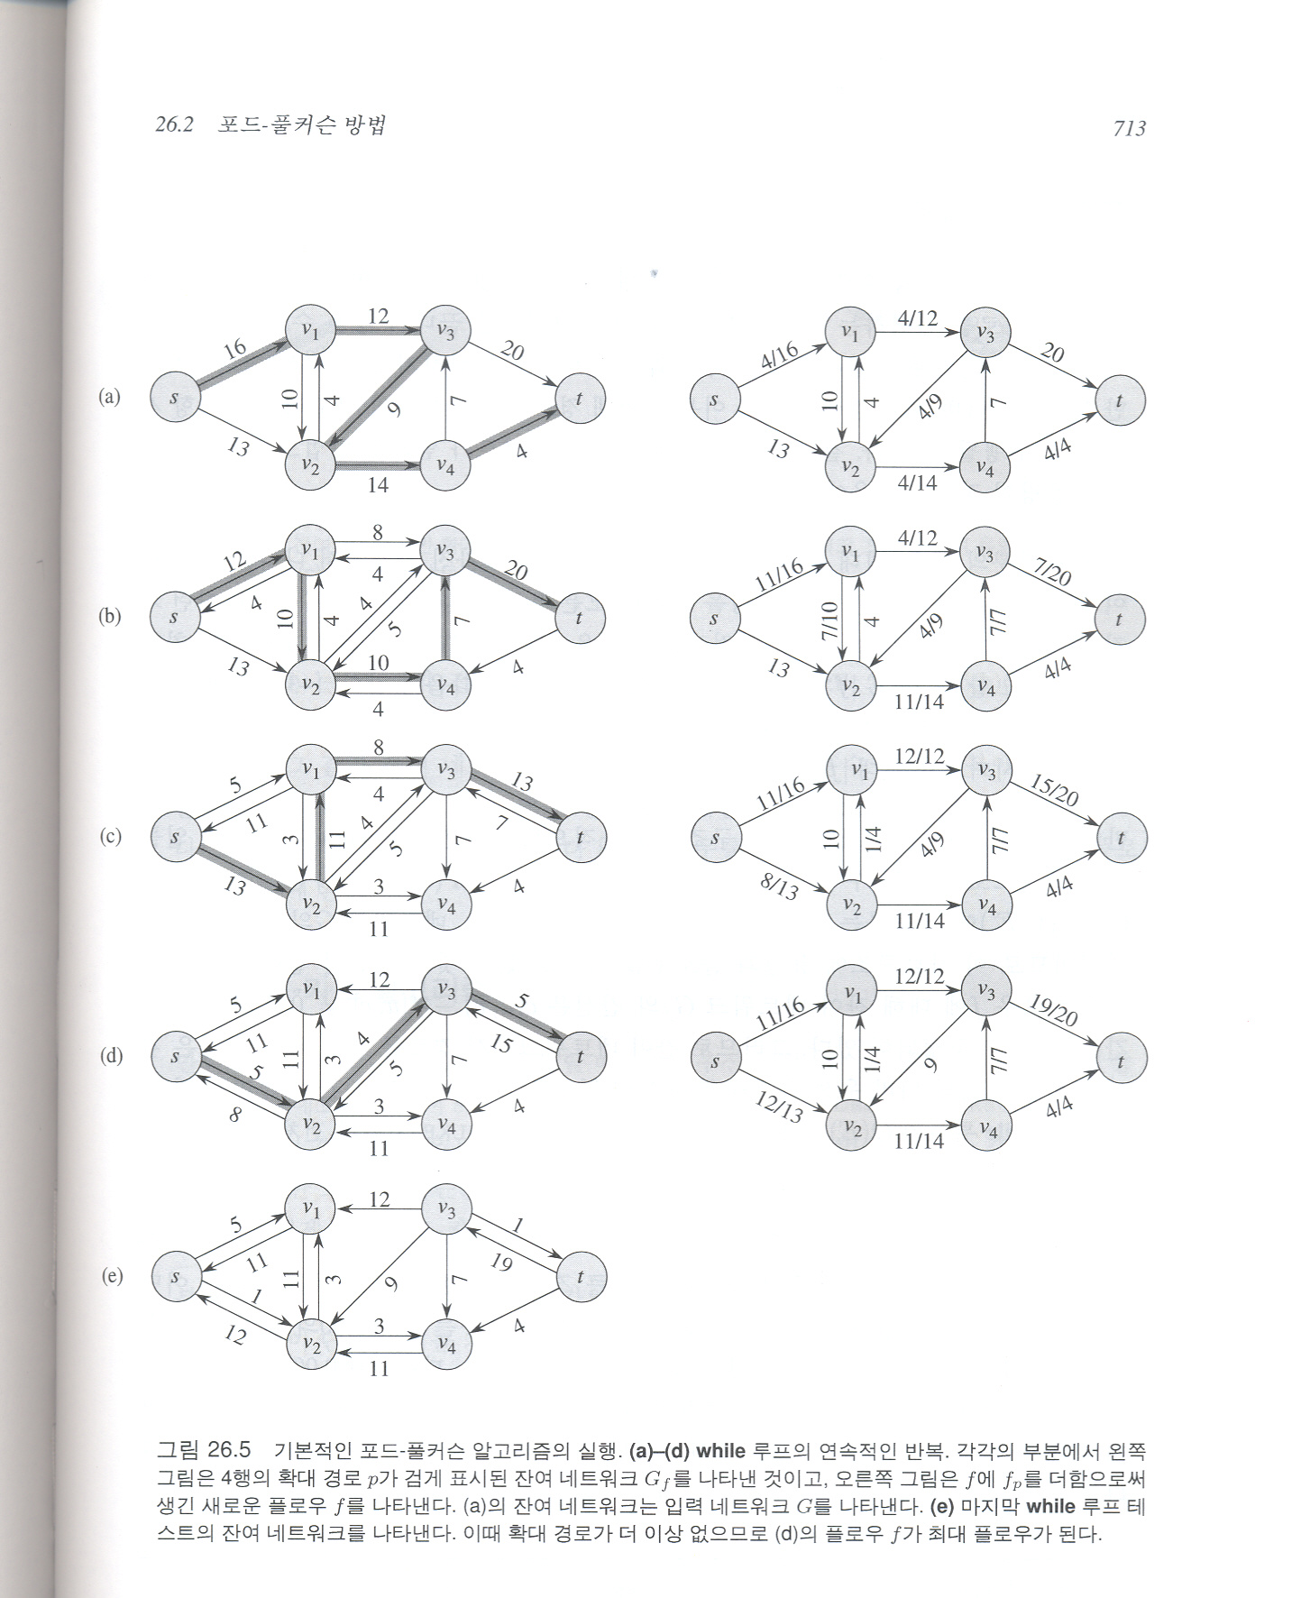
The Ford-Fulkerson Max-Flow

Slide 27
The Ford-Fulkerson Max-Flow

Slide 28
How Do We Know When A Flow Is Optimal?
1
8,
8
10
,
9
s
1,
1
t
6,
6
10,
7
2
METHOD
  There is no augmenting path in the residual network
1
8
reachable from s in G(x)
1
s
9
1
t
3
not reachable from s in G(x)
6
7
2

Slide 29
A Simple And Very Bad Example
1
M
M
s
1
t
M
M
2

Slide 30
After 1 Augmentation
1
M-1
M
1
s
1
t
M
M-1
1
2

Slide 31
After Two Augmentations
1
M-1
M-1
1
1
s
1
t
M-1
M-1
1
1
2

Slide 32
After Three Augmentations
1
M-2
M-1
2
1
s
1
t
M-1
M-2
1
2
2
And so on

Slide 33
After 2M Augmentations
1
M
M
s
t
1
M
M
2

Slide 34

P or NP
I couldn’t find a polynomial time algorithm. I guess I’m too dumb.

Slide 35

P or NP
I couldn’t find a polynomial time algorithm, because no such algorithm exists !

Slide 36

P or NP
I couldn’t find a polynomial time algorithm, but neither could all these other smart people.

Slide 37
NP-Completeness
Some problems are intractable
  They grow large, we are unable to solve them in reasonable time
What constitutes reasonable time?
Standard working definition: polynomial time
  On an input of size n the worst-case running time is O(n^{k})
  for some constant k
  Polynomial time: O(n²), O(n³), O(1), O(n lg n)
  Not in polynomial time: O(2^{n}), O(n^{n}), O(n!)

Slide 38
Polynomial-Time Algorithms
Are some problems solvable in polynomial time?
  Of course: every algorithm we’ve studied provides polynomial-time solution to some problem
  We define P to be the class of problems solvable in polynomial time
Are all problems solvable in polynomial time?
  No: Turing’s “Halting Problem” is not solvable by any computer, no matter how much time is given
  Such problems are clearly intractable, not in P

Slide 39
NP-Complete Problems
Examples of an NP-Complete problem:
  The Hamiltonian path problem
  Traveling salesman problem
  0-1 Knapsack problem
  Longest path problem
Definition
  The class P (or NP) denotes the family of all problems that can be solved by deterministic (nondeterministic) polynomial time algorithms
  All problems are decision problems only answers YES or NO
Nondeterministic polynomial time algorithm exist ?

Slide 40
NP-Complete Problems
The NP-Complete problems are an interesting class of problems whose status is unknown
  No polynomial-time algorithm has been discovered for an NP-Complete problem
We call this the P = NP question
  The biggest open problem in CS

Slide 41

Good Luck !

