Slide 1
Lecture 1.
Introduction / Insertion Sort / Merge Sort
한국산업기술대학교
컴퓨터 공학과
방 영 철

Slide 2
Algorithm
A well-defined computational procedure that transforms the input to the output
Describes a specific computational procedure for achieving the desired input/output relationship
An instance of a problem is all the inputs needed to compute a solution to the problem
A correct algorithm
  halts with the correct output for every input instance.
  is said to solve the problem

Slide 3

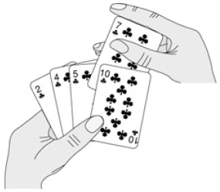
Algorithm
Example: Sorting
  Input: A sequence of n numbers <a₁, a₂, ..., a_{n}>
  Output: A permutation (reordering) <b₁, b₂, ..., b_{n}> of the input sequence such that b₁ b₂ ... b_{n}
  Instance: <6, 4, 3, 7, 1, 4>

Slide 4
Algorithm
Insertion Sort
  In-place sorting: Uses only a fixed amount of storage beyond that needed for the data
Example:
  6 4 3 7 1 4 4 6 3 7 1 4
  ^ * ^ *
  3 4 6 7 1 4 3 4 6 7 1 4
  * ^ *
  1 3 4 6 7 4 1 3 4 4 6 7
  ^ *

Slide 5
Algorithm
Example: 6 4 3 7 1 4
6
4
3
7
1
4

Slide 6
Algorithm
Pseudocode:
INSERTION-SORT(A) /* A is an array of numbers */
1 for j ← 2 to length[A]
2 do key ← A[j]
3 /* insert A[j] into the sorted sequence A[1 .. j-1] */
4 i ← j - 1
5 while i > 0 and A[i] > key
6 do A[i+1] ← A[i]
7 i ← i - 1
8 A[i+1] ← key

Slide 7
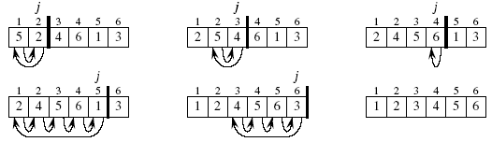
Algorithm
Example:
  5 2 4 6 1 3

Slide 8
Analyzing Algorithm
Predicting the resources, such as memory, bandwidth, logic gates, or running time
Assumed implementation model
  Random-access machine (RAM)
Running time: f ( input size )
Input size:
  Sorting: number of items to be sorted.
  Multiplication: number of bits.
  Graphs: numbers of vertices and edges.

Slide 9
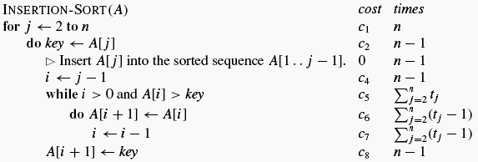
Analyzing Algorithm
Running time for a particular input is the number of primitive operations executed
Assumption: Constant time c_{i} for the execution of the i^{th} line (of pseudocode)
Note: t_{j} is the number of times the while loop test in line 5 is executed for the value of j.

Slide 10
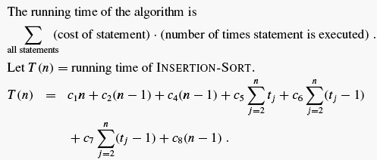
Analyzing Algorithm

Slide 11
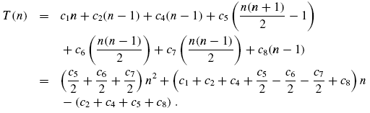
Analyzing Algorithm
Best case
  Array is already sorted, so t_{j} = 1 for j = 2, 3, ..., n.
  T(n) = c₁n + c₂(n - 1) + c₄(n - 1) + c₅(n - 1) + c₈(n - 1)
  = (c₁ + c₂ + c₄ + c₅ + c₈)n - (c₂ + c₄ + c₅ + c₈)
  = an + b (linear in n)
Worst case
  = an² + bn + c (quadratic in n).

Slide 12
Analyzing Algorithm
Average Case ?
Concentrate on worst-case running time
  Provides the upper bound
  Occurs often
  Average case is often as bad as the worst case
Order of Growth
  The order of a running-time function is the fastest growing term, discarding constant factors
  Insertion sort
    Best case: an + b → Θ(n)
    Worst case: an² + bn + c → Θ(n²)

Slide 13
Designing Algorithms
Incremental design
  Iterative
  Example: insertion sort
Divide-and-conquer algorithm
  Recursive
  Example: merge sort
Three steps in the divide-and-conquer paradigm
  Divide the problem into smaller subproblems
  Conquer subproblems by solving them recursively
  Combine solutions of subproblems

Slide 14
Designing Algorithms
Merge Sort
  Divide the n-element sequence into two subsequence of n/2 elements each
  Conquer (sort) the two subsequences recursively using merge sort
  Combine (merge) the two sorted subsequences to produce the sorted answer
Note: Recursion bottoms out when only one element to be sorted

Slide 15
Divide ...
5
1
4
2
10
3
9
15
5
1
4
2
10
3
9
15
5
1
4
2
10
3
9
15
5
1
4
2
10
3
9
15

Slide 16
And Conquer
1
2
3
4
5
9
10
15
1
2
4
5
3
9
10
15
1
5
2
4
3
10
9
15
5
1
4
2
10
3
9
15

Slide 17
Merge Sort
For MERGE_SORT, an initial array is repeatedly divided into halves (usually each is a separate
array), until arrays of just one element remain
At each level of recombination, two sorted arrays are merged into one
This is done by copying the smaller of the two
elements from the sorted arrays into the new
array, and then moving along the arrays
1
13
24
26
2
15
27
38
Aptr
Bptr
Cptr

Slide 18
Merging
1
13
24
26
2
15
27
38
1
Aptr
Bptr
Cptr
1
13
24
26
2
15
27
38
1
2
Aptr
Bptr
Cptr
1
13
24
26
2
15
27
38
1
2
13
Aptr
Bptr
Cptr
etc.

Slide 19
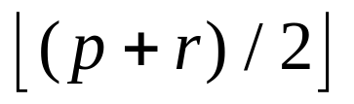
Merge Sort Algorithm
MERGE_SORT(A, p, r)
1 if p < r
2 then q ←
3 MERGE_SORT(A, p, q)
4 MERGE_SORT(A, q+1, r)
5 MERGE(A, p, q, r)

Slide 20
Merge Sort Algorithm
Note:
  The MERGE_SORT(A, p, r) sorts the elements in the subarray A[p .. r]
  If p >= r, the subarray has at most one element and is therefore already sorted
  The procedure MERGE(A, p, q, r), where p <= q < r, merges two already sorted subarrays A[p ..q] and A[q+1 .. r]. It takes Θ(n) time
  To sort an array A[1 .. n], we call MERGE_SORT(A, 1, n)

Slide 21
Analyzing Divide-And-Conquer Algorithms
Running time is described by a recurrence equation or recurrence
Assume:
  A problem is divided into a subproblems, each of which is 1/b the size of the original
  Dividing the problem takes D(n) time
  Combining the solutions to subproblems into the solution to the original problem takes C(n) time
T(n) = Θ(1) if n <= c,
= aT(n/b) + D(n) + C(n) otherwise.

Slide 22
Analyzing Divide-And-Conquer Algorithms
Analysis of Merge Sort
  Divide: Computes the middle of the subarray D(n) = Θ(1)
  Conquer: We recursively solve two subproblems, each of size n/2, contributing 2T(n/2)
  Combine: The MERGE procedure takes Θ(n),
  so C(n) = Θ(n)
The worst-case running time of merge sort is:
  T(n) = Θ(1) if n = 1,
  = 2T(n/2) + Θ(n) if n > 1

