Slide 1
Lecture 2.
Growth of Functions / Asymptotics
한국산업기술대학교
컴퓨터 공학과
방 영 철

Slide 2
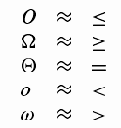
Overview for Asymptotic Notation
A way to describe behavior of functions in the limit
  We’re studying asymptotic efficiency
Describe growth of functions
Focus on what’s important by abstracting away low-order terms and constant factors
How we indicate running times of algorithms
A way to compare “sizes” of functions

Slide 3
Asymptotic Notation
Asymptotic efficiency of algorithms
  Concerned with how the running time increases with the size of the input in the limit
    i.e., as the size of the input increases without bound.
  An asymptotically more efficient algorithm is the best choice
Asymptotic running time of an algorithm is defined in terms of functions whose domains are the set of natural numbers
N = {0, 1, 2, ...}

Slide 4


Θ - Notation
Θ - notation (theta)
  Θ( g(n) ) = { f(n) : there exist positive constants c₁, c₂, and n₀ such that
  for all }
  Θ(g(n)) is the set of functions
  f(n) = Θ(g(n)) really means that f(n) belongs to Θ(g(n))
  g(n) is called an asymptotically tight bound for f(n)

Slide 5
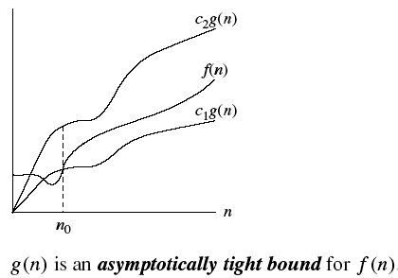
Θ - Notation
Θ - notation

Slide 6
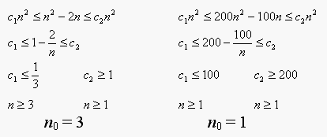
Θ - Notation
Θ - notation
  If f(n) is a polynomial of degree d, then f(n) = Θ(n^{d})
  Example:
    n² - 2n = Θ(n²)
    200n² - 100n = Θ(n²)
    Some choice for c₁, c₂, and n₀ exists, the functions are Θ(n²)
    Θ(n⁰) ?

Slide 7
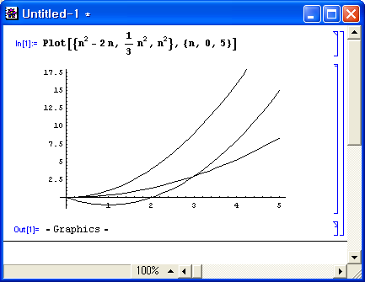
Θ - Notation
n² - 2n = Θ(n²)

Slide 8
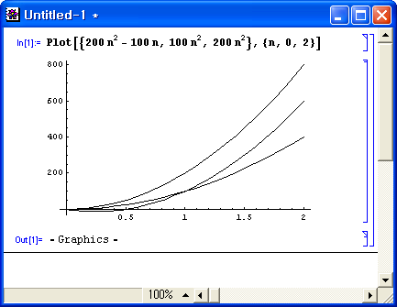
Θ - Notation
200n² - 100n = Θ(n²)

Slide 9


O - Notation
O - notation (big-oh)
  f(n) = O(g(n)): g(n) is an asymptotic upper bound for f(n)
  O(g(n)) = { f(n): there exist positive constants c and n₀
  such that for all }
f(n) = Θ(g(n)) implies f(n) = O(g(n)),
but f(n) = O(g(n)) does NOT imply f(n) = Θ(g(n)).
Example:
  n² - 2n = O(n²)
  200n² - 100n = O(n²) = O(n³) = ...
  n = O(n²)
O is good for describing the worst-case running time of an algorithm

Slide 10
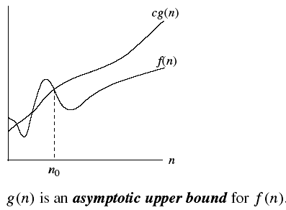
O - Notation
O - notation

Slide 11

Ω - Notation
Ω - notation (omega)
  f(n) = Ω(g(n)): g(n) is an asymptotic lower bound for f(n)
  Ω(g(n)) = {f(n): there exist positive constants c and n₀ such that
  for all }
f(n) = Θ(g(n)) implies f(n) = Ω (g(n)),
but f(n) = Ω (g(n)) does NOT imply f(n) = Θ(g(n))
Example:
  n² - 2n = Ω (n²)
  200n² - 100n = Ω (n²) = Ω (n) = Ω(1)
  n² = Ω (n)
Ω is good for describing the best case running time of an algorithm
Theorem
  f(n) = Θ(g(n)) if and only if f(n) = O(g(n)) and f(n) = Ω (g(n))

Slide 12
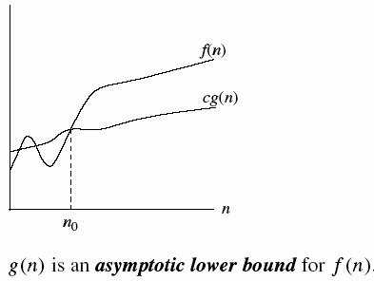
Ω - Notation
Ω - notation (omega)

Slide 13
Asymptotic Notation in Equations
On the right-had-side
  n = O(n²) means “n belongs to O(n²)”
In general, asymptotic notation stands for some anonymous function
Example:
  2n² + 3n + 1 = 2n² + Θ(n) means
    there is some function f(n) ∈ Θ(n) that makes the equation true, i.e. f(n) = 3n + 1
  2n² + Θ(n) = Θ(n²) means
    for any function f(n) ∈ Θ(n), there is some function
    g(n) ∈ Θ(n²) such that 2n² + f(n) = g(n) for all n
  2n² + 3n + 1 = 2n² + Θ(n) = Θ(n²)

Slide 14
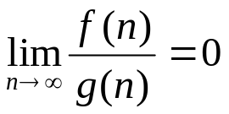
o - Notation
o - notation (little-oh)
  O - notation may or may not be asymptotically tight
  2n² = O(n²) is asymptotically tight, but 2n = O(n²) is not
  f(n) = o(g(n)): g(n) is an upper bound of f(n) that is not asymptotically tight
  o(g(n)) = { f(n): for any positive constant c > 0, there exists a constant n₀ > 0 such that for all }
  2n = o(n²), but 2n² ≠ o(n²)
O: for some constant c, o: for all constant c
In the o-notation, the function f(n) becomes insignificant relative to g(n) as n approaches infinity
  i.e.,

Slide 15

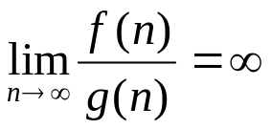
ω - Notation
ω - notation (little-omega)
  2n² = Ω(n²) is asymptotically tight, but 2n³ = Ω(n²) is not
  f(n) = ω (g(n)): g(n) is a lower bound of f(n) that is not asymptotically tight
  ω(g(n)) = { f(n): for any positive constant c > 0, there exists a constant n₀ > 0 such that for all }
  2n² = ω(n), but 2n² ≠ ω(n²)
In the ω-notation, the function f(n) becomes arbitrarily large relative to g(n) as n approaches infinity
  i.e.,

Slide 16
Relations Between the Growth Sets
O( g )
Ω( g )
• g
o( g )
Θ( g )
ω( g )

Slide 17
Comparison of Functions
Many of the relational properties of real numbers apply to asymptotic comparisons too
  Reflexivity
    f(n) = Θ(f(n))
    This is true for O, Ω
  Symmetry
    f(n) = Θ(g(n)) if and only if g(n) = Θ(f(n))
  Transpose symmetry
    f(n) = O(g(n)) if and only if g(n) = Ω(f(n))
    f(n) = o(g(n)) if and only if g(n) = ω(f(n))
  Transitivity
    f(n) = Θ(g(n)) and g(n) = Θ(h(n)) imply f(n) = Θ(h(n))
    This is true for O, Ω, o, and ω

Slide 18
Comparison of Functions
Analogy to real numbers
  f(n) = O(g(n)) ≈ a ≤ b
  f(n) = Ω(g(n)) ≈ a ≥ b
  f(n) = Θ(g(n)) ≈ a = b
  f(n) = o(g(n)) ≈ a < b
  f(n) = ω(g(n)) ≈ a > b
Example: f(n) = 3n³ + 4
  f(n) = Θ(n³)
  f(n) = O(n³) = O(n⁴) = ...
  f(n) = Ω(n³) = Ω(n²) = Ω(n) = Ω(1)
  f(n) = o(n⁴) = o(n⁵) = ...
  f(n) = ω(n²) = ω(n) = ω(1)

Slide 19





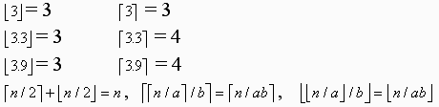
Standard Notations and Common Functions
Monotonicity: A function f(n) is:
  monotonically increasing if implies
  monotonically decreasing if implies
  strictly increasing if a < b implies f(a) < f(b)
  strictly decreasing if a < b implies f(a) > f(b)
Floors and ceilings
  Floor: is the greatest integer ≤ x
  Ceiling: is the least integer ≥ x
  Examples:

Slide 20
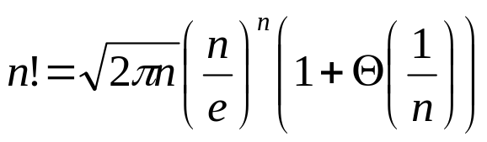
Standard Notations and Common Functions
Logarithms
  log_{b} n: logarithm of n base b
  lg n = log₂ n (binary logarithm)
  ln n = log_{e} n (natural logarithm, e = 2.7182...)
Factorials
  n! = 1 if n = 0,
  n(n - 1) ! if n > 0.
  n! = 1 * 2 * 3 * ... * n
  n! ≤ n^{n}, thus O(n^{n})
Stirling’s Approximation
  From Stirling’s approximation, the followings hold:
    n! = o(n^{n})
    n! = ω(2^{n})
    lg (n!) = Θ(n lg n)

