Slide 1
Lecture 3.
Recurrences / Heapsort
한국산업기술대학교
컴퓨터 공학과
방 영 철

Slide 2
Overview for Recurrences
Define what a recurrence is
Discuss three methods of solving recurrences
  Substitution method
  Recursion-tree method
  Master method
Examples of each method

Slide 3
Definition
A recurrence is an equation or inequality that describes a function in terms of its value on smaller inputs.
Example from MERGE-SORT
Θ(1) if n=1
T(n) =
2T(n/2) + Θ(n) if n>1

Slide 4
Technicalities
Normally, independent variables only assume integral values
Example from MERGE-SORT revisited
Θ(1) if n=1
T(n) =
T(⎡n/2⎤) + T(⎣n/2⎦) + Θ(n) if n>1
For simplicity, ignore floors and ceilings – often insignificant

Slide 5
Technicalities
Boundary conditions (small n) are also glossed over
T(n) =
2T(n/2) + Θ(n)
Value of T(n) assumed to be small constant for small n

Slide 6
Substitution Method
Involves two steps:
  Guess the form of the solution
  Use mathematical induction to find the constants and show the solution works
Drawback
  Applied only in cases where it is easy to guess at solution
Useful in estimating bounds on true solution even if latter is unidentified

Slide 7
Substitution Method
Example:
T(n) = 2T(⎣n/2⎦) + n
Guess:
T(n) = O(n lg n)
Prove by induction:
T(n) ≤ cn lg n
for suitable c>0.

Slide 8
Inductive Proof
We’ll not worry about the basis case for the moment – we’ll choose this as needed – clearly we have:
T(1) = Θ(1) ≤ cn lg n
Inductive hypothesis:
For values of n < k the inequality holds,
i.e., T(n) ≤ cn lg n
We need to show that this holds for
n = k as well.

Slide 9
Inductive Proof
In particular, for n = ⎣k/2⎦, the inductive hypothesis should hold, i.e.,
T(⎣k/2⎦) ≤ c ⎣k/2⎦ lg ⎣k/2⎦
The recurrence gives us:
T(k) = 2T(⎣k/2⎦) + k
Substituting the inequality above yields:
T(k) ≤ 2[c ⎣k/2⎦ lg ⎣k/2⎦] + k

Slide 10
Inductive Proof
Because of the non-decreasing nature of the functions involved, we can drop the “floors” and obtain:
T(k) ≤ 2[c (k/2) lg (k/2)] + k
Which simplifies to:
T(k) ≤ ck (lg k − lg 2) + k
Or, since lg 2 = 1, we have:
T(k) ≤ ck lg k − ck + k = ck lg k + (1− c)k
So if c ≥ 1, T(k) ≤ ck lg k Q.E.D.

Slide 11
Recursion-Tree Method
Straightforward technique of coming up with a good guess
Can help the Substitution Method
Recursion tree: visual representation of recursive call hierarchy where each node represents the cost of a single subproblem

Slide 12
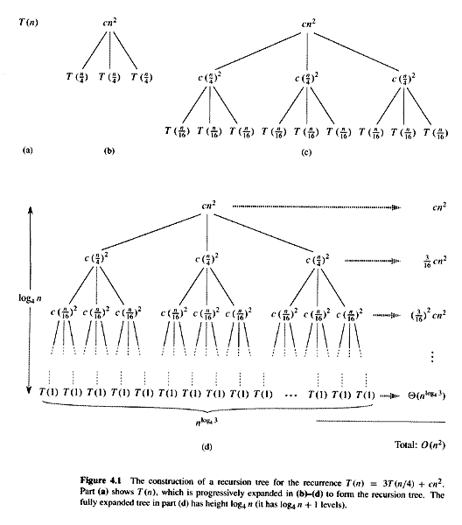
Recursion-Tree Method
T(n) =
3T(⎣n/4⎦) + Θ(n²)

Slide 13
Recursion-Tree Method
T(n) =
3T(⎣n/4⎦) + Θ(n²)

Slide 14
Recursion-Tree Method
T(n) =
3T(⎣n/4⎦) + Θ(n²)

Slide 15
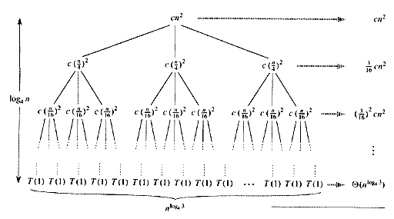
Recursion-Tree Method

Slide 16
Recursion-Tree Method
Gathering all the costs together:
log₄n−1
T(n) =
Σ
(3/16)^{i}cn² + Θ(n^{log43})
i=0
∞
T(n) ≤
Σ
(3/16)^{i}cn² + o(n)
i=0
T(n) ≤
(1/(1−3/16))cn² + o(n)
T(n) ≤
(16/13)cn² + o(n)
T(n) =
O(n²)

Slide 17
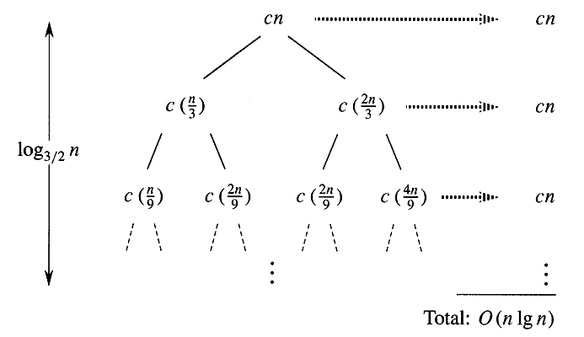
Recursion-Tree Method
T(n) =
T(n/3) + T(2n/3) + O(n)

Slide 18
Recursion-Tree Method
An overestimate of the total cost:
log_{3/2}n−1
T(n) =
Σ
cn + Θ(n^{log3/22})
i=0
Counter-indications:
T(n) =
O(n lg n) + ω(n lg n)
Notwithstanding this, use as “guess”:
T(n) =
O(n lg n)

Slide 19
Substitution Method
Recurrence:
T(n) = T(n/3) + T(2n/3) + cn
Guess:
T(n) = O(n lg n)
Prove by induction:
T(n) ≤ dn lg n
for suitable d>0 (we already use c)

Slide 20
Inductive Proof
Again, we’ll not worry about the basis case
Inductive hypothesis:
For values of n < k the inequality holds,
i.e., T(n) ≤ dn lg n
We need to show that this holds for
n = k as well.
In particular, for n = k/3, and n = 2k/3, the inductive hypothesis should hold…

Slide 21
Inductive Proof
That is
T(k/3) ≤ d k/3 lg k/3
T(2k/3) ≤ d 2k/3 lg 2k/3
The recurrence gives us:
T(k) = T(k/3) + T(2k/3) + ck
Substituting the inequalities above yields:
T(k) ≤ [d (k/3) lg (k/3)] + [d (2k/3) lg (2k/3)] + ck

Slide 22
Inductive Proof
Expanding, we get
T(k) ≤ [d (k/3) lg k − d (k/3) lg 3] +
[d (2k/3) lg k − d (2k/3) lg(3/2)] + ck
Rearranging, we get:
T(k) ≤ dk lg k − d[(k/3) lg 3 + (2k/3) lg(3/2)] + ck
T(k) ≤ dk lg k − dk[lg 3 − 2/3] + ck
When d≥c/(lg3 − (2/3)), we should have
the desired:
T(k) ≤ dk lg k

Slide 23
Master Method
Provides a “cookbook” method for solving recurrences
Recurrence must be of the form:
T(n) =
aT(n/b) + f(n)
where a≥1 and b>1 are constants and f(n) is an asymptotically positive function.

Slide 24
Master Method
Theorem 4.1:
Given the recurrence previously defined, we have:
If f(n) = O(n ^{logba−ε})
for some constant ε>0,
then T(n) = Θ(n ^{logba})
If f(n) = Θ(n ^{logba}),
then T(n) = Θ(n^{logba} lg n)

Slide 25
Master Method
If f(n) = Ω(n ^{logba+ε})
for some constant ε>0,
and if
af(n/b) ≤ cf(n)
for some constant c<1
and all sufficiently large n,
then T(n) = Θ(f(n))

Slide 26

Example
Estimate bounds on the following recurrence:
Use the recursion tree method to arrive at a “guess” then verify using induction
Point out which case in the Master Method this falls in

Slide 27

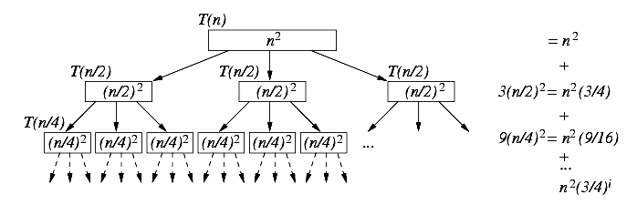
Recursion Tree
Recurrence produces the following tree:

Slide 28

Cost Summation
Collecting the level-by-level costs:
A geometric series with base less than one; converges to a finite sum, hence, T(n) = Θ(n²)

Slide 29


Exact Calculation
If an exact solution is preferred:
Using the formula for a partial geometric series:

Slide 30
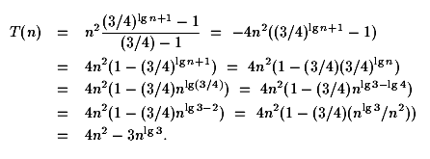
Exact Calculation
Solving further:

Slide 31
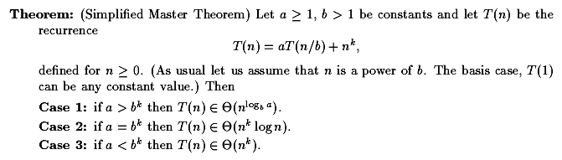
Master Theorem (Simplified)

Slide 32
Introduction for Heapsort
Heapsort
  Running time: O(n lg n)
    Like merge sort
  Sorts in place: only a constant number of array elements
  are stored outside the input array at any time
    Like insertion sort
Heap
  A data structure used by Heapsort to manage information
  during the execution of the algorithm
  Can be used as an efficient priority queue

Slide 33
Perfect Binary Tree
For binary tree with height h
  All nodes at levels h–1 or less have 2 children (full)
h = 0
h = 1
h = 2
h = 3

Slide 34
Complete Binary Trees
For binary tree with height h
  All nodes at levels h–2 or less have 2 children (full)
  All leaves on level h are as far left as possible
h = 0
h = 2
h = 1

Slide 35
Complete Binary Trees
h = 3

Slide 36
Heaps
Two key properties
  Complete binary tree
  Value at node
    Smaller than or equal to values in subtrees
    Greater than or equal to values in subtrees
Example max-heap
  Y ≤ X
  Z ≤ X
X
Y
Z

Slide 37
Heap and Non-heap Examples
5
5
8
5
45
6
45
5
2
2
6
22
6
22
6
22
25
8
45
25
8
45
25
Min-heaps
Non-heaps

Slide 38
Binary Heap
An array object that can be viewed as a nearly
complete binary tree
  Each tree node corresponds to an array element
  that stores the value in the tree node
  The tree is completely filled on all levels except possibly the lowest, which is filled from the left up to a point
  A has two attributes
    length[A]: number of elements in the array
    heap-size[A]: number of elements in the heap stored within A
    heap-size[A] ≤ length[A]
  max-heap and min-heap

Slide 39
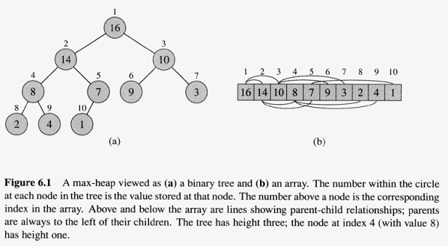
A Max-heap

Slide 40
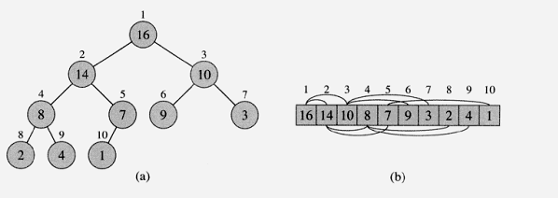
Length and Heap-Size
11
7
11
7
Length = 10
Heap-Size = 7

Slide 41
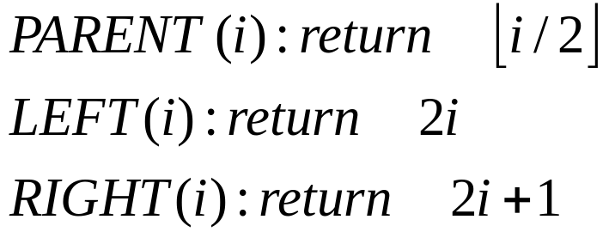
Heap Computation
Given the index i of a node, the indices of its parent,
left child, and right child can be computed simply:

Slide 42
Heap Computation
1
parent(i) = floor(i/2)
left-child(i) = 2i
right-child(i)= 2i +1
0
1
2
3
16
2
3
14
10
4
5
6
7
8
7
9
3
8
9
10
1 2 3 4 5 6 7 8 9 10
2
4
1
16 | 14 | 10 | 8 | 7 | 9 | 3 | 2 | 4 | 1

Slide 43
Heap Property
Heap property
  The property that the values in the node must satisfy
Max-heap property, for every node i other than the root
  A[PARENT(i)] ≥ A[i]
  The value of a node is at most the value of its parent
  The largest element in a max-heap is stored at the root
  The subtree rooted at a node contains values
  no larger than that contained at the node itself

Slide 44

Heap Height
The height of a node in a heap
  The number of edges on the longest simple downward path from
  the node to a leaf
The height of a heap is the height of its root
  The height of a heap of n elements is Θ(lg n)
    Exercise 6.1-2 on page 129

Slide 45
Heap Procedures
MAX-HEAPIFY
  Maintains the max-heap property
  O(lg n)
BUILD-MAX-HEAP
  Produces a max-heap from an unordered input array
  O(n)
HEAPSORT
  Sorts an array in place
  O(n lg n)

Slide 46
Maintaining the Heap Property
MAX-HEAPIFY
  Inputs: an array A and an index i into the array
  Assume the binary tree rooted at LEFT(i) and RIGHT(i) are max-heaps, but A[i] may be smaller than its children
    violate the max-heap property
  MAX-HEAPIFY let the value at A[i] floats down in the max-heap

Slide 47
Example of MAX-HEAPIFY
16
4
10
4 < 14
14
7
9
3
2
8
1

Slide 48
Example of MAX-HEAPIFY
16
14
10
4
7
9
3
4 < 8
2
8
1

Slide 49
Example of MAX-HEAPIFY
16
14
10
8
7
9
3
2
4
1

Slide 50
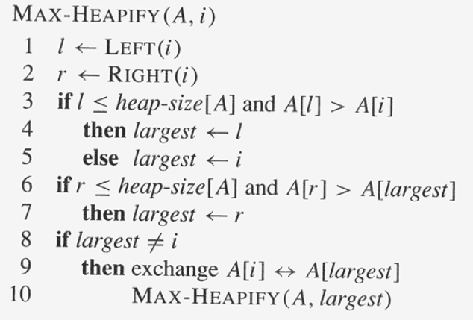
MAX-HEAPIFY
Extract the indices of LEFT and RIGHT
children of i
Choose the largest of A[i], A[l], A[r]
Float down A[i] recursively

Slide 51
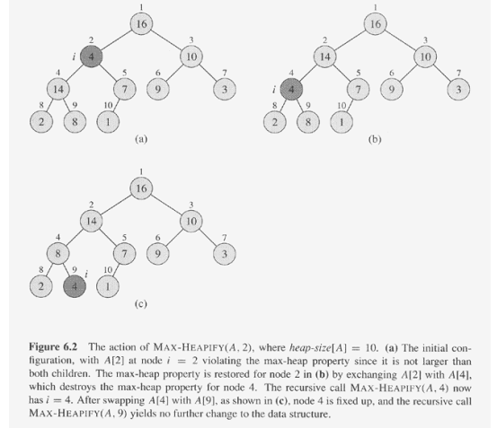
Running Time of MAX-HEAPIFY
Θ(1) to find out the largest among
A[i], A[LEFT(i)], and A[RIGHT(i)]
Plus the time to run MAX-HEAPIFY on a
subtree rooted at one of the children of node i
  The children’s subtrees each have size
  at most 2n/3 (why?)
    the worst case occurs when the last row of the tree is
    exactly half full
T(n) ≤ T(2n/3) + Θ(1)
  By case 2 of the master theorem
  T(n) = O(lg n)
7/11 = 0.63

Slide 52
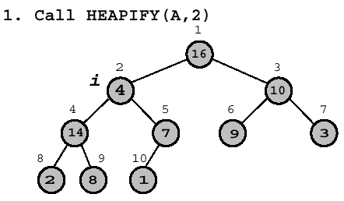

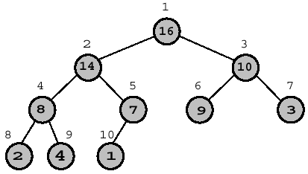
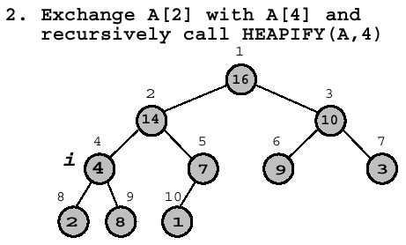

Heapify Example

Slide 53
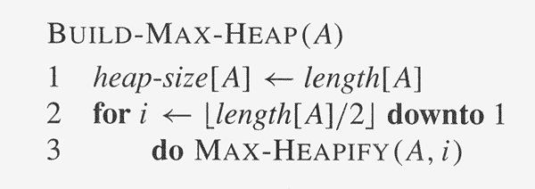
Building a Max-Heap
Observation: A[(⎣n/2⎦+1)..n] are all leaves of the tree
  Exercise 6.1-7 on page 130
  Each is a 1-element heap to begin with
Upper bound on the running time
  O(lg n) for each call to MAX-HEAPIFY, and call n times → O(n lg n)
    Not tight

Slide 54
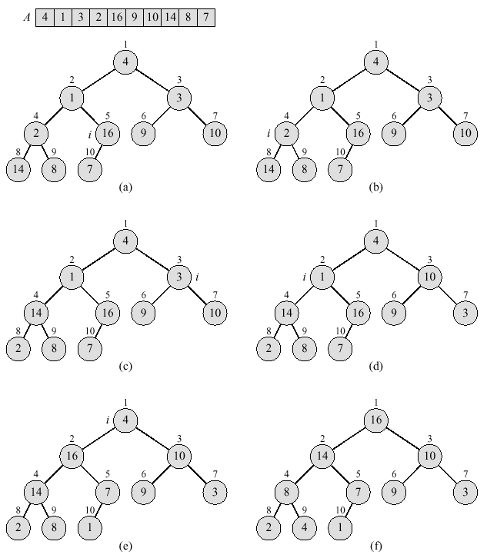
Building a Max-Heap

Slide 55
Loop Invariant
At the start of each iteration of the for loop of lines 2-3, each node i+1,
i+2, .., n is the root of a max-heap
  Initialization: Prior to the first iteration of the loop, i = ⎣n/2⎦. Each
  node ⎣n/2⎦+1, ⎣n/2⎦+2,.., n is a leaf and the root of a trivial max-heap.
  Maintenance: Observe that the children of node i are numbered
  higher than i. By the loop invariant, therefore, they are both roots of
  max-heaps. This is precisely the condition required for the call
  MAX-HEAPIFY(A, i) to make node i a max-heap root. Moreover, the
  MAX-HEAPIFY call preserves the property that nodes i+1, i+2, …, n
  are all roots of max-heaps. Decrementing i in the for loop update
  reestablishes the loop invariant for the next iteration.
  Termination: At termination, i=0. By the loop invariant, each node 1, 2, …, n
  is the root of a max-heap. In particular, node 1 is.

Slide 56
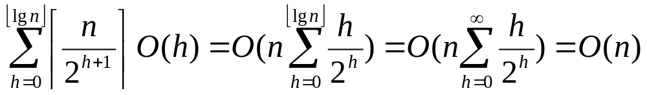
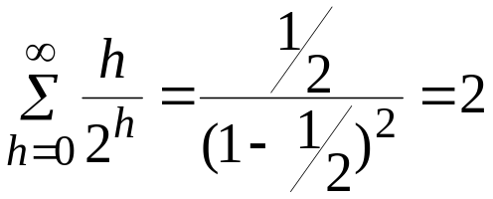
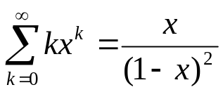
Cost for Build-MAX-HEAP
Heap-properties of an n-element heap
  Height = ⎣lg n⎦
  At most ⎡n/2^{h+1}⎤ nodes of any height h
    Exercise 6.3-3 on page 135
Ignore the constant ½
(for |x| < 1)

Slide 57
Heapsort
Using BUILD-MAX-HEAP to build a max-heap on the input array A[1..n], where n=length[A]
Put the maximum element, A[1], to A[n]
  Then discard node n from the heap by decrementing heap-size(A)
A[2..n-1] remain max-heaps, but A[1] may violate
  call MAX-HEAPIFY(A, 1) to restore the max-heap property
  for A[1..n-1]
Repeat the above process from n down to 2
Cost: O(n lg n)
  BUILD-MAX-HEAP: O(n)
  Each of the n-1 calls to MAX-HEAPIFY takes time O(lg n)

Slide 58
Example: Heapsort
1
16
2
3
14
10
4
5
6
7
8
7
9
3
8
9
10
2
4
1
16 | 14 | 10 | 8 | 7 | 9 | 3 | 2 | 4 | 1

Slide 59
Example: Heapsort (2)
1
14
2
3
8
10
4
5
6
7
4
7
9
3
8
9
10
2
1
16

Slide 60
Example: Heapsort (3)
1
10
2
3
8
9
4
5
6
7
4
7
1
3
8
9
10
2
14
16

Slide 61
Example: Heapsort (4)
1
9
2
3
8
3
4
5
6
7
4
7
1
2
8
9
10
10
14
16

Slide 62
Example: Heapsort (5)
1
7
2
3
4
3
4
5
6
7
1
2
8
9
8
9
10
10
14
16

Slide 63
Example: Heapsort (6)
1
4
2
3
2
3
4
5
6
7
1
7
8
9
8
9
10
10
14
16

Slide 64
Example: Heapsort (7)
1
1
2
3
2
3
4
5
6
7
4
7
8
9
8
9
10
10
14
16

Slide 65
Example: Heapsort (8)
1
1
2
3
2
3
4
5
6
7
4
7
8
9
8
9
10
10
14
16
1 | 2 | 3 | 4 | 7 | 8 | 9 | 10 | 14 | 16

Slide 66
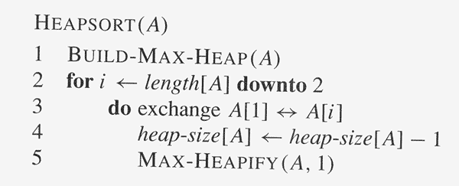
Heapsort Algorithm

Slide 67
Priority Queues
We can implement the priority queue ADT with a heap. The operations are:
  Max(S) – returns the maximum element
  Extract-Max(S) – remove and return the maximum element
  Insert(x,S) – insert element x into S
  Increase-Key(S,x,k) – increase x’s value to k

Slide 68
Extract-Max
Θ(1)
Heap-Maximum(A) return A[1]
Heap-Extract-Max(A)
if heapsize[A] < 1
then error “heap underflow”
max ← A[1]
A[1] ← A[heapsize[A]]
heapsize[A]← heapsize[A] –1
Max-Heapify(A,1)
return max
O(lg n)

Slide 69
Increase-Key
O(lg n)
Heap-Increase-key(A, i, key)
if key < A[i]
then error “new key smaller than existing one”
A[i] ← key
while i > 1 and A[parent(i)] < A[i]
do Exchange(A[i], parent(A[i]))
i ← parent(i)

Slide 70
Example: increase key (1)
1
16
2
3
14
10
4
5
6
7
8
7
9
3
8
9
10
2
4
1
increase 4 to 15

Slide 71
Example: increase key (2)
1
16
2
3
14
10
4
5
6
7
8
7
9
3
8
9
10
2
15
1

Slide 72
Example: increase key (3)
1
16
2
3
14
10
4
5
6
7
15
7
9
3
8
9
10
2
8
1

Slide 73
Example: increase key (4)
1
16
2
3
15
10
4
5
6
7
14
7
9
3
8
9
10
2
8
1

Slide 74
Insert-Max
O(lg n)
Heap-Insert-Max(A, key)
heapsize[A]← heapsize[A] + 1
A[heapsize[A]] ← -∞
Heap-Increase-Key(A, heapsize[A], key)

