Slide 1
Lecture 4.
Quicksort
한국산업기술대학교
컴퓨터 공학과
방 영 철

Slide 2
Introduction for Quicksort
Worst-case running time: (n²)
Expected running time: (n lg n)
Constants hidden in (n lg n) are small
Another divide-and-conquer algorithm
  The array A[p..r] is partitioned into two non-empty subarrays A[p..q] and A[q+1..r]
    Invariant: All elements in A[p..q] are less than all elements in A[q+1..r]
  The subarrays are recursively sorted by calls to QUICKSORT
  Unlike merge sort, no combining step: two subarrays form an already-sorted array

Slide 3
Quicksort
To sort the subarray A[p . . r]
  Divide
    Partition A[p..r], into two (possibly empty) subarrays
    A[p .. q-1] and A[q+1 .. r], such that each element in the first subarray A[p .. q-1] is ≤ A[q] and A[q] is ≤ each element in the second subarray A[q+1 .. r]
  Conquer
    Sort the two subarrays by recursive calls to QUICKSORT
  Combine
    No work is needed to combine the subarrays, because they are sorted in place
Perform the divide step by a procedure PARTITION, which returns the index q that marks the position separating the subarrays

Slide 4
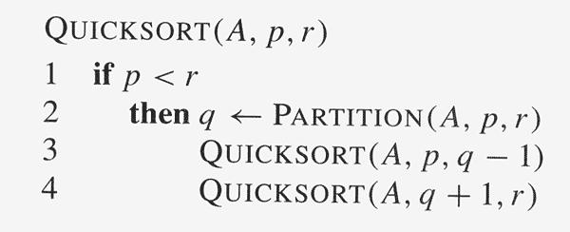
Quicksort Code

Slide 5
Partition
Clearly, all the action takes place in the partition() function
  Rearranges the subarray in place
  End result:
    Two subarrays
    All values in first subarray ≤ all values in second one
  Returns the index of the “pivot” element separating the two subarrays
How do you suppose we implement this?

Slide 6
Partition
PARTITION always selects the last element A[r] in the subarray A[p .. r] as the pivot
  The element around which to partition
As the procedure executes, the array is partitioned into four regions, some of which may be empty

Slide 7
Partition
Loop invariant:
1. All entries in A[p .. i ] ≤ pivot
2. All entries in A[i+1 .. j-1] > pivot
3. A[r] = pivot
It’s not needed as part of the loop invariant, but the fourth region is A[ j . . r-1], whose entries have not yet been examined, and so we don’t know how they compare to the pivot.

Slide 8
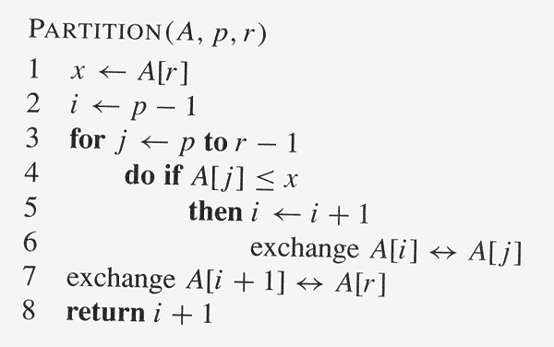
Partition

Slide 9
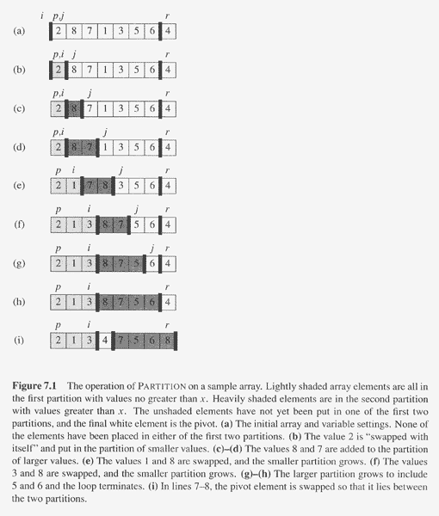
Partition

Slide 10
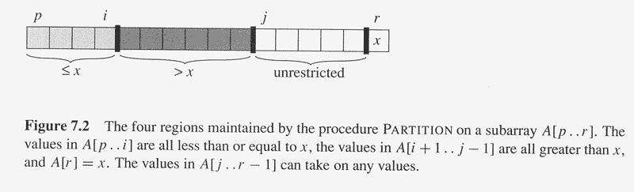
Partition

Slide 11
Partition
If A[j] > pivot:
only increment j
If A[j] ≤ pivot:
i is incremented, A[j] and A[i] are swapped and then j is incremented
p
i
j
r
>x
x
≤ x
> x
p
i
j
r
x
≤ x
> x
p
i
j
r
≤x
x
≤ x
> x
p
i
j
r
x
≤ x
> x

Slide 12
Correctness of Partition
Initialization:
  Before the loop starts, all the conditions of the loop invariant are satisfied, because r is the pivot and the subarrays A[p .. i] and A[i+1 .. j-1] are empty
Maintenance:
  While the loop is running,
    if A[ j ] ≤ pivot, then A[ j] and A[i +1] are swapped and i and j are incremented
    If A[ j ] > pivot, then increment only j

Slide 13
Correctness of Partition
Termination:
  When the loop terminates, j = r, so all elements in A are partitioned into one of the three cases:
    A[p . . i ] ≤ pivot, A[i+1 .. r-1] > pivot, and A[r] = pivot
The last two lines of PARTITION move the pivot element from the end of the array to between the two subarrays:
  swapping the pivot(A[r]) and the first element of the second subarray(A[i + 1])
Time for partitioning:
  Θ(n) to partition an n-element subarray

Slide 14
Performance of Quicksort
The running time of Quicksort depends on the partitioning of the subarrays:
  If the subarrays are balanced, then quicksort can run as fast as mergesort
  If they are unbalanced, then quicksort can run as slowly as insertion sort
Worst-case
  Occurs when the subarrays are completely unbalanced
  Has 0 elements in one subarray and n-1 elements in the other subarray

Slide 15
Performance of Quicksort
Worst-case
  Get the recurrence:
    T(n) = T(n-1) + T(0) + Θ(n)
    = T(n-1) + Θ(n) ( = Θ(n²) )
  Same running time as insertion sort
  In fact, the worst-case running time occurs when quicksort takes a sorted array as input, but insertion sort runs in O(n) time in this case

Slide 16
Performance of Quicksort
Best-case
  Occurs when the subarrays are completely balanced every time.
  Each subarray has ≤ n/2 elements
  Get the recurrence:
    T(n) = 2T(n/2) + Θ(n) ( = Θ(n lg n) )

Slide 17
Performance of Quicksort
Balanced partitioning
  Quicksort’s average running time is much closer to the best case than to the worst case.
  Imagine that PARTITION always produces a 9-to-1 split.
  Get the recurrence:
    T(n) ≤ T(9n/10) + T(n/10) + Θ(n)
    O(n lg n)

Slide 18
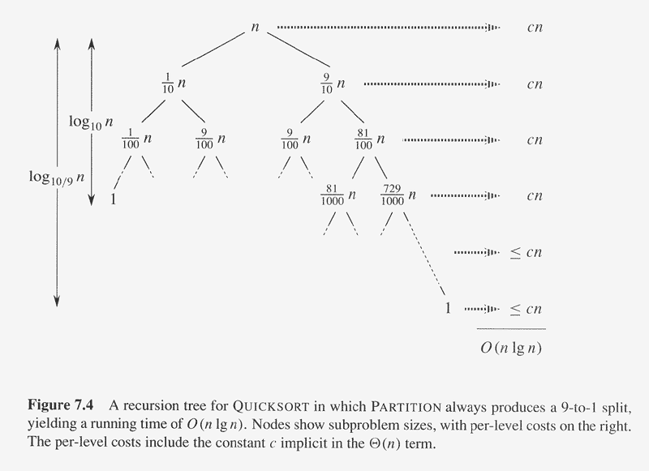
Performance of Quicksort

Slide 19
Performance of Quicksort
Intuition for the Average case
  Splits in the recursion tree will not always be constant
  There will usually be a mix of good and bad splits throughout the recursion tree
  To see that this doesn’t affect the asymptotic running time of Quicksort, assume that levels alternate between best-case and worst-case splits

Slide 20
Performance of Quicksort
Intuition for the Average case
  The extra level in the left-hand figure only adds to the constant hidden in the Θ-notation
  There are still the same number of subarrays to sort, and only twice as much work was done to get to that point
  Both figures(Fig.7.5 a & b) result in O(n lg n) time, though the constant for the figure on the left is higher than that of the figure on the right

Slide 21
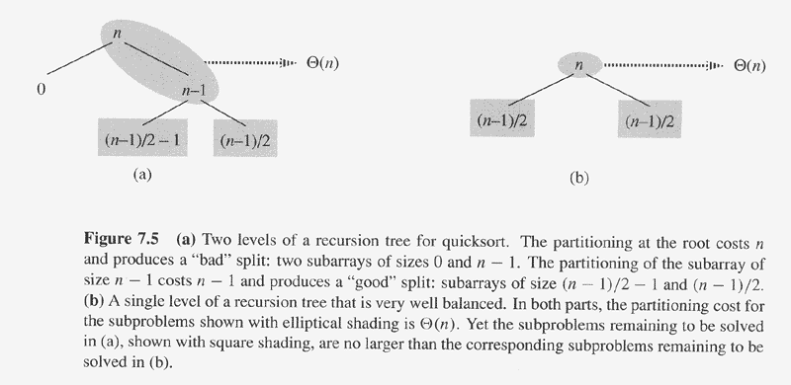
Performance of Quicksort

Slide 22
Quicksort
Sort an array A[p…r]
Divide
  Partition the array A into 2 subarrays A[p..q] and A[q+1..r], such that each element of A[p..q] is smaller than or equal to each element in A[q+1..r]
  The index (pivot) q is computed
Conquer
  Recursively sort A[p..q] and A[q+1..r] using Quicksort
Combine
  Trivial: the arrays are sorted in place ⇒ no work needed to combine them: the entire array is now sorted
A[p…q]
≤
A[q+1…r]

Slide 23
Quicksort
QUICKSORT(A, p, r)
if p < r
then q ← PARTITION(A, p, r)
QUICKSORT (A, p, q)
QUICKSORT (A, q+1, r)

Slide 24
Partitioning the Array
Idea
  Select a pivot element x around which to partition
  Grows two regions
A[p…i] ≤ x
x ≤ A[j…r]
A[p…i] ≤ x
x ≤ A[j…r]
i
j

Slide 25
Example
A[p…r]
5
3
2
6
4
1
3
7
5
3
2
6
4
1
3
7
i
j
i
j
3
3
2
6
4
1
5
7
3
3
2
6
4
1
5
7
i
j
i
j
A[p…q]
A[q+1…r]
3
3
2
1
4
6
5
7
3
3
2
1
4
6
5
7
i
j
j
i

Slide 26
Partitioning the Array
PARTITION (A, p, r)
x ← A[p]
i ← p – 1
j ← r + 1
while TRUE
do repeat j ← j – 1
until A[j] ≤ x
repeat i ← i + 1
until A[i] ≥ x
if i < j
then exchange A[i] ↔ A[j]
else return j
p
r
A:
5
3
2
6
4
1
3
7
i
j
A[p…q]
≤
A[q+1…r]
A:
a_{p}
a_{r}
j=q
i
Running time: Θ(n)
n = r – p + 1

Slide 27
Performance of Quicksort
Average case
  All permutations of the input numbers are equally likely
  On a random input array, we will have a mix of well balanced and unbalanced splits
  Good and bad splits are randomly distributed across throughout the tree
n
combined cost:
2n-1 = Θ(n)
n
combined cost:
n = Θ(n)
1
n - 1
(n – 1)/2 + 1
(n – 1)/2
(n – 1)/2
(n – 1)/2
Alternate of a good
and a bad split
Nearly well
balanced split
Running time of Quicksort when levels alternate between good and bad splits is O(nlgn)

Slide 28
Randomizing Quicksort
Randomly permute the elements of the input array
before sorting
Modify the PARTITION procedure
  At each step of the algorithm we exchange element A[p] with an element chosen at random from A[p…r]
  The pivot element x = A[p] is equally likely to be any one of
  the r – p + 1 elements of the subarray

Slide 29
Randomized Algorithms
The behavior is determined in part by values produced by a random-number generator
  RANDOM(a, b) returns an integer r, where a ≤ r ≤ b and each of the b-a+1 possible values of r is equally likely
Algorithm generates its own randomness
No input can elicit worst case behavior
  Worst case occurs only if we get “unlucky” numbers from the random number generator

Slide 30
Randomized PARTITION
RANDOMIZED-PARTITION(A, p, r)
i ← RANDOM(p, r)
exchange A[p] ↔ A[i]
return PARTITION(A, p, r)

Slide 31
Randomized Quicksort
RANDOMIZED-QUICKSORT(A, p, r)
if p < r
then q ← RANDOMIZED-PARTITION(A, p, r)
RANDOMIZED-QUICKSORT(A, p, q)
RANDOMIZED-QUICKSORT(A, q + 1, r)

Slide 32
Worst-Case Analysis of Quicksort
T(n) = worst-case running time
T(n) = max (T(q) + T(n-q)) + Θ(n)
^{1 ≤ q ≤ n-1}
Use substitution method to show that the running time of Quicksort is O(n²)
Guess T(n) = O(n²)
  Induction goal: T(n) ≤ cn²
  Induction hypothesis: T(k) ≤ ck² for any k ≤ n

Slide 33
Worst-Case Analysis of Quicksort
Proof of induction goal:
T(n) ≤ max (cq² + c(n-q)²) + Θ(n)
^{1 ≤ q ≤ n-1}
= c ⋅ max (q² + (n-q)²) + Θ(n)
^{1 ≤ q ≤ n-1}
The expression q² + (n-q)² achieves a maximum over the range
1 ≤ q ≤ n-1 at one of the endpoints
max (q² + (n - q)²) ≤ 1² + (n - 1)² = n² – 2(n – 1)
^{1 ≤ q ≤ n-1}
T(n) ≤ cn² – 2c(n – 1) + Θ(n)
≤ cn²

Slide 34
Random Variables and Expectation
Consider running time T(n) as a random variable
  This variable associates a real number with each possible outcome (split) of partitioning
Expected value (expectation, mean) of a discrete random variable X is:
E[X] = Σ_{x} x Pr{X = x}
  “Average” over all possible values of random variable X

Slide 35
Indicator Random Variables
Given a sample space S and an event A, we define the indicator random variable I{A} associated with A:
  I{A} = 1 if A occurs
  0 if A does not occur
The expected value of an indicator random variable X_{A} is:
E[X_{A}] = Pr {A}
Proof: E[X_{A}] = E[I{A}] =
1 ∗ Pr{A} + 0 ∗ Pr{Ā}
= Pr{A}

Slide 36
Number of Comparisons in PARTITION
Need to compute the total number of comparisons performed in all calls to PARTITION
X_{ij} = I {z_{i} is compared to z_{j} }
  For any comparison during the entire execution of the algorithm, not just during one call to PARTITION

Slide 37
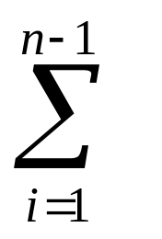
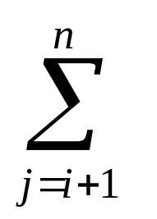
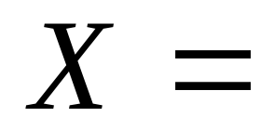
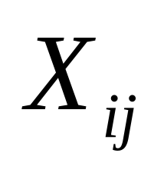
Number of Comparisons in PARTITION
Each pair of elements can be compared at most once
  X_{ij} = I {z_{i} is compared to z_{j} }
i
n-1
i+1
n
X represents the total number of comparisons performed by the algorithm

Slide 38
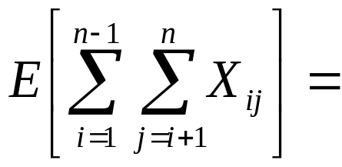
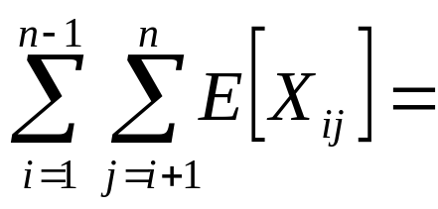
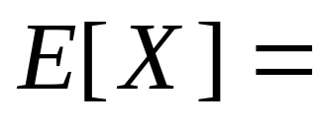
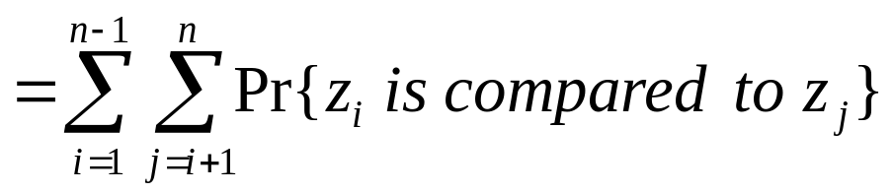
Number of Comparisons in PARTITION
X is an indicator random variable
  Compute the expected value
by linearity
of expectation
the expectation of X_{ij} is equal to the probability of the event “z_{i} is compared to z_{j}”

Slide 39
When Do We Compare Two Elements?
z₂
z₉
z₈
z₃
z₅
z₄
z₁
z₆
z₁₀
z₇
2
9
8
3
5
4
1
6
10
7
Z_{1,6}= {1, 2, 3, 4, 5, 6}
Rename the elements of A as z₁, z₂, . . . , z_{n}, with z_{i} being the i-th smallest element
Define the set Z_{ij} = {z_{i} , z_{i+1}, . . . , z_{j} } the set of elements between z_{i} and z_{j}

Slide 40
When Do We Compare Two Elements?
z₂
z₉
z₈
z₃
z₅
z₄
z₁
z₆
z₁₀
z₇
2
9
8
3
5
4
1
6
10
7
Z_{1,6}= {1, 2, 3, 4, 5, 6}
Pivot chosen such as: z_{i} < x < z_{j}
  z_{i} and z_{j} will never be compared
z_{i} or z_{j} is the pivot
  z_{i} and z_{j} will be compared
  only if one of them is chosen as pivot before any other element in range z_{i} to z_{j}
Only the pivot is compared with elements in both sets

Slide 41
Number of Comparisons in PARTITION
Pr{
z_{i} is compared to z_{j}
}
=
Pr{
z_{i} is the first pivot chosen from Z_{ij}
}
+
OR
Pr{
z_{j} is the first pivot chosen from Z_{ij}
}
  = 1/( j - i + 1) + 1/( j - i + 1) = 2/( j - i + 1)
There are j – i + 1 elements between z_{i} and z_{j}
  Pivot is chosen randomly and independently
  The probability that any particular element is the first one chosen is 1/( j - i + 1)

Slide 42
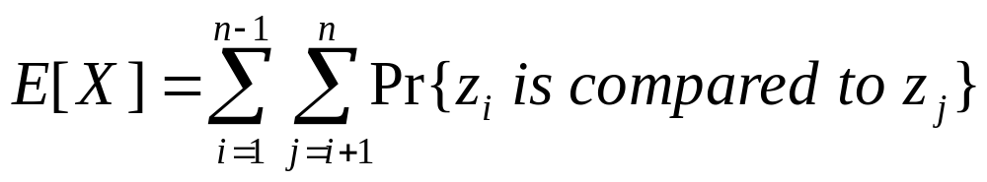
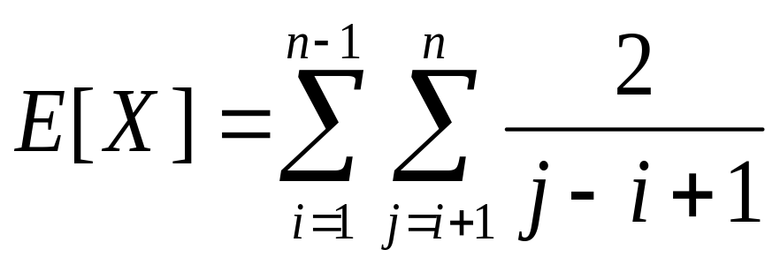
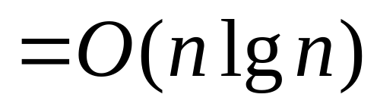
Number of Comparisons in PARTITION
Expected number of comparisons in PARTITION:
⇒ Expected running time of Quicksort using RANDOMIZED-PARTITION is O(nlgn)

