Slide 1
Lecture 5.
Counting Sort / Radix Sort
한국산업기술대학교
컴퓨터 공학과
방 영 철

Slide 2
Sorting So Far
Insertion Sort
  Easy to code
  Fast on small inputs (less than ~ 50 elements)
  Fast on nearly-sorted inputs
  O(n²) worst case
  O(n²) average (equally-likely inputs) case
  O(n²) reverse-sorted case

Slide 3
Sorting So Far
Merge Sort
  Divide-and-Conquer
    Split array in half
    Recursively sort subarrays
    Linear-time merge step
  O(n lg n) worst case
  It does not sort in place

Slide 4
Sorting So Far
Heap Sort
  It uses the very useful heap data structure
    Complete binary tree
    Heap property: parent key > children’s keys
  O(n lg n) worst case
  It sorts in place

Slide 5
Sorting So Far
Quick Sort
  Divide-and-Conquer
    Partition array into two subarrays, recursively sort
    All of first subarray < all of second subarray
    No merge step needed !
  O(n lg n) average case
  Fast in practice
  O(n²) worst case
    Naïve implementation: worst case on sorted input
    Address this with randomized quicksort

Slide 6
How Fast Can We Sort?
We will provide a lower bound, then beat it
  How do you suppose we’ll beat it?
First, an observation: all of the sorting algorithms so far are comparison sorts
  The only operation used to gain ordering information about a sequence is the pairwise comparison of two elements
  Theorem: all comparison sorts are Ω(n lg n)

Slide 7
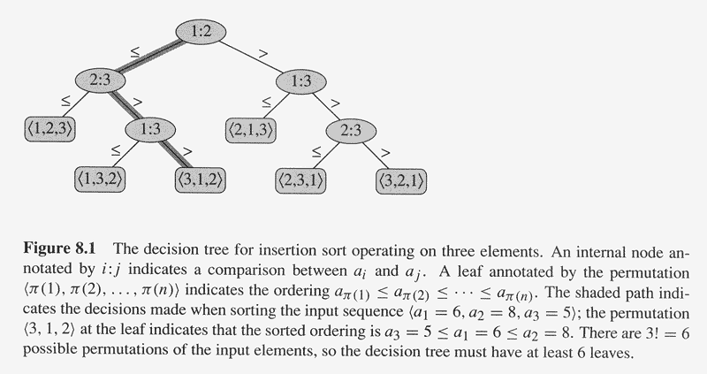
Decision Trees
5
7
3
5
3
7
7
3
3
5
3
7
5

Slide 8
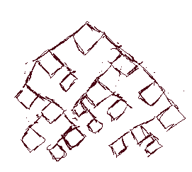
Decision Trees
Decision trees provide an abstraction of comparison sorts
  A decision tree represents the comparisons made by a comparison sort.
What do the leaves represent?
How many leaves must there be?

Slide 9
Decision Trees
Decision trees can model comparison sorts
For a given algorithm:
  One tree for each n
  Tree paths are all possible execution traces
  What’s the longest path in a decision tree for insertion sort?
  For merge sort?
What is the asymptotic height of any decision tree for sorting n elements?
Answer: Ω(n lg n) (Now let’s prove it…)

Slide 10
A Lower Bound for Comparison Sorting
Theorem: Any decision tree that sorts n elements has height Ω(n lg n)
What’s the minimum number of leaves?
What’s the maximum number of leaves of a binary tree of height h?
Clearly the minimum number of leaves is less than or equal to the maximum number of leaves

Slide 11
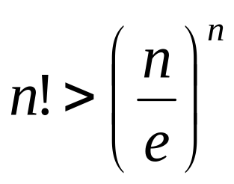
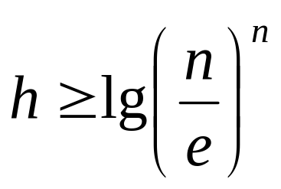
A Lower Bound for Comparison Sorting
So we have…
n! ≤ 2^{h}
Taking logarithms:
lg (n!) ≤ h
Stirling’s approximation tells us:
Thus:

Slide 12
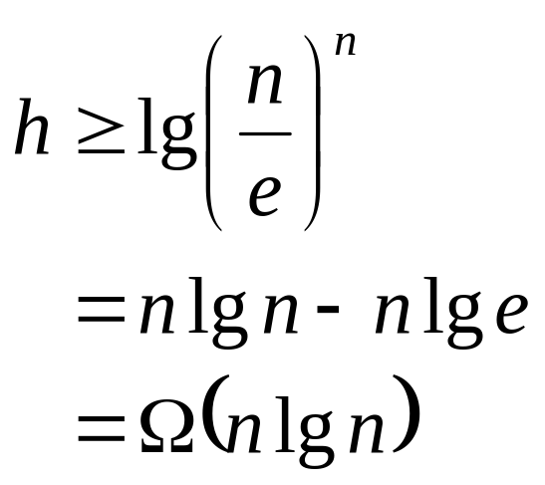
A Lower Bound for Comparison Sorting
So we have
Thus the minimum height of a decision tree is Ω(n lg n)

Slide 13
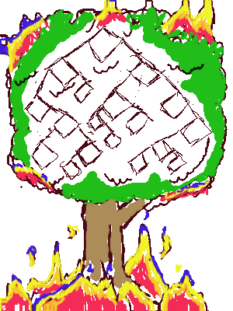
A Lower Bound for Comparison Sorts
Thus the time to comparison sort n elements is Ω(n lg n)
Corollary: Heapsort and Mergesort are asymptotically optimal comparison sorts
But the name of this lecture is “Sorting in linear time”!
  How can we do better than Ω(n lg n)?

Slide 14
Sorting in Linear Time
Counting Sort
  No comparisons between elements !
  But…depends on assumption about the numbers being sorted
Basic Idea
  For each input element x,
  determine the number of elements less than or equal to x
  For each integer i (0 ≤ i ≤ k), count how many elements whose
  values are i
    Then we know how many elements are less than or equal to i
Algorithm Storage
  A[1..n]: input elements
  B[1..n]: sorted elements
  C[0..k]: hold the number of elements less than or equal to i

Slide 15
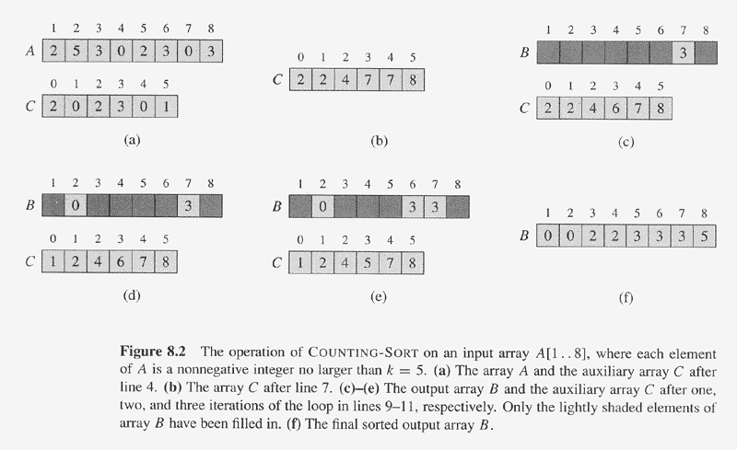
Counting Sort Illustration
(Range from 0 to 5)

Slide 16
Counting Sort Illustration
2
2
5
5
3
3
0
0
2
A
2
3
0
3
B
0
3
3
B
0
2
3
3
C
1
2
4
4
5
7
8
C
1
1
2
3
5
7
8
B
0
0
2
3
3
B
0
0
2
3
3
3
B
0
0
2
3
3
3
8
C
0
2
3
5
5
7
8
C
0
2
3
4
7
8
C
0
2
3
4
7
7
8
2
B
0
0
2
2
3
3
3
8
C
0
2
3
4
7
7

Slide 17
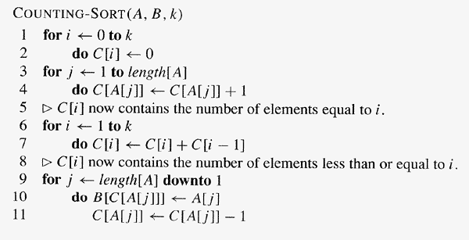
Counting Sort
Θ(k)
Θ(n)
Θ(k)
Θ(n)
Θ(n+k)

Slide 18
Counting Sort
Total time: O(n + k)
  Usually, k = O(n)
  Thus counting sort runs in O(n) time
But sorting is Ω(n lg n)!
  No contradiction
    This is not a comparison sort
    In fact, there are no comparisons at all !
  Notice that this algorithm is stable

Slide 19
Radix Sort
Intuitively, you might sort on the least significant digit, then the second lsd, etc.
Problem
  Lots of intermediate piles of cards (read: scratch arrays)
  to keep track of
Key idea
  Sort the least significant digit first
  RadixSort(A, d)
  for i=1 to d
  StableSort(A) on digit i

Slide 20
Radix Sort Example
Input data:
a
b
a
b
a
c
c
a
a
a
c
b
b
a
b
c
c
a
a
a
c
b
b
a

Slide 21
Radix Sort Example
Pass 1: Looking at rightmost position.
a
b
a
b
a
c
c
a
a
a
c
b
b
a
b
c
c
a
a
a
c
b
b
a
Place into appropriate pile.
a
b
c

Slide 22
Radix Sort Example
Pass 1: Looking at rightmost position.
b
b
a
Join piles.
c
c
a
c
a
a
b
a
b
a
a
c
a
b
a
a
c
b
b
a
c
a
b
c

Slide 23
Radix Sort Example
Pass 2: Looking at next position.
a
b
a
c
a
a
c
c
a
b
b
a
a
c
b
b
a
b
b
a
c
a
a
c
Place into appropriate pile.
a
b
c

Slide 24
Radix Sort Example
Pass 2: Looking at next position.
a
a
c
Join piles.
b
a
c
b
a
b
b
b
a
a
c
b
c
a
a
a
b
a
c
c
a
a
b
c

Slide 25
Radix Sort Example
Pass 3: Looking at last position.
c
a
a
b
a
b
b
a
c
a
a
c
a
b
a
b
b
a
c
c
a
a
c
b
Place into appropriate pile.
a
b
c

Slide 26
Radix Sort Example
Pass 3: Looking at last position.
Join piles.
a
c
b
b
b
a
a
b
a
b
a
c
c
c
a
a
a
c
b
a
b
c
a
a
a
b
c

Slide 27
Radix Sort Example
Result is sorted.
a
a
c
a
b
a
a
c
b
b
a
b
b
a
c
b
b
a
c
a
a
c
c
a

Slide 28
Radix Sort Example
13
30
28
56
36
56
36
30
28
13
13
30
28
56
36
28
36
56
13
30
28
36
56
13
30
36
13 28 30 56
36
30 13 56 28
Radix Bins 0 1 2 3 4 5 6 7 8 9

Slide 29
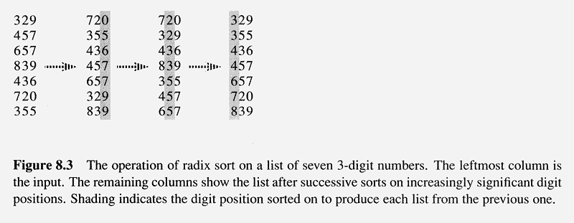
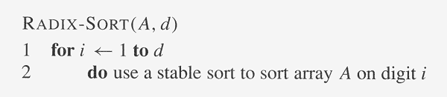
Radix Sort Example
d digits in total

Slide 30
Radix Sort
Counting sort is obvious choice:
  Sort n numbers on digits that range from 1..k
  Time: O(n + k)
Each pass over n numbers with d digits takes time O(n+k),
so total time O(dn+dk)
  When d is constant and k=O(n), takes O(n) time
In general, radix sort based on counting sort is
  Fast
  Asymptotically fast (i.e., O(n))
  Simple to code

Slide 31
Medians and Order Statistics
The ith order statistic of a set of n elements is the ith smallest element
The median is the halfway point
Define the selection problem as:
  Given a set A of n elements, find an element x ∈ A that is larger than x-1 elements
Obviously, this can be solve in O(n lg n). Why?
Is it really necessary to sort all the numbers?

Slide 32
Order Statistics
The ith order statistic in a set of n elements is the ith smallest element
The minimum is thus the 1st order statistic
The maximum is the nth order statistic
The median is the n/2 order statistic
  If n is even, there are 2 medians
    The lower median ⎣(n+1)/2 ⎦
    The upper median ⎡(n+1)/2⎤
How can we calculate order statistics?
What is the running time?

Slide 33
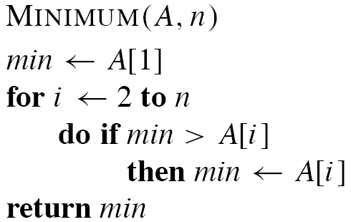
Minimum and Maximum
The maximum can be found in exactly the same way by replacing the > with < in the above algorithm.

Slide 34
Simultaneous Min and Max
How many comparisons are needed to find the minimum element in a set? The maximum?
Can we find the minimum and maximum with less than twice the cost?
Yes:
  Walk through elements by pairs
    Compare each element in pair to the other
    Compare the largest to maximum, smallest to minimum
      Pair (a_{i}, a_{i+1}), assume a_{i} < a_{i+1}, then
      Compare (min,a_{i}), (a_{i+1},max)
      3 comparisions for each pair.
  Total cost: 3 comparisons per 2 elements
    O( 3 n/2 )

Slide 35
The Selection Problem
A more interesting problem is selection
  Finding the i^{th} smallest element of a set
We will show
  A practical randomized algorithm with O(n) expected running time
  A cool algorithm of theoretical interest only with O(n) worst-case running time

Slide 36
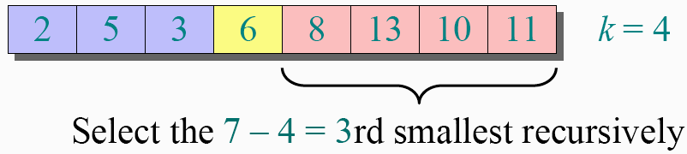
Randomized Selection
Key idea: use partition() from quicksort
  But, only need to examine one subarray
  This savings shows up in running time: O(n)
Select the i=7th smallest
i - k

Slide 37
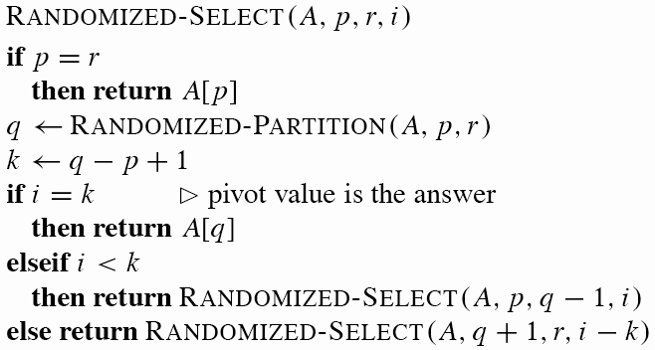
Randomized Selection
k
≤ A[q]
≥ A[q]
p
q
r

Slide 38
Randomized Selection
Analyzing Randomized-Select()
  Worst case: partition always 0:n-1
    T(n) = T(n-1) + O(n)
    = O(n²) (arithmetic series)
    No better than sorting !
  Best case: suppose a 9:1 partition
    T(n) = T(9n/10) + O(n)
    = O(n) (Master Theorem, case 3)
    Better than sorting!
    What if this had been a 99:1 split?

Slide 39
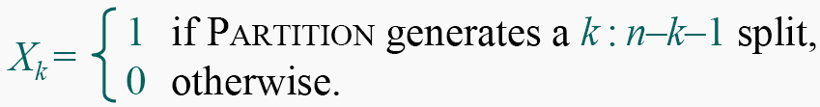
Randomized Selection
Analysis of expected time
  The analysis follows that of randomized quicksort, but it’s a little different.
  Let T(n) be the random variable for the running time of Randomized-Select on an input of size n, assuming random numbers are independent.
  For k = 0, 1, …, n–1, define the indicator random variable

Slide 40
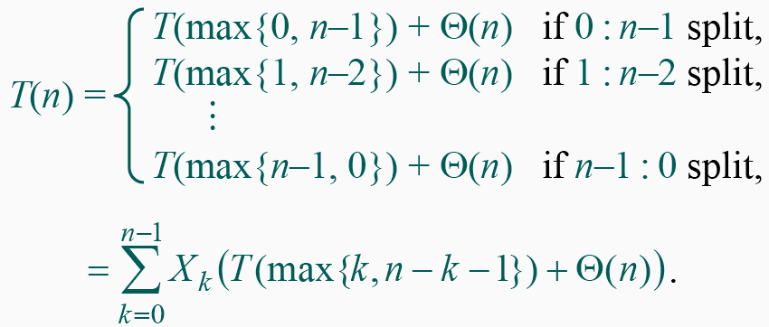
Randomized Selection
To obtain an upper bound, assume that the i^{th} element always falls in the larger side of the partition:

Slide 41
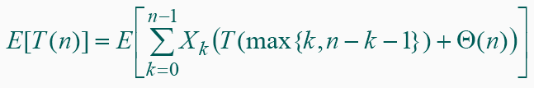
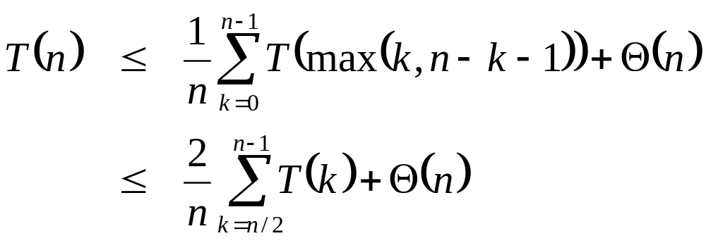
Randomized Selection
Take expectations of both sides
Let’s show that T(n) = O(n) by substitution

Slide 42
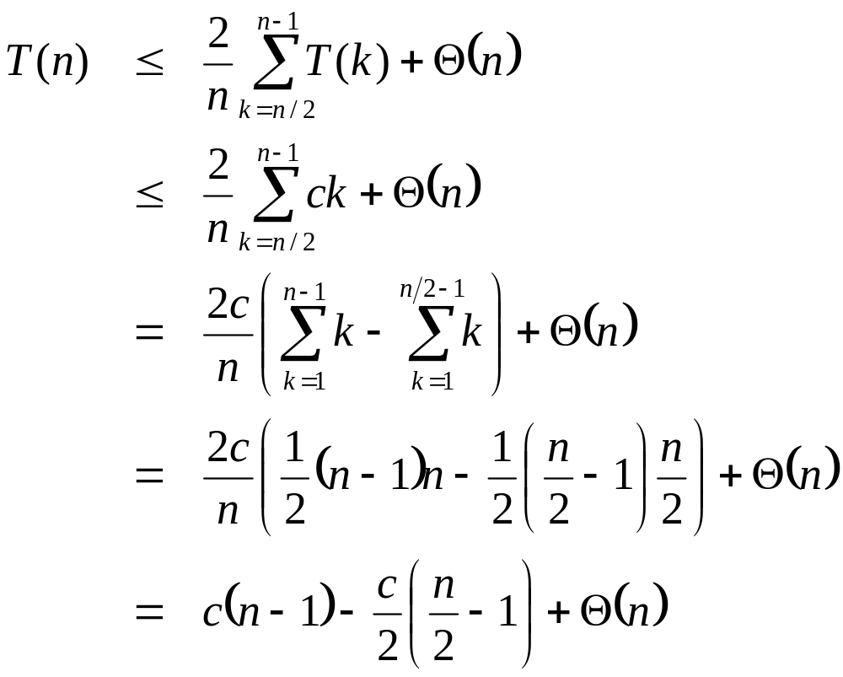
Randomized Selection
Assume T(k) ≤ ck for sufficiently large c:
The recurrence we started with
Substitute T(n) ≤ cn for T(k)
What happened here?
What happened here?
“Split” the recurrence
Expand arithmetic series
What happened here?
Multiply it out
What happened here?

Slide 43
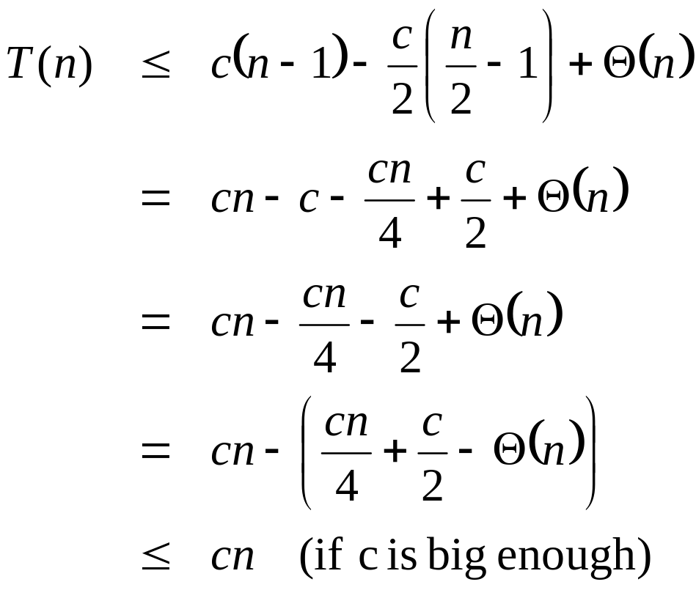
Randomized Selection
Assume T(k) ≤ ck for sufficiently large c:
The recurrence so far
What happened here?
Multiply it out
What happened here?
Subtract c/2
Rearrange the arithmetic
What happened here?
What we set out to prove
What happened here?

Slide 44
Selection in Worst-Case Linear Time
Randomized algorithm works well in practice
What follows is a worst-case linear time algorithm, really of theoretical interest only
Basic idea:
  Generate a good partitioning element
  Call this element x

Slide 45
Selection in Worst-Case Linear Time
The algorithm in words:
  1. Divide n elements into groups of 5
  2. Find median of each group ( How? How long? )
  3. Use Select() recursively to find median x of the ⎣n/5⎦ medians
  4. Partition the n elements around x. Let k = rank(x)
  5. if (i == k) then return x
  if (i < k) then use Select() recursively to find ith smallest element in first partition
  else (i > k) use Select() recursively to find (i-k)th smallest element in last partition
A:
x₁
x₂
x₃
x_{⎡n/5⎤}
x
k – 1 elements
x
n - k elements

Slide 46
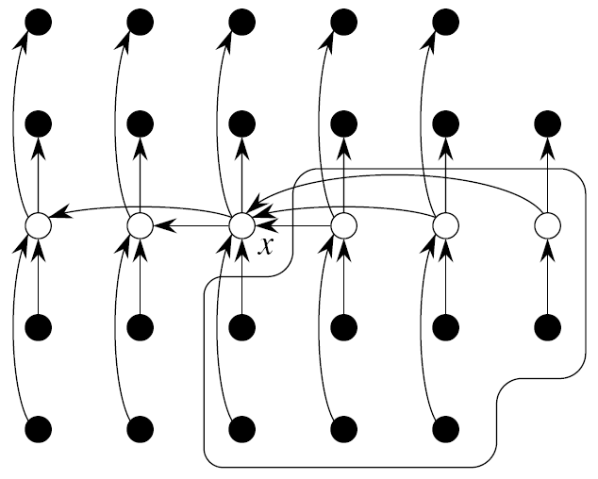
Order Statistics Analysis
Lesser
Elements
Median
Greater
Elements
One group of 5 elements

Slide 47
Order Statistics Analysis
Lesser
Medians
Median of
Medians
Greater
Medians
All groups of 5 elements
(And at most one smaller group)

Slide 48
Order Statistics Analysis
Definitely Lesser
Elements
Definitely Greater
Elements

Slide 49
Example
Find the –11th smallest element in array:
  A = {12, 34, 0, 3, 22, 4, 17, 32, 3, 28, 43, 82, 25, 27, 34,
  2 ,19 ,12 ,5 ,18 ,20 ,33, 16, 33, 21, 30, 3, 47}
Divide the array into groups of 5 elements
12
34
0
3
22
4
17
32
3
28
43
82
25
27
34
2
19
12
5
18
20
33
16
33
21
30
3
47

Slide 50
Example
Sort the groups and find their medians
0
3
12
22
34
3
4
17
28
32
25
27
34
43
82
2
5
12
18
19
16
20
21
33
33
3
30
47

Slide 51
Example
Find the median of the medians
0
3
12
22
34
2
5
12
18
19
3
4
17
28
32
16
20
21
33
33
25
27
34
43
82
3
30
47

Slide 52
Example
Partition the array around the median of medians (17)
  First partition:
    {12, 0, 3, 4, 3, 2, 12, 5, 16, 3}
  Pivot:
    17 (position of the pivot is q = 11)
  Second partition:
    {34, 22, 32, 28, 43, 82, 25, 27, 34, 19, 18,
    20, 33, 33, 21, 30, 47}
To find the 6-th smallest element we would have to recur our search in the first partition

Slide 53
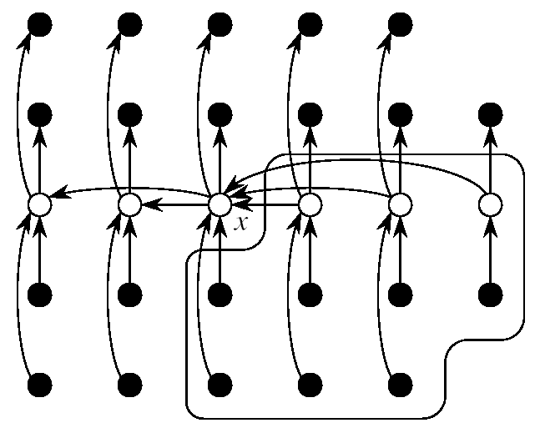
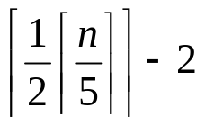
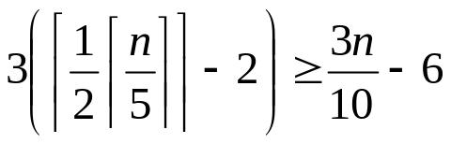
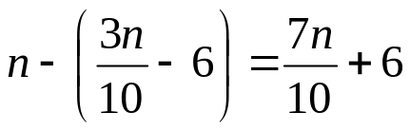
Analysis of Running Time
At least half of the medians found in step 2 are ≥ x
All but two of these groups contribute 3 elements > x
groups with 3 elements > x
At least elements greater than x
SELECT is called on at most elements

Slide 54
Analysis of Running Time
Step 1: making groups of 5 elements takes
Step 2: sorting n/5 groups in O(1) time each takes
Step 3: calling SELECT on ⎡n/5⎤ medians takes time
Step 4: partitioning the n-element array around x takes
Step 5: recursing on one partition takes
T(n) = T(⎡n/5⎤) + T(7n/10 + 6) + O(n)
  Show that T(n) = O(n)
O(n)
O(n)
T(⎡n/5⎤)
O(n)
≤ T(7n/10 + 6)

Slide 55
Analysis of Running Time
Let’s show that T(n) = O(n) by substitution
T(n) ≤ c ⎡n/5⎤ + c (7n/10 + 7) + an
≤ cn/5 + 7cn/10 + 7c + an
= 9cn/10 + 7c + an
= cn + (-cn/10 + 7c + an)
≤ cn if: -cn/10 + 7c + an ≤ 0

