Slide 1
Lecture 6.
Hash Tables
한국산업기술대학교
컴퓨터 공학과
방 영 철

Slide 2

Hash Tables
Motivation: symbol tables
  A compiler uses a symbol table to relate symbols to associated data
    Symbols: variable names, procedure names, etc.
    Associated data: memory location, call graph, etc.
  For a symbol table (also called a dictionary), we care about search, insertion, and deletion
  We typically don’t care about sorted order

Slide 3
Hash Tables
0
U
(universe of keys)
h(k₁)
h(k₄)
k₁
K
(actual
keys)
h(k₂)
k₄
k₂
k₃
h(k₃)
m - 1

Slide 4
Hash Tables
Idea
  Use a function h to compute the slot for each key
  Store the element in slot h(k)
A hash function h transforms a key into an index in a hash table T[0…m-1]:
h : U → {0, 1, . . . , m - 1}
We say that k hashes to slot h(k)
Advantages:
  Reduce the range of array indices handled: m instead of |U|
  Storage is correspondingly reduced

Slide 5
Hash Tables
More formally:
  Given a table T and a record x, with key (= symbol) and satellite data, we need to support:
    Insert (T, x)
    Delete (T, x)
    Search(T, x)
  We want these to be fast, but don’t care about sorting the records
The structure we will use is a hash table
  Supports all the above in O(1) expected time !

Slide 6
Direct-Address Tables
Suppose:
  The range of keys is 0..m-1
  Keys are distinct
The idea:
  Set up an array T[0..m-1] in which
    T[i] = x if x∈ T and key[x] = i
    T[i] = NULL otherwise
  This is called a direct-address table
    Operations take O(1) time!
    So what’s the problem?

Slide 7
Direct-Address Tables
Dictionary operations are trivial and take O(1) time each:
  DIRECT-ADDRESS-SEARCH(T, k)
  return T [k]
  DIRECT-ADDRESS-INSERT(T, x)
  T [ key[x] ] ← x
  DIRECT-ADDRESS-DELETE(T, x)
  T [ key[x] ] ← NIL

Slide 8
The Problem With Direct Addressing
Direct addressing works well when the range m of keys is relatively small
But what if the keys are 32-bit integers?
  Problem 1: direct-address table will have
  2³² entries, more than 4 billion
  Problem 2: even if memory is not an issue, the time to initialize the elements to NULL may be …
Solution: map keys to smaller range 0..m-1
This mapping is called a hash function

Slide 9

Hash Functions
Next problem: collision
T
U
(universe of keys)
0
h(k₁)
k₁
h(k₄)
K
(actual
keys)
k₄
k₅
h(k₂) = h(k₅)
k₂
h(k₃)
k₃
m - 1

Slide 10
Resolving Collisions
How can we solve the problem of collisions?
  Solution 1: chaining
  Solution 2: open addressing

Slide 11
Chaining
index
LL Head
0
1
2
3
4
5
...
n-1

Slide 12
Chaining
key1: data1
Hash
Function
index
LL Head
0
1
3
2
3
key1:data1
4
5
...
n-1

Slide 13
Chaining
key2: data2
Hash
Function
index
LL Head
0
1
key2:data2
1
2
3
key1:data1
4
5
...
n-1

Slide 14
Chaining
key3: data3
Hash
Function
index
LL Head
0
1
key2:data2
4
2
3
key1:data1
4
key3:data3
5
...
n-1

Slide 15
Chaining
key4: data4
Hash
Function
index
LL Head
0
1
key2:data2
3
2
3
key4:data4
key1:data1
4
key3:data3
5
...
Note: Insertion at
beginning of list
n-1

Slide 16
Chaining
Chaining puts elements that hash to the same slot in a linked list:
T
U
(universe of keys)
——
k₁
k₄
——
——
k₁
——
K
(actual
keys)
k₄
k₅
——
k₇
k₅
k₂
k₇
——
——
k₂
k₃
k₈
k₃
——
k₆
k₈
k₆
——
——

Slide 17
Chaining
How do we insert an element?
T
U
(universe of keys)
——
k₁
k₄
——
——
k₁
——
K
(actual
keys)
k₄
k₅
——
k₇
k₅
k₂
k₇
——
——
k₂
k₃
k₈
k₃
——
k₆
k₈
k₆
——
——

Slide 18
Chaining
How do we delete an element?
  Do we need a doubly-linked list for efficient delete?
T
U
(universe of keys)
——
k₁
k₄
——
——
k₁
——
K
(actual
keys)
k₄
k₅
——
k₇
k₅
k₂
k₇
——
——
k₂
k₃
k₈
k₃
——
k₆
k₈
k₆
——
——

Slide 19
Chaining
How do we search for a element with a given key?
T
U
(universe of keys)
——
k₁
k₄
——
——
k₁
——
K
(actual
keys)
k₄
k₅
——
k₇
k₅
k₂
k₇
——
——
k₂
k₃
k₈
k₃
——
k₆
k₈
k₆
——
——

Slide 20
Chaining
  CHAINED-HASH-INSERT(T, x)
  insert x at the head of list T [ h( key[x] ) ]
  CHAINED-HASH-SEARCH(T, k)
  search for an element with key k in list T [ h[k] ]
  CHAINED-HASH-DELETE(T, x)
  delete x from the list T [ h(key[x]) ]

Slide 21
Analysis of Chaining
Assume simple uniform hashing: each key in table is equally likely to be hashed to any slot
Given n keys and m slots in the table, the
load factor α = n / m = average # keys per slot
What will be the average cost of an unsuccessful search for a key?
  O(1+α)
What will be the average cost of a successful search?
  O(1 + α/2) = O(1 + α)

Slide 22
Analysis of Chaining
So the cost of searching
  O(1 + α)
If the number of keys n is proportional to the number of slots in the table, what is α?
  α = O(1)
  In other words, we can make the expected cost of searching constant if we make α constant

Slide 23
Choosing A Hash Function
Clearly choosing the hash function well is crucial
What are desirable features of the hash function?
  Should distribute keys uniformly into slots
  Should not depend on patterns in the data

Slide 24
Hash Functions: The Division Method
Idea
  Map a key k into one of the m slots by taking the reminder of k divided by m
  h(k) = k mod m
Advantage
  fast, requires only one operation
Disadvantage
  Certain values of m are bad: power of 2 and non-prime numbers

Slide 25
The Division Method
A good choice for m: a prime number, not too close to an exact power of 2
e.g., allocate a hash table, with collisions resolved through chaining
  n = 2000 character strings (8 bits/character)
  Choose m roughly n/3: m = 701 (prime near 2000/3, not near a power of 2)
  h(k) = k mod 701

Slide 26
Hash Functions: The Multiplication Method
Idea:
Multiply key k by a constant A, 0 < A < 1
Extract the fractional part of kA
Multiply the fractional part by m
Take the floor of the result
h(k) = ⎣m (k A mod 1)⎦
Disadvantage: Slower than division method
Advantage: Value of m is not critical: typically 2^{p}
fractional part of kA = kA - ⎣kA⎦

Slide 27
The Multiplication Method
For a constant A, 0 < A < 1:
h(k) = ⎣ m (kA - ⎣kA⎦) ⎦
Choose m = 2^{P}
Choose A not too close to 0 or 1
Knuth: Good choice for A = (√5 - 1)/2
Fractional part of kA

Slide 28
e.g. Multiplication Method
Given: m = 8 ⇒ p = 3
w = 5, k = 21
Choose s (0 < s < 2⁵) ⇒ s = 13 ⇒ A = 13/32
Use the formula to compute h(k):
kA = 21 · 13/32 = 273/32 = 8 17/32 ⇒
k A mod 1 = 17/32 ⇒
m (k A mod 1) = 8 · 17/32 = 17/4 = 4 1/4 ⇒
⎣m (k A mod 1)⎦ = 4 ⇒
h(k) = 4

Slide 29
Hash Functions: Universal Hashing
As before, when attempting to foil an malicious adversary: randomize the algorithm
Universal hashing:
  Guarantees good performance on average, no matter what keys adversary chooses
  Suppose we want the hash function to uniformly distribute hash values over the hash table of size m
  Given h(x), we want Prob{h(x)=h(y)}=1/m
  The # of functions |f| in H s.t. h(x)=h(y) for any x, y in U
  |f| / |H| = 1/m equivalent to |f| = |H| / m

Slide 30
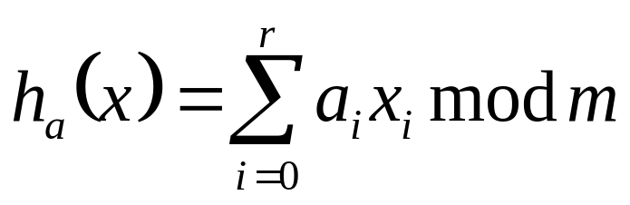
A Universal Hash Function
Choose table size m to be prime
Decompose key x into r+1 bytes, so that
x = {x₀, x₁, …, x_{r}}
  Only requirement is that max value of byte < m
  Let a = {a₀, a₁, …, a_{r}} denote a sequence of r+1 elements chosen randomly from {0, 1, …, m - 1}
  Define corresponding hash function h_{a}

Slide 31
e.g. Universal Hash Functions
p = 17, m = 6
h_{a,b}(k) = ((ak + b) mod p) mod m
h_{3,4}(8) = ((3⋅8 + 4) mod 17) mod 6
= (28 mod 17) mod 6
= 11 mod 6
= 5

Slide 32
Open Addressing
If we have enough contiguous memory to store all the keys (m > N)
⇒ store the keys in the table itself
No need to use the linked lists anymore
Collision resolution
  Put the elements that collide in the available empty places in the table

Slide 33
Open Addressing
Basic idea:
  To insert: if slot is full, try another slot, …, until an open slot is found (probing)
  To search, follow same sequence of probes as would be used when inserting the element
    If reach element with correct key, return it
    If reach a NULL pointer, element is not in table
Good for fixed sets (adding but no deletion)
  Example: spell checking
Table needn’t be much bigger than n

Slide 34
Open Addressing
index
data
0
1
2
3
4
5
...
n-1

Slide 35
Open Addressing
key1: data1
index
data
0
1
2
Hash
Function
3
key1:data1
4
5
...
n-1
3

Slide 36
Open Addressing
key2: data2
index
data
0
1
key2:data2
2
Hash
Function
3
key1:data1
4
5
...
n-1
1

Slide 37
Open Addressing
key3: data3
index
data
0
1
key2:data2
2
Hash
Function
3
key1:data1
4
key3:data3
5
...
n-1
4

Slide 38
Open Addressing
key4: data4
index
data
0
1
key2:data2
2
Hash
Function
3
key1:data1
4
key3:data3
5
...
n-1
3
?

Slide 39
Open Addressing
key4: data4
index
data
0
1
key2:data2
2
Hash
Function
3
key1:data1
4
key3:data3
5
key4:data4
...
n-1
3

Slide 40

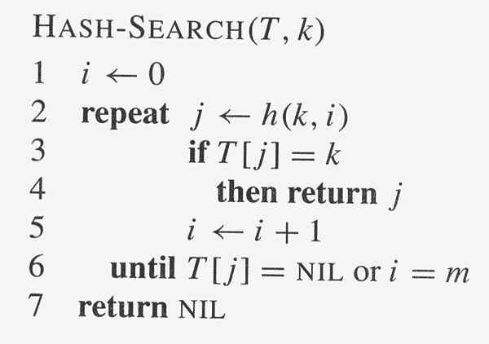
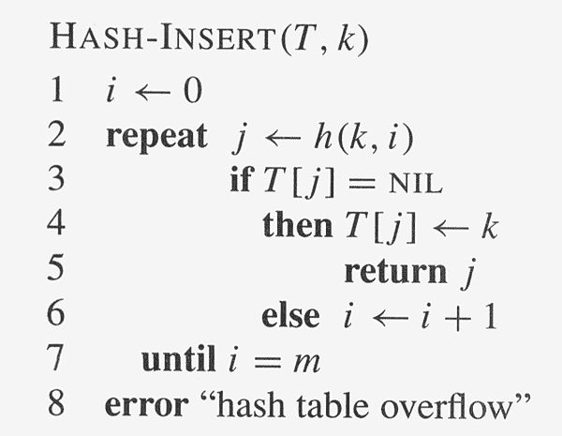
Open Addressing

Slide 41
Linear Probing
When there is a collision, check the next available position in the table (probing)
h(i, k) = (h₁(k) + i) mod m
First slot probed: h₁(k), second: h₁(k) + 1 and so on

Slide 42
Linear Probing
Searching for a key
Three situations:
  Position in table is occupied with an element of equal key
  Position in table is empty
  Position in table occupied with a different element
Probe the next higher index until the element is found or an empty position is found
The process wraps around to the beginning of the table
0
h(k₁)
h(k₄)
h(k₂) = h(k₅)
h(k₃)
m - 1

Slide 43
Linear Probing
Deleting a key
  Cannot mark the slot as empty
  Impossible to retrieve keys inserted after that slot was occupied
Solution
  Mark the slot with a sentinel value DELETED
The deleted slot can later be used for insertion
Searching will be able to find all the keys
0
m - 1

Slide 44
Double Hashing
Use a first hash function to determine the first slot
Use a second hash function to determine the increment for the probe sequence
h(i, k) = (h₁(k) + i h₂(k) ) mod m
Initial probe: h₁(k), second probe is offset by h₂(k) mod m, so on
Advantage: avoids clustering
Disadvantage: harder to delete an element

Slide 45
Double Hashing
0
79
69
98
72
50
h₁(k) = k mod 13
h₂(k) = 1+ (k mod 11)
h(i, k) = (h₁(k) + i h₂(k) ) mod 13
Insert key 14:
h₁(14) = 14 mod 13 = 1
h(1, 14) = (h₁(14) + h₂(14)) mod 13
= (1 + 4) mod 13 = 5
h(2, 14) = (h₁(14) + 2 h₂(14)) mod 13
= (1 + 8) mod 13 = 9
1
2
3
4
5
6
7
8
9
14
10
11
12

Slide 46
Double Hashing
Choosing the second hash function
h(i, k) = (h₁(k) + i h₂(k) ) mod m
h₂ should not evaluate to 0 ⇒ infinite loop
h₂ should be relatively prime to the table size m
  m = 2 h₂: only few slots will be visited
Solution 1
  Choose m prime
  Design h₂ such that it produces an integer less than m
Solution 2
  Choose m = 2^{p}
  Design h₂ such that it always produces an odd number

