Slide 1
Lecture 7.
Binary Search Trees / AVL Trees
한국산업기술대학교
컴퓨터 공학과
방 영 철

Slide 2
Introduction
Tree
  Single parent, multiple children
Binary tree
  Tree with 0–2 children per node
Tree
Binary Tree

Slide 3
Introduction
Search trees support
  SEARCH, MINIMUM, MAXIMUM, PREDECESSOR,
  SUCCESSOR, INSERT, and DELETE
  Dictionary and priority queue
  Basic operations take time proportional to the height of the tree
    Complete binary tree: Θ(lg n)
    Linear-chain tree: Θ(n)
    Expected height of a randomly built binary search tree: O(lg n)

Slide 4
Trees
Terminology
  Root ⇒ no predecessor
  Leaf ⇒ no successor
  Interior ⇒ non-leaf
  Height ⇒ distance from root to leaf
Root node
Interior nodes
Height
Leaf nodes

Slide 5
Types of Binary Trees
Degenerate – only one child
Balanced – mostly two children
Complete – always two children
Degenerate Binary Tree
Balanced Binary Tree
Complete Binary Tree

Slide 6
Binary Trees Properties
Degenerate
  Height = O(n) for n nodes
  Similar to linear list
Balanced
  Height = O( lg n ) for n nodes
  Useful for searches
Degenerate Binary Tree
Balanced Binary Tree

Slide 7
Binary Search Trees
Key property
  Value at node
    Smaller values in left subtree
    Larger values in right subtree
  Example
    X > Y
    X < Z
X
Y
Z

Slide 8
Binary Search Trees
Binary Search Tree (BST)
  Binary tree
  Represented by a linked data structure
  → each node is an object
    key + satellite data
    Pointers: left → left child, right → right child, p → parent
Binary search tree property
  Let x be a node in a BST
    If y is a node in the left subtree of x, then key[y] ≤ key[x]
    If y is a node in the right subtree of x, then key[y] ≥ key[x]

Slide 9
Binary Search Trees
Examples
5
10
10
2
45
5
45
5
30
30
2
25
30
2
25
45
10
25
Binary Search Trees
Non-Binary Search Tree

Slide 10
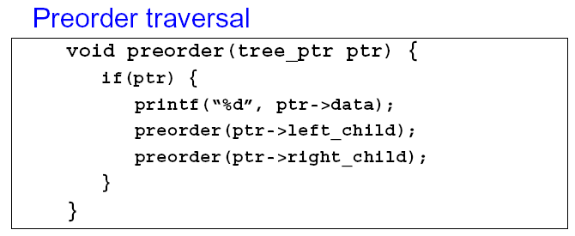
Tree Traversal
Tree Traversal
  A technique for processing the nodes of a tree in some order
Preorder traversal
  Process all nodes of a tree by processing the root,
  then recursively processing all subtrees
  Also known as prefix traversal

Slide 11
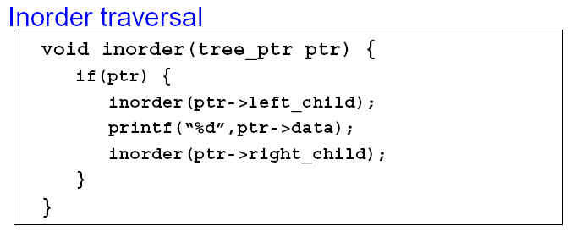
Tree Traversal
Inorder traversal
  Process all nodes of a tree by recursively processing
  the left subtree, then processing the root,
  and finally the right subtree

Slide 12
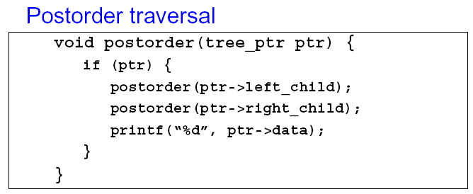
Tree Traversal
Postorder traversal
  Process all nodes of a tree by recursively processing all subtrees, then finally processing the root
  Also known as postfix traversal

Slide 13
Tree Traversal
Tree Traversal
  Preorder
    The key of the root of a subtree is printed before the values
    in its left subtree and those in its right subtree
    a, b, d, e, c, f, h, i, g
  Inorder
    The key of the root of a subtree is printed between the values
    in its left subtree and those in its right subtree
    d, b, e, a, h, f, i, c, g
  Postorder
    The key of the root of a subtree is printed after the values
    in its left subtree and those in its right subtree
    d, e, b, h, i, f, g, c, a
a
b
c
f
d
e
g
h
i

Slide 14
Computation Time of INORDER
If x is the root of an n-node subtree,
then the call INORDER-TREE-WALK(x)
takes Θ(n) time
  Use the substitution method
  T(n) = T(k) + T(n-k-1) + d; T(0)=c
  Show that T(n) = Θ(n)
  by proving that T(n) = (c+d)n+c
    For n=0 → (c+d)*0 + c = c
    For n > 0
      T(n) = T(k) + T(n-k-1) + d = ((c+d) *k+c)+((c+d) *(n-k-1)+c) + d
      = (c+d) *n+c-(c+d)+c+d = (c+d) *n + c

Slide 15
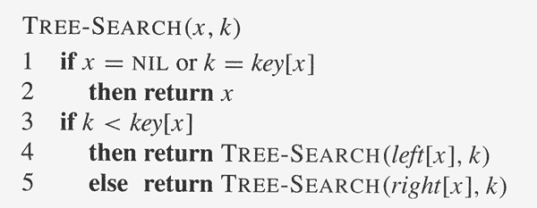
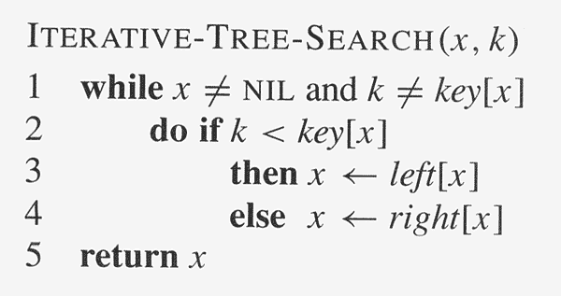
Searching

Slide 16
Example Binary Searches
Find ( 2 )
10
5
10 > 2, left
5 > 2, left
2 = 2, found
5 > 2, left
2 = 2, found
5
30
2
45
2
25
45
30
10
25

Slide 17
Example Binary Searches
Find ( 25 )
10
5
10 < 25, right
30 > 25, left
25 = 25, found
5 < 25, right
45 > 25, left
30 > 25, left
10 < 25, right
25 = 25, found
5
30
2
45
2
25
45
30
10
25

Slide 18
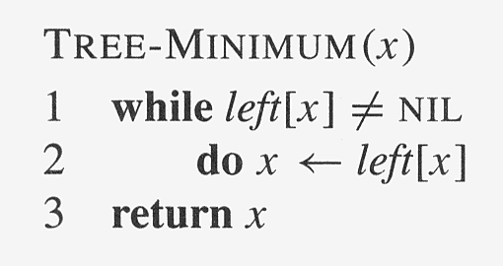
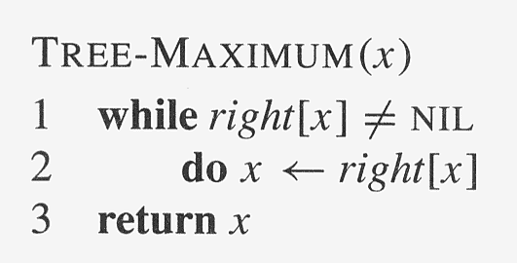
Minimum and Maximum
The element with the minimum/maximum key
can be found by following left/right child pointers
from the root until NIL is encountered

Slide 19
Successor And Predecessor
Assume distinct keys
The successor of a node x is the node with the
smallest key greater than key[x]
  Right subtree nonempty → successor is the leftmost
  node in the right subtree (Line 2)
  Otherwise, the successor is the lowest ancestor of x
  whose left child is also an ancestor of x → go up the tree
  until we encounter a node that is the left child of its
  parent (Lines 3-7)

Slide 20
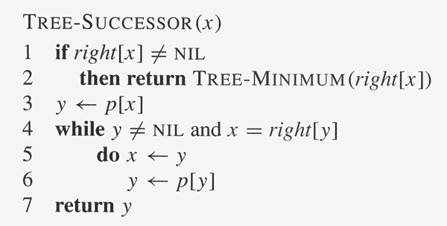
TREE-SUCCESSOR(X)

Slide 21
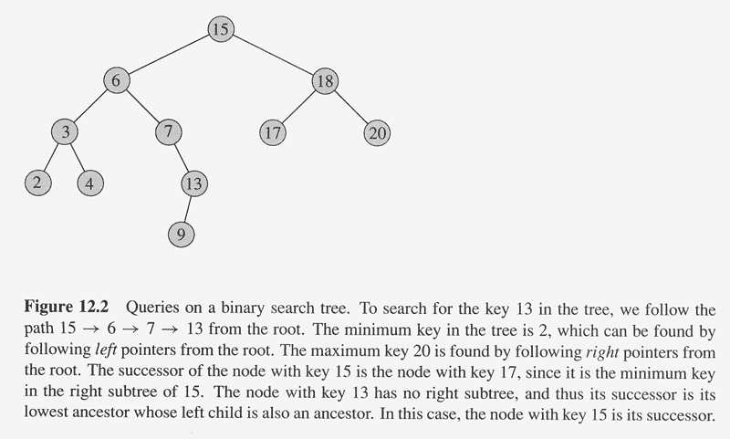
Examples

Slide 22
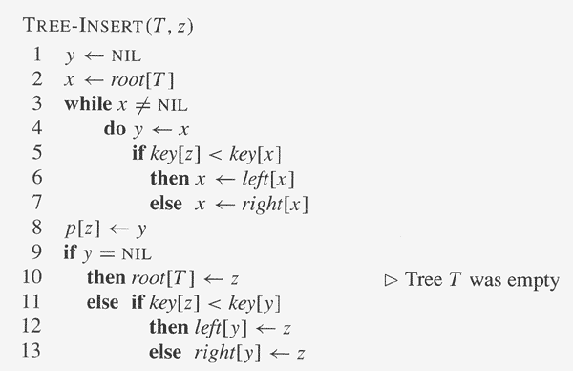
Insertion
Trace down the tree until a leaf
Should be inserted in the left subtree
Should be inserted in the right subtree

Slide 23
Insertion Example
Insert ( 20 )
10
10 < 20, right
30 > 20, left
25 > 20, left
Insert 20 on left
5
30
2
25
45
20

Slide 24
Insertion Example
12
12
Insert an item with key 13
into a BST
5
18
18
2
9
15
15
19
13
17

Slide 25
Deletion
Consider three cases for the node z to be deleted
  z has no children: modify p[z] to replace z with NIL as its child
  z has only one child: splice out z by making a new link between its child and its parent
  z has two children: splice z’s successor y,
  which has no left child and replace z’s key and
  satellite data with y’s key and satellite

Slide 26
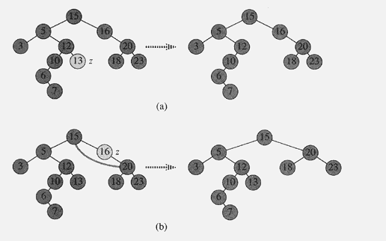
Deletion Example

Slide 27

Deletion Example

Slide 28
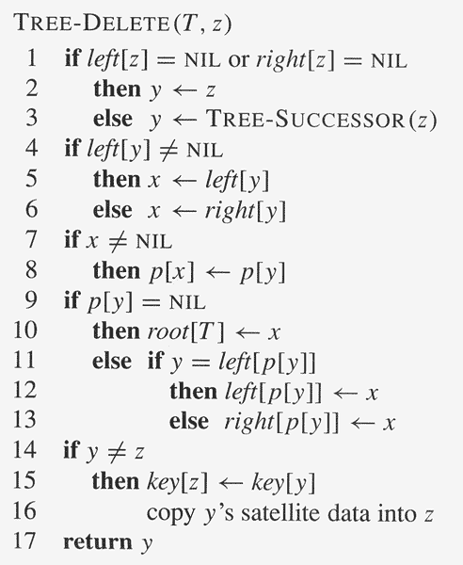
TREE-DELETE Algorithm

Slide 29
TREE-DELETE Algorithm
TREE-DELETE Algorithm
  Lines 1-3: determines a node y to splice out
  (z itself or z’s successor)
  Lines 4-6: x is set to the non-NIL child of y,
  or to NIL if y has no children
  Lines 7-13: splice out y by modifying pointers
  in p[y] and x
    Special care for when x=NIL or when y is the root
  Lines 14-16: if the successor of z was the node
  spliced out, y’s key and satellite data are moved to
  z, overwriting the previous key and satellite data
  Line 17: return node y for recycle it via the free list

Slide 30
Example Deletion (Leaf)
Delete ( 25 )
10
10
10 < 25, right
30 > 25, left
25 = 25, delete
5
30
5
30
2
25
45
2
45

Slide 31
Example Deletion (Internal Node)
Delete ( 10 )
10
25
25
5
30
5
30
5
30
2
25
45
2
25
45
2
45
Replacing 10 with smallest value in right subtree
Deleting leaf
Resulting tree

Slide 32
Example Deletion (Internal Node)
Delete ( 10 )
10
5
5
5
30
5
30
2
30
2
25
45
2
25
45
2
25
45
Replacing 10 with largest value in left subtree
Replacing 5 with largest value in left subtree
Deleting leaf

Slide 33
AVL Trees
AVL Trees (Adelson-Velskii and Landis)
  BST : all values in T₁ ≤ x ≤ all values in T₂
  T1, T2 are AVL trees and height(T1) - height(T2) ≤ 1
x
T
T
1
2

Slide 34
AVL Trees
AVL Tree Property: It is a BST in which the heights
of the left and right subtrees of the root differ by at most 1
and in which the right and left subtrees are also AVL trees
Example: Select a AVL tree !
OK
NO

Slide 35
Insertion
Very much like as in BST with operations to maintain height balance-rotation code associated with each node
-2, -1, 0, 1, 2
-2
-1
0
h
h
h
h
h+2
h+1
+1
+2
h
h
h+1
h+2

Slide 36
Rotation
4 Types
  Single Left Rotation
  Double Left Rotation
  Single Right Rotation
  Double Right Rotation
    SLR, DLR : left ( +2 )
    SRR, DRR : right ( -2 )

Slide 37
Rotation
-2
Case 1
Case 2
h
h+2
+2
h
h+2

Slide 38
Rotation
Case 1 (a)
C
-2
A
0
-1
A
T₃
C
0
T₁
SRR
T₁
T₂
h
T₂
T₃
h
h
h+1
h
h+1

Slide 39
Rotation
Case 1 (a)`
C
-2
A
1
0
A
T₃
C
-1
T₁
SRR
T₁
T₂
h-1
T₂
T₃
h
h-1
h
h
h

Slide 40
Rotation
Case 1 (b)
C
-2
B
0
0
+1
+1
A
T₄
A
C
0
DRR
T₁
B
-1
h+1
T₁
T₂
T₃
T₄
0
h
h+1
T₂
T₃
h+1
h+1
h
h+1
h
h
h
h
h
h+1
h
h
h

Slide 41
Rotation
Case 2 (a)
A
+2
C
-1 or 0
T₁
C
0 or 1
A
0
T₃
SLR
h
T₂
T₃
T₁
T₂
h or h+1
h
h or h+1
h
h

Slide 42
Rotation
Case 2 (b)
  DLR = SRR at C + SLR at A
  DRR = SLR at A + SRR at C
A
+2
B
0
0
0
C
-1
T₁
A
C
DLR
h
B
T₄
T₁
T₂
T₃
T₄
T₂
T₃
h
h
h
h
h
h
h

Slide 43
Example
5 6 9 8 10 7 4 1 3 2
+2
5
5
5
SLR
6
+1
6
6
5
9
9
+1
+2
6
6
6
-1
DLR
5
9
5
9
5
9
8
8
10
8
10
7

Slide 44
Example
5 6 9 8 10 7 4 1 3 2
+2
6
8
8
-1
DLR
5
9
6
9
6
9
8
10
5
7
10
5
7
10
7
4
8
8
-2
6
9
6
9
SRR
5
7
10
4
7
10
-1
4
1
5
1

Slide 45
Example
5 6 9 8 10 7 4 1 3 2
8
8
-2
6
9
4
9
-1
4
7
10
SRR
1
6
10
1
5
3
5
7
3
8
8
4
9
4
9
DLR
+2
1
6
10
2
6
10
-1
3
5
7
1
3
5
7
2

Slide 46
Insertion Strategy
0
Insert at leaf
Keep going upward and update code from leaf to
parent if
Stop when
Rotate when
+1
0
-1
+1
0
-1
+1
+2
-1
-2

Slide 47
Insertion Strategy
+2
+2
-1
+1
Left
-2
-2
+1
-1
Right
Double
Single

Slide 48
Deletion Strategy
Delete the node as in BST deletion
Keep going upward and update code from leaf to
parent if
Stop when
Rotate when
+1
0
-1
+1
0
-1
+1
+2
-1
-2

Slide 49
Example
-1
-1
10
10
+1
+2
-1
6
12
6
12
0
Delete 5
0
5
8
11
8
11
7
9
7
9
10
SLR
8
12
Delete 10
6
9
11
7
Moonseong Kim 7-<number>/51

Slide 50
Example
-2
11
-1
8
12
10
6
9
SRR
8
12
Delete 10
7
6
9
11
7
9
-2
8
12
+1
6
11
DRR
7
Moonseong Kim 7-<number>/51

Slide 51
Example
-2
11
8
-1
8
12
6
11
6
9
SRR
7
9
12
7
9
9
-2
8
12
7
12
+1
6
11
DRR
6
8
11
7
Moonseong Kim 7-<number>/51

