Slide 1
Lecture 10.
Elementary Graph Algorithm
2008년 2학기 알고리즘

Slide 2
Graphs
Graph G = (V, E)
  V is set of vertices
  E is set (family) of edges ⊆ (V×V)
    edge or link or arc
Types of graphs
  Undirected: edge (u, v) = (v, u)
    (v, v) ∉ E (No self loops) for all v ∈ V
  Directed: (u, v) is edge from u to v, denoted as u → v
    self loops are allowed
  Weighted: each edge has an associated weight,
  given by a weight function w : E → R
  Dense: |E| ≈ |V|²
  Sparse: |E| << |V|²
|E| = O(|V|²)

Slide 3
Graphs
If (u, v) ∈ E, then vertex v is adjacent to vertex u
Adjacency relationship is:
  Symmetric if G is undirected
  Not necessarily so if G is directed
If G is connected:
  There is a path between every pair of vertices
  |E| ≥ |V| – 1
  Furthermore, if |E| = |V| – 1, then G is a tree
Other definitions in Appendix B (B.4 and B.5) as needed
  On pages 1080-1093

Slide 4
Eulerian and Hamiltonian Graphs
A graph containing paths that include every ‘edge’ exactly once and end at the initial vertex is called an Eulerian graph
A graph containing paths that include every ‘vertex’ exactly once and end at the initial vertex is called a Hamiltonian graph
P
Q
Hamiltonian but
not Eulerian
R
T
S

Slide 5
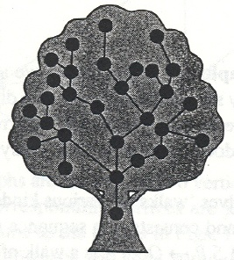
Trees and Planar Graphs
A connected graph with only one path between each pair of vertices is called a tree
A tree can also be defined as a connected graph containing no cycles (Fig. 1)
A graph that can be redrawn without crossings is called a planar graph (Fig. 2 and 3)
P
Q
P
Q
R
R
T
S
T
S
Fig. 1
Fig. 2
Fig. 3

Slide 6
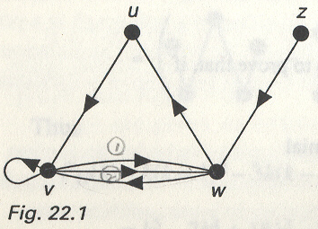
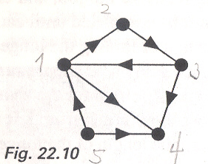
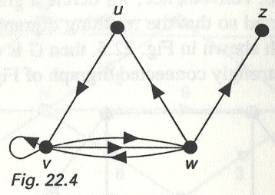
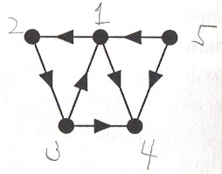
Other Definitions
Two digraphs are isomorphic if there is an isomorphism between their underlying graphs that preserves the ordering of the vertices in each arc
  See Fig. 4 and 5 : not isomorphic
  See Fig. 6 and 7 : isomorphic
2
1
3
Fig. 6
5
4
Fig. 4
1
2
5
3
4
Fig. 5
Fig. 7

Slide 7
Connected and Strongly Connected
A digraph D is connected if it cannot be expressed as the union of two digraphs
  Directed graph is abbreviated as digraph
  This is equivalent to saying that the underlying graph of D is a connected graph
    Underlying graph is obtained by removing the arrows in digraph
D is strongly connected if, for any two vertices v and w of D, there is a path from v to w
Every strongly connected digraph is connected, but not all connected digraphs are strongly connected
  See Fig. 4
Fig. 4

Slide 8
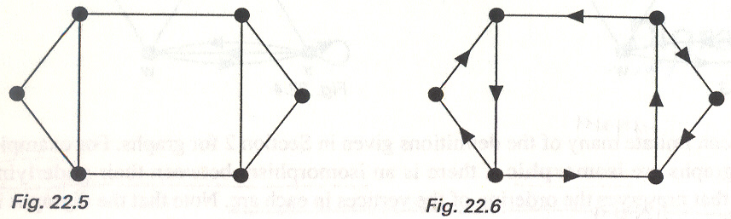
Connected and Strongly Connected
We define a graph G to be orientable if each edge of G can be directed so that the resulting digraph is strongly connected
  See Fig. 8 and 9
Any Eulerian graph is orientable
Fig. 8
Fig. 9

Slide 9
Adjacency
Two vertices v and w are adjacent if there is an edge (v,w) joining them, and the vertices v and w are then incident with such an edge
Two distinct edges e and f are adjacent if they have a vertex in common
v
w
e
f
adjacent vertices
adjacent edges

Slide 10
Representation of Graphs
Two standard ways
  Adjacency lists
  Adjacency matrix
a
b
a
b
d
c
b
a
c
c
d
c
d
a
b
d
a
c
1
2
1 2 3 4
1 0 1 1 1
2 1 0 1 0
3 1 1 0 1
4 1 0 1 0
a
b
c
d
3
4

Slide 11
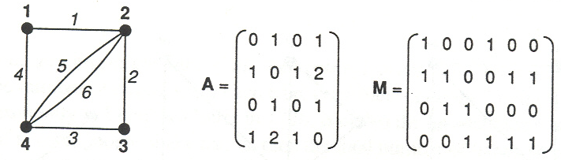
Representation of Graphs
Adjacency matrix A
Incidence matrix M

Slide 12
Adjacency Lists
Consists of an array Adj of |V| lists
One list per vertex
For u ∈ V, Adj[u] consists of all vertices adjacent to u
a
b
a
b
d
c
b
c
If weighted, store weights also in adjacency lists
c
d
c
d
d
a
b
a
b
d
c
b
a
c
c
d
c
d
a
b
d
a
c

Slide 13
Degree
The degree of a vertex v is the number of edges
incident with v, and is written deg(v)
A loop at v contributes 2 to the degree of v
A vertex of degree 0 is an isolated vertex
A vertex of degree 1 is an end-vertex
Remember the handshaking lemma and its corollary
u
z
i
v
w

Slide 14
Handshaking Lemma
Handshaking Lemma
  If several people shake hands, then the total number of hands shaken must be even
  In any graph the sum of all the vertex degrees is an even number
    in fact, twice the number of edges
Corollary
  In any graph the number of vertices of odd degree is even

Slide 15
Handshaking Dilemma
The out-degree of a vertex v of G is the number of arcs of the form (v,w), and is denoted by outdeg(v)
The in-degree of a vertex v of G is the number of arcs of the form (w,v), and is denoted by indeg(v)
The sum of the out-degrees of all the vertices of G is equal to the sum of their in-degrees
We call this result the handshaking dilemma
A source of G is a vertex with in-degree 0
A sink of G is a vertex with out-degree 0

Slide 16
Storage Requirement
For directed graphs
  Sum of lengths of all adj. lists is
∑outdeg(v) = |E|
^{v∈V}
  Total storage: Θ(V+E)
For undirected graphs
  Sum of lengths of all adj. lists is
∑deg(v) = 2|E|
^{v∈V}
  Total storage: Θ(V+E)

Slide 17
Pros and Cons: Adj List
Pros
  Space-efficient, when a graph is sparse
  Can be modified to support many graph variants
Cons
  Determining if an edge (u,v) ∈E is not efficient
    Have to search in u’s adjacency list, Θ(deg(u)) time
    Θ(V) in the worst case

Slide 18
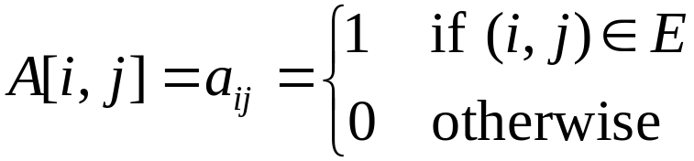
Adjacency Matrix
|V| × |V| matrix A
Number vertices from 1 to |V| in some arbitrary manner
A is then given by:
1
2
1 2 3 4
1 0 1 1 1
2 0 0 1 0
3 0 0 0 1
4 0 0 0 0
1
2
1 2 3 4
1 0 1 1 1
2 1 0 1 0
3 1 1 0 1
4 1 0 1 0
a
b
a
b
c
d
4
c
d
3
3
4
A = A^{T} for undirected graphs

Slide 19
Space and Time
Space: Θ(V²)
  Not memory efficient for large graphs
Time: to list all vertices adjacent to u
  Θ(V)
Time: to determine if (u, v) ∈ E
  Θ(1)
Can store weights instead of bits for weighted graph

Slide 20
Graph-Searching Algorithms
Searching a graph
  Systematically follow the edges of a graph to visit the vertices of the graph
Used to discover the structure of a graph
Standard graph-searching algorithms
  Breadth-First Search (BFS)
  Depth-First Search (DFS)

Slide 21
Breadth-First Search
Input
  Graph G = (V, E), either directed or undirected, and source vertex s ∈ V
Output
  d[v] = distance (smallest number of edges, or shortest path) from s to v,
  for all v ∈ V
  d[v] = ∞ if v is not reachable from s
  π[v] = u such that (u, v) is last edge on shortest path s v
    u is v’s predecessor
  Builds Breadth-First Tree with root s that contains all reachable vertices

Slide 22
Breadth-First Search
Expands the frontier between discovered and undiscovered vertices uniformly across the breadth of the frontier
  A vertex is “discovered” the first time it is encountered during the search
  A vertex is “finished” if all vertices adjacent to it have been discovered
Colors the vertices to keep track of progress
  White – Undiscovered
  Gray – Discovered but not finished
  Black – Finished
    Colors are required only to reason about the algorithm.
    Can be implemented without colors.

Slide 23
Breadth-First Search
2
3
3
2
2
3
1
S
S
S
2
1
1
2
2
3
3
Finished
Discovered
Undiscovered

Slide 24
Pseudo Code
BFS(G,s)
1. for each vertex u in V[G] – {s}
2 do color[u] ← white
3 d[u] ← ∝
4 π[u] ← nil
5 color[s] ← gray
6 d[s] ← 0
7 π[s] ← nil
8 Q ← Φ
9 enqueue(Q,s)
10 while Q ≠ Φ
11 do u ← dequeue(Q)
12 for each v in Adj[u]
13 do if color[v] = white
14 then color[v] ← gray
15 d[v] ← d[u] + 1
16 π[v] ← u
17 enqueue(Q,v)
18 color[u] ← black
white: undiscovered
gray: discovered
black: finished
Q: a queue of discovered vertices
color[v]: color of v
d[v]: distance from s to v
π[u]: predecessor of v

Slide 25
BFS Example
r
s
t
u
∞
0
∞
∞
∞
∞
∞
∞
v
w
x
y
Q: s
0

Slide 26
BFS Example
r
s
t
u
1
0
∞
∞
∞
1
∞
∞
v
w
x
y
Q: w r
1 1

Slide 27
BFS Example
r
s
t
u
1
0
2
∞
∞
1
2
∞
v
w
x
y
Q: r t x
1 2 2

Slide 28
BFS Example
r
s
t
u
1
0
2
∞
2
1
2
∞
v
w
x
y
Q: t x v
2 2 2

Slide 29
BFS Example
r
s
t
u
1
0
2
3
2
1
2
∞
v
w
x
y
Q: x v u
2 2 3

Slide 30
BFS Example
r
s
t
u
1
0
2
3
2
1
2
3
v
w
x
y
Q: v u y
2 3 3

Slide 31
BFS Example
r
s
t
u
1
0
2
3
2
1
2
3
v
w
x
y
Q: u y
3 3

Slide 32
BFS Example
r
s
t
u
1
0
2
3
2
1
2
3
v
w
x
y
Q: y
3

Slide 33
BFS Example
r
s
t
u
1
0
2
3
2
1
2
3
v
w
x
y
Q: ∅

Slide 34
BFS Example
r
s
t
u
1
0
2
3
2
1
2
3
v
w
x
y
BF Tree

Slide 35
Analysis of BFS
Initialization takes O(V)
Traversal Loop
  After initialization, each vertex is enqueued and dequeued at most once, and each operation takes O(1). So, total time for queuing is O(V)
  The adjacency list of each vertex is scanned at most once. The sum of lengths of all adjacency lists is Θ(E)
Summing up over all vertices
  total running time of BFS is O(V+E), linear in the size of the adjacency list representation of graph

Slide 36
Breadth-First Trees
For a graph G = (V, E) with source s, the predecessor subgraph of G is G_{π} = (V_{π} , E_{π}) where
  V_{π} ={v∈V : π[v] ≠ NIL}  {s}
  E_{π} ={ (π[v],v)∈E : v ∈ V_{π} - {s} }
The predecessor subgraph G_{π} is a breadth-first tree if:
  V_{π} consists of the vertices reachable from s and
  for all v∈V_{π} , there is a unique simple path from s to v in G_{π} that is also a shortest path from s to v in G.
The edges in E_{π} are called tree edges
  |E_{π} | = |V_{π} | - 1

Slide 37
Depth-First Search
Explore edges out of the most recently discovered vertex v
When all edges of v have been explored, backtrack to explore other edges leaving the vertex from which v was discovered (its predecessor)
“Search as deep as possible first”
Continue until all vertices reachable from the original source are discovered
If any undiscovered vertices remain, then one of them is chosen as a new source and search is repeated from that source

Slide 38
Depth-First Search
Input
  G = (V, E), directed or undirected. No source vertex given!
Output
  2 timestamps on each vertex. Integers between 1 and 2|V|.
    d[v] = discovery time (v turns from white to gray)
    f [v] = finishing time (v turns from gray to black)
  π[v] : predecessor of v = u, such that v was discovered during the scan of u’s adjacency list.
Uses the same coloring scheme for vertices as BFS
  White – Undiscovered
  Gray – Discovered but not finished
  Black – Finished

Slide 39
Pseudo Code
DFS-Visit(u)
color[u] ← GRAY
∇ White vertex u has been discovered
time ← time + 1
d[u] ← time
for each v ∈ Adj[u]
do if color[v] = WHITE
then π[v] ← u
DFS-Visit(v)
color[u] ← BLACK
∇ Blacken u; it is finished.
f[u] ← time ← time + 1
DFS(G)
1. for each vertex u ∈ V[G]
2. do color[u] ← white
3. π[u] ← NIL
4. time ← 0
5. for each vertex u ∈ V[G]
6. do if color[u] = white
7. then DFS-Visit(u)
white: undiscovered
gray: discovered
black: finished
Uses a global timestamp time

Slide 40
DFS Example
u
v
w
1/
x
y
z

Slide 41
DFS Example
u
v
w
1/
2/
x
y
z

Slide 42
DFS Example
u
v
w
1/
2/
3/
x
y
z

Slide 43
DFS Example
u
v
w
1/
2/
4/
3/
x
y
z

Slide 44
DFS Example
u
v
w
1/
2/
B
4/
3/
x
y
z

Slide 45
DFS Example
u
v
w
1/
2/
B
4/5
3/
x
y
z

Slide 46
DFS Example
u
v
w
1/
2/
B
4/5
3/6
x
y
z

Slide 47
DFS Example
u
v
w
1/
2/7
B
4/5
3/6
x
y
z

Slide 48
DFS Example
u
v
w
1/
2/7
F
B
4/5
3/6
x
y
z

Slide 49
DFS Example
u
v
w
1/8
2/7
F
B
4/5
3/6
x
y
z

Slide 50
DFS Example
u
v
w
1/8
2/7
9/
F
B
4/5
3/6
x
y
z

Slide 51
DFS Example
u
v
w
1/8
2/7
9/
F
B
C
4/5
3/6
x
y
z

Slide 52
DFS Example
u
v
w
1/8
2/7
9/
F
B
C
4/5
3/6
10/
x
y
z

Slide 53
DFS Example
u
v
w
1/8
2/7
9/
F
B
C
4/5
3/6
10/
B
x
y
z

Slide 54
DFS Example
u
v
w
1/8
2/7
9/
F
B
C
4/5
3/6
10/11
B
x
y
z

Slide 55
DFS Example
u
v
w
1/8
2/7
9/12
F
B
C
4/5
3/6
10/11
B
x
y
z

Slide 56
Analysis of DFS
Loops on lines 1-2 and 5-7 take Θ(V) time, excluding time to execute DFS-Visit
DFS-Visit is called once for each white vertex v∈V when it’s painted gray the first time. Lines 3-6 of DFS-Visit is executed |Adj[v]| times. The total cost of executing DFS-Visit is ∑_{v∈V}|Adj[v]| = Θ(E)
Total running time of DFS is Θ(V+E)

Slide 57
Depth-First Trees
Predecessor subgraph defined slightly different from that of BFS
The predecessor subgraph of DFS is G_{π} = (V, E_{π})
where E_{π} ={ (π[v],v) : v ∈ V and π[v] ≠ NIL }
  How does it differ from that of BFS?
  The predecessor subgraph G_{π} forms a depth-first forest composed of several depth-first trees. The edges in E_{π} are called tree edges.

Slide 58
Classification of Edges
Tree edge: in the depth-first forest.
Found by exploring (u, v)
Back edge: (u, v), where u is a descendant of v
(in the depth-first tree)
Forward edge: (u, v), where v is a descendant of u, but not a tree edge
Cross edge: any other edge
Can go between vertices in same depth-first tree or in different depth-first trees

Slide 59
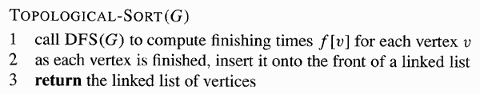
Topological Sort
A topological sort of a Directed Acyclic Graph (DAG) is a linear order of all its vertices such that if G contains
an edge (u, v), then u appears before v in the ordering
  If the graph is not acyclic,
  then no linear ordering is possible
  A topological sort can be viewed as an ordering of
  its vertices along a horizontal line so that all
  directed edges go from left to right
Θ(V+E)

Slide 60
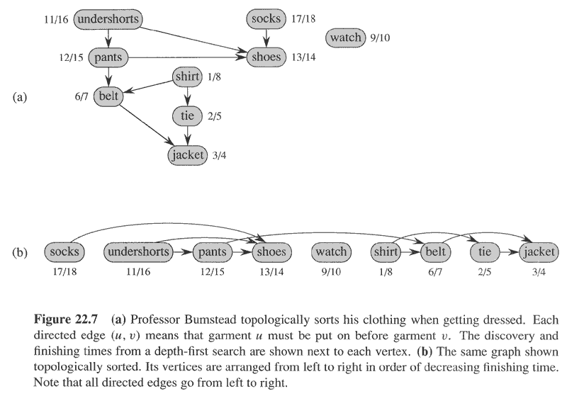
Topological Sort

