Slide 1
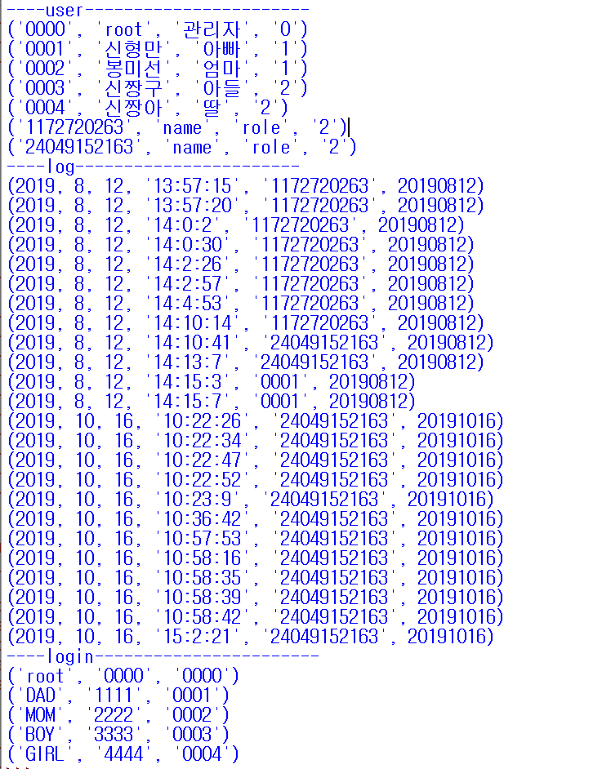
User table
UID | NAME | ROLE | PERM
Log table
YEAR | MONTH | DAY | TIME | ID | TIMESTRING
Login table
ID | PASSWD | UID

