Slide 1
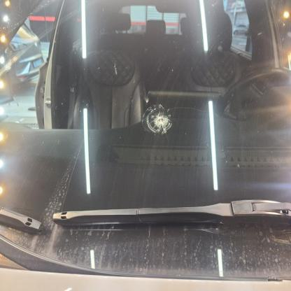
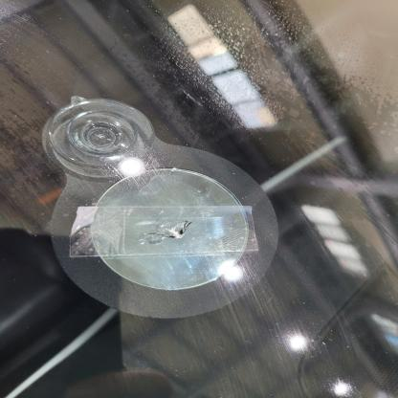
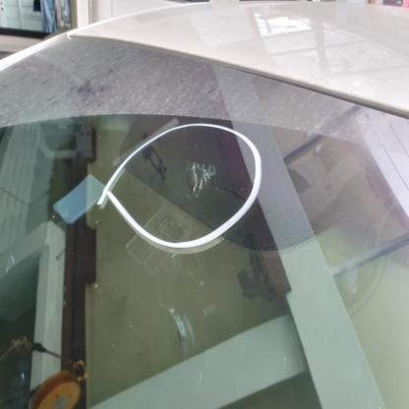
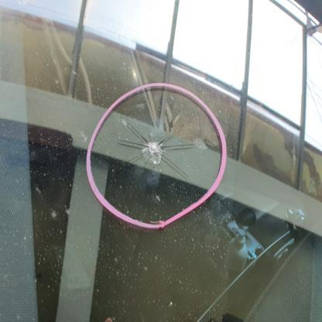
Notes:
Figure 1

Slide 2
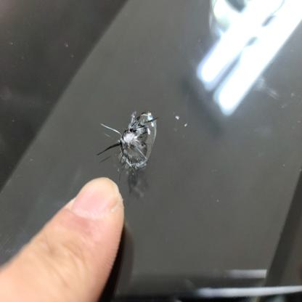
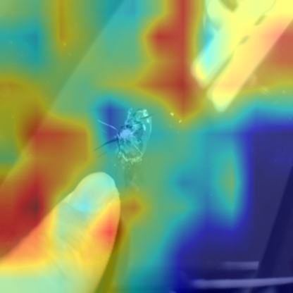
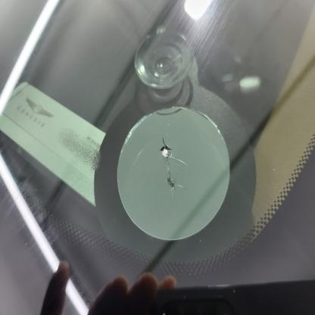
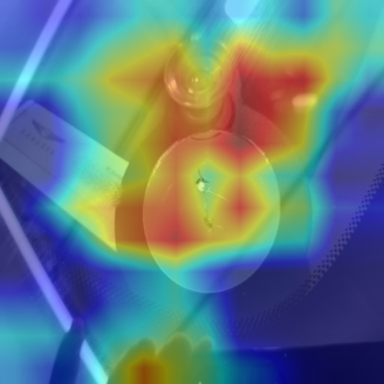
(a) Input Image
(b) Grad-CAM

Slide 3
Phase I: Sequential Preprocessing Pipeline
Phase II: Augmentation & Model Training
Input Image
Padding
Training
Original
YOLO-Crop
GAC
Hybrid
Gen AI
Evaluate
Aug1
train
Split
Augment
train
Aug2
Restore
Predict
test
Dataset
valid
Aug3
Evaluate
ROI Crop
Train
repair
GAC
YOLO Crop
train
test
valid
replace
Hybrid
Dataset
CNN Classifier
Notes:
Figure 2

Slide 4
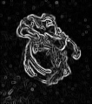
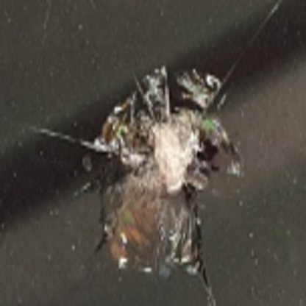
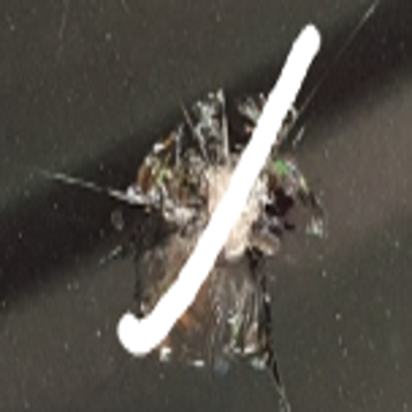
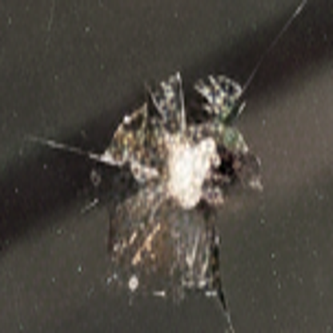
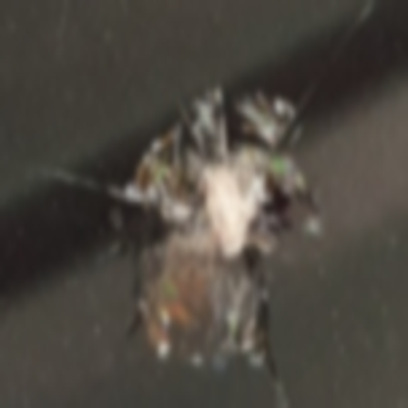
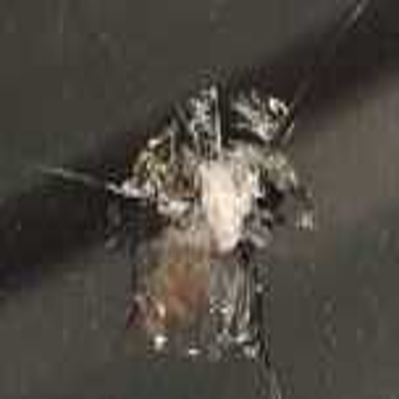
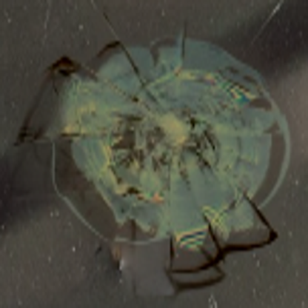


























Data Preprocessing
Evaluation
Input ($I_{clean}$)
Semantic Preservation ($D_{FeatMap}$)
$$Bezier$$
$$f_{clean}$$
Synthic ($I_{mark}$)
$$Augment$$
$$C_{clean}$$
Pre-trained VGG
Feature Extractor
$$GAC$$
$L$2 Distance
Restore ($I_{GAC}$)
$I_{blur},I_{jpeg}$, $I_{mix}$
$$C_{others}$$
$$f_{others}$$
Geometric Focusing (ROI Crop)
Structural Integrity (Edge $L_{1})$
$$C_{clean}$$
Sobel Filter
$L$1 Distance
$$C_{clean}$$
$$C_{mark}$$
$$C_{GAC}$$
$$C_{blur}$$
$$C_{jpeg}$$
$$C_{mix}$$
$$C_{ood}$$
$$C_{others}$$
Ref
Occ
Ours
Benign
Malign
OOD

Slide 5
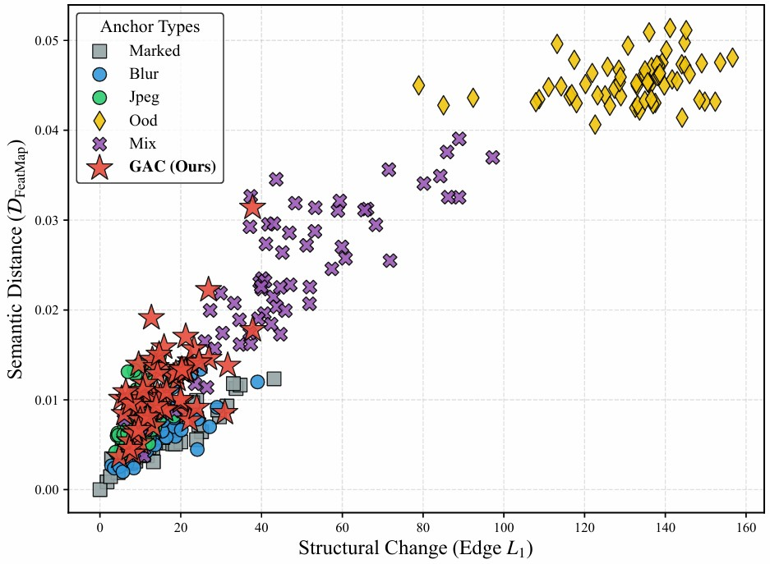

Slide 6
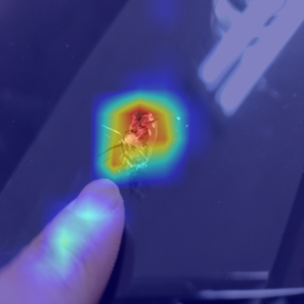
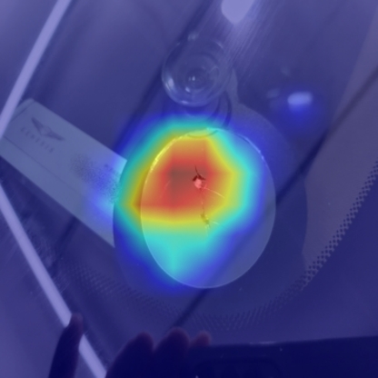
(a) Input (Original)
(b) Previous
(c) Ours

Slide 7
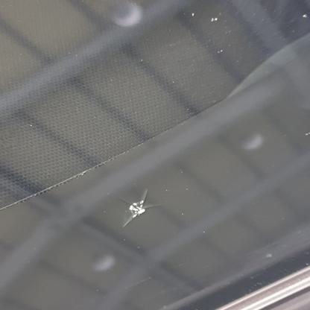
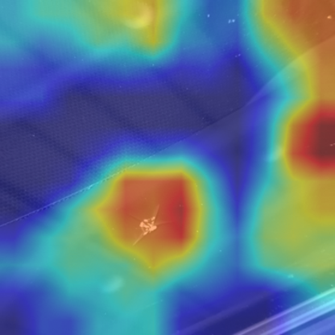
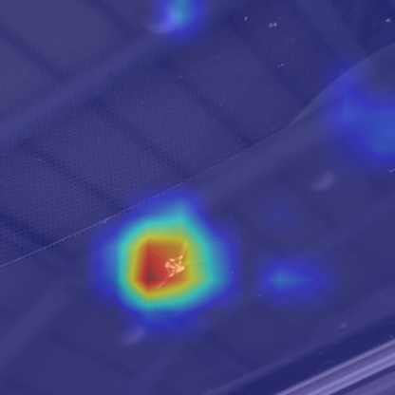
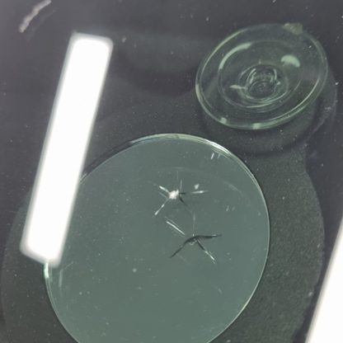
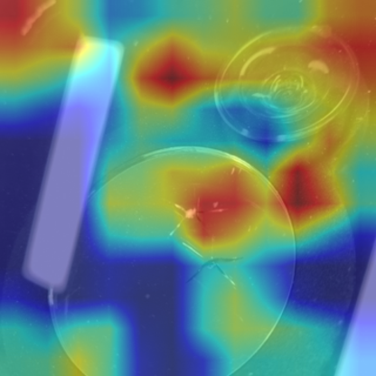
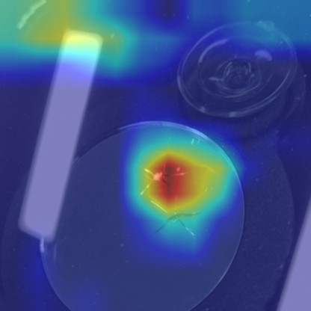
(a) Input (GAC)
(b) Previous
(c) Ours

Slide 8
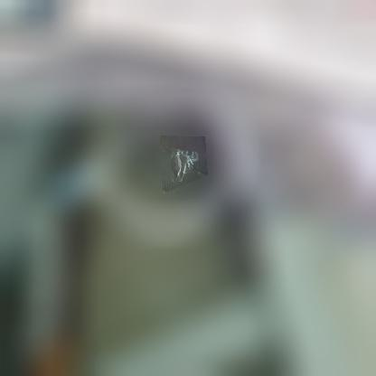
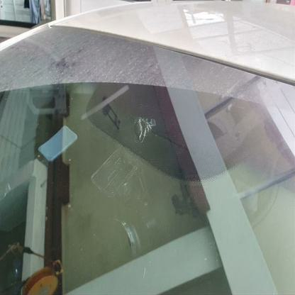
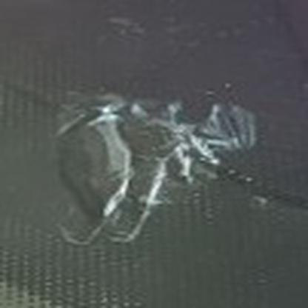
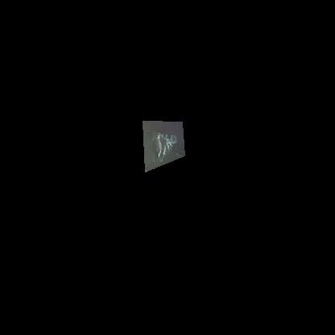
GAC Image | Blur Image | Black-Out Image | Ours (YOLO-Crop)

Slide 9

YOLO V5
YOLO V8 Medium
YOLO V8 Small
YOLO V2
YOLO V4
YOLO V8 Large
YOLO V8 X
Δ
$$D_{GAC}$$
Notes:
Figure 7

