Slide 1
Reproducible Research for OMNeT++
Based on Python and Pweave
Kyeong Soo (Joseph) Kim
Department of Electrical and Electronic Engineering
Xi’an Jiaotong-Liverpool University
07 September 2017

Slide 2
Outline
Reproducible Research
Python and Pweave
Reproducible Research for OMNeT++
Example: OMNeT++ FIFO Simulation

Slide 3
Reproducible Research

Slide 4
Reproducible Research
Reproducible research is a key to any scientific method and ensures repeating an experiment and the results of its analysis in any place with any person.
A study can be truly reproducible when it satisfies at least the following three criteria:
  All experimental methods are fully reported.
  All data and files used for the analysis are (publicly) available.
  The process of analyzing raw data is well reported and preserved.
Reproducible research is to ensure
  Same data + Same script = Same results

Slide 5
Why Do We Need Reproducible Research:
Two Examples
LIGO - Gravitational Wave Detection
Schön scandal - Molecular Computing

Slide 6
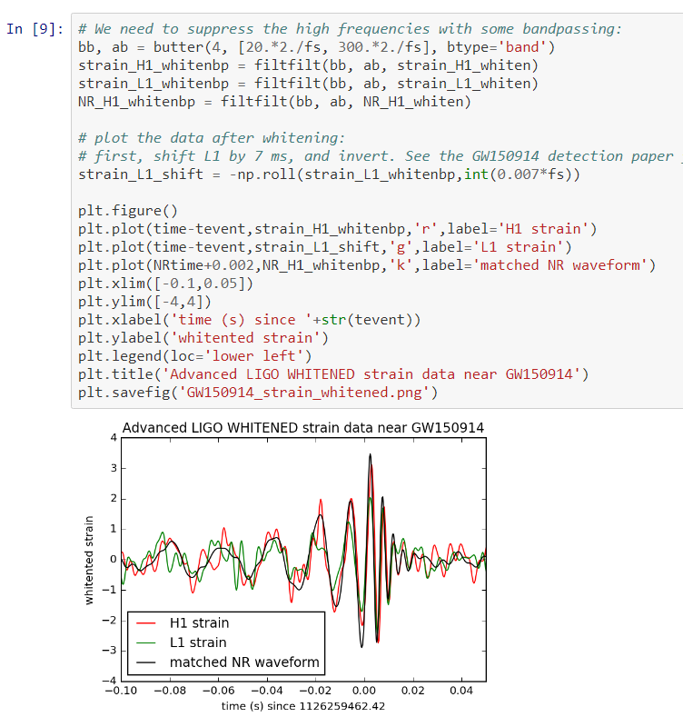

LIGO - Gravitational Wave Detection
The Laser Interferometer Gravitational-Wave Observatory (LIGO) is a large-scale physics experiment and observatory to detect cosmic gravitational waves.
  The detection of gravitational wave was reported in Physical Review Letters in Feb. 2016, together with ipython notebook with analysis code and data.

Slide 7
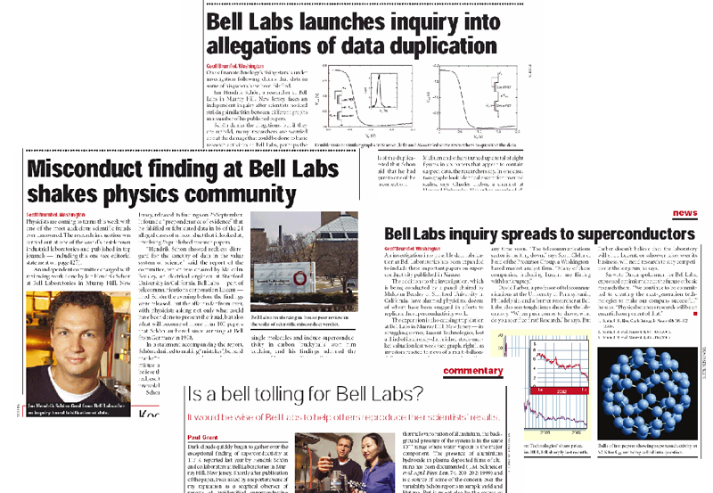
Schön Scandal - Molecular Computing
No records found for his ground-breaking experimental results, including lab notebook, experimental samples and data, hard disk drives.
During the investigation, he kept repeating
“I clearly observed them in the Lab but …”

Slide 8
Python and Pweave

Slide 9
R/Sweave to Python/Pweave
Until recently, R was the language of choice for statistical processing and data analysis.
  Still, R has the largest code base for a wide variety of statistical and graphical techniques.
Like ipython (now jupyter), R provides a nice tool called Sweave (now replaced by knitr) to weave documentation and the results of the execution of R code chunks into one source file for integrated documentation.
Python ⎯ one of the most popular languages in scientific computing, including artificial intelligence & machine learning ⎯ recently takes over R in statistical processing and data analysis as well.
  Thanks to pandas implementing DataFrame object similar to R and Pweave, python can replace R for most statistical and data analysis tasks, while retaining its many advantages over R (i.e., fully-featured programming language with easy syntax and higher speed).

Slide 10
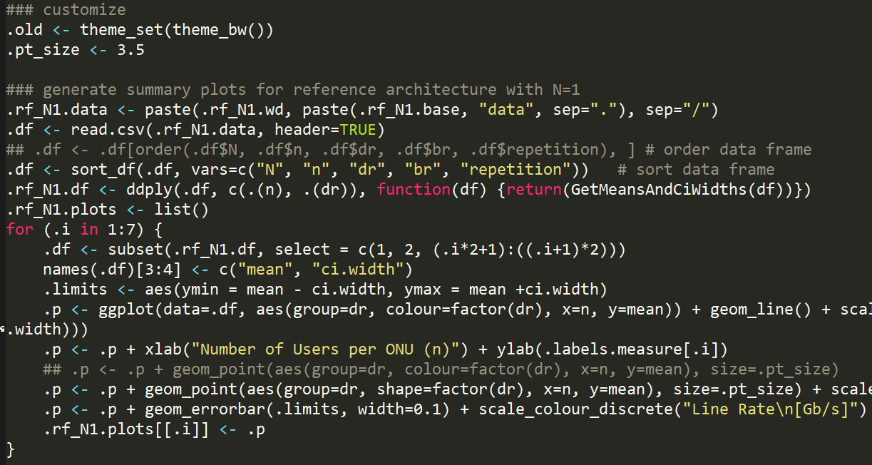
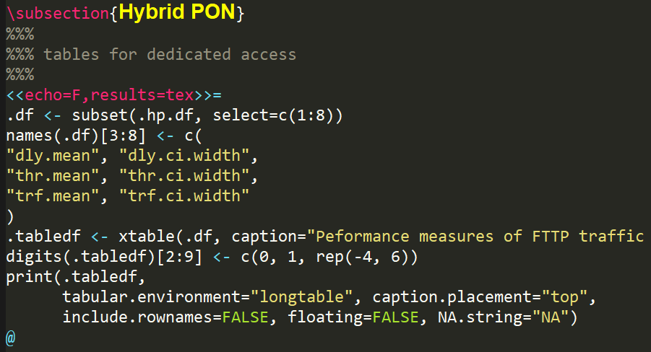
Snippets of R Source Code
and Sweave File for LaTeX

Slide 11
Pweave source file (“*.Plw”)
Mix of documentation (e.g., LaTeX) and code Chunks (e.g., Python)
Weaving (pweave)
Tangling (ptangle)
Document 1
Code Chunk 1
Result of the Execution of Code Chunk 1
…
…
Code Chunk N
Document N
A program source file for separate execution and debugging
e.g., “*.py” for Python
Result of the Execution of Code Chunk N
A documentation source file
e.g., “*.tex” for LaTeX

Slide 12
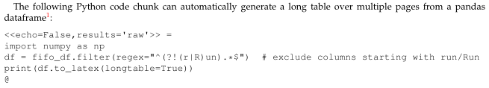
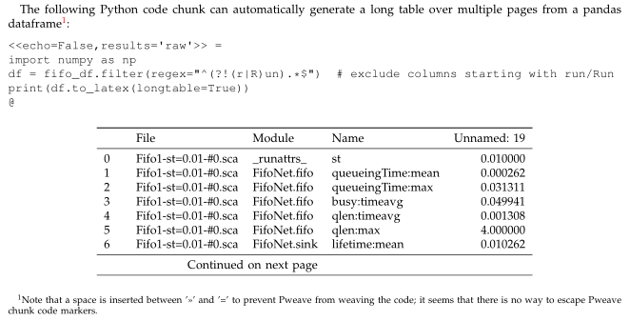
Weaving Example: Automatic Table Generation
Weaving & LaTeXing

Slide 13
Reproducible Research for OMNeT++

Slide 14
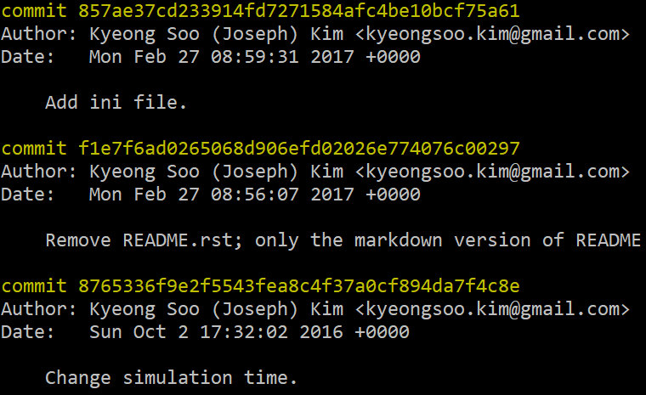
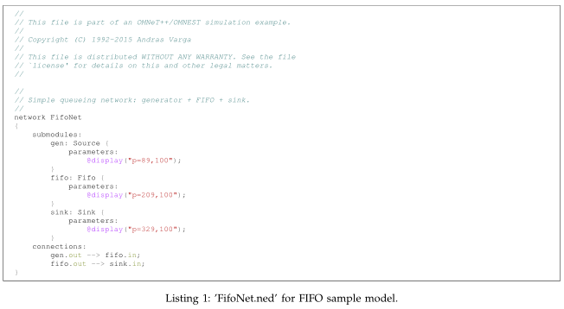
How to Deal with Simulation Input Files
Include them the document.
  OK for small simulations
Use a snapshot of the whole configurations.
  e.g., git commit hashes

Slide 15
How to Guarantee Match Between
Input Files and Output Data
Online generation of results
  Include simulation execution code within a document
    Refer to the provided sample Pweave file.
  OK for smaller simulations, but not for larger simulations.
Use a snapshot of the whole configurations and data
  e.g., git commit hashes
  Version controlling output data together with source code and input configuration files, however, may greatly increase the size of a repository.

Slide 16
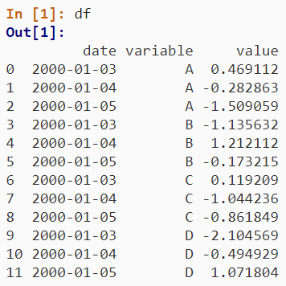
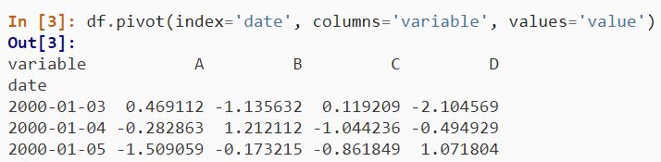
How to Present and Analyze Output Data
Unstacking of stacked DataFrame
  Use pivot function (see the example shown here).
Aggregated processing of measurement data over independent variables
  Use pivot_table function.
  Useful for the calculation of mean and confidence intervals over multiple iterations.
Online calculation of confidence intervals
  Confidence intervals (CIs) can be calculated by assigning a custom function for CI to aggfunc paramenter of pivot_table function.
  Now pandas support error bars in its own plot functions.

Slide 17
Example: OMNeT++ FIFO Simulation

