Slide 1
CIS 579 Project: Self-taught AI Control
Kenneth Yesh (kyesh@umich.edu|05502176)
For Dr. Ortiz, Fall 2017

Slide 2
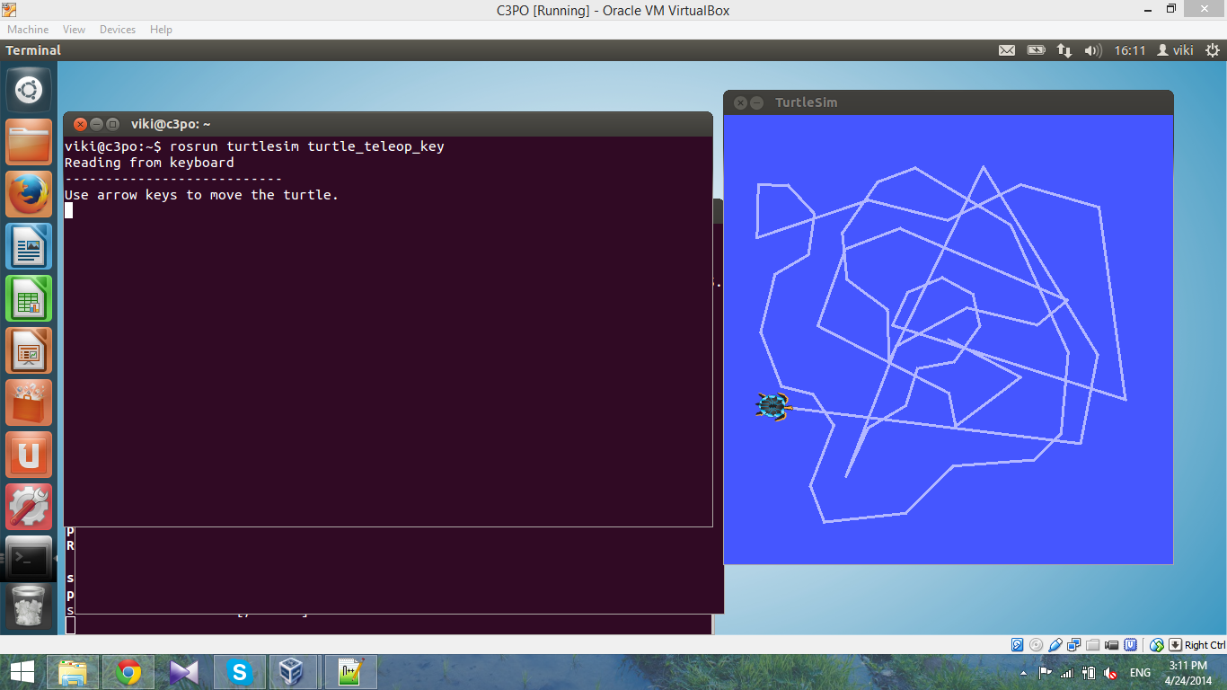


Develop an AI to get to desired x,y destination from random start position
Have it learn the solution itself given it’s current state and available actions

Slide 3
Background
ROS Framework
TurtleSim
Messeges
turtlesim/Pose
geometry_msgs/Twist
Services
turtlesim/TeleportAbsolute
turtlesim/SetPen
turtlesim/Spawn
turtlesim/Kill

Slide 4
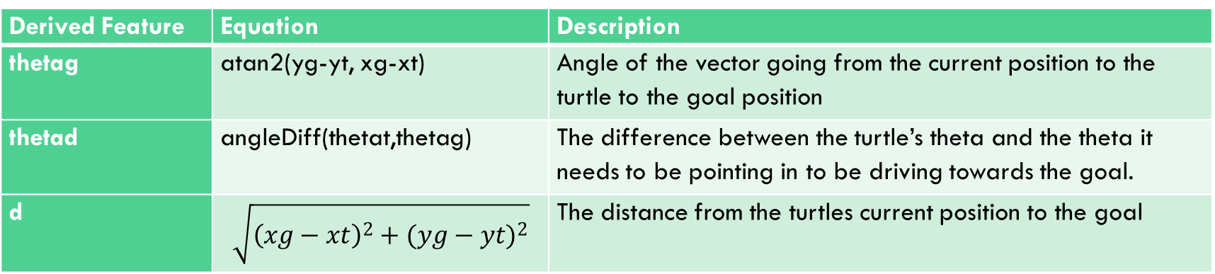
Algorithm: Features
Low Level Feature | Description
xt | Turtle’s x position from turtlesim/Pose message
yt | Turtle’s y position from turtlesim/Pose message
theta | Turtle’s theta position from turtlesim/Pose message
xg | Randomly generated x coordinate of goal
yg | Randomly generate y coordinate of goal
Derived Feature | Equation | Description
thetag | atan2(yg-yt, xg-xt) | Angle of the vector going from the current position to the turtle to the goal position
thetad | angleDiff(thetat,thetag) | The difference between the turtle’s theta and the theta it needs to be pointing in to be driving towards the goal.
d | $$\sqrt{{\left(xg−xt\right)}^{2}+{(yg−yt)}^{2}}$$ | The distance from the turtles current position to the goal

Slide 5

Algorithm: Initial Policy
Initial Policy:
$LinearVelocity=A×thetad+B×d$
$AngularVelocity=C×thetad+D×d$
Score:
(5.0 - distance(state.x, state.y, XG, YG))

Slide 6

Algorithm: New Policy
$$LinearVelocity=A×abs(thetad)+B×d +E$$
$AngularVelocity=C×thetad+D×d+ F$

Slide 7
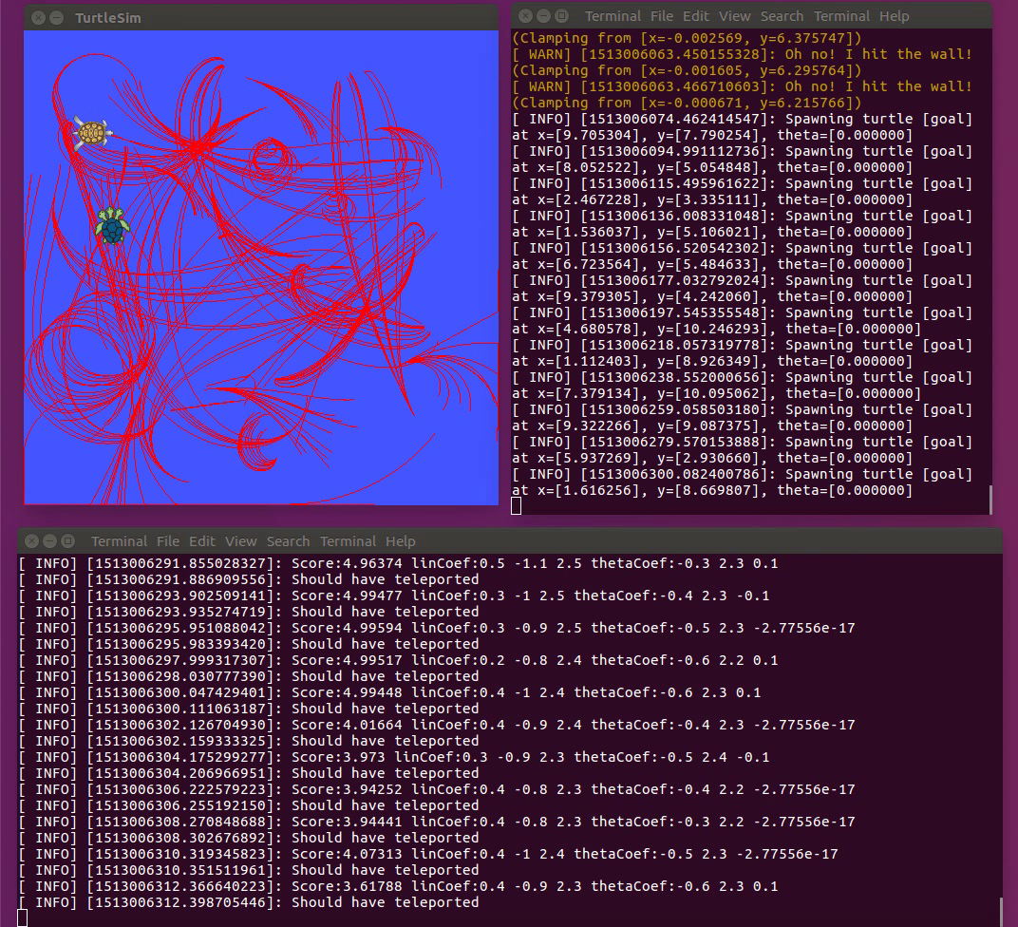
Results

Slide 8
Future Work
Adding Time to the Reward Function
More complicated Policies
Single Parameter instead of random

