Slide 1
Fundamentals of Data Mining Concepts
Data Mining and Visualization
ICT, Fac. Sci. PSU
29-JAN-2020

Slide 2
What is Data Mining?
Data Mining is defined as extracting information from huge sets of data. In other words, we can say that data mining is the procedure of mining knowledge from data. The information or knowledge extracted so can be used for any of the following applications:
Market Analysis and Management
Customer Profiling, Identifying Customer Requirements, Cross Market Analysis, Target Marketing, Determining customers, purchasing pattern, Providing Summary Information, etc.
Corporate Analysis & Risk Management
Finance Planning and Asset Evaluation, Resource Planning, Product Control, Competitor Analysis, etc.
Fraud Detection
Science Exploration

Slide 4
Business understanding
In this phase, business and data-mining goals are established.
First, you need to understand business and client objectives. You need to define what your client wants (which many times even they do not know themselves)
Take stock of the current data mining scenario. Factor in resources, assumption, constraints, and other significant factors into your assessment.
Using business objectives and current scenario, define your data mining goals.
A good data mining plan is very detailed and should be developed to accomplish both business and data mining goals.

Slide 5
Data Understanding
In this phase, sanity check on data is performed to check whether its appropriate for the data mining goals.
First, data is collected from multiple data sources available in the organization.
These data sources may include multiple databases, flat filer or data cubes. There are issues like object matching and schema integration which can arise during Data Integration process. It is a quite complex and tricky process as data from various sources unlikely to match easily. For example, table A contains an entity named cust_no whereas another table B contains an entity named cust-id.
Therefore, it is quite difficult to ensure that both of these given objects refer to the same value or not. Here, Metadata should be used to reduce errors in the data integration process.
Next, the step is to search for properties of acquired data. A good way to explore the data is to answer the data mining questions (decided in business phase) using the query, reporting, and visualization tools.
Based on the results of query, the data quality should be ascertained. Missing data if any should be acquired.

Slide 6
Data Preparation
In this phase, data is made production ready.
The data preparation process consumes about 90% of the time of the project.
The data from different sources should be selected, cleaned, transformed, formatted, anonymized, and constructed (if required).
Data cleaning is a process to "clean" the data by smoothing noisy data and filling in missing values.
For example, for a customer demographics profile, age data is missing. The data is incomplete and should be filled. In some cases, there could be data outliers. For instance, age has a value 300. Data could be inconsistent. For instance, name of the customer is different in different tables.
Data transformation operations change the data to make it useful in data mining. Following transformation can be applied.

Slide 7
Data transformation
Data transformation operations would contribute toward the success of the mining process.
Smoothing: It helps to remove noise from the data.
Aggregation: Summary or aggregation operations are applied to the data. I.e., the weekly sales data is aggregated to calculate the monthly and yearly total.
Generalization: In this step, Low-level data is replaced by higher-level concepts with the help of concept hierarchies. For example, the city is replaced by the county.
Normalization: Normalization performed when the attribute data are scaled up o scaled down. Example: Data should fall in the range -2.0 to 2.0 post-normalization.
Attribute construction: these attributes are constructed and included the given set of attributes helpful for data mining.
The result of this process is a final data set that can be used in modeling.

Slide 8
Data Exploration
Before proceeding to create a model, it is always good and necessary to know more about your data.
Eye-check
Even a very limited data check can give us some insight on what kinds of characteristics the data may have.
Statistical Summary
Mean, Standard Deviation, and other statistical values also let us know something particularly about how biased the data are.
Simple Visualization
Statistical Summary can also be visualized.
In most cases, statistical values give us information on where the center is, and how the data are distributed from the center. Simple visualization, on the other hand, gives us both such overall information and a bit more detailed tendencies of the data, though visualization itself cannot be used for further computational analysis

Slide 9
Modeling
In this phase, mathematical models are used to determine data patterns.
Based on the business objectives, suitable modeling techniques should be selected for the prepared dataset.
Create a scenario to test check the quality and validity of the model.
Run the model on the prepared dataset.
Results should be assessed by all stakeholders to make sure that model can meet data mining objectives.

Slide 10
Evaluation
In this phase, patterns identified are evaluated against the business objectives.
Results generated by the data mining model should be evaluated against the business objectives.
Gaining business understanding is an iterative process. In fact, while understanding, new business requirements may be raised because of data mining.
A go or no-go decision is taken to move the model in the deployment phase

Slide 11
Deployment
In the deployment phase, you ship your data mining discoveries to everyday business operations.
The knowledge or information discovered during data mining process should be made easy to understand for non-technical stakeholders.
A detailed deployment plan, for shipping, maintenance, and monitoring of data mining discoveries is created.
A final project report is created with lessons learned and key experiences during the project. This helps to improve the organization's business policy.
Remember that the most important point in this phase is good communication and presentation on your findings. In almost all the cases, you will talk about your findings to people of different backgrounds, of different roles, and of different perspectives.

Slide 12
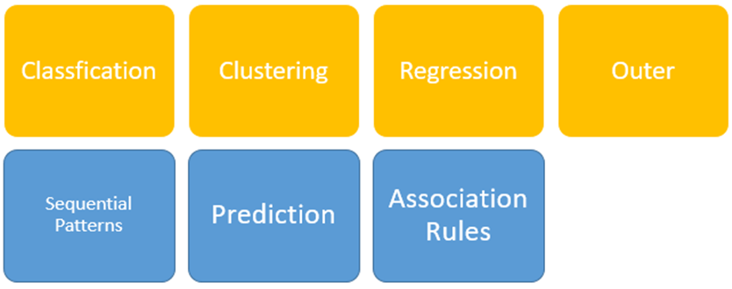
Typical Data Mining Techniques

Slide 13
Classification
Classification technique is used for assigning the items into target categories or classes which is used to predict what will occur within the class accurately.
It classifies each item in a set of data into one of a predefined set of classes or groups.
We use it to classify different data in different classes.
As this process is like clustering. It relates a way that segments data records into different segments called classes.
An example is an Outlook email. They use specific algorithms to characterize an email as authenticating or spam.

Slide 14
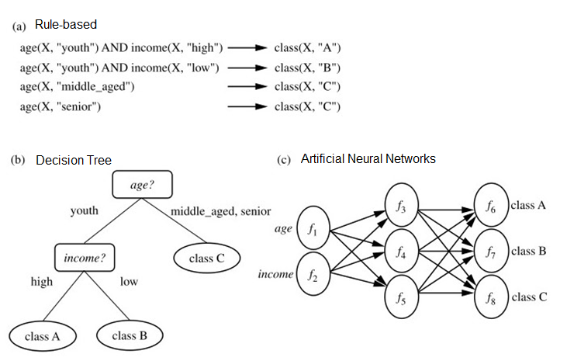
Examples of classification

Slide 15
Clustering
Cluster analysis is one of the techniques of data mining by which related records are grouped. As a result, objects are like one another within the same group. Although, they are different in same or other clusters.
The objects are clustered based on the principle of maximizing the intra-class similarity and minimizing the inter-class similarity.
In clustering, the class labels are not present in the training because they are not known to begin with which is called unsupervised learning.

Slide 16
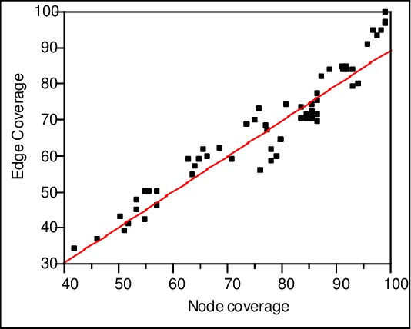
Regression
This technique is used for establishing the dependency between the two variables so that causal relationship can be used to predict the outcome.
In statistical ways, we use to identify and analyze the relationship between variables.
It helps you to know the characteristic value of the dependent variable.
Generally, used for prediction and forecasting.

Slide 17
Outlier (or Anomaly) Detection
Outliers is defined as the data objects that do not comply with the general behavior or model of the data available.
It refers mainly to an observation of data items in a dataset for the data sets that do not match an expected pattern.
Anomalies are also known as outliers, novelties, noise, deviations, and exceptions as this anomaly provide critical and actionable information.

Slide 18
Prediction
Prediction has used a combination of the other data mining techniques like trends, sequential patterns, clustering, classification, etc. It analyzes past events or instances in a right sequence for predicting a future event.
Prediction is made by finding the relationship between independent and dependent variables.
Suppose the deal is an independent variable and profit could be a dependent variable. Then we can draw a fitted regression curve that is used for profit prediction.

Slide 19
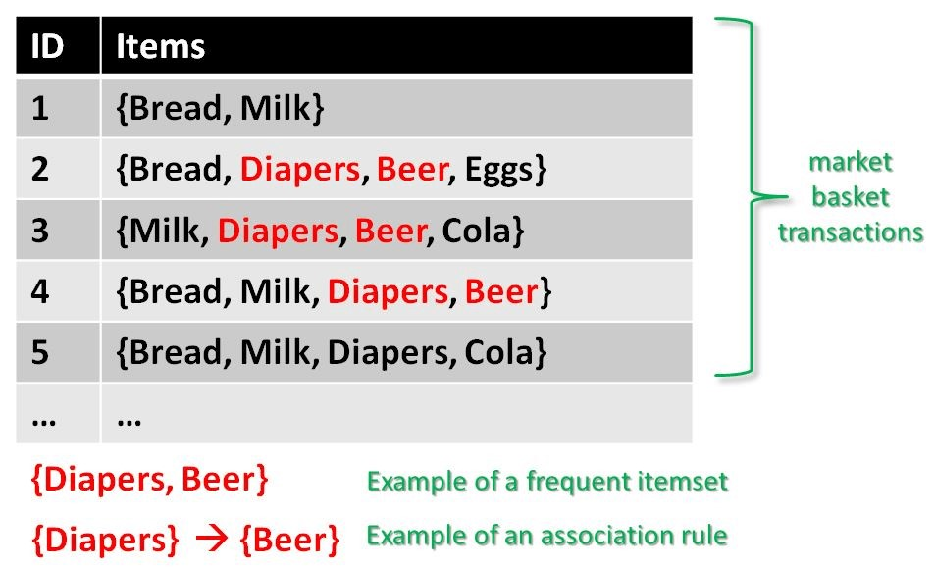
Association
It is also known as relation technique.
A pattern is recognized based upon the relationship of items in a single transaction.
The association technique is used in market basket analysis to identify a set of products that customers frequently purchase together.
Retailers used the association technique to research customer’s buying habits. Based on historical sale data, retailers might find out that customers always buy crisps when they buy beers, and, therefore, they can put beers and crisps next to each other to save time for the customer and increase sales.

Slide 20
Sequential Data Processing
Some data are sequential: The occurrence of each record and/or the occurrence of each feature is ordered.
As our typical data have no order among records or features, a completely different approach is needed for sequential data.
A typical example is natural language sentences, which we already saw last week.
Also another typical example is time-sequential data, with which we want to find some time-sequential pattern of the occurrence of events.
For example, can we expect when electricity use will increase after what events happen?
Or when do we want to buy coke after what events happen?
Sequential Data Processing tries to find some pattern of a series of events.

Slide 21
Challenges (difficult points)
Skilled Experts are needed to formulate the data mining queries.
Overfitting: Due to small size training database, a model may not fit future states.
Data mining needs large databases which sometimes are difficult to manage
Business practices may need to be modified to determine to use the information uncovered.
If the data set is not diverse, data mining results may not be accurate.
Integration information needed from heterogeneous databases and global information systems could be complex

Slide 22
Benefits of Data Mining
Data mining technique helps companies to get knowledge-based information.
Data mining helps organizations to make the profitable adjustments in operation and production.
The data mining is a cost-effective and efficient solution compared to other statistical data applications.
Data mining helps with the decision-making process.
Facilitates automated prediction of trends and behaviors as well as automated discovery of hidden patterns.
It can be implemented in new systems as well as existing platforms
It is the speedy process which makes it easy for the users to analyze huge amount of data in less time.

Slide 23
Disadvantages of Data Mining
There are chances of companies may sell useful information of their customers to other companies for money. For example, American Express has sold credit card purchases of their customers to the other companies. → Privacy issues
The findings of data mining may enforce existing discrimination → Ethical issues
Many data mining analytics software is difficult to operate and requires advance training to work on. → But that’s why more professional data scientists are needed
Different data mining tools work in different manners due to different algorithms employed in their design. Therefore, the selection of correct data mining tool is a very difficult task.
The data mining techniques are not accurate, and so it can cause serious consequences in certain conditions.
Always remember that our data mining model that we want to create is a “model”, which is sort of abstraction and simplification of the world.

Slide 24
Examples
From now on, we will see some actual examples of data mining, implemented by Python.
During the class, you don’t have to focus on every detail. Rather, get the overall procedure.
After the class, check each line of code. They contain many coding that we cannot explain in simple introductory tutorials, but that you can imitate in your own tasks.
Always read, considering what meaning there is in each line.
Take advantage of Web search.

Slide 25
https://www.guru99.com/data-mining-tutorial.html

