Slide 1
Text Analysis
15-JAN-2020
Data Mining and Visualization
ICT, Fac. Sci., PSU Hat Yai

Slide 2
What is Natural Language Processing(NLP)?
NLP is a branch of artificial intelligence that deals with analyzing, understanding and generating the languages that humans use naturally in order to interface with computers in both written and spoken contexts using natural human languages instead of computer languages.
Applications of NLP
Machine translation(Google Translate)
Natural language generation
Web Search
Spam filters
Sentiment Analysis
Chatbots
… and many more

Slide 3
What is special in Text Analysis?
The original data are not numeric.
So, how do we represent text data with numbers?
Texts are not of fixed-lengths.
So, how do we put texts into a table?
Each word (feature) has meanings, and they change in contexts.
So, how do we use words’ meaning?

Slide 4
Thai is the most difficult
Thai language is not word-segmented.
This is the same with Chinese, Japanese, and other few Asian languages.
Thai is not sentence-segmented.
Only Thai, Lao, and Khmer.
Thai scripts are pronunciation-based, but some vowel sounds are not explicitly written
which itself is not the problem of usual data mining when we are not dealing with sounds)
Many Thais use unauthoritative spellings.
So, today, sorry to say, we are not dealing with the Thai language.

Slide 5
The will to make a success is important.
Important is the will to make a success.
Somchai is a good student.
A good student is Somchai.
Subj + BE + Complement
Complement can be a noun phrase, an adjective
The roles of adjectives
Modifying a noun: a cute girl,
Complement: He is handsome.

Slide 6
Basic information of text
We can use text data to extract a number of features even if we don’t have sufficient knowledge of Natural Language Processing. So let’s discuss some of them in this section.

Slide 7
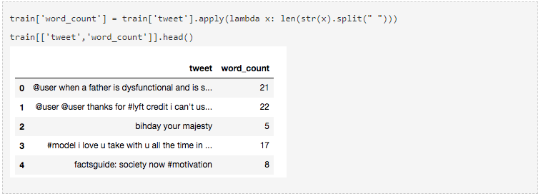
1. Number of Words
One of the most basic features we can extract is the number of words in each tweet. The basic intuition behind this is that generally, the negative sentiments contain a lesser amount of words than the positive ones.
To do this, we simply use the split function in python:

Slide 8
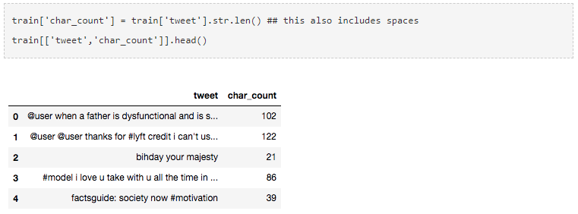
2. Number of Characters
This feature is also based on the previous feature intuition. Here, we calculate the number of characters in each tweet. This is done by calculating the length of the tweet.
Note that the calculation will also include the number of spaces, which you can remove, if required.

Slide 9
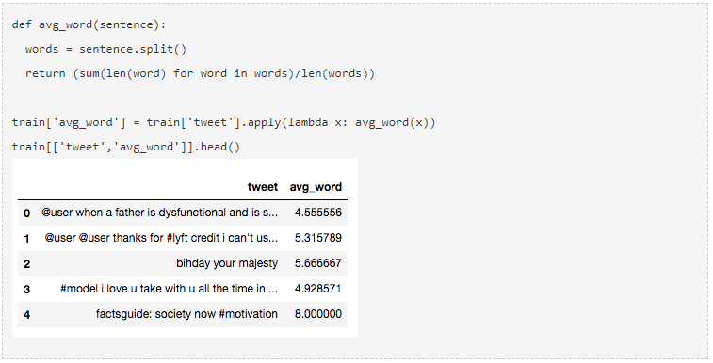
3. Average Word Length
We will also extract another feature which will calculate the average word length of each tweet. This can also potentially help us in improving our model.
Here, we simply take the sum of the length of all the words and divide it by the total length of the tweet:

Slide 10
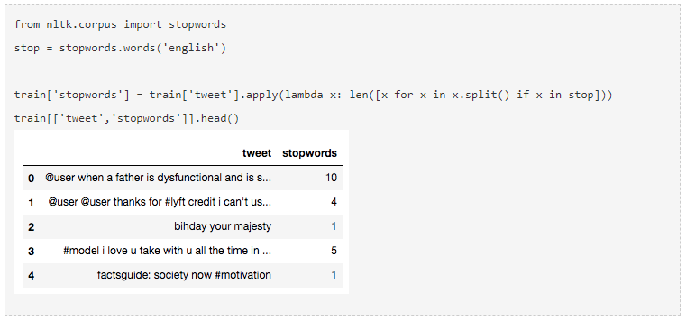
4. Number of stopwords
Generally, while solving an NLP problem, the first thing we do is to remove the stopwords. But sometimes calculating the number of stopwords can also give us some extra information which we might have been losing before.
Here, we have imported stopwords from NLTK, which is a basic NLP library in python.

Slide 11
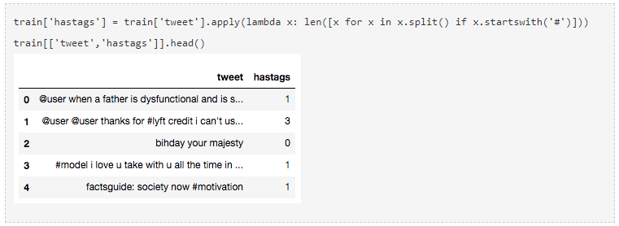
5. Number of special characters
One more interesting feature which we can extract from a tweet is calculating the number of hashtags or mentions present in it. This also helps in extracting extra information from our text data.
Here, we make use of the ‘starts with’ function because hashtags (or mentions) always appear at the beginning of a word.

Slide 12
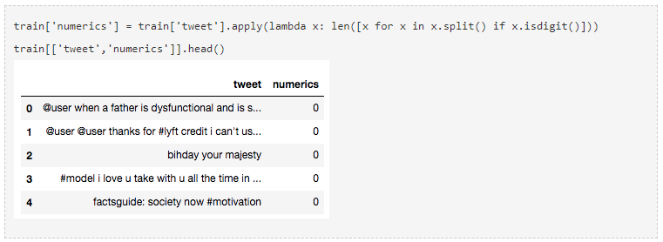
6. Number of numerics
Just like we calculated the number of words, we can also calculate the number of numerics which are present in the tweets. It does not have a lot of use in our example, but this is still a useful feature that should be run while doing similar exercises. For example,

Slide 13
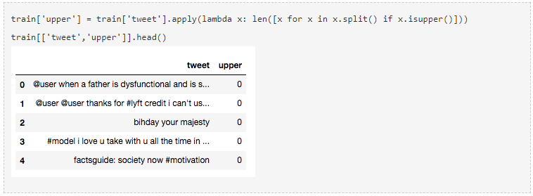
7. Number of Uppercase words
Anger or rage is quite often expressed by writing in UPPERCASE words which makes this a necessary operation to identify those words.

Slide 14
Preprocessing

Slide 15
ชอบมาก
ชอบมมาาก
ชอบมมาาาก
ชอบมมาาาาาาก

Slide 16
It is always good and necessary to know what kind of data we are using.
This is particularly true for text data.
Before starting, let’s quickly read the training file from the dataset in order to perform different tasks on it. Today, we will use the twitter sentiment dataset from the datahack platform.
https://datahack.analyticsvidhya.com/contest/practice-problem-twitter-sentiment-analysis/
train = pd.read_csv('train_E6oV3lV.csv')

Slide 17
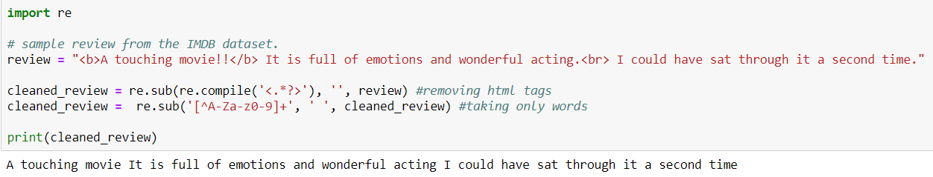
Data Cleaning
In data cleaning process, we remove special characters, symbols, punctuation, html tags<> etc from the raw data which contains no information for the model to learn, these are simply noise in our data.
This process also depends on the problem statement, like what to remove from raw text. For example if the problem contains text from economics or business world then symbols like $ or other currency symbols may contain some hidden information which we do not want to lose. But in most of the cases we remove them.

Slide 18
Preprocessing of data
Preprocessing of data is a data mining technique that involves transforming the raw data into an understandable format.

Slide 19
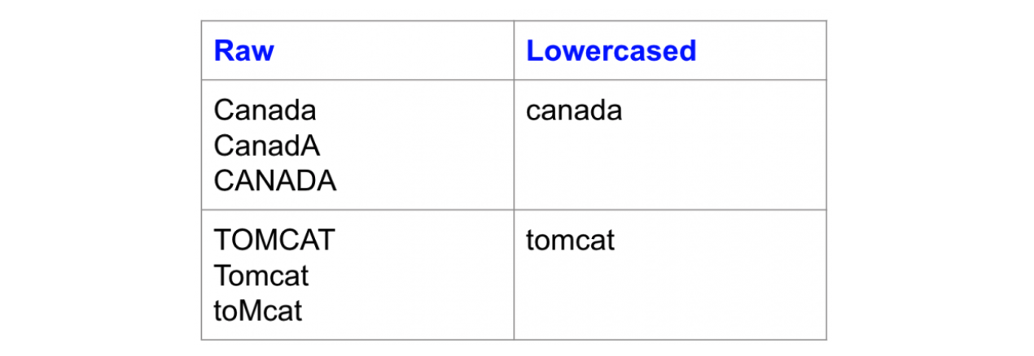
Lowercase
Making all the text lower case is one of the simplest and most effective forms of text preprocessing.

Slide 20
Sentence and Word Segmentation
In many cases, text data just contains a series of texts. We want, as a first step, to separate each sentence (sentence segmentation) and each word (word segmentation)
Word segmentation is applied only to the languages whose writing do not separate words in writing. (= Thai, Japanese, etc.)
E.g., He said, “Hello. Nice to meet you.”

Slide 21
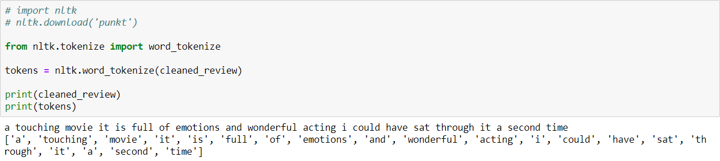
Tokenization
Tokenization is the process of breaking up text document into individual words called tokens.
As seen above sentence is broken down into words(tokens). Natural language toolkit(NLTK) is a popular open source library used extensively for NLP tasks. For this blog we will use nltk for all the text preprocessing steps.

Slide 22
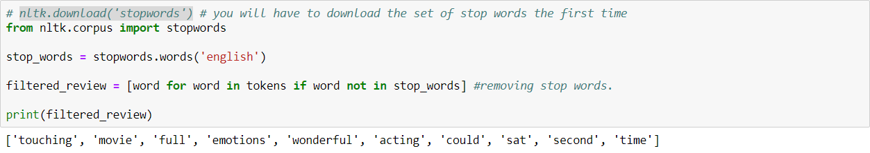
Stop words removal
Stop words are common words that do not contribute much of the information in a text document. Words like ‘the’, ‘is’, ‘a’ have less value and add noise to the text data.
There is an in-built stopword list in NLTK which we can use to remove stop words from text documents. However this is not the standard stopwords list for every problem, we can also define our own set of stop words based on the domain.
NLTK has predefined list of stop words for English and some major languages. We can add or remove stopwords from this list or use as it is based on the specific task.

Slide 23
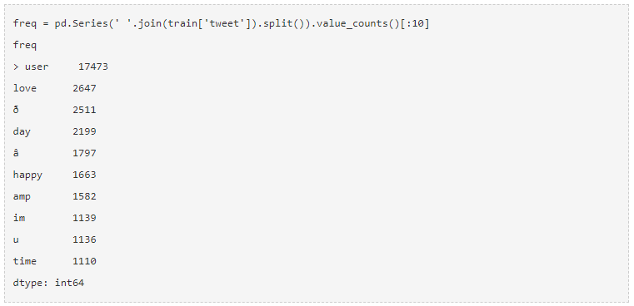
Common Word Removal
Previously, we just removed commonly occurring words in a general sense. We can also remove commonly occurring words from our text data First, let’s check the 10 most frequently occurring words in our text data then take call to remove or retain.

Slide 24
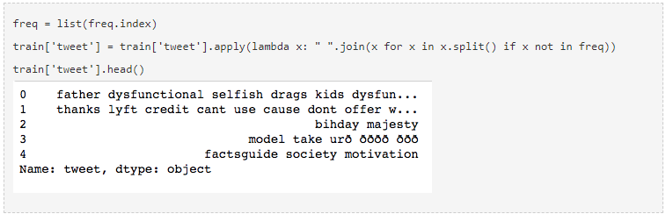
Common Word Removal (cont’d.)
Now, let’s remove these words as their presence will not of any use in classification of our text data.

Slide 25
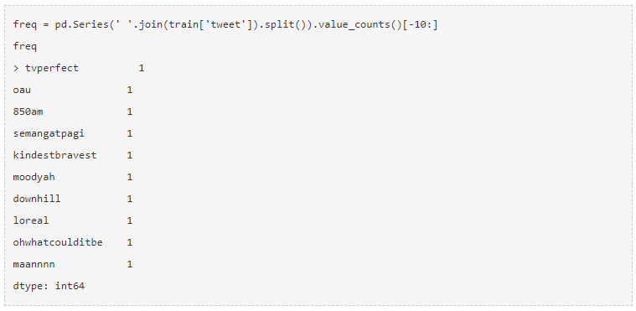
Rare Word Removal
Similarly, just as we removed the most common words, this time let’s remove rarely occurring words from the text. Because they’re so rare, the association between them and other words is dominated by noise. You can replace rare words with a more general form and then this will have higher counts.

Slide 26
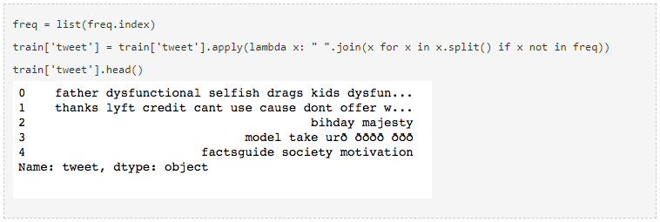
Rare Word Removal (cont’d.)
Removal of stopwords, common words, and rare words are essential and help us in reducing our vocabulary clutter so that the features produced in the end are more effective.

Slide 27
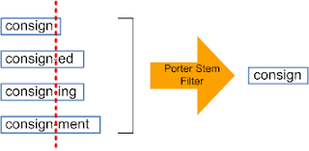
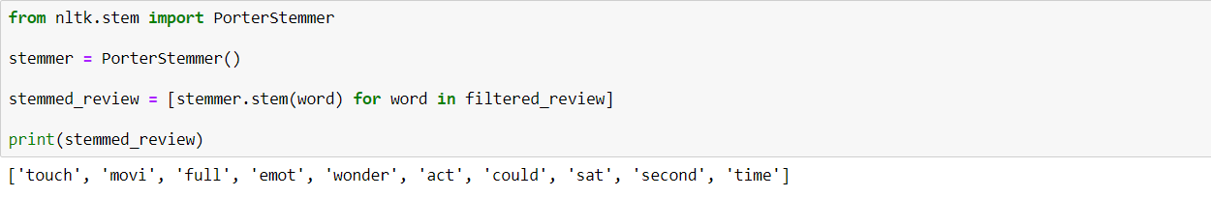
Stemming
Stemming is the process of reducing a word to its stem/root word. It reduces inflection in words (e.g. ‘help’, ’helping’, ’helped’, ’helpful’) to their root form (e.g. ‘help’). It removes the morphological affixes from words, leaving only the word stem.
The stem word may or may not be a valid word in the language. For example ‘movi’ is the root word for ‘movie’, ‘emot’ is the root word for ‘emotion’.

Slide 28
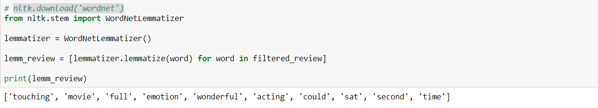
Lemmatization
Lemmatization does the same thing as stemming, converting a word to its root form but with one difference i.e., the root word in this case belongs to a valid word in the language. For example the word caring would map to ‘care’ and not ‘car’ as the in case of stemming.
WordNet is a database of valid words in english language. NLTK’s WordNetLemmatizer() uses valid words from WordNet.

Slide 29
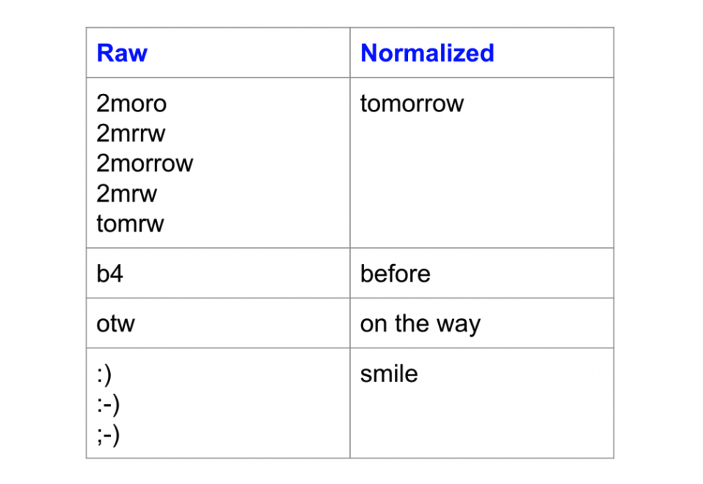
Normalization
A highly overlooked preprocessing step is text normalization. Text normalization is the process of transforming a text into a canonical (standard) form. For example, the word “gooood” and “gud” can be transformed to “good”, its canonical form. Another example is mapping of near identical words such as “stopwords”, “stop-words” and “stop words” to just “stopwords”.
Text normalization is important for noisy texts such as social media comments, text messages and comments to blog posts where abbreviations, misspellings and use of out-of-vocabulary words (oov) are prevalent.

Slide 30
Normalization (cont’d)
Notice how the variations map to the same canonical form.
Unfortunately, unlike stemming and lemmatization, there isn’t a standard way to normalize texts. It typically depends on the task. For example, the way you would normalize clinical texts would arguably be different from how you normalize sms text messages.
Some common approaches to text normalization include dictionary mappings (easiest), statistical machine translation (SMT) and spelling-correction based approaches.

Slide 31
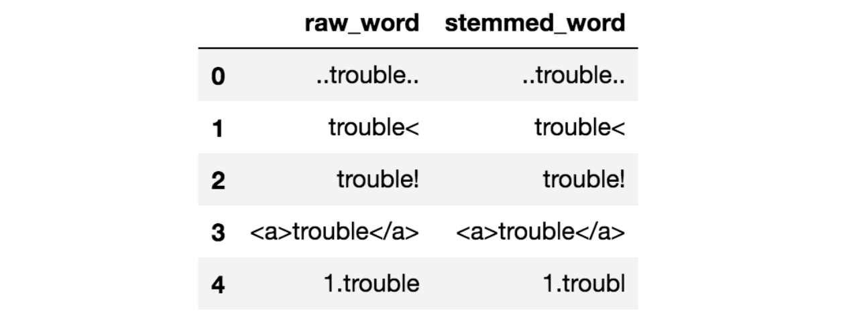
Noise removal
Noise removal is about removing characters digits and pieces of text that can interfere with your text analysis. Noise removal is one of the most essential text preprocessing steps. It is also highly domain dependent.
For example, in Tweets, noise could be all special characters except hashtags as it signifies concepts that can characterize a Tweet. The problem with noise is that it can produce results that are inconsistent in your downstream tasks. Let’s take the example below:

Slide 32
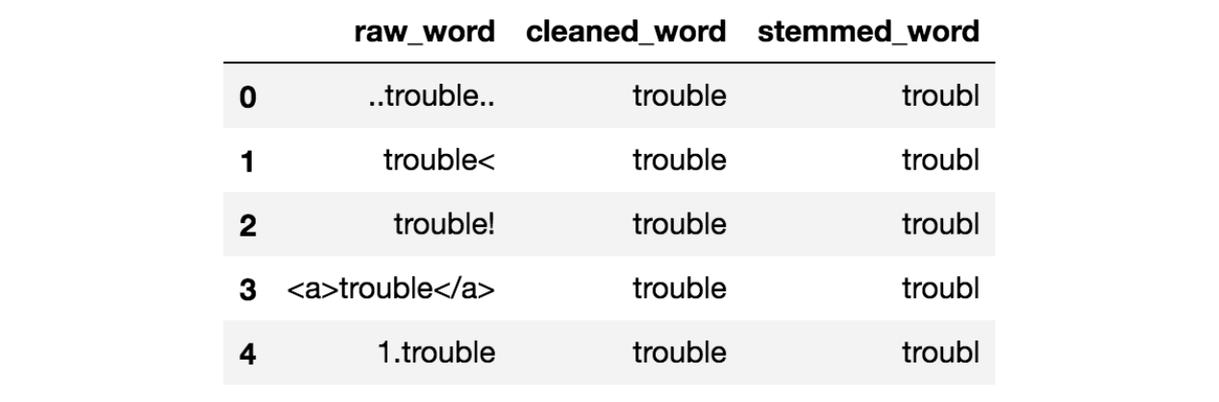
Stemming without Noise Removal
Notice that all the raw words above have some surrounding noise in them. If you stem these words, you can see that the stemmed result does not look very pretty. None of them have a correct stem. However, with some cleaning as applied in this notebook, the results now look much better:

Slide 33
Stemming with Noise Removal
Noise removal is one of the first things you should be looking into when it comes to Text Mining and NLP. There are various ways to remove noise. This includes punctuation removal, special character removal, numbers removal, html formatting removal, domain specific keyword removal (e.g. ‘RT’ for retweet), source code removal, header removal and more. It all depends on which domain you are working in and what entails noise for your task.

Slide 34
Preprocessing: Text Enrichment / Augmentation
Text enrichment involves augmenting your original text data with information that is not included in the original data.
In an information retrieval example, expanding a user’s query to improve the matching of keywords is a form of augmentation. A query like text mining could become text document mining analysis. While this doesn’t make sense to a human, it can help fetch documents that are more relevant.
You can get really creative with how you enrich your text. You can use part-of-speech tagging to get more granular information about the words in your text.
For example, in a document classification problem, the appearance of the word book as a noun could result in a different classification than book as a verb as one is used in the context of reading and the other is used in the context of reserving something. This article talks about how Chinese text classification is improved with a combination of nouns and verbs as input features.

Slide 35
With the availability of large amounts texts however, people have started using embeddings to enrich the meaning of words, phrases and sentences for classification, search, summarization and text generation in general. This is especially true in deep learning based NLP approaches where a word level embedding layer is quite common. You can either start with pre-established embeddings or create your own and use it in downstream tasks.
Other ways to enrich your text data include phrase extraction, where you recognize compound words as one (aka chunking), expansion with synonymsand dependency parsing.

Slide 36
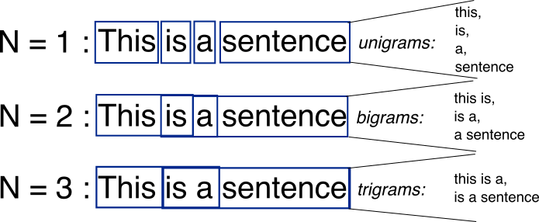
Preprocessing: N-grams
N-grams are the combination of multiple words used together, Ngrams with N=1 are called unigrams. Similarly, bigrams (N=2), trigrams (N=3) and so on can also be used.
N-grams can be used when we want to preserve sequence information in the document, like what word is likely to follow the given one. Unigrams don’t contain any sequence information because each word is taken individually.

Slide 37
What preprocessing is needed?
Must Do:
Noise removal
Lowercasing (can be task dependent in some cases)
Should Do:
Simple normalization — (e.g. standardize near identical words)
Task Dependent:
Advanced normalization (e.g. addressing out-of-vocabulary words)
Stop-word removal
Stemming / lemmatization
Text enrichment / augmentation

Slide 38
Not all tasks need the same level of preprocessing. For some tasks, you can get away with the minimum. However, for others, the dataset is so noisy that, if you don’t preprocess enough, it’s going to be garbage-in-garbage-out.
Here’s a general rule of thumb.
If you have a lot of well written texts to work with in a fairly general domain, then preprocessing is not extremely critical; you can get away with the bare minimum (e.g. training a word embedding model using all of Wikipedia texts or Reuters news articles).
if you are working in a very narrow domain (e.g. Tweets about health foods) and data is sparse and noisy, you could benefit from more preprocessing layers, although each layer you add (e.g. stop word removal, stemming, normalization) needs to be quantitatively or qualitatively verified as a meaningful layer.

Slide 39
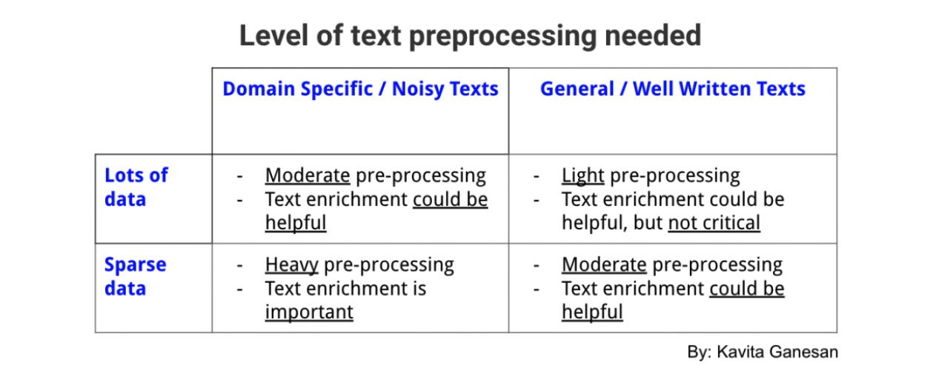

Slide 40
Text Data Vectorization
The process of converting text into numbers is called text data vectorization. Now after text preprocessing, we need to numerically represent text data i.e., encoding the data in numbers which can be further used by algorithms.

Slide 41
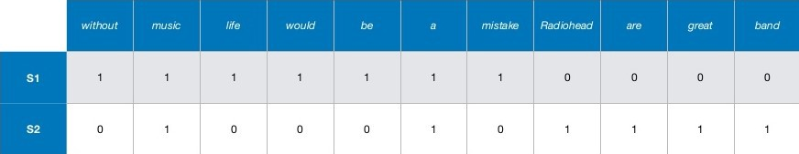
Bag of words(BOW)
It is one of the simplest text vectorization techniques. The intuition behind BOW is that two sentences are said to be similar if they contain similar set of words.
Consider these two sentences:
S1: Without music life would be a mistake
S2: Radiohead are a great music band
BOW constructs a dictionary of d unique words in corpus(collection of all the tokens in data). For example corpus in the above image is made up of combined words in S1 and S2.
Now, we can think of like creating a table where columns are all the set of unique d words in the corpus with each row corresponding to a sentence(document). We set the value as 1 if the word is present in the sentence else we set it to 0.
This will create a matrix of dxn where d is the total number of unique tokens in the corpus and n equals to the number of documents. In the above example, matrix will be of shape 11x2.

Slide 42
TF-IDF
It stands for Term Frequency(TF)-Inverse Document Frequency.
Term Frequency:
Term Frequency defines the probability of finding a word in the document. Now let’s say we want to find what is the probability of finding a word wi in document dj.
Term Frequency(w_{i}, d_{j}) = Number of times w_{i} occurs in d_{j}/Total number of words in d_{j}
Inverse Document Frequency:
The intuition behind IDF is that a word is not of much use if it is appearing in all the documents. It defines how unique is the word in the total corpus.
IDF(w_{i}, Dc) = log(N/n_{i})
Here, Dc = All documents in the corpus,
N = Total number of documents,
n_{i} = documents which contain word (w_{i}).
If w_{i} is more frequent in the corpus then IDF value decreases.
If w_{i} is not frequent which means n_{i} decreases and hence IDF value increases.
TF(w_{i}, d_{j}) * IDF(w_{i}, Dc)
TF-IDF is the multiplication of TF and IDF values. It gives more weightage to words which occurs more in the document and less in the corpus.

Slide 43
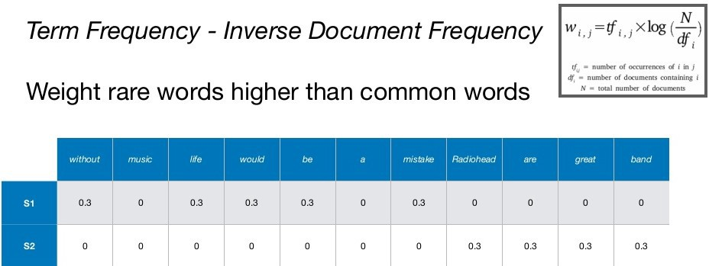
TF-IDF

Slide 44
Text Analysis Example: Sentiment Analysis of movie reviews

Slide 45
Sentiment analysis is to estimate whether a document delivers a positive or a negative opinion.
The dataset contains a collection of 50,000 reviews from IMDB Website with equal number of positive and negative reviews. Task is to predict the polarity (positive or negative) of a given review(text).

Slide 46
1. Loading and exploration of Data
IMDB Database can be downloaded from
http://ai.stanford.edu/~amaas/data/sentiment/aclImdb_v1.tar.gz

Slide 47
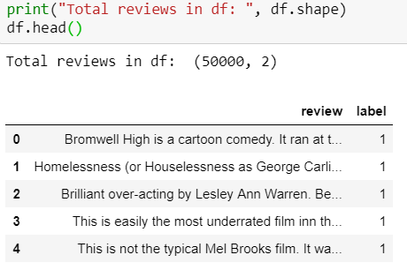
Dataset overview
As seen, Positive reviews are labeled as 1 and negative as 0.

Slide 48
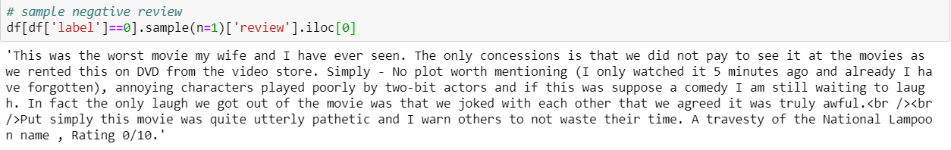
samples
Sample positive review
Sample negative review

Slide 49
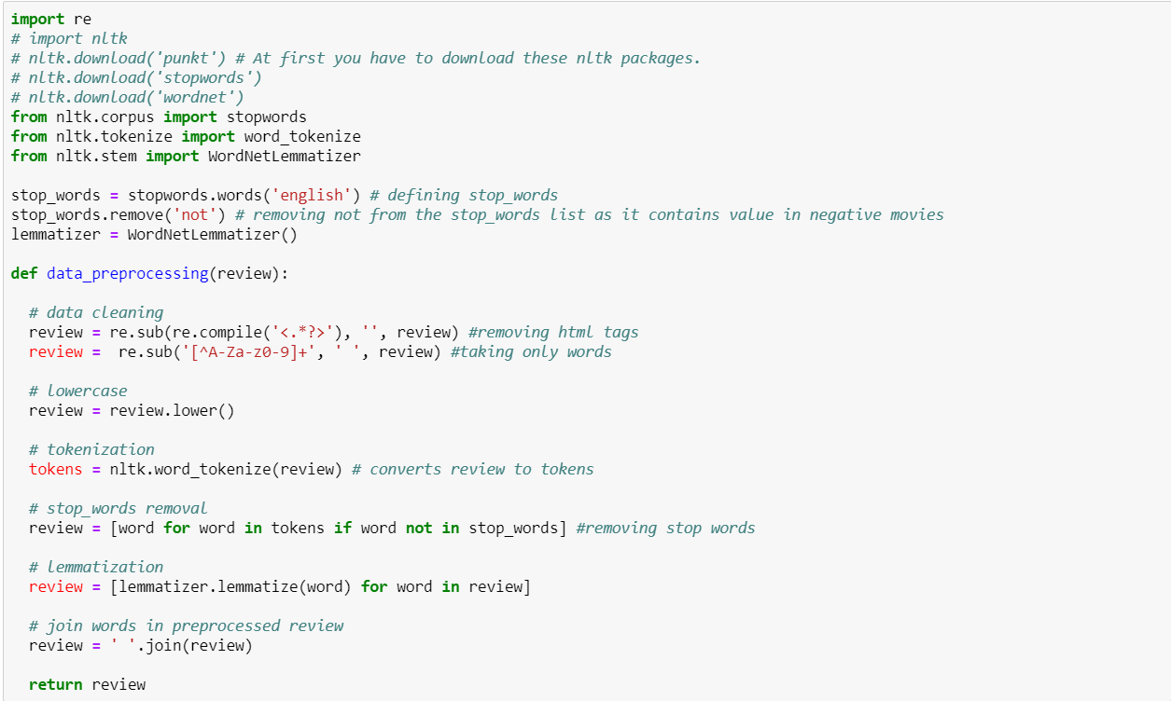
2. Data preprocessing

Slide 50
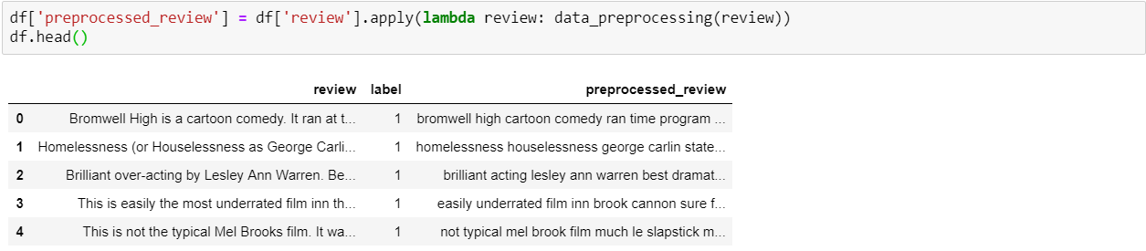
Here we are doing all the steps of data cleaning and preprocessing in one method as discussed above. We are using lemmatization and not stemming because while testing results with both, lemmatization gives slightly better results compared to stemming.
Usage of stemming or lemmatization or both depends on the problem, so we should try and see which way works best for the given task.
Adding a new column preprocessed_review in dataframe by applying data_preprocessing() on all the reviews.

Slide 51
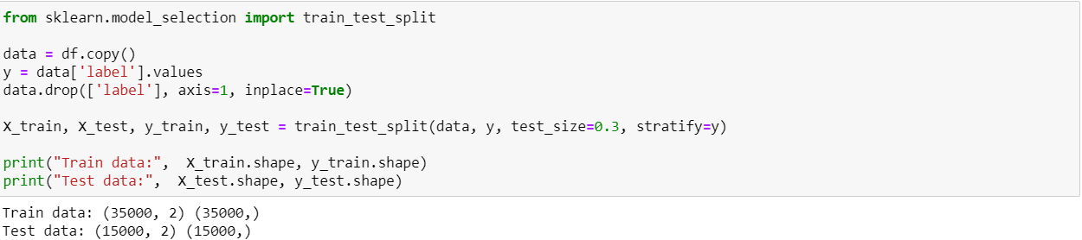
3. Vectorizing Text(reviews)
Splitting the data set into train and test(70–30)
We are using sklearn’s train_test_split to split data into train and test. Here we are using parameter stratify, to have equal proportion of classes in train and test.

Slide 52
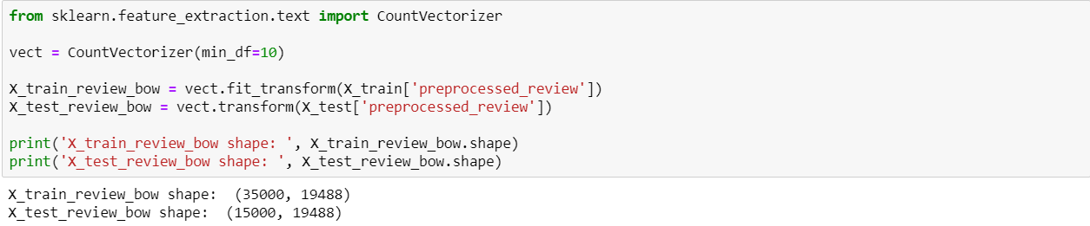
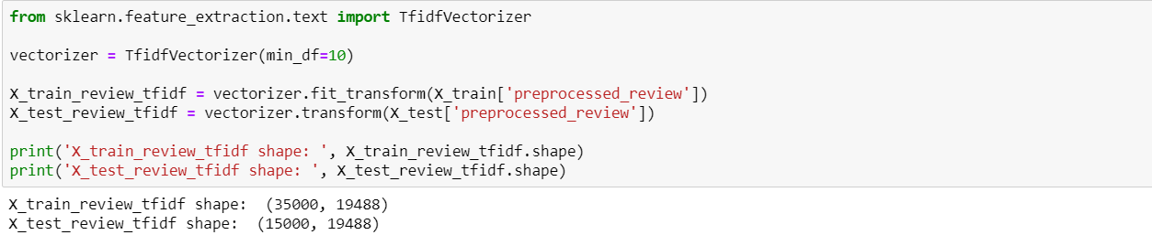
3. Vectorizing Text(reviews): TF-IDF
Simple Occurrence-based BOW
Here we have used min_df=10 as we only wants those words which occurs at least 10 times in the whole corpus.
TF-IDF-based BOW

Slide 53
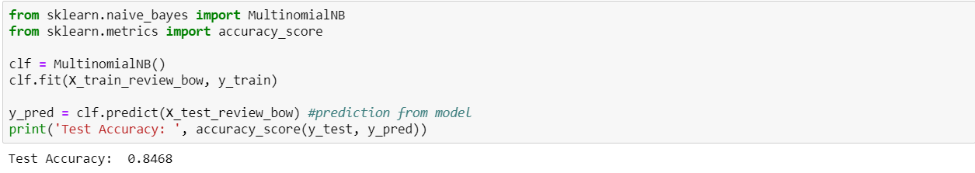
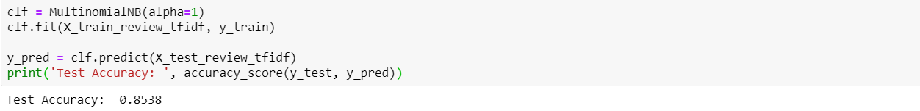
4. Building ML Classifiers
Naive Bayes with reviews BOW encoded
Naive Bayes with BOW gives accuracy of 84.6%. Let’s try with TF-IDF.
Naive Bayes with reviews TF-IDF encoded
TF-IDF gives slightly better results(85.3%) then BOW. Now let’s try TF-IDF with simple linear model, Logistic Regression.

Slide 54
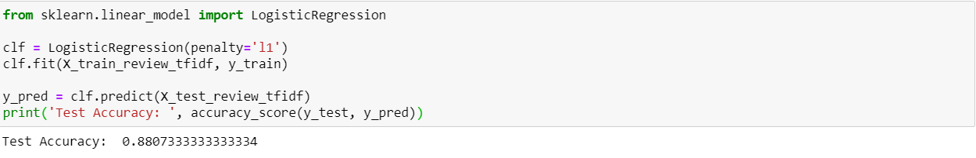
4. Building ML Classifiers
Logistic Regression with reviews TF-IDF encoded
Logistic Regression with reviews TFIDF encoded, gives better results than Naive Bayes with accuracy 88.0%.

Slide 55
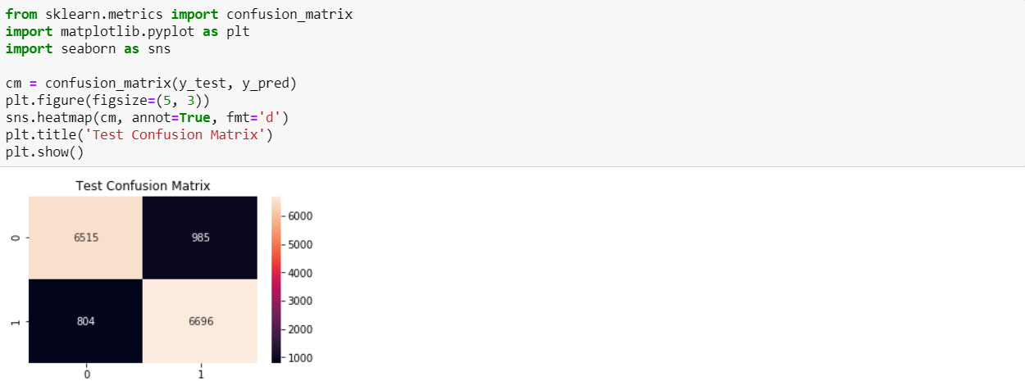
Plotting confusion matrix gives us the information about how much of the data points are correctly and incorrectly classified by the model.
Out of 7500 negative reviews, 6515 were correctly classified as negative and 985 were incorrectly classified as positive. Out of 7500 positive reviews, 6696 were correctly classified as positive and 804 were incorrectly classified as negative.

