Slide 1
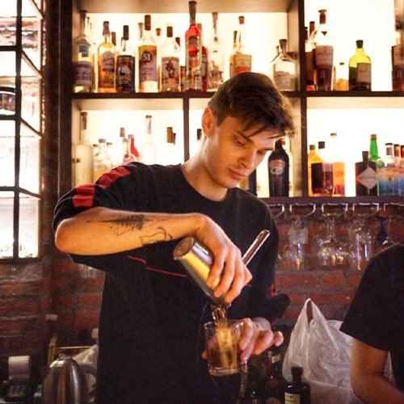








NIKITA BRAZHNIK (NICK)
OBJECTIVE
Seeking a bar supervisor position at bar with friendly team where I may share my passion for drinks, pleasant, fast, and high-quality service for guests. I had experience to work in high class bars like Portico, Ophelia, Reign Caviar, WTF and others bars or restaurants.
Hong Kong
52188760
worldoro@yahoo.com
EXPERIENCE
EDUCATION
Bartender | SOHO House — 2024 - 2025
City University of Hong Kong – Marketing – 3d year (uninished)
Enhancing my service skills and establishing proficiency in a fine dining environment
Bar Supervisor | WTF at Central — 2023 - 2024
SKILLS
Staff management, inventory control, menu creating and developing great service etc.
Creating a great working relationship with my coworkers;
Bar supervisor | APE (A perfect escape) — 2021 - 2023
Knowledge of three languages: English, Russian and Ukrainian
Cost control, quality assurance, ordering stock and providing excellent service to our guests etc
Head Bartender | Reign Caviar — 2019 – 2021
Over 7 years working experience in catering service and bartendering
Creating cocktail list from the scratch, training and hiring staff, coordinating and ensuring special events and promotions runs smoothly etc.
Event planning and execution
Bar supervisor | WTF bar — 2018 – 2019
Financial acumen
Vendor relations, marketing and promotions with upselling our unique cocktails, quality control etc.
Highly responsible and reliable
Able to work under pressure
Bartender | Spiga ( Portico | Dining concepts) — 2017 –2018 Bartender | Butchers club — 2016-2017 Media Marketing Manager | Kingston Technologies (HyperX) — June 2016 – Dec 2016
PERSONAL STATEMENT & HOBBIES:
An individual with a profound love for learning and adventure, my life outside work involves immersing myself in the pages of books, the narratives of films, and the lessons of different cultures through travel. These pursuits not only enrich my personal life but also bring unique insights and creativity to my professional endeavors.

