Slide 1


Expert-Driven Topical Classification of Short Message Streams
Krishna Y. Kamath and James Caverlee
Texas A&M University

Slide 2


Goal
Can we organize un-structured data into structured categories?
Other Social Message Streams
Example:
1.
Patriots
Red Sox
Bruins
2.
Sports
Politics
Technology
Entertainment

Slide 3
Example: Organizing Twitter
Politics
Sports
No Cat
No Cat
Sports
Technology
Entertainment
Technology
Stream Classification Problem
Notes:
Describe the stream classification problem

Slide 4
Stream Classification - Challenges
Challenge 1: Training data
Challenge 2: Concept drift
Challenge 3: Features

Slide 5
Training Data
Use tweets from “experts”
Snowball sample of Twitter lists
  "Who Says What to Whom on Twitter” WWW 2011
  (Wu, S.; Hofman, J.M.; Mason, W.A.; Watts, D.J.)

Slide 6
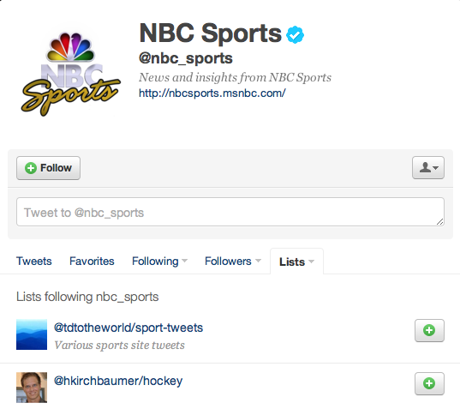
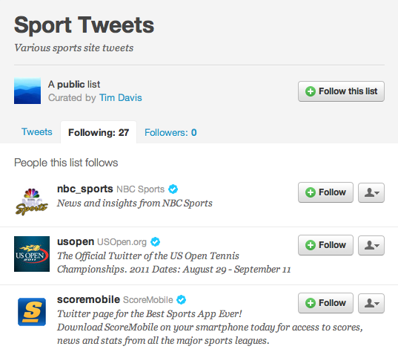
Experts for Sports
Seed users: {nbc_sports}; Key-words: {sport}

Slide 7
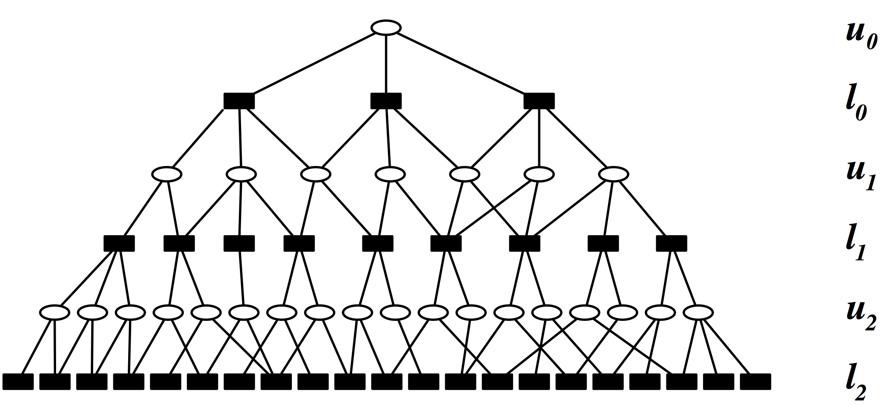
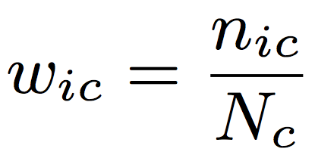
Expert Users
Users, Labeled Twitter lists
  n_{ic} = Number of lists in category c that contain users i
  N_{c} = Total number of lists in category c
Our data set – 1,250 users for each category
{ sports, politics, entertainment, technology}

Slide 8

Stream Classification - Challenges
Challenge 1: Training data
Challenge 2: Concept drift
Challenge 3: Features

Slide 9
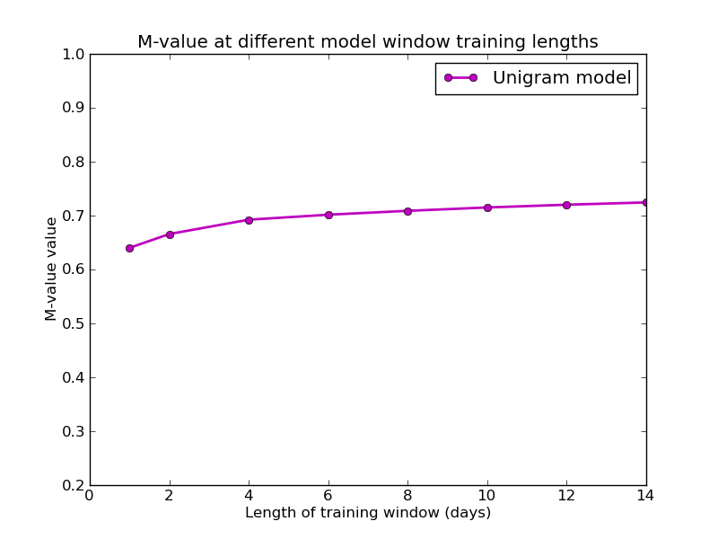
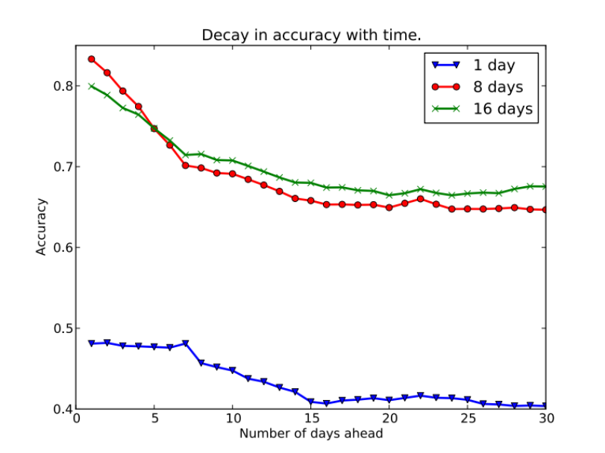
Training Window Length
We use 8 days as window length

Slide 10
Stream Classification - Challenges
Challenge 1: Training data
Challenge 2: Concept drift
Challenge 3: Features

Slide 11
Features - Collocation-Based Enrichment
“Collocation is a sequence of words or terms that co-occur more often than would be expected by chance”
Ex: “kobe bryant”, “dallas cowboys”
Pearson’s Χ² (chi squared) test
Dunning’s log-likelihood ratio test

Slide 12
Results
Split data from experts into training and test sets.
Maximum entropy classifier using sliding window (8-days).
Feature | M-value
X² test | 0.74
Log-likelihood test | 0.69

Slide 13
Summary
Politics
Sports
Politics
Sports
Technology
Entertainment
Technology
Entertainment
Challenge 1: Training data – Identify experts
Challenge 2: Concept drift - Window
Challenge 3: Features – Collocations and more

