Slide 1
Signal Temporal Logic
LOGIC
Temporal logics provide rules and formalisms for representing, and reasoning about propositions qualified in terms of time.
E.g., Planes flying in this area will eventually land in the next 5 minutes.
STL is specified over dense-time real-valued signals, such as time-series data produced from continuous and hybrid systems.
AND
OR
NOT
TEMPORAL
Time
SIGNAL

Slide 2
Grammar of Signal Temporal Logic
True | predicate | not | and | until
or
implies
eventually
always

Slide 3
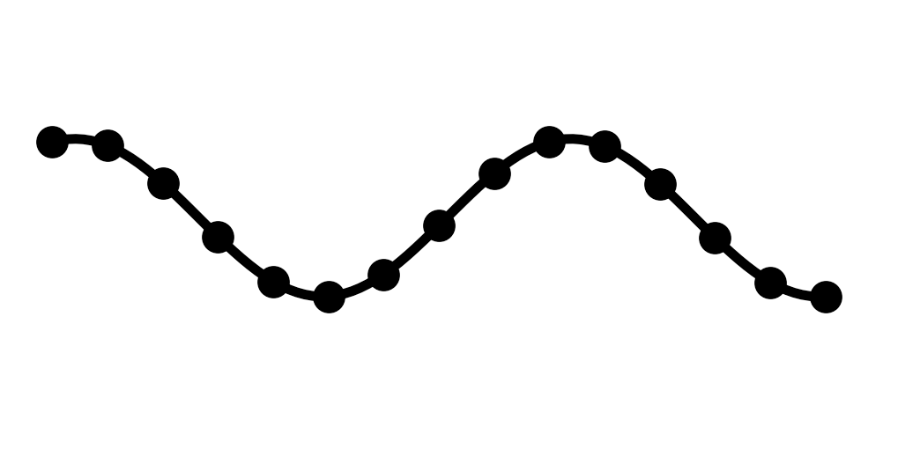
Robustness of STL formulas
Boolean
Does the signal satisfy the formula?
Robustness
How much does the signal satisfy or violate the formula?

Slide 4
Robustness formulas of STL
Quantitative semantics

