Slide 1
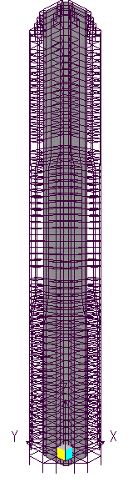

1st mode frequency estimates
for Republic Plaza, Singapore
First mode natural frequency estimates (Hz)
Architect (a priori) 0.146Hz
SAP90 0.185/0.191
AVT (unoccupied) 0.191/0.199
AVT (occupied) 0.184/0.194
ANSYS (a-posteriori) 0.191/0.214
Empirical f=46/H (Ellis) 0.164
90% of consultant FEMs underpredict
tall building 1st mode frequencies.
(CPP, Colorado).
Republic Plaza
FE model

Slide 2
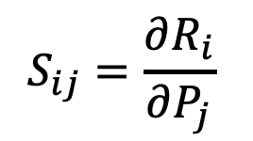
FEM updating techniques: first (macro)step using domain expertise, second (micro) step using using mathematical optimisation
Finite element analysis to predict analytical modal paramerters e.g f_{i,FEM}
Eperimental modal analysis to obtain experimental estimates ofmodal parameters e.g. f_{i,EMA}
FEA
EMA
coarse
elements?
experience
engineering judgement
Macro
model updating
Knowledge
base
fine
parameters?
error localization
sensitivity analysis
Micro
model Updating
-sensitivity based
Sensitivity matrix relating changes in modal properties to changes in structural parameters

Slide 3
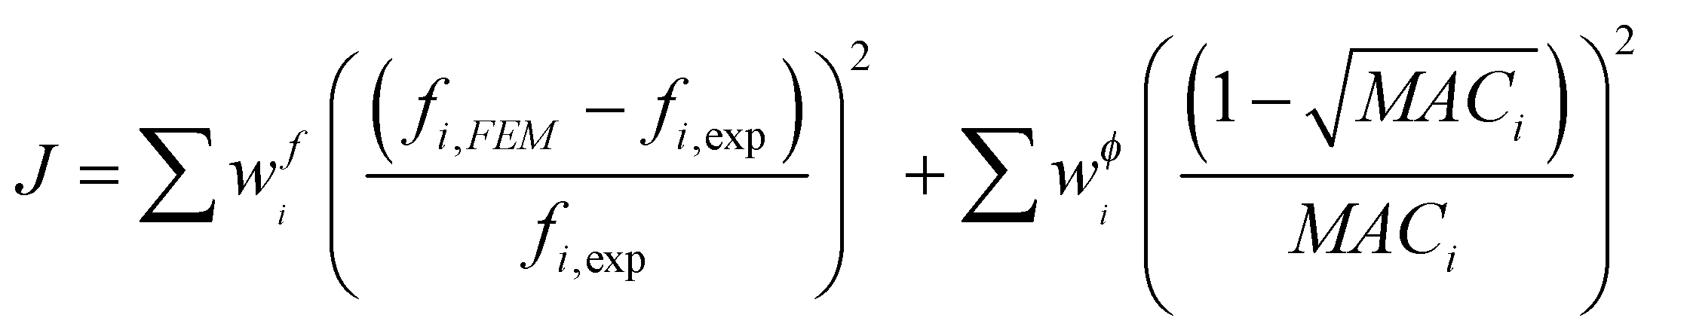
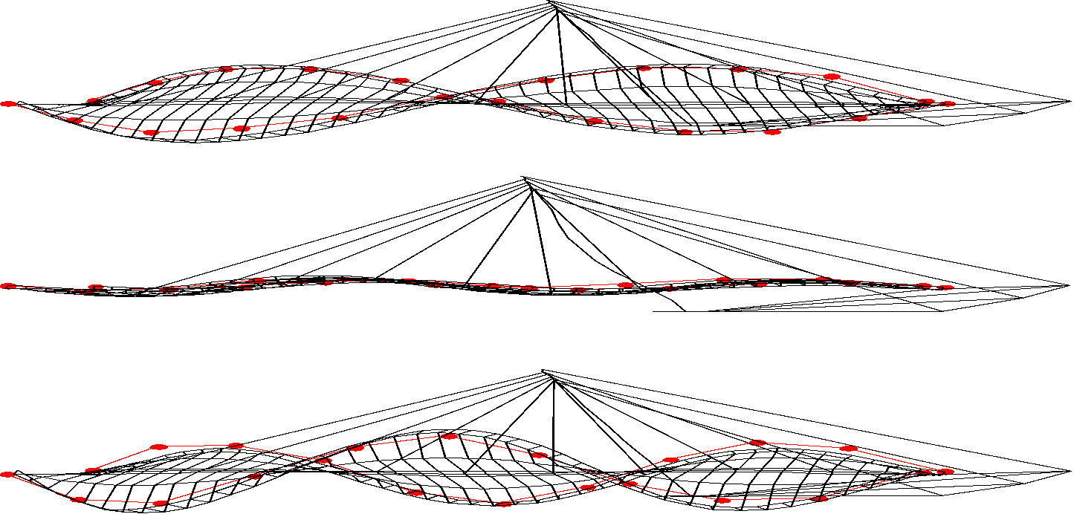
(Micro) FEM updating
Aim is to minimise objective function J by ‘Weighted Sum’ approach.
J=residual errors in response parameters R, FEM-predicted vs measured: Find global minimum of J.
J is a function of structural parameters P e.g. stiffnesses i.e. write J(P).
We seek the value of P that minimses J, weighting importances of the R
Weighting Factors w
To balance the significance of modal parameters or ‘responses’ R e.g. mode shapes and frequencies
Little is known how to set weighting factors effectively
There is no right way: use trial-and-error approach
Better solution may exist if weighting factors are changing?
MAC is a correlation function between mode shapes:
If their shapes match perfectly it is 1, here MAC ~1:
the red dots (experimental mode shapes) match well the FEA ordinates.

Slide 4

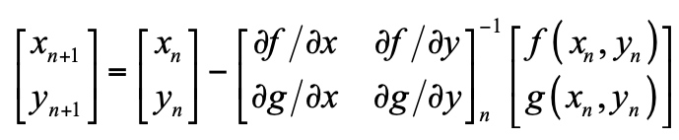
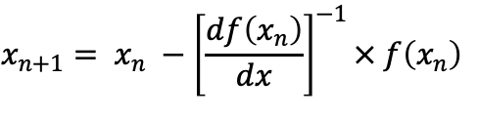
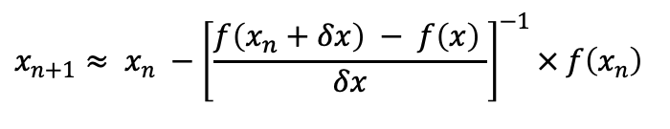
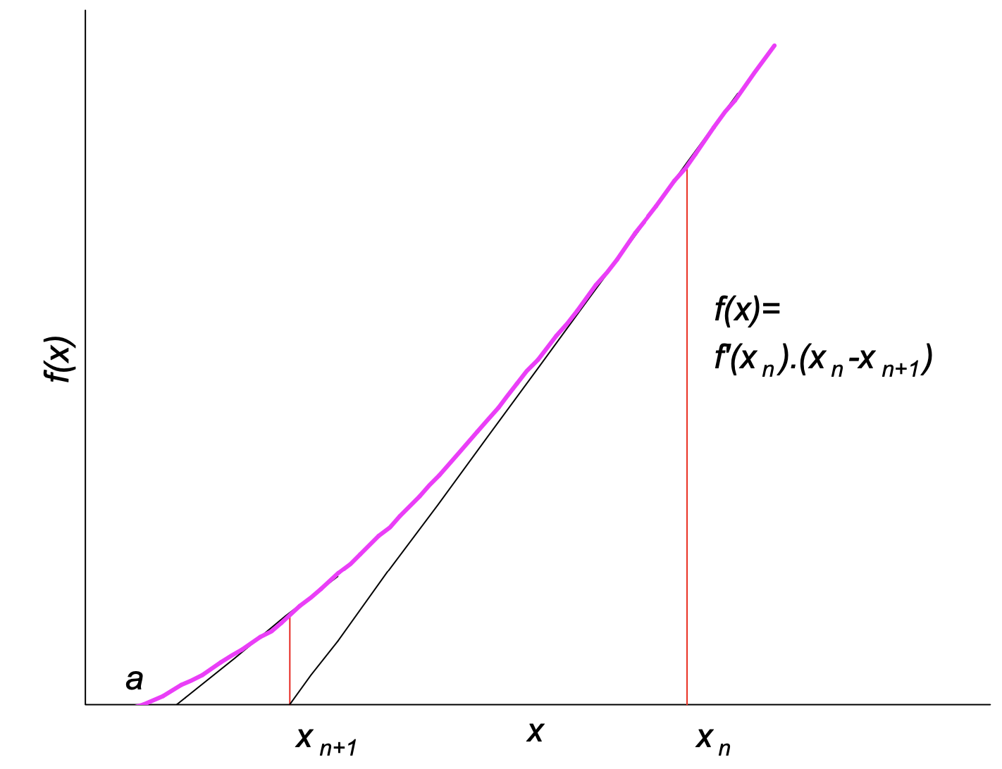
Minimising J to find ‘best’ P
It works like Newton’s method, which finds a value of x such that f(x)=0.
In FEM updating we seek values of P that set J(P)=0.
For a single parameter P (read x) and single response ‘errors’ R (read f)
For two parameters P (read x,y) and two response errors R (read f,g)
Approximate derivative by ‘finite difference’ when derivative cannot be obtained explicitly
Possible J, or take absolute or square, to get to zero or close.
In practice S is obtained not by calculus but by finite difference (FD) approximation, as in the examples following.

Slide 5
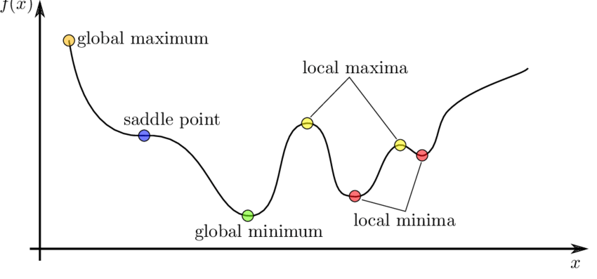
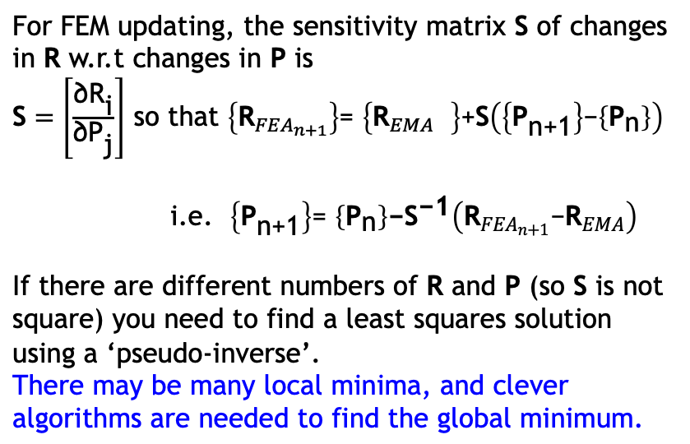
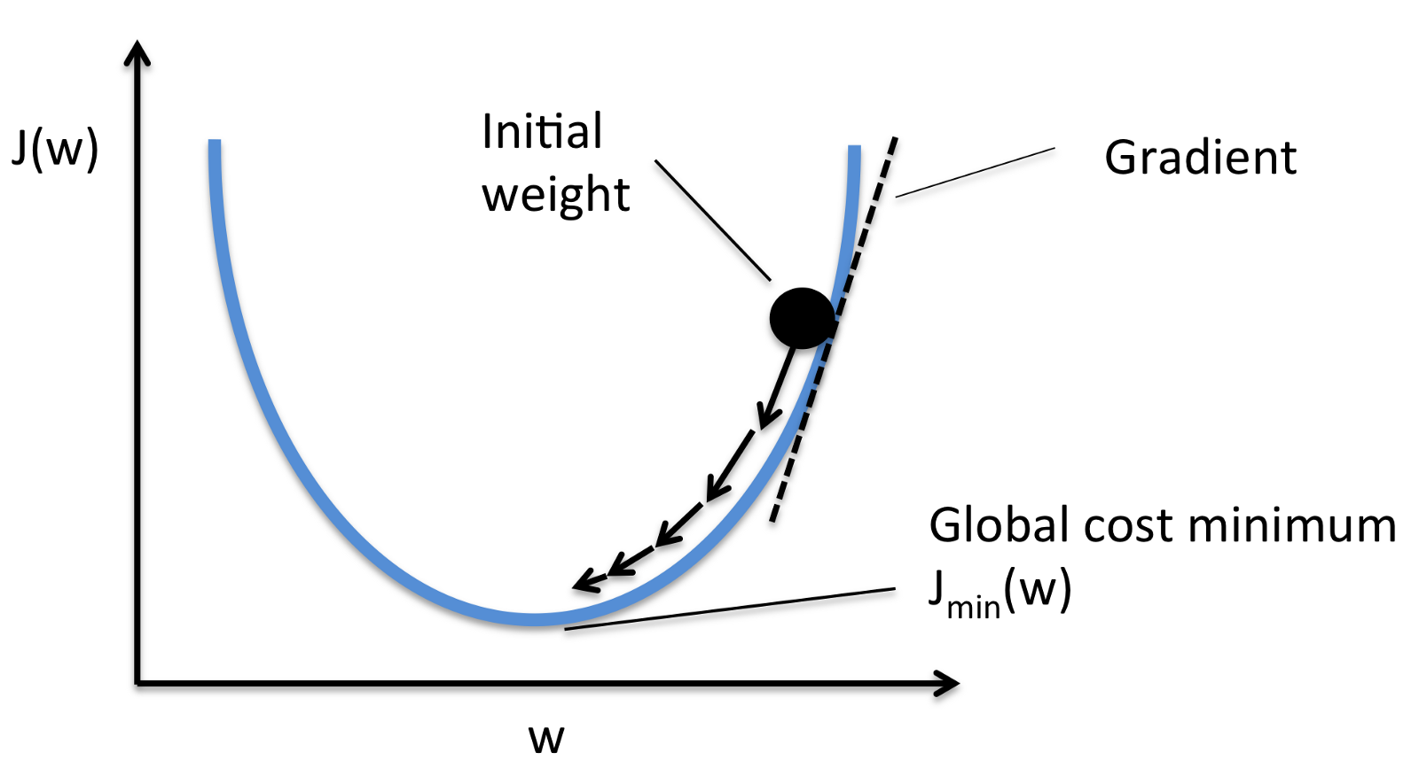
Minimising J to find ‘best’ P
It works like Newton’s method, which finds a value of x such that f(x)=0.
In FEM updating we seek values of P that set J(P)=0.
Actually we can never reach J(P)=0; we can only get close to zero because our model using P is too simple and our measurements R not precise.
In fact there is no ‘zero crossing’, as in Newton’s method and we seek to minimize J.

Slide 6
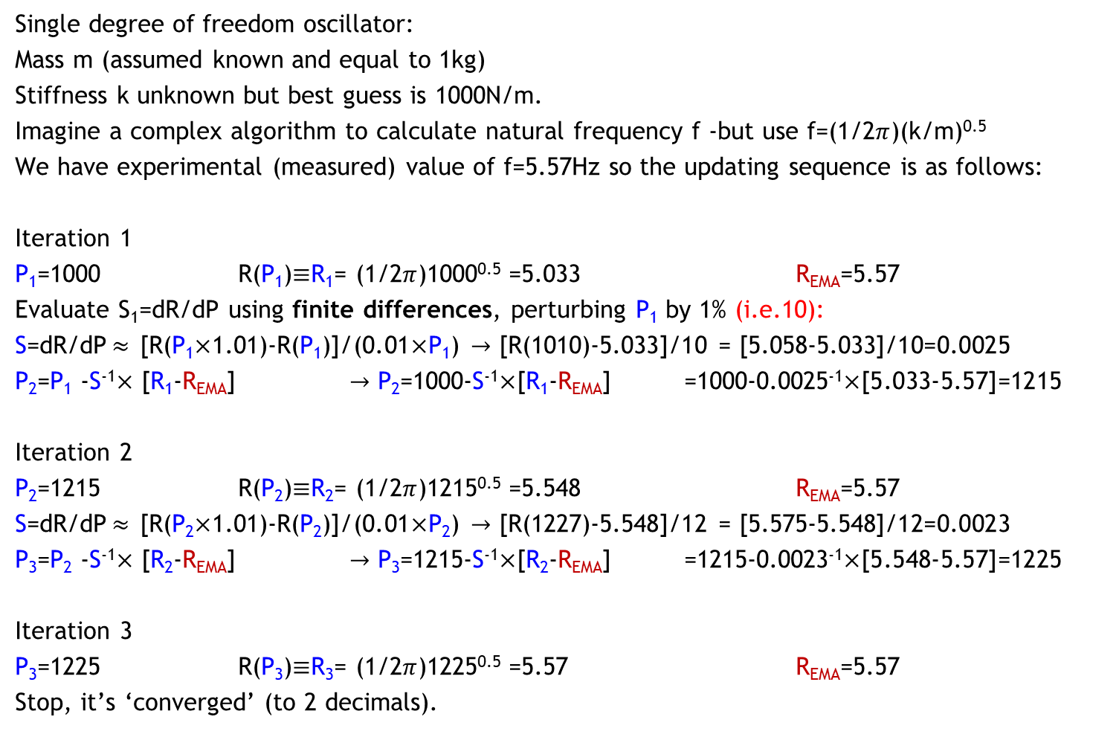
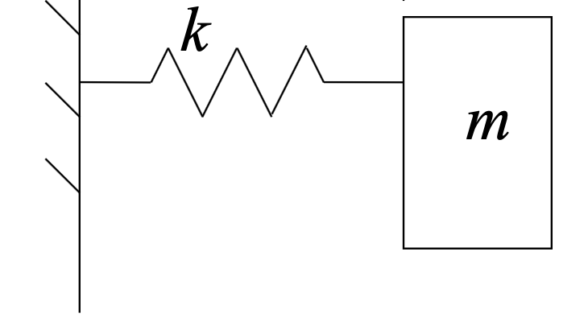
SDOF updating example

Slide 7
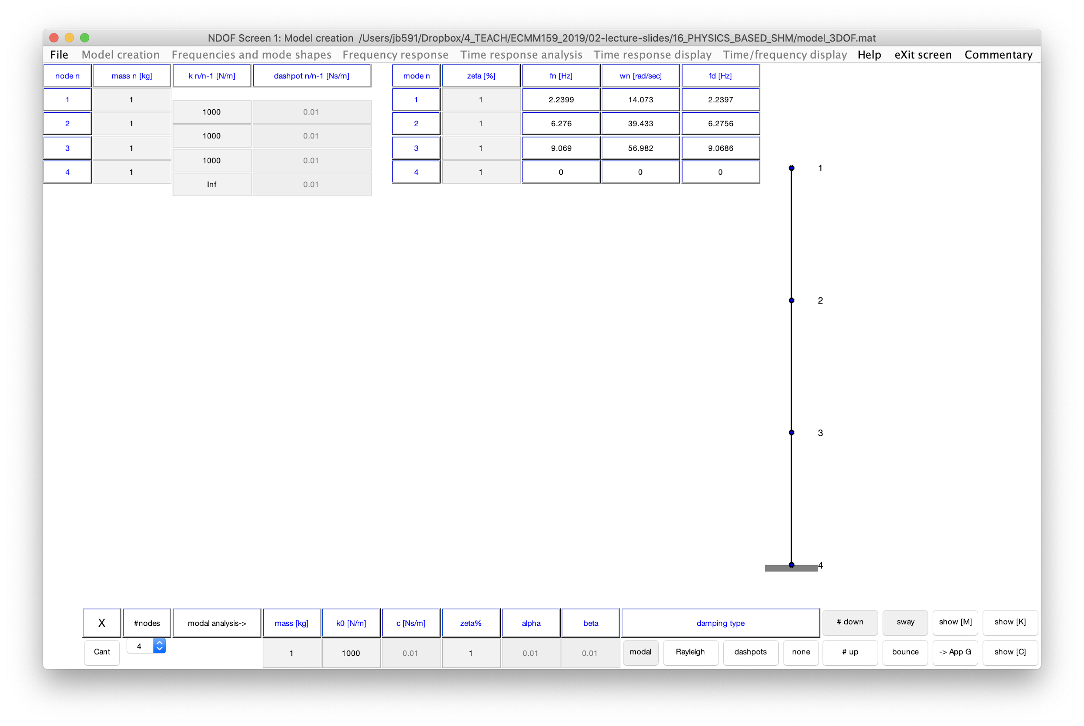

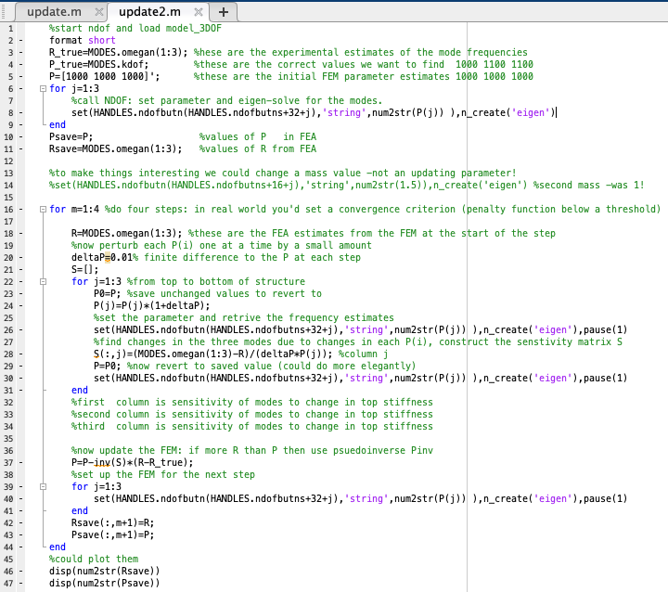
3DOF updating exercise -see video in the next slide
Correct model
Initial FEM estimate

Slide 8
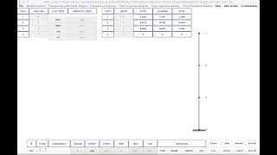

Slide 9
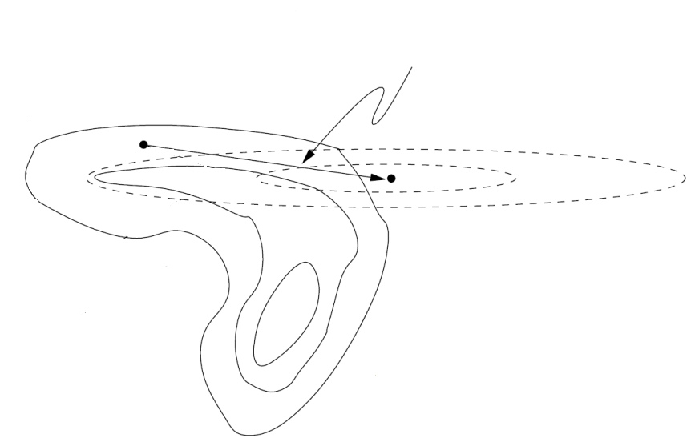
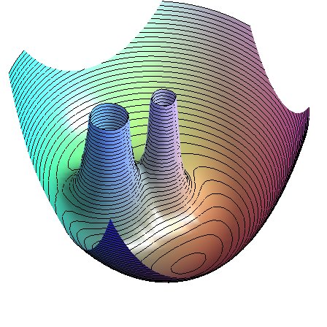
Global minimum searches ’Sequential quadratic programming and downhill simplex’
It’s Newton’s method in multiple dimensions.
We can find minimum along a line by constructing a local quadratic of J, because function minima can be approximated by parabolae.
Line search
Contour of local model
(quadratic form)
Contour of
objective function J
3D Objective Function Space
Global Minimum
Contour Line Space

Slide 10

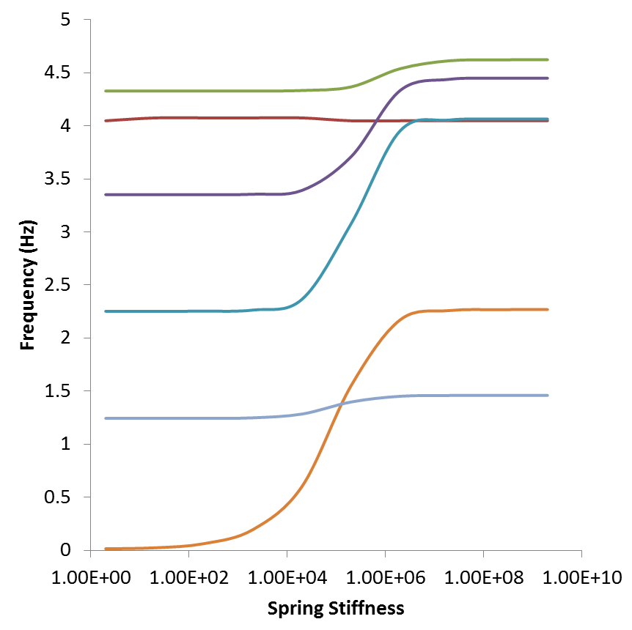
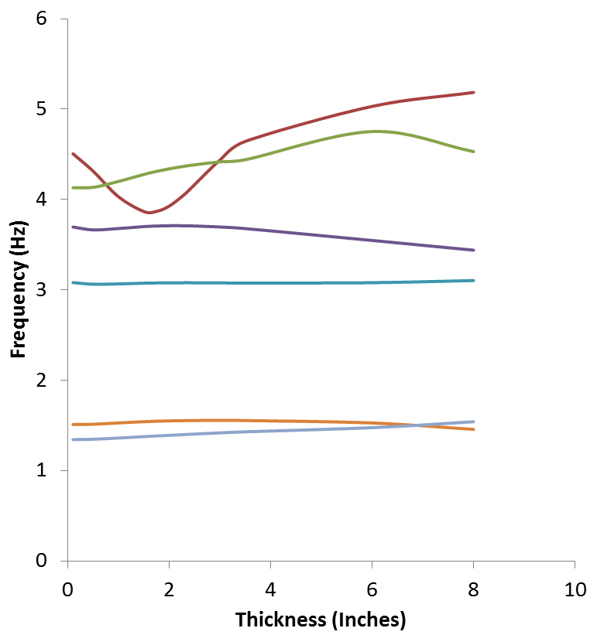
Boundaries of updating parameter 1
Boundaries of updating parameter 2
Mode 6
Mode 6
Mode 4
Mode 5
Mode 5
Mode 5
Mode 4
Mode 3
Mode 6
Mode 4
Mode 3
Mode 3
Mode 1
Mode 2
Mode 1
Mode 2
Mode 2
Initial Value
Initial Value
Mode 1
Updating Parameter 1
Updating Parameter 2
modes 1, 3, 4, and 6 sensitive to P₁
modes 5 and 6 sensitive to P₂

Slide 11


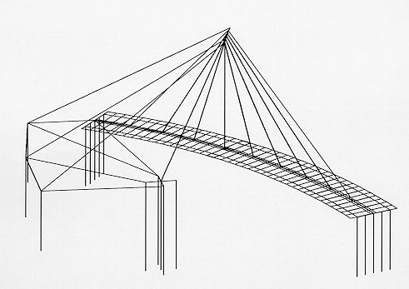
SAFTI Link Bridge
Rail
Parapet
Wall
Traffic
Deck
Upper Central
Deck
Prestress
Cable
Walkway
Deck
Lower
Deck
Web
Lower Central
Deck

Slide 12
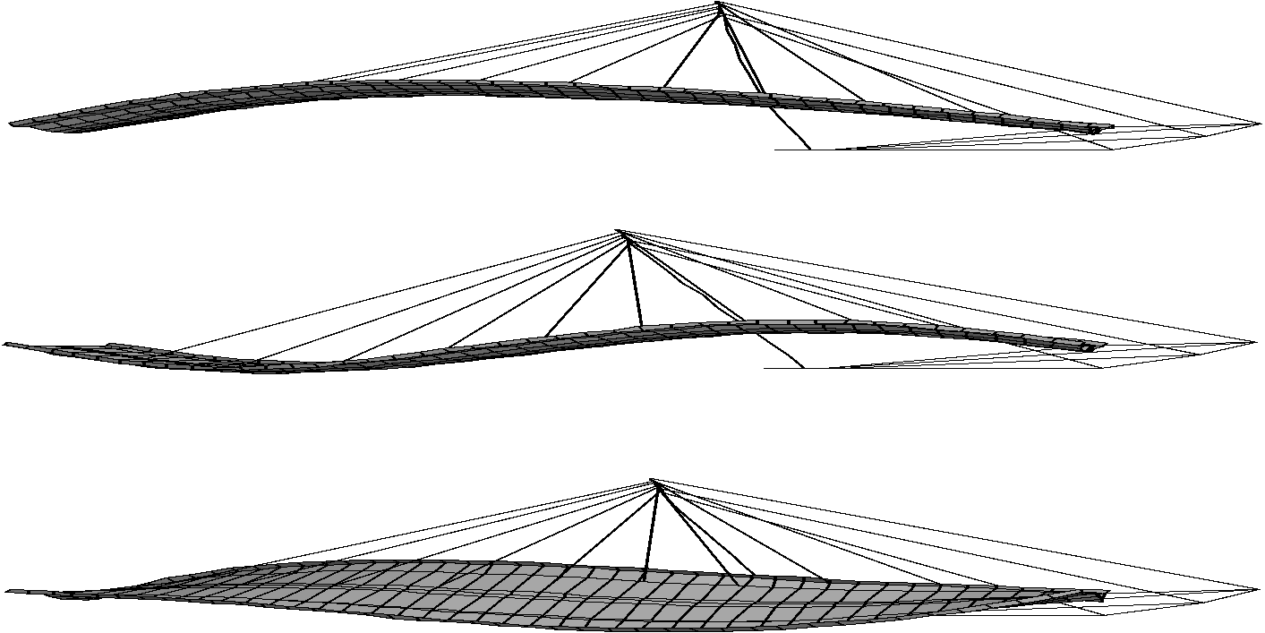
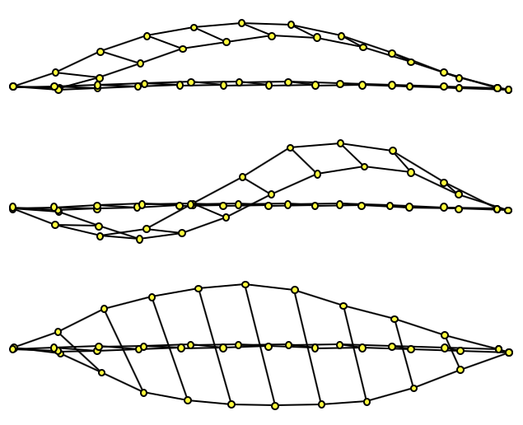
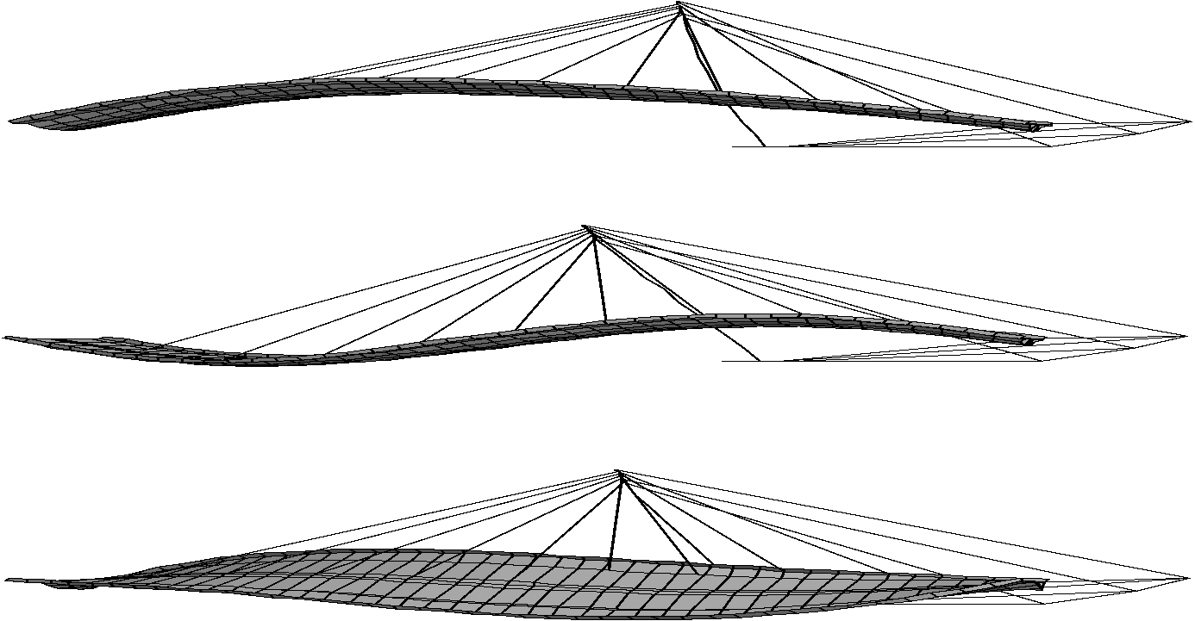

Mode shape pairing aim to get all points on a straight line: f(EMA)=f(FEA)
10
Mode Pair
8
6
EMA (Hz)
4
2
0
0
2
4
6
8
10
FEA (Hz)
Modal test (EMA)
Finite element model (FEA)

Slide 13
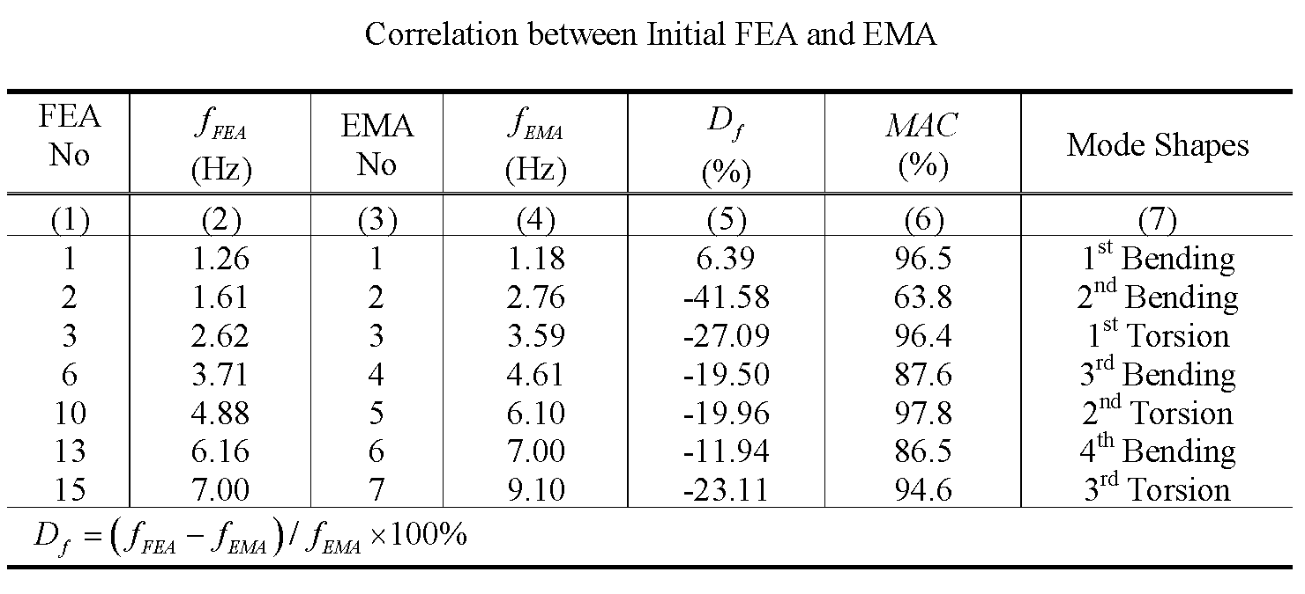
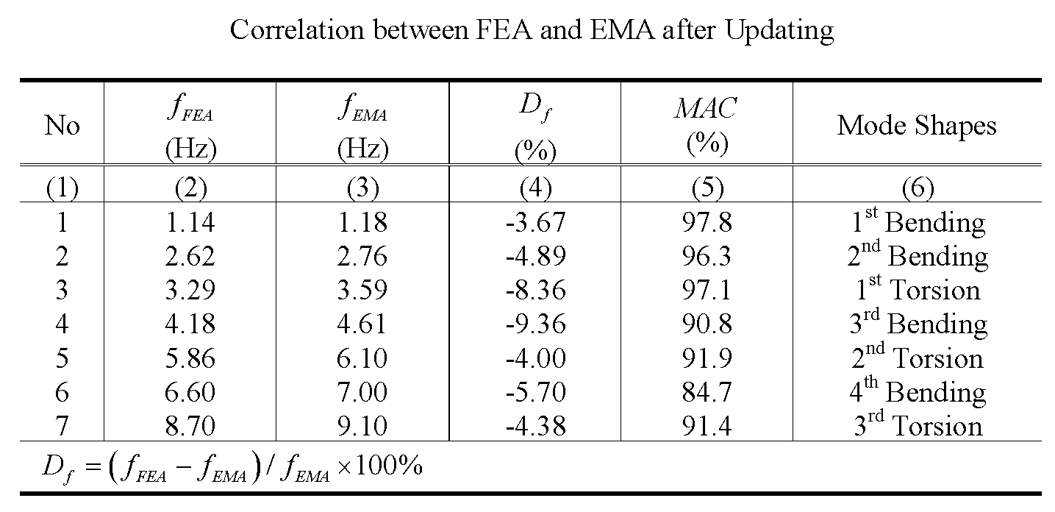
Modal parameters (responses) R

Slide 14
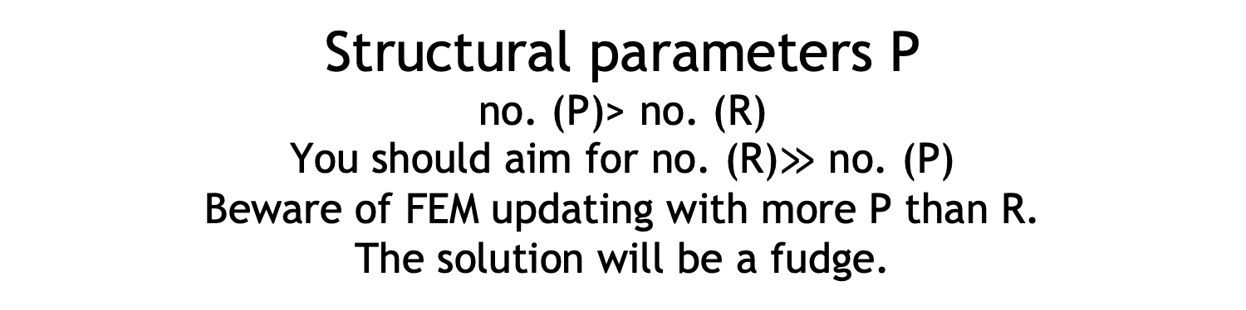
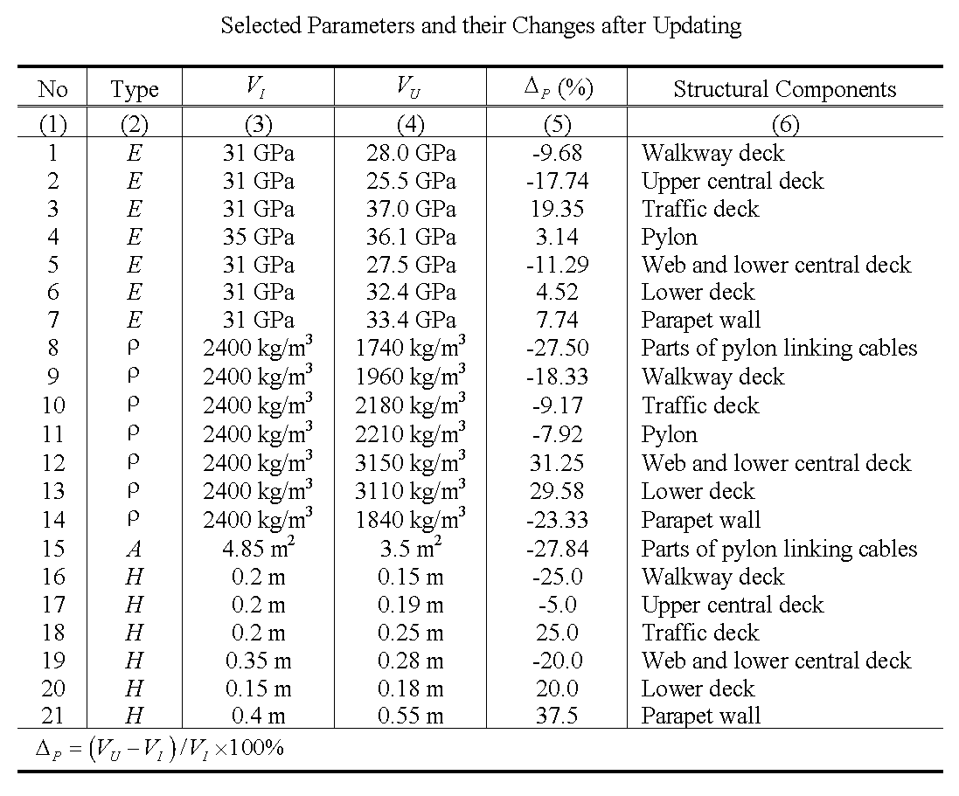

Slide 15
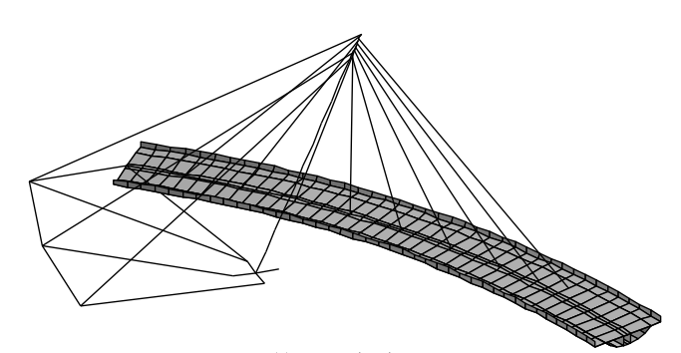
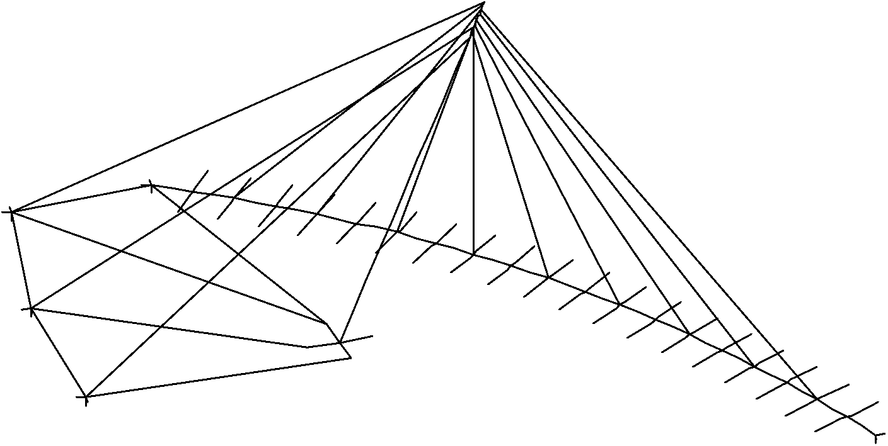
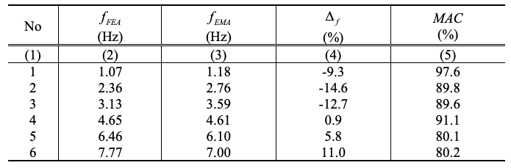
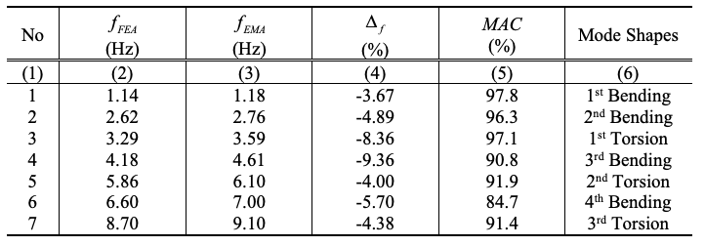
Model structure error
SAFTI Link Bridge: ‘complete’ model able to reduce J to lower value than with original ‘spine beam’ model. How close a ‘match’ depends on your modelling skill. You will never get J=0.

Slide 16
How to avoid problems
Features:
First determine the most appropriate model structure structure: don’t leave out a major feature, making a match impossible
Choose uncertain P to which important R are most sensitive
Use best judgement to get starting values
Problems:
Solutions strongly depend on model errors and parameter selection
Boundary conditions are hard to get right
It’s impossible to improve a parameter not included in the model
Avoid too many P to update with two few (insensitive) R
Avoid poorly conditioned solution due to low sensitivities

Slide 17
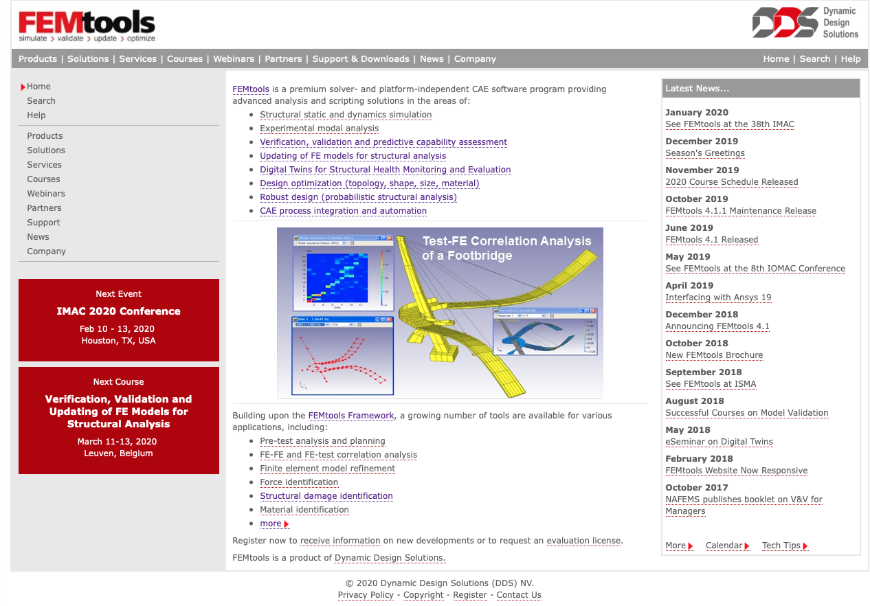
Commercial software FEMTools (Eddy Dascotte DDS solutions)

Slide 18
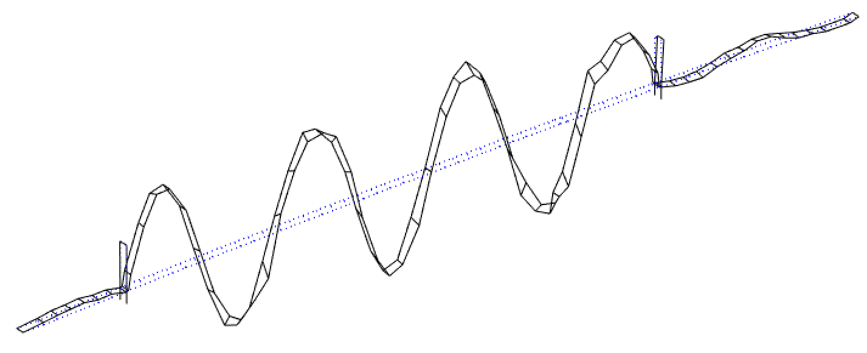

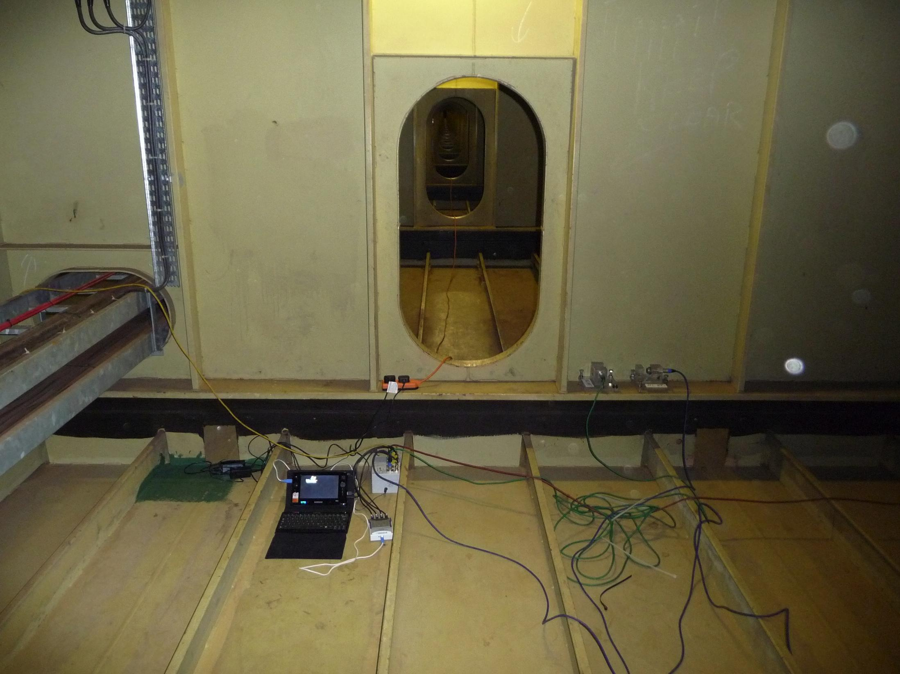
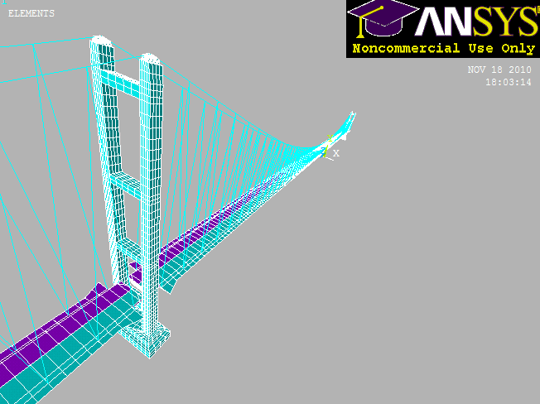
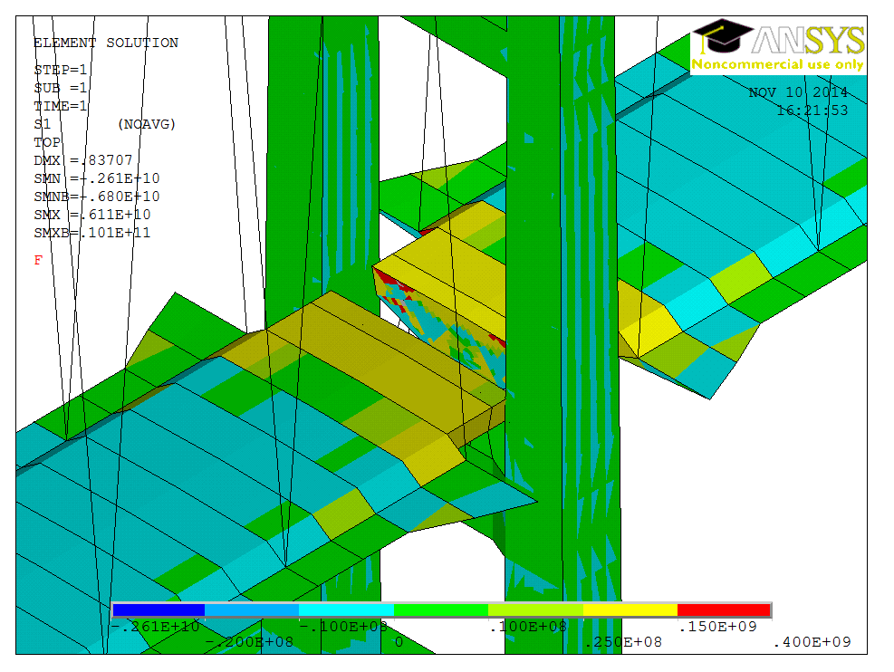
Digital twin: measuring without sensors We can calibrate FE models with full-scale observation. The we can use these for performance diagnosis and prognosis
Modal test + monitoring
Experimental modal parameters
(mode frequencies, shapes etc.)
Calibrated/updated
FE model
FE model used to interpret performance: stress concentrations at bearings

Slide 19
Observations
Physics based models are mostly for FEM geeks and high end consultants
Without a high dose of scepticism and real world experience many FEMs end up over complicated and unreliable: beautiful garbage
FEM (micro) updating is niche, other than in aerospace and academia
Most FEM engineers use macro updating by domain expertise, trial and error
You can turbo-charge this with crude manual micro-updating
Pick your parameters P that strongly affect the important R
Beware of P straying outside sensible boundaries e.g, impossible E
Think hard to keep your P to the ones that are important
With a validated FEM you have power to run scenario simulations; it can be a very powerful tool.

