Slide 1
NAME: Agyemang Samuel Asare ID: 10827950
ONLINE TICKET RESERVATION SYSTEM PRESENTATION.

Slide 2
Online ticket reservation system
An online booking system is a piece of a software used for reservation management. It allows travel and hospitality businesses to accept bookings online and manage mobile and personal bookings in a better way. Online booking and reservation system can be easily integrated into your website or even social media page.

Slide 3
REQUIREMENTS
The user should be able to perform every online booking with or without an account.
The user should not be restricted by the number of bookings he can make..
The user should be able to search and find the most relevant booking options.
Accept date and time to check available rooms for that particular time.

Slide 4
Software Process
The process involves the use of agile-process. Planning is incremental and it is easier to change the process to reflect changing customer requirements.

Slide 5
Software Modeling
An incremental development model type is used here. This is because as customer requirements changes, it will be easier to inculcate change in our system.

Slide 6
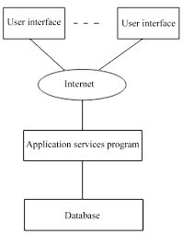
Software Architecture

Slide 7
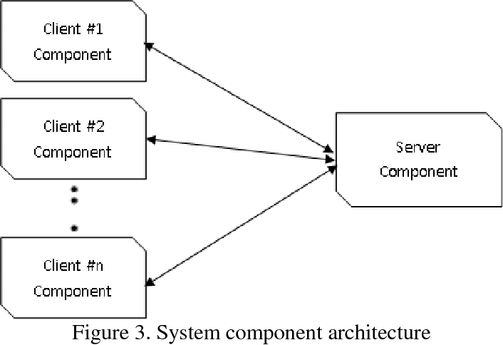
Design and implementation

Slide 8
Testing
The software was tested severally until defects/bugs were discovered which guarantees the quality of the software. This makes the software more reliable and easy to use. Thoroughly tested software ensures reliable and high-performance software operation.
Unit Testing is done to check whether the individual modules of the source code are working properly. i.e. testing each and every unit of the application separately by the developer in the developer’s environment. It is AKA Module Testing or Component Testing.

Slide 9
Software Project Management
Software Project Management
Software managers develop steps to estimate the size of the software work products and resources needed to produce a schedule.
Costing
Software managers predict the effort required to develop a software system. The cost of the software project relies on the software size estimate. Cost estimation in software engineering is typically concerned with the financial spend on the effort to develop and test the software, this can also include requirements review, maintenance, training, managing and buying extra equipment, servers and software.
Scheduling
Software managers gives sets of activities, deliverables and milestone. A schedule also usually includes a planned start and finish date, duration, and resources assigned to each activity.

