Slide 1
Julia Gender Inclusive Learn Julia With Us
(KYLA MCCONNELL & JULIA MÜLLER)

Slide 2
TODAY’S DEMO
Who are we? Who are you? What is Julia?
Intro to Pluto notebooks
The interactive Julia REPL

Slide 3
Upcoming events
March 17 Your first Julia code
Error messages and debugging
April 14 Strings and data containers
Functions
Project: Programming mad libs prompts
May 12 Number types
User-defined functions

Slide 4
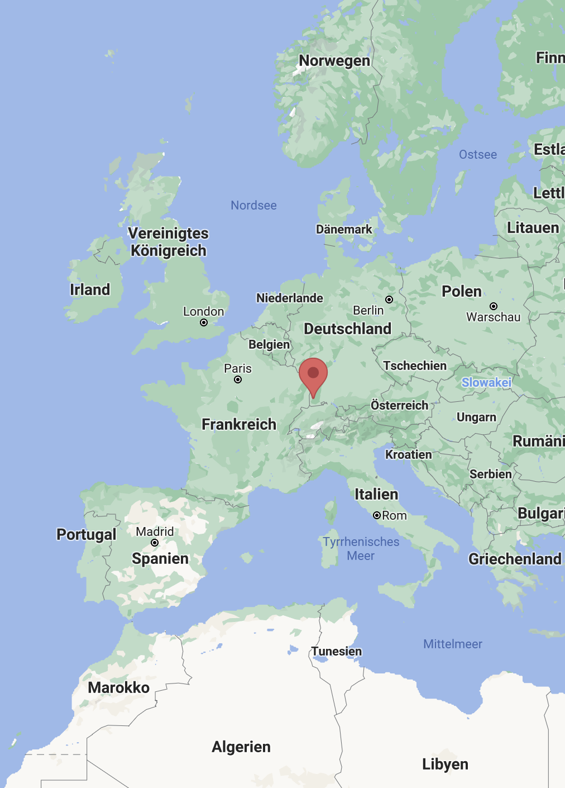
WHO ARE WE?
@McConnellKyla & @JuliaMuellerFr
Ph.D. students in linguistics at the University of Freiburg, Germany
Co-organizers of @RLadiesFreiburg
Recently discovered the joys of Julia
Our use case: academic research, incl. data wrangling, plotting & fitting statistical models (LMEs, etc.)

Slide 5
WHO ARE WE?
@McConnellKyla & @JuliaMuellerFr
Previous experience: R & Python
Invite you to learn Julia together with us, with the help of great resources on JuliaAcademy, etc.

Slide 6
WHO ARE YOU?

Slide 7

WHAT IS JULIA?
General-purpose programming language but popular in data science communities
Built with data science and machine learning in mind
Free & open source (like R and Python)
Developed to be readable like Python but compiled quickly like C
Young: < 10 years old (R is closer to 30 years old)
Note: Please don’t gender “Julia” (i.e. by using she/her)

Slide 8
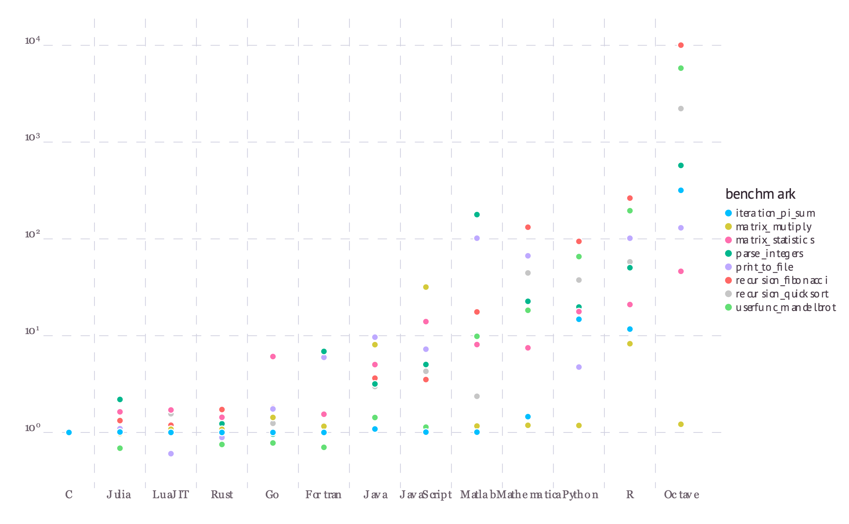
WHY JULIA?
Julia is…
Fast
Readable
Reproducible
Able to handle complex statistical models
Easy to integrate with other programming languages
“These micro-benchmarks, while not comprehensive, do test compiler performance on a range of common code patterns, such as function calls, string parsing, sorting, numerical loops, random number generation, recursion, and array operations.”
single core, Julia 1.0.0
https://julialang.org/benchmarks/

Slide 9
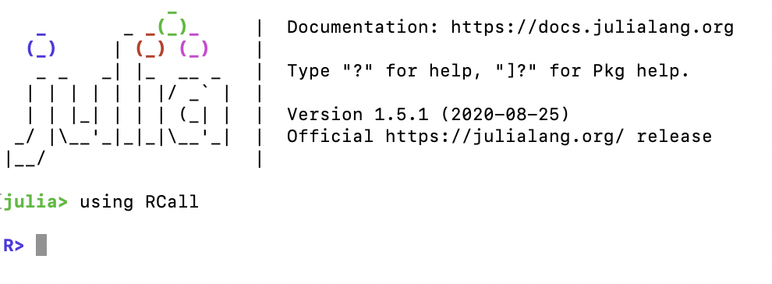
WORKING WITH JULIA
Options:
REPL
Julia script .jl
Julia Markdown .jmd
IDE like Visual Studio Code
Pluto Notebooks

Slide 10
In the REPL
Read help pages about commands by entering help mode with ? (leave with backspace)
Enter the package manager with ] and leave it with backspace
add / rm to add and remove packages to base
update to update packages

Slide 11
Pluto
Enter packager manager with ]
From package manager: add Pluto
Leave package manager with backspace
Run: using Pluto
Run: Pluto.run()

