Slide 1
Julia for R-lovers
Ideas for a dual-language workflow

Slide 2
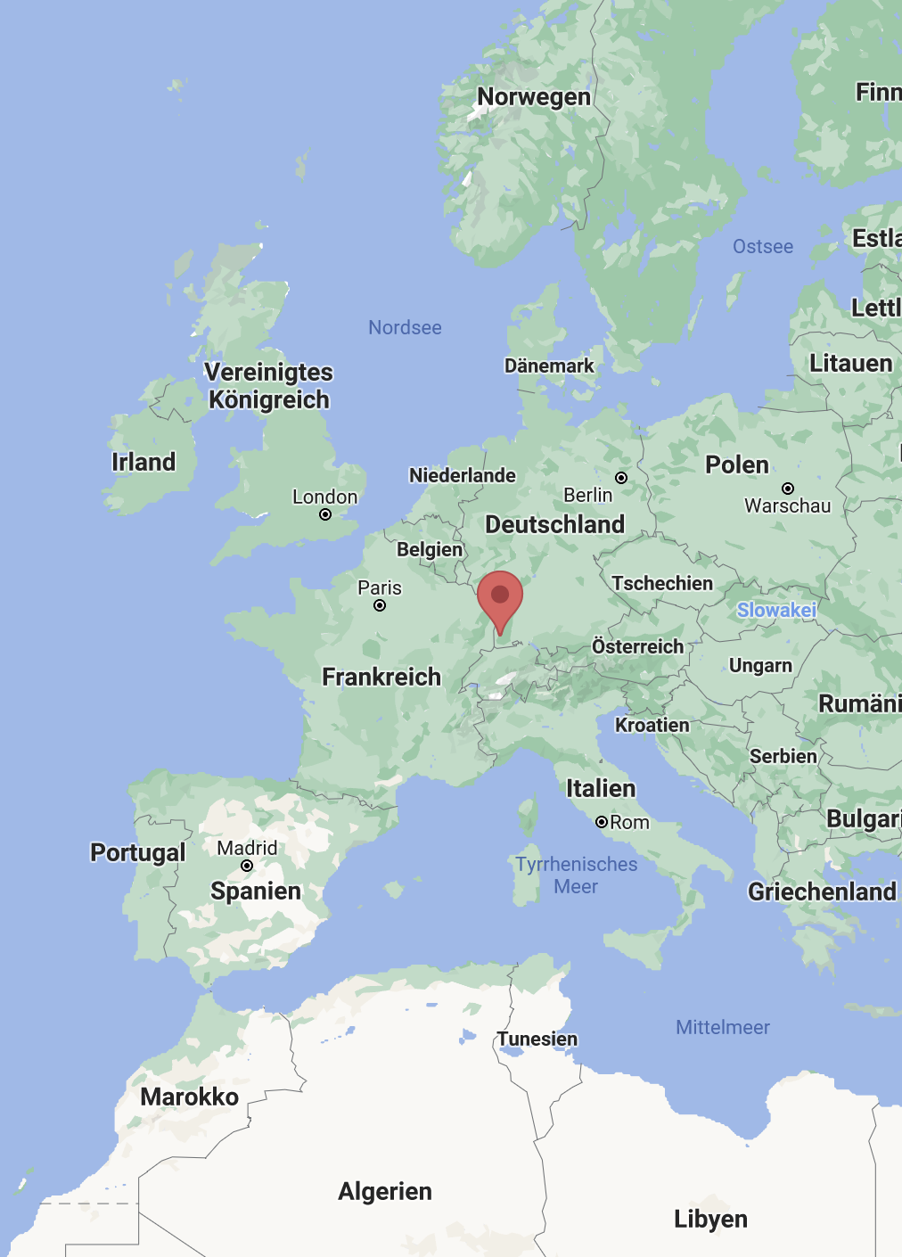
ABOUT ME
Kyla McConnell:
PhD student in linguistics at the University of Freiburg
R-stats enthusiast, recently discovered the joys of Julia
Co-organizer of @RLadiesFreiburg

Slide 3
TODAY’S DEMO
Why Julia?
Using Julia and R in the Julia REPL
Demo: Basics with RCall.jl
Demo: Fitting an LMM with MixedModels.jl

Slide 4
WHAT I WON’T COVER
Installing Julia, using iJulia for Jupyter Notebooks
01
https://www.youtube.com/watch?v=oyx8M1yoboY
Programming concepts in Julia -> Julia Academy
02
https://juliaacademy.com/p/julia-programming-for-nervous-beginners
https://juliaacademy.com/p/intro-to-julia
https://juliaacademy.com/p/julia-for-data-science

Slide 5
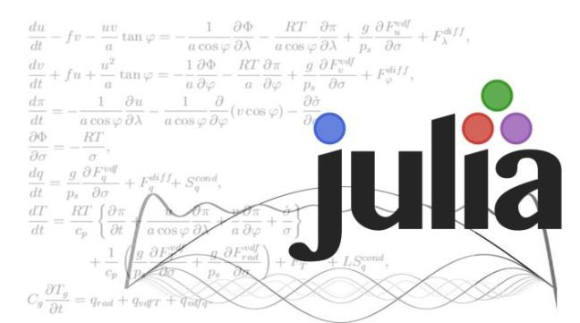
WHY JULIA?
Gains in:
Speed
Model complexity
Without sacrificing:
Readability
Reproducibility
R packages that you know well

Slide 6
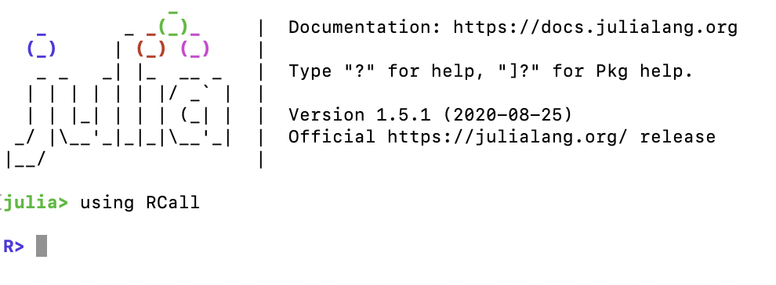
WORKING WITH R IN JULIA
This talk: workflow heavily based in R, using Julia for only some major models
Julia packages:
“RCall”: https://juliainterop.github.io/RCall.jl
Once loaded into your environment, you can switch to R within the Julia REPL
using RCall
$
Exit the R environment with backspace
Use R within a Julia script, markdown, or notebook
R“ ”

